Slide 1
Getting Started with Thonny MicroPython (Python) IDE for ESP32
Training

Slide 2
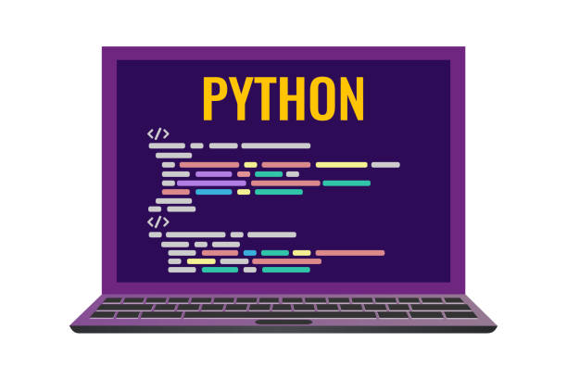
Content
Installing Thonny IDE
Installing Library for Thonny
Flashing MicroPython Software

Slide 3

Installing Thonny IDE
In this guide, we provide instructions to install Thonny IDE in different operating systems, read the section that fits your needs:
A) Installing Thonny IDE – Windows PC
B) Installing Thonny IDE – Mac OS X
C) Installing Thonny IDE – Linux
Guido Van Rossum
Python was created by Guido Van Rossum, a Netherland at Centrum Wixson and Informatica (CWI).
Download the ESP32 USB driver at: CP210x USB to UART Bridge VCP Drivers

Slide 4
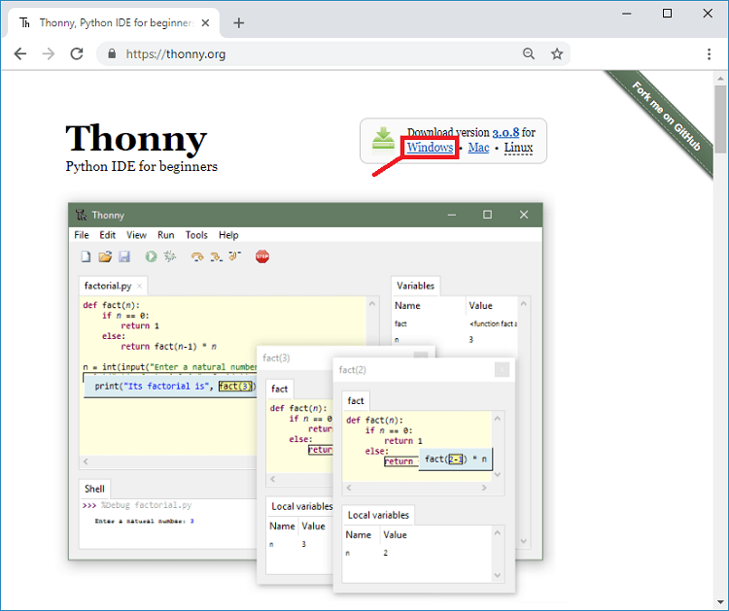
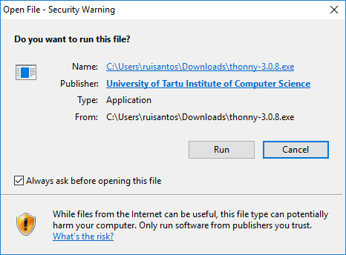
A) Installing Thonny IDE – Windows PC
To install Thonny on your Windows PC, follow the next instructions:
1. Go to https://thonny.org
2. Download the version for Windows and wait a few seconds while it downloads.
3. Run the .exe file.
4. Follow the installation wizard to complete the installation process. You just need to click “Next”.

Slide 5
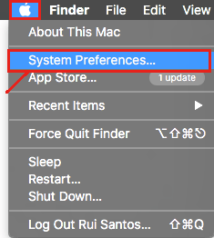
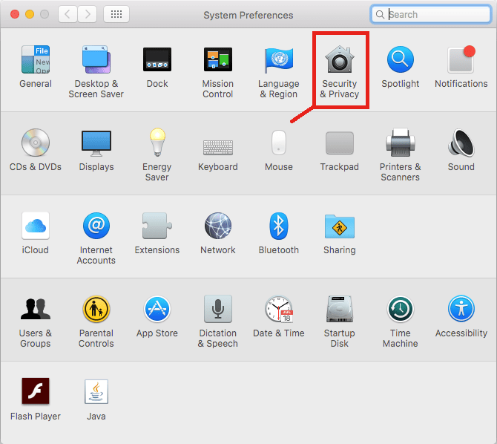
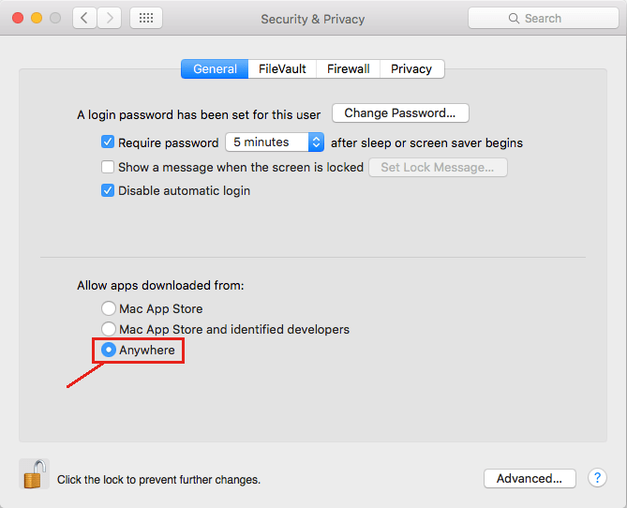
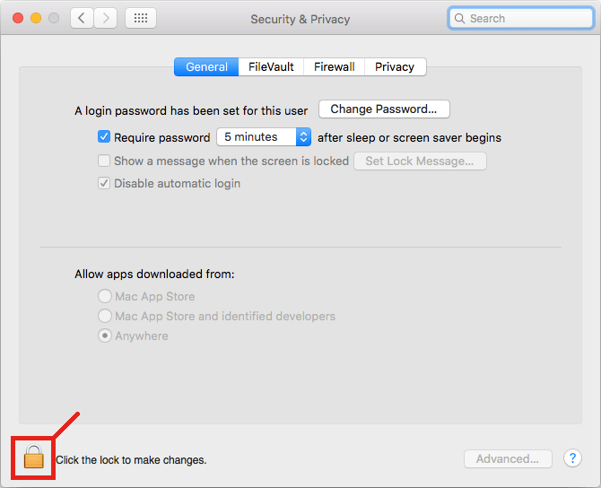
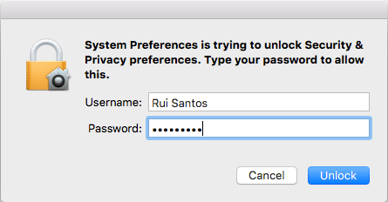
B) Installing Thonny IDE – Mac OS X
Since Thonny IDE is open source and downloaded from the Internet, it’s not a verified app in the App Store. For security reasons, Mac OS X blocks unknown apps to run on your computer. Follow these next instructions to enable any downloaded software to run in your Mac.
1. Open the “System Preferences...” menu.
2. Open the “Security & Privacy” menu.
3. At the bottom left corner, click the lock icon to modify your “Security & Privacy” settings:
4. Type your username/password and click the “Unlock” button.
5. Finally, select the option “Allow apps downloaded from: Anywhere“.

Slide 6
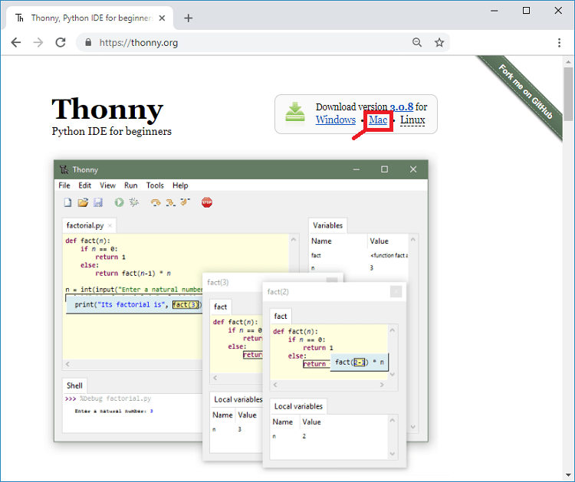
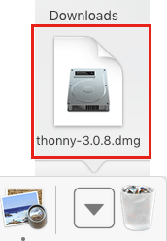
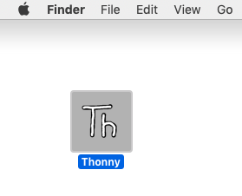
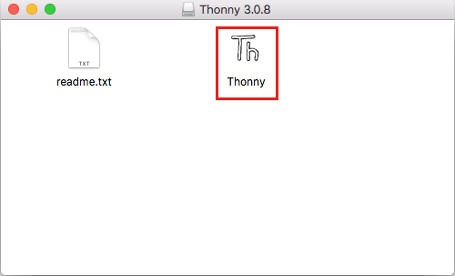
B) Installing Thonny IDE – Mac OS X
To install Thonny on Mac OS X, follow the next instructions:
1. Go to https://thonny.org
2. Download the version for Mac OS X and wait a few seconds while it downloads.
3. Open the .dmg file.
4. Drag the “Thonny” application to your Desktop:
5. Thonny IDE is now installed and you can double-click to open it:

Slide 7
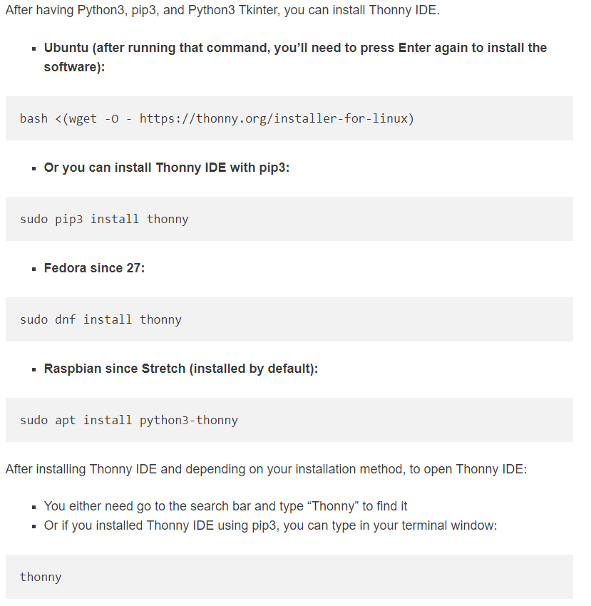
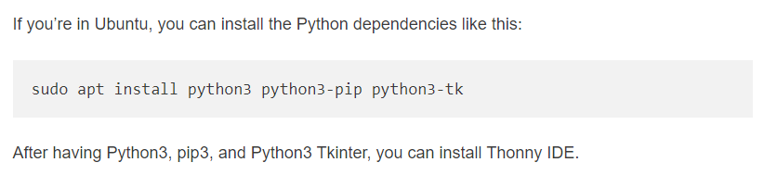
C) Installing Thonny IDE – Linux
To install Thonny on your Linux computer, it depends on your Linux distribution and version, follow the next instructions for your system. First, we recommend installing these dependencies: python3, python3-pip, and python3-tk

Slide 8
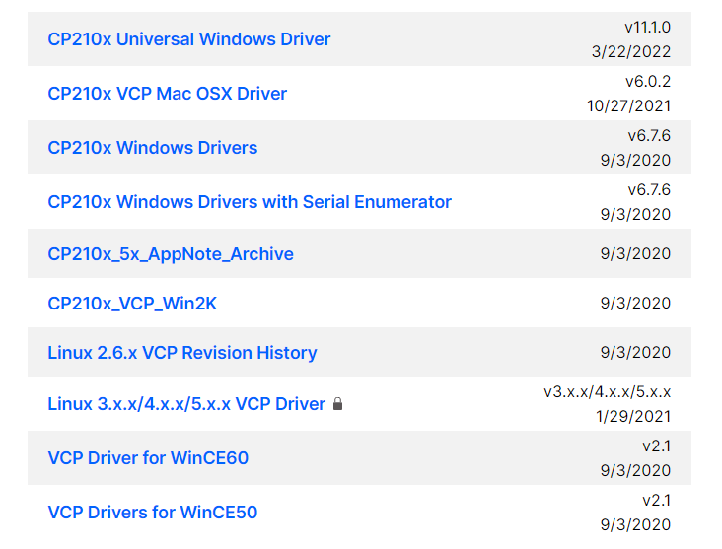
Install the ESP32 USB driver Library for Thonny
Like install Thonny, you must chose your Operating System driver to Install in your computer.
If Windows, chose CP210X Universal Windows Drivers
If Mac, chose CP210X
In Linux, Driver is already in Operating System

Slide 9
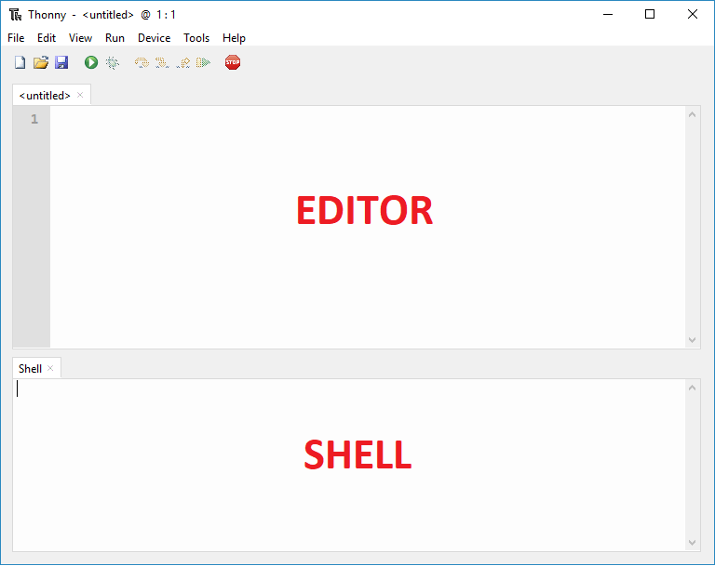
2. Installing Library for Thonny
Next, we will learn how to use features of Thonny. At First, we look at the Thonny
Open Thonny IDE. There are two different sections: the Editor and the MicroPython Shell/Terminal:
The Editor section is where you write your code and edit your .py files. You can open more than one file, and the Editor will open a new tab for each file.
On the MicroPython Shell you can type commands to be executed immediately by your ESP board without the need to upload new files. The terminal also provides information about the state of an executing program, shows errors related with upload, syntax errors, prints messages, etc…

Slide 10
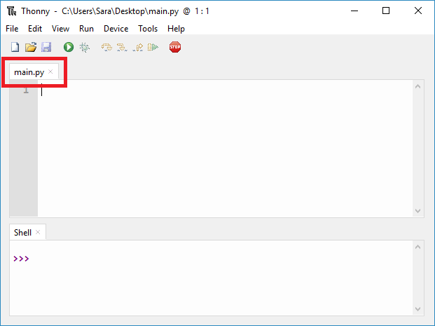
2. Installing Library for Thonny
Running Your First Script!
To get you familiar with the process of writing a file and executing code to draw a figure.
1. When you open Thonny IDE for the first time, the Editor shows an untitled file. Save that file as main.py by clicking on the save icon. Select the “This computer” option. We recommend saving the file inside a folder with a name that identifies the project, for example Figure. The file must be called main.py. Otherwise, it will not work.
2. The Editor should now have a tab called main.py.

Slide 11
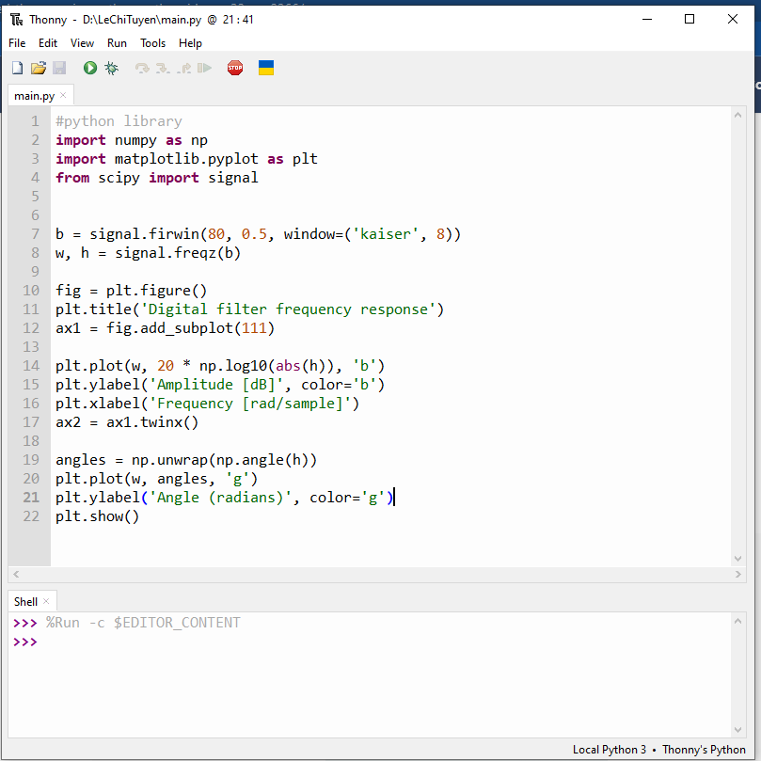
2. Installing Library for Thonny
#python library
import numpy as np
import matplotlib.pyplot as plt
from scipy import signal
b = signal.firwin(80, 0.5, window=('kaiser', 8))
w, h = signal.freqz(b)
fig = plt.figure()
plt.title('Digital filter frequency response')
ax1 = fig.add_subplot(111)
plt.plot(w, 20 * np.log10(abs(h)), 'b')
plt.ylabel('Amplitude [dB]', color='b')
plt.xlabel('Frequency [rad/sample]')
ax2 = ax1.twinx()
angles = np.unwrap(np.angle(h))
plt.plot(w, angles, 'g')
plt.ylabel('Angle (radians)', color='g')
plt.show()
3. Copy the following code to the main.py file:

Slide 12
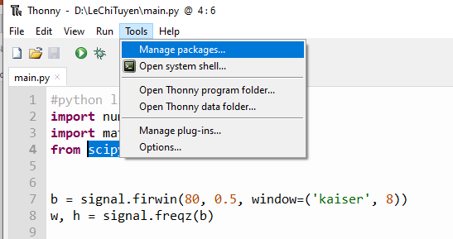
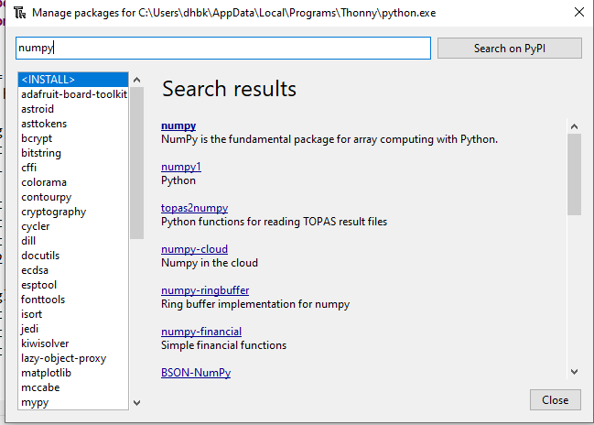
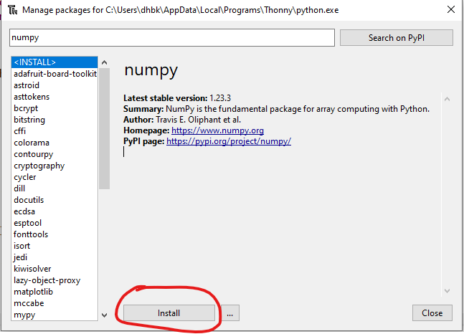
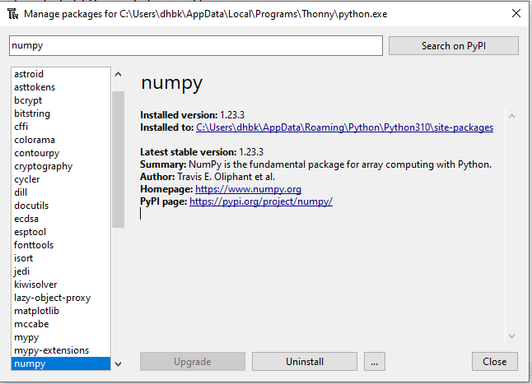
2. Installing Library for Thonny
4. We need install some python libraries before run the code.
Go to tools, select Manager Packages. Then enter three name: numpy, matplotlib, scipy. Search on PyPi and Install it.

Slide 13

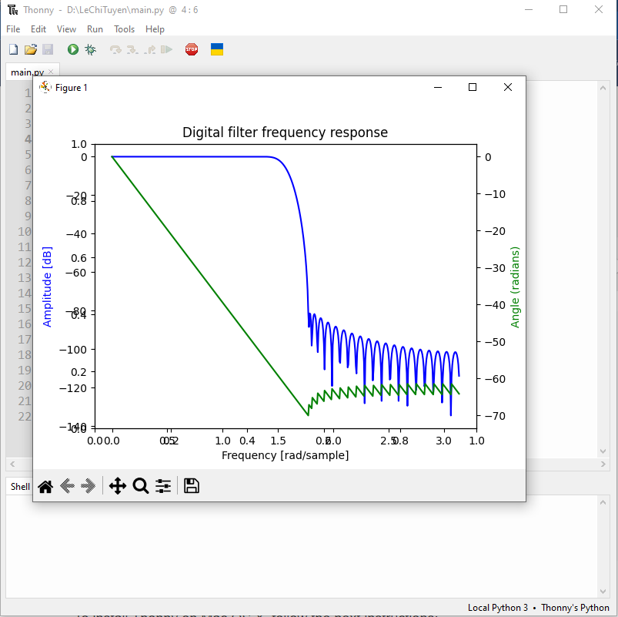
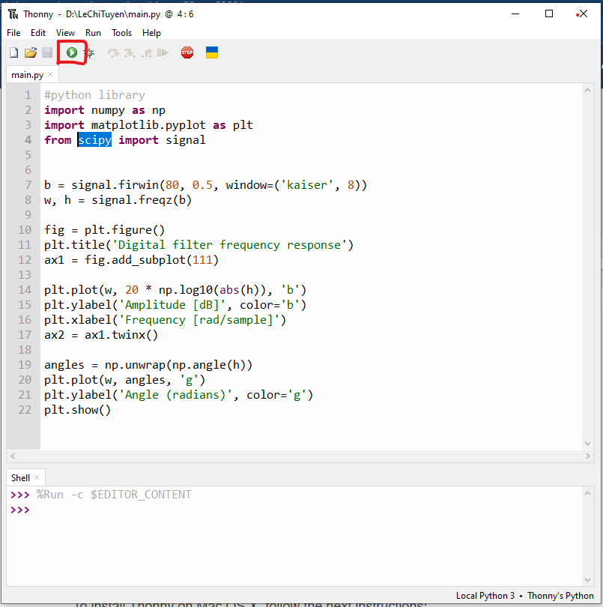
2. Installing Library for Thonny
Now, we can run the code.
In the top taskbar of Thonny, when we click on a button have play icon, the code will draw a figure in the Screen.

Slide 14
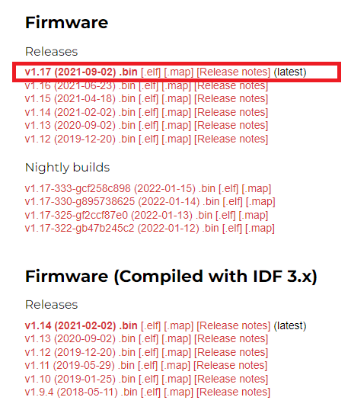
3. Flashing MicroPython Software
Next, we will learn how to code MicroPython from Thonny for ESP32. We need to prepare some things before start to code.
Downloading MicroPython Firmware
Go to the MicroPython Downloads page: https://micropython.org/download/.
Select the type of board you’re using. Here are the quick links for “regular” ESP32 and ESP8266 boards:
ESP32 MicroPython firmware
ESP8266 MicroPython firmware
You should see a similar web page (see figure below) with links to download .bin files. Download the latest release.
The downloaded file will probably go to the Downloads folder. Continue reading to learn how to flash the firmware on your boards.

Slide 15
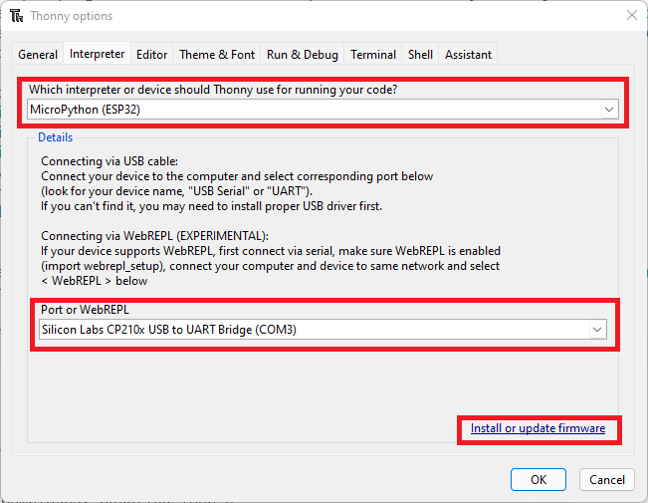
3. Flashing MicroPython Software
In this section, you’ll learn how to flash MicroPython firmware on your boards using Thonny IDE. Follow the next steps:
1) Connect your ESP32 board to your computer.
2) Open Thonny IDE. Go to Tools > Options > Interpreter.
3) Select the interpreter you want to use accordingly to the board you’re using and select the COM port your board is connected to. Finally, click on the link Install or update firmware.

Slide 16
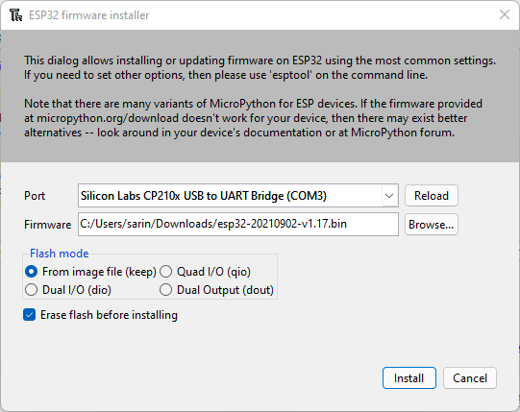
3. Flashing MicroPython Software
4) Select the port once again, and then click on the Browse button to open the .bin file with the firmware you’ve downloaded on the previous step. Select the options as shown in the picture below and finally click on Install.
After a few seconds, the installation should be completed.

Slide 17
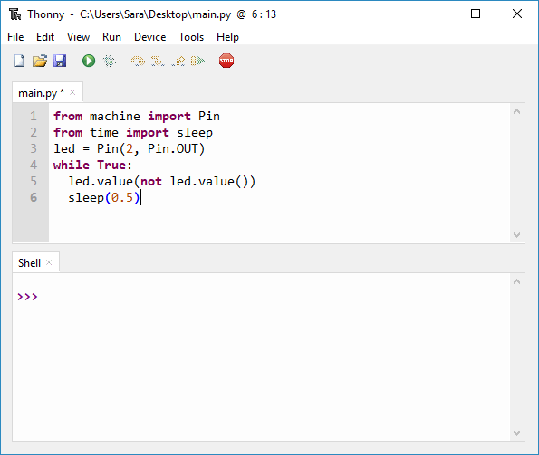
3. Flashing MicroPython Software
Testing the Installation
Creating the main.py file on your board. We recommend saving the file inside a folder with a name that identifies the project, for example Blink.
Copy the following code to the main.py file:
from machine import Pin
from time import sleep
led = Pin(2, Pin.OUT)
while True:
led.value(not led.value())
sleep(0.5)

Slide 18
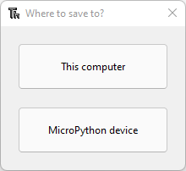
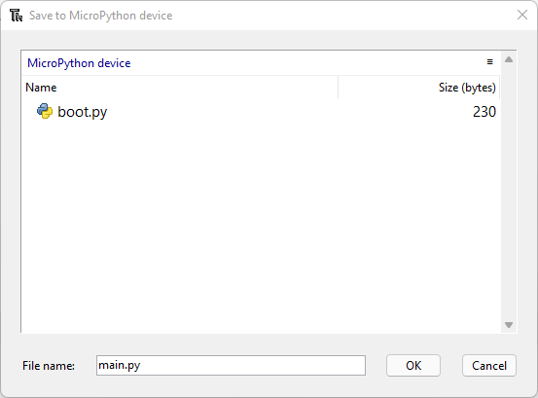
3. Flashing MicroPython Software
Uploading the Script
1) Go to File > Save as… or click on the save icon. The following window will open.
2) Select MicroPython device.
3) Name the file main.py, otherwise, it won’t work. Notice that the window that pops up shows the files currently saved on the board filesystem. There should be a file called boot.py. That file is created by default when you burn MicroPython firmware.
4) Finally, click Ok to proceed.
5) Now, press the on-board RST/EN button so that the board restarts and starts running the code.
6) Now, your board should be blinking the blue on-board LED every 500 milliseconds.

Slide 19
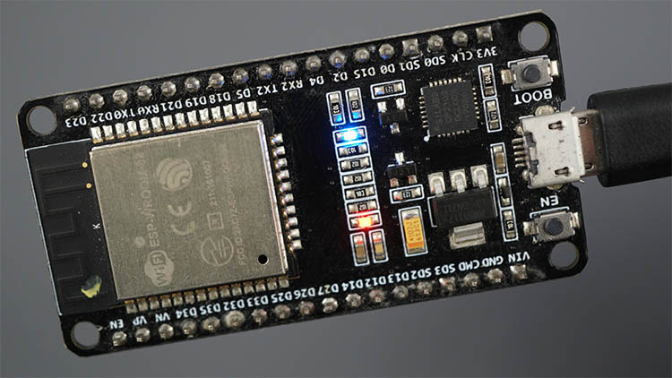
3. Flashing MicroPython Software
The following figure shows the ESP32 on-board LED light up.

Slide 20
Thank You for listening !

