Slide 1
Read Dust Sensor
Exercise 1
SPARC Lab –SET- HUST
Dr. Han Huy Dung –
(+84) 988968338
dung.hanhuy@hust.edu.vn

Slide 2





Content
Introduce about Hardware
Sensor Library by MicroPython
Demo read PM2.5 data
Exercise

Slide 3
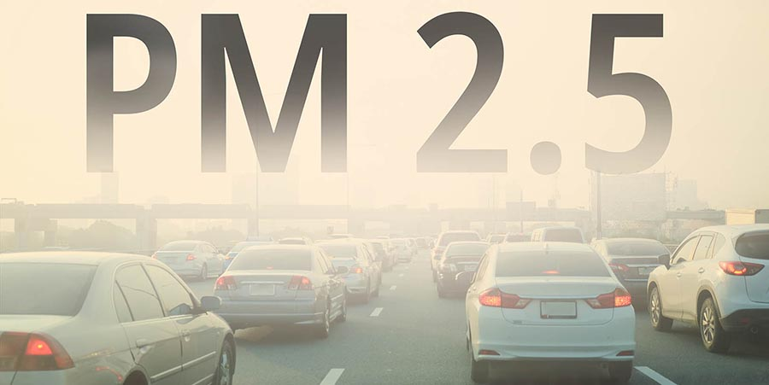
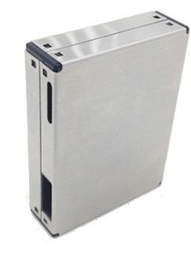
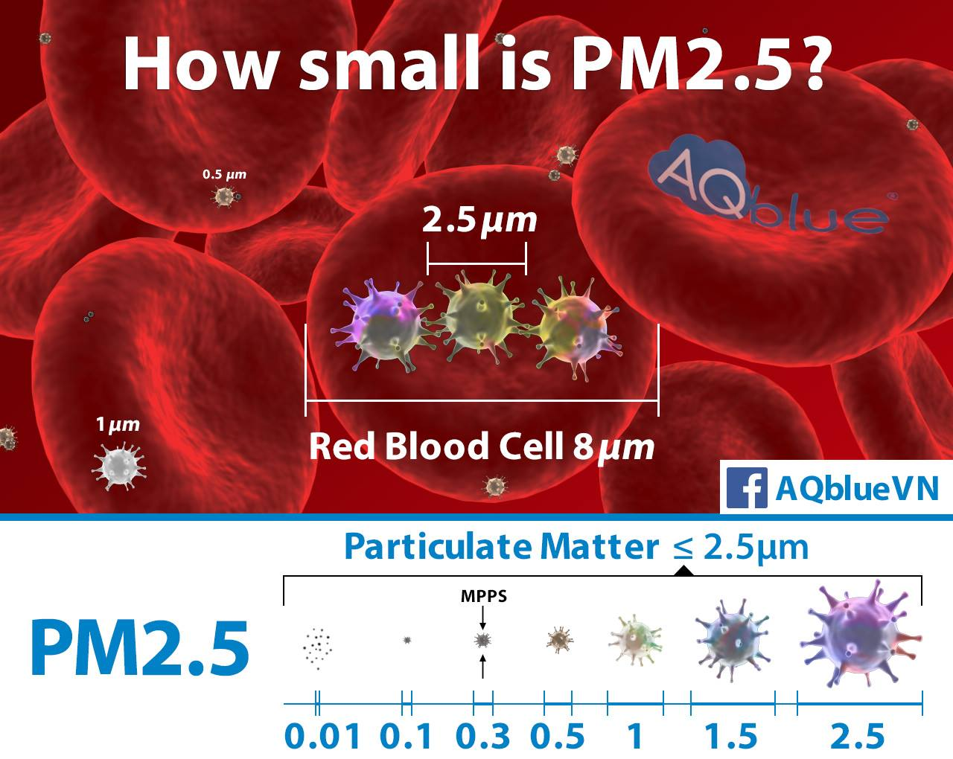
Introduce about Hardware
PMS7003 is a kind of digital and universal particle concentration sensor, which can be used to obtain the number of suspended particles in the air, i.e. the concentration of particles, and output them in the form of digital interface. This sensor can be inserted into variable instruments related to the concentration of suspended particles in the air or other environmental improvement equipments to provide correct concentration data in time.

Slide 4
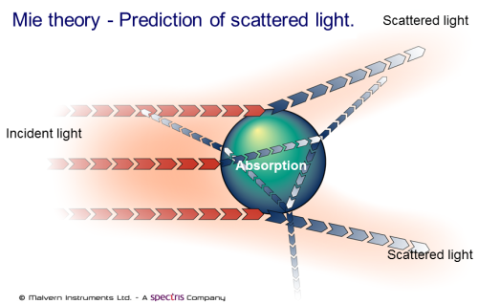
2. Introduce about Hardware
Using a laser to shine on particles that are suspended in the air
Then collect and analyze the scattered light over time
Calculation based on MIE theory (mie theory of light scattering)

Slide 5
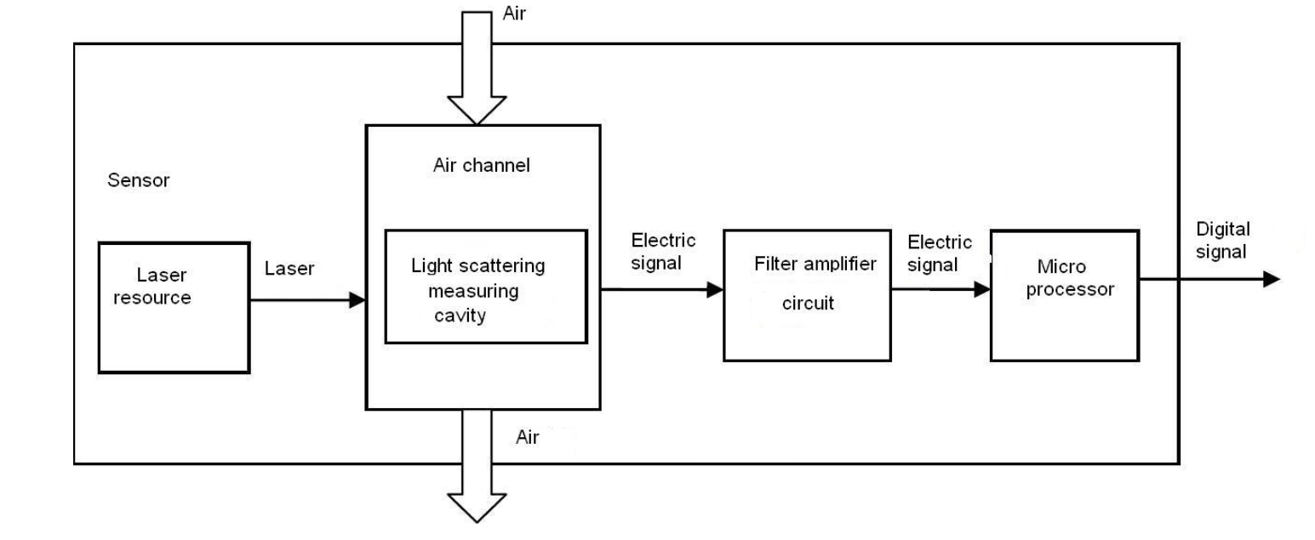
Introduce about Hardware
Air is drawn in through a pipe in which there is a built-in laser jar
The light then passes through a measured, calculated aperture into electrical signals

Slide 6
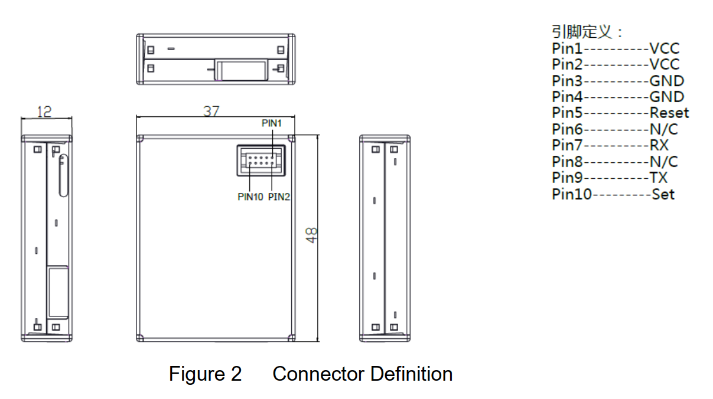
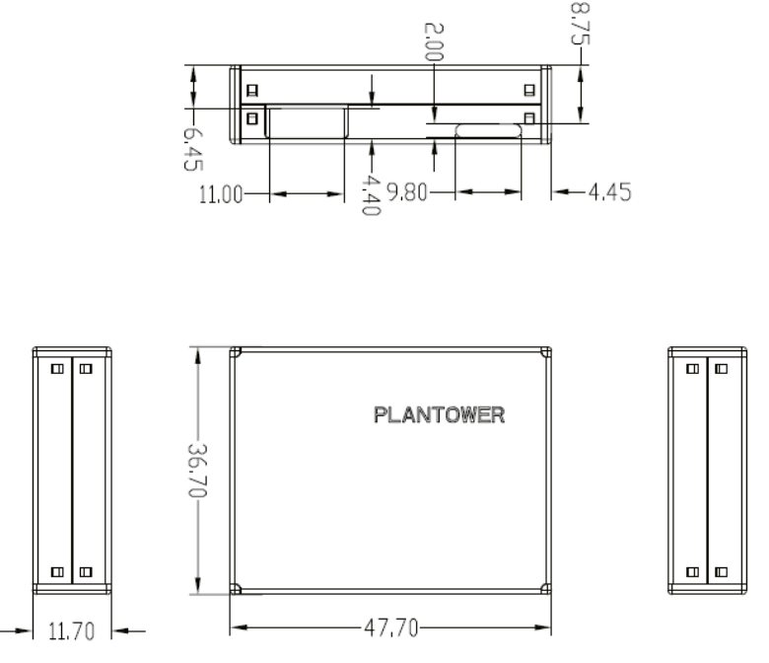
Introduce about Hardware
Physical size of PMS7003 sensor

Slide 7
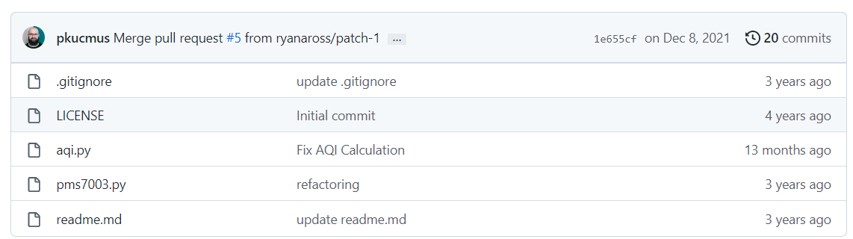
2. Sensor Library by MicroPython
The information about library, we can find it in this repository: https://github.com/pkucmus/micropython-pms7003

Slide 8
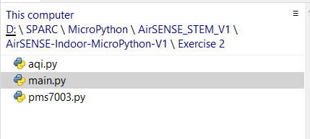
2. Sensor Library by MicroPython
But, we can use the code example in Exercises 2.
There are 3 files: pms7003.py and aqi.py are library files, main.py is main program.

Slide 9
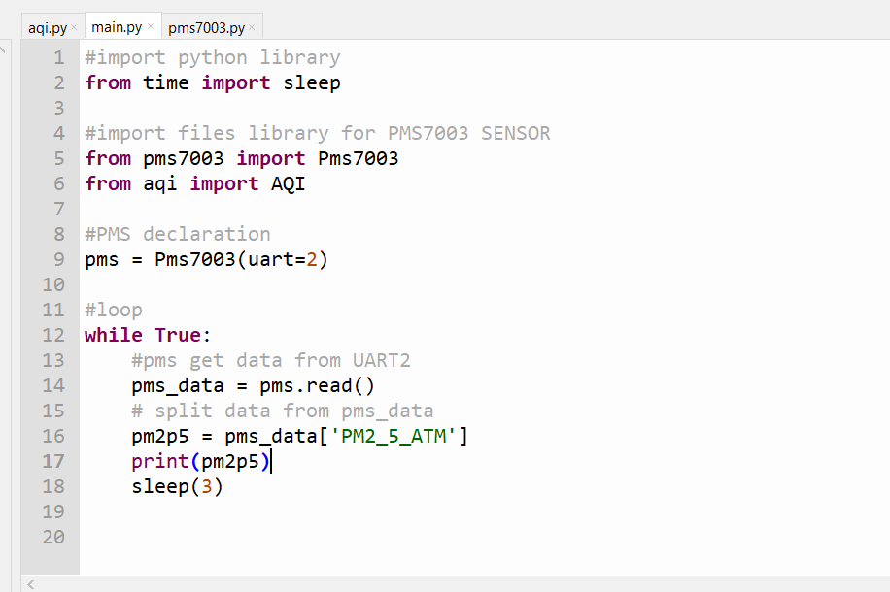
3. Demo read PM2.5 Data
With Thonny, Open the folder /Exercise 2 then open main.py file
Here is the code to read PM2.5 data and print to shell in Thonny

Slide 10
3. Demo read PM2.5 Data
At the 16 line, I have the key “PM2_5_ATM” to extract PM2.5 data, we can extract another data by the key below
Key | Description
PM1_0 | PM 1.0 concentration μ g/m3 (factory environment)
PM2_5 | PM 2.5 concentration μ g/m3 (factory environment)
PM10_0 | PM 10 concentration μ g/m3 (factory environment)
PM1_0_ATM | PM 1.0 concentration μ g/m3 (atmospheric environment)
PM2_5_ATM | PM 2.5 concentration μ g/m3 (atmospheric environment)
PM10_0_ATM | PM 10 concentration μ g/m3 (atmospheric environment)
PCNT_0_3 | Particle count of diameter beyond 0.3 um in 0.1 liter or air
PCNT_0_5 | Particle count of diameter beyond 0.5 um in 0.1 liter or air
PCNT_1_0 | Particle count of diameter beyond 1.0 um in 0.1 liter or air
PCNT_2_5 | Particle count of diameter beyond 2.5 um in 0.1 liter or air
PCNT_5_0 | Particle count of diameter beyond 5.0 um in 0.1 liter or air
PCNT_10_0 | Particle count of diameter beyond 10 um in 0.1 liter or air

Slide 11
4. Exercises
Now, your task is to write the code to print:
PM1.0 data
PM2.5 data
PM10.0 data
To shell in Thonny

Slide 12
Thank You for listening !

