Slide 1
Display text to ILI9341 Screen with AirSENSE Device
Exercise 2
SPARC Lab –SET- HUST
Dr. Han Huy Dung –
(+84) 988968338
dung.hanhuy@hust.edu.vn

Slide 2

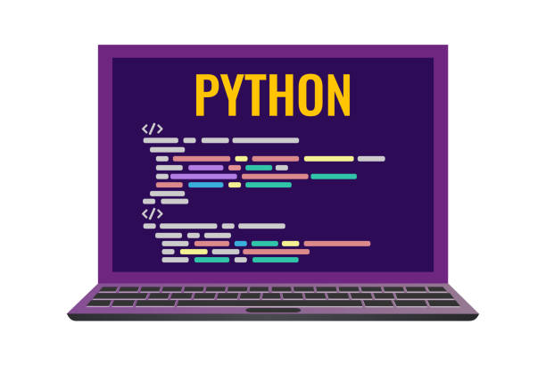



Content
Introduce about Hardware
Display Library by MicroPython
Demo display with Hello World
Exercise

Slide 3
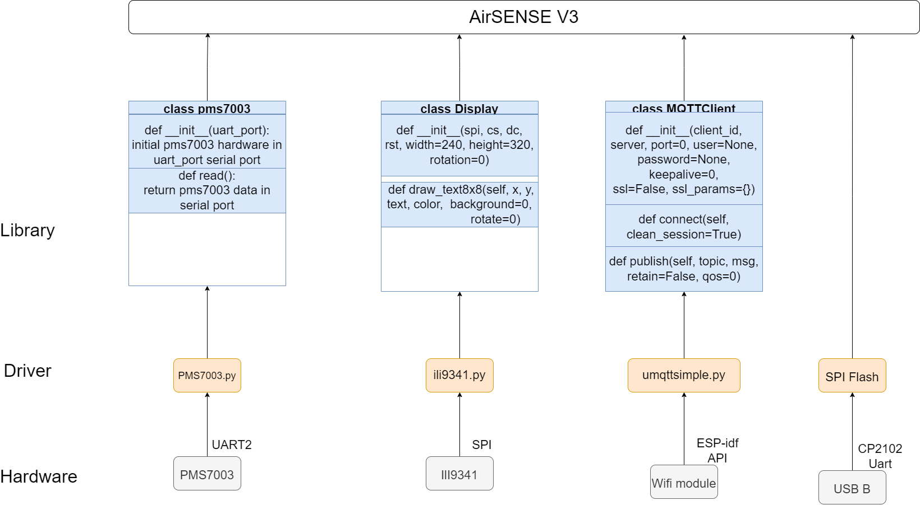
Introduce about Hardware
We will learn about this part

Slide 4
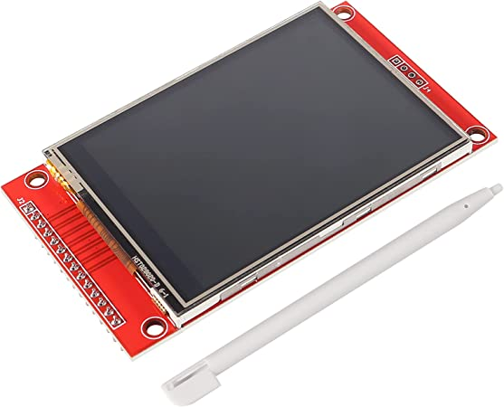
2. Display Library by MicroPython
ILI9341 is a 262,144-color single-chip SOC driver for a-TFT liquid crystal display with resolution of 240RGBx320 dots, comprising a 720-channel source driver, a 320-channel gate driver, 172,800 bytes GRAM for graphic display data of 240RGBx320 dots, and power supply circuit
ILI9341 display

Slide 5
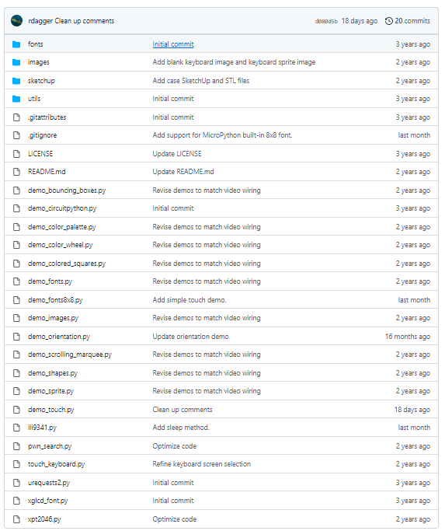
2. Display Library by MicroPython
The information about library, we can find it in this repository: https://github.com/rdagger/micropython-ili9341
there is a lot of code and examples there, but you don't have to learn them all by yourself, we will gradually learn the libraries through exercises.

Slide 6
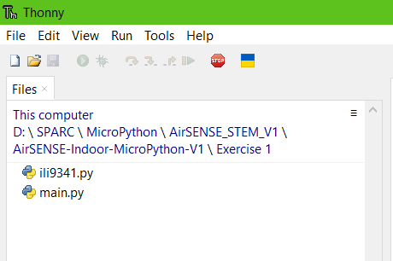
3. Demo display with Hello World
With Thonny, Open the folder /Exercise 1
In this folder, we have 2 file:
Ili9341.py: file library for ili9341 display which we are using in this AirSENSE device.
Main.py: file contains the executable instructions of the main program

Slide 7
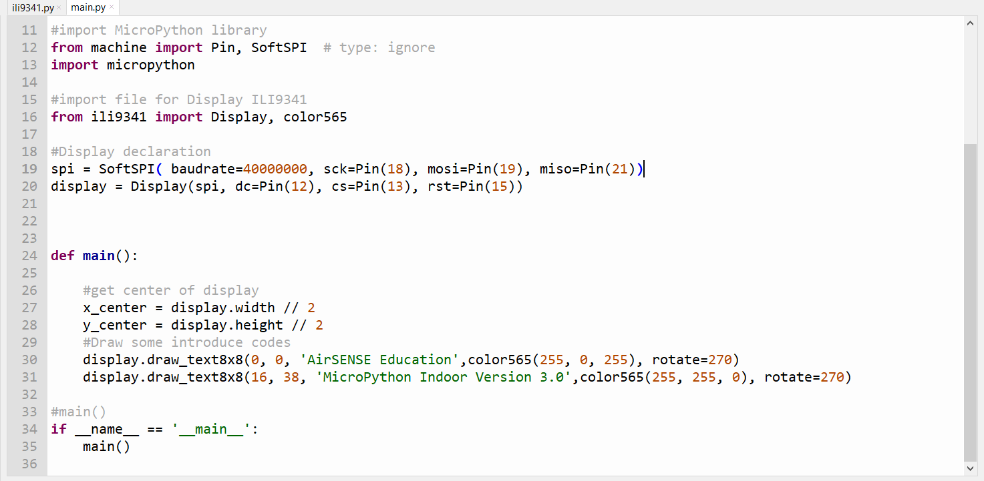
3. Demo display with Hello World
Below, we have the code of main.py

Slide 8
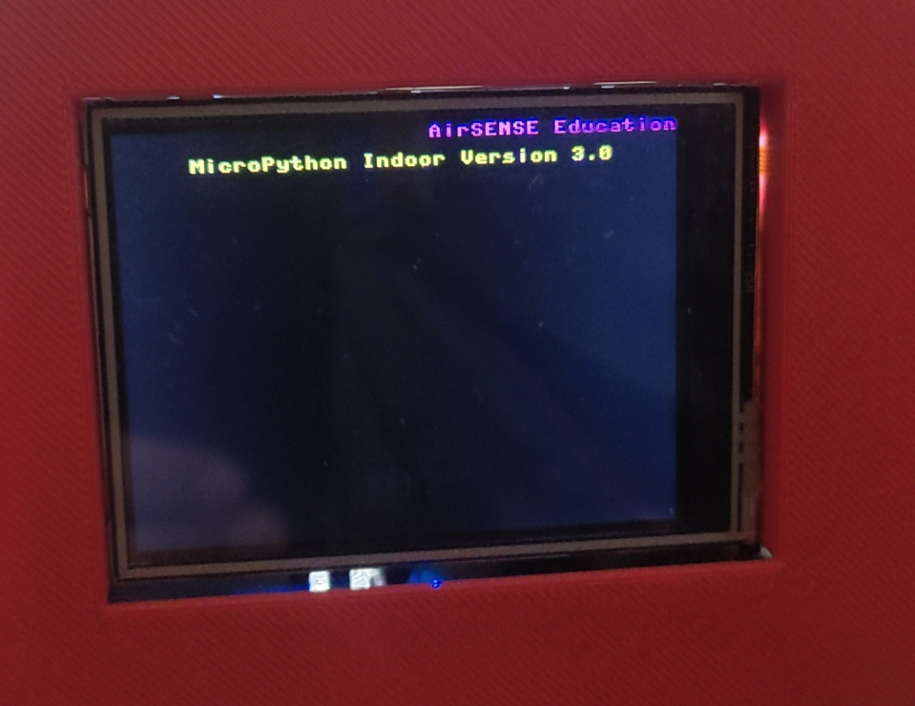
3. Demo display with Hello World
Result after we have done upload the code to AirSENSE device.

Slide 9
4. Demo display with Hello World
With a demo display above, your task is create a display will show
Your name
Your age
Your maxim

Slide 10
Thank You for listening !

