Slide 1
Learn NumPy Library In Python
Training

Slide 2
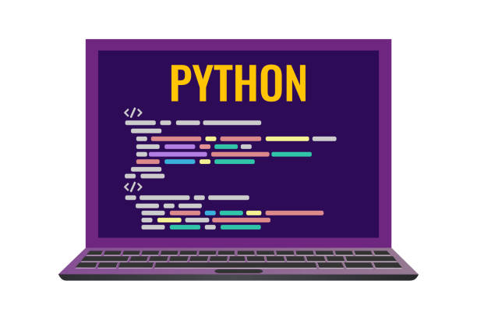
Content
Installing Numpy
Working with Numpy
Exercises

Slide 3
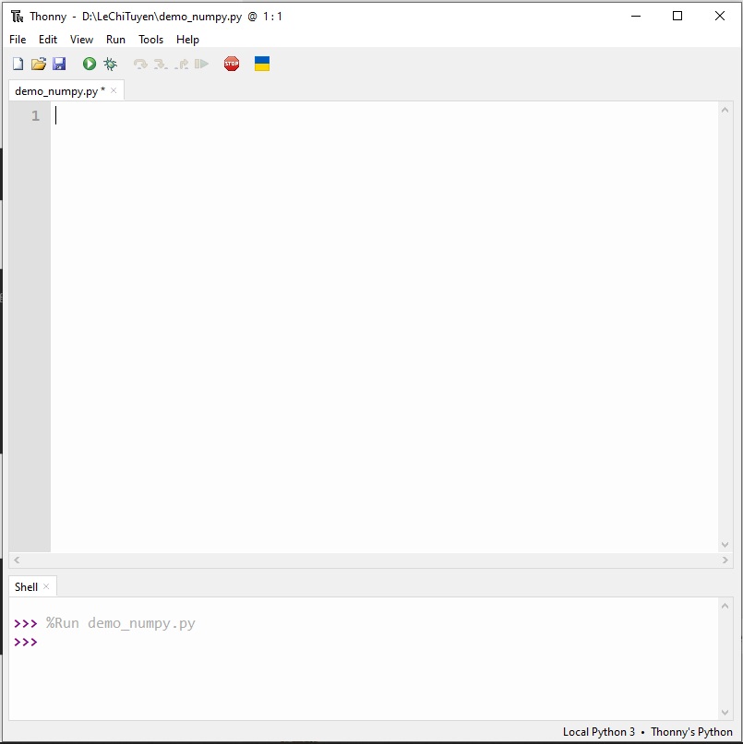
Installing Numpy
In this guide, we will using Thonny for all the exams.
Now, Create a new file. We recommend saving the file inside a folder with a name that identifies the project, for this example: “demo_numpy.py”

Slide 4
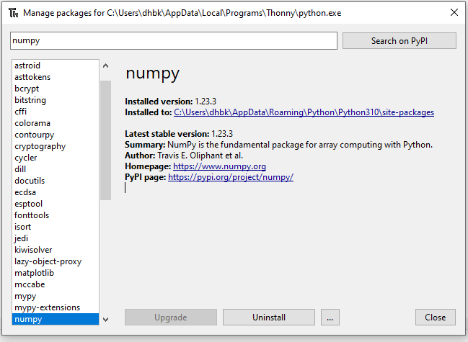
Installing Numpy
For Installing Numpy, like installing before this instruction, we select Tools -> Manager Packages -> Search Numpy on PyPi
But we had installed. We don’t reinstall it.
This step check if numpy had installed.

Slide 5
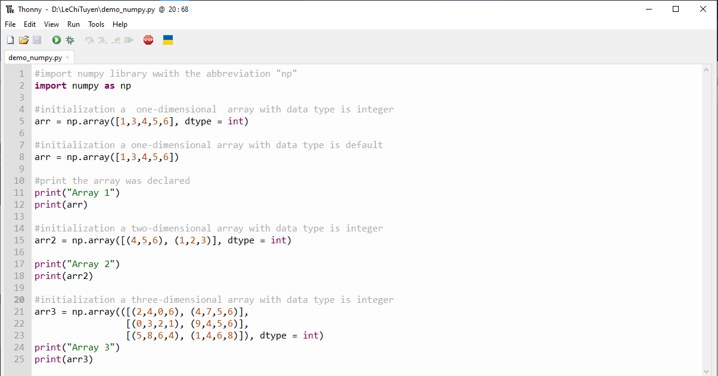
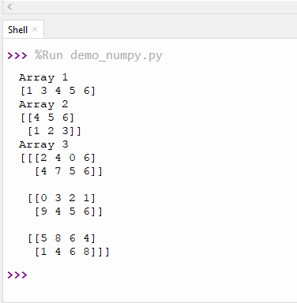
2. Working with Numpy
First, I have some examples about declare the array by Numpy

Slide 6
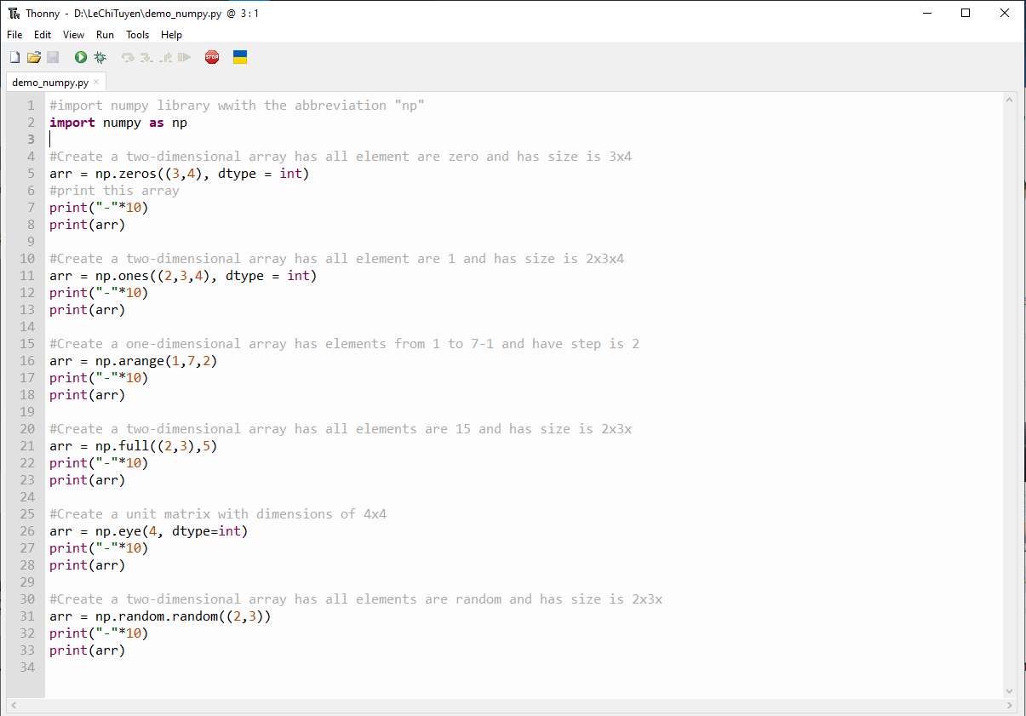
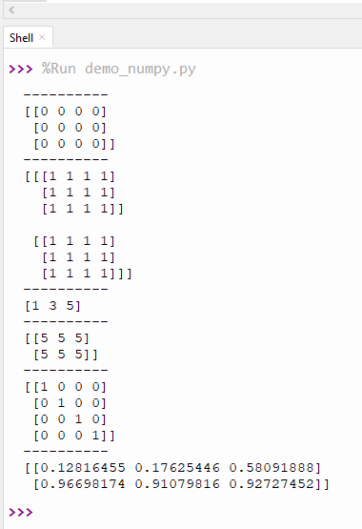
2. Working with Numpy
With Numpy, we have some built-in functions, I have list it in here:

Slide 7
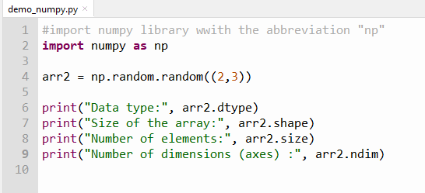
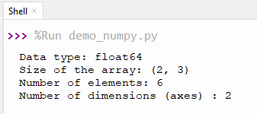
2. Working with Numpy
Attributes of a NumPy Array:
dtype: type of elements in array.
shape: size of array.
size: the total number of elements in the array.
ndim: represents the number of dimensions (axes) of the ndarray.

Slide 8
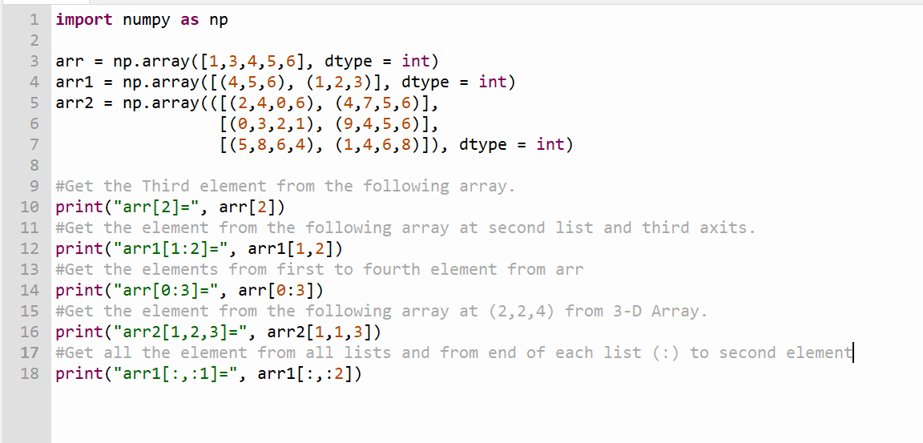
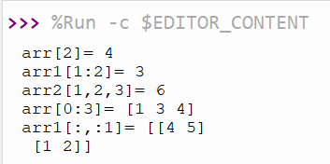
2. Working with Numpy
Access Array Elements
Array indexing is the same as accessing an array element.
You can access an array element by referring to its index number.
The indexes in NumPy arrays start with 0, meaning that the first element has index 0, and the second has index 1 etc

Slide 9
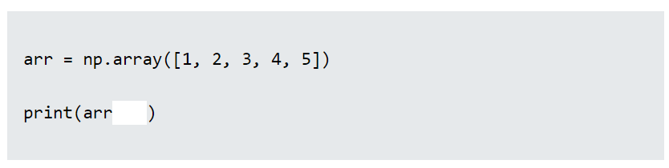
2. Exercises
Insert the correct syntax for printing the first item in the array.

Slide 10
Thank You for listening !

