Slide 1
Course contents
<number>/Chapter2
Introduction to microprocessor systems
The Intel 8088/8086 microprocessors
Assembly programming for 8086
Memory and I/O Interfacing
Interrupt
Didect memory access (DMA)
Real life microprocessors

Slide 2
Chapter 2: The Intel 8088/8086 microprocessors
<number>/Chapter2
2.1 Internal architecture
2.2 Pin map
2.3 Memory map of IBM-PC
2.4 Addressing modes of 8086
2.5 Instruction encoding
2.6 Instruction set of 8086
2.7 Protected mode memory management of 80286 machines and above

Slide 3
Chapter 2: The Intel 8088/8086 microprocessors
<number>/Chapter2
2.1 Internal architecture
  2.1.1 Block diagram
  2.1.2 General purpose registers
  2.1.3 Segment registers
  2.1.4 Index and pointer registers
  2.1.5 Flag register
  2.1.6 Instruction queue
2.2 Pin map
2.3 Memory map of IBM-PC
2.4 Addressing modes of 8086
2.5 Instruction encoding
2.6 Instruction set of 8086
2.7 Protected mode memory management of 80286 machines and above

Slide 4
Chapter 2: The Intel 8088/8086 microprocessors
<number>/Chapter2
2.1 Internal architecture
  2.1.1 Block diagram
  2.1.2 General purpose registers
  2.1.3 Segment registers
  2.1.4 Index and pointer registers
  2.1.5 Flag register
  2.1.6 Instruction queue
2.2 Pin map
2.3 Memory map of IBM-PC
2.4 Addressing modes of 8086
2.5 Instruction encoding
2.6 Instruction set of 8086
2.7 Protected mode memory management of 80286 machines and above

Slide 5
2.1.1 Block diagram of 8088/8086
<number>/Chapter2
EU
Execution Unit
Khối thực thi
Address bus
20 bit
BIU
Bus Interface Unit
Khối giao tiếp BUS ngoài
General purpose
registers
AX
∑
BX
CX
DX
Segment registers
and instruction
pointer
SP
CS
Index and pointer
register
DS
BP
SI
SS
DI
ES
IP
Data bus
ALU 16 bit
Bus control
logic
Temporary registers (hidden)
EU Control
Unit
External
Bus
ALU
Arithmetic
Logic Unit
Instruction queue
Flags

Slide 6
Chapter 2: The Intel 8088/8086 microprocessors
<number>/Chapter2
2.1 Internal architecture
  2.1.1 Block diagram
  2.1.2 General purpose registers
  2.1.3 Segment registers
  2.1.4 Index and pointer registers
  2.1.5 Flag register
  2.1.6 Instruction queue
2.2 Pin map
2.3 Memory map of IBM-PC
2.4 Addressing modes of 8086
2.5 Instruction encoding
2.6 Instruction set of 8086
2.7 Protected mode memory management of 80286 machines and above

Slide 7
2.1.2 General purpose registers
<number>/Chapter2
AX (accumulator): stores the result of operations. 8 bit results are stored in register AL
BX (base): stores the base address
CX (count): stores the number of iterations in Loop instruction. CL is used to store the number of shift or rotation positions in shift and rotate instructions.
DX (data): used in conjuntion with AX to store the results of 16 bit multiplicaton and division operations. DX can also be used to store the I/O port addresses in direct I/O instructions IN/OUT.
8 Higher bits
8 lower bits
8088/8086 to 80286 : 16 bits
80386 and above: 32 bits EAX, EBX, ECX, EDX
AX
AH
AL
BX
BH
BL
CX
CH
CL
DX
DH
DL

Slide 8
Chapter 2: The Intel 8088/8086 microprocessors
<number>/Chapter2
2.1 Internal architecture
  2.1.1 Block diagram
  2.1.2 General purpose registers
  2.1.3 Segment registers
  2.1.4 Index and pointer registers
  2.1.5 Flag register
  2.1.6 Instruction queue
2.2 Pin map
2.3 Memory map of IBM-PC
2.4 Addressing modes of 8086
2.5 Instruction encoding
2.6 Instruction set of 8086
2.7 Protected mode memory management of 80286 machines and above

Slide 9

2.1.3 Segment registers
<number>/Chapter2
Memory organization in 1 Mbytes momory space
  Memory segment
    2¹⁶ bytes =64 KB
    Segment 1: starting address 00000H
    Segment 2: starting address 00010H
    Last segment: starting address FFFF0H
  Memory cells in one segment:
    Offset address
    Cell 1: offset=0000H
    Last cell: offset=FFFFH
  Physical address:
    Segment : offset
FFFFF
1FFFF
1F000
Offset=F000
10000
1 0 0 0
Physical address=Segment*16 + offset
Segment register
real mode memory managment
00000

Slide 10
2.1.3 Segment registers
<number>/Chapter2
Example 1: Physical address 12345H
Example 2: Given the beginning address of the segment 49000 H, determine the ending address
Segment | Offset
1000 H | 2345H
1200 H | 0345H
1004 H | ?
0300 H | ?

Slide 11
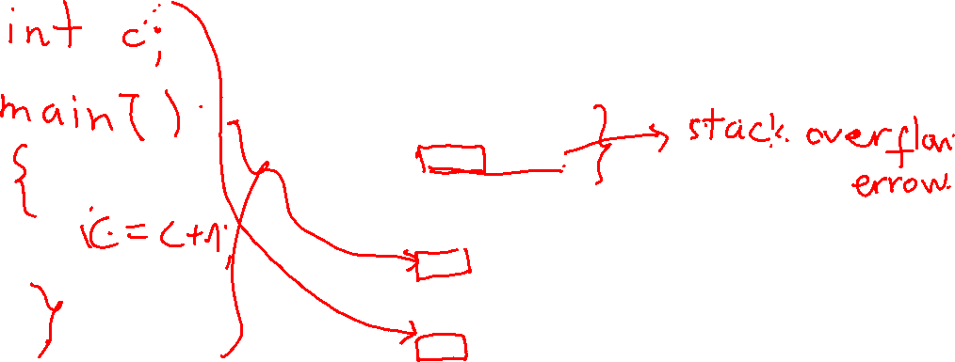
2.1.3 Segment registers
<number>/Chapter2
Segment registers: store the corresponding segment address
FFFFF
.............
58FFF
Đoạn dữ liệu phụ
extra segment
49000
4 9 0 0
ES
43FFF
Đoạn ngăn xếp
Stack segment
34000
SS
3 4 0 0
30000
2FFFF
Đoạn mã
Code segment
20000
1FFFF
CS
2 0 0 0
Đoạn dữ liệu
Data segment
10000
1 0 0 0
DS
00000

Slide 12
2.1.3 Segment registers
<number>/Chapter2
Overlapped segments
FFFFF
s
t
a
c
k
d
a
t
a
0A480
0A47F
c
o
d
e
Stack
0A280
0A27F
SS
Data
0 A 2 8
0A0F0
0A0EF
DS
0 A 0 F
Code
090F0
0 9 0 F
CS
00000

Slide 13
Chapter 2: The Intel 8088/8086 microprocessors
<number>/Chapter2
2.1 Internal architecture
  2.1.1 Block diagram
  2.1.2 General purpose registers
  2.1.3 Segment registers
  2.1.4 Index and pointer registers
  2.1.5 Flag register
  2.1.6 Instruction queue
2.2 Pin map
2.3 Memory map of IBM-PC
2.4 Addressing modes of 8086
2.5 Instruction encoding
2.6 Instruction set of 8086
2.7 Protected mode memory management of 80286 machines and above

Slide 14
2.1.4 Index and pointer registers
<number>/Chapter2
Store the offset address:
  Instruction pointer IP: stores the offset address of the next instruction to be executed in the Code Segment
    CS:IP
  Base Pointer BP: stores the offset address of data in Stack segment SS:BP
  Stack Pointer SP: stores the offset address of the top of the stack
    SS:SP
  Source Index SI: stores the offset address of source data in the Data Segment in string instructions
    DS:SI
  Destination Index DI: stores the offset address of destination data in the Data Segment in string instructions
    DS:DI
  SI and DI may be used as general purpose registers
  80386 and above: 32 bit: EIP, EBP, ESP, EDI, ESI

Slide 15
2.1.4 Index and pointer registers
<number>/Chapter2
Default segment and offset
Segment | Offset | Note
CS | IP | Instruction address
SS | SP or BP | Stack address
DS | BX, DI, SI, 8 bit or 16 bit number | Data address
ES | DI | Destination string address

Slide 16
Chapter 2: The Intel 8088/8086 microprocessors
<number>/Chapter2
2.1 Internal architecture
  2.1.1 Block diagram
  2.1.2 General purpose registers
  2.1.3 Segment registers
  2.1.4 Index and pointer registers
  2.1.5 Flag register
  2.1.6 Instruction queue
2.2 Pin map
2.3 Memory map of IBM-PC
2.4 Addressing modes of 8086
2.5 Instruction encoding
2.6 Instruction set of 8086
2.7 Protected mode memory management of 80286 machines and above

Slide 17
2.1.5 Flag Register
<number>/Chapter2
9 bits are used, 6 status flags:
  C or CF (carry flag): CF=1 when there is carry or borrow from MSB
  P or PF (parity flag): PF=1 (0) when there is an even (odd) number of 1 bit in the result
  A or AF (auxilary carry flag): AF=1 when there is carry or borrow from a low BCD digit to higher one.
  Z or ZF (zero flag): ZF=1 when the result is zero
  S or SF (Sign flag): SF=1 when the result is negative.
  O or OF (Overflow flag): OF=1 when the result exceeds the representation range in signed number addition/subtraction.
15
14
2
1
0
O
D
I
T
S
Z
A
P
C

Slide 18
2.1.5 Flag Register
<number>/Chapter2
3 control flags
  T or TF (trap flag)): TF=1 => CPU will execute only one instruction at a time
  I or IF (Interrupt enable flag): IF=1 => maskable interrupts are enabled
  D or DF (direction flag): DF=1 => CPU will work with string from right to left (instruction STD, CLD)
15
14
2
1
0
O
D
I
T
S
Z
A
P
C

Slide 19
2.1.5 Flag Register
<number>/Chapter2
Example:
  SF=0 since msb =0
  PF=1 since the numbe of 1 bit is 0 (even number)
  ZF=1 since the result is 0
  CF=1 since there is carry bit from msb
  OF=1 since adding two negative numbers results a positive number
80h
+
80h
100h

Slide 20
Chapter 2: The Intel 8088/8086 microprocessors
<number>/Chapter2
2.1 Internal architecture
  2.1.1 Block diagram
  2.1.2 General purpose registers
  2.1.3 Segment registers
  2.1.4 Index and pointer registers
  2.1.5 Flag register
  2.1.6 Instruction queue
2.2 Pin map
2.3 Memory map of IBM-PC
2.4 Addressing modes of 8086
2.5 Instruction encoding
2.6 Instruction set of 8086
2.7 Protected mode memory management of 80286 machines and above

Slide 21
2.1.6 Instruction queue
<number>/Chapter2
4 bytes for 8088 and 6 bytes for 8086
Pipelining
without
pipelining
F1
D1
E1
F2
D2
E2
F3
D3
E3
t
F1
D1
E1
with pipelining
F2
D2
E2
F3
D3
E3
t

Slide 22
Chapter 2: The Intel 8088/8086 microprocessors
<number>/Chapter2
2.1 Internal architecture
2.2 Pin map
2.3 Memory map of IBM-PC
2.4 Addressing modes of 8086
2.5 Instruction encoding
2.6 Instruction set of 8086
2.7 Protected mode memory management of 80286 machines and above

Slide 23
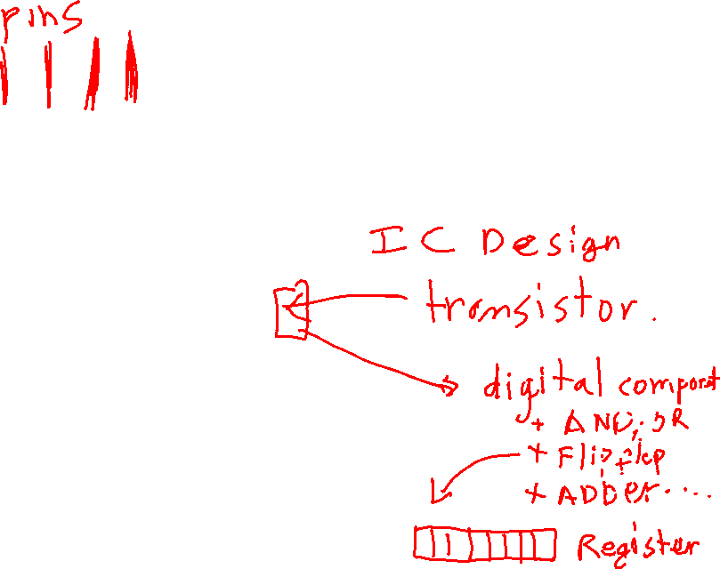
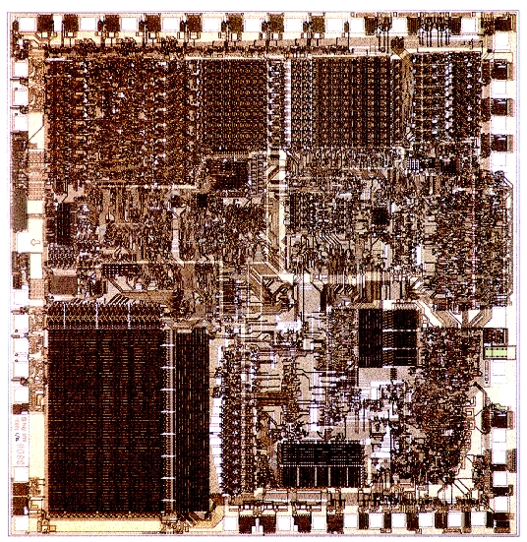
2.2 Pin map
Intel 8088
<number>/Chapter2
16-bit processor
introduced in 1979
3 µm, 5 to 8 MHz, 29 KTOR, 0.33 to 0.66 MIPS

Slide 24
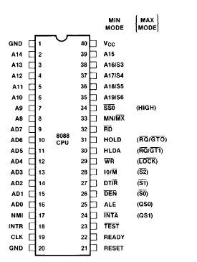

2.2 Pin map
Intel 8088
<number>/Chapter2
Min and Max modes:
MN/MX = 1 Min mode
= 0 Max mode with bus controller 8288

Slide 25
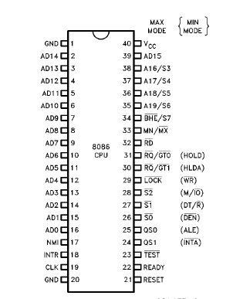
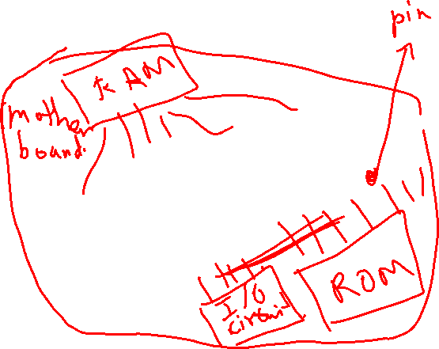
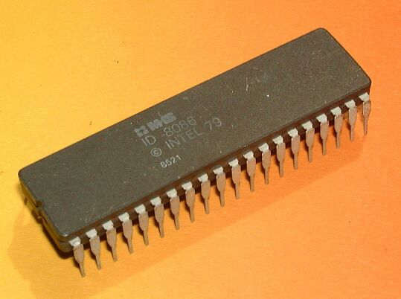
2.2 Pin map
Intel 8086
<number>/Chapter2

Slide 26
Chapter 2: The Intel 8088/8086 microprocessors
<number>/Chapter2
2.1 Internal architecture
2.2 Pin map
2.3 Memory map of IBM-PC
2.4 Addressing modes of 8086
2.5 Instruction encoding
2.6 Instruction set of 8086
2.7 Protected mode memory management of 80286 machines and above

Slide 27
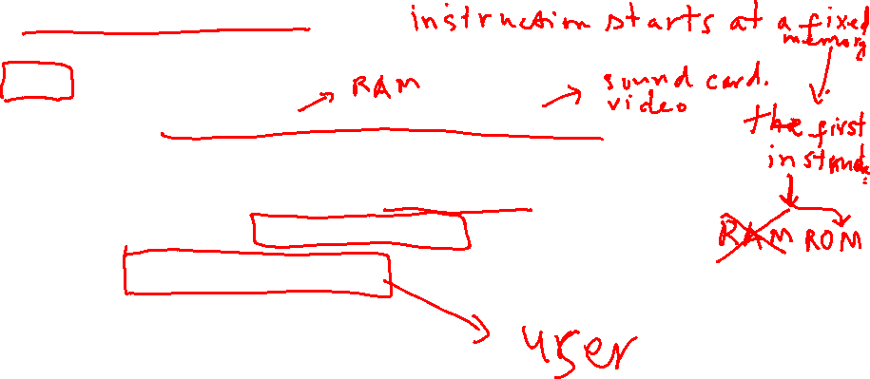
2.3.1 Start up routine
<number>/Chapter2
When power up or at Reset
  CS=FFFFh and IP=0000 => instructions at FFFF0 directs CPU to jump to the BIOS programs.
  BIOS programs check memory and system hardwares
  BIOS programs initiates interrupt vector table and BIOS data area
  BIOS loads boot program from the hard disk to main memory
  Boot program loads the operating system into memory
  The OS loads application programs into memory

Slide 28
2.3.2 Memory map of IBM-PC
<number>/Chapter2
Extended
memory
FFFFF
System memory
384 Kbytes
A0000
9FFFF
1 Mbytes
Physical memory
Program memory
640 Kbytes
00000

Slide 29

2.3.2 Memory map of IBM-PC
Program memory
<number>/Chapter2
9FFFF
MSDOS
9FFF0
Application program area
08E30
COMMAND.COM
08490
Device drivers (mouse.sys)
02530
MSDOS
01160
IO.SYS
00700
DOS area
00500
BIOS area
00400
00000
Interrupt vector table

Slide 30
2.3.2 Memory map of IBM-PC
System memory
<number>/Chapter2
FFFFF
ROM BIOS
F0000
ROM BASIC
E0000
Reserved area
C8000
Video BIOS ROM
C0000
Video RAM (text)
B0000
Video RAM (graphics)
A0000

Slide 31
2.3.2 Memory map of IBM-PC
Reserved memory area of 8088/8086
<number>/Chapter2
FFFFF
Reset Bootstrap
program jump
FFFF0
003FF
Interrupt vectors
00000

Slide 32
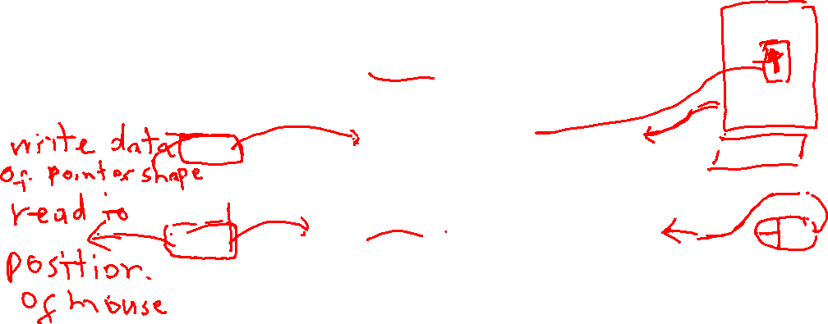
2.3.2 Memory map of IBM-PC
I/O address
<number>/Chapter2
Addresses: 0000H –FFFFH, M/IO =0
FFFF
Extended area
COM1
03F8
Floppy disk controller
03F0
CGA adapter
03D0
LPT1
0378
Hard disk controller
0320
COM2
02F8
8255
0060
Timer (8253)
0040
Interrupt controller
0020
0000
DMA conntroller

Slide 33
Chapter 2: The Intel 8088/8086 microprocessors
<number>/Chapter2
2.1 Internal architecture
2.2 Pin map
2.3 Memory map of IBM-PC
2.4 Addressing modes of 8086
  2.4.1 Register addressing
  2.4.2 Immediate addressing
  2.4.3 Direct addressing
  2.4.4 Register indirect addressing
  2.4.5 Based relative addressing
  2.4.6 Indexed relative addressing
  2.4.7 Based Indexed relative Addressing
2.5 Instruction encoding
2.6 Instruction set of 8086
2.7 Protected mode memory management of 80286 machines and above

Slide 34
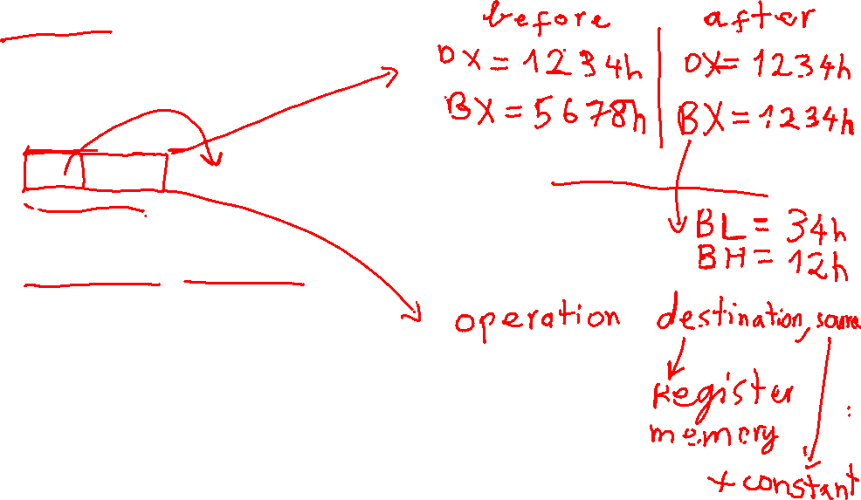
2.4.1 Register Addressing Mode
<number>/Chapter2
Registers are used as operands
High speed
Examples:
  MOV BX, DX ; Copy the content of DX into BX, the content of DX is unchanged
  MOV AL, BL ;
  ADD AL, DL ; AL=AL+DL

Slide 35
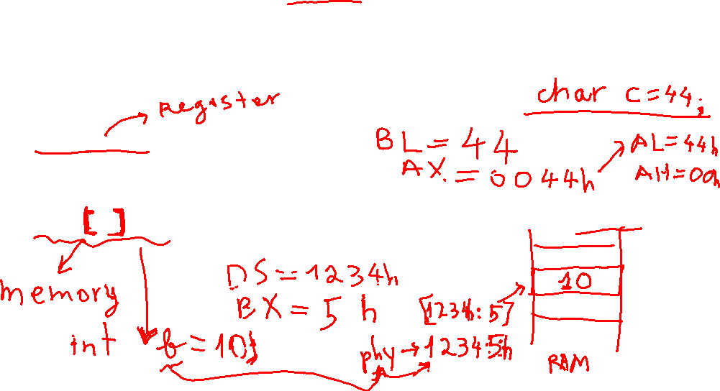
2.4.2 Immediate Addressing Mode
<number>/Chapter2
Destination operand is a register or memory location
Source operand is a constant
Used to load a constant into registers (except segment registers and flags) or memory location in Data segment.
Examples:
  MOV BL, 44 ; Copy 44 into BL
  MOV AX, 44H ; Copy 0044H into AX
  MOV AL, ‘A’ ; Copy ASCII code of ‘A’ into AL
  MOV [BX], 10 ; copy 10 into memory location with address DS:BX

Slide 36
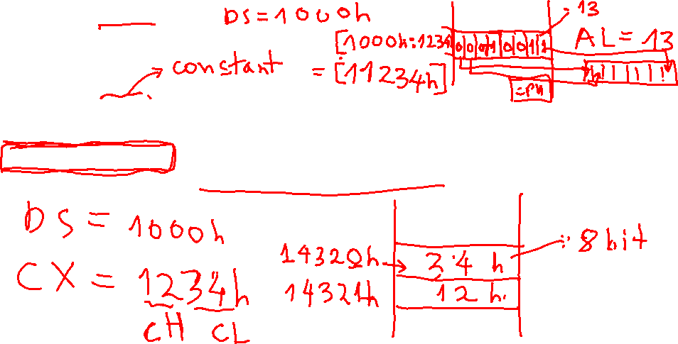
2.4.3 Direct Addressing Mode
<number>/Chapter2
One operand is memory address which stores data, the other must be a register
Examples:
  MOV AL, [ 1234H ] ; Copy the content of memory location with address DS:1234 into AL
  MOV [ 4320H ], CX ; Copy the content of CX into two consecutive memory locations with addresses DS: 4320 and DS: 4321

Slide 37
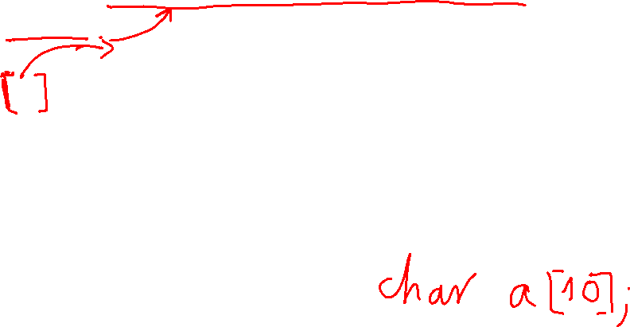
2.4.4 Register indirect Addressing Mode
<number>/Chapter2
One operand is a memory address stored in a register, the other must be a register
Examples:
  MOV AL, [BX] ; Copy the content of memory location with address DS:BX into AL
  MOV [ SI ], CL ; Copy the content of CL into memory location with address DS:SI
  MOV [ DI ], AX ; copy the content of AX into two consecutive memory locations with addresses DS: DI and DS: (DI +1)

Slide 38
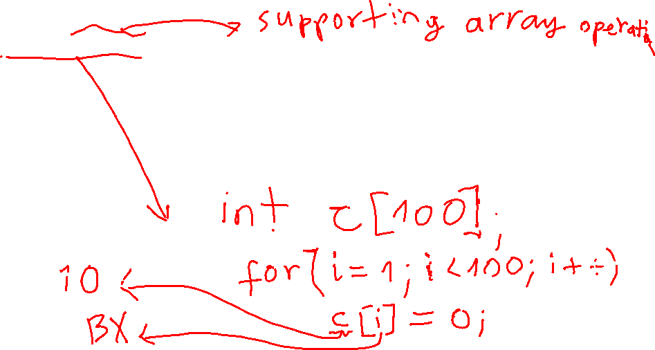
2.4.5 Based relative Addressing Mode
<number>/Chapter2
One operand is base registers BX, BP plus constants representing displacements, the other must be a register.
Examples:
  MOV CX, [BX]+10 ; Copy the content of two consecutive memory locations with addresses DS:BX+10 and DS:BX+11 into CX
  MOV CX, [BX+10] ; similar to the above example
  MOV AL, [BP]+5 ; copy the content of memory location with address SS:BP+5 into AL

Slide 39
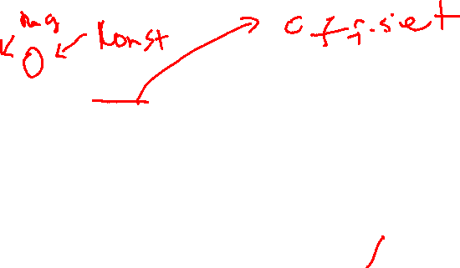
2.4.6 Indexed relative Addressing Mode
<number>/Chapter2
One operand is index registers SI, DI plus constants representing displacements, the other must be a register
Examples:
  MOV AX, [SI]+10 ; Copy the content of two consecutive memory locations with addresses DS:SI+10 and DS:SI+11 into AX
  MOV AX, [SI+10] ; similar to the above example
  MOV AL, [DI]+5 ; copy the content of memory location with address DS:DI+5 into AL

Slide 40
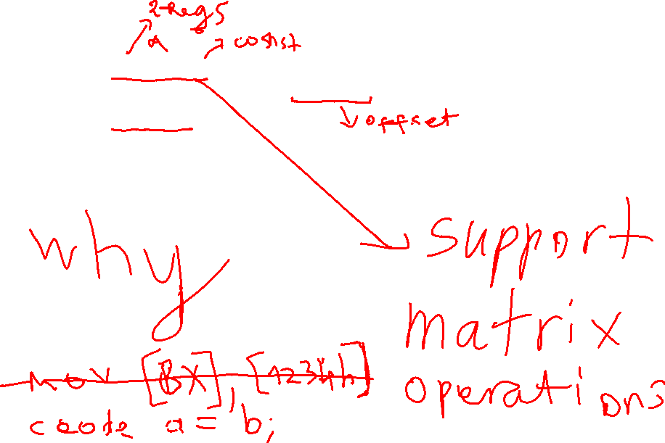
2.4.7 Based Indexed relative Addressing Mode
<number>/Chapter2
Examples:
  MOV AX, [BX] [SI]+8 ; Copy the content of two consecutive memory locations with addresses DS:BX+SI+8 and DS:BX+SI+9 into AX
  MOV AX, [BX+SI+8] ;
  MOV CL, [BP+DI+5] ; copy the content of memory location with address SS:BP+DI+5 into CL

Slide 41
Summary of addressing modes
<number>/Chapter2
Addressing mode | Operand | Default segment register
Register | Registers
Immediate | Constant data
Direct | [offset] | DS
Register indirect | [BX] [SI] [DI] | DS DS DS
Based relative | [BX] + displacement [BP] + displacement | DS SS
Indexed relative | [DI] + displacement [SI] + displacement | DS DS
Based indexed relative | [BX] + [DI]+ displacement [BX] + [SI]+ displacement [BP] + [DI]+ displacement [BP] + [SI]+ displacement | DS DS SS SS

Slide 42
Segment override
<number>/Chapter2
Examples:
  MOV AL, [BX]; Copy the content of memory location with address DS:BX into AL
  MOV AL, ES:[BX] ; Copy the content of memory location with address ES:BX into AL

Slide 43
Chapter 2: The Intel 8088/8086 microprocessors
<number>/Chapter2
2.1 Internal architecture
2.2 Pin map
2.3 Memory map of IBM-PC
2.4 Addressing modes of 8086
2.5 Instruction encoding
2.6 Instruction set of 8086
2.7 Protected mode memory management of 80286 machines and above

Slide 44
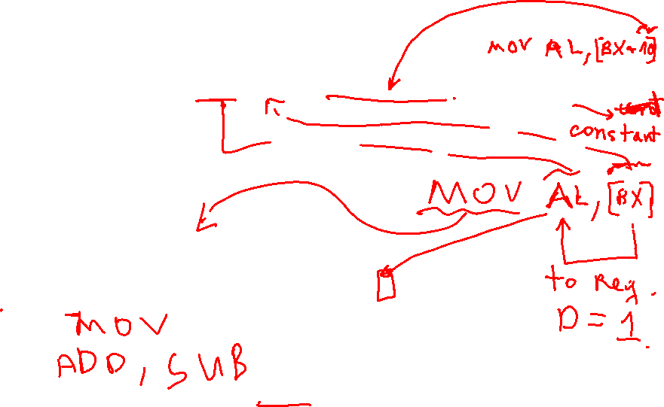
2.5 8086 Instruction encoding
<number>/Chapter2
One instruction may have a size from 1 to 6 bytes
Opcode
1-2 byte
MOD-REG-R/M
0-1 byte
Displacement
0-2 byte
Immediate
0-2 byte
Byte Opcode
D
W
W=0 1 byte data
W=1 2 byte data
Opcode
D=1 data flow to the register encoded with 3 bits REG
D=0 data flow from the register encoded with 3 bits REG

Slide 45



2.5 8086 Instruction encoding
<number>/Chapter2
7 6 5 4 3 2 1 0
MOD
REG
R/M
MOD <> 11
00 no displacement
01 8 bit displacement
16 bit displacement
R/M is a register
Register Code
W=1 W=0
AX AL 000
BX BL 011
CX CL 001
DX DL 010
SP AH 100
DI BH 111
BP CH 101
SI DH 110
Code Addressing mode
000 DS:[BX+SI]
001 DS:[BX+DI]
010 SS:[BP+SI]
011 SS:[BP+DI]
100 DS:[SI]
101 DS:[DI]
110 SS:[BP]
111 DS:[BX]

Slide 46
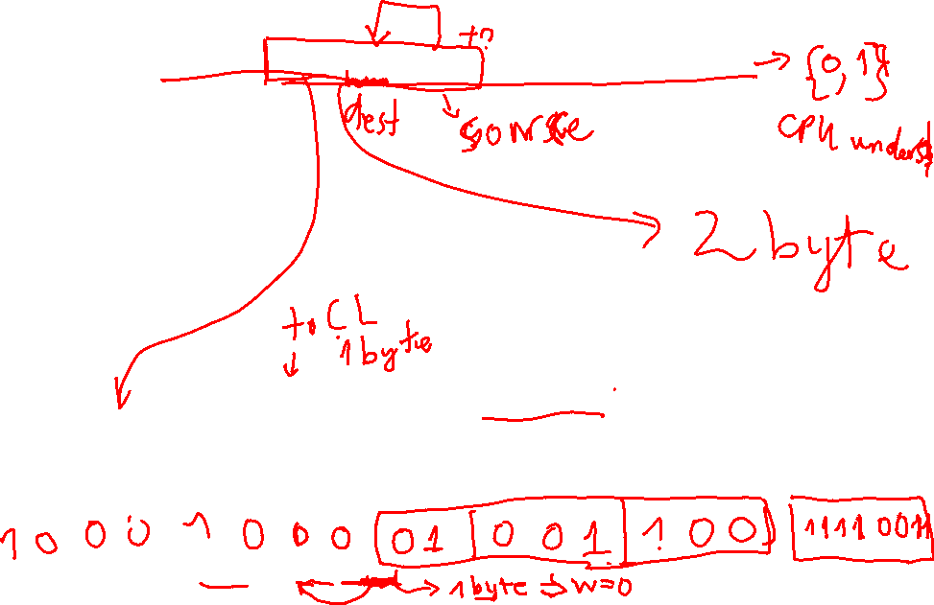
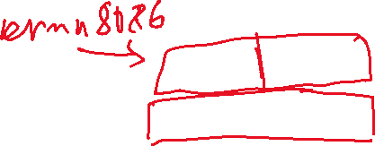
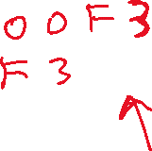
2.5 8086 Instruction encoding
<number>/Chapter2
Example 1: Encode MOV CL, [BX] into machine code
  opcode MOV: 100010
  1 byte data: W=0
  To register: D=1
  No displacement: MOD=00
  [BX] => R/M=111
  CL => REG=001
1
0
0
0
1
0
1
0
0
0
0
0
1
1
1
1
MOV
MOD
CL
[BX]
D
W
Example 2: Encode MOV [SI+F3H], CL into machine code

Slide 47
Chapter 2: The Intel 8088/8086 microprocessors
<number>/Chapter2
2.1 Internal architecture
2.2 Pin map
2.3 Memory map of IBM-PC
2.4 Addressing modes of 8086
2.5 Instruction encoding
2.6 Instruction set of 8086
  2.6.1 Data movement/modification instructions
  2.6.2 Arithmetic and logic instructions
  2.6.3 Program control instructions
  2.6.4 Other instructions
2.7 Protected mode memory management of 80286 machines and above

Slide 48
Chapter 2: The Intel 8088/8086 microprocessors
<number>/Chapter2
2.1 Internal architecture
2.2 Pin map
2.3 Memory map of IBM-PC
2.4 Addressing modes of 8086
2.5 Instruction encoding
2.6 Instruction set of 8086
  2.6.1 Data movement/modification instructions
  2.6.2 Arithmetic and logic instructions
  2.6.3 Program control instructions
  2.6.4 Other instructions
2.7 Protected mode memory management of 80286 machines and above

Slide 49
2.6.1 Data movement instructions
<number>/Chapter2
MOV, XCHG, POP, PUSH, POPF, PUSHF, IN, OUT, LDS, LEA, LES
String movement instructions MOVS, MOVSB, MOVSW, LODS(B/W)
MOV
  Used to move data amongst registers, between one register and one memory location or move a constant into a register or a memory location
  Syntax: MOV Destination, source
  This instruction doesn’t affect flags.
  Examples:
    MOV AX, BX
    MOV AH, ‘A’
    MOV AL, [1234H]

Slide 50
2.6.1 Data movement instructions
<number>/Chapter2
Operands combination possibilities for MOV instruction
 | GPR | Segment register | Memory location | Constant
GPR | YES | YES | YES | NO
Segment register | YES | NO | YES | NO
Memory location | YES | YES | NO | NO
Constant | YES | NO | YES | NO
Dest
Source

Slide 51
2.6.1 Data movement instructions
<number>/Chapter2
XCHG (Exchange 2 operands)
  Used to swap the content of two registers or one register and one memory location
  Syntax: XCHG destination, source
  Constraint: operands must not be segment registers
  This instruction has no effect on flags
  Examples:
    XCHG AX, BX
    XCHG AX, [BX]
LEA- Load Effective Address
  Load effective address into a register
  Operation: Destination= offset address (i.e. effective address) of source
  Examples:
    LEA DX,Message
    LEA CX,[BX][DI]

Slide 52
2.6.1 Data movement instructions
<number>/Chapter2
PUSH
  Used to store one word from a register or memory to the top of the stack
  Syntax: PUSH Source
  Description: SP=SP-2, Source => {SP}
  Constraint: 16 bit register or 16 bit memory
  This instruction has no effect on flags
  Examples:
    PUSH BX
    PUSH PTR[BX]
PUSHF
  Store the content of flag register on top of the stack

Slide 53
2.6.1 Data movement instructions
<number>/Chapter2
PUSH example
PUSH AX
PUSH BX
SP
1300A
1300A
1300A
13009
13009
12
13009
12
13008
13008
SP
13008
34
34
13007
13007
13007
78
13006
13006
13006
SP
56
13005
13005
13005
13004
13004
13004
13003
13003
13003
13002
13002
13002
13001
13001
13001
13000
13000
13000
SS
1 3 0 0
SS
1 3 0 0
SS
1 3 0 0
SP
0 0 0 A
SP
0 0 0 8
SP
0 0 0 6
AX
1 2 3 4
AX
1 2 3 4
BX
7 8 5 6

Slide 54
2.6.1 Data movement instructions
<number>/Chapter2
POP
  Used to retrieve one word from the top of the stack into a register or memory locations.
  Syntax: POP Destination
  Description: {SP} => Destination, SP=SP+2
  Constraint: 16 bit registers (except IP) or 16 bit memory
  This instruction has no effect on flags
  Examples:
    POP BX
    POP PTR[BX]
POPF
  Copy 16 bits from the top of the stack to Flag register

Slide 55
2.6.1 Data movement instructions
<number>/Chapter2
POP instruction example
POP DX
1300A
1300A
13009
12
13009
12
13008
34
13008
34
SP
13007
78
13007
78
13006
SP
13006
56
56
13005
13005
13004
13004
13003
13003
13002
13002
13001
13001
13000
13000
SS
1 3 0 0
SS
1 3 0 0
SP
0 0 0 6
SP
0 0 0 8
DX
1 2 3 4
DX
7 8 5 6

Slide 56
2.6.1 Data movement instructions
<number>/Chapter2
Example of using PUSH, POP
MOV AX, 10
MOV BX, 20
LCALL subProgram; call sub program
;AX=?, BX=?
subProgram:
PUSH AX ; Store AX into stack
PUSH BX ; Store BX into stack
PUSHF
MOV AX,0 ;
MOV BX, 10
POPF
POP BX ; Get back the old values of AX, BX
POP AX
RET ;Return to the main program

Slide 57
2.6.1 Data movement instructions
<number>/Chapter2
IN
  Used to read 1 byte or 2 bytes data from a port into AL or AX
  Syntax: IN Acc, Port
  This instruction has no effect on flags
  Examples:
    IN AX, 00H
    IN AL, F0H
    IN AX, DX
OUT
  Used to write 1 byte or 2 bytes data from AL or AX to a port
  Syntax: OUT Port, Acc
  This instruction has no effect on flags
  Examples:
    OUT 00H, AX
    OUT F0H, AL
    OUT DX, AX
MOV DX,03F8h
IN AL,DX

Slide 58
Chapter 2: The Intel 8088/8086 microprocessors
<number>/Chapter2
2.1 Internal architecture
2.2 Pin map
2.3 Memory map of IBM-PC
2.4 Addressing modes of 8086
2.5 Instruction encoding
2.6 Instruction set of 8086
  2.6.1 Data movement/modification instructions
  2.6.2 Arithmetic and logic instructions
  2.6.3 Program control instructions
  2.6.4 Other instructions
2.7 Protected mode memory management of 80286 machines and above

Slide 59
2.6.2 Arithmetic and logic instructions
<number>/Chapter2
ADD, ADC, SUB, MUL, IMUL, DIV, IDIV, INC, DEC
AND, OR, NOT, NEG, XOR
Rotate and shift: RCL, ROL, RCR, ROR, SAL, SAR, SHL, SHR
Comparison: CMP, CMPS
ADD
  Syntax: ADD destination, source
  Operation: destination=detination + source
  Constraints: both operands must not be memory locations nor segment registers
  This instruction affects the following flags: AF, CF, OF, PF, SF, ZF
  Examples:
    ADD AX, BX
    ADD AX, 40H

Slide 60
2.6.2 Arithmetic and logic instructions
<number>/Chapter2
ADC (add with carry)
  Syntax: ADC destination, source
  Operation: destination=detination + source + CF
  Constraints: both operands must not be memory locations nor segment registers
  This instruction affects the following flags: AF, CF, OF, PF, SF, ZF
  Example:
    ADD AL, 30H
SUB
  Syntax: SUB destination, source
  Operation: destination=destination - source
  Constraints: both operands must not be memory locations nor segment registers
  This instruction affects the following flags: AF, CF, OF, PF, SF, ZF
  Example:
    SUB AL, 30H

Slide 61
2.6.2 Arithmetic and logic instructions
<number>/Chapter2
MUL
  Unsigned multiplication
  Syntax: MUL source (source must be a register)
  Operation:
    AX=AL* 8bitSource
    DXAX=AX * 16bitSource
  This instruction affects the following flags : CF, OF
  Examples:
    MUL BL ; AX=AL*BL
    MUL BX ; DXAX=AX*BX
IMUL
  Singed multiplication

Slide 62
2.6.2 Arithmetic and logic instructions
<number>/Chapter2
DIV
  Unsigned division
  Syntax: DIV source
  Operation:
    AL = quotient (AX / 8bitSource) ; AH=remainder (AX / 8bitSource)
    AX = quotient (DXAX / 16bitSource) ; DX=remainder (DXAX / 16bitSource)
  This instruction has no effect on flags
  Example:
    DIV BL
IDIV
  Singed division

Slide 63
2.6.2 Arithmetic and logic instructions
<number>/Chapter2
INC-Increase by 1
  Syntax: INC destination
  Operation: destination=destination + 1
  This instruction affects the following flags : AF, OF, PF, SF, ZF
  Example:
    INC AX
DEC-Decrease by 1
  Syntax: DEC destination
  Operation: destination=destination - 1
  This instruction affects the following flags : AF, OF, PF, SF, ZF
  Example:
    DEC [BX]

Slide 64
2.6.2 Arithmetic and logic instructions
<number>/Chapter2
AND
  Syntax: AND destination, source
  Operation: destination=destination And source
  Constraints: both operands must not be memory locations nor segment registers
  This instruction modifies: PF, SF, ZF and clears CF, OF
  Example:
    AND BL, 0FH
XOR, OR: similar to AND
NOT: returns one-complement of the operand
NEG: returns two-complement of the operand

Slide 65
2.6.2 Arithmetic and logic instructions
<number>/Chapter2
CMP-Compare 2 operands to Update the Flags
  Syntax: CMP destination, source
  Operation:
    dest =src : CF=0 ZF=1
    dest> src : CF=0 ZF=0
    dest < src : CF=1 ZF=0

Slide 66
2.6.2 Arithmetic and logic instructions
<number>/Chapter2
TEST - AND 2 operands to Update the Flags
  Syntax: TEST Operand1,Operand2
  Example: test bit 0 of AL
    TEST AL,01h ;ZF=1 if AL.0=0, ZF=0 if AL.0=1
Flag setting instructions
  STC-Set the Carry Flag CF=1
  STD-Set the Direction Flag DF=1
  STI-Set the Interrupt Flag IF=1
Flag clear instructions
  CLC-Clear the Carry Flag CF=0
  CLD-Clear the Direction Flag DF=0
  CLI-Clear the Interrupt Flag IF=0
CMC-Complement the Carry Flag CF=not(CF)

Slide 67
2.6.2 Arithmetic and logic instructions
<number>/Chapter2
RCL-Rotate through Carry flag to the Left
  Syntax: RCL destination, CL
        RCL destination, 1
  RCL destination, number of places # 1 (only for 80286 and above)
  Operation: rotate destination CL places
  This instruction modifies: CF, OF
RCR-Rotate through Carry flag to the Right
CF
MSB
LSB

Slide 68
2.6.2 Arithmetic and logic instructions
<number>/Chapter2
Example 1: RCL AL,1
CF
AL
1
0 1 0 0 1 1 0 1
Example 2: RCR AL,1
CF
AL
0 1 0 0 1 1 0 1
1

Slide 69
2.6.2 Arithmetic and logic instructions
<number>/Chapter2
SAL-Shift Arithmetically Left
  Syntax: SAL destination, CL
  SAL destination, 1
  SAL destination, number of placess # 1 (only for 80286 and above)
  Operation: shift left destination CL places, dest=dest*2^{CL}
  This instruction modifies SF, ZF, PF
SHL-SHift Left
  Logic shift left, similar to SAL
CF
MSB
LSB
0

Slide 70
2.6.2 Arithmetic and logic instructions
<number>/Chapter2
Example: SAL AL,1
CF
AL
0 0 1 0 0 1 0 1
0
Before: AL=25H=37
After: AL=4AH=74

Slide 71
2.6.2 Arithmetic and logic instructions
<number>/Chapter2
SAR-Shift Arithmetically Right
  Syntax: SAR destination, CL
  SAR destination, 1
  SAR destination, number of places # 1 (only for 80286 and above)
  Operation: shift right destination CL places. dest=dest/2^{CL}
  This instruction modifies SF, ZF, PF. CF takes the value of LSB
MSB
LSB
CF

Slide 72
2.6.2 Arithmetic and logic instructions
<number>/Chapter2
SHR-SHift Right
  Syntax: SHR destination, CL
  SHR destination, 1
  SHR destination, number of places # 1 (only for 80286 and above)
  Operation: shift right destination CL places.
  This instruction modifies SF, ZF, PF. CF takes the value of LSB
MSB
LSB
CF
0

Slide 73
2.6.2 Arithmetic and logic instructions
<number>/Chapter2
Example 1: SAR AL,1
AL
CF
1 0 1 0 0 1 1 0
1
Before: AL=A6H=-90(166)
After: AL=D3H=-45(211)
Example 2: SHR AL,1
AL
CF
0
1 0 1 0 0 1 1 0
Before: AL=A6H=-90 (166)
After: AL=53H=+83

Slide 74
Chapter 2: The Intel 8088/8086 microprocessors
<number>/Chapter2
2.1 Internal architecture
2.2 Pin map
2.3 Memory map of IBM-PC
2.4 Addressing modes of 8086
2.5 Instruction encoding
2.6 Instruction set of 8086
  2.6.1 Data movement/modification instructions
  2.6.2 Arithmetic and logic instructions
  2.6.3 Program control instructions
  2.6.4 Other instructions
2.7 Protected mode memory management of 80286 machines and above

Slide 75
2.6.3 Program control instructions
Unconditional jump JMP
<number>/Chapter2
Used to jump to a memory location in memory
3 types: short jump, near jump and far jump
  Short jump
    Instruction length 2 bytes:
    Jump scope: -128 to 127 bytes from the instruction right after JMP instruction
    Operation: IP=IP + displacement
    Example:
E B
displacement
XOR BX, BX
Label1: MOV AX, 1
ADD AX, BX
JMP SHORT Label1

Slide 76
2.6.3 Program control instructions
Unconditional jump JMP
<number>/Chapter2
  Near jump
    Jump scope: ± 32 Kbytes from the instruction right after JMP instruction
    Example:
XOR BX, BX
Label1: MOV AX, 1
ADD AX, BX
JMP NEAR Label1
XOR CX, CX
MOV AX, 1
ADD AX, BX
JMP NEAR PTR BX
XOR CX, CX
MOV AX, 1
ADD AX, BX
JMP WORD PTR [BX]
Operation: IP=IP+ displacement IP=BX IP=[BX+1] [BX]
E 9
DispLo
DispHi
Indirect jump

Slide 77
2.6.3 Program control instructions
Conditional jump
<number>/Chapter2
JE/JZ, JNE/JNZ, JG/JNLE, JGE/JNL, JL/JNGE, JLE/JNG (used for singed numbers) and
JA/JNBE, JB/JC/JNAE, JAE/JNB/JNC, JBE/JNA (used for unsigned numbers) and
JNP/JPO, JP/JPE, JNS
Jump operation depends on the flags
Conditional jump instructions are short jump.
Example:
Lable1: XOR BX, BX
Label2: MOV AX, 1
CMP AL, 10H
JNE Label1
JE Label2
Operation: IP=IP + displacement

Slide 78
2.6.3 Program control instructions
LOOP instructions
<number>/Chapter2
LOOP, LOOPE/LOOPZ, LOOPNE/LOOPNZ
Combination between DEC CX and JNZ
XOR AL, AL
MOV CX, 16
Label1: INC AL
LOOP Label1
XOR AL, AL
MOV CX, 16
Label1: INC AL
CMP AL, 10
LOOPE Label1
XOR AL, AL
MOV CX, 16
Label1: INC AL
CMP AL, 10
LOOPNE Label1
Loop until CX=0
Loop until CX=0
or AL<>10 (ZF=0)
Loop until CX=0
or AL=10

Slide 79
2.6.3 Program control instructions
CALL and RET instructions
<number>/Chapter2
Used to call subprogram
2 types: near CALL and far CALL
  near call: similar to near jump instruction
    Call sub program in the same code segment
Tong PROC NEAR
ADD AX, BX
ADD AX, CX
RET
Tong ENDP
...
CALL Tong
Tong PROC NEAR
ADD AX, BX
ADD AX, CX
RET
Tong ENDP
...
MOV BX, OFFSET Tong
CALL BX
Store IP into the stack
IP=IP + displacement
RET: get IP back from stack
Store IP into the stack
IP= BX
RET: get IP back from stack

Slide 80
2.6.3 Program control instructions
CALL and RET instructions
<number>/Chapter2
  Far call
    Call a sub program outside the current code segment
Tong PROC FAR
ADD AX, BX
ADD AX, CX
RET
Tong ENDP
...
CALL Tong
Store CS in stack
Store IP in stack
IP=IP of Tong
CS =CS of Tong
RET: get IP and CS back
from stack

Slide 81
2.6.3 Program control instructions
INT and IRET instructions
<number>/Chapter2
INT call interrupt service subroutines (ISS)
Interrupt vector table: 1 Kbytes 00000H to 003FFH
  256 interrupt vectors
  1 vector 4 bytes, contains IP and CS of ISS
  32 first vectors are reserved for Intel
  224 last vectors are for user use
Syntax: INT Number
Example: INT 21H call the ISS of DOS

Slide 82
2.6.3 Data Input/output
<number>/Chapter3
2 methods:
  Using IN, OUT
    Need to know the details of hardware, i.e., the port address
    Different hardware system can have different address design
  Using interrupt function of DOS BIOS
    Easy to use as DOS provides the advanced functions for input/out taskes
    Independence of hardware (DOS takes care of that)
Interrupt 21h from DOS (there is a book describes all interrupts)
  Function 1: get 1 character from keyboard
    Input parameter: AH=1
    Returned result: AL=ASCII code of the input character,if AL=0 the character is the functional character
  Function 2: Display 1 character (to the screen)
    Input parameters: AH=2
    DL= ASCII code of the character
  Function 9: Display a string (the string is an array of character with ‘$’ at the end
    Input parameters : AH=9
    DX=(Offset) address of the string
  Function 4CH: End the program (of type .exe)
    Input parameters : AH=4CH

Slide 83
2.6.3 Program control instructions
INT and IRET instructions
<number>/Chapter2
INT operations:
  Store flag register in the stack
  Set IF=0, TF=0
  Store CS in the stack
  Store IP in the stack
  IP=[N*4], CS=[N*4+2]
IRET:
  Get IP back from the stack
  Get CS back from the stack
  Get Flag register back from the stack

Slide 84
Chapter 2: The Intel 8088/8086 microprocessors
<number>/Chapter2
2.1 Internal architecture
2.2 Pin map
2.3 Memory map of IBM-PC
2.4 Addressing modes of 8086
2.5 Instruction encoding
2.6 Instruction set of 8086
  2.6.1 Data movement/modification instructions
  2.6.2 Arithmetic and logic instructions
  2.6.3 Program control instructions
  2.6.4 Other instructions
2.7 Protected mode memory management of 80286 machines and above

Slide 85
2.6.4 Other instructions
<number>/Chapter2
NOP-No Operation (takes 3 clock cycles)
WAIT-Wait for TEST or INTR Signal
  Wait until TEST pin is asserted or INTR pin is asserted

Slide 86
Chapter 2: The Intel 8088/8086 microprocessors
<number>/Chapter2
2.1 Internal architecture
2.2 Pin map
2.3 Memory map of IBM-PC
2.4 Addressing modes of 8086
2.5 Instruction encoding
2.6 Instruction set of 8086
2.7 Protected mode memory management of 80286 machines and above

Slide 87
2.7 Protected mode memory management of 80286 machines and above
<number>/Chapter2
Why?
  Support multitasking for 80286 machines and above.
  Backward compatible with 8086.
  Allow to access data and instruction in the memory area above 1M
Offset registers store offset address
Segment registers store segment selector
  Segment selector selects one segment descriptor in one of two Descriptor Tables, each is 64 KB in size.
    Global DT: stores information about the memory segments which can be accessed by all programs.
    Local DT stores information about memory segements of one particular program.
  Segment descriptor stores information about the starting address of the segment.

Slide 88
2.7 Protected mode memory management of 80286 machines and above
<number>/Chapter2
segment selector
15
2
1
0
Index
TI
RPL
RPL: requested priority level, 00 highest, 11 lowest
TI=0, use GDT, TI=1 use LDT
Index: 13 bit to select 1 from 8K segment descriptors in DT
7
0 0 0 0 0 0 0 0
0 0 0 0 0 0 0 0
7
Base(B31-B24)
G D O A Limit
V (L19-L16)
6
6
5
Access rights
Base(B23-B16)
4
5
Access rights
Base(B23-B16)
4
3
Base(B15-B0)
2
3
Base(B15-B0)
2
1
Limit(L15-L0)
0
1
Limit(L15-L0)
0
Segment descriptor of 80286
Segment descriptor of 80386
and above
Base: starting address of the segment
Limit: the last offset address found in a segment

Slide 89
2.7 Protected mode memory management of 80286 machines and above
<number>/Chapter2
80286
  Base 24 bit: 000000H to FFFFFFH (16 MB)
  Limit 16 bit: segment size from 1 to 64 KB
  Physical address= Base + offset
  1 program can use at maximum: 2*8K*64 K= 1GB memory => virtual memory
80386/486/Pentium
  Base 32 bit: 00000000H to FFFFFFFFH (4 GB)
  Limit 20 bit:
    G=0: segment size from 1 to 1MB
    G=1: segment size from 4K to 4 GB
  Physical address= Base + offset
  1 program can use at maximum : 2*8K*4 GB= 64 Terabytes memory

