Slide 1
Getting Started with F0AM
Note: It is recommended that new users read the F0AM_readme.pdf file as well.

Slide 2
Contents
Using MATLAB
Downloading and “installing” the model
Running the examples
Making your own setup script
Making your own MCM sub-mechanism

Slide 3
Using MATLAB
Users will need some knowledge of the MATLAB language and environment. At a minimum, new users should be familiar with:
MATLAB desktop panes: Command Window, Editor, Workspace, Current Folder, Help Window
The MATLAB search path
Difference between a “script” and a “function”
Variable classes: numerical arrays, character arrays (strings), logical arrays, cell arrays, structures
Basic syntax: how to call a function, how to index an array, etc.
There are many resources available online and elsewhere for learning the basics. If nothing else, try typing “getting started” into the MATLAB help window search bar. Surprisingly enough, MATLAB Help is an excellent first stop for many questions.

Slide 4
Downloading F0AM
Presumably you have already figured this out if you are reading this file, but just in case…
Go to https://sites.google.com/site/wolfegm/code-archive and download the F0AM zip file.
Unzip the file and put the folder somewhere that you can remember.

Slide 5
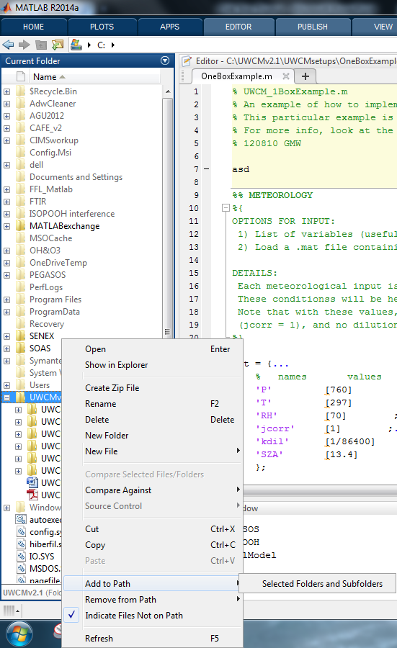
Adding the Model to Your Search Path
MATLAB can only “see” files that are on its search path. To add the model to your search path:
Navigate to the F0AM folder in the Current Folder window
Right click the folder → Add to Path →Selected Folders and Subfolders
Alternatively, you can add the model folders by entering the following in the command window:
addpath(genpath(F0AMdir));
Here, F0AMdir is the full directory name, e.g. C:\Science\F0AMv3.1.

Slide 6
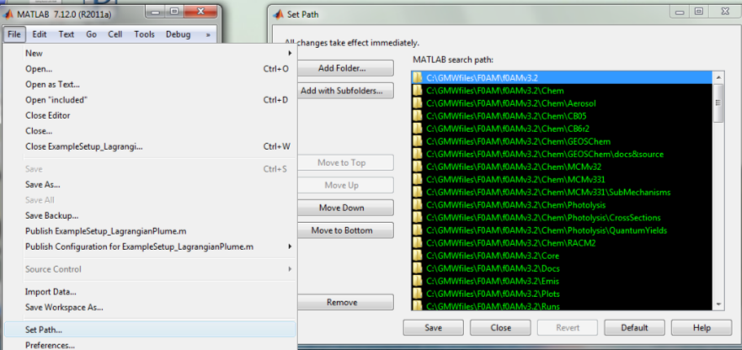
Notes on Search Paths
You can see which folders are in your search path (and add/remove/rearrange them) by going into the file menu (top of screen) and choosing “Set Path…”to get to the Set Path Dialog.
MATLAB resets the search path every time you restart it. If you want to keep the F0AM directories on your search path, type “savepath” (without quotes) into the command window or use the Set Path Dialog.
MATLAB searches the folders in the set path sequentially. If you have multiple functions or scripts with the same name, only the first one (in the search path) will be called. If you think you have an error stemming from shadowed file names, use the “which” command to see which file is being called.

Slide 7
Running the Examples
There are five example setup scripts in the Setups/Examples/ folder:
ExampleSetup_Chamber.m
ExampleSetup_DielCycle.m
ExampleSetup_FlightSS.m
ExampleSetup_LagrangianPlume.m
ExampleSetup_MechCompare.m
The last example shows how to loop through multiple mechanisms before calling the FlightSS example, so ignore it for now.
Try to run one of the examples: type a script name into the Command Window and hit ENTER. Some of the examples can take several minutes to execute, depending on your hardware. The example should run without errors and generate a bunch of figure windows. Next, read through the example script that you ran and try to get an understanding of the inputs and outputs. The scripts are heavily commented to walk you through the setup. The F0AM_ReadMe is also helpful here.
Repeat for all examples.

Slide 8
Making your Own Setup Script
The example setups encompass a range of standard applications. Generally, it is easiest to start with the one that most closely matches your research problem and modify the inputs as needed.
Don’t forget to save the new script under a different name!

Slide 9

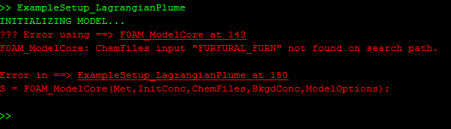
Troubleshooting Setups
Errors are normal when running new code. Learning to debug is part of becoming a proficient programmer. Keep calm and debug like so:
Check for obvious errors first. The error shown above is just a typo (“FURFURAL_FURN” instead of “FURFURAL_FURAN”).
Read the error message and try to decipher the problem. MATLAB usually provides clues, and F0AM includes input checking to screen out common mistakes.
Click the link to go to the error location. Insert a breakpoint and run the code to this point, then look at the variables in the local workspace to find issues (wrong size, wrong type, NaNs, etc.).
Ask someone for help, but only after you’ve tried to debug yourself.

Slide 10
MCM Extraction
The MCM is big, and it is rare that users will need all of the species contained therein. You can extract a portion of the mechanism for use in F0AM as follows.

Slide 11
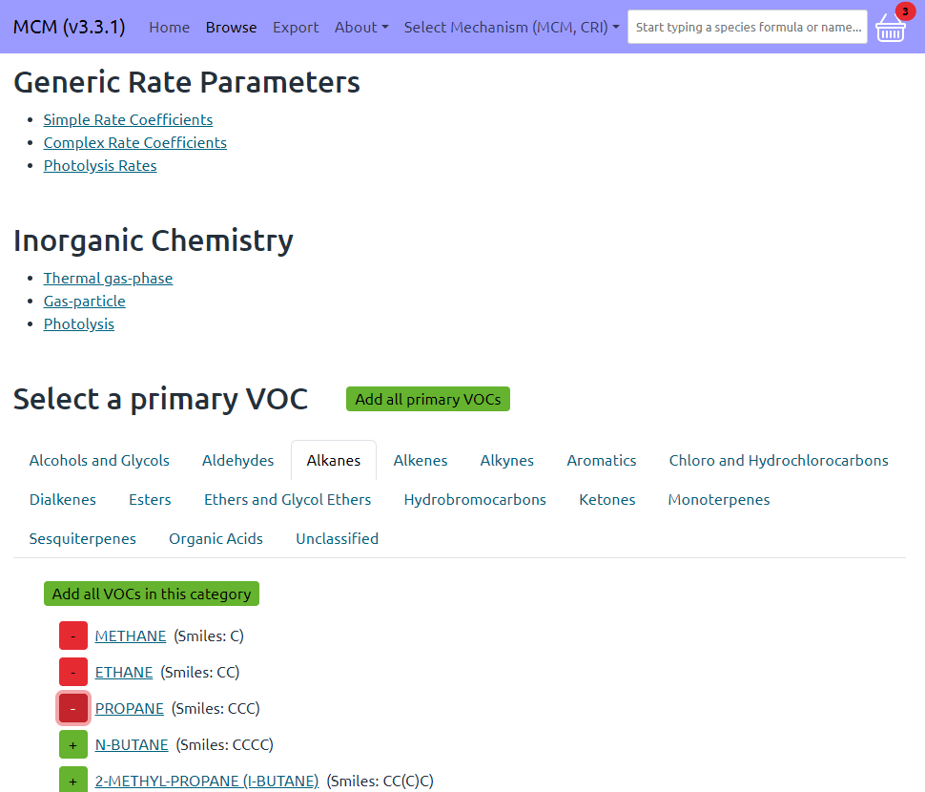
MCM Extraction
Go to the MCM website, https://mcm.york.ac.uk/MCM/
Near the top, click “Browse.”
Click through the categories to find species you want.
Click the green “+” to include species.
Species can be removed by clicking the red “–” here or in the Mark List.
You can also add species using the search tools.
2
6
5
3
4

Slide 12
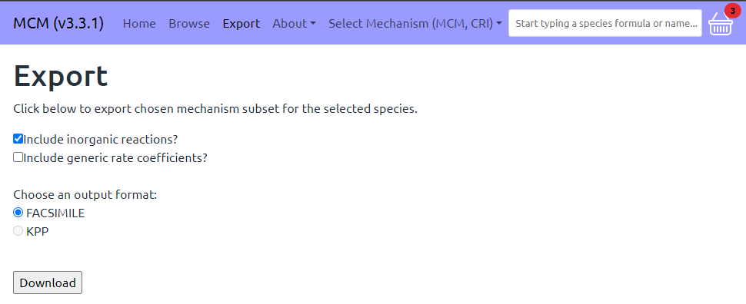
MCM Extraction
Near the top, click “Export.”
Select “FACSIMILE input format” and “Include inorganic reactions.” Unselect “include generic rate coefficients.”
Click “Download” to download to a text file (default name is mcm_export.fac)
Give this file a more descriptive name and move it to somewhere on your MATLAB search path, e.g. F0AMv31\Chem\MCMv331\Alkanes.fac).
7
8
9

Slide 13
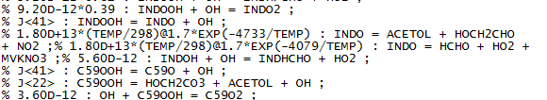
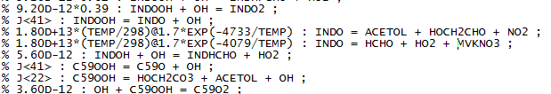
MCM Extraction
In the MATLAB command window, call the FAC2F0AM function, e.g.:
FAC2F0AM(‘Alkanes.fac’)
This will create a script that contains properly formatted reactions, with the same name and in the same directory(e.g. Alkanes.m).
12. Add the mechanism to your ChemFiles input.
Note: DO NOT USE MULTIPLE MCM-EXTRACTED MECHANISMS SIMULTANEOUSLY!
This will lead to duplicate reactions.
TROUBLESHOOTING: the FAC2F0AM script will sometimes fail if the .fac file is not formatted properly, which can happen. In this case, you will need to scroll through the .fac file in a text editor and fix aberrant lines.

