Slide 1
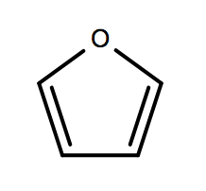
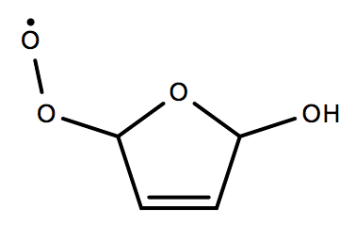
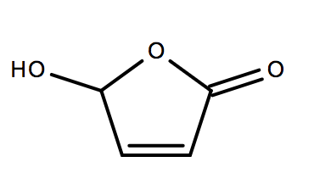
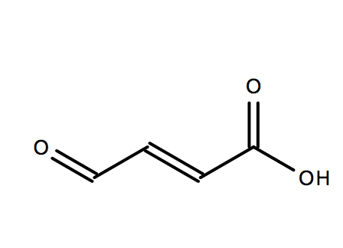
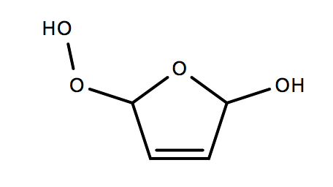
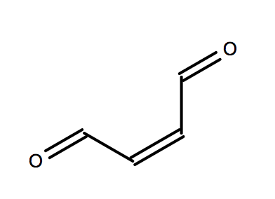
Furan + OH Reactions
OH reactions
RO2 reactions
Photolysis Reactions
+ OH
4.2D-11*0.7
KRO2NO
+ HO2
+ NO
+ NO2 + HO2
FURAN
MALDIAL
HYDFURANO2
MALDALCO2H
+ OH
4.2D-11*0.3
FURAN
HYDFURANO2
KRO2HO2
+ HO2
4De-11
+ OH
+ OH
HYDFURANO2
HYDFURANOOH
HYDFURANOOH
MALDALCO2H
J<41>
5E-13*RO2
+ HO2
+ OH
HYDFURANOOH
MALDALCO2H
HYDFURANO2
MALDALCO2H
J<4>*0.14
Bierbach, 1994
FUMDIAL
MALDIAL
+ OH
FUMDIALPROD
FUMDIAL
+ OH
4.2D-11*0.5
+ HO2
Bierbach, 1994
FURAN
FUMDIAL
Notes:
Logic: The split between furan-compound pathways is based on Bierbach 1994 and Aschmann 2014. FUMDIAL was added based on Bierbach et al. 1994 and to allow to interconversion to MALDIAL. HO2 reactions were added to account for radical reactions with RO2 (not covered by Ashmann or Bierbach). RO2 reactions added to cover basis for RO2-RO2 reactions. Assume all RO2RO2 lead to alkoxy radical and decomposition pathway. This is reasonable because it is a secondary RO2 radical and it mostly forms carbonyls via reaction with other RO2 radicals.

Slide 2
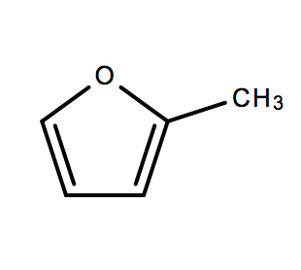
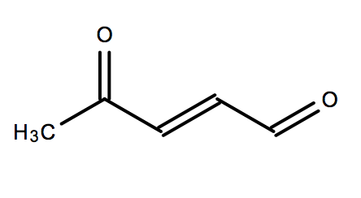
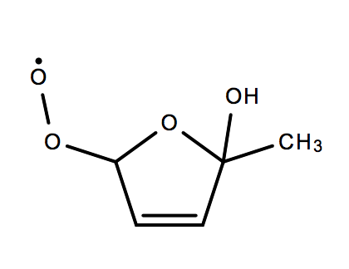
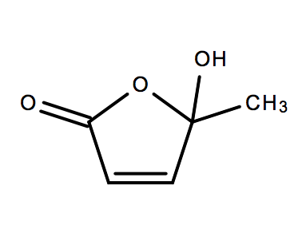
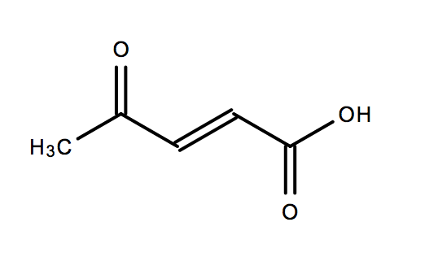
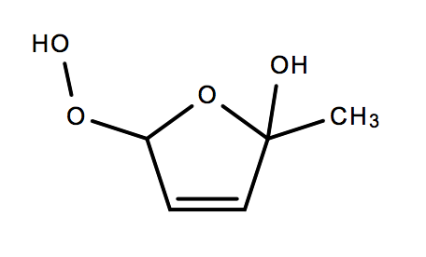
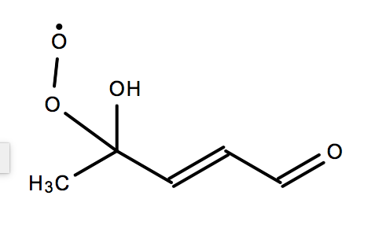
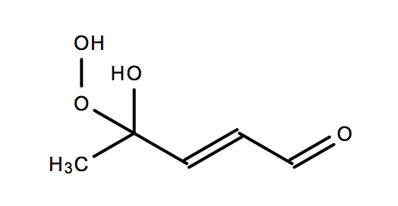
2-Methyl Furan + OH Reactions
OH reactions
RO2 reactions
Photolysis Reactions
+ OH
6.2D-11*0.31
KRO2NO
+ HO2
+ NO
+ HO2 + NO2
M2F
C5DICARB
HYDMEFURANO2
C5CO14OH
+ OH
6.2D-11*0.3
KRO2HO2
+ HO2
M2F
HYDMEFURANO2
HYDMEFURANOOH
HYDMEFURANO2
+ OH
6.2D-11*0.39
5E-13*RO2
+ HO2
M2F
C5HYDCARBO2
HYDMEFURANO2
C5CO14OH
+ OH
4De-11
+ OH
KRO2NO
+ NO
+ NO2 + CH3O2
HYDMEFURANOOH
C5CO14OH
C5HYDCARBO2
MALDALCO2H
J<41>
KRO2HO2
+ OH
+ HO2
HYDMEFURANOOH
C5CO14OH
C5HYDCARBO2
C5HYDCARBOOH
J<41>
1E-14*RO2
+ HO2 + CH3O2
+ OH + CH3O2
C5HYDCARBOOH
MALDALCO2H
C5HYDCARBO2
MALDALCO2H
Notes:
Logic: The split in the MEFURAN pathways is dependent on the observation that Bierbach investigated aldehyde splitting in Low Nox chemistry (0.7 to the dialdehyde) and Ashmann saw 38% yield to the dialdehyde. The dialdehyde pathway constitutes 70% of the reaction, while the remaining 30% is assumed to go down the other pathway. Then, a total of 30% is assumed to go down the ring-retaining pathway while the remaining percentage (32%) is assumed to go down a NO pathway. Assume all RO2 reactions for tertiary end with MALDALCO2H. Assume a slow rate constant of 1E-14, which is appropriate for tertiary reactions.

Slide 3
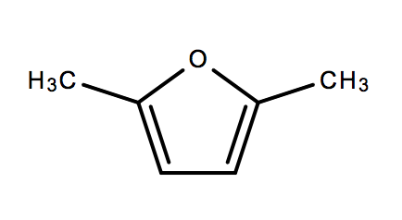
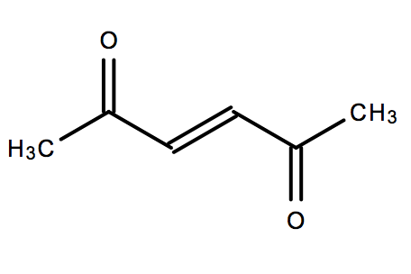
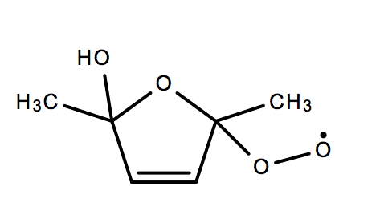
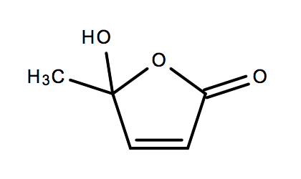
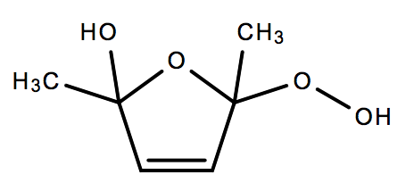
Dimethyl Furan Reactions
OH reactions
RO2 reactions
Photolysis Reactions
+ OH
1.3e-10*0.27
+ HO2
KRO2NO
+ NO
+ NO2 + CH3O2
DIMEFURAN
C4DBDIKET
HYDDIMEFURANO2
C5CO14OH
+ OH
1.3e-10*0.73
+ HO2
KRO2HO2
DIMEFURAN
HYDDIMEFURANO2
HYDDIMEFURANO2
HYDDIMEFURANOOH
J<41>
1E-14*RO2
+ OH + CH3O2
+ CH3O2
HYDDIMEFURANOOH
C5CO14OH
HYDDIMEFURANO2
C5CO14OH
Notes:
Assume the RO2 reaction rate constant for DIMEFURAN is slow due to a tertiary peroxy radical.

Slide 4
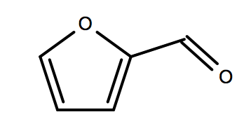
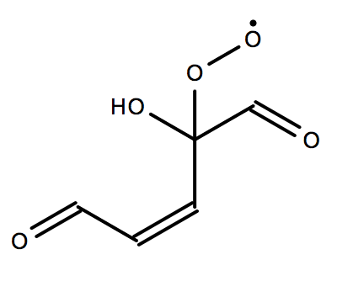
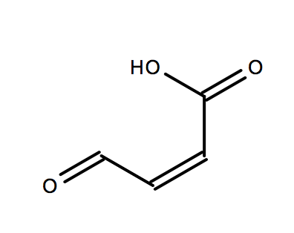
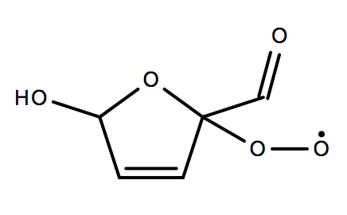
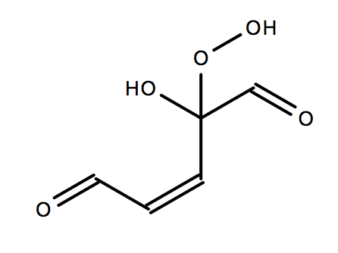
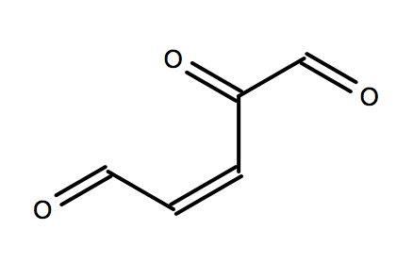
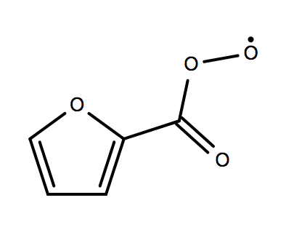
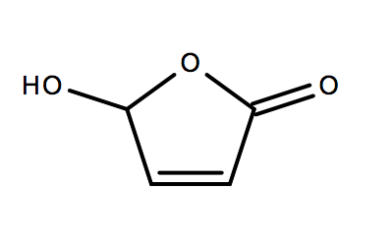
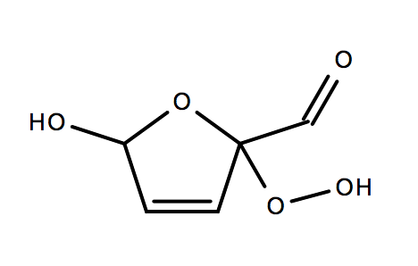
2-Furfural Reactions
OH reactions
RO2 reactions
Photolysis Reactions
3.5D-11*0.01
+ NO
KRO2NO
+ OH
+ NO2 + CO + HO2
FURFURAL
FURFURALO2
FURFURALO2
MALDALCO2H
3.5D-11*0.53
+ HO2
KRO2HO2
+ OH
FURFURAL
HYDFURFURALO2
FURFURALOOH
FURFURALO2
3.5D-11*0.44
+HO2
+ OH
1E-14*RO2
+ CO + HO2
FURFURAL
C5DIALCO
MALDALCO2H
FURFURALO2
3.5D-11*0.029
+HO2
+ OH
KRO2NO
+ NO
+ NO2 + CO + HO2
FURFURAL
ALDFUFURALO2
MALDALCO2H
HYDFURFURALO2
J<41>
+ OH + CO + HO2
KRO2HO2
+ HO2
FURFURALOOH
MALDALCO2H
HYDFURFURALO2
HYDFURFURALOOH
J<41>
+ OH + CO + HO2
1E-14*RO2
+ CO + HO2
HYDFURFURALOOH
MALDALCO2H
HYDFURFURALO2
MALDALCO2H
Notes:
For the Furfural chemistry, assume that the split in the dicarbonyl and the other product is ~50/50 (i.e., 0.373*0.5 = 0.185), which is similar to the split for methyl furan.
THIS CHEMISTRY IS FOR v. 20171026 and later!

Slide 5
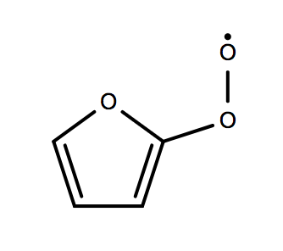
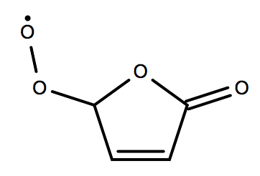
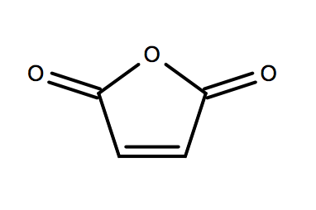
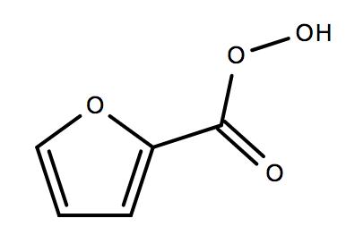
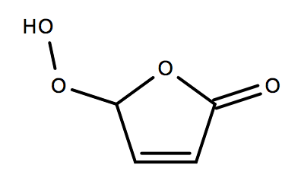
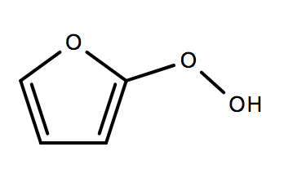
2-Furfural Reactions (Continued)
OH reactions
RO2 reactions
Photolysis Reactions
+ NO
KRO2NO
+ NO2 + CO2
KRO2NO
+ NO
+ NO2 + HO2
ALDFUFURALO2
FURANO2
CARBFURANO2
MALANHY
+ HO2
KRO2HO2
+ HO2
KRO2HO2
ALDFUFURALO2
ALDFURFURALOOH
CARBFURANO2
CARBFURANOOH
1D-11*RO2
+ HO2 + CO2
5E-13*RO2
+ HO2
ALDFUFURALO2
FURANO2
CARBFURANO2
MALANHY
+ NO
KRO2NO
+ NO2
J<41>
+ OH + CO2 + HO2
FURANO2
CARBFURANO2
ALDFURFURALOOH
FURANO2
+ HO2
KRO2HO2
J<41>
+ OH + HO2
FURANO2
FURANOOH
FURANOOH
CARBFURANO2
5E-13*RO2
+ HO2
J<41>
+ OH + HO2
FURANO2
CARBFURANO2
CARBFURANOOH
MALANHY
Notes:
For the remainder of this furfural chemistry, I assume that the smaller pathyway (stripping the H of the aldehyde group) could occur via a series of RO2 reactions. The Acyl group reaction with RO2 is expected to be fast, which is similar to assumptions made for benzaldehyde.
THIS CHEMISTRY IS FOR v. 20171026 and later!

Slide 6
Photolysis Reactions
0.15*J
+ CO
FURFURAL
FURAN
0.85*J
C3H4
+ 2 CO
FURFURAL
C3 products
Notes:
Use the furfural cross sections of Colmenar (2015) and Ferreirada Silva(2015) [MAINZ database]. The UV cross sections are averages about a 1nm bin. The quantum yield of furfural photolysis is about 0.05 (according to Hiraoka and Srinivasen 1968 and roughly agreed upon by Gandini et al. 1967).

Slide 7
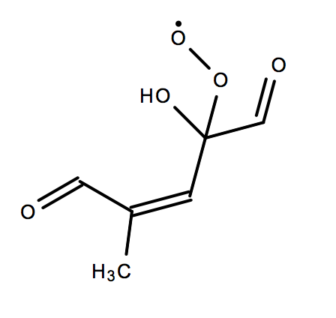
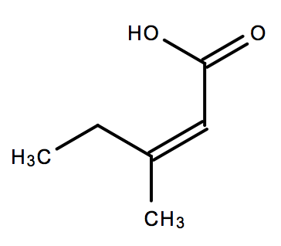
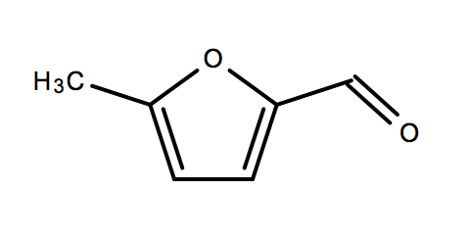
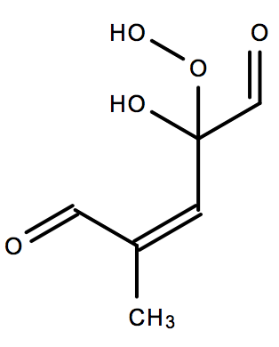
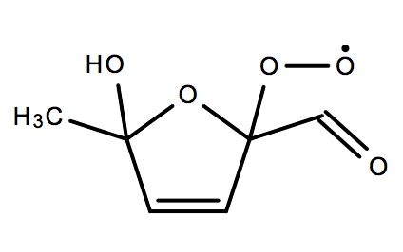
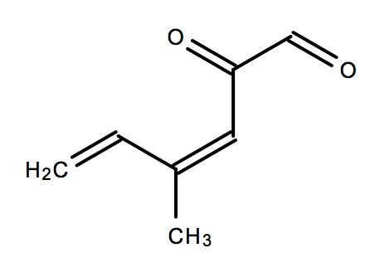
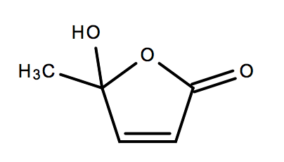
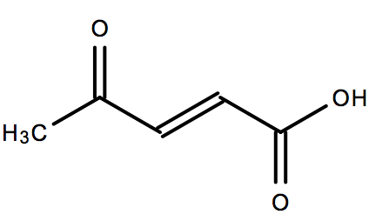
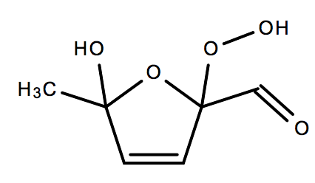
Methyl Furfural Reactions
OH reactions
RO2 reactions
Photolysis Reactions
KRO2NO
+ NO2 + CO + HO2
5.1D-11*0.01
+ NO
+ OH
MEFURFURAL
MEFURFURALO2
C3MCOCO2H
MEFURFURALO2
+ HO2
KRO2HO2
5.1D-11*0.53
+ OH
MEFURFURALOOH
MEFURFURALO2
MFURFURAL
HYDMEFURFURALO2
1E-14*RO2
5.1D-11*0.46
+ CO + HO2
+ OH
+HO2
MEFURFURALO2
C3MCOCO2H
MEFURFURAL
C5MCO3DB
+ NO
KRO2NO
+ NO2 + CO + HO2
J<41>
HYDMEFURFURALO2
C5CO14OH
+ OH + CO + HO2
+ HO2
KRO2HO2
MEFURFURALOOH
C3MCOCO2H
HYDMEFURFURALO2
HYDMEFURFURALOOH
J<41>
+ OH + CO + HO2
1E-14*RO2
+ CO + HO2
HYDMEFURFURALOOH
C5CO14OH
HYDMEFURFURALO2
C5CO14OH
Notes:
There is no literature on MEFURFURAL oxidation. I just assume a similar mechanism as furfural, except there is a methyl group on the end.
THIS CHEMISTRY IS FOR v. 20171026 and later!

Slide 8
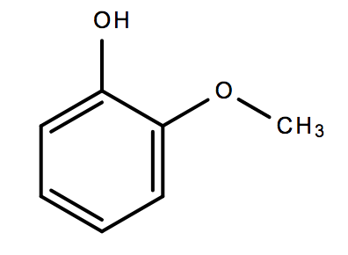
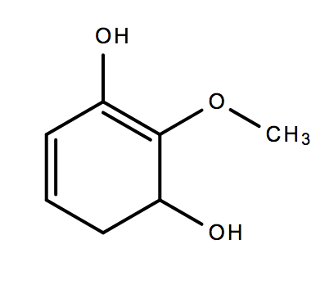
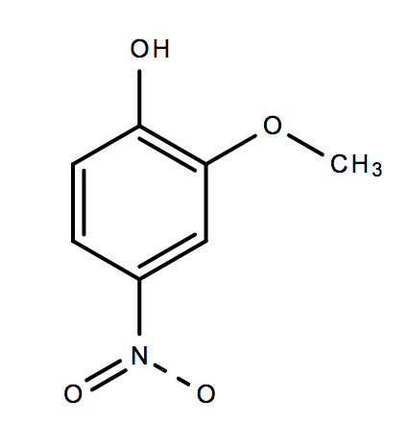
Guaiacol + OH Reactions
OH reactions
RO2 reactions
7.4D-11*0.1
+ OH
.
GUAIACOL
GUAIACOLO
7.4D-11*0.9
+ OH
PPGUAIACOL + HO₂
GUAIACOL
2.08D-12
.
+ NO₂
+ H₂O
GUAIACOLO
NGUAIACOL
Notes:
There is no literature on MEFURFURAL oxidation. I just assume a similar mechanism as furfural, except there is a methyl group on the end.
THIS CHEMISTRY IS FOR v. 20171026 and later!

Slide 9
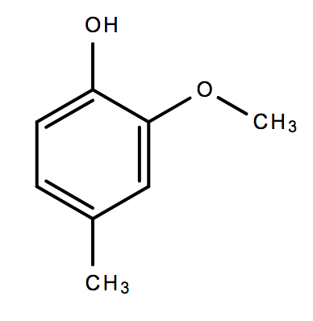
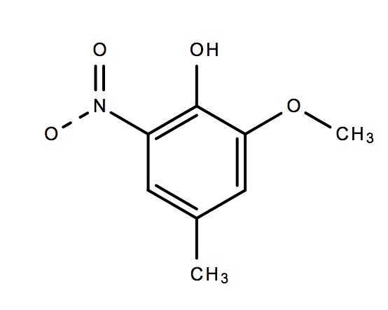
Guaiacol + NO3 Reactions
Methyl Guaiacol + NO3 Reactions
2.69E-11
8.41E-11
+ NO₃
+ NO₃
MGUAIACOL
RMGUAIACOL
GUAIACOL
RGUAIACOL
1E-10
1E-10
+ NO₂
+ NO₂
RGUAIACOL
RMGUAIACOL
NRMGUAIACOL
NRGUAIACOL
+ HNO₃
KDEC
+ HNO₃
KDEC
NRGUAIACOL
NGUAIACOL
NRMGUAIACOL
NMGUAIACOL

Slide 10
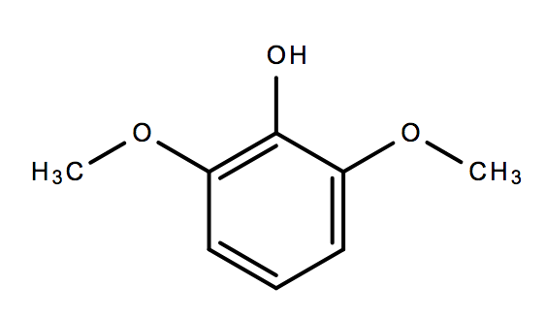
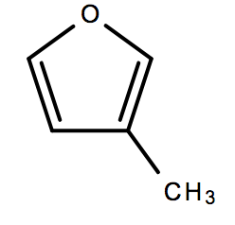



Syringol + NO3 Reactions
3-Methyl Furan + NO3 Reactions
1.58E-10
1.9D-11*0.3401
+ NO₃
+ NO₃
RSYRINGOL
M3F
C4MDIAL
SYRINGOL
1E-10
1.9D-11*0.0036
+ NO₂
+ NO₃
M3F
FURFUR3AL
RSYRINGOL
NRSYRINGOL
KDEC
1.9D-11*0.6563
+ HNO₃
+ NO₃
PPM3FURAN
M3F
NRSYRINGOL
NSYRINGOL

