Slide 1
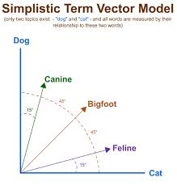
Distributional Semantics
COMP90042 LECTURE 5

Slide 2
co-occurrence and semantics
“You shall know a word by the company it keeps” (Firth)
Local context reflects a word’s semantic class
E.g. eat a pizza, eat a burger
Document co-occurrence often indicative of topic
E.g. voting and politics

Slide 3
Outline
Word-word association using PMI
The vector space model
Weighting for information retrieval: tf-idf
Dimensionality reduction: SVD
Similarity in vector space: cosine

Slide 4
Co-occurrence matrix
 | … | the | country | hell | …
…
state |  | 1973 | 10 | 1
fun |  | 54 | 2 | 0
heaven |  | 55 | 1 | 3
……
Lists how often words appear with other words
In some predefined context (e.g. sentence in Brown corpus)
The obvious problem with raw frequency: dominated by common words

Slide 5
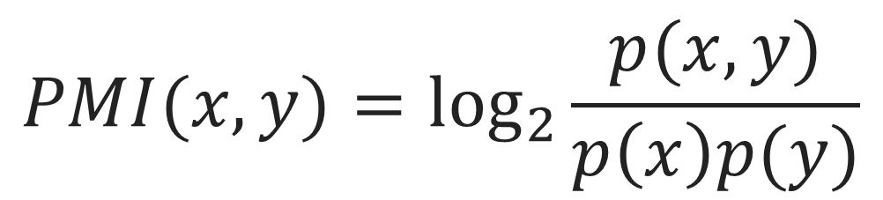
Pointwise mutual information
For two events x and y, pointwise mutual information (PMI) comparison between the actual joint probability of the two events (as seen in the data) with the expected probability under the assumption of independence
$$PMI(x,y)=\log_{2}{\frac{p(x,y)}{p\left(x\right)p(y)}}$$

Slide 6
Calculating PMI
 | … | the | country | hell | … |  | Σ
…
state |  | 1973 | 10 | 1 |  |  | 12786
fun |  | 54 | 2 | 0 |  |  | 633
heaven |  | 55 | 1 | 3 |  |  | 627
…
Σ |  | 1047519 | 3617 | 780 |  |  | 15871304
x= state, y = country p(x,y) = 10/15871304 = 6.3 x 10⁻⁷ p(x) = 12786/15871304 = 8.0 x 10⁻⁴ p(y) = 3617/15871304 = 2.3 x 10⁻⁴ PMI(x,y) = log₂(6.3 x 10⁻⁷)/((8.0 x 10⁻⁴) (2.3 x 10⁻⁴)) = 1.78
p(x,y) = count(x,y)/Σ p(x) = Σ_{x}/ Σ p(y) = Σ_{y}/ Σ

Slide 7
PMI matrix
 | … | the | country | hell | …
…
state |  | 1.22 | 1.78 | 0.63
fun |  | 0.37 | 3.79 | -inf
heaven |  | 0.41 | 2.80 | 6.60
……
PMI does a better job of capturing interesting semantics
E.g. heaven and hell
But it is obviously biased towards rare words
And doesn’t handle zeros well

Slide 8
PMI tricks
Zero all negative values (PPMI)
Avoid –inf and unreliable negative values
Counter bias towards rare events
Artificially increase marginal probabilities
Smooth probabilities

Slide 9
Other Association measures
t-test
Chi-squared
Likelihood ratio
…

Slide 10
Uses of association measures
Collocation extraction
Word similarity
Lexicon creation
Weighting for vector space models

Slide 11
The Vector space model
Fundamental idea: represent meaning as a vector
One matrix, two viewpoints
Documents represented by their words (web search)
Words represented by their documents (text analysis)
 | … | 425 | 426 | 427 | …
…
state |  | 0 | 3 | 0
fun |  | 1 | 0 | -0
heaven |  | 0 | 0 | 0
……
 | … | state | fun | heaven | …
…
425 |  | 0 | 1 | 0
426 |  | 3 | 0 | 0
427 |  | 0 | 0 | 0
……

Slide 12
Manipulating the VSM
Weighting the values
Creating low-dimensional dense vectors
Comparing vectors

Slide 13

Tf-idf
Standard weighting scheme for information retrieval
Also discounts common words
$${idf}_{w}=\log{\frac{|D|}{{df}_{w}}}$$
tf matrix
tf-idf matrix
 | … | the | country | hell | …
…
425 |  | 43 | 5 | 1
426 |  | 24 | 1 | 0
427 |  | 37 | 0 | 3
…
df |  | 500 | 14 | 7
 | … | the | country | hell | …
…
425 |  | 0 | 25.8 | 6.2
426 |  | 0 | 5.2 | 0
427 |  | 0 | 0 | 18.5
…

Slide 14
Dimensionality reduction
Term-document matrices are very sparse
Dimensionality reduction: create shorter, denser vectors
More practical (less features)
More generalizable (less overfitting)
Captures synonymy
Remove noise

Slide 15

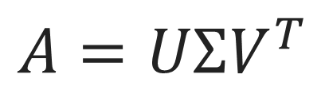
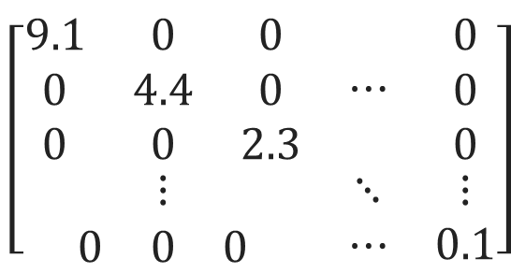
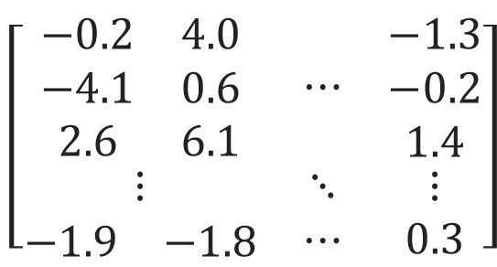
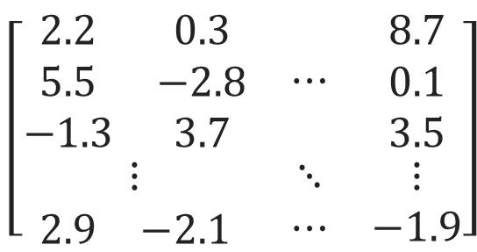
Singular value Decomposition
|D|
$$A=UΣV^{T}$$
$$\left[\begin{matrix}\begin{matrix}0 & 1 & 0 \\ 0 & 0 & 0 \\ 0 & 0 & 0\end{matrix} & ⋯ & \begin{matrix}0 \\ 0 \\ 0\end{matrix} \\ ⋮ & ⋱ & ⋮ \\ \begin{matrix}0 & 0 & 0\end{matrix} & ⋯ & 0\end{matrix}\right]$$
A (term-document matrix)
|V|
m=Rank(A)
U (new term matrix)
Σ (singular values)
V^{T} (new document matrix)
m
m
|D|
$$\left[\begin{matrix}\begin{matrix}2.2 & 0.3 \\ 5.5 & −2.8 \\ −1.3 & 3.7\end{matrix} & ⋯ & \begin{matrix}8.7 \\ 0.1 \\ 3.5\end{matrix} \\ ⋮ & ⋱ & ⋮ \\ \begin{matrix}2.9 & −2.1\end{matrix} & ⋯ & −1.9\end{matrix}\right]$$
$$\left[\begin{matrix}\begin{matrix}9.1 & 0 & 0 \\ 0 & 4.4 & 0 \\ 0 & 0 & 2.3\end{matrix} & ⋯ & \begin{matrix}0 \\ 0 \\ 0\end{matrix} \\ ⋮ & ⋱ & ⋮ \\ \begin{matrix}0 & 0 & 0\end{matrix} & ⋯ & 0.1\end{matrix}\right]$$
$$\left[\begin{matrix}\begin{matrix}−0.2 & 4.0 \\ −4.1 & 0.6 \\ 2.6 & 6.1\end{matrix} & ⋯ & \begin{matrix}−1.3 \\ −0.2 \\ 1.4\end{matrix} \\ ⋮ & ⋱ & ⋮ \\ \begin{matrix}−1.9 & −1.8\end{matrix} & ⋯ & 0.3\end{matrix}\right]$$
m
m
|V|

Slide 16


Truncating
Truncating U, Σ, and V^{T} to k dimensions produces best possible k rank approximation of original matrix
So truncated, U_{k} (or V_{k}^{T} ) is a new low dimensional representation of the word (or document)
Typical values for k are 100-5000
When applied to words in documents, often called LSA
U
U_{k}
m
k
k
$$\left[\begin{matrix}\begin{matrix}2.2 & 0.3 \\ 5.5 & −2.8 \\ −1.3 & 3.7\end{matrix} & ⋯ & \begin{matrix}−2.4 \\ 1.1 \\ 4.7\end{matrix} & ⋯ & \begin{matrix}8.7 \\ 0.1 \\ 3.5\end{matrix} \\ ⋮ & ⋱ & ⋮ & ⋱ & ⋮ \\ \begin{matrix}2.9 & −2.1\end{matrix} & ⋯ & −3.3 & ⋯ & −1.9\end{matrix}\right]$$
$$\left[\begin{matrix}\begin{matrix}2.2 & 0.3 \\ 5.5 & −2.8 \\ −1.3 & 3.7\end{matrix} & ⋯ & \begin{matrix}−2.4 \\ 1.1 \\ 4.7\end{matrix} \\ ⋮ & ⋱ & ⋮ \\ \begin{matrix}2.9 & −2.1\end{matrix} & ⋯ & −3.3\end{matrix}\right]$$
|V|
|V|

Slide 17
more Dimensionality reduction
Principal components analysis (PCA)
Independent components analysis
Factor analysis
Nonnegative matrix factorization
Latent Dirichlet allocation
…

Slide 18
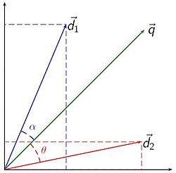
similarity
Regardless of vector representation, classic use of vector is comparison with other vector
Though vectors can also be used directly as features
For IR: find documents most similar to query

Slide 19
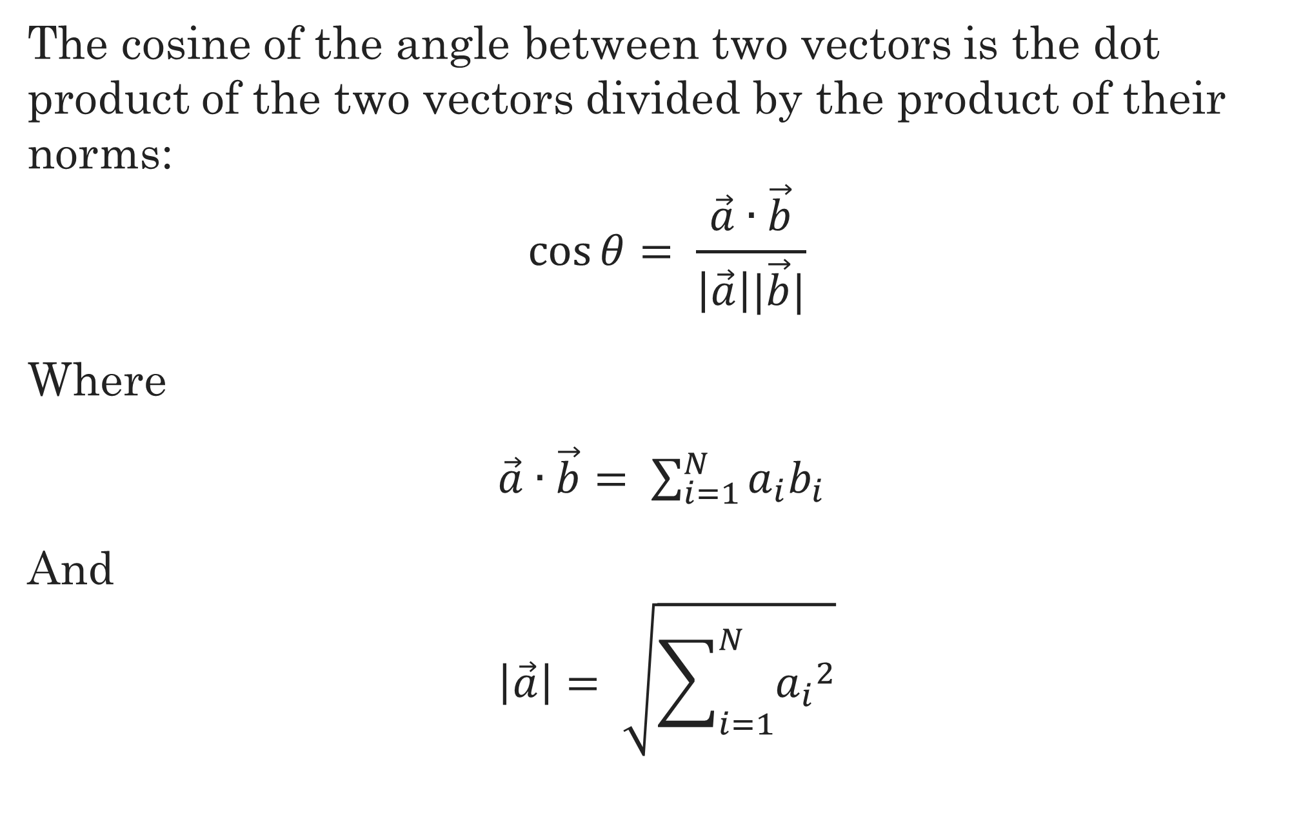
Cosine similarity
The cosine of the angle between two vectors is the dot product of the two vectors divided by the product of their norms:
$$\cos{θ= \frac{\vec{a}∙\vec{b}}{\left|\vec{a}\right||\vec{b}|}}$$
Where
$\vec{a}∙\vec{b}= \sum_{i=1}^{N}{a_{i}b_{i}}$
And
$$\left|\vec{a}\right|= \sqrt{\sum_{i=1}^{N}{{a_{i}}^{2}}}$$

Slide 20

Cosine similarity example
$\vec{a}$ = $[0,0,1,0,1, 1, 1]$
$\vec{b}$ = $\left[0,1,1,0, 1, 1,0\right]$
$\vec{a}∙\vec{b}$ = 1 + 1 + 1 = 3
$\left|\vec{a}\right|$ = $\left|\vec{b}\right|$ = $\sqrt{1+1+1+1}=2$
$\cos{θ}$ = $\frac{3}{2∗2}$ = 0.75

Slide 21
Other metrics for Vector similarity
Euclidean
Jaccard
Dice
Kullback-Leibler (KL) Divergence
Jenson-Shannon Divergence
…

Slide 22
A final Word
Distributional semantics is fundamental to both fields covered by this course
Basic methodology presented here is not new, but still very much used
In the next lecture we will continue with distributional semantics, looking at a recent, state-of-the-art approach to dimensionality reduction using neural networks

Slide 23
Further reading
J&M3, Ch 15, J&M3 Ch 16.1
(Optional) From Frequency to Meaning: Vector Space Models of Semantics

