Slide 1
Evaluation and re-ranking
comp90042 lecture 20

Slide 2
overview
Evaluation
Re-ranking documents
Learning-to-Rank

Slide 3
Efficiency vs effectiveness
Up till now we looked at how to make an inverted index
Space efficient (Compression)
Fast (Top-K query processing)
Today we will investigate the quality of returned results for a search query:
How do you measure quality?
Ways to improve result quality.

Slide 4
Evaluating effectiveness
Hard to characterise the quality of a system’s results
a subjective problem, depends on the user’s information need and how well the results meet that need
query is not the information need itself, but an expression thereof
Obvious evaluation method: human judgements
directly measure effectiveness in user studies; for reported satisfaction, completion of tasks, …
but too expensive and slow, especially when tuning parameters of the system (e.g., flavour of TF*IDF, use of stopwords, etc…)

Slide 5
automatic evaluation
Make simplifying assumptions
retrieval is ad-hoc
query performed only once, and with no prior knowledge of the user or their behavior
effectiveness based on relevance
each document is either relevant or irrelevant to information need (often binary, sometimes also multiple grades of relevance)
relevance of documents are independent from others (no consideration of redundancy)
Effectiveness is a function of the relevance of documents returned by the system

Slide 6
Test collections
Several reusable test collections constructed for IR evaluation, e.g., for TREC competitions; comprising
corpus of documents
set of queries, sometimes including long-form elaboration of information need
relevance judgements (qrels) for each document and query, a human judgement of whether the document is relevant to the information need in the given query.
Typically not all documents have qrels, collection is simply too big and most are likely to be irrelevant.

Slide 7
Example from trec 5

Slide 8
Example relevance vector
Based on retrieval run, calculate binary vector indicating relevance for each ranked document

Slide 9
relevance measures
How to map relevance vector to a number?
Natural candidates are precision & recall
but recall is hard to calculate (why?); and
how to deal with ranked outputs?
Mainly use precision oriented metrics:
precision @ k: compute precision using only ranks 1 .. k
average precision: take average over prec@k for each k where rank k item is relevant; measure becomes rank sensitive
Mean Average Precision (MAP): AP averaged across multiple queries
Notes:
Bias towards top-end; may truncate AP; mean AP = mean over many queries.

Slide 10
Relevance example
Relevance vector < 1, 0, 0, 0, 0, 1, 0, 1, 0, 0 >
Precision
P@1 = 1/1 P@2 = ½ P@3 = 1/3 P@4 = ¼ P@5 = 1/5 P@6 = 2/6 P@7 = 2/7 P@8 = 3/8 P@9 = 3/9 P@10 = 3/10
AP (average precision) = 1/3 *(P@1 + P@6 + P@8) = 0.57 (assuming only 3 docs are relevant, giving 1/3 scale)
Results then averaged over all queries in test collection (MAP).
Many more measures exist! (RBP, NDCG etc.)

Slide 11
UTILITY BASED RELEVANCE METRICS
Example: Rank-biased precision (Moffat & Zobel 2008)
Idea: User will pay $1 for each relevant answer but nothing for irrelevant answers. Models utility gained by searcher.
User processes list top-to-bottom with persistence (probability) P
User always looks at first result. User looks at second result with probability P. Third result: P²,P³,P⁴...
Search engine gets paid based on how much relevant documents it provides until the user stops

Slide 12
Rank-biased precision
RBP Formula (r_{i} is the ith element of the relevance vector of length d)
User Model:
Patient user: p = 0.95, Inpatient user: p=0.50
Taken from: Rank-Biased Precision for Measurement of Retrieval Effectiveness, Moffat , Zobel, TOIS 2008

Slide 13
RBP EXAMPLE
Relevance vector: <1,1,0,0,0,1,0,0,0,0,1,0,0,0,0,0,1,0,0,0>
Taken from: Rank-Biased Precision for Measurement of Retrieval Effectiveness, Moffat , Zobel, TOIS 2008

Slide 14
Effectiveness in practice
In addition to explicit human judgements we also look at query logs and click logs
For a given query and a specific result page, which result did users click on?
After clicking, did they come back and click on other results?
Indirect relevance feedback! Why?

Slide 15
Improving effectiveness
Suppose, we find that for some queries, users click on the second result instead of the first result
How do we incorporate this information into our similarity metric (BM25?) to rank these results higher?
Construct (learn!) a similarity metric automatically from training data (queries, click data, documents) to better rank documents by relevance

Slide 16
MULTI STAGE RETRIEVAL
Use a cheap, fast, simple similarity metric (such as BM25) to retrieve an initial set of relevant documents (top-k retrieval)
For those k documents, apply a Machine Learning algorithm which uses more features to re-rank the initial set of k documents
Why not apply Machine Learning to rank all documents? Expensive!

Slide 17
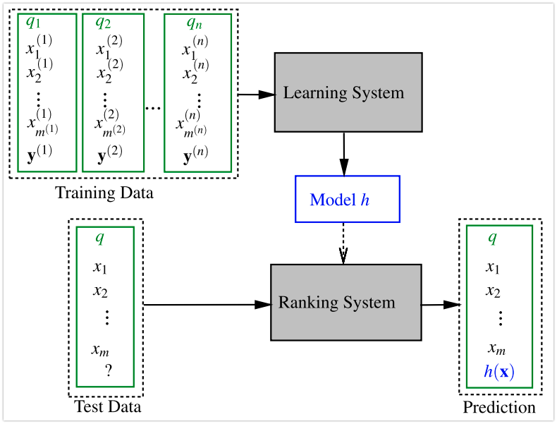
Learning to Rank
Given queries, m (k before) documents documents for each query, click data (or human judgements) use Machine Learning techniques to rank documents
Taken from: Tie-Yan Liu: Learning to Rank for Information Retrieval

Slide 18
Learning to Rank II
Learn a ranking model that can rank the list of k documents for an unknown query
Use training data consisting of tuples <q,d_{i},u,r_{i}> which represent the query q, the k documents (d₁,…,d_{k}), user u and Relevance Vector R (r₁,…,r_{k}),
Learn to combine features representing x =<q,d_{i},u> to to predict r_{i}
Challenges:
Finding the right features representing x =<q,d_{i},u>
Defining the objective that we want to optimize that corresponds to ranking documents

Slide 19
USER features
What kind of documents has the user been looking for?
What kind of links is the user clicking on?
How long does the user stay on a URL before returning?
What are your friends searching/clicking on?
Location
Native Language
Age
…

Slide 20
DOCUMENT FEATURES
Various tf/idf features (for example document lengths)
Number of slashes in URL
Main topics (see Topic Models!)
Length of URL
Pagerank / Number of Inlinks or Outlinks
How long do users stay on the URL before returning to search engine (dwell time)
Quality score (spam or no spam?)
Navigational vs Informational
For a given query Q, how often was document D first click, last click, only click?
Users that come view are documents come from the same location?
…

Slide 21
Query Features
Number of queries terms
Popularity of the query (query log)
Time sensitive? ”World Cup”
Number of matching documents
BM25 score distribution
…

Slide 22
Learning to rank OBJECTIVES
Point-wise objective
Given a query q, a document d_{i}, and a user u, find a function f(q,d_{i},u) that predicts r_{i} for document d_{i}.
Ask the user: How relevant is d_{i}?
Relevance judgement might be binary (yes or no) or muli-graded relevance (very relevant, relevant, not relevant)

Slide 23
Point-wise objective
Input: feature vectors x_{i} for each <q,d_{i},u> tuple
Learn model y = f(x_{i}) that outputs real numbers
Rank documents by sorting based on y = f(x_{i})
To ”learn a model” we define an objective that we try to minimize. This is usually referred to as a loss function
Here: the output y should correspond to relevance!
How do we do this?

Slide 24
Point-wise – ALGORITHM SKETCH
Train classifier that can predict r_{i}
Train model that can compute:
Sort documents by the probability of being relevant
Multiple classes: Assign classes a value and compute expectation (e.g. -2 highly non relevant, 2 highly relevant)

Slide 25
MORE Learning-2-Rank OBJECTIVES
Pair-wise objective
Given a query q, user u, and two documents d₁ and d₂ predict the correct relative order of d₁ and d₂
Ask the user: Which of these two documents is more relevant?
List-wise objective (Given query q, user u, and set of k documents D)
Output is a ranked lists. Knows about positions of documents. Cannot be decomposed into scores of individual documents or pairs.
Ask the user: Rearrange this list of documents based on relevance

Slide 26
LEARNING to RANK – PRACTICE
The secret sauce behind many search engines (and other websites such as Amazon)
Rank high and make lots of money
Use many features to create complex personalized, localized ranking models
Use A/B testing to test new ranking models
SEO – Reverse engineer the features used to rank higher

Slide 27
SUMMARY
Evaluation using relevance judgements
Precision@k, (M)AP, RBP evaluation metrics
Use BM25 as a first step in multi-stage retrieval system
Use complex trained ranking models to re-rank the original BM25 ranking
Many features and training methods exists

Slide 28
FURTHER READING
Reading
MRS Chapter 8
Tie-Yan Liu: Learning to Rank for Information Retrieval Chapter 1.3, ISBN 978-3-642-14266-6
Additional
Tie-Yan Liu: Learning to Rank for Information Retrieval. Springer 2011, ISBN 978-3-642-14266-6, pp. I-XVII, 1-285
Hang Li: Learning to Rank for Information Retrieval and Natural Language Processing, Morgan & Claypool, 2015
Alistair Moffat, Justin Zobel: Rank-Biased Precision for Measurement of Retrieval Effectiveness. TOIS 2008

