Slide 1

DISCOURSE
COMP90042 LECTURE 13

Slide 2
Beyond the sentence
Discourse: a coherent, structured group of sentences (utterances)
Yesterday, Ted was late for work. [It all started when his car wouldn’t start. He first tried to jump start it with a neighbour’s help, but that didn’t work.] [So he decided to take public transit. He walked 15 minutes to the tram stop. Then he waited for another 20 minutes, but the tram didn’t come. The tram drivers were on strike that morning.] [ So he walked home and got his bike out of the garage. He started riding but quickly discovered he had a flat tire. He walked his bike back home. He looked around but his wife had cleaned the garage and he couldn’t find the bike pump.] He started walking, and didn’t arrive until lunchtime.

Slide 3
Three Big discourse tasks
Discourse segmentation
Discourse parsing
Coreference resolution

Slide 4
Discourse segmentation
Assumption: text can be divided into a number of discrete, contiguous sections
Task: classifying whether a boundary exists between any two sentences

Slide 5
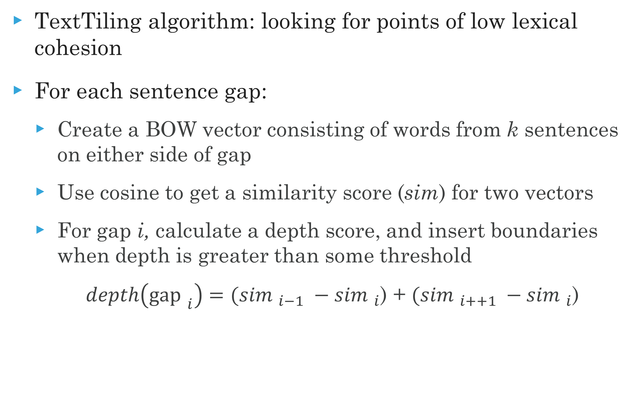
An unsupervised approach
TextTiling algorithm: looking for points of low lexical cohesion
For each sentence gap:
Create a BOW vector consisting of words from k sentences on either side of gap
Use cosine to get a similarity score (sim) for two vectors
For gap i, calculate a depth score, and insert boundaries when depth is greater than some threshold
$depth\left({\text{gap} }_{i}\right)=({sim }_{i−1} −{sim }_{i}$) + $({sim }_{i++1} −{sim }_{i}$)

Slide 6
Text Tiling example (k=2)
Dot product: 3
He walked 15 minutes to the tram stop.
Then he waited for another 20 minutes, but the tram didn’t come.
The tram drivers were on strike that morning.
So he walked home and got his bike out of the garage.
He started riding but quickly discovered he had a flat tire
He walked his bike back home.
He looked around but his wife had cleaned the garage and he couldn’t find the bike pump.
Dot product: 2
Dot product: 0
Dot product: 2
Dot product: 4
Dot product: 2

Slide 7
Supervised discourse segmentation
Get data from easy sources (documents with paragraphs)
Apply a binary classifier to classify boundaries
Or use sequential classifiers
Potentially include classification of section types (introduction, conclusion, etc.)
Integrate a wider range of features, including
distributional semantics
coreference cues
discourse markers

Slide 8
Discourse parsing
A proper discourse must be coherent
Then he waited for another 20 minutes, but the tram didn’t come.
✓The tram drivers were on strike that morning. ✗ A platypus is a kind of monotreme.
Discourse units (DUs) are related by specific coherence relations
Two related DUs form a new DUs
All DUs in a coherent discourse must be related
A discourse will form a tree, which can be parsed

Slide 9
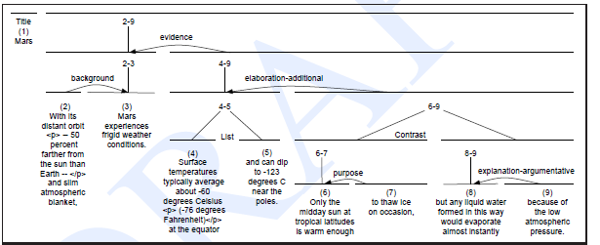
An RST Tree
RST= Rhetorical Structure Theory
23 relations, most having nucleus and satellite

Slide 10
Parsing using discourse markers
Some discourse markers (cue phrases) explicitly indicate relations
Some examples: although, but, for example, in other words, so, because, in conclusion,…
Can be used to build a simple rule-based parser
However, (which is also a discourse marker)
Many relations are not marked by discourse marker at all
Particular at the supra-sentential level
Many important discourse markers (e.g. and) ambiguous
Sometimes not a discourse marker
Can signal multiple relations

Slide 11
Full-text Discourse Parsing
Full CYK/chart discourse parsing of entire texts not practical
Most discourse parsers use a greedy approach
Steps:
First, segment into elementary DUs (EDUs)
Classify all adjacent EDUs as being same DU or not
Combine most probable EDU to a single DU
Repeat until entire text is a single DU

Slide 12
Discourse parsing features
Discourse markers
Text location
Starting/ending n-grams
Syntax (POS, dependency arcs, CFG productions)
Lexical and distributional similarities
Discourse structure within DUs
Relations in adjoining DUs

Slide 13
Why identify Text structure?
Summarization
Sentiment analysis
Argumentation
Authorship attribution

Slide 14
Further reading
J&M3, Ch 28

