Slide 1
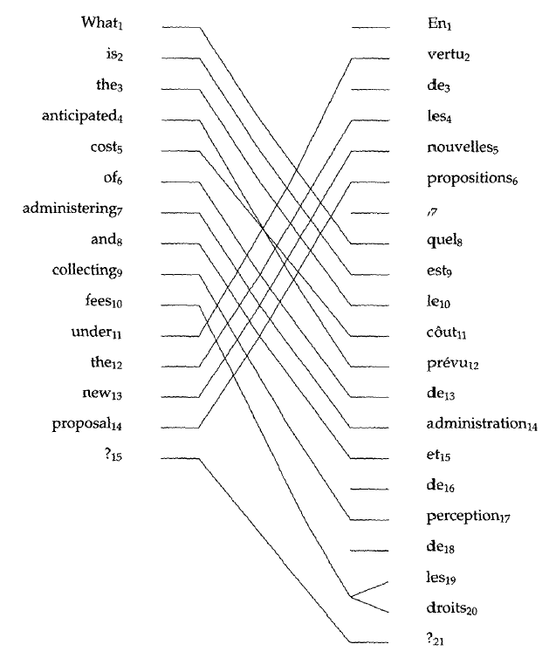
Machine translation: word-based models
comp90042 lecture 20

Slide 2
overview: Word alignment in SMT
Motivation
Word based translation models
IBM model 1
Training using the Expectation Maximisation algorithm
Decoding to find the best translation

Slide 3
Why translate?
Translation is a classic “AI-hard” challenge
Aims to convert from one human language to another, while preserving the meaning and the fluency of the text
Now in wide-spread use, including
Google, Bing translation tools
Cross language information retrieval
Speech translation
Computer-aided translation
…

Slide 4
Translation is hard
Not just simple word for word translation
structural changes, e.g., syntax and semantic
multiple word translations, idioms
inflections for gender, case etc
missing information (e.g., determiners)
Example from Lopez, 2008,
PhD dissertation UMD

Slide 5
historical view
Interlingua
(knowledge representation)
4. Knowledge-based
Transfer
English
(semantic
representation)
French
(semantic
representation)
3. Semantic Transfer
English
(syntactic parse)
French
(syntactic parse)
2. Syntactic Transfer
English
(word string)
French
(word string)
1. Direct Translation
modern methods mostly at word level
Notes:
‘60s-’90s = semantic / interlingua
‘90s-’00s = word and some syntax
‘10s = still word based!

Slide 6
Statistical MT
Language Model
P(e)
encoder channel
P(f|e)
decoder
argmax P(e|f)
Noisy Channel Model
When I look at an article in Russian, I say: “This is really written in English, but it has been coded in some strange symbols. I will now proceed to decode.” Warren Weaver (1949)
Assume that we started with an English sentence.
The sentence was then corrupted by translation into French.
… we want to recover the original.
Notes:
P(e|f) = \frac{P(e) P(f|e)}{P(f)}
\hat{e} = \operatorname{argmax}_e P(e) P(f|e)

Slide 7
Noisy channel
Language Model
P(e)
encoder channel
P(f|e)
decoder
argmax P(e|f)
Use Bayes' inversion:
Decoder seeks to maximise:
N.b., denominator constant wrt e, can be dropped
Notes:
P(e|f) = \frac{P(e) P(f|e)}{P(f)}
\hat{e} = \operatorname{argmax}_e P(e) P(f|e)

Slide 8
Noisy channel MT
Two components:
Responsible for:
P(f|e) rewards good translations, but permissive of disfluent e
P(e) rewards e which look like fluent English, and helps put words in the correct order
Why not just one TM to model P(e|f) directly?
Translation Model (TM)
Language Model (LM)

Slide 9
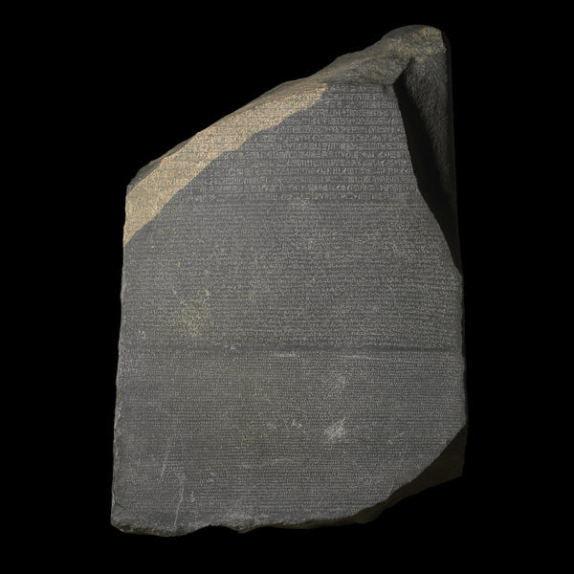
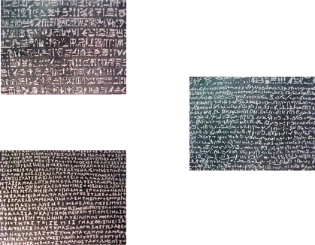
Learning
How to learn the LM and TM
LM: based on text frequencies in large monolingual corpora (as seen in previous lecture)
TM: based on word co-occurrences in parallel texts
Parallel texts (or bitexts)
one text in multiple languages
Produced by human translation; readily available on web
news, legal transcripts, literature, subtitles, bible, …
See e.g. http://opus.lingfil.uu.se/

Slide 10
models of translation
Statistical machine translation learns translations from bitexts
requires separate sentence alignment process → fairly easy if sentences in similar order, can use length in chars
key questions are:
how to formulate process of translation?
how can we learn without explicit word-level instruction? → just have sentence pairs, but no indication of what words translate one another
how can we produce new translations?

Slide 11
Alignment in translation
Consider following bitext:
Not always word for word translation, nor do they have the same word order:
inserted and dropped words
rearrangement of word order, aka ‘re-ordering’
some word/s translate as several words
das Haus ist klein the house is small
klein ist das Haus the house is small
das Haus ist klitzeklein the house is very small
das Haus ist ja klein the house is small

Slide 12
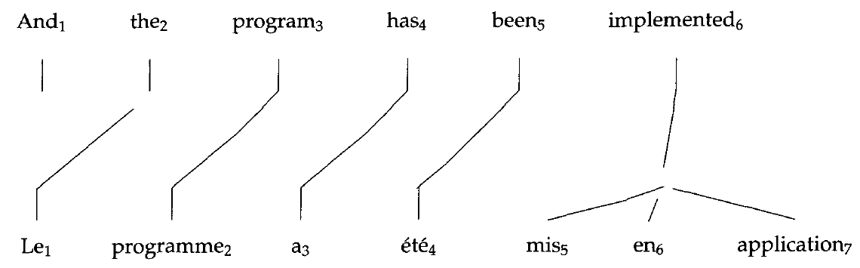
Representing Alignment
Representation: E = e₁ ... e_{I} = And the program has been implemented F = f₁ ... f_{J} = Le programme a ete mis en application A = a₁ ... a_{J} = 2, 3, 4, 5, 6, 6, 6
Figure from Brown, Della Pietra, Della Pietra, Mercer, 1993

Slide 13
Cautionary note
Consider translating in the other direction
What are the alignment values?
a=0 denotes an unaligned word (also called NULL)
this approach to alignment imposes modelling limitations & asymmetry

Slide 14
Estimating P(f|e)
If we knew the alignments this would be easy
Simply count frequencies:
e.g., p(programme | program) = c(programme, program) / c(program)
counts aggregated over all aligned word pairs in the corpus
However, word-alignments are rarely observed
have to infer the alignments
define probabilistic model and use the Expectation-Maximisation (EM) algorithm

Slide 15
IBM model 1
Formulate probabilistic model of translation
where
t(f|e) are translation probabilities
alignments a_{j} indexes the translation of word j
Notes:
P(F, A | E) = \frac{\epsilon}{(I+1)^J} \prod_{j=1}^{J} t(f_j | e_{a_j})

Slide 16
IBM Model 1
Where does the leading factor come from?
𝜖 is a small constant reflecting the choice of length J
1/(I+1) reflects the alignment probability, using uniform distribution over
aligning with any of the I words in E; or aligning to NULL (i=0)
Notes:
P(F, A | E) = \frac{\epsilon}{(I+1)^J} \prod_{j=1}^{J} t(f_j | e_{a_j})

Slide 17
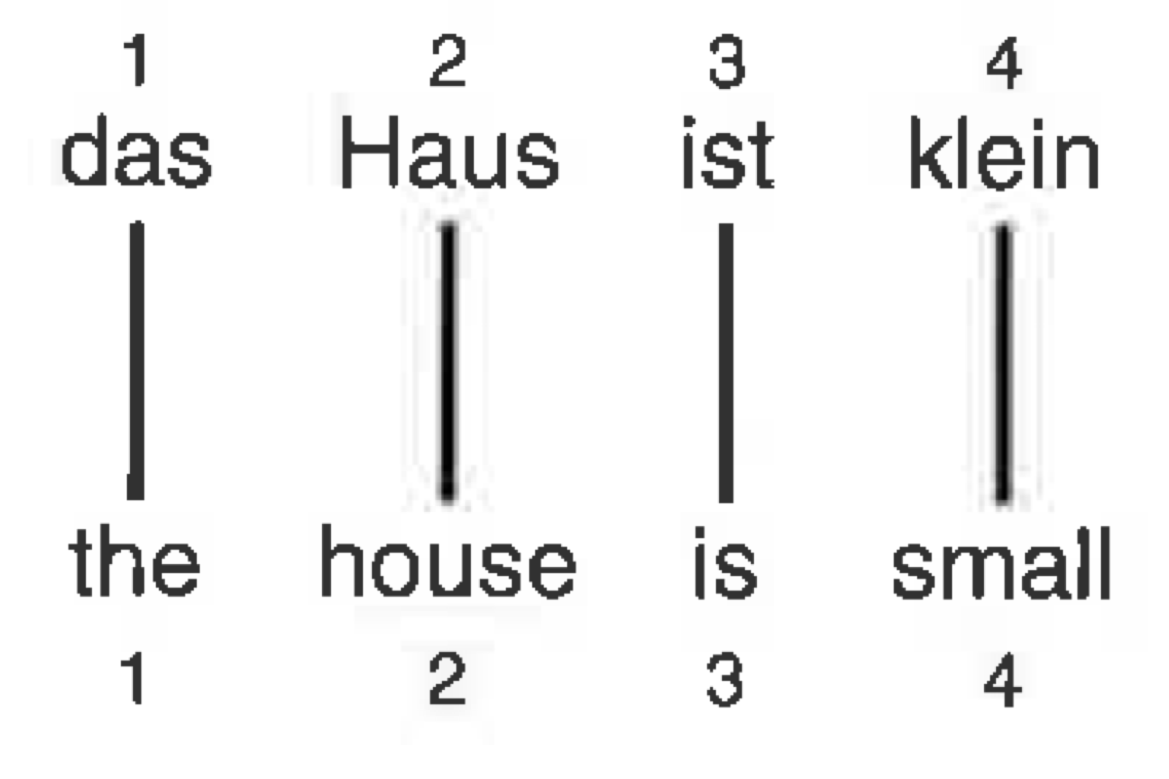
Example IBM
Given translation table, evaluate the probability of the aligned sentence pair
e = the
e = house
e = is
e = small
f | t(f|e) | f | t(f|e) | f | t(f|e) | f | t(f|e)
das | 0.4 | Haus | 0.35 | ist | 0.2 | klein | 0.4
der | 0.35 | Geschlect | 0.05 | bin | 0.15 | gering | 0.25
die | 0.25 | Häuser | 0.15 | bist | 0.10 | schmal | 0.15
 |  | aufnehmen | 0.20 | sein | 0.30
 |  | Heim | 0.25 | sind | 0.25
Example adapted from Koehn 09
Notes:
P(E, A | F) & = \frac{\epsilon}{5^4} t(\text{the} | \text{das}) t(\text{house} | \text{Haus}) t(\text{is} | \text{ist}) t(\text{small} | \text{klein}) \\
& = 0.00029\epsilon

Slide 18
Incomplete data
To learn the parameter tables, t, need the word alignments
However, word-alignments are rarely available; how to handle?
if we had a good model, we could use it to guess alignments
if we had a good guess about the alignments, we could train a model
a ‘chicken and egg’ problem…

Slide 19
Estimating the MODEL
Instance of “expectation maximization” (EM) algorithm
make initial guess of t parameters, e.g., uniform
estimate alignments of each sentence pair in corpus P(A | E, F)
learn parameters t, based on expected (fractional) alignments over corpus (from step 2)
repeat from step 2
In each step we are improving the fit of our model to the data
terminate after fixed number of steps (e.g., 5-10)
Notes:
p(\mathbf{f}, \mathbf{a} | \mathbf{e})
= \frac{\epsilon}{(l+1)^m} \prod_{j=1}^m t(f_j | e_{a_j})

Slide 20
EM for IBM1
Need to calculate expected alignments under our model (step 2)
Numerator is from before:
Denominator more complex:
Notes:
P( A|E,F) &= \frac{P(F,A|E)}{P(F|E)}

Slide 21
EM for IBM1: computing P(e|F)
green background = Just for fun
Key trick! Can swap order of sum and product, as a_{j} only used in a single factor.
Notes:
Mention factorisation of sum_x sum_y sum_z f(x) g(y) h(z)
P(F| E) &= \sum_A P(F,A|E) \\
&= \sum_{a_1}
\sum_{a_2} \cdots \sum_{a_J} P(F, A|E) \\
&= \sum_{a_1}
\sum_{a_2} \cdots \sum_{a_J} \frac{\epsilon}{(I+1)^J} \prod_{j=1}^{J} t(f_j | e_{a_j}) \\
&= \frac{\epsilon}{(I+1)^J} \sum_{a_1}
\sum_{a_2} \cdots \sum_{a_J} \prod_{j=1}^{J} t(f_j | e_{a_j}) \\
&= \frac{\epsilon}{(I+1)^J} \prod_{j=1}^{J} \sum_{a_j} t(f_j | e_{a_j})

Slide 22
EM for IBM1: putting it together
Fairly simple end result &, even better, it factorises
Notes:
P(A | E, F) &= \frac{P(F,A|E)}{P(F|E)} \\
&= \frac{ \frac{\epsilon}{(I+1)^J} \prod_{j=1}^{J} t(f_j | e_{a_j})}
{\frac{\epsilon}{(I+1)^J} \prod_{j=1}^{J} \sum_{a_j} t(f_j | e_{a_j})} \\
&= \prod_{j=1}^{J} \frac{t(f_j | e_{a_j})}{\sum_{a_j} t(f_j | e_{a_j})}
P(a_j | E, F) &= \frac{t(f_j | e_{a_j})}{\sum_{a_j} t(f_j | e_{a_j})}

Slide 23
EM for IBM1: summary
make initial guess of t parameters, e.g., uniform
initialise counts, c, of translation pairs to 0
for each sentence pair, (E, F)
for each position j, and value of a_{j} ∈ {0, 1, 2, …, l}
compute P(a_{j}|E, F) i.e.,
update fractional counts, c(e_{j}, f_{aj}) ← c(e_{j}, f_{aj}) + P(a_{j}|E, F)
update t with normalised counts, t(f|e) = c(e, f) / c(e)
repeat from step 2
Notes:
p(\mathbf{f}, \mathbf{a} | \mathbf{e})
= \frac{\epsilon}{(l+1)^m} \prod_{j=1}^m t(f_j | e_{a_j})

Slide 24
EM for IBM1 demonstration
See ipython notebook

Slide 25
Modelling limitations
Simple model and quite naïve
ignores the positions of words in both strings
alignments exhibit consistent patterns
More general issues:
limited to word-based phenonema
asymmetric, can’t handle 1:many or many:many
learning from sparse data (solution: using large corpora)
Figure from Brown, Della Pietra², Mercer, 1993

Slide 26
other alignment models
IBM paper introduced several models of varying complexity
IBM2: non-uniform alignment probability, p(i|j, I, J)
IBM3: fertility for each word in E
how many words should it translate as in the other language? (e.g., ɸ(did) ~ 0, ɸ(the) ~ 1, ɸ(implemented) ~ 3)
IBM4,5: includes word clusters in distortion model
to represent consistent syntactic reordering
Hidden Markov Model
better distortion model favouring monotone alignment with small ‘jumps’

Slide 27
HMMs for alignment
How to better model the alignment prior?
IBM 2 & 3 include an explicit term for modelling typical alignment values using table of condition probabilities, Pr(a_{j} = i|j, l, m)
suffers for long sentence pairs, where there too little data to estimate
HMM provides a better solution
each alignment a_{j} depends on the previous alignment a_{j-1}
Notes:
P(A) &= P(a_1) P(a_2 | a_1) P(a_3 | a_2) \ldots P(a_l | a_{l-1})

Slide 28
HMMs for alignment
Formulated as
where P(a₁ |a₀, I) is a placeholder for P(a₁ | I)
Notes:
P(F, A | E) &= P(J|I) \times \prod_j P(a_j | a_{j-1}, I) P(f_j | e_{a_j})

Slide 29
HMM for alignment cf tagging
Emission probability of f_{j} being generating conditioned on a_{j} th word in E
versus generating from ‘cluster’ a_{j} in tagging HMM
Transition probability based on jump distance, a_{j} – a_{j-1}
versus the pair of integer ‘cluster’ identifiers in tagger
I.e., transition dist
Notes:
P(E, A | F) &= \epsilon \times \prod_j P(a_j | a_{j-1}) P(e_j | f_{a_j})

Slide 30
Training the HMM
The HMM benefits from efficient algorithms for computing expectations
the forward-backward algorithm here has O(JI²) time complexity (why?)
Train the model as per IBM1, but alter step 3
calculate expectations using Baum-Welch (forward-backward) over the sentence
accumulate counts based on expected values of each a_{j} as before

Slide 31
Decoding
Objective
sometimes includes other components, such as
distortion cost based on word reordering (translations are largely left-to-right, penalise big ‘jumps’)
number of words to discourage very short output
Search problem
find the translation with the best overall score
use beam search a form of dynamic programming akin to Viterbi search in HMMs and chart parsing with grammars
Typically embedded complex phrase-based approaches, based on translating several words at a time

Slide 32
Summary
Translation as word-based approach for modelling bitexts
Noisy channel formulation of translation
IBM model1 and EM training
Reading:
JM2 #25, 25.4-25.6
Koehn09 #4, 4.1-4.3 (more detailed treatment)

