Slide 1

Question Answering
COMP90042 LECTURE 12

Slide 2
What is question answering?
The task of automatically determining an answer for a user-provided question
Focus in the field (and this lecture) is on factoid QA
Question: Who said ‘you will know a word by the company it keeps’?
Answer: Firth
But there are other kinds of QA, e.g.
“episodic” QA: tell a story, ask a question about it
“community” QA: match a new question to an existing question on QA websites (StackExchange)

Slide 3
Why do QA?
Why do people create QA systems?
Because we want quick access to specific information
More human-friendly than traditional web search
Why are we learning about QA?
It’s a richly challenging text processing task
Related to nearly every major topic in this class
The subject of the final project

Slide 4
How do we do QA?
QA as mapping of question to a knowledge-base query
QA as information retrieval
QA as information extraction
QA as sequential deep learning

Slide 5
QA Scope
Restricted-domain
E.g. LUNAR, 50 year-old system for asking about lunar rock samples
Open-domain
E.g. IBM Watson, modern system which won the Jeopardy! challenge

Slide 6
anatomy of a FACTOID question
Focus
What company did Bill Gates found?
Wh-word
Headword
Focus is the part of the question that “stands in” for the answer
Will usually disappear a full correct answer (Bill Gates founded Microsoft)
Some Wh-words (Who, where, how, when) give general information about the type of answer required
For what and which, the headword gives more info

Slide 7
Logical forms
In KB-driven QA, goal is to convert questions to a logical form appropriate for database query (semantic parsing)
Logical forms typically include
Named entities, e.g. BILL_GATES
Predicates, e.g. founder(·,·)
Variables, e.g. ?x, ?y
Logical connectives (^, v, ⌐) and quantifiers (∀, ∃)
What company did Bill Gates found? →
?x s.t. founder(BILL_GATES, ?x) ^ company(?x)

Slide 8

Semantic Parsing
For simple questions in closed-domains, rules work well
With supervised data, can learn general mappings between dependency parse fragments and logical forms
Problem: natural language is too variable
learn how to paraphrase using machine translation; or
align existing KBs with results of large-scale unsupervised relation extraction

Slide 9
Open Information extraction
Bill Gates is a founder of Microsoft, a software company based in Redmond, Washington.
< Bill Gates, be a founder of, Microsoft > < Microsoft, based in, Redmond, Washington>
Purely unsupervised
Use POS regex (chunking) and normalization
Main difficulty: Lots of junk!
After entity linking, different possible realisations can be clustered together by known relations in database

Slide 10
Some Harder (to parse) Questions
What is the city where the Eiffel Tower is located? →
located-in(EIFFEL_TOWER,?x) ^ city(?x)
What kind of mammal lays eggs? →
Is-a(?x, MAMMAL)^egg-laying(?x)
When was the Magna Carta signed? →
year(MAGNA_CARTA_SIGNING, ?x)
How many countries are there in the United Nations? →
Count(∀ ?x s.t. member-of(?x, UNITED_NATIONS))

Slide 11
Query Formulation for IR QA
Convert the question to information retrieval query
Used when searching for the answer in a text corpus
Remove stopwords
Including wh-word and common verbs
Query expansion using morphological variants, synonyms, or similar words
E.g. for found, include founder, start a company
Re-order and rephrase so query structured like declarative answer
E.g. “Where is X?” → “X is in/at/on”

Slide 12
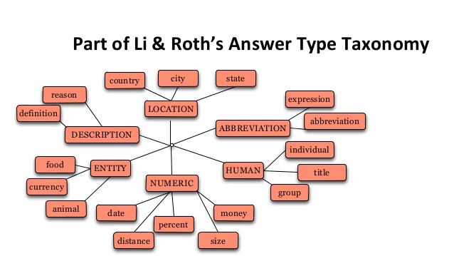
Answer type recognition
Select the best answer type from an answer type taxonomy, e.g.
Rule-based classification using wh-word/headword question pattern
Supervised classification with BOW, POS, NE, and WordNet information

Slide 13
Answer type examples
What kind of cheese is most common on pizza?
Answer type: food
What’s the capital of Nepal?
Answer type: city
How long did World War 2 last?
Answer type: duration
Which company was founded by Bill Gates?
Answer type: group/organization
What does perspicacity mean?
Answer type: definition

Slide 14
Passage Retrieval
Information retrieval of large documents of limited use for Factoid QA
Too much reading involved
Highly relevant documents might not contain answer
Passage retrieval: IR on small documents within a larger text collection
E.g. section, paragraph, sentence
Can be done by unsupervised VSM model
But often considered a supervised ranking task

Slide 15
Features for passage retrieval
Count of named entities corresponding to answer type
Count of query words in document
Longest overlapping sequence of query words
Proximity of query words to each other
N-gram overlap between original question and passage

Slide 16
Answer extraction
Possibly trivial, if only one named entity of correct type in retrieved passage(s)
But sometimes multiple entities
Or answer isn’t a (named) entity at all, e.g. definition
Harder cases can be addressed with regex patterns
What is Microsoft?
“he found a job with Microsoft, a software company best known for creating the Windows operating system.”
<QP>, a <AP>

Slide 17
Features for answer extraction
Matches answer type
Matches regex pattern
Number of matched question keywords
Contains novel words
Distance from keywords
Word distance
Syntactic distance using parse
Followed by punctuation

Slide 18
Open-domain Corpora for QA
TREC (IR shared task)
Series of Factoid QA datasets with guaranteed answer in corpus of newswire
WEBQUESTIONS
~6k constrained questions asked by netizens, hand-written answers drawn from Freebase page
SQuAD
Latest and greatest in QA, reading comprehension based on paragraphs inWikipedia, annotated by crowdsourcing 100000+ question answer pairs

Slide 19
Mean reciprocal rank
Reciprocal rank: inverse rank of the first correct answer
Zero if correct answer not ranked
Averaged across all test instances
Only appropriate for ranking models
Gives partial credit for near-misses
In non-ranking situations, f-score most common

Slide 20
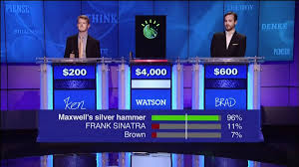
END-TO-END real QA SYSTEM: Watson
Watson beat Jeopardy! grandmaster in 2011
In Jeopardy! question and answer are reversed
“Questions” tend to be simple, no definitions/descriptions
But otherwise extremely open-domain
Robert Redford and Paul Newman starred in this depression-ear grifter flick.
What is The String?

Slide 21
Question Processing
Preprocessing: Parsing and NER
Identify focus, e.g. this depression-era grifter flick
Relation extraction, e.g. starred-in(Robert_Redford, focus)
Identify answer type(s)
Watson has some 5000 total answer types!
Often identified based on headword of focus (e.g. flick)
Or the category of the clue
But may require co-reference resolution
He was a bank clerk in the Yukon before he published “Songs of a Sourdough” in 1907.

Slide 22
Candidate answer generation
For extracted relations (logical forms), query databases like IMBD or DBpedia to find potential answers
I.e. find all movies starring Robert Redford
Search text collections with weighted query
For Wikipedia, take titles of high ranked documents
For other texts, identify anchor texts or Wikipedia document titles

Slide 23
Answer selection
Look at overlap of words in question with texts which contain possible answers
Use WordNet to see if candidate is a potential instance of identified answer type
Encourage temporal consistency
Remove redundant candidates
Apply logistic regression classifier to choose final answer
Rank using output probability

Slide 24
A Final word
QA a complex problem: many approaches, many steps
Requires a system with full linguistic competence: morphology, syntax, semantics, and discourse
More on discourse next week…

Slide 25
Further reading
J&M3, Ch 28

