Slide 1
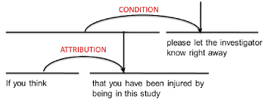
DISCOURSE
COMP90042 LECTURE 13

Slide 2
Beyond the sentence
Discourse: a coherent, structured group of sentences (utterances)
Yesterday, Ted was late for work. [It all started when his car wouldn’t start. He first tried to jump start it with a neighbour’s help, but that didn’t work.] [So he decided to take public transit. He walked 15 minutes to the tram stop. Then he waited for another 20 minutes, but the tram didn’t come. The tram drivers were on strike that morning.] [ So he walked home and got his bike out of the garage. He started riding but quickly discovered he had a flat tire. He walked his bike back home. He looked around but his wife had cleaned the garage and he couldn’t find the bike pump.] He started walking, and didn’t arrive until lunchtime.

Slide 3
Three Key discourse tasks
Discourse segmentation
Discourse parsing
Anaphor resolution

Slide 4
Discourse segmentation
Assumption: text can be divided into a number of discrete, contiguous sections
Task: classifying whether a boundary exists between any two sentences

Slide 5
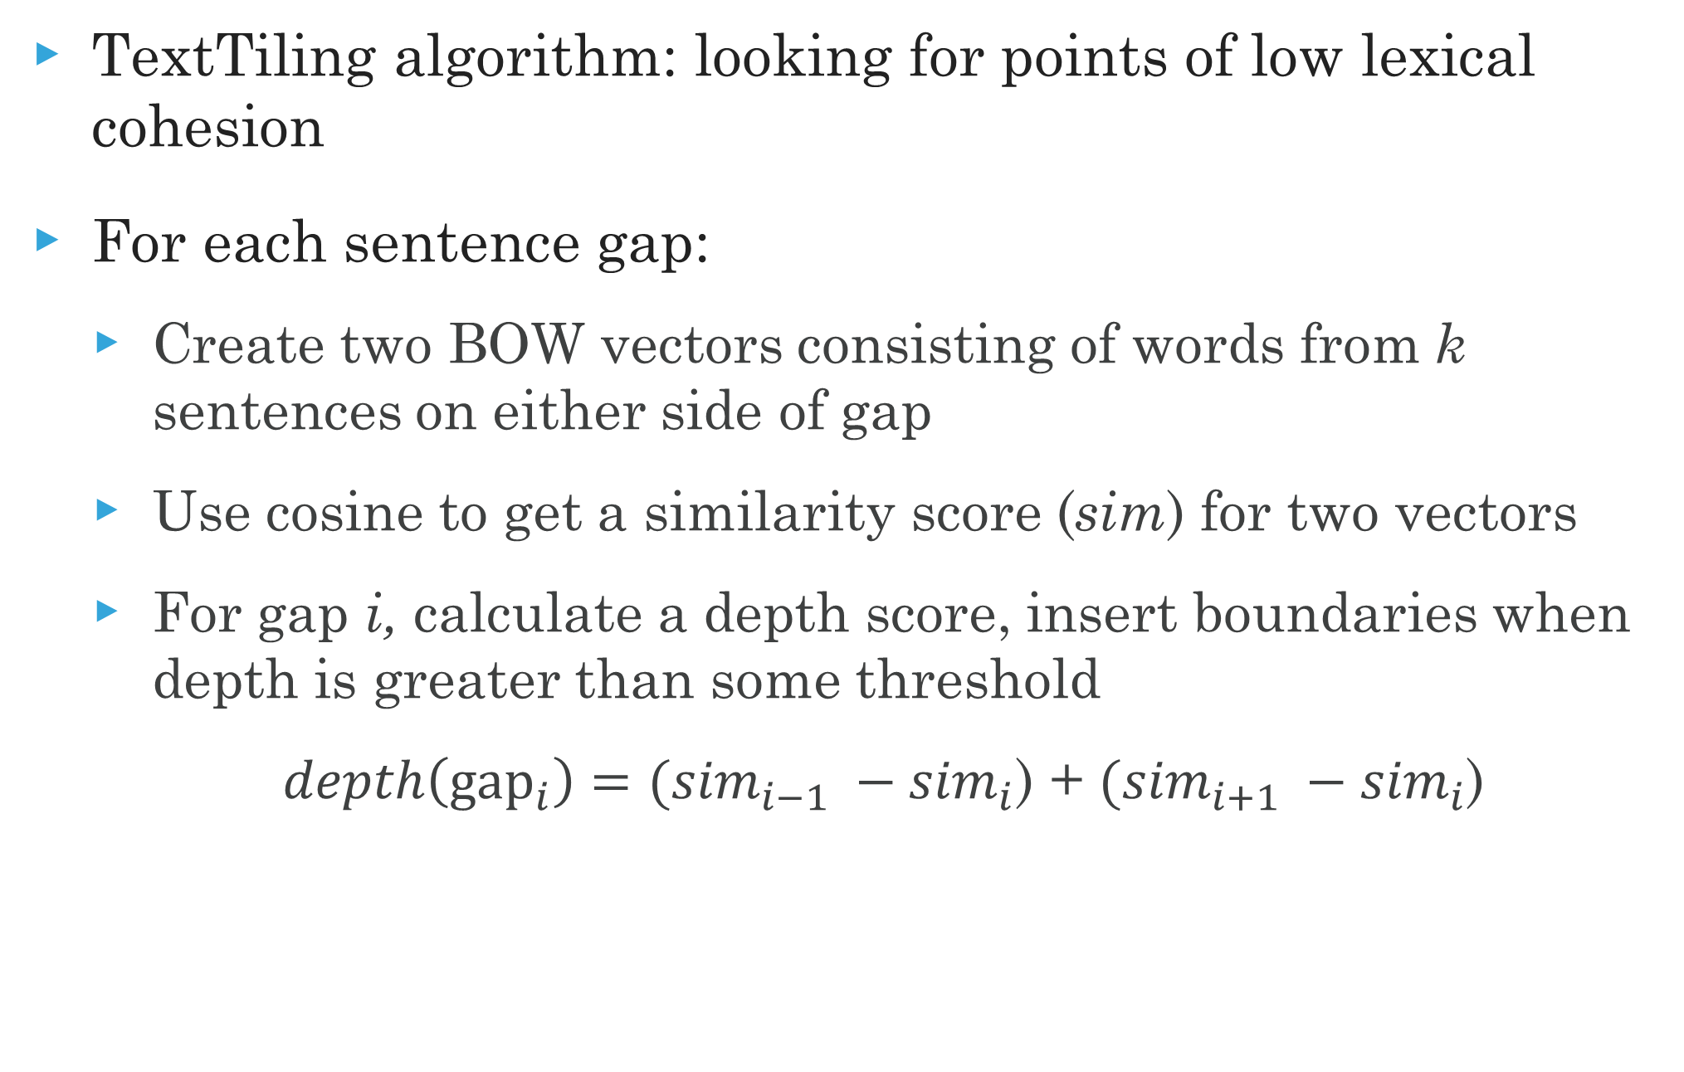
An unsupervised approach
TextTiling algorithm: looking for points of low lexical cohesion
For each sentence gap:
Create two BOW vectors consisting of words from k sentences on either side of gap
Use cosine to get a similarity score (sim) for two vectors
For gap i, calculate a depth score, insert boundaries when depth is greater than some threshold
$depth\left({\text{gap}}_{i}\right)=({sim}_{i−1} −{sim}_{i}$) + $({sim}_{i+1} −{sim}_{i}$)

Slide 6
Text Tiling example (k=2)
Dot product: 3
He walked 15 minutes to the tram stop.
Then he waited for another 20 minutes, but the tram didn’t come.
The tram drivers were on strike that morning.
So he walked home and got his bike out of the garage.
He started riding but quickly discovered he had a flat tire
He walked his bike back home.
He looked around but his wife had cleaned the garage and he couldn’t find the bike pump.
Dot product: 2
Dot product: 0
Dot product: 2
Dot product: 4
Dot product: 2

Slide 7
Supervised discourse segmentation
Get data from easy sources (documents with paragraphs)
Apply a binary classifier to identify boundaries
Or use sequential classifiers
Potentially include classification of section types (introduction, conclusion, etc.)
Integrate a wider range of features, including
distributional semantics
coreference cues
discourse markers

Slide 8
Discourse parsing
A proper discourse must be coherent
Then he waited for another 20 minutes, but the tram didn’t come.
✓The tram drivers were on strike that morning. ✗ His bike had a flat tire.
Discourse units (DUs) are related by specific coherence relations
Two related DUs form a new DUs
All DUs in a coherent discourse must be related
A discourse will form a tree, which can be parsed

Slide 9
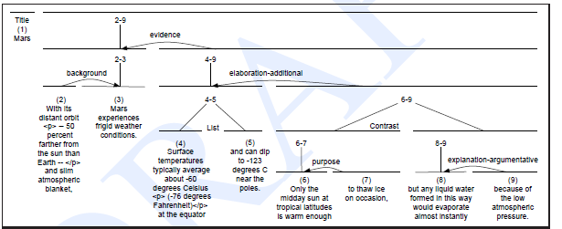
An RST Tree
RST= Rhetorical Structure Theory
23 relations, most with a nucleus and satellite

Slide 10
Parsing using discourse markers
Some discourse markers (cue phrases) explicitly indicate relations
Some examples: although, but, for example, in other words, so, because, in conclusion,…
Can be used to build a simple rule-based parser
However, (another discourse marker!)
Many relations are not marked by discourse marker at all
Particularly at the supra-sentential level
Many important discourse markers (e.g. and) ambiguous
Sometimes not a discourse marker
Can signal multiple relations

Slide 11
Full-text Discourse Parsing
Full CYK/chart discourse parsing of entire texts not practical
Most existing discourse parsers use a greedy approach
Steps:
First, segment into elementary DUs (EDUs)
Classify all adjacent EDUs as being same DU or not
Combine most probable into a single DU
Repeat until entire text is a single DU

Slide 12
Discourse parsing features
Discourse markers
Starting/ending n-grams
Location in the text
Syntax (POS, dependency arcs, CFG productions)
Lexical and distributional similarities
Discourse structure within DUs
Relations in adjoining DUs

Slide 13
Why identify Text structure?
Summarization
Sentiment analysis
Argumentation
Authorship attribution
Essay scoring
Anaphor resolution

Slide 14
Anaphors
Anaphor: linguistic expressions that refer back to earlier elements in the text
Anaphors have a antecedent in the discourse, often but not always a noun phrase
Yesterday, Ted was late for work. It all started when his car wouldn’t start.
Pronouns are the most common anaphor
But there are various others
Demonstratives (that problem)
Definites (the problem)

Slide 15
Antecedent Restrictions
Pronouns must agree in number with their antecedents
His coworkers were leaving for lunch when Ted arrived. They invited him, but he said no.
Pronouns must agree in gender with their antecedents
Sue was leaving for lunch when Ted arrived. She invited him, but he said no.
Pronouns whose antecendents are the subject of the same syntactic clause must be reflexive
Ted was angry at him. [him ≠ Ted] Ted was angry at himself. [himself = Ted]

Slide 16
Antecedent Preferences
The antecedent should satisfy the selectional preferences of the verb
The antecedents of pronouns should be recent
He waited for another 20 minutes, but the tram didn’t come. So he walked home and got his bike out of the garage. He started riding it to work.
The antecedent should be salient, as determined by grammatical position
Subject > object > argument of preposition
Ted usually rode to work with Bill. He was never late.

Slide 17
The centering Algorithm
Idea: at any given moment, discourse is focused on a single entity, the center
Goal: assign pronoun to antecedents in a manner which avoids “rough” shifts in the center
Definitions:
C_{f}(U_{n}) = list of entities of U_{n}, ordered by salience
C_{b}(U_{n}) = backward center of U_{n}, highest ranked entity C_{f}(U_{n-1}) that appears in C_{f}(U_{n})
C_{b}(U_{n}) = forward center of U_{n}, highest ranked entity of C_{f}(U_{n})

Slide 18
The centering Algorithm
If some entity in C_{f}(U_{n-1}) is realized as a pronoun in U_{n}, then C_{b}(U_{n}) must be realized as a pronoun.
Ted worked in the CBD. He usually rode to work with Bill. ✗He had a nicer car than Ted. ✓Bill had a nicer car than Ted.
Prefer assignments of pronouns where C_{b}(U_{n}) = C_{b}(U_{n+1})
Ted worked in the CBD. He usually rode to work with Bill. He was never late.
Otherwise, prefer C_{b}(U_{n}) = C_{p}(U_{n})
The tram didn’t come. Ted went back to get his bike. It had a flat tire.

Slide 19
Supervised anaphor resolution
Build a binary classifier for anaphor/antecedent pairs
Use confidence values to optimize globally
Convert restrictions and preferences into features
Binary features for number/gender compatibility
Include features about type of antecedent
With enough data, can approximate the centering algorithm
But also easy to include features which indicate tendencies, rather than rules
Like repetition, parallelism

Slide 20
Motivation for Anaphor resolution
Essential for proper semantic analysis
Very useful for reading comprehension QA!
Ted’s car broke down. So he went over to Bill’s house to borrow his car. Bill said that was fine.
Who borrowed a car?

Slide 21
A final word
For many tasks, the larger context of language is important
Traditional NLP has been sentence-focused, but that is beginning to change…

Slide 22
Further reading
J&M2, Ch 21.1-21.3 , 21.5-21.6
Text-level Discourse Parsing with Rich Linguistic Features

