Slide 1
The Web as a graph: link analysis for retrieval
Image: https://commons.wikimedia.org/wiki/File:PageRanks-Example.svg
comp90042 lecture 18

Slide 2
overview
The web as a graph
Two methods for automatically determining web-page importance
Page-rank
Hubs and authorities (HITS)

Slide 3
Not all documents are equal
Documents assumed to be ‘equal’
Usefulness for ranking only affected by how well the terms in the document match with the query terms
e.g., assumed P(r|d) uniform prior in probabilistic methods
Can we do better than this?
some documents are authoritative and should be ranked higher than others for any query
Notes:
might be misspelled in the collection;
lexicon of terms may be massive, million+ entries

Slide 4
The web as a graph
Pages on the Web do not stand alone
Treatment as independent “documents” is over-simplification
Considerable information in hyperlink structure

Slide 5
What information does a hyperlink convey?
Directs user’s attention to other pages
Conferral of authority (not always!)
Anchor text to explain why linked page is of interest
“IBM computers” links to www.ibm.com
“search portal” links to www.yahoo.com
“click here” links to Adobe Acrobat
Additional source of terms for indexing
Perhaps the most important pages have more incoming links?

Slide 6
The web as a directed graph
Formally, consider
in-links Number of incoming edges
out-links Number of outgoing edges
connected components Path connects all pairs of nodes

Slide 7
Not all links are equal
Who and what to trust?
outgoing links from reputable sites should carry more weight than user-generated content and links from unknown websites
Web has “bow-tie” structure, comprising
in pages that only have outgoing edges to
strongly connected component whose pages are highly interlinked, and also link to
out pages that only have incoming edges
Typically don’t consider internal links within a web-site (why?)

Slide 8
Page rank
Assumptions
links convey authority of the source page
pages with more in links from authoritative sources are more important
Formalised using model of Random web surfer
Consider surfer who visits a web page
then follows a random out link, uniformly (repeat above)
occasionally types a new random URL into the address bar (called “teleporting” to a new random page)
Inference problem: which pages does the surfer visit most often?

Slide 9
Example graph
Transition probabilities (no teleport for now)
Example from MRS, Ch 21

Slide 10
Example graph

Slide 11
Adding teleportation
If at each time step we randomly jump to another node in the graph with probability α
scale our original P matrix by 1 − α
add α/N to all cells of the resulting matrix

Slide 12
Markov chain
Formally we have defined a Markov chain
a discrete time stochastic process consisting of N states, one per web page
assuming the prob. of reaching a state (page) is based only on previous state (page)
characterised by the transition matrix
Déjà vu: seen before for HMMs

Slide 13
Transitions as matrix mult.

Slide 14
example
Start at state x
after one time step, prob on next state is xP
after two time steps, now (xP)P = xP²
Example
x = [0 1 0]
xP = [0.4167 0.1667 0.4167]
xP² = [0.2083 0.5833 0.2083]
...
xP⁹⁹ = [0.2778 0.4444 0.2778]
xP¹⁰⁰ = [0.2778 0.4444 0.2778] (denoted 𝜋)

Slide 15
Markov chain convergence
Run sufficiently long, state membership converges
reaches a steady-state, denoted 𝜋
transitions from this state leave the state unmodified
𝜋 record frequency of visiting each page for random surfer in the limit as t → ∞
JFF: When will the Markov Chain converge? Must have the properties:
ergodicity: For any start state i, all states j must be reachable with non-zero probability in finite steps. Ergodicity in turn requires
irreducibility: reachability between i and j; and
aperiodicity: relating to partitioning into sets with internal cycles.

Slide 16
Computing pagerank
Definition of a steady-state is
This is a classic linear algebra problem (finding the left eigenvalues), of the form
Can recover several solution vectors for different values of λ
Want the principle eigenvector, for which λ = 1
In practice, may use the power iteration method to handle large graphs

Slide 17
Pagerank in python

Slide 18

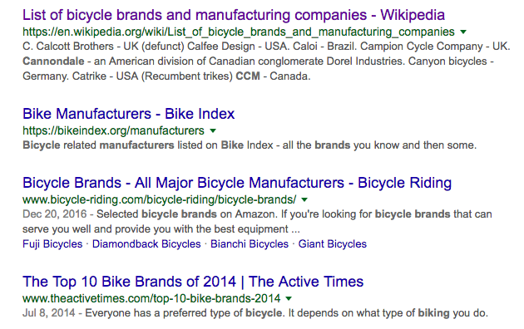


Hubs and Authorities (HITS)
Assumes there are two kinds of pages on web
authorities providing authoritative and detailed information
hubs containing mainly links to lots of pages about a topic
good
authorities
good hubs

Slide 19
HITS motivation
Depending on our query, we might prefer one type or the other
broad topic query, e.g., information about biking in Melbourne … → hub
specific query, e.g., is the Yarra trail sealed? → authority
More generally, both types of page can be informative
but don’t know what kind each page is!

Slide 20
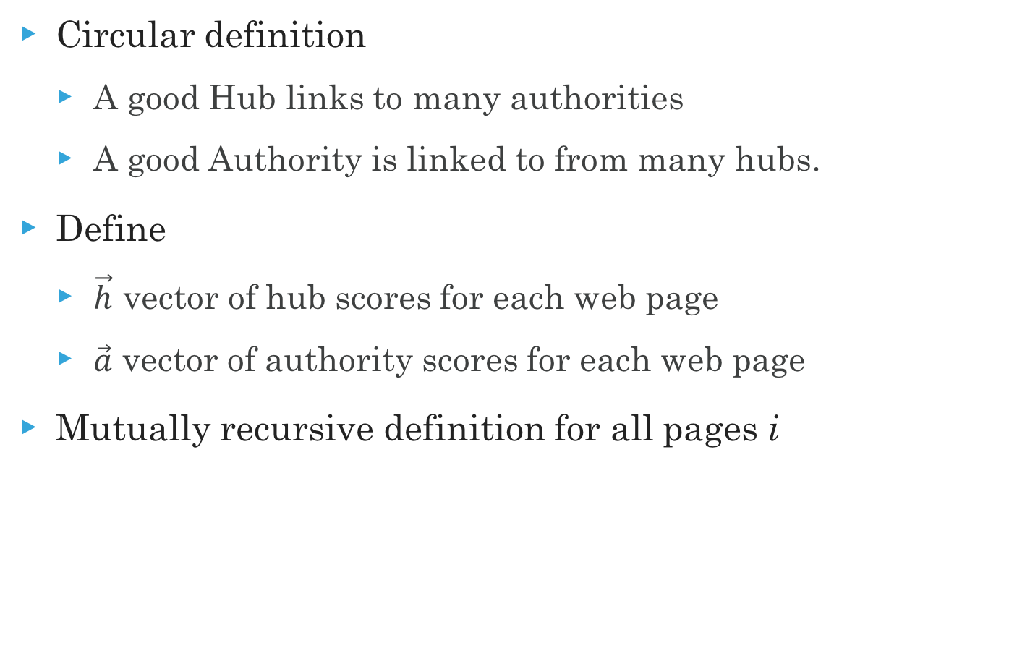
Formulating Hubs and authorities
Circular definition
A good Hub links to many authorities
A good Authority is linked to from many hubs.
Define
$\vec{h}$ vector of hub scores for each web page
$\vec{a}$ vector of authority scores for each web page
Mutually recursive definition for all pages i

Slide 21
inference

Slide 22
HITS example
Steps:
Compute adjacency matrix, A
(optional) Adjust A based on query
Solve eigenvalue problem to find a, h
Fig 21.4, MRS

Slide 23
Comparing Pagerank and HITS
Both static query-independent measures of web page quality
Can be run offline to score each web page
Based on latent (unobserved) quality metric for each page
single importance score (pagerank)
hub and authority scores (hits)
Plus a specific transition mechanism
Gives rise to document rankings

Slide 24
use in a retrieval system?
Use as part of a feature representation, e.g.,
Features for TF*IDF, BM25 factors, LM, PageRank, HITS etc, each with their own weight α
Learn α values using machine learned scoring function
to match binary relevance judgements
to match click-throughs or query reformulations
Caveat: graph methods can be exploited, e.g., link spam, Google bombs etc.

Slide 25
Summary
Link structure of web gives rise to a graph, which conveys information about page importance
PageRank models a random surfer in the limit, with Markov Chain
HITS models hub and authority status of pages
Both solved for steady-state using iteration/linear algebra
Reading
(Review of Eigen decompositions) 18.1, “Linear algebra review” of Manning, Raghavan, and Schutze, Introduction to Information Retrieval.
Chapter 21, “Link Analysis” of Manning, Raghavan, and Schutze, Introduction to Information Retrieval.

