Slide 1
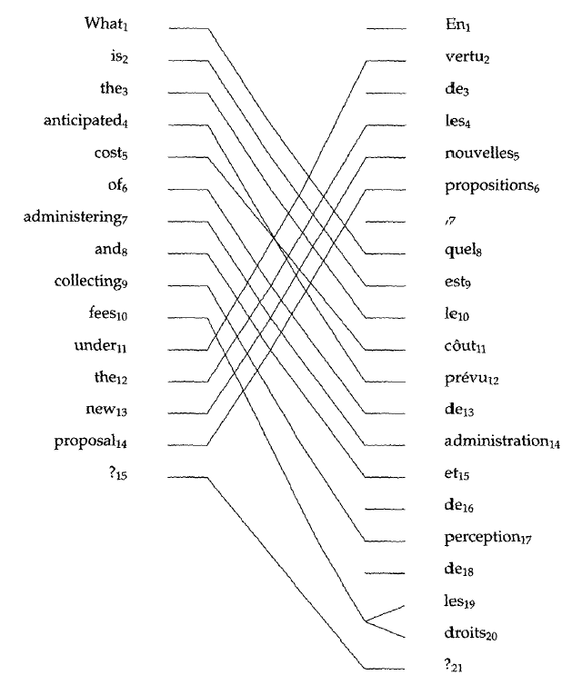
Machine translation II: Statistical word-based models
comp90042

Slide 2
overview: Word alignment in SMT
Word based translation models
IBM model 1
IBM model 2, 3, 4, 5 & the HMM
Training using the Expectation Maximisation algorithm
‘Symmetrising’ word alignments for use in phrase-based SMT

Slide 3
word based models of translation
Statistical machine translation learns translations from data
primarily from bitexts, using sentences and their translations
key questions are:
how to formulate process of translation?
how can we learn without explicit word-level instruction?
how can we use this to produce new translations?
Seek to describe translation using a formal probabilistic model, and perform maximum likelihood estimation

Slide 4
Alignment in translation
Consider sentences and their translations:
Not always word for word translation, nor do they have the same word order:
inserted and dropped words
rearrangement of word order, aka ‘re-ordering’
some word/s translate as several words
das Haus ist klein the house is small
klein ist das Haus the house is small
das Haus ist klitzeklein the house is very small
das Haus ist ja klein the house is small
ich gehe ja nicht zum haus I do not go to the house

Slide 5
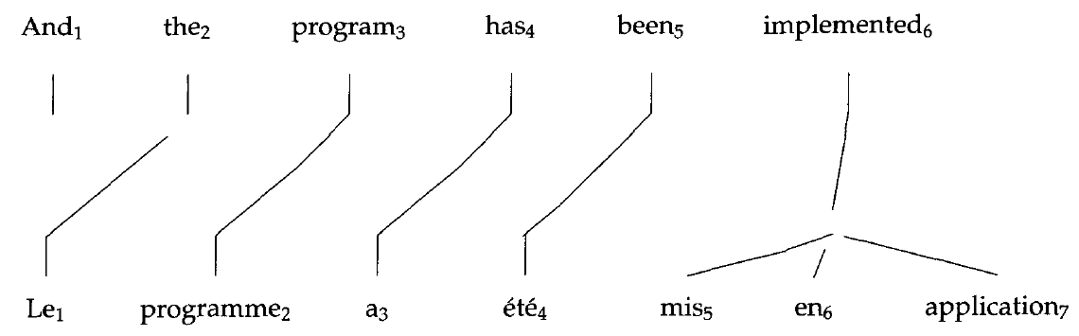
Representing Alignment
Representation: E = e₁ ... e_{J} = And the program has been implemented F = f₁ ... f_{I} = Le programme a ete mis en application A = a₁ ... a_{I} = 2, 3, 4, 5, 6, 6, 6
Figure from Brown, Della Pietra, Della Pietra, Mercer, 1993

Slide 6
Cautionary note
Consider translating in the other direction
What are the alignment values?
a=0 denotes an unaligned word (also called NULL)
this approach to alignment imposes modelling limitations & asymmetry

Slide 7
IBM1: A word based model of translation
Formulate probabilistic model of translation
where
t(e|f) are translation probabilities, aka ‘T-table’
alignment links each word and its translation
Notes:
P(F, A | E) = \frac{\epsilon}{(I+1)^J} \prod_{j=1}^{J} t(f_j | e_{a_j})

Slide 8
IBM1: A word based model of translation
Where does the leading factor come from?
𝜖 is a small constant reflecting the choice of length J
1/(I+1) reflects the alignment probability, using uniform distribution over
aligning with any of the I words in E
aligning to the NULL position (i=0)
Notes:
P(F, A | E) = \frac{\epsilon}{(I+1)^J} \prod_{j=1}^{J} t(f_j | e_{a_j})

Slide 9
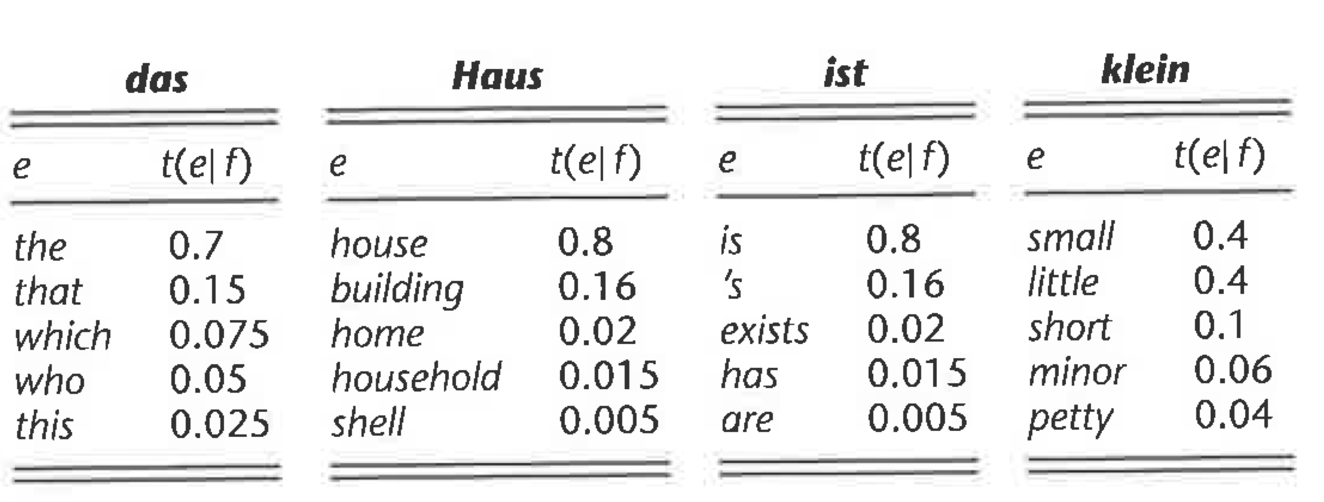
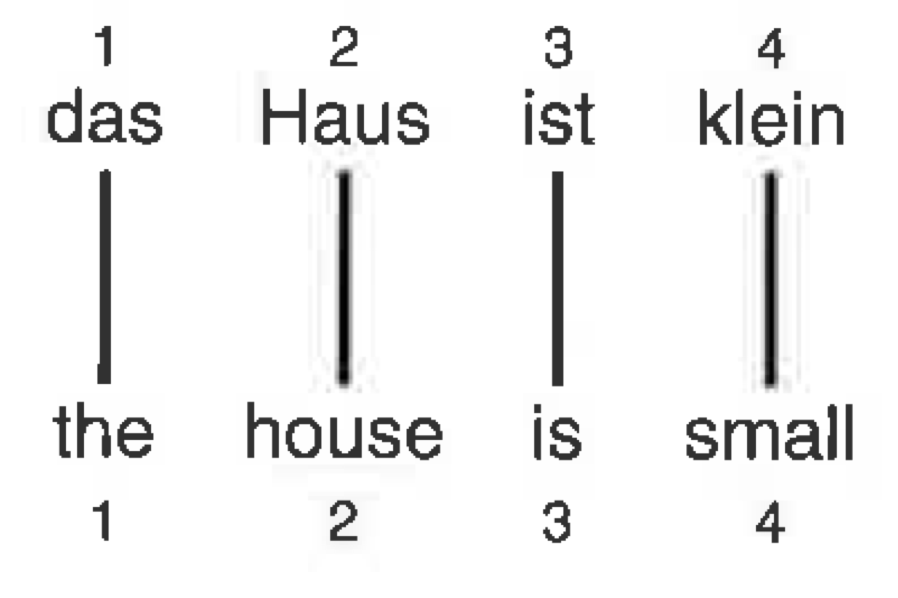
Example IBM1 DIRECTION reversed
Given translation table, evaluate the probability of the aligned sentence pair
Fig from Koehn 09
Notes:
P(E, A | F) & = \frac{\epsilon}{5^4} t(\text{the} | \text{das}) t(\text{house} | \text{Haus}) t(\text{is} | \text{ist}) t(\text{small} | \text{klein}) \\
& = 0.00029\epsilon

Slide 10
Incomplete data
Seek to learn parameters of the model, namely t
If word alignments are given, this would be easy t(house| Haus) = c(house, Haus) / c(Haus)
where c are counts over all aligned word pairs in the corpus
However, word-alignments are rarely available; how to handle?
if we had a good model, we could use it to guess alignments
if we had a good guess about the alignments, we could train a model
a ‘chicken and egg’ problem…

Slide 11
Estimating the MODEL
Instance of “expectation maximization” (EM) algorithm
make initial guess of t parameters, e.g., uniform
estimate alignments of each sentence pair in corpus P(A | E, F)
learn new t values, using expected (fractional) alignments over corpus
repeat from step 2
In each step we are improving the fit of our model to the data
terminate after fixed number of steps, or
if data likelihood, P(F|E), does not improve
Notes:
p(\mathbf{f}, \mathbf{a} | \mathbf{e})
= \frac{\epsilon}{(l+1)^m} \prod_{j=1}^m t(f_j | e_{a_j})

Slide 12
EM for IBM1
Need to calculate expected alignments under our model (step 2)
Numerator is from before:
Denominator more complex:
Notes:
P( A|E,F) &= \frac{P(F,A|E)}{P(F|E)}

Slide 13
EM for IBM1: computing P(e|F)
Corrected, 27/4/16
Key trick! Can swap order of sum and product, as a_{j} only used in a single factor.
Notes:
Mention factorisation of sum_x sum_y sum_z f(x) g(y) h(z)
P(F| E) &= \sum_A P(F,A|E) \\
&= \sum_{a_1}
\sum_{a_2} \cdots \sum_{a_J} P(F, A|E) \\
&= \sum_{a_1}
\sum_{a_2} \cdots \sum_{a_J} \frac{\epsilon}{(I+1)^J} \prod_{j=1}^{J} t(f_j | e_{a_j}) \\
&= \frac{\epsilon}{(I+1)^J} \sum_{a_1}
\sum_{a_2} \cdots \sum_{a_J} \prod_{j=1}^{l} t(f_j | e_{a_j}) \\
&= \frac{\epsilon}{(I+1)^J} \prod_{j=1}^{J} \sum_{a_j} t(f_j | e_{a_j})

Slide 14
EM for IBM1: putting it together
Fairly simple end result &, even better, it factorises
Notes:
P(A | E, F) &= \frac{P(F,A|E)}{P(F|E)} \\
&= \frac{ \frac{\epsilon}{(I+1)^J} \prod_{j=1}^{J} t(f_j | e_{a_j})}
{\frac{\epsilon}{(I+1)^J} \prod_{j=1}^{J} \sum_{a_j} t(f_j | e_{a_j})} \\
&= \prod_{j=1}^{J} \frac{t(f_j | e_{a_j})}{\sum_{a_j} t(f_j | e_{a_j})}
P(a_j | E, F) &= \frac{t(f_j | e_{a_j})}{\sum_{a_j} t(f_j | e_{a_j})}

Slide 15
EM for model1, summary
EM algorithm:
make initial guess of t parameters, e.g., uniform
initialise counts, c, of translation pairs to 0
for each sentence pair, (E, F)
for each position j, and value of a_{j} ∈ {0, 1, 2, …, l}
compute P(a_{j}|E, F) i.e.,
update fractional counts, c(e_{j}, f_{aj}) ← c(e_{j}, f_{aj}) + P(a_{j}|E, F)
update t with normalised counts, t(f|e) = c(e, f) / c(e)
repeat from step 2
Notes:
p(\mathbf{f}, \mathbf{a} | \mathbf{e})
= \frac{\epsilon}{(l+1)^m} \prod_{j=1}^m t(f_j | e_{a_j})

Slide 16
EM for IBM1 demonstration
See ipython notebook

Slide 17
Modelling limitations
Simple model and quite naïve
ignores the positions of words in both strings
alignments exhibit consistent patterns
More general issues:
limited to word-based phenonema
asymmetric, can’t handle 1:many or many:many
learning from sparse data (solution: using large corpora)
Figure from Brown, Della Pietra², Mercer, 1993

Slide 18
other alignment models
IBM paper introduced several models of varying complexity
IBM2: non-uniform alignment probability, p(i|j, I, J)
IBM3: fertility for each word in E
how many words should it translate as in the other language? (e.g., ɸ(did) ~ 0, ɸ(the) ~ 1, ɸ(implemented) ~ 3)
IBM4,5: includes word clusters in distortion model
to represent consistent syntactic reordering
Vogel’s HMM
better distortion model favouring monotone alignment with small ‘jumps’

Slide 19
IBM3 generative process
Fig from Koehn 09

Slide 20
hidden markov models for word alignment
How to better model the alignment prior?
IBM 2 & 3 include an explicit term for modelling typical alignment values using table of condition probabilities, Pr(a_{j} = i|j, l, m)
suffers for long sentence pairs, where there too little data to estimate
HMM provides a better solution
each alignment a_{j} depends on the previous alignment a_{j-1}
Notes:
P(A) &= P(a_1) P(a_2 | a_1) P(a_3 | a_2) \ldots P(a_l | a_{l-1})

Slide 21
Vogel’s HMM
Formulated as
where P(a₁ |a₀, I) is a placeholder for P(a₁ | I)
Notes:
P(F, A | E) &= P(J|I) \times \prod_j P(a_j | a_{j-1}, I) P(f_j | e_{a_j})

Slide 22
HMM for alignment cf tagging
Emission probability of f_{j} being generating conditioned on a_{j} th word in E
versus generating from ‘cluster’ a_{j} in tagging HMM
Transition probability based on jump distance, a_{j} – a_{j-1}
versus the pair of integer ‘cluster’ identifiers in tagger
I.e., transition dist
Notes:
P(E, A | F) &= \epsilon \times \prod_j P(a_j | a_{j-1}) P(e_j | f_{a_j})

Slide 23
Training the HMM
The HMM benefits from efficient algorithms for computing expectations
the forward-backward algorithm here has O(JI²) time complexity (why?)
Train the model as per IBM1, but alter step 3
calculate expectations using Baum-Welch (forward-backward) over the sentence
accumulate counts based on expected values of each a_{j} as before

Slide 24
Extracting word alignments
IBM1-5 proposed for training SMT system, but no longer used this way
infer word alignment for extracting larger phrase-based or grammar rules
Best to consolidate alignments F → E and E → F
take the intersection -- models agree
add some entries from the union
range of heuristics in play here!
Why is this needed?
Fig from Koehn09

Slide 25
Extracting phrases
Extract all phrase pairs that are consistent with the alignment
Consistency defined as
all words in the phrase pair are not aligned to words outside the phrase pair
at least one alignment within the phrase pair
Michael; michael
michael assumes; michael geht davon aus
assumes; geht davon aus
assumes that; geht davon aus , dass
that he; dass er
will stay in the house; im haus bleibt
…
Fig from Koehn09

Slide 26
Summary
IBM1, a word based statistical model of translation
EM training method
Now used widely in learning complex phrase- and grammar-based models to define the space of translation rules learned from bitexts
Reading:
JM #25, 25.4-25.6 (optional 25.11 for IBM3)
(optional) Koehn09 #4, 4.1-4.3 (more detailed treatment)

