Slide 1
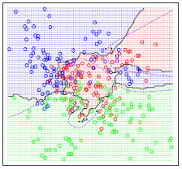
Text Classification
COMP90042 LECTURE 2

Slide 2
Outline
Fundamentals of classification
Algorithms for classification
Text classification tasks

Slide 3
Classification
Input
A document d
Often represented as a vector of features
A fixed output set of classes C = {c₁,c₂,…c_{k}}
Categorical, not continuous (regression) or ordinal (ranking)
Output
A predicted class c ∈ C

Slide 4
Types of classification
Rule-based vs. statistical
Rule-based methods often accurate on simple problems
Statistical models usually preferred for large feature spaces
Supervised vs. unsupervised
Supervised usually more accurate
But generally requires hand-labelled data
Generative vs. discriminative
Generative classifiers model how classes generate features
Discriminative classifiers find best discriminating features

Slide 5
Building a Text classifier
Identify a task of interest
Collect an appropriate corpus
Carry out annotation
Select features
Choose a machine learning algorithm
Tune hyperparameters using held-out development data
Repeat earlier steps as needed
Train final model
Evaluate model on held-out test data

Slide 6
Evaluation: Accuracy
 | Classified As
Class | A | B
A | 79 | 8
B | 13 | 11
Accuracy = correct classifications/total classifications
= (79 + 11)/(79 + 11 + 13 + 8)
= 0.81
0.81 looks good, but most common class baseline accuracy is 0.83

Slide 7
Evaluation: Precision & Recall
 | Classified As
Class | A | B
A | 79 | 8
B | 13 | 11
False Positives (fp)
True Positives (tp)
False Negatives (fn)
B as “positive class”
Precision = correct classifications of B (tp) /total classifications as B (tp + fp)
= 11/(11 + 8)
= 0.57
Recall = correct classifications of B (tp)/total instances of B (tp + fn)
= 11/(11 + 13)
= 0.46

Slide 8
Evaluation: F(1)-score
Harmonic mean of precision and recall
F1 = 2 precision*recall/(precision + recall)
Like precision and recall, defined relative to a specific positive class
But can be used as a general multiclass metric
Macroaverage: Average F-score across classes
Microaverage: Calculate F-score using sum of counts

Slide 9
HyperParameter tuning
Dataset for tuning
Development set
Not the training set or the test set
k-fold cross-validation
Specific hyperparameters are classifier specific
E.g. tree depth for decision trees
But many hyperparameters relate to regularization
Regularization hyperparameters penalize model complexity
Used to prevent overfitting
For multiple hyperparameters, use grid search

Slide 10
Choosing a classification algorithm
Bias vs. Variance
Feature independence
Feature scaling
Complexity
Speed

Slide 11
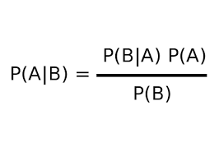

Naïve Bayes
Finds the class with the highest likelihood under Bayes law
i.e. probability of the class times probability of features given the class
Naïvely assumes features are independent
$$p\left(c_{n} | f_{1}…f_{m}\right)=\prod_{i=1}^{m}{p(f_{i}}\left|c_{n}\right)p(c_{n})$$
The proportion of training documents which are class n
The proportion of features (i.e. words) for documents of class n which are feature (word) i

Slide 12
Naïve Bayes
Pros: Fast to “train” and classify; robust, low-variance; good for low data situations; optimal classifier if independence assumption is correct
Cons: Independence assumption rarely holds; low accuracy compared to similar methods in most situations; smoothing required for unseen class/feature combinations

Slide 13
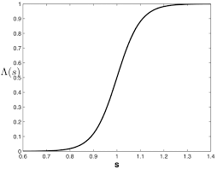
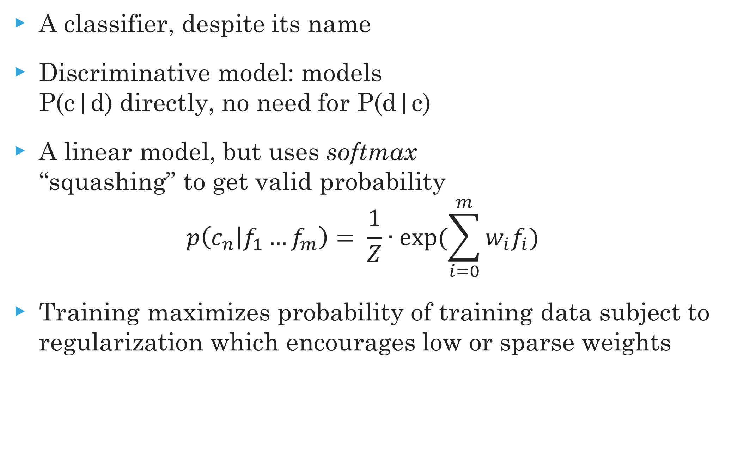
Logistic Regression
A classifier, despite its name
Discriminative model: models P(c|d) directly, no need for P(d|c)
A linear model, but uses softmax “squashing” to get valid probability
$$p\left(c_{n} | f_{1}…f_{m}\right)= \frac{1}{Z}∙exp(\sum_{i=0}^{m}{w_{i}f_{i}})$$
Training maximizes probability of training data subject to regularization which encourages low or sparse weights

Slide 14
Logistic Regression
Pros: A simple yet low-bias classifier; unlike Naïve Bayes not confounded by diverse, correlated features
Cons: Slow to train; some feature scaling issues; often needs a lot of data to work well; choosing regularisation a nuisance but important since overfitting is a big problem

Slide 15
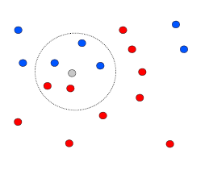
K-Nearest Neighbour
Classify based on majority class of k-nearest training examples in feature space
Definition of nearest can vary
Euclidean distance
Cosine distance
Pros: Simple, effective; no training required; inherently multiclass; optimal with infinite data
Cons: Have to select k; issues with unbalanced classes; often slow (need to find those k-neighbours); features must be selected carefully

Slide 16
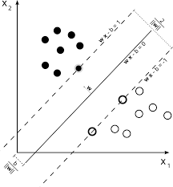
Support vector machines
Finds hyperplane which separates the training data with maximum margin
Allows for some misclassification
Weight vector is a sum of support vectors (examples on the margin)
Pros: fast and accurate linear classifier; can do non-linearity with kernel trick; works well with huge feature sets
Cons: Multiclass classification awkward; feature scaling can be tricky; deals poorly with class imbalances; uninterpretable

Slide 17
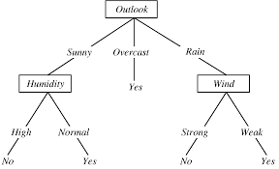
Decision tree
Construct a tree where nodes correspond to tests on individual features
Leaves are final class decisions
Based on greedy maximization of mutual information
Pros: in theory, very interpretable; fast to build and test; feature representation/scaling irrelevant; good for small feature sets, handles non-linearly-separable problems
Cons: In practice, often not that interpretable; highly redundant sub-trees; not competitive for large feature sets

Slide 18
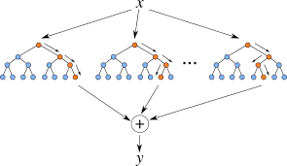
Random forests
An ensemble classifier
Consists of decision trees trained on different subsets of the training and feature space
Final class decision is majority vote of sub-classifiers
Pros: Usually more accurate and more robust than decision trees, a great classifier for small- to moderate-sized feature sets; training easily parallelised
Cons: Same negatives as decision trees: too slow with large feature sets

Slide 19
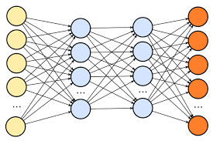
Neural Networks
An interconnected set of nodes typically arranged in layers
Input layer (features), output layer (class probabilities), and one or more hidden layers
Each node performs a linear weighting of its inputs from previous layer, passes result through activation function to nodes in next layer
Pros: Extremely powerful, state-of-the-art accuracy on many tasks in natural language processing and vision
Cons: Not an off-the-shelf classifier, very difficult to choose good parameters; slow to train; prone to overfitting

Slide 20
Text classification tasks
Obviously more than can be enumerated here
But let’s briefly look at some major examples:
Topic classification
Polarity classification
Genre classification
Authorship attribution
Native-language identification
Not necessarily a full-sized “text”
E.g. sentence or tweet-level polarity classification

Slide 21
Topic classification
Motivation: library science, information retrieval
Classes: Topic categories, e.g. “jobs”, “anxiety disorders”
Features
Unigram bag of words (BOW), with stop-words removed
Longer n-grams (bigrams, trigrams) for phrases
Examples of corpora
Reuters news corpus (RCV1, see NLTK sample)
Pubmed abstracts
Tweets with hashtags

Slide 22
Topic classification Example
Is the topic of this text from the Reuters news corpus acquisitions or earnings?
LIEBERT CORP APPROVES MERGER
Liebert Corp said its shareholders approved the merger of a wholly-owned subsidiary of Emerson Electric Co. Under the terms of the merger, each Liebert shareholder will receive .3322 shares of Emerson stock for each Liebert share.
Answer: Acquisitions

Slide 23
Polarity classification
Motivation: Sentiment analysis, opinion mining
Classes: Positive/Negative/(Neutral)
Features
N-grams
Polarity lexicons
Examples of corpora
Polarity movie review dataset (in NLTK)
SEMEVAL Twitter polarity datasets

Slide 24
Polarity classification example
What is the polarity of this tweet from the SEMEVAL dataset?
anyone having problems with Windows 10? may be coincidental but since i downloaded, my WiFi keeps dropping out. Itunes had a malfunction
Answer: negative

Slide 25
Genre classification
Motivation: Information retrieval, study of genre differences
Classes: types of document, e.g. newswire, fiction, e-mails
Features
Word N-grams
Structural features (spacing, punctuation)
Text statistics (word/sentence length, lexical density, frequency of word categories)
Examples of corpora
Brown corpus (see NLTK sample)
British National Corpus (BNC)

Slide 26
Genre classification example
What is the genre of this text from the Brown corpus?
The expense and time involved are astronomical. However, we sent a third vessel out, a much smaller and faster one than the first two. We have learned much about interstellar drives since a hundred years ago; that is all I can tell you about them.
`”But the third ship came back several years ago and reported. That it had found a planet on which human beings could live and which was already inhabited by sentient beings!'' said Hal, forgetting in his enthusiasm that he had not been asked to speak .
Answer: Science Fiction

Slide 27
Authorship attribution
Motivation: forensic linguistics, plagiarism detection
Classes: Authors (e.g. Shakespeare)
Features
Frequency of function words
Character n-grams
Discourse structure
Examples of corpora
Project Gutenberg corpus (see NLTK sample)
Livejournal blog corpus

Slide 28
Author attribution example
Which famous novelist wrote this text from Project Gutenberg?
Mr. Dashwood's disappointment was, at first, severe; but his temper was cheerful and sanguine; and he might reasonably hope to live many years, and by living economically, lay by a considerable sum from the produce of an estate already large, and capable of almost immediate improvement. But the fortune, which had been so tardy in coming, was his only one twelvemonth. He survived his uncle no longer; and ten thousand pounds, including the late legacies, was all that remained for his widow and daughters.
Answer:Jane Austen

Slide 29
Native-Language Identification
Motivation: forensic linguistics, educational applications
Classes: first language of author (e.g. Chinese)
Features
Word N-grams
Syntactic patterns (POS, parse trees)
Phonological features
Examples of corpora
TOEFL/IELTS essay corpora
Lang-8 language learner website

Slide 30
Native-Language Identification
What is the native language of the writer of this text?
Now a festival of my university is being held, and my club is joining it by offering a target practice game using bows and arrows of archery. I'm a manager of the attraction, so I have worked to make it succeed. I found it puzzled to manage a event or a program efficiently without generating a free rider.The event is not free, so we earn a lot of money.
Answer:Japanese

Slide 31
A final word
Lots of algorithms available to try out on your task of interest (see scikit-learn)
But if good results on a new task are your goal, then well-annotated, plentiful datasets and appropriate features often more important than the specific algorithm used

Slide 32
Further reading
J&M3 Ch. 6,7
Optional: For more in-depth discussion of machine-learning algorithms mentioned here (and more), Pattern Recognition and Machine Learning by Bishop is a good general introduction.

