Slide 1
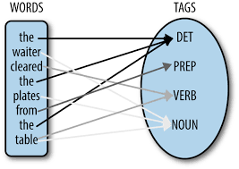
Part of speech tagging
COMP90042 LECTURE 3

Slide 2
Outline
Parts of speech
Tagsets
Automatic tagging

Slide 3
Open classes
Nouns
Proper (Australia) versus common (wombat)
Mass (rice) versus count (bowls)
Verbs
Rich inflection (go/goes/going/gone/went)
Auxiliary verbs (be, have, and do in English)
Transitivity (wait versus hit versus give)

Slide 4
Open classes
Adjectives
Gradable (happy) versus non-gradable (computational)
Adverbs
Manner (slowly)
Locative (here)
Degree (really)
Temporal (yesterday)

Slide 5
Closed classes (for English)
Prepositions (in, on, with, for, of, over,…)
Regular (transitive; e.g. on the table)
Particles (intransitive; e.g. turn it on)
Determiners
Articles (a, an, the)
Demonstratives (this, that, these, those)
Quantifiers (each, every, some, two,…)
Pronouns
Personal (I, me, she,…)
Possessive (my, our,…)
Interrogative or Wh (who, what, …)

Slide 6
Closed classes (for English)
Conjunctions
Coordinating (and, or, but)
Subordinating (if, although, that, …)
Modals
Ability (can, could)
Permission (can, may)
Possibility (may, might, could, will)
Necessity (must)
And some more…

Slide 7
Ambiguity
Many word types belong to multiple classes
Compare:
Time flies like an arrow
Fruit flies like a banana
Time | flies | like | an | arrow
noun | verb | preposition | determiner | noun
Fruit | flies | like | a | banana
noun | noun | verb | determiner | noun

Slide 8
pos ambiguity Headlines
British Left Waffles on Falkland Islands
Juvenile Court to Try Shooting Defendant
Teachers Strike Idle Kids
Ban On Soliciting Dead in Trotwood
Eye Drops Off Shelf

Slide 9
Tagsets
A compact representation of POS information
Usually ≤ 4 capitalized characters
Often includes inflectional distinctions
Major English tagsets
Brown (87 tags)
Penn Treebank (45 tags)
CLAWS/BNC (61 tags)
Universal (12 tags)
At least one tagset for all major languages

Slide 10
Major Penn Treebank tags
NN noun VB verb
JJ adjective RB adverb
DT determiner CD cardinal number
IN preposition PRP personal pronoun
MD modal CC coordinating conjunction
RP particle WH wh-pronoun
TO to

Slide 11
Penn treebank derived tags
NN: NNS (plural, wombats), NNP (proper, Australia), NNPS (proper plural, Australians)
VB: VBP (base, eat), VB (infinitive, eat), VBZ (3rd person singular, eats), VBD (past tense, ate), VBG (gerund, eating), VBN (past participle, eaten)
JJ: JJR (comparative, nicer), JJS (superlative, nicest)
RB: RBR (comparative, faster), RBS (superlative, fastest)
PRP: PRP$ (possessive, my)
WH: WH$ (possessive, whose), WDT(wh-determiner, who), WRB (wh-adverb, where)

Slide 12
Tagged text Example
The/DT limits/NNS to/TO legal/JJ absurdity/NN stretched/VBD another/DT notch/NN this/DT week/NN when/WRB the/DT Supreme/NNP Court/NNP refused/VBD to/TO hear/VB an/DT appeal/VB from/IN a/DT case/NN that/WDT says/VBZ corporate/JJ defendants/NNS must/MD pay/VB damages/NNS even/RB after/IN proving/VBG that/IN they/PRP could/MD not/RB possibly/RB have/VB caused/VBN the/DT harm/NN ./.

Slide 13
Why automatically pos tag?
Important for morphological analysis, e.g. lemmatisation
For some applications, we want to focus on certain POS
E.g. nouns are important for information retrieval, adjectives for sentiment analysis
Very useful features for certain classification tasks
E.g. genre classification
POS tags can offer word sense disambiguation
E.g. cross/NN vs cross/VB vs cross/JJ
Can use them to create larger structures (chunk parsing)

Slide 14
Automatic Taggers
Rule-based taggers
Hand-coded
Transformation-based (Brill)
Statistical taggers
Unigram tagger
N-gram taggers
Hidden Markov Model (HMM) taggers
Classifier-based taggers

Slide 15
Hand-coded rules
Typically starts with a list of possible tags for each word
From a lexical resource, or a corpus
Often includes other lexical information, e.g. verb subcategorisation (its arguments)
Apply rules to narrow down to a single tag
E.g. If DT comes before word, then eliminate VB
Relies on some unambiguous contexts
Large systems have 1000s of constraints

Slide 16
Transformation-based tagging
Requires a tagged training corpus
First, apply unigram tagger to get an initial tagging
Then, sequentially learn rules to correct tags
Possible rules are generated from a small set of templates
Eg. Convert X to Y if previous tag is Z
Test the effect of all possible rules on current tagging
Apply rule that most improves tagging accuracy
E.g. NN VB PREV-TAG TO
Accurate and very fast

Slide 17
Unigram tagger
Assign most common tag to each word type
Requires a corpus of tagged words
“Model” is just a look-up table
But actually quite good, ~90% accuracy
Correctly resolves about 75% of ambiguity
Often considered the baseline for more complex approaches

Slide 18
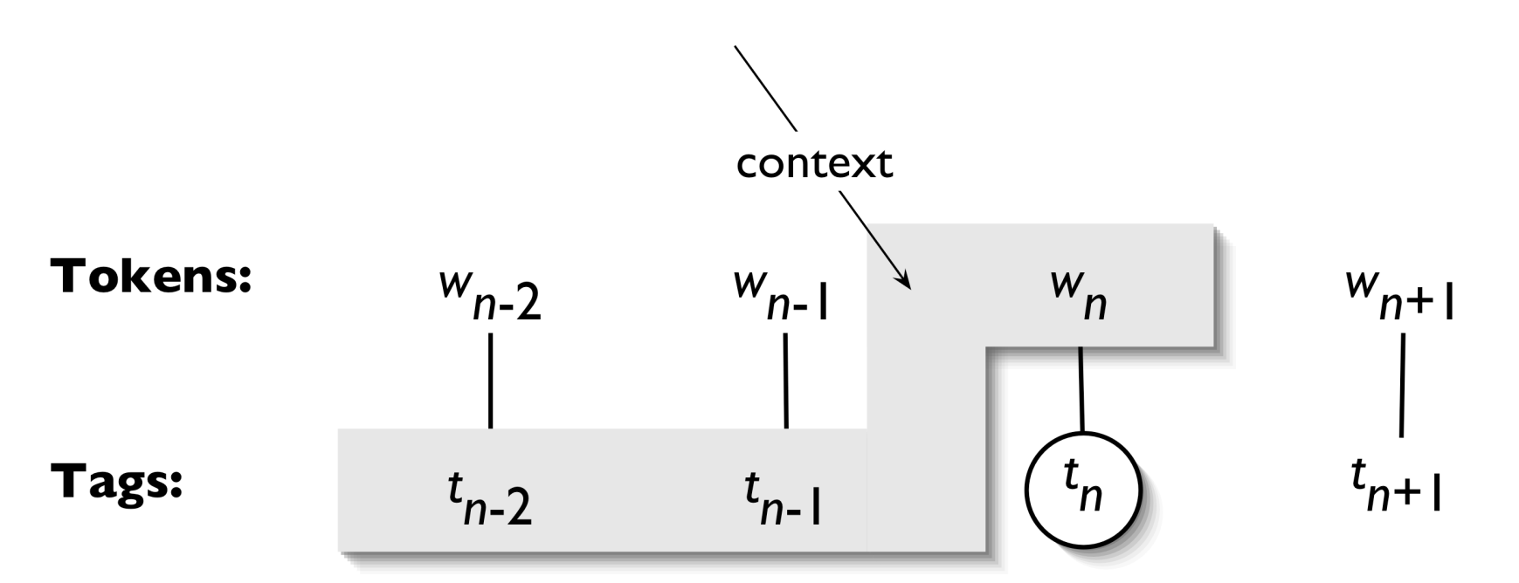
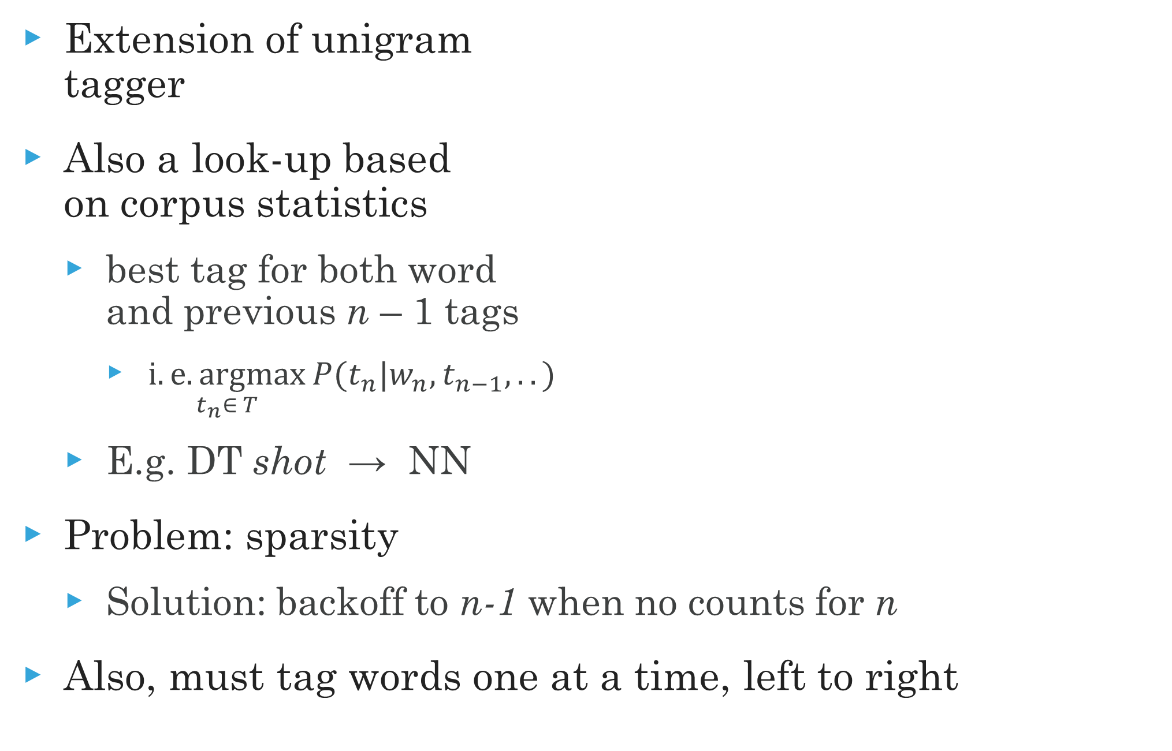
N-Gram tagger
Extension of unigram tagger
Also a look-up based on corpus statistics
best tag for both word and previous n – 1 tags
$\underset{t_{n}∈ T}{i.e. argmax}{P(t_{n}|w_{n},t_{n−1},..)}$
E.g. DT shot → NN
Problem: sparsity
Solution: backoff to n-1 when no counts for n
Also, must tag words one at a time, left to right

Slide 19
Hidden Markov models
A basic sequential (or structured) model
Like n-gram taggers, use both previous tag and lexical evidence
Unlike n-gram taggers, treat previous tag(s) evidence and lexical evidence as independent from each other
Less sparsity
Fast algorithms for sequential prediction, i.e. finding the best tagging of entire word sequence
More on this in the next lecture…

Slide 20
Classifier-Based tagging
Use a standard discriminative classifier (e.g. logistic regression)
Classify tag of target word based on
Target word
Lexical context around the word
Already classified tags in sentence
Almost as good as best sequential models
And generally much faster
MEMMs and CRFs combine sequential and classifier-based tagging

Slide 21
Unknown words
Huge problem in morphologically rich languages (e.g. Turkish)
Can use hapax legomena (things we’ve seen only once) to best guess for things we’ve never seen before
Can use morphology (look for common affixes)

Slide 22
A final word
Part of speech is a fundamental intersection between linguistics and automatic text analysis
It’s worth learning the basics
POS tagging is fundamental task in NLP, provides useful information for many other applications
Methods applied to it are very typical of language tasks in general, e.g. probabilistic, sequential machine learning

Slide 23
Additional Reading
J&M2 Ch. 5.1-5.4, 5.6-5.8

