Slide 1
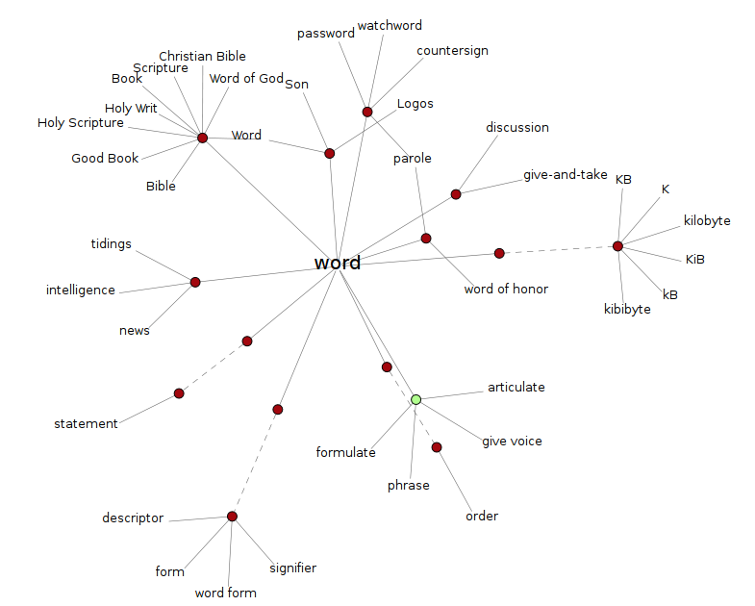
Lexical Semantics
COMP90042 LECTURE 4

Slide 2
What do words mean?
Referents in the physical or social world
But not usually useful in text analysis
Their dictionary definition
But dictionary definitions are necessarily circular
Only useful if meaning is already understood
Their relationships with other words
Also circular, but more practical

Slide 3
Three Kinds of semantics
Lexical semantics
How the meanings of words relate to one another
Distributional semantics
How the position of words in texts reflect their meaning
Logical semantics
How facts about the world are represented

Slide 4
Words and senses
Orthographic word type is wrong unit for semantic analysis
Bank (noun):
1. A financial institution; a building where a financial institution offers services; a repository; a container for holding money 2. Land sloping down to a body of water
Bank has many senses (more than just these)
1 and 2 are homonyms
Considered different lexical items by lexicographers
1 shows polysemy
Related senses of the same lexical item

Slide 5
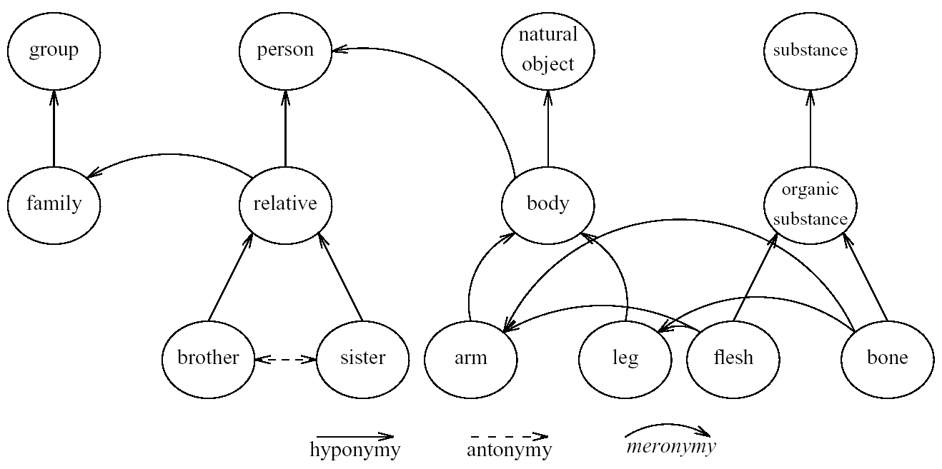
Basic Lexical Relations
Synonyms (same) and antonyms (opposite/complementary)
Hypernyms (generic), hyponyms/troponyms (specific/manner)
Meronyms (part) and holoynms (whole); entailment

Slide 6
WordNet
A database of lexical relations
English WordNet includes ~120,000 nouns, ~12,000 verbs, ~12,000 adverbs, ~4,000 adverbs
WordNets available in most major languages (www.globalwordnet.org)
English version freely available (accessible via NLTK)

Slide 7
Synsets
The nodes of WordNet are not words, but meanings
There are represented by sets of synonyms, or synsets
>>> nltk.corpus.wordnet.synsets(‘bank’)
[Synset('bank.n.01'), Synset('depository_financial_institution.n.01'), Synset('bank.n.03'), Synset('bank.n.04'), Synset('bank.n.05'), Synset('bank.n.06'), Synset('bank.n.07'), Synset('savings_bank.n.02'), Synset('bank.n.09'), Synset('bank.n.10'), Synset('bank.v.01'), Synset('bank.v.02'), Synset('bank.v.03'), Synset('bank.v.04'), Synset('bank.v.05'), Synset('deposit.v.02'), Synset('bank.v.07'), Synset('trust.v.01')]
>>> nltk.corpus.wordnet.synsets(‘bank’)[0].definition()
u'sloping land (especially the slope beside a body of water)‘
>>> nltk.corpus.wordnet.synsets(‘bank’)[1].lemma_names()
[u'depository_financial_institution', u'bank', u'banking_concern', u'banking_company']

Slide 8
Lexical Relations in wordnet
Connections between nodes are lexical relations
Including all the major ones mentioned earlier
>>> nltk.corpus.wordnet.synsets('relative')[0].hypernyms()
[Synset('person.n.01')]
>>> nltk.corpus.wordnet.synsets(‘body')[0].part_meronyms()
[Synset('arm.n.01'), Synset('articulatory_system.n.01'), Synset('body_substance.n.01'), Synset('cavity.n.04'), Synset('circulatory_system.n.01'), Synset('crotch.n.02'), Synset('digestive_system.n.01'), Synset('endocrine_system.n.01'), Synset('head.n.01'), Synset('leg.n.01'), Synset('lymphatic_system.n.01'), Synset('musculoskeletal_system.n.01'), Synset('neck.n.01'), Synset('nervous_system.n.01'), Synset('pressure_point.n.01'), Synset('respiratory_system.n.01'), Synset('sensory_system.n.02'), Synset('torso.n.01'), Synset('vascular_system.n.01')]
>>> print nltk.corpus.wordnet.lemmas(‘sister')[0].antonyms()
[Lemma('brother.n.01.brother')]

Slide 9
Word similarity with paths
Want to go beyond specific lexical relations
E.g. money and nickel are related, despite no direct lexical relationship
Given WordNet, find similarity based on path length in hypernym/hyponym tree
simpath(c₁,c₂) = 1/pathlen(c₁,c₂)
simpath(nickel,coin) = 1/2 = .5
simpath(nickel,currency) = 1/4 = .25
simpath(nickel,money) = 1/6 = .17
simpath(nickel,Richter scale) = 1/8 = .13

Slide 10
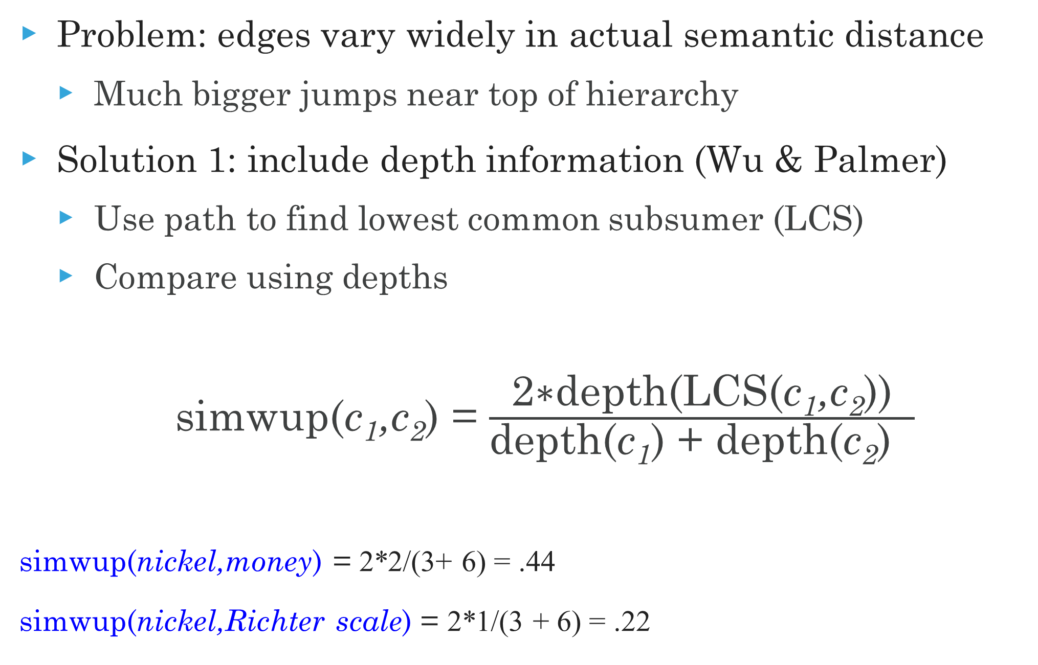
Beyond path length
Problem: edges vary widely in actual semantic distance
Much bigger jumps near top of hierarchy
Solution 1: include depth information (Wu & Palmer)
Use path to find lowest common subsumer (LCS)
Compare using depths
simwup(c₁,c₂) = $\frac{\text{2∗}\text{depth}\text{(}\text{LCS}\text{(}\text{c}\text{1}\text{,}\text{c}\text{2}\text{))}}{\text{depth}\text{(}\text{c}\text{1}\text{) + }\text{depth}\text{(}\text{c}\text{2}\text{) }}$
simwup(nickel,money) = 2*2/(3+ 6) = .44
simwup(nickel,Richter scale) = 2*1/(3 + 6) = .22

Slide 11
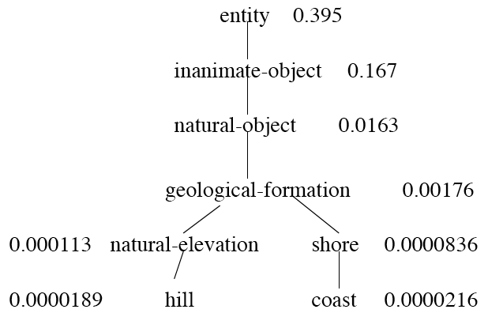
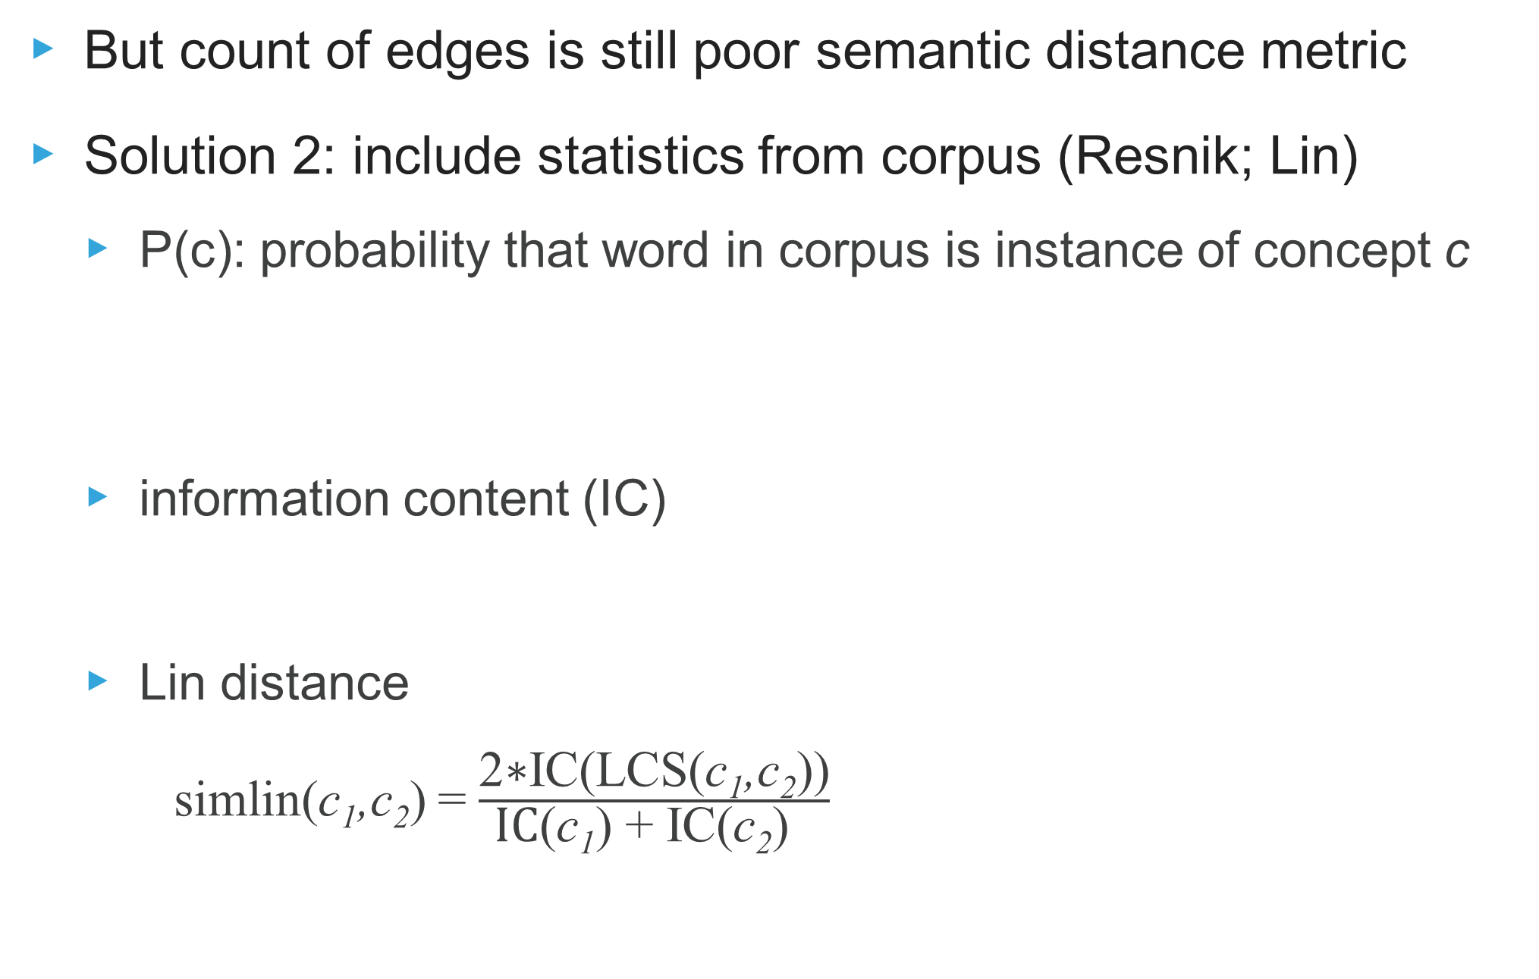
Information content
But count of edges is still poor semantic distance metric
Solution 2: include statistics from corpus (Resnik; Lin)
P(c): probability that word in corpus is instance of concept c
information content (IC)
Lin distance
simlin(c₁,c₂) = $\frac{\text{2∗}\text{IC}\text{(}\text{LCS}\text{(}\text{c}\text{1}\text{,}\text{c}\text{2}\text{))}}{\text{IC}\text{(}\text{c}\text{1}\text{) + }\text{IC}\text{(}\text{c}\text{2}\text{) }}$

Slide 12
Word sense disambiguation
But how to go from words in text to senses in WordNet?
Hacky (but popular) “solutions”:
Assume the most popular sense
For word similarity, take minimum across senses
The proper (but difficult) solution: Word Sense Disambiguation
WordNet as sense inventory a great resource for WSD
Also problematic, because too comprehensive
Beyond WordNet, good WSD useful for many tasks in NLP
In practice, often ignored because good WSD too hard

Slide 13
Supervised WSD
Apply standard machine classifiers such as SVMs
Requires sense tagged corpora
E.g. SENSEVEL, SEMCOR (available in NLTK)
Very time consuming to create!
Feature vectors typically words and syntax around target
But context is ambiguous too!
How big should context window be? (typically very small)

Slide 14
Less supervised approaches
Lesk: Use overlap of context with dictionary gloss from WN
Yarowsky: Bootstrap method
Create a small seed training set
E.g for plant (factory vs. vegetation): manufacturing plant, plant life
Iteratively expand training set with untagged examples by
Assuming one sense per collocation, one sense per document
Training a statistical classifier on current training set, add confidently predicted examples to training set
Graph methods in WordNet
Clustering for Word Sense Induction

Slide 15
Framenet
A lexical data base of frames, typically prototypical situations
E.g. “apply_heat” frame
Includes lists of lexical units that evoke the frame
E.g. cook, fry, bake, boil, etc.
Lists of semantic roles or frame elements
E.g. “the cook”, “the food”, “the container”, “the instrument”
Distinguish between core and non-core roles
Semantic relationships among frames
“apply_heat” is Causitive of “absorb_heat”, is Used by “cooking_creation”

Slide 16
Other useful lexicons In NLTK
Names: List of male and female names
Gazetteer List: lists of cities and countries
Comprehensive lists of locations at www.geonames.org
WordList: lists of words for various languages
Stopwords: list of stopwords for various languages
Cmudict: a pronounciation dictionary

Slide 17
Lexicons for Text analysis
General Inquirer lexicon
Large words tagged for 150+ categories
Tags for psychological, social, and topic distinctions
Best known in NLP for positive/negative tags
Linguistic Inquiry and Word Count (LIWC) lexicons
Largest and most well known text analysis tool
Major lexical categories: affect; social; cognitive processes; perpetual processes; biological processes; core drives and needs; time orientation; relativity; personal concerns; informal speech

Slide 18
Text Analysis Lexicons
MRC Psycholinguistic database
Numerical scores on major psychological dimensions
Including familiarity, concreteness, imaginability, meaningfulness
Used in Cohmetrix text analysis tool
Sentiment/emotion lexicons
Many other sentiment-specific lexical resources out there
More later in the course…

Slide 19
Multiword Lexicons
Many lexical items involve multiple words
Semantically non-compositional (United States ≠ United + States)
Sometimes non-contiguous (take him/her/them for a ride)
Both WordNet and FrameNet contain multiword expressions (MWEs)
But far from comprehensive
In fact, no comprehensive collection of MWEs exists
MWE/collocation identification is a classic NLP task
See http://www.cs.cmu.edu/~ark/LexSem/ for a good collection taken from various sources

Slide 20
Moving on to the corpus
Manually-tagged lexical resources an important starting point for text analysis
But much modern work attempts to derive semantic information directly from corpora, without human intervention
Let’s add some distributional information

Slide 21
Further reading
JM2 19.1-19.4 (lexical semantics and Word/FrameNet)
JM2 20.1-20.6 (WSD and word similarity)

