Slide 1

N-gram language models
COMP90042 LECTURE 13

Slide 2
Language models
Assign a probability to a sequence of words
Useful for
Speech recognition
Spelling correction
Machine translation
…
But it must be recognized that the notion of "probability of a sentence" is an entirely useless one, under any known interpretation of this term. -Noam Chomsky

Slide 3
Outline
Deriving n-gram language models
Smoothing to deal with sparsity
Evaluating language models

Slide 4
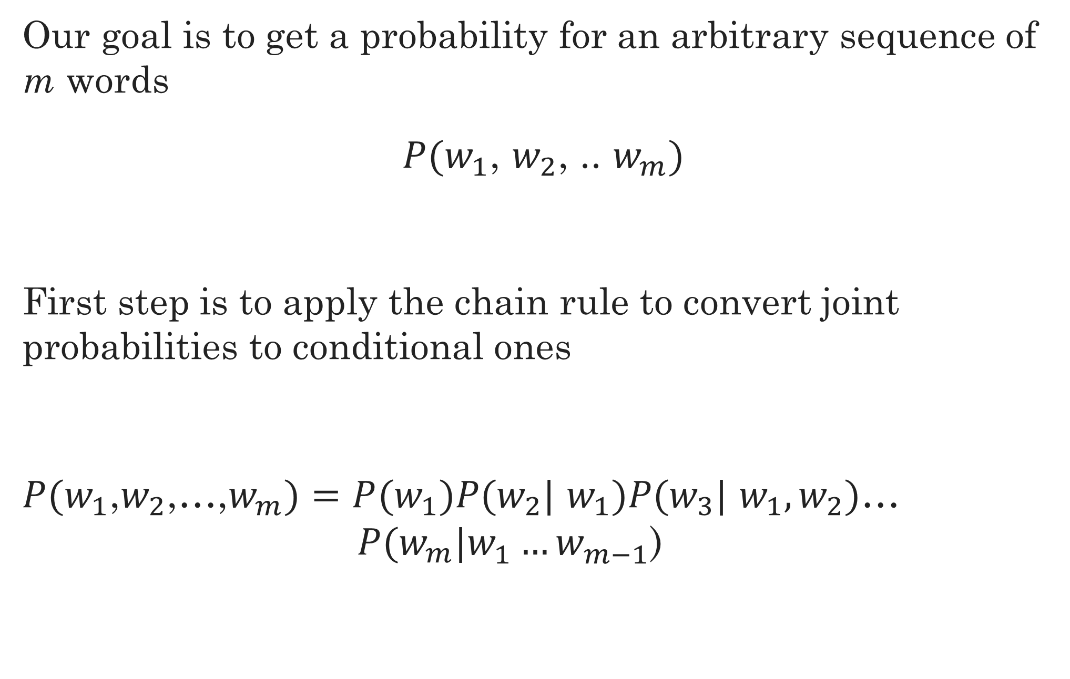
Probabilities: Joint to conditional
Our goal is to get a probability for an arbitrary sequence of m words
$P(w_{1}$, $w_{2}$, .. $w_{m})$
First step is to apply the chain rule to convert joint probabilities to conditional ones
$P(w_{1}$,$w_{2}$,…,$w_{m})=P(w_{1}\text{)}P\text{(}w_{2}\text{|} w_{1})P\text{(}w_{3}\text{|} w_{1},w_{2})$… $P(w_{m}|w_{1}^{}…w_{m−1}^{}$)

Slide 5
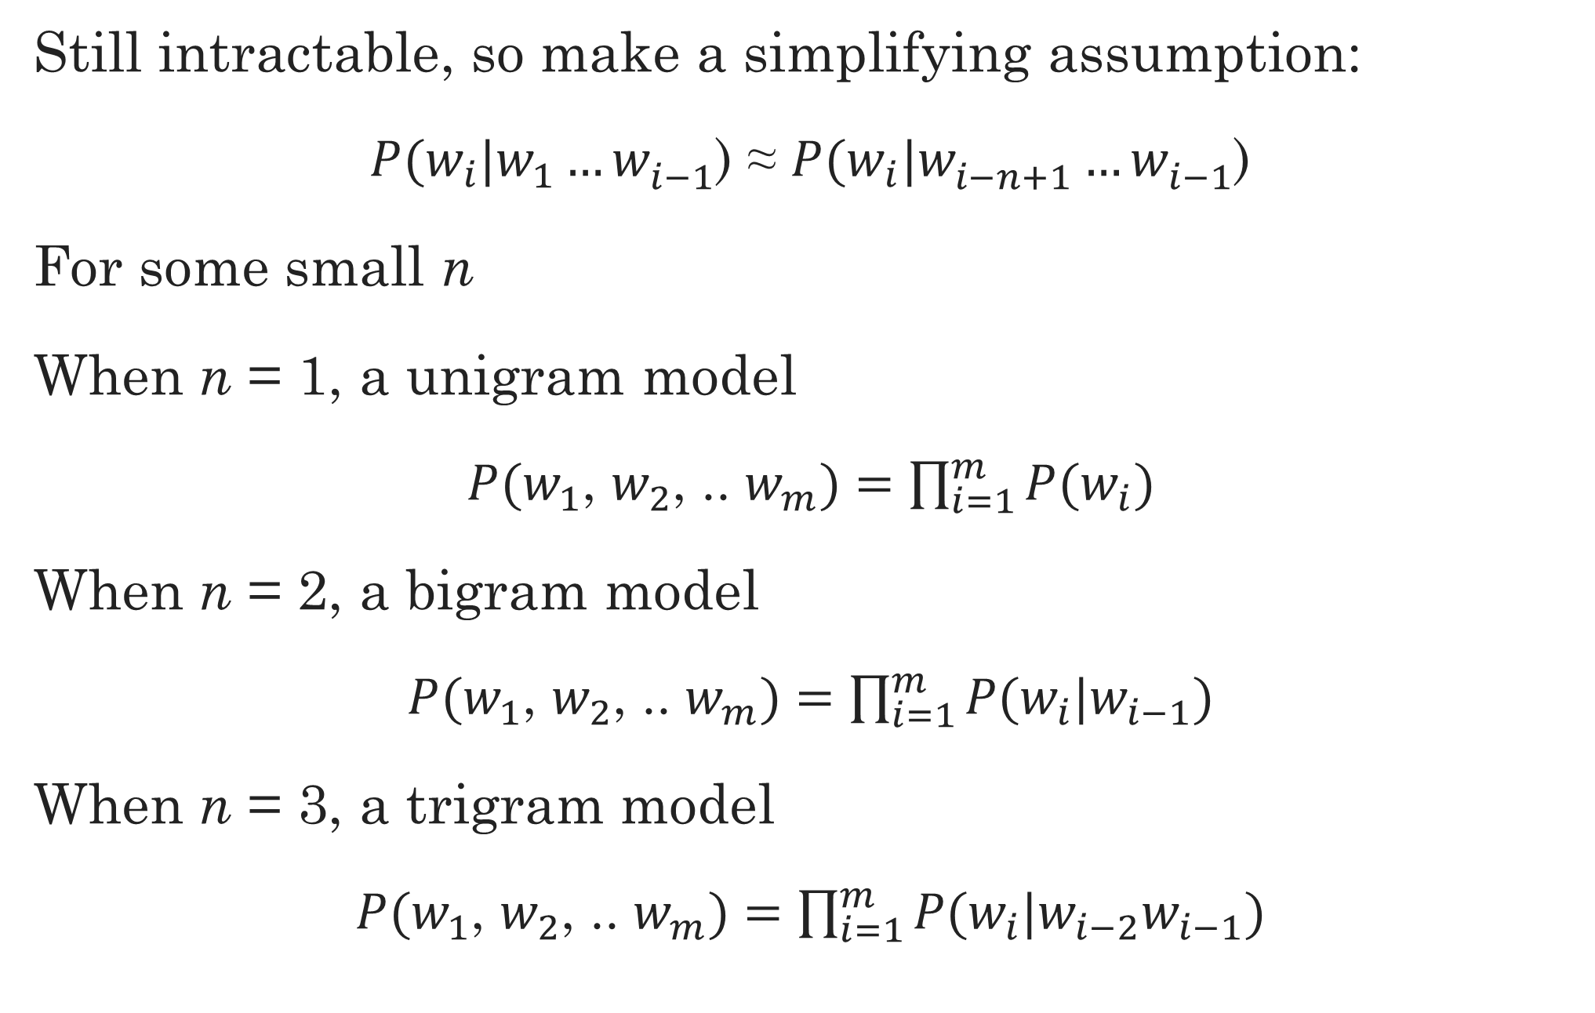
The Markov Assumption
Still intractable, so make a simplifying assumption:
$P(w_{i}|w_{1}^{}…w_{i−1}^{}$) ≈ $P(w_{i}|w_{i−n+1}^{}…w_{i−1}^{}$)
For some small n
When n = 1, a unigram model
$P(w_{1}$, $w_{2}$, .. $w_{m})=\prod_{i=1}^{m}{P(w_{i})}$
When n = 2, a bigram model
$P(w_{1}$, $w_{2}$, .. $w_{m})=\prod_{i=1}^{m}{P\text{(}w_{i}|w_{i−1}})$
When n = 3, a trigram model
$P(w_{1}$, $w_{2}$, .. $w_{m})=\prod_{i=1}^{m}{P\text{(}w_{i}|{w_{i−2}w}_{i−1}})$

Slide 6
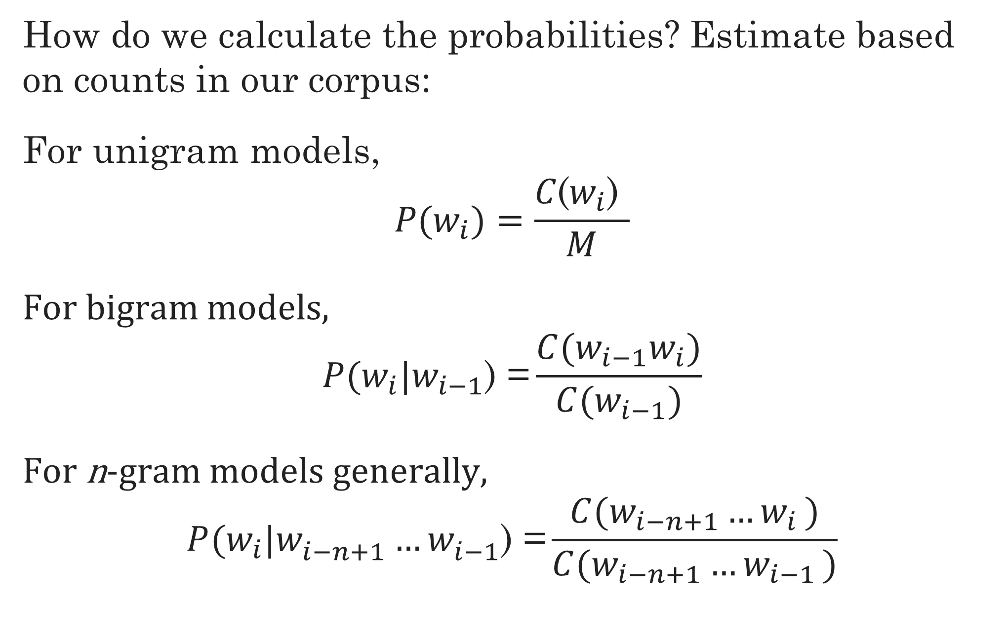
Maximum Likelihood estimation
How do we calculate the probabilities? Estimate based on counts in our corpus:
For unigram models,
$$P\text{(}w_{i})=\frac{C\text{(}w_{i}\text{) }}{M}$$
For bigram models,
$$P(w_{i}|w_{i−1}\text{) =}\frac{C(w_{i−1}w_{i})}{C(w_{i−1})}$$
For n-gram models generally,
$$P(w_{i}|w_{i−n+1}^{}…w_{i−1}^{}\text{)}\text{ =}\frac{C(w_{i−n+1}{…w}_{i})}{C(w_{i−n+1}{…w}_{i−1})}$$

Slide 7
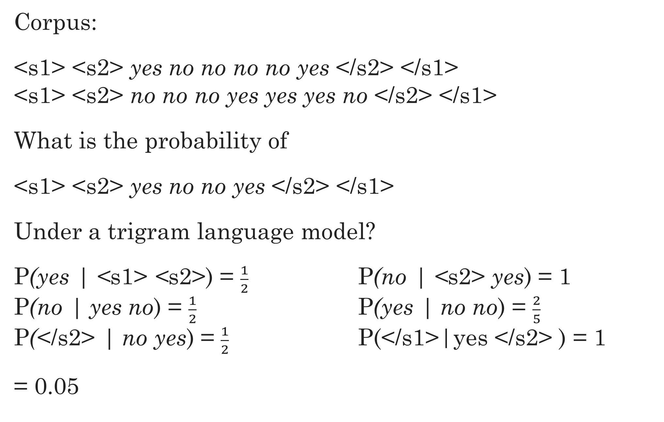
Trigram example
Corpus:
<s1> <s2> yes no no no no yes </s2> </s1> <s1> <s2> no no no yes yes yes no </s2> </s1>
What is the probability of
<s1> <s2> yes no no yes </s2> </s1>
Under a trigram language model?
P(yes | <s1> <s2>) = $\frac{1}{2}$ P(no | <s2> yes) = 1 P(no | yes no) = $\frac{1}{2}$ P(yes | no no) = $\frac{2}{5}$ P(</s2> | no yes) = $\frac{1}{2}$ P(</s1>|yes </s2> ) = 1
= 0.05

Slide 8
Several problems
Resulting probabilities are often very small
Use log probability to avoid numerical underflow
No probabilities for unknown words
Convert infrequent words into <UNK> token
Or skip unknown words entirely
Words in new contexts
By default, zero count for any n-gram we’ve never seen before, zero probability for the sentence
Need to smooth the LM

Slide 9
Smoothing (or discounting)
Basic idea: give events you’ve never seen before some probability
Have to take away probability from events you have seen
Must be the case that P(everything) = 1
Many different kinds of smoothing
Laplacian (add-one) smoothing
Add-k smoothing
Jelinek-Mercer interpolation
Katz backoff
Absolute discounting
Kneser-Ney
And others…

Slide 10
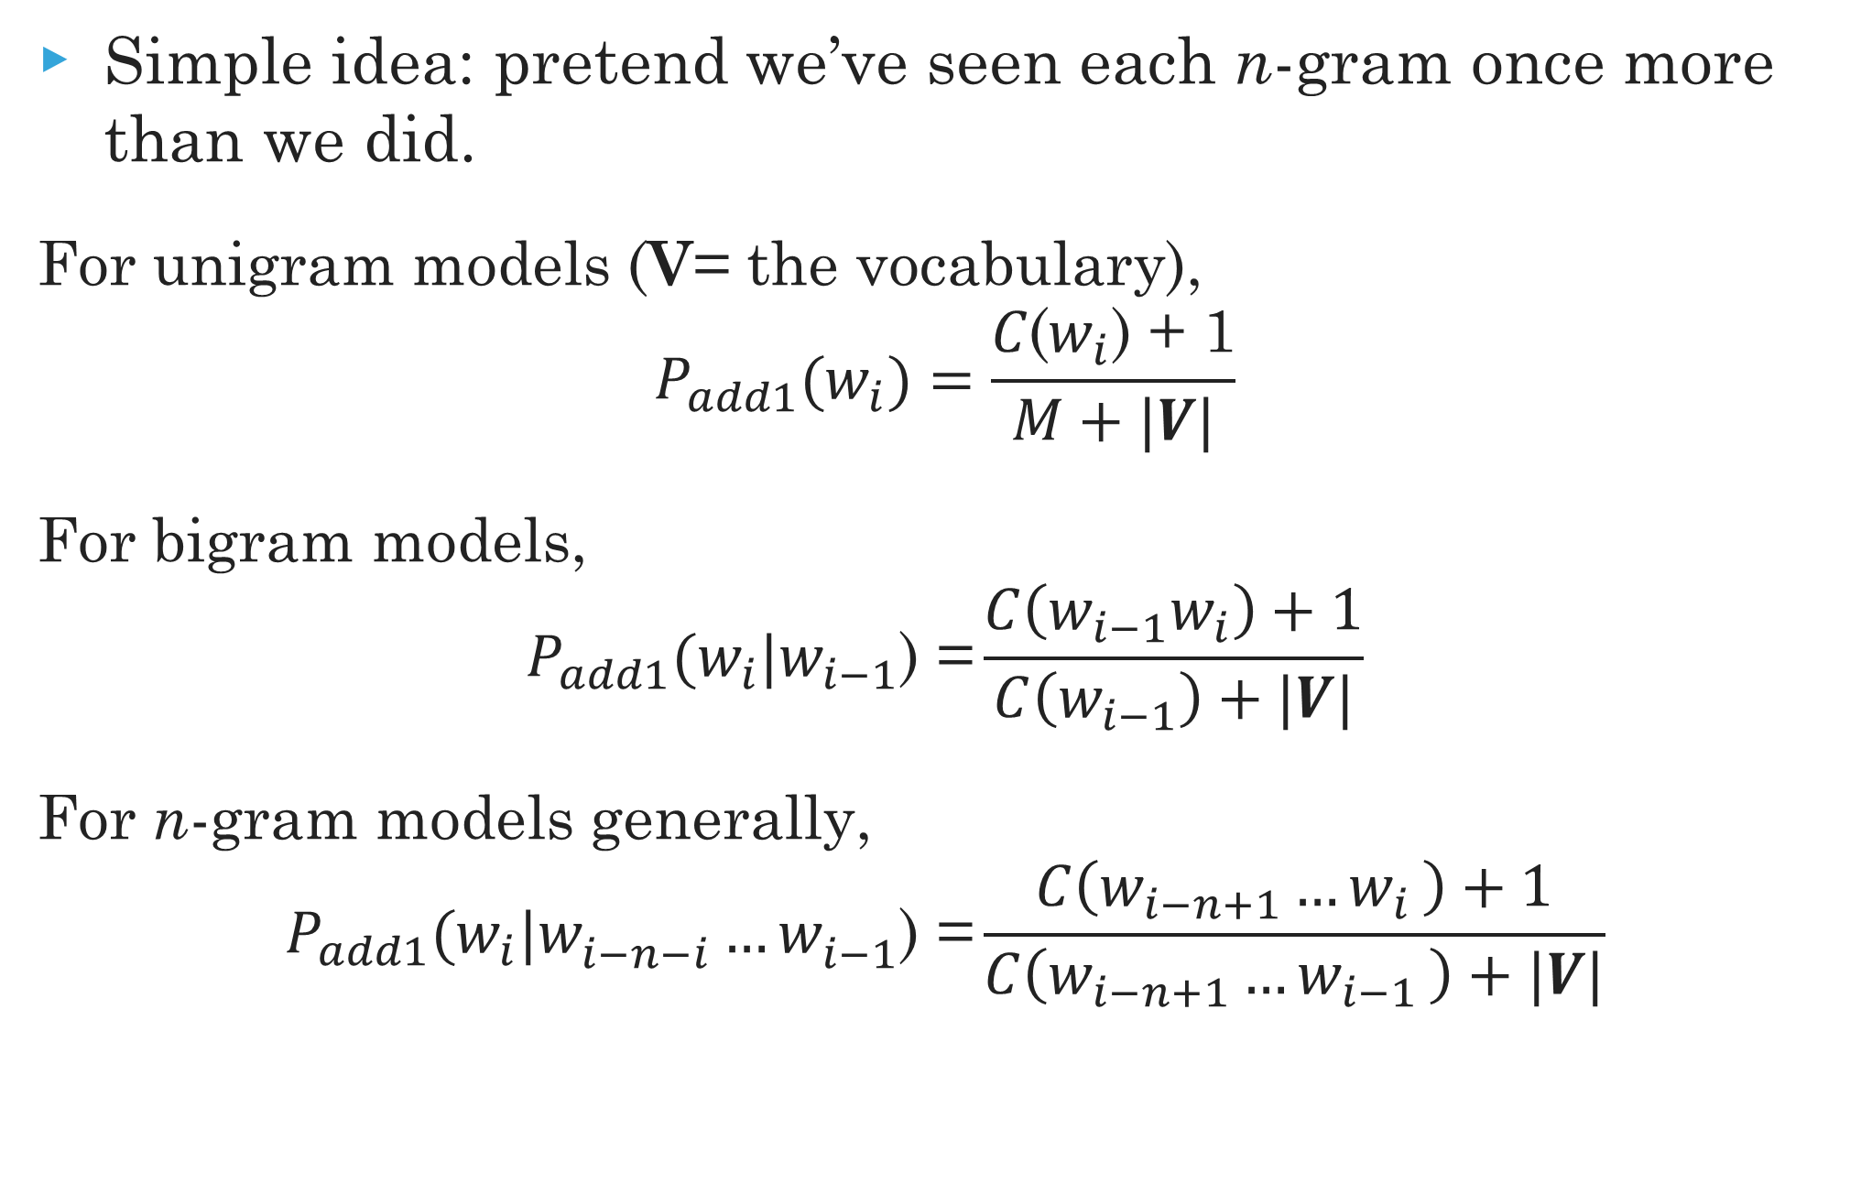
Laplacian (Add-one) smoothing
Simple idea: pretend we’ve seen each n-gram once more than we did.
For unigram models (V= the vocabulary),
$$P_{add1}\text{(}w_{i})=\frac{C\text{(}w_{i}\text{) }\text{+ 1}}{M+|V|}$$
For bigram models,
$$P_{add1}(w_{i}|w_{i−1}\text{) =}\frac{C\left(w_{i−1}w_{i}\right)+1}{C\left(w_{i−1}\right)+|V|}$$
For n-gram models generally,
$$P_{add1}(w_{i}|w_{i−n−i}^{}…w_{i−1}^{}\text{) =}\frac{C\left(w_{i−n+1}{…w}_{i}\right)+1}{C\left(w_{i−n+1}{…w}_{i−1}\right)+|V|}$$

Slide 11
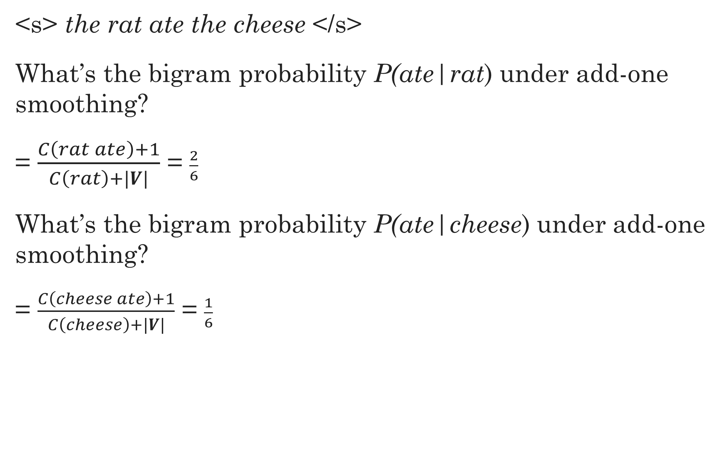
Add-one Example
<s> the rat ate the cheese </s>
What’s the bigram probability P(ate|rat) under add-one smoothing?
= $\frac{C\left(rat ate\right)+1}{C\left(rat\right)+|V|}$ = $\frac{2}{6}$
What’s the bigram probability P(ate|cheese) under add-one smoothing?
= $\frac{C\left(cheese ate\right)+1}{C\left(cheese\right)+|V|}$ = $\frac{1}{6}$

Slide 12
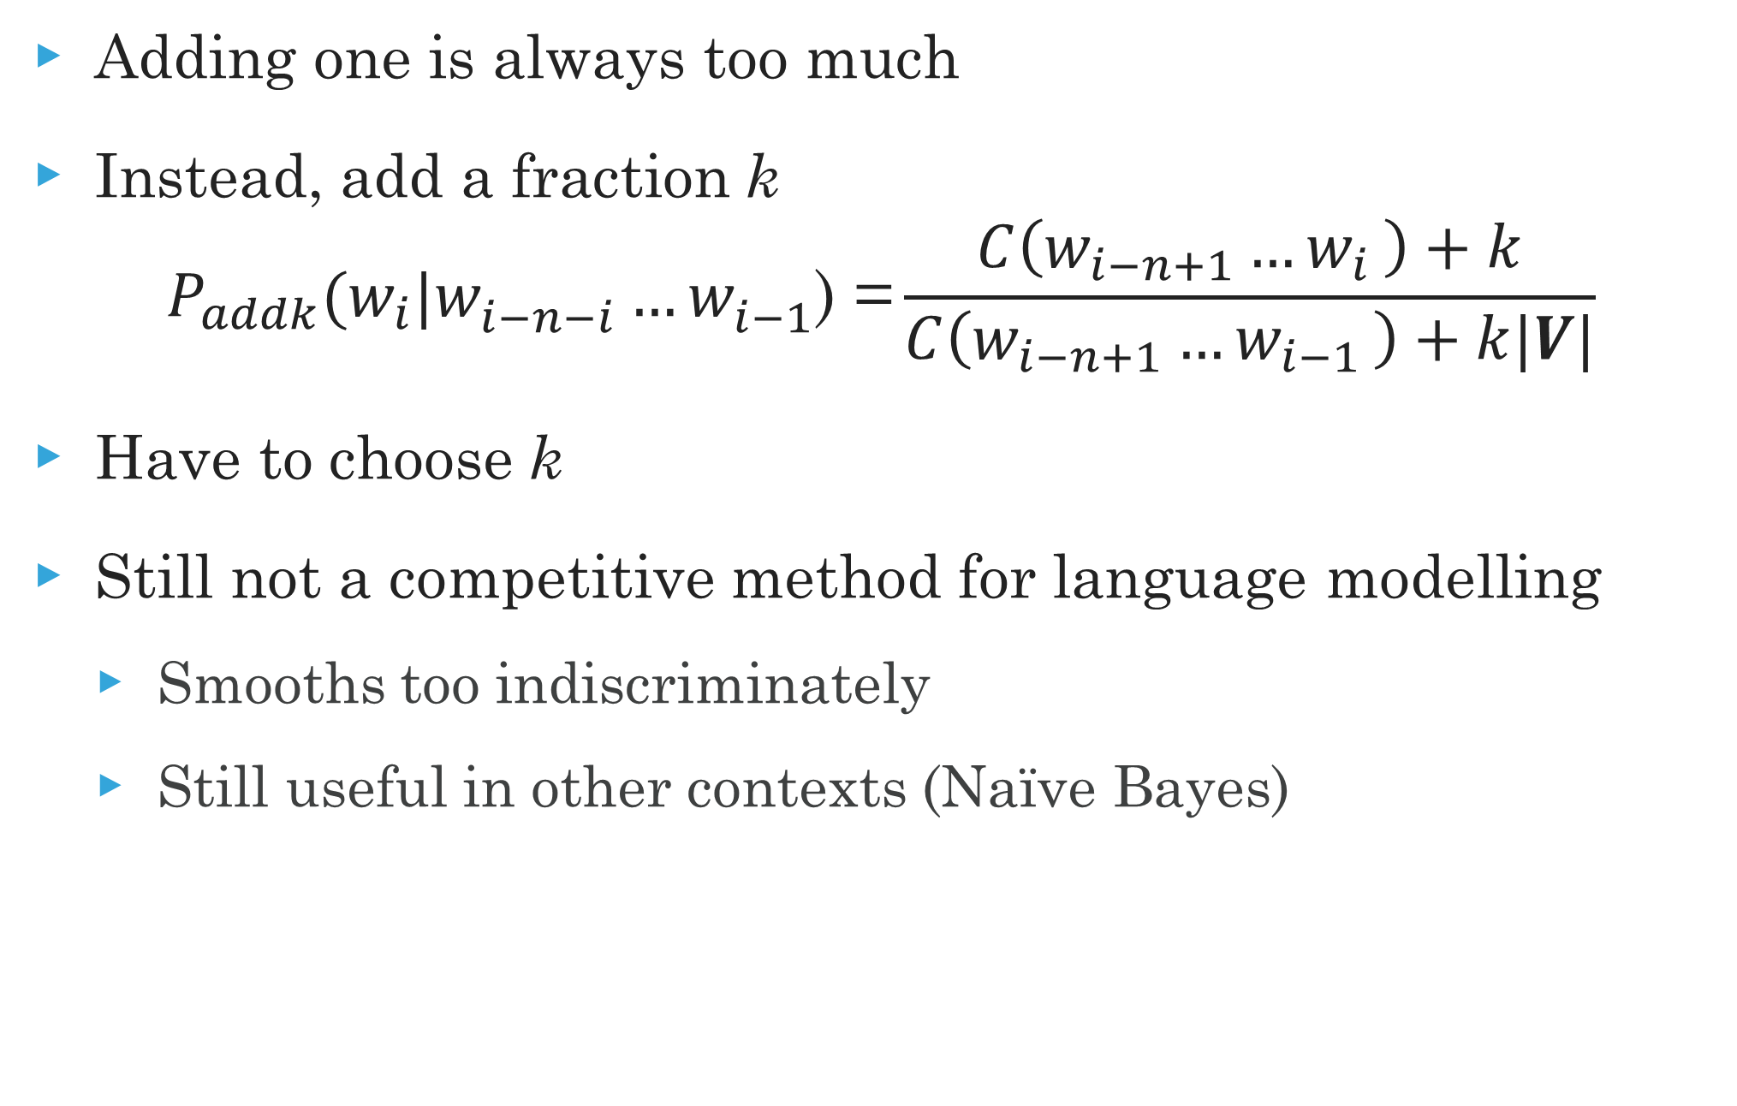
Add-k smoothing
Adding one is always too much
Instead, add a fraction k
$$P_{addk}(w_{i}|w_{i−n−i}^{}…w_{i−1}^{}\text{) =}\frac{C\left(w_{i−n+1}{…w}_{i}\right)+k}{C\left(w_{i−n+1}{…w}_{i−1}\right)+k|V|}$$
Have to choose k
Still not a competitive method for language modelling
Smooths too indiscriminately
Still useful in other contexts (Naïve Bayes)

Slide 13
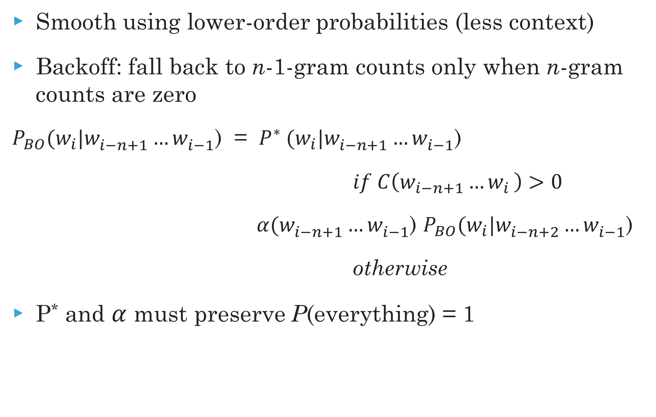
Backoff and Interpolation
Smooth using lower-order probabilities (less context)
Backoff: fall back to n-1-gram counts only when n-gram counts are zero
$P_{BO}(w_{i}|w_{i−n+1}^{}…w_{i−1}^{}\text{)} \text{=}$ $P^{∗} (w_{i}|w_{i−n+1}^{}…w_{i−1}^{}\text{) }$
$if C\left(w_{i−n+1}{…w}_{i}\right)>0$
$α(w_{i−n+1}^{}…w_{i−1}^{}$) $P_{BO}(w_{i}|w_{i−n+2}^{}…w_{i−1}^{}\text{) }$
otherwise
P* and $α$ must preserve P(everything) = 1

Slide 14
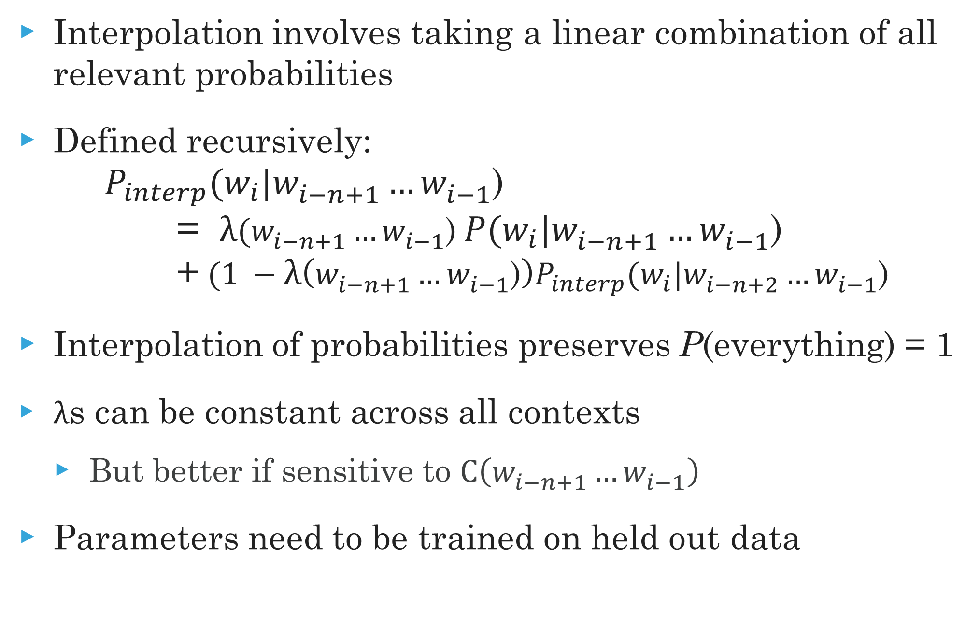
Backoff and Interpolation
Interpolation involves taking a linear combination of all relevant probabilities
Defined recursively:
$$P_{interp}(w_{i}|w_{i−n+1}^{}…w_{i−1}^{}\text{)} \text{=} λ(w_{i−n+1}^{}…w_{i−1}^{}\text{)} P(w_{i}|w_{i−n+1}^{}…w_{i−1}^{}\text{) }\text{+} {(1 −λ\left(w_{i−n+1}^{}…w_{i−1}^{}\text{)}\right)P}_{interp}(w_{i}|w_{i−n+2}^{}…w_{i−1}^{}\text{)}$$
Interpolation of probabilities preserves P(everything) = 1
$λ$s can be constant across all contexts
But better if sensitive to $C\left(w_{i−n+1}^{}…w_{i−1}^{}\right)$
Parameters need to be trained on held out data

Slide 15
Absolute discounting
How many counts to take away from seen n-grams?
Can get good estimate from corpora
Compare counts in two equally sized sets
Turns out a single absolute discounting works for almost all n-grams
Most mass taken from low counts
Doesn’t effect high counts much

Slide 16
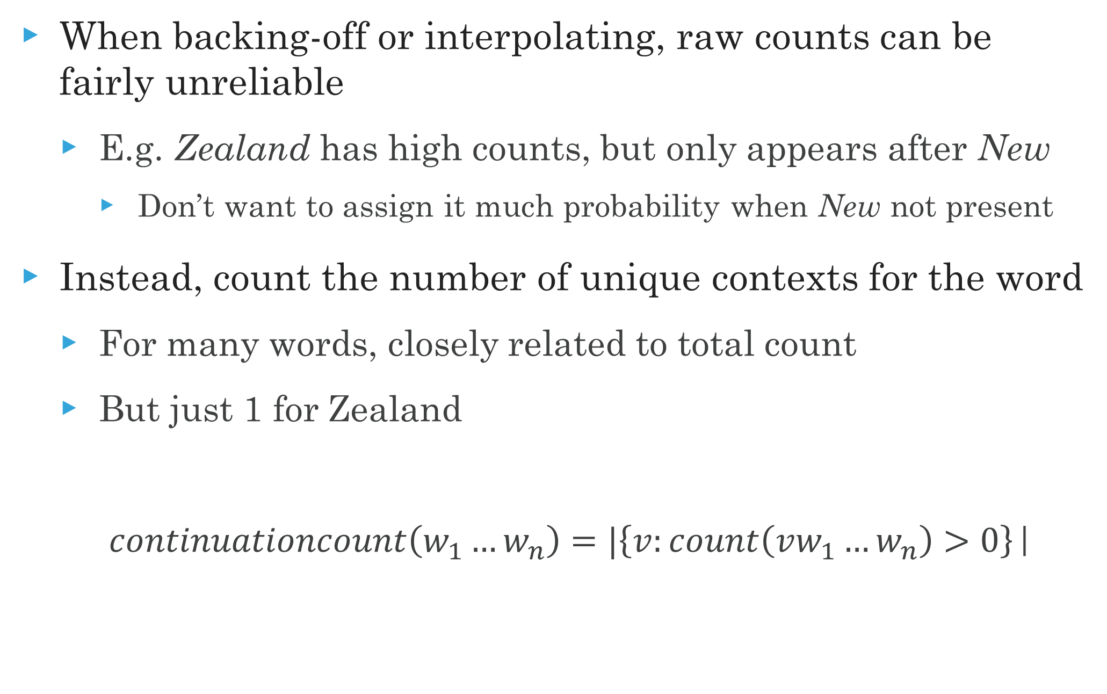
Continuation counts
When backing-off or interpolating, raw counts can be fairly unreliable
E.g. Zealand has high counts, but only appears after New
Don’t want to assign it much probability when New not present
Instead, count the number of unique contexts for the word
For many words, closely related to total count
But just 1 for Zealand
$continuationcount\left(w_{1}…w_{n}\right)=|\left\{v:count\left(vw_{1}…w_{n}\right)>0\right\}$|

Slide 17
Kneser-Ney smoothing
Standard, state-of-the-art smoothing method
Combines
Interpolation (or, alternatively, backoff)
Absolute discounting
Continuation counts for all i-grams (i < n)

Slide 18
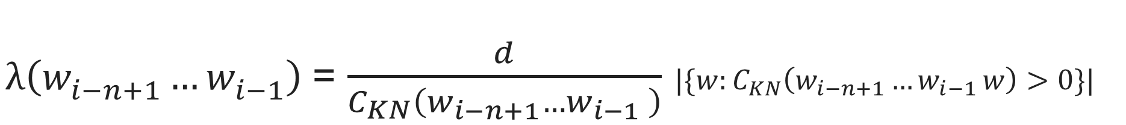
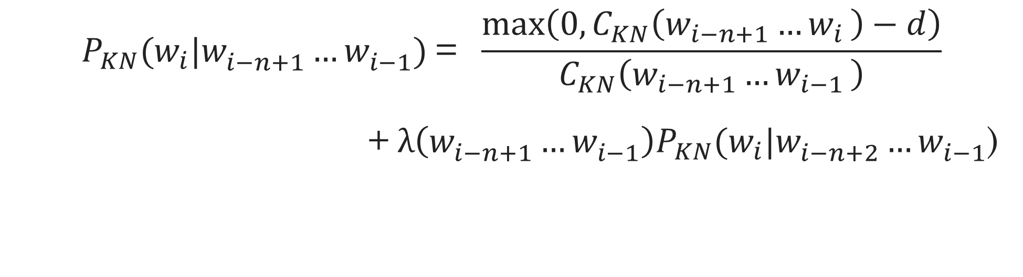
Kneser-Ney smoothing
$$P_{KN}(w_{i}|w_{i−n+1}^{}…w_{i−1}^{}\text{) }\text{= } \frac{\max\left(0,C_{KN}\left(w_{i−n+1}{…w}_{i}\right)−d\right)}{C_{KN}\left(w_{i−n+1}{…w}_{i−1}\right)}$$
$\text{+}{ λ\left(w_{i−n+1}^{}…w_{i−1}^{}\right)P}_{KN}(w_{i}|w_{i−n+2}^{}…w_{i−1}^{}\text{)}$
C_{KN}(◦) is regular counts for highest order n-gram, but continuation counts for all others
$λ\left(w_{i−n+1}^{}…w_{i−1}^{}\right)$ = $\frac{d}{C_{KN}\left(w_{i−n+1}{…w}_{i−1}\right)}$ ${|\{w:C}_{KN}\left(w_{i−n+1}{…w}_{i−1}w\right)>0\}|$

Slide 19
Evaluation
Extrinsic
E.g. spelling correction, machine translation
Intrinsic
Perplexity on held-out test set

Slide 20

Perplexity
Inverse probability of entire test set
Normalized by number of words
The lower the better
$$PP\left(w_{1}\text{, }w_{2}\text{, .. }w_{m}\right)= \sqrt[m]{\frac{1}{P(w_{1}\text{, }w_{2}\text{, .. }w_{m}) }}$$

Slide 21
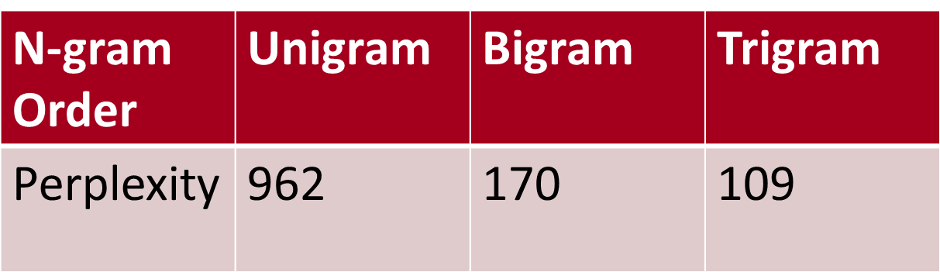
Example perplexity scores
Wall Street Journal corpus
Trained with 38 million words
Tested on 1.5 million words

Slide 22
Generated texts
Language models can also be used to generate texts
Can you guess the corpus used to create the sentences below?
What do you think the n is for the n-gram language model?
This shall forbid it should be branded, if renown made it empty
They also point to ninety nine point six billion dollars from two hundred four oh three percent of the rates of interest stores as Mexico and Brazil on market conditions

Slide 23
A final word
N-gram language models are a structure-neutral way to capture the predictabilty of language
Information can be derived in an unsupervised fashion, scalable to large corpora
Require smoothing to be effective, due to sparsity
Latest work in language models involve using recurrent neural networks
But in many circumstances not practical

Slide 24
Required Reading
J&M3 Ch. 4

