Slide 1

Mall Customer Segmentation
San Jose State University
Erik Rodriguez
08/03/2025
Analysis of Mall Customers and which groups to target for Campaigns using Machine Learning K Means Algorithm

Slide 2
Problem Statement
Understanding the best Target Customer groups to run Campaigns for the marketing department
Identifying the most important groups based on Income, Age, and Spending Score

Slide 3
Dataset Summary
The average income of a mall goer is 60,560
Median Income of a person going to the mall is 61,500
The youngest person going to the mall is 18 and the oldest person going to the mall is 70
200 Customer Data Entries
Python Clustering
K Means Unsupervised Machine Learning Algorithm
Univariate, Bivariate, and Multivariate Analysis

Slide 4

Distribution Plot of Age and Income describing the shape
Scatter Plot to reveal patterns in multiple variables
Box Plot to see the means and outliers of our data
Heatmap Plot for any correlations between variables like income and spending score
Types of Visualizations

Slide 5
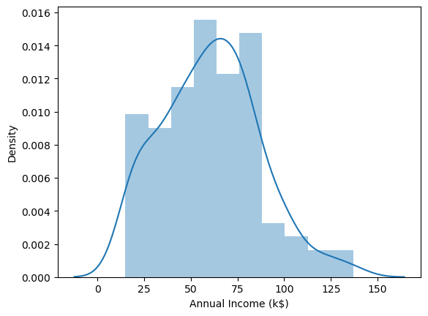
Found a Normal Distribution of Annual Income in our demographic of Mall Customers
Distribution Plot

Slide 6
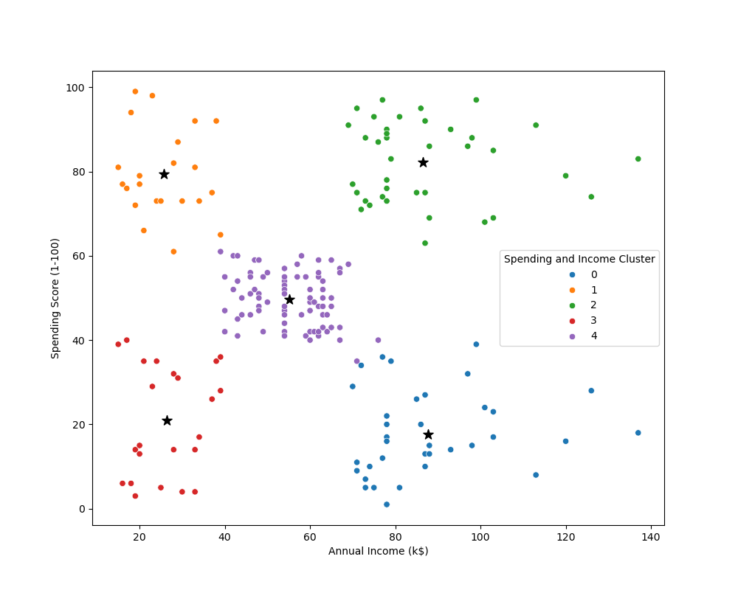
Cluster 2 has the highest amount of annual Income and Spending Score. I would prioritize making campaigns for this group, 53% of them are female.
Cluster 1 has the Youngest Age. Lowest Income but a very High Spending score. This could suggest us to run Sales campaigns for young people to spend on high ticket items like Game Consoles or Nike Jordans
Scatter Plot

Slide 7
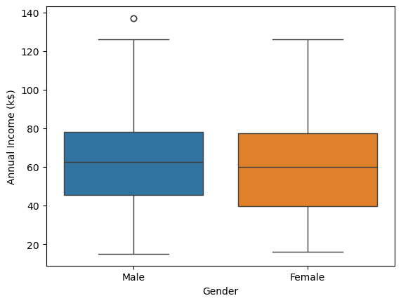
Outlier of Annual Income in the Male group around 138k
Box Plot

Slide 8
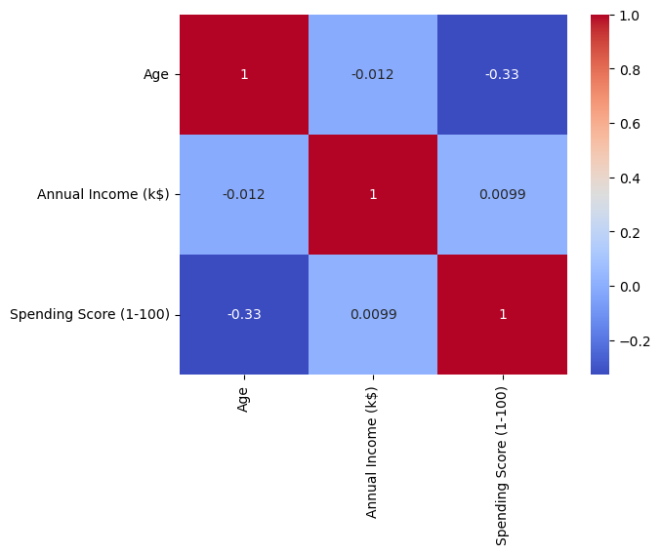
Correlation between variables such as Annual Income and Spending Score
Heat Map Plot

Slide 9
Key Findings
The best group to target would be Cluster 2 with a high spending score and high income, 53% of them are female which suggests us to make campaigns for those customers
Another popular group would be Cluster 1, they are a young demographic with not a lot of income but do spend a lot. We can run sales campaigns for them for high ticket items.

Slide 10
References
Absent Data. (2021, August 30). Data Analyst Portfolio Project #2: Python Customer Segmentation & Clustering [Video]. YouTube. https://youtu.be/iwUli5gIcU0?si=VSJP3BdPdrCMljj9
Absent Data. (n.d.). Mall_Customers.csv [Data set]. AbsentData. https://absentdata.com/data-analysis/where-to-find-data/
Live Demo: https://airtechwick.github.io/MallCustomersAnalysis/
Github with all Files used: https://github.com/AirTechWick/MallCustomersAnalysis

