Slide 1

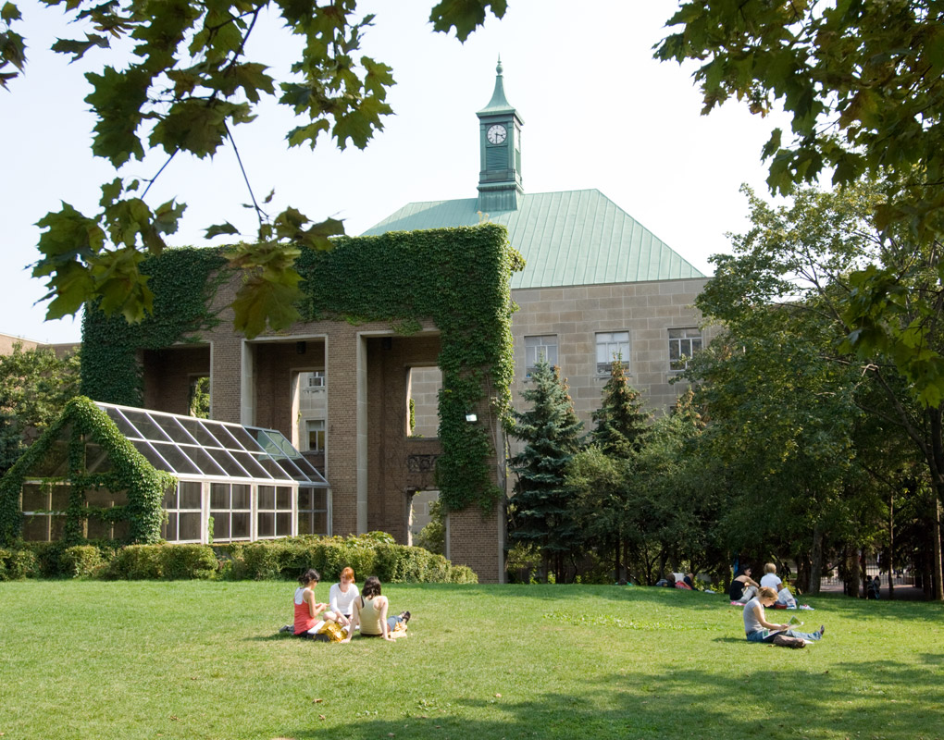
Welcome St. Michael’s Choir School and UMCA Rich Tree to Ryerson University
www.ryerson.ca/science

Slide 2
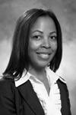
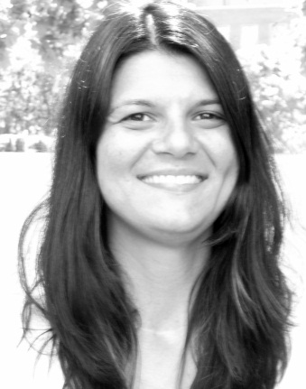
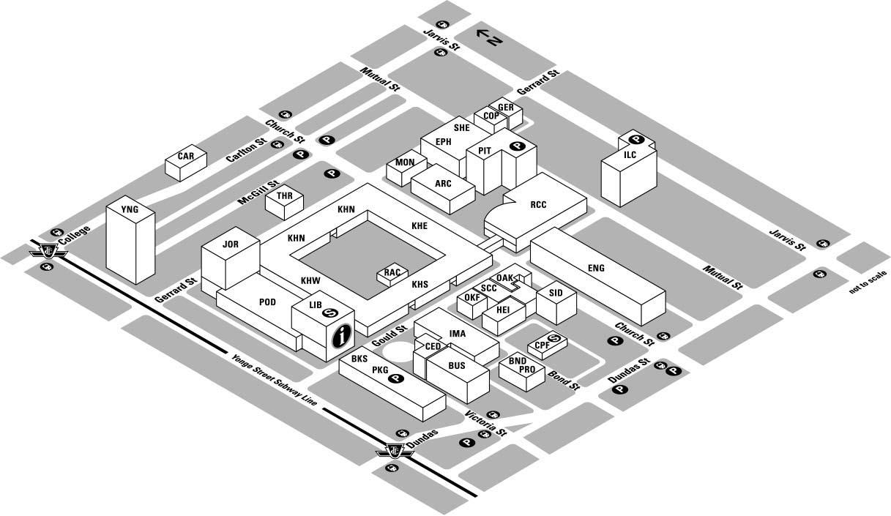
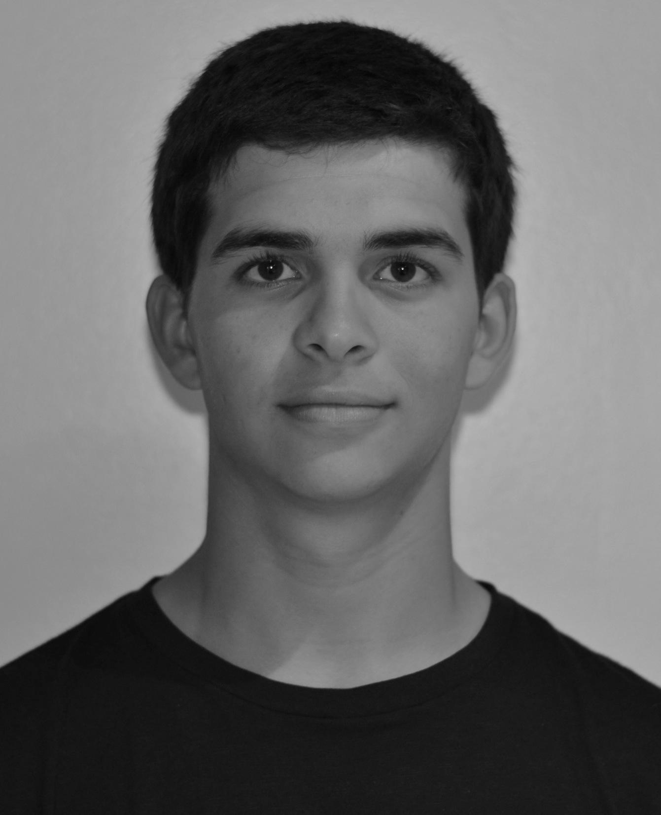
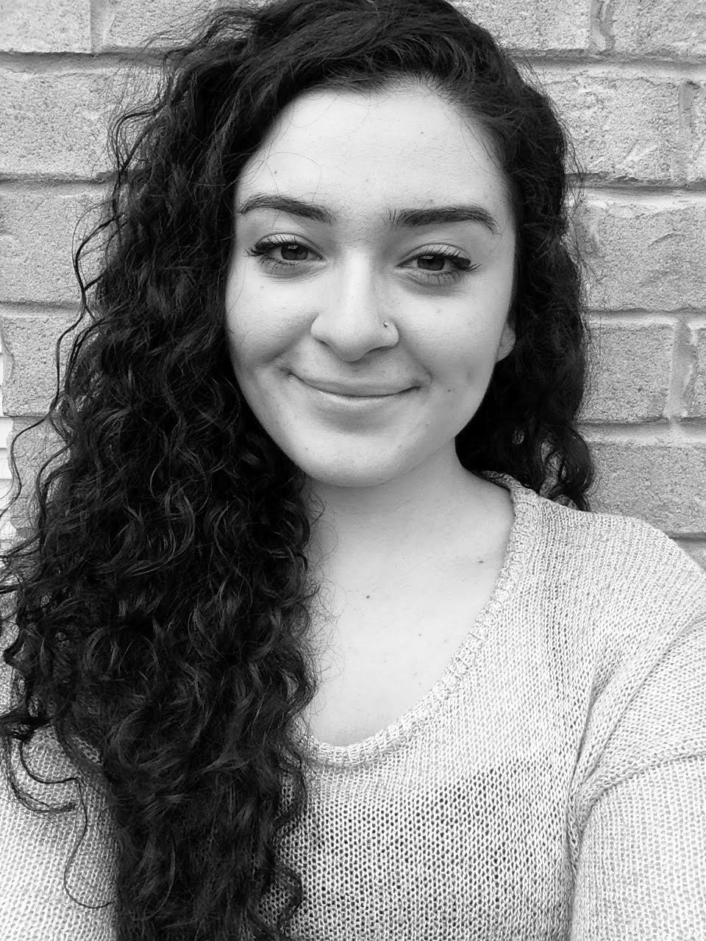
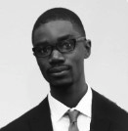
Office of Science Outreach and Enrichment (OSOE)
Kerr Hall East 124
Dr. Emily Agard
Director
Mira Grkavac
Program Facilitator
Akin Olukunle-Ojo, Nathan Battersby and Tanya Aziz
Student Liaison & Promotions Officer

Slide 3
Faculty of Science
www.ryerson.ca/science
Biology
Biomedical Science
Chemistry
Computer Science
Mathematics and its Applications
Financial Mathematics
Medical Physics
Science Undeclared

Slide 4
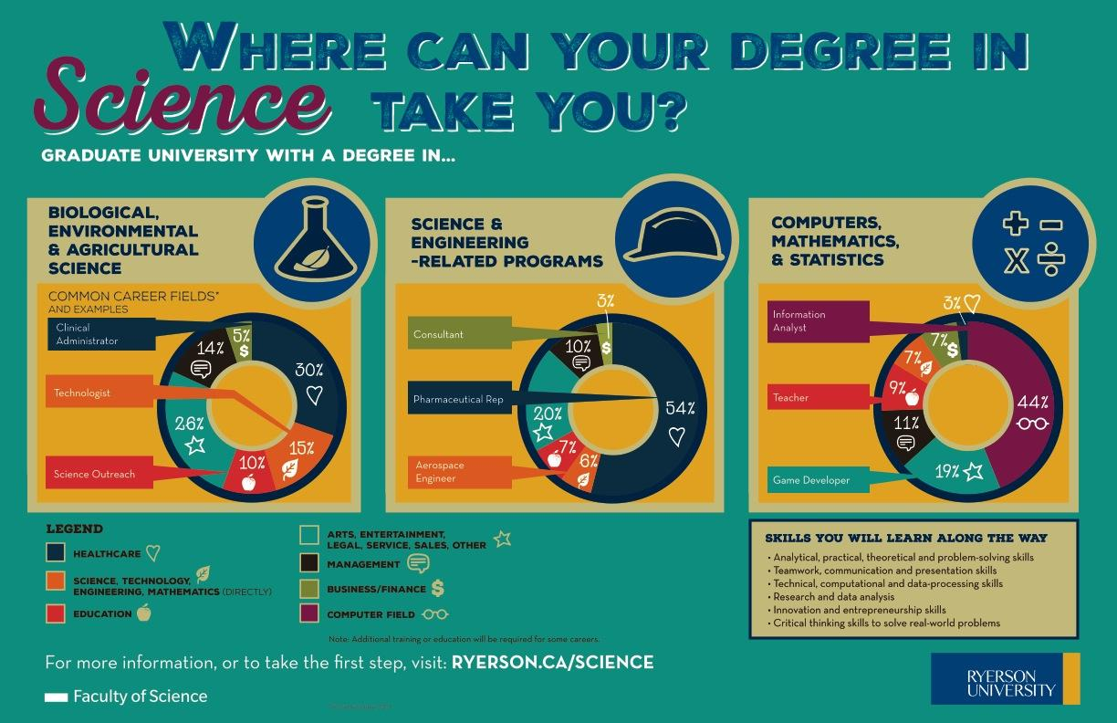

Slide 5

1st YEAR
1st SEMESTER
Common to Biology, Chemistry, and Medical Physics - both Co-operative and Regular Programs
REQUIRED:
BLG 143 Biology I
CHY 103 General Chemistry I
CPS 118 Introductory Programming for Scientists
MTH 131 Modern Mathematics I
PCS 120 Physics I
SCI 180 * Orientation
*This course is graded on a pass/fail basis.
2nd SEMESTER
BLG 144 Biology II
CHY 113 General Chemistry II
MTH 231 Modern Mathematics II
PCS 130 Physics II
LIBERAL STUDIES: One course from Table A.

Slide 6

BIOMEDICAL SCIENCE
1st SEMESTER
REQUIRED:
BLG 143 Biology I
CHY 103 General Chemistry I
MTH 131 Modern Mathematics I
PCS 120 Physics I
LIBERAL STUDIES: One course from Table A.
SCI 180 * Orientation
2nd SEMESTER
REQUIRED:
BLG 144 Biology II
CHY 113 General Chemistry II
PCS 130 Physics II
ELECTIVE
PSY 102 Intro to Psychology I

Slide 7
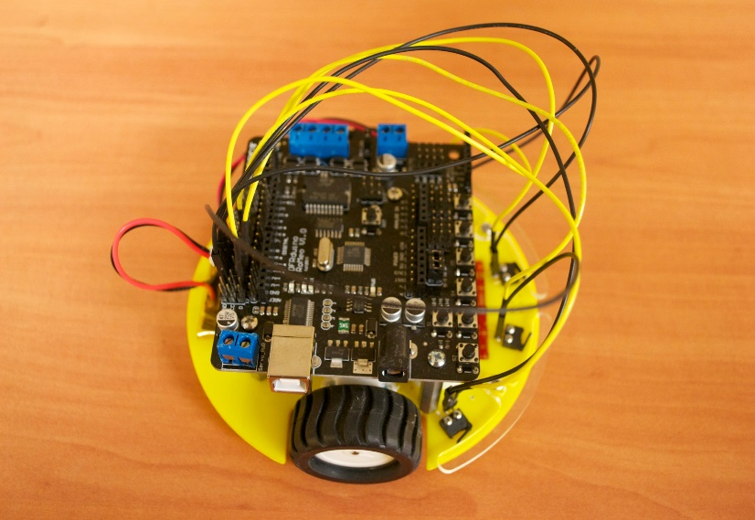
Computer Science
1st SEMESTER
CPS 109 Computer Science I
MTH 110 Discrete Mathematics I
MTH 207 Calculus and Computational Methods I
REQUIRED GROUP 1: One course from the following:
BLG 143 Biology I
CHY 103 General Chemistry I
PCS 110 Units and Vectors
LIBERAL STUDIES: One course from Table A.
2nd SEMESTER
REQUIRED:
CPS 209 Computer Science II
CPS 393 Introduction to C and UNIX
MTH 210 Discrete Mathematics II
MTH 310 Calculus and Computational Methods II
LIBERAL STUDIES: One course from Table A.

Slide 8
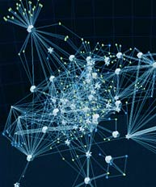
Mathematics and Its Applications
1st SEMESTER
REQUIRED:
CPS 118 Introductory Programming for Scientists
MTH 110 Discrete Mathematics I
MTH 207 Calculus and Computational Methods I
SCI 180 * Orientation
REQUIRED GROUP 1: One course from the following:
BLG 143 Biology I
CHY 103 General Chemistry I
PCS 120 Physics I
LIBERAL STUDIES: One course from Table A.
2nd SEMESTER
REQUIRED:
MTH 210 Discrete Mathematics II
MTH 310 Calculus and Computational Methods II
REQUIRED GROUP 2: One course from the following:
BLG 144 Biology II
CHY 113 General Chemistry II
PCS 130 Physics II
OPEN ELECTIVES: One course from the Open Elective Table
LIBERAL STUDIES: One course from Table A.

Slide 9

Financial Mathematics
1st SEMESTER
REQUIRED:
ACC 100 Financial Accounting
CPS 118 Introductory Programming for Scientists
ECN 104 Introductory Microeconomics
MTH 207 Calculus and Computational Methods I
SCI 180 * Orientation
REQUIRED Group 1: One course from the following;
BLG 143 Biology I
CHY 103 General Chemistry I
PCS 120 Physics I
2nd SEMESTER
REQUIRED:
CMN 279 Introduction to Professional Communication
MTH 310 Calculus and Computational Methods II
FIN 300 Managerial Finance I
REQUIRED Group 2: One course from the following
BLG 144 Biology II
CHY 113 General Chemistry II
PCS 130 Physics II
LIBERAL STUDIES: One course from Table A.

Slide 10
Bachelor of Science
Undergraduate Science Programs (Page 123)
Biology
Biomedical Science
Chemistry
Medical Physics
Undeclared Science
Grade 12 U Subject Requirements:
English (ENG4U) /Anglais (EAE4U)
Advanced Functions (MHF4U)
Two of: Biology (SBI4U), Chemistry (SCH4U) or Physics (SPH4U)
Completion of all three science courses is recommended for all programs.
Computer Science
Mathematics and Its Applications
Financial Mathematics
Grade 12 U Subject Requirements:
English (ENG4U)/Anglais (EAE4U)
Advanced Functions (MHF4U)
One of: Calculus and Vectors (MCV4U) or Mathematics of Data Management (MDM4U)
One of: Biology (SBI4U) or Chemistry (SCH4U) or Physics (SPH4U)
Grade 12U Physics (SPH4U) is the recommended science course

Slide 11
Faculty of Science 2015
Programs | Intake numbers
Biology | 141
Biomedical Science | 140
Chemistry | 65
Computer Science | 227
Financial Mathematics | 52
Mathematics & Its Application | 52
Medical Physics | 52
Undeclared | 63

Slide 12
Entrance Scholarships
New for 2015, for students attending a Canadian secondary school, we offer Guaranteed and Renewable Scholarships across all programs. FINAL ADMISSION TOTAL VALUE AWARDED IN ANNUAL
AVERAGE YEAR 1 YEAR 1 RENEWABLE AMOUNT
95%+ $16,000 $4,000 $4,000
90-94.9% $8,000 $2,000 $2,000
86-89.9% $4,000 $1,000 $1,000
80-85.9% $2,000 $500 $500
Other Scholarships
https://www.scholarships.com

