Slide 1
Introduction
COE 301
Computer Organization
Dr. Muhamed Mudawar
Computer Engineering Department
King Fahd University of Petroleum and Minerals

Slide 2
Presentation Outline
Welcome to COE 301
Assembly-, Machine-, and High-Level Languages
Classes of Computers
Programmer's View of a Computer System

Slide 3
Welcome to COE 301
Instructor: Dr. Muhamed F. Mudawar
Office: Building 22, Room 410-2
Office Phone: 4642
Schedule and Office Hours:
http://faculty.kfupm.edu.sa/coe/mudawar/schedule/
Course Web Page:
http://faculty.kfupm.edu.sa/coe/mudawar/coe301/
Email:
mudawar@kfupm.edu.sa

Slide 4
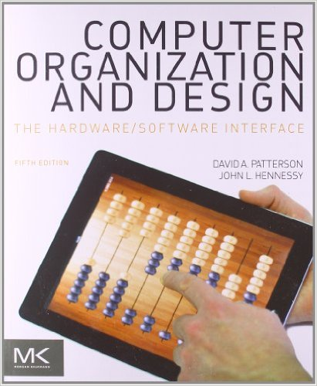
Which Textbook will be Used?
Computer Organization & Design:
The Hardware/Software Interface
Fifth Edition, 2013
David Patterson and John Hennessy
Morgan Kaufmann
Read the textbook in addition to slides

Slide 5
Grading Policy
Quizzes 10%
MIPS Programming 10%
Lab Work 15%
CPU Design Project 15%
Midterm Exam 25%
Final Exam 25%
No makeup will be given for missing exam or quiz

Slide 6
Software Tools
MIPS Simulators
MARS: MIPS Assembly and Runtime Simulator
Runs MIPS-32 assembly language programs
Website: http://courses.missouristate.edu/KenVollmar/MARS/
SPIM
Also Runs MIPS-32 assembly language programs
Website: http://www.cs.wisc.edu/~larus/spim.html
CPU Design and Simulation Tool
Logisim
Educational tool for designing and simulating CPUs
Website: http://ozark.hendrix.edu/~burch/logisim/

Slide 7
Course Learning Outcomes
Towards the end of this course, you should be able to …
Describe the instruction set architecture of a processor
Analyze, write, and test assembly language programs
Describe organization/operation of integer & floating-point units
Design the datapath and control of a single-cycle CPU
Design the datapath/control of a pipelined CPU & handle hazards
Describe the organization/operation of memory and caches
Analyze the performance of processors and caches
Required Background
Ability to program confidently in Java or C
Ability to design a combinational and sequential circuit

Slide 8
Next . . .
Welcome to COE 301
Assembly-, Machine-, and High-Level Languages
Classes of Computers
Programmer's View of a Computer System

Slide 9
Some Important Questions to Ask
What is Assembly Language?
What is Machine Language?
How is Assembly related to a high-level language?
Why Learn Assembly Language?
What is an Assembler, Linker, and Debugger?

Slide 10
A Hierarchy of Languages
Application Programs
High-Level Languages
Machine independent
High-Level Language
Machine specific
Low-Level Language
Assembly Language
Machine Language
Hardware

Slide 11
Assembly and Machine Language
Machine language
Native to a processor: executed directly by hardware
Instructions consist of binary code: 1s and 0s
Assembly language
Slightly higher-level language
Readability of instructions is better than machine language
One-to-one correspondence with machine language instructions
Assemblers translate assembly to machine code
Compilers translate high-level programs to machine code
Either directly, or
Indirectly via an assembler

Slide 12
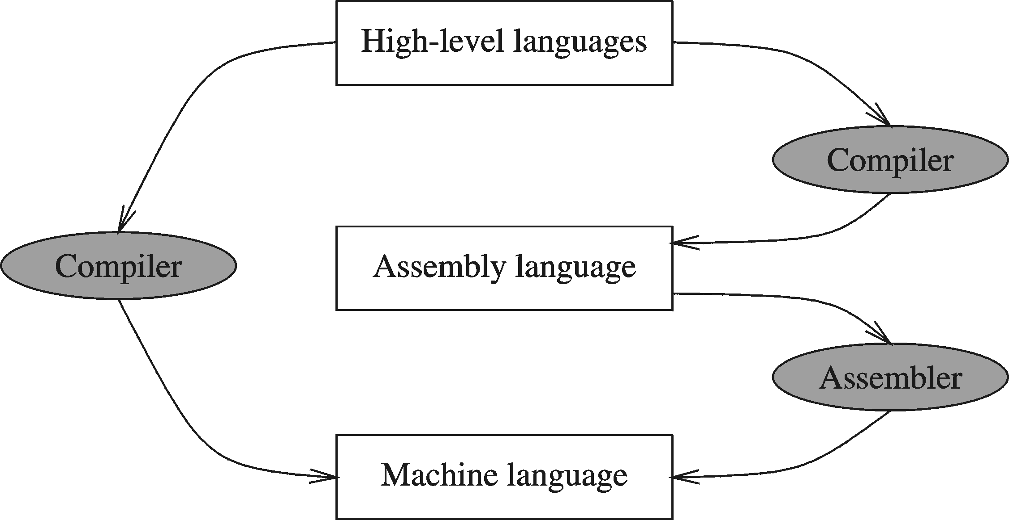
Compiler and Assembler

Slide 13
Translating Languages
Program (C Language):
swap(int v[], int k) {
int temp;
temp = v[k];
v[k] = v[k+1];
v[k+1] = temp;
}
A statement in a high-level language is translated typically into several machine-level instructions
Compiler
MIPS Assembly Language:
sll $2,$5, 2
add $2,$4,$2
lw $15,0($2)
lw $16,4($2)
sw $16,0($2)
sw $15,4($2)
jr $31
MIPS Machine Language:
00051080
00821020
8C620000
8CF20004
ACF20000
AC620004
03E00008
Assembler

Slide 14
Advantages of High-Level Languages
Program development is faster
High-level statements: fewer instructions to code
Program maintenance is easier
For the same above reasons
Programs are portable
Contain few machine-dependent details
Can be used with little or no modifications on different machines
Compiler translates to the target machine language
However, Assembly language programs are not portable

Slide 15
Why Learn Assembly Language?
Many reasons:
Accessibility to system hardware
Space and time efficiency
Writing a compiler for a high-level language
Accessibility to system hardware
Assembly Language is useful for implementing system software
Also useful for small embedded system applications
Programming in Assembly Language is harder
Requires deep understanding of the processor architecture
However, it is very rewarding to system software designers
Adds a new perspective on how programs run on real processors

Slide 16
Assembly Language Programming Tools
Editor
Allows you to create and edit assembly language source files
Assembler
Converts assembly language programs into object files
Object files contain the machine instructions
Linker
Combines object files created by the assembler with link libraries
Produces a single executable program
Debugger
Allows you to trace the execution of a program
Allows you to view machine instructions, memory, and registers

Slide 17
Assemble and Link Process
Source
File
Assembler
Object
File
Source
File
Assembler
Object
File
Linker
Executable
File
Source
File
Assembler
Object
File
Link
Libraries
A program may consist of multiple source files
Assembler translates each source file into an object file
Linker links all object files together and with link libraries
The result executable file can run directly on the processor

Slide 18
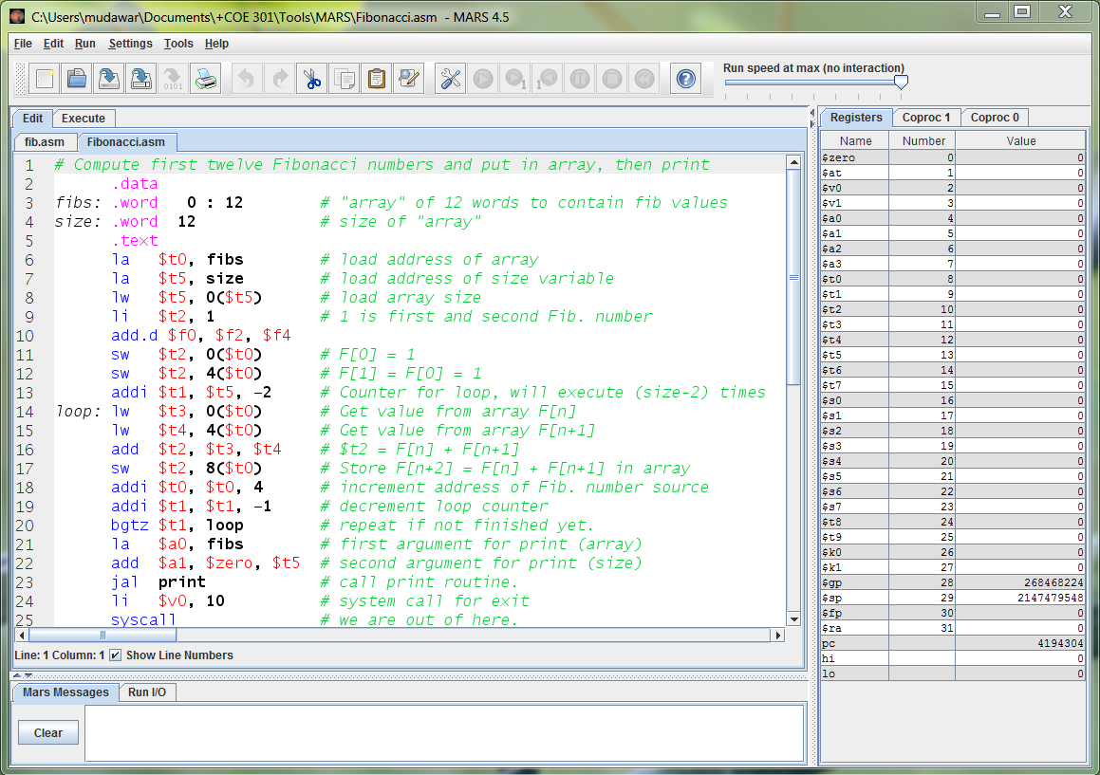
MARS Assembler and Simulator Tool

Slide 19
MARS Assembler and Simulator Tool
Simulates the execution of a MIPS program
No direct execution on the underlying Intel processor
Editor with color-coded assembly syntax
Allows you to create and edit assembly language source files
Assembler
Converts MIPS assembly language programs into object files
Console and file input/output using system calls
Debugger
Allows you to trace the execution of a program and set breakpoints
Allows you to view machine instructions, edit registers and memory
Easy to use and learn assembly language programming

Slide 20
Next . . .
Welcome to COE 301
Assembly-, Machine-, and High-Level Languages
Classes of Computers
Programmer's View of a Computer System

Slide 21
Classes of Computers
Personal computers
General purpose, variety of software, subject to cost/performance
Server computers
Network based, high capacity, performance, and reliability
Range from small servers to building sized
Supercomputers
High-end scientific and engineering calculations
Highest capability but only a small fraction of the computer market
Embedded computers
Hidden as components of systems
Stringent power/performance/cost constraints

Slide 22
Classes of Computers (cont'd)
Personal Mobile Device (PMD)
Battery operated
Connects to the Internet
Low price: hundreds of dollars
Smart phones, tablets, electronic glasses
Cloud Computing
Warehouse Scale Computers (WSC)
Software, Platform, and Infrastructure as a Service
However, security concerns of storing "sensitive data" in "the cloud"
Examples: Amazon and Google

Slide 23
Components of a Computer System
Processor
Datapath and Control
Memory & Storage
Main Memory
Disk Storage
Input / Output devices
User-interface devices
Network adapters
For communicating with other computers
Bus: Interconnects processor to memory and I/O
Essentially the same components for all kinds of computers
Computer
Memory
I/O Devices
Control
Input
BUS
Processor
Output
Datapath
Disk
Network

Slide 24
Fetch - Execute Cycle
Instruction Fetch
Fetch instruction
Compute address of next instruction
Instruction Decode
Generate control signals for instruction
Read operands from registers
Execute
Compute result value
Infinite Cycle implemented in Hardware
Memory Access
Read or write memory
Writeback Result
Writeback result in a register

Slide 25
Clock
Operation of digital hardware is governed by a clock
Clock period
Clock (cycles)
Data transfer and computation
Update state
Clock period: duration of a clock cycle
e.g., 250 ps = 0.25 ns = 0.25 ×10^{–9} sec
Clock frequency (rate) = 1 / clock period
e.g., 1/ 0.25 ×10^{–9} sec = 4.0×10⁹ Hz = 4.0 GHz

Slide 26

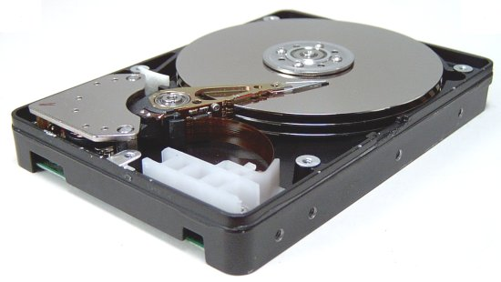

Memory and Storage Devices
Volatile Memory Devices
RAM = Random Access Memory
DRAM = Dynamic RAM
Dense but must be refreshed (typical choice for main memory)
SRAM: Static RAM
Faster but less dense than DRAM (typical choice for cache memory)
Non-Volatile Storage Devices
Magnetic Disk
Flash Memory (Solid State Disk)
Optical Disk (CDROM, DVD)

Slide 27
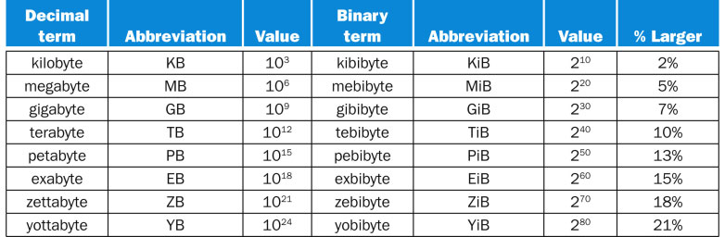
Units for Storage and Memory
Size of disk storage
Value = 10^{n} (base 10)
Size of memory
Value = 2^{n} (base 2)
The binary terms are used to avoid the confusion with the commonly used decimal terms. The size of memory is 2^{n} because the memory address is an n-bit binary number.

Slide 28
Next . . .
Welcome to COE 301
Assembly-, Machine-, and High-Level Languages
Classes of Computers
Programmer's View of a Computer System

Slide 29
Programmer’s View of a Computer System
Application Programs
High-Level Language
Increased level of abstraction
Level 5
Software
Assembly Language
Level 4
Operating System
Level 3
Interface SW & HW
Instruction Set
Architecture
Level 2
Microarchitecture
Level 1
Each level hides the details of the level below it
Hardware
Physical Design
Level 0

Slide 30
Programmer's View (cont'd)
Application Programs (Level 5)
Written in high-level programming languages
Such as Java, C++, Pascal, Visual Basic . . .
Programs compile into assembly language level (Level 4)
Assembly Language (Level 4)
Instruction mnemonics (symbols) are used
Have one-to-one correspondence to machine language
Calls functions written at the operating system level (Level 3)
Programs are translated into machine language (Level 2)
Operating System (Level 3)
Provides services to level 4 and 5 programs
Translated to run at the machine instruction level (Level 2)

Slide 31
Programmer's View (cont'd)
Instruction Set Architecture (Level 2)
Interface between software and hardware
Specifies how a processor functions
Machine instructions, registers, and memory are exposed
Machine language is executed by Level 1 (microarchitecture)
Microarchitecture (Level 1)
Controls the execution of machine instructions (Level 2)
Implemented by digital logic
Physical Design (Level 0)
Implements the microarchitecture at the transistor-level
Physical layout of circuits on a chip

