Slide 1
Data Representation
COE 301
Computer Organization
Prof. Muhamed Mudawar
College of Computer Sciences and Engineering
King Fahd University of Petroleum and Minerals

Slide 2
Presentation Outline
Positional Number Systems
Binary and Hexadecimal Numbers
Base Conversions
Integer Storage Sizes
Binary and Hexadecimal Addition
Signed Integers and 2's Complement Notation
Sign Extension
Binary and Hexadecimal subtraction
Carry and Overflow
Character Storage

Slide 3
Positional Number Systems
Different Representations of Natural Numbers
XXVII Roman numerals (not positional)
27 Radix-10 or decimal number (positional)
11011₂ Radix-2 or binary number (also positional)
Fixed-radix positional representation with k digits
Number N in radix r = (d_{k–1}d_{k–2} . . . d₁d₀)_{r}
Value = d_{k–1}×r ^{k–1} + d_{k–2}×r ^{k–2} + … + d₁×r + d₀
Examples: (11011)₂ = 1×2⁴ + 1×2³ + 0×2² + 1×2 + 1 = 27
(2103)₄ = 2×4³ + 1×4² + 0×4 + 3 = 147

Slide 4
Binary Numbers
Each binary digit (called bit) is either 1 or 0
Bits have no inherent meaning, can represent
Unsigned and signed integers
Characters
Floating-point numbers
Images, sound, etc.
Bit Numbering
Least significant bit (LSB) is rightmost (bit 0)
Most significant bit (MSB) is leftmost (bit 7 in an 8-bit number)
Most
Significant Bit
Least
Significant Bit
7
6
5
4
3
2
1
0
1
0
0
1
1
1
0
1
2
7
2
6
2
5
2
4
2
3
2
2
2
1
2
0

Slide 5
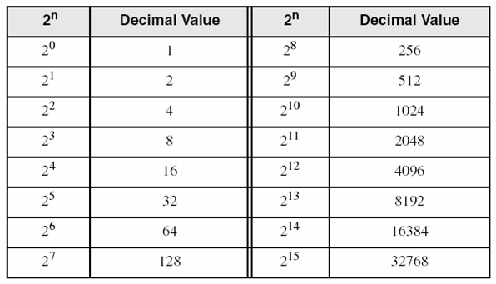
Converting Binary to Decimal
Each bit represents a power of 2
Every binary number is a sum of powers of 2
Decimal Value = (d_{n-1} × 2^{n-1}) + ... + (d₁ × 2¹) + (d₀ × 2⁰)
Binary (10011101)₂ = 2⁷ + 2⁴ + 2³ + 2² + 1 = 157
7
6
5
4
3
2
1
0
1
0
0
1
1
1
0
1
2
7
2
6
2
5
2
4
2
3
2
2
2
1
2
0
Some common powers of 2

Slide 6
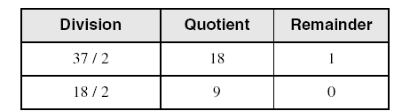
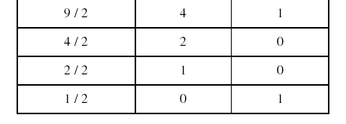
Convert Unsigned Decimal to Binary
Repeatedly divide the decimal integer by 2
Each remainder is a binary digit in the translated value
least significant bit
37 = (100101)₂
most significant bit
stop when quotient is zero

Slide 7
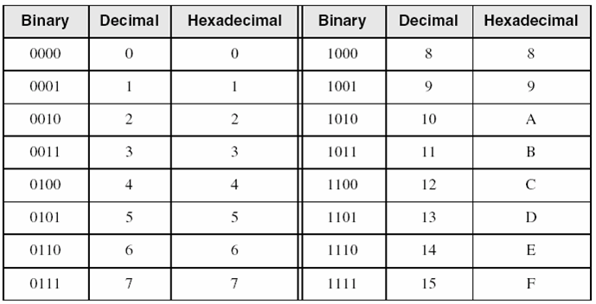
Hexadecimal Integers
16 Hexadecimal Digits: 0 – 9, A – F
More convenient to use than binary numbers
Binary, Decimal, and Hexadecimal Equivalents

Slide 8
Converting Binary to Hexadecimal
Each hexadecimal digit corresponds to 4 binary bits
Example:
Convert the 32-bit binary number to hexadecimal
1110 1011 0001 0110 1010 0111 1001 0100
Solution:
E
B
1
6
A
7
9
4
1110
1011
0001
0110
1010
0111
1001
0100

Slide 9
Converting Hexadecimal to Decimal
Multiply each digit by its corresponding power of 16
Value = (d_{n-1} × 16^{n-1}) + (d_{n-2} × 16^{n-2}) + ... + (d₁ × 16) + d₀
Examples:
(1234)₁₆ = (1 × 16³) + (2 × 16²) + (3 × 16) + 4 =
Decimal Value 4660
(3BA4)₁₆ = (3 × 16³) + (11 × 16²) + (10 × 16) + 4 =
Decimal Value 15268

Slide 10
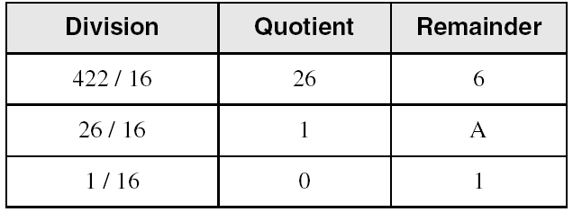
Converting Decimal to Hexadecimal
Repeatedly divide the decimal integer by 16
Each remainder is a hex digit in the translated value
least significant digit
most significant digit
stop when quotient is zero
Decimal 422 = 1A6 hexadecimal

Slide 11
Integer Storage Sizes
Byte
8
Storage Sizes
Half Word
16
Word
32
Double Word
64
Storage Type | Unsigned Range | Powers of 2
Byte | 0 to 255 | 0 to (2⁸ – 1)
Half Word | 0 to 65,535 | 0 to (2¹⁶ – 1)
Word | 0 to 4,294,967,295 | 0 to (2³² – 1)
Double Word | 0 to 18,446,744,073,709,551,615 | 0 to (2⁶⁴ – 1)
What is the largest 20-bit unsigned integer?
Answer: 2²⁰ – 1 = 1,048,575

Slide 12
Binary Addition
Start with the least significant bit (rightmost bit)
Add each pair of bits
Include the carry in the addition, if present
carry
1
1
1
1
0
0
1
1
0
1
1
0
(54)
+
0
0
0
1
1
1
0
1
(29)
0
1
0
1
0
0
1
1
(83)
bit position:
7
6
5
4
3
2
1
0

Slide 13
Hexadecimal Addition
Start with the least significant hexadecimal digits
Let Sum = summation of two hex digits
If Sum is greater than or equal to 16
Sum = Sum – 16 and Carry = 1
Example:
carry:
1
1
1
1
C
3
7
2
8
6
A
+
A + B = 10 + 11 = 21
Since 21 ≥ 16
Sum = 21 – 16 = 5
Carry = 1
9
3
9
5
E
8
4
B
A
F
C
D
1
0
B
5

Slide 14
Signed Integers
Several ways to represent a signed number
Sign-Magnitude
Biased
1's complement
2's complement
Divide the range of values into 2 equal parts
First part corresponds to the positive numbers (≥ 0)
Second part correspond to the negative numbers (< 0)
Focus will be on the 2's complement representation
Has many advantages over other representations
Used widely in processors to represent signed integers

Slide 15
Two's Complement Representation
Positive numbers
Signed value = Unsigned value
Negative numbers
Signed value = Unsigned value – 2^{n}
n = number of bits
Negative weight for MSB
Another way to obtain the signed value is to assign a negative weight to most-significant bit
= -128 + 32 + 16 + 4 = -76
8-bit Binary value | Unsigned value | Signed value
00000000 | 0 | 0
00000001 | 1 | +1
00000010 | 2 | +2
. . . | . . . | . . .
01111110 | 126 | +126
01111111 | 127 | +127
10000000 | 128 | -128
10000001 | 129 | -127
. . . | . . . | . . .
11111110 | 254 | -2
11111111 | 255 | -1
1
0
1
1
0
1
0
0
-128
64
32
16
8
4
2
1

Slide 16
Forming the Two's Complement
starting value | 00100100 = +36
step1: reverse the bits (1's complement) | 11011011
step 2: add 1 to the value from step 1 | + 1
sum = 2's complement representation | 11011100 = -36
Sum of an integer and its 2's complement must be zero:
00100100 + 11011100 = 00000000 (8-bit sum) ⇒ Ignore Carry
Another way to obtain the 2's complement:
Start at the least significant 1
Leave all the 0s to its right unchanged
Complement all the bits to its left
Binary Value
= 00100 1 00
2's Complement
= 11011 1 00
least
significant 1

Slide 17
Sign Bit
Highest bit indicates the sign
1 = negative
0 = positive
Sign bit
1
1
1
1
0
1
1
0
Negative
0
0
0
0
1
0
1
0
Positive
For Hexadecimal Numbers, check most significant digit
If highest digit is > 7, then value is negative
Examples: 8A and C5 are negative bytes
B1C42A00 is a negative word (32-bit signed integer)

Slide 18
Sign Extension
Step 1: Move the number into the lower-significant bits
Step 2: Fill all the remaining higher bits with the sign bit
This will ensure that both magnitude and sign are correct
Examples
Sign-Extend 10110011 to 16 bits
Sign-Extend 01100010 to 16 bits
Infinite 0s can be added to the left of a positive number
Infinite 1s can be added to the left of a negative number
10110011 = -77
11111111 10110011 = -77
01100010 = +98
00000000 01100010 = +98

Slide 19
Two's Complement of a Hexadecimal
To form the two's complement of a hexadecimal
Subtract each hexadecimal digit from 15
Add 1
Examples:
2's complement of 6A3D = 95C2 + 1 = 95C3
2's complement of 92F15AC0 = 6D0EA53F + 1 = 6D0EA540
2's complement of FFFFFFFF = 00000000 + 1 = 00000001
No need to convert hexadecimal to binary

Slide 20
Binary Subtraction
When subtracting A – B, convert B to its 2's complement
Add A to (–B)
0 1 0 0 1 1 0 1 0 1 0 0 1 1 0 1
0 0 1 1 1 0 1 0 1 1 0 0 0 1 1 0 (2's complement)
0 0 0 1 0 0 1 1 0 0 0 1 0 0 1 1 (same result)
Final carry is ignored, because
Negative number is sign-extended with 1's
You can imagine infinite 1's to the left of a negative number
Adding the carry to the extended 1's produces extended zeros
borrow:
1
1
1
carry:
1
1
1
1
–
+

Slide 21
Hexadecimal Subtraction
16 + 5 = 21
Borrow:
1
1
1
Carry:
1
1
1
1
1
B
1
4
F
C
6
7
5
B
1
4
F
C
6
7
5
-
+
8
3
9
E
A
2
4
7
7
C
6
1
5
D
B
9
(2's complement)
2
D
B
1
2
4
2
E
2
D
B
1
2
4
2
E
(same result)
When a borrow is required from the digit to the left, then
Add 16 (decimal) to the current digit's value
Last Carry is ignored

Slide 22
Ranges of Signed Integers
For n-bit signed integers: Range is -2^{n–1} to (2^{n–1} – 1)
Positive range: 0 to 2^{n–1} – 1
Negative range: -2^{n–1} to -1
Storage Type | Signed Range | Powers of 2
Byte | –128 to +127 | –2⁷ to (2⁷ – 1)
Half Word | –32,768 to +32,767 | –2¹⁵ to (2¹⁵ – 1)
Word | –2,147,483,648 to +2,147,483,647 | –2³¹ to (2³¹ – 1)
Double Word | –9,223,372,036,854,775,808 to +9,223,372,036,854,775,807 | –2⁶³ to (2⁶³ – 1)
Practice: What is the range of signed values that may be stored in 20 bits?

Slide 23
Carry and Overflow
Carry is important when …
Adding or subtracting unsigned integers
Indicates that the unsigned sum is out of range
Either < 0 or >maximum unsigned n-bit value
Overflow is important when …
Adding or subtracting signed integers
Indicates that the signed sum is out of range
Overflow occurs when
Adding two positive numbers and the sum is negative
Adding two negative numbers and the sum is positive
Can happen because of the fixed number of sum bits

Slide 24
Carry and Overflow Examples
We can have carry without overflow and vice-versa
Four cases are possible (Examples are 8-bit numbers)
1
1
1
1
1
1
0
0
0
0
1
1
1
1
15
0
0
0
0
1
1
1
1
15
+
+
0
0
0
0
1
0
0
0
8
1
1
1
1
1
0
0
0
248 (-8)
0
0
0
1
0
1
1
1
23
0
0
0
0
0
1
1
1
7
Carry = 0 Overflow = 0
Carry = 1 Overflow = 0
1
1
1
1
0
1
0
0
1
1
1
1
79
1
1
0
1
1
0
1
0
218 (-38)
+
+
0
1
0
0
0
0
0
0
64
1
0
0
1
1
1
0
1
157 (-99)
1
0
0
0
1
1
1
1
143
(-113)
0
1
1
1
0
1
1
1
119
Carry = 0 Overflow = 1
Carry = 1 Overflow = 1

Slide 25
Range, Carry, Borrow, and Overflow
Unsigned Integers: n-bit representation
Signed Integers: n-bit 2's complement representation
Numbers < min
Numbers > max
Borrow = 1
Subtraction
Finite Set of Unsigned Integers
Carry = 1
Addition
min = 0
max = 2^{n}–1
Numbers < min
Numbers > max
Negative
Overflow
Finite Set of Signed Integers
Positive
Overflow
min = -2^{n-1}
0
max = 2^{n-1}–1

Slide 26
Character Storage
Character sets
Standard ASCII: 7-bit character codes (0 – 127)
Extended ASCII: 8-bit character codes (0 – 255)
Unicode: 16-bit character codes (0 – 65,535)
Unicode standard represents a universal character set
Defines codes for characters used in all major languages
Used in Windows-XP: each character is encoded as 16 bits
UTF-8: variable-length encoding used in HTML
Encodes all Unicode characters
Uses 1 byte for ASCII, but multiple bytes for other characters
Null-terminated String
Array of characters followed by a NULL character

Slide 27
Printable ASCII Codes
 | 0 | 1 | 2 | 3 | 4 | 5 | 6 | 7 | 8 | 9 | A | B | C | D | E | F
2 | space | ! | " | # | $ | % | & | ' | ( | ) | * | + | , | - | . | /
3 | 0 | 1 | 2 | 3 | 4 | 5 | 6 | 7 | 8 | 9 | : | ; | < | = | > | ?
4 | @ | A | B | C | D | E | F | G | H | I | J | K | L | M | N | O
5 | P | Q | R | S | T | U | V | W | X | Y | Z | [ | \ | ] | ^ | _
6 | ` | a | b | c | d | e | f | g | h | i | j | k | l | m | n | o
7 | p | q | r | s | t | u | v | w | x | y | z | { | | | } | ~ | DEL
Examples:
ASCII code for space character = 20 (hex) = 32 (decimal)
ASCII code for 'L' = 4C (hex) = 76 (decimal)
ASCII code for 'a' = 61 (hex) = 97 (decimal)

Slide 28
Control Characters
The first 32 characters of ASCII table are used for control
Control character codes = 00 to 1F (hexadecimal)
Not shown in previous slide
Examples of Control Characters
Character 0 is the NULL character ⇒ used to terminate a string
Character 9 is the Horizontal Tab (HT) character
Character 0A (hex) = 10 (decimal) is the Line Feed (LF)
Character 0D (hex) = 13 (decimal) is the Carriage Return (CR)
The LF and CR characters are used together
They advance the cursor to the beginning of next line
One control character appears at end of ASCII table
Character 7F (hex) is the Delete (DEL) character

