Slide 1
Performance
COE 301 / ICS 233
Computer Organization
Dr. Muhamed Mudawar
College of Computer Sciences and Engineering
King Fahd University of Petroleum and Minerals

Slide 2
What is Performance?
How can we make intelligent choices about computers?
Why is some computer hardware performs better at some programs, but performs less at other programs?
How do we measure the performance of a computer?
What factors are hardware related? software related?
How does machine’s instruction set affect performance?
Understanding performance is key to understanding underlying organizational motivation

Slide 3
Response Time and Throughput
Response Time
Time between start and completion of a task, as observed by end user
Response Time = CPU Time + Waiting Time (I/O, OS scheduling, etc.)
Throughput
Number of tasks the machine can run in a given period of time
Decreasing execution time improves throughput
Example: using a faster version of a processor
Less time to run a task ⇒ more tasks can be executed
Increasing throughput can also improve response time
Example: increasing number of processors in a multiprocessor
More tasks can be executed in parallel
Execution time of individual sequential tasks is not changed
But less waiting time in scheduling queue reduces response time
Notes:
Have them raise their hands when answering questions

Slide 4
Higher Performance = Less Execution Time
For some program running on machine X
X is n times faster than Y
1
Performance_{X} =
Execution time_{X}
Performance_{X}
Execution time_{Y}
=
= n
Performance_{Y}
Execution time_{X}

Slide 5
What do we mean by Execution Time?
Real Elapsed Time
Counts everything:
Waiting time, Input/output, disk access, OS scheduling, … etc.
Useful number, but often not good for comparison purposes
Our Focus: CPU Execution Time
Time spent while executing the program instructions
Doesn't count the waiting time for I/O or OS scheduling
Can be measured in seconds, or
Can be related to number of CPU clock cycles
CPU Execution Time = CPU cycles × Cycle time
CPU cycles
=
Clock rate

Slide 6
What is the Clock Cycle?
Operation of digital hardware is governed by a clock
Clock Cycle
Clock
Data transfer & Computation
Clock Cycle 1
Clock Cycle 2
Clock Cycle 3
Update state
Clock Cycle = Clock period
Duration between two consecutive rising edges of the clock signal
Clock rate = Clock frequency = 1 / Clock Cycle
1 Hz = 1 cycle/sec 1 KHz = 10³ cycles/sec
1 MHz = 10⁶ cycles/sec 1 GHz = 10⁹ cycles/sec
2 GHz clock has a cycle time = 1/(2×10⁹) = 0.5 nanosecond (ns)

Slide 7
Improving Performance
To improve performance, we need to
Reduce the number of clock cycles required by a program, or
Reduce the clock cycle time (increase the clock rate)
Example:
A program runs in 10 seconds on computer X with 2 GHz clock
What is the number of CPU cycles on computer X ?
We want to design computer Y to run same program in 6 seconds
But computer Y requires 10% more cycles to execute program
What is the clock rate for computer Y ?
Solution:
CPU cycles on computer X = 10 sec × 2 × 10⁹ cycles/s = 20 × 10⁹ cycles
CPU cycles on computer Y = 1.1 × 20 × 10⁹ = 22 × 10⁹ cycles
Clock rate for computer Y = 22 × 10⁹ cycles / 6 sec = 3.67 GHz

Slide 8
Clock Cycles per Instruction (CPI)
Instructions take different number of cycles to execute
Multiplication takes more time than addition
Floating point operations take longer than integer ones
Accessing memory takes more time than accessing registers
CPI is an average number of clock cycles per instruction
Important point
Changing the cycle time often changes the number of cycles required for various instructions
I1
I2
I3
I4
I5
I6
I7
CPI =
14/7 = 2.0
1
2
3
4
5
6
7
8
9
10
11
12
13
14
cycles

Slide 9
Performance Equation
To execute, a given program will require …
Some number of machine instructions
Some number of clock cycles
Some number of seconds
We can relate CPU clock cycles to instruction count
Performance Equation: (related to instruction count)
CPU cycles = Instruction Count × CPI
CPU Execution Time = Instruction Count × CPI × Cycle time

Slide 10
Understanding Performance Equation
Execution Time = Instruction Count × CPI × Cycle time
 | I-Count | CPI | Cycle
Program | X
Compiler | X | X
ISA | X | X
Organization |  | X | X
Technology |  |  | X

Slide 11
Using the Performance Equation
Suppose we have two implementations of the same ISA
For a given program
Machine A has a clock cycle time of 250 ps and a CPI of 2.0
Machine B has a clock cycle time of 500 ps and a CPI of 1.2
Which machine is faster for this program, and by how much?
Solution:
Both computer execute same count of instructions = I
CPU execution time (A) = I × 2.0 × 250 ps = 500 × I ps
CPU execution time (B) = I × 1.2 × 500 ps = 600 × I ps
Computer A is faster than B by a factor = = 1.2
600 × I
500 × I

Slide 12
Determining the CPI
Different types of instructions have different CPI
Let CPI_{i} = clocks per instruction for class i of instructions
Let C_{i} = instruction count for class i of instructions
Designers often obtain CPI by a detailed simulation
Hardware counters are also used for operational CPUs
CPI =
n
∑
(CPI_{i} × C_{i})
CPU cycles = (CPI_{i} × C_{i})
n
∑
i = 1
n
∑
i = 1
C_{i}
i = 1

Slide 13
Example on Determining the CPI
Problem
A compiler designer is trying to decide between two code sequences for a particular machine. Based on the hardware implementation, there are three different classes of instructions: class A, class B, and class C, and they require one, two, and three cycles per instruction, respectively.
The first code sequence has 5 instructions: 2 of A, 1 of B, and 2 of C
The second sequence has 6 instructions: 4 of A, 1 of B, and 1 of C
Compute the CPU cycles for each sequence. Which sequence is faster?
What is the CPI for each sequence?
Solution
CPU cycles (1st sequence) = (2×1) + (1×2) + (2×3) = 2+2+6 = 10 cycles
CPU cycles (2nd sequence) = (4×1) + (1×2) + (1×3) = 4+2+3 = 9 cycles
Second sequence is faster, even though it executes one extra instruction
CPI (1st sequence) = 10/5 = 2 CPI (2nd sequence) = 9/6 = 1.5

Slide 14
Second Example on CPI
Given: instruction mix of a program on a RISC processor
What is average CPI?
What is the percent of time used by each instruction class?
Class_{i} Freq_{i} CPI_{i}
ALU 50% 1
Load 20% 5
Store 10% 3
Branch 20% 2
CPI_{i} × Freq_{i}
0.5×1 = 0.5
0.2×5 = 1.0
0.1×3 = 0.3
0.2×2 = 0.4
%Time
0.5/2.2 = 23%
1.0/2.2 = 45%
0.3/2.2 = 14%
0.4/2.2 = 18%
Average CPI = 0.5+1.0+0.3+0.4 = 2.2
How faster would the machine be if load time is 2 cycles?
What if two ALU instructions could be executed at once?

Slide 15
MIPS as a Performance Measure
MIPS: Millions Instructions Per Second
Sometimes used as performance metric
Faster machine ⇒ larger MIPS
MIPS specifies instruction execution rate
We can also relate execution time to MIPS
Instruction Count
Clock Rate
MIPS =
=
Execution Time × 10⁶
CPI × 10⁶
Inst Count
Inst Count × CPI
Execution Time =
=
MIPS × 10⁶
Clock Rate
Notes:
Book page 61 has an example to show that a machine with a bigger MIPS performance worse than a machine with a smaller MIPS

Slide 16
Drawbacks of MIPS
Three problems using MIPS as a performance metric
Does not take into account the capability of instructions
Cannot use MIPS to compare computers with different instruction sets because the instruction count will differ
MIPS varies between programs on the same computer
A computer cannot have a single MIPS rating for all programs
MIPS can vary inversely with performance
A higher MIPS rating does not always mean better performance
Example in next slide shows this anomalous behavior

Slide 17
MIPS example
Two different compilers are being tested on the same program for a 4 GHz machine with three different classes of instructions: Class A, Class B, and Class C, which require 1, 2, and 3 cycles, respectively.
The instruction count produced by the first compiler is 5 billion Class A instructions, 1 billion Class B instructions, and 1 billion Class C instructions.
The second compiler produces 10 billion Class A instructions, 1 billion Class B instructions, and 1 billion Class C instructions.
Which compiler produces a higher MIPS?
Which compiler produces a better execution time?

Slide 18
Solution to MIPS Example
First, we find the CPU cycles for both compilers
CPU cycles (compiler 1) = (5×1 + 1×2 + 1×3)×10⁹ = 10×10⁹
CPU cycles (compiler 2) = (10×1 + 1×2 + 1×3)×10⁹ = 15×10⁹
Next, we find the execution time for both compilers
Execution time (compiler 1) = 10×10⁹ cycles / 4×10⁹ Hz = 2.5 sec
Execution time (compiler 2) = 15×10⁹ cycles / 4×10⁹ Hz = 3.75 sec
Compiler1 generates faster program (less execution time)
Now, we compute MIPS rate for both compilers
MIPS = Instruction Count / (Execution Time × 10⁶)
MIPS (compiler 1) = (5+1+1) × 10⁹ / (2.5 × 10⁶) = 2800
MIPS (compiler 2) = (10+1+1) × 10⁹ / (3.75 × 10⁶) = 3200
So, code from compiler 2 has a higher MIPS rating !!!

Slide 19
Amdahl’s Law
Amdahl's Law is a measure of Speedup
How a program performs after improving portion of a computer
Relative to how it performed previously
Let f = Fraction of the computation time that is enhanced
Let s = Speedup factor of the enhancement only
Execution Time _{old}
Fraction f of old time to be enhanced
1 – f
Execution Time _{new}
f / s of old time
1 – f
Speedup_{overall} = =
Execution Time _{old}
1
Execution Time _{new}
((1 – f ) + f / s)

Slide 20
Example on Amdahl's Law
Suppose a program runs in 100 seconds on a machine, with multiply responsible for 80 seconds of this time. How much do we have to improve the speed of multiplication if we want the program to run 4 times faster?
Solution: suppose we improve multiplication by a factor s
25 sec (4 times faster) = 80 sec / s + 20 sec
s = 80 / (25 – 20) = 80 / 5 = 16
Improve the speed of multiplication by s = 16 times
How about making the program 5 times faster?
20 sec ( 5 times faster) = 80 sec / s + 20 sec
s = 80 / (20 – 20) = ∞ Impossible to make 5 times faster!

Slide 21
Example 2 on Amdahl's Law
Suppose that floating-point square root is responsible for 20% of the execution time of a graphics benchmark and ALL FP instructions are responsible for 60%
One proposal is to speedup FP SQRT by a factor of 10
Alternative choice: make ALL FP instructions 2X faster, which choice is better?
Answer:
Choice 1: Improve FP SQRT by a factor of 10
Speedup (FP SQRT) = 1/(0.8 + 0.2/10) = 1.22
Choice 2: Improve ALL FP instructions by a factor of 2
Speedup = 1/(0.4 + 0.6/2) = 1.43 ➔ Better

Slide 22
Benchmarks
Performance is measured by running real applications
Use programs typical of expected workload
Representatives of expected classes of applications
Examples: compilers, editors, scientific applications, graphics, ...
SPEC (System Performance Evaluation Corporation)
Website: www.spec.org
Various benchmarks for CPU performance, graphics, high-performance computing, Web servers, etc.
Specifies rules for running list of programs and reporting results
Valuable indicator of performance and compiler technology
SPEC CPU 2006 (12 integer + 17 FP programs)

Slide 23
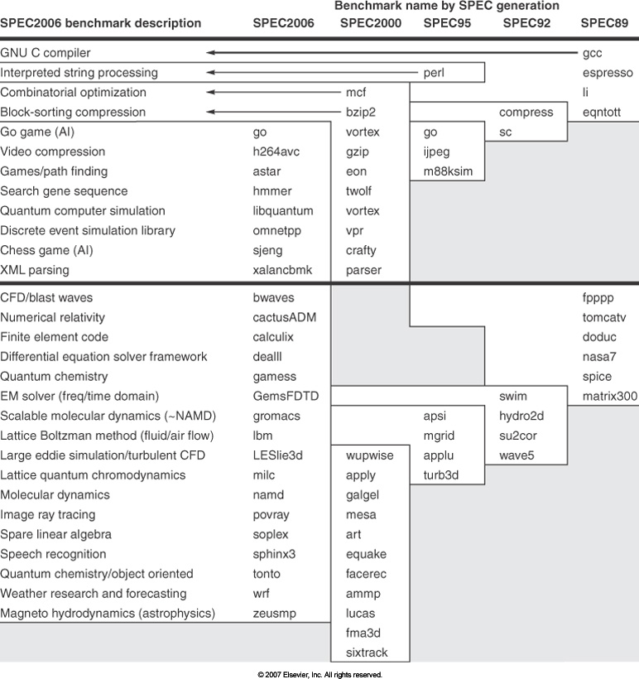
SPEC CPU Benchmarks
Wall clock time is used as a performance metric
Benchmarks measure CPU time, because of little I/O

Slide 24
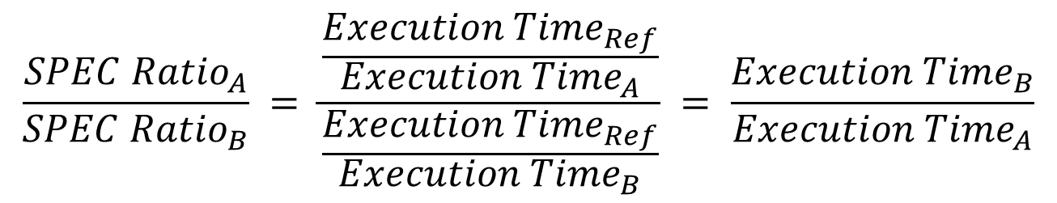
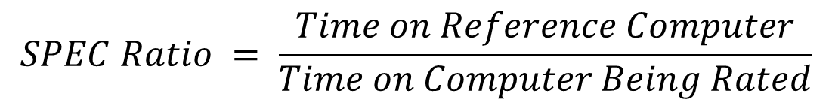
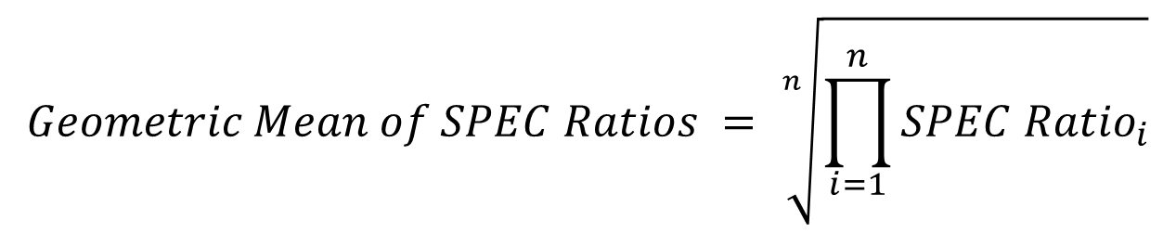
Summarizing Performance Results
$$SPEC Ratio = \frac{Time on Reference Computer}{Time on Computer Being Rated}$$
$$\frac{{SPEC Ratio}_{A}}{{SPEC Ratio}_{B}} = \frac{\frac{{Execution Time}_{Ref}}{{Execution Time}_{A}}}{\frac{{Execution Time}_{Ref}}{{Execution Time}_{B}}} = \frac{{Execution Time}_{B}}{{Execution Time}_{A}}$$
Choice of the Reference computer is irrelevant
$$Geometric Mean of SPEC Ratios = \sqrt[n]{\prod_{i=1}^{n}{{SPEC Ratio}_{i}}}$$

Slide 25
Execution Times & SPEC Ratios
Benchmark | Ultra 5 Time (sec) | Opteron Time (sec) | SpecRatio Opteron | Itanium2 Time (sec) | SpecRatio Itanium2 | Opteron/ Itanium2 Times | Itanium2/ Opteron SpecRatios
wupwise | 1600 | 51.5 | 31.06 | 56.1 | 28.53 | 0.92 | 0.92
swim | 3100 | 125.0 | 24.73 | 70.7 | 43.85 | 1.77 | 1.77
mgrid | 1800 | 98.0 | 18.37 | 65.8 | 27.36 | 1.49 | 1.49
applu | 2100 | 94.0 | 22.34 | 50.9 | 41.25 | 1.85 | 1.85
mesa | 1400 | 64.6 | 21.69 | 108.0 | 12.99 | 0.60 | 0.60
galgel | 2900 | 86.4 | 33.57 | 40.0 | 72.47 | 2.16 | 2.16
art | 2600 | 92.4 | 28.13 | 21.0 | 123.67 | 4.40 | 4.40
equake | 1300 | 72.6 | 17.92 | 36.3 | 35.78 | 2.00 | 2.00
facerec | 1900 | 73.6 | 25.80 | 86.9 | 21.86 | 0.85 | 0.85
ammp | 2200 | 136.0 | 16.14 | 132.0 | 16.63 | 1.03 | 1.03
lucas | 2000 | 88.8 | 22.52 | 107.0 | 18.76 | 0.83 | 0.83
fma3d | 2100 | 120.0 | 17.48 | 131.0 | 16.09 | 0.92 | 0.92
sixtrack | 1100 | 123.0 | 8.95 | 68.8 | 15.99 | 1.79 | 1.79
apsi | 2600 | 150.0 | 17.36 | 231.0 | 11.27 | 0.65 | 0.65
Geometric Mean |  |  | 20.86 |  | 27.12 | 1.30 | 1.30
Geometric mean of ratios = 1.30 = Ratio of Geometric means = 27.12 / 20.86

Slide 26
Things to Remember about Performance
Two common measures: Response Time and Throughput
Response Time = duration of a single task
Throughput is a rate = Number of tasks per duration of time
CPU Execution Time = Instruction Count × CPI × Cycle
MIPS = Millions of Instructions Per Second (is a rate)
FLOPS = Floating-point Operations Per Second
Amdahl's Law is a measure of speedup
When improving a fraction of the execution time
Benchmarks: real applications are used
To compare the performance of computer systems
Geometric mean of SPEC ratios (for a set of applications)

Slide 27
Performance and Power
Power is a key limitation
Battery capacity has improved only slightly over time
Need to design power-efficient processors
Reduce power by
Reducing frequency
Reducing voltage
Putting components to sleep
Performance per Watt: FLOPS per Watt
Defined as performance divided by power consumption
Important metric for energy-efficiency

Slide 28
Power in Integrated Circuits
Power is the biggest challenge facing computer design
Power should be brought in and distributed around the chip
Hundreds of pins and multiple layers just for power and ground
Power is dissipated as heat and must be removed
In CMOS IC technology, dynamic power is consumed when switching transistors on and off
Dynamic Power = Capacitive Load × Voltage² × Frequency
× 40
5V → 1V
× 1000

Slide 29
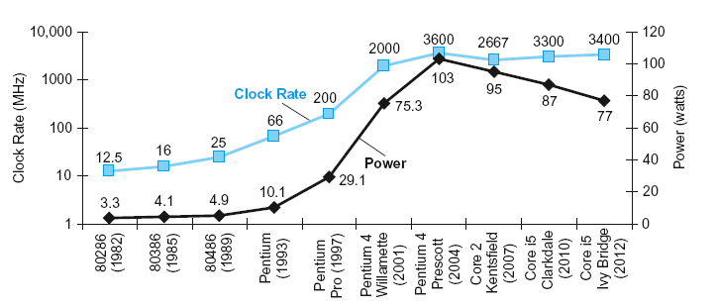
Trends in Clock Rates and Power
Power Wall: Cannot Increase the Clock Rate
Heat must be dissipated from a 1.5 × 1.5 cm chip
Intel 80386 (1985) consumed about 2 Watts
Intel Core i7 running at 3.3 GHz consumes 130 Watts
This is the limit of what can be cooled by air

Slide 30
Example on Power Consumption
Suppose a new CPU has
85% of capacitive load of old CPU
15% voltage and 15% frequency reduction
Relate the Power consumption of the new and old CPUs
Answer:
The Power Wall
We cannot reduce voltage further
We cannot remove more heat from the integrated circuit
How else can we improve performance?

Slide 31
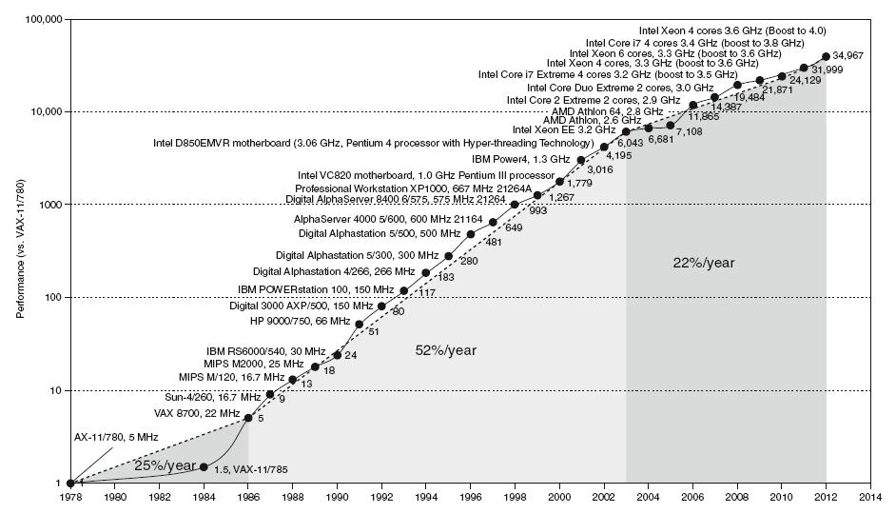
Moving to Multicores
Moving to
Multicore

Slide 32
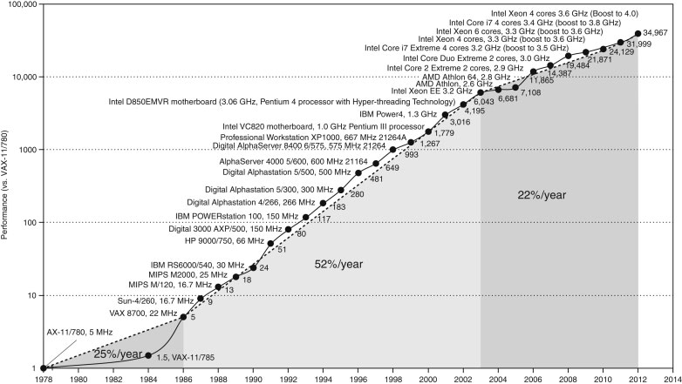
Processor Performance
Move to multicore
~35000X improvement in processor performance between 1978 and 2012
Performance is slowed down to 22% / year due to power consumption and memory latency

Slide 33
Multicore Processors
Multiprocessor on a single chip
Requires explicit parallel programming
Harder than sequential programming
Parallel programming to achieve higher performance
Optimizing communication and synchronization
Load Balancing
In addition, each core supports instruction-level parallelism
Parallelism at the instruction level
Parallelism is extracted by the hardware or the compiler
Each core executes multiple instructions each cycle
This type of parallelism is hidden from the programmer

