Slide 1
Memory Hierarchy and Caches
COE 301 / ICS 233
Computer Organization
Dr. Muhamed Mudawar
College of Computer Sciences and Engineering
King Fahd University of Petroleum and Minerals

Slide 2
Presentation Outline
Random Access Memory and its Structure
Memory Hierarchy and the need for Cache Memory
The Basics of Caches
Cache Performance and Memory Stall Cycles
Improving Cache Performance
Multilevel Caches

Slide 3
Memory Technology
Static RAM (SRAM)
Used typically to implement Cache memory
Requires 6 transistors per bit
Low power to retain bit
Dynamic RAM (DRAM)
Used typically to implement Main Memory
One transistor + capacitor per bit
Must be re-written after being read
Must be refreshed periodically
By reading and rewriting all the rows in the DRAM

Slide 4
Static RAM Storage Cell
Static RAM (SRAM) Memory
Typically used for caches
Provides fast access time
Cell Implementation:
6-Transistor cell
Cross-coupled inverters store bit
Two pass transistors
Row decoder selects the word line
Pass transistors enable the cell to be read and written
Word line
Vcc
bit
bit
Typical SRAM cell
Word line
bit
bit

Slide 5
Dynamic RAM Storage Cell
Dynamic RAM (DRAM): cheap, dense, but slower than SRAM
Typical choice for main memory
Cell Implementation:
1-Transistor cell (pass transistor)
Trench capacitor (stores bit)
Bit is stored as a charge on capacitor
Must be refreshed periodically
Because of leakage of charge from tiny capacitor
Refreshing for all memory rows
Reading each row and writing it back to restore the charge
Word line
Pass
Transistor
Capacitor
bit
Typical DRAM cell
Notes:
Let’s summarize today’s lecture. The first thing we covered is the principle of locality.
There are two types of locality: temporal, or locality of time and spatial, locality of space.
We talked about memory system design.
The key idea of memory system design is to present the user with as much memory as possible in the cheapest technology while by taking advantage of the principle of locality, create an illusion that the average access time is close to that of the fastest technology.
As far as Random Access technology is concerned, we concentrate on 2: DRAM and SRAM.
DRAM is slow but cheap and dense so is a good choice for presenting the use with a BIG memory system.
SRAM, on the other hand, is fast but it is also expensive both in terms of cost and power, so it is a good choice for providing the user with a fast access time.
I have already showed you how DRAMs are used to construct the main memory for the SPARCstation 20.
On Friday, we will talk about caches.
+2 = 78 min. (Y:58)

Slide 6
Example of a Memory Chip
24-pin dual in-line package: 2²² × 4-bit = 16Mibit memory
22-bit address is divided into
11-bit row address
11-bit column address
Interleaved on same address lines
Legend
Ai
Address bit i
CAS
Column address strobe
Dj
Data bit j
NC
No connection
OE
Output enable
RAS
Row address strobe
WE
Write enable
Vss
D4
D3
CAS
OE
A9
A8
A7
A6
A5
A4
Vss
24
23
22
21
20
19
18
17
16
15
14
13
1
2
3
4
5
6
7
8
9
10
11
12
Vcc
D1
D2
WE
RAS
NC
A10
A0
A1
A2
A3
Vcc

Slide 7
Typical Memory Structure
Row decoder
Select row to read/write
Column decoder
Select column to read/write
Cell Matrix
2D array of tiny memory cells
Sense/Write amplifiers
Sense & amplify data on read
Drive bit line with data in on write
Same data lines are used for data in/out
2^{r} × 2^{c} × m bits
Cell Matrix
Row Decoder
r
. . .
Row address
Sense/write amplifiers
Data
m
Row Latch 2^{c} × m bits
. . .
Column Decoder
c
Column address

Slide 8
DRAM Operation
Row Access (RAS)
Latch and decode row address to enable addressed row
Small change in voltage detected by sense amplifiers
Latch whole row of bits
Sense amplifiers drive bit lines to recharge storage cells
Column Access (CAS) read and write operation
Latch and decode column address to select m bits
m = 4, 8, 16, or 32 bits depending on the DRAM package
On read, send latched bits out to chip pins
On write, charge storage cells to required value
Can perform multiple column accesses to same row (burst mode)

Slide 9
Burst Mode Operation
Used for Block Transfer
Row address is latched and decoded
A read operation causes ALL cells in a selected row to be read
Selected row is latched internally inside the DRAM chip
Column address is latched and decoded
Selected column data is placed in the data output register
Column address is incremented automatically
Multiple data items are read depending on the block length
Fast transfer of blocks between main memory and cache
Fast transfer of pages between main memory and disk

Slide 10
SDRAM and DDR SDRAM
SDRAM is Synchronous Dynamic RAM
Added clock to DRAM interface
SDRAM is synchronous with the system clock
Older DRAM technologies were asynchronous
As system bus clock improved, SDRAM delivered higher performance than asynchronous DRAM
DDR is Double Data Rate SDRAM
Like SDRAM, DDR is synchronous with the system clock, but the difference is that DDR reads data on both the rising and falling edges of the clock signal

Slide 11
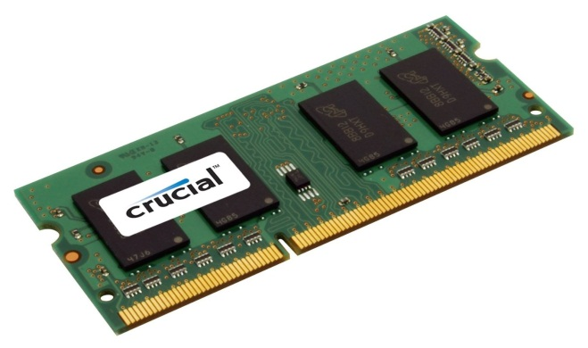
Memory Modules
Memory Rank: Set of DRAM chips accessed in parallel
Same Chip Select (CS) and Command (CMD)
Same address, but different data lines
Increases memory capacity and bandwidth
Example: 64-bit data bus using 4 × 16-bit DRAM chips
CLK
CS
CMD
CLK
CS
CMD
CLK
CS
CMD
Address
Address
. . .
Address
Data
Data
Data
m
. .
m
Data width = p × m bits

Slide 12
Trends in DRAM
Year | Memory Standard | Chip Capacity (Mibit) | Bus Clock (MHz) | Data Rate (MT/s) | Peak Bandwidth (MB/s) | Total latency to a new row / column
1996 | SDRAM | 64-128 | 100-166 | 100-166 | 800-1333 | 60 ns
2000 | DDR | 256-512 | 100-200 | 200-400 | 1600-3200 | 55 ns
2004 | DDR2 | 512-2048 | 200-400 | 400-800 | 3200-6400 | 50 ns
2010 | DDR3 | 2048-8192 | 400-800 | 800-1600 | 6400-12800 | 40 ns
2014 | DDR4 | 8192-32768 | 800-1600 | 1600-3200 | 12800-25600 | 35 ns
Memory chip capacity: 1 Mibit = 2²⁰ bits, 1 Gibit = 2³⁰ bits
Data Rate = Millions of Transfers per second (MT/s)
Data Rate = 2 × Bus Clock for DDR, DDR2, DDR3, DDR4
1 Transfer = 8 bytes of data ➔ Bandwidth = MT/s × 8 bytes

Slide 13
Memory Latency versus Bandwidth
Memory Latency
Elapsed time between sending address and receiving data
Measured in nanoseconds
The total latency to a new row/column is the time between opening a new row of memory and accessing a column within it.
Reduced from 60 ns to 35 ns (between 1996 and 2016)
Improvement in memory latency is less than 2X (1996 to 2016)
Memory Bandwidth
Rate at which data is transferred between memory and CPU
Bandwidth is measured as millions of Bytes per second
Increased from 800 to 25600 MBytes/sec (between 1996 and 2016)
Improvement in memory bandwidth is 32X (1996 to 2016)

Slide 14
DRAM Refresh Cycles
Refresh cycle is about tens of milliseconds
Refreshing is done for the entire memory
Each row is read and written back to restore the charge
Some of the memory bandwidth is lost to refresh cycles
Voltage
1 Written
Refreshed
Refreshed
Refreshed
for 1
Threshold
voltage
0 Stored
Refresh Cycle
Voltage
Time
for 0

Slide 15
Next . . .
Random Access Memory and its Structure
Memory Hierarchy and the need for Cache Memory
The Basics of Caches
Cache Performance and Memory Stall Cycles
Improving Cache Performance
Multilevel Caches

Slide 16
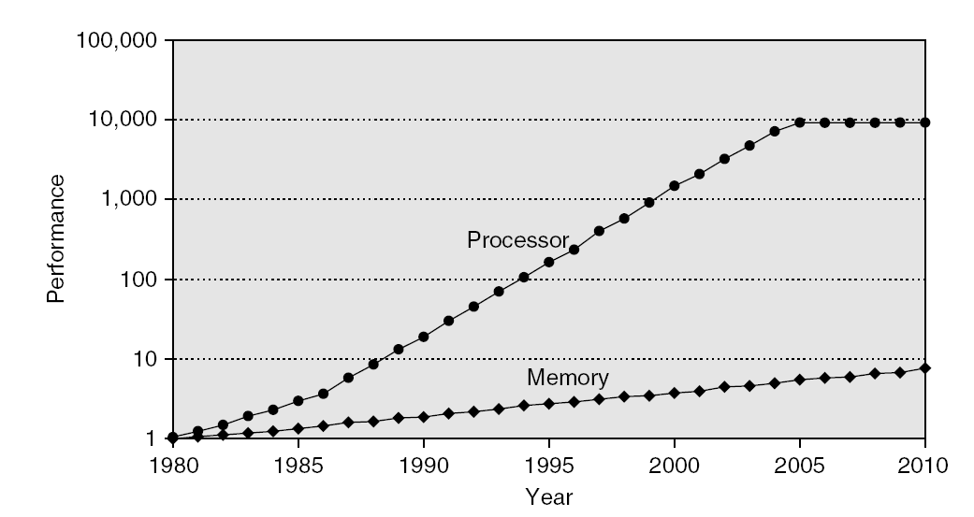
Processor-Memory Performance Gap
CPU Performance: 55% per year, slowing down after 2004
Performance Gap
DRAM: 7% per year
1980 – No cache in microprocessor
1995 – Two-level cache on microprocessor

Slide 17
The Need for Cache Memory
Widening speed gap between CPU and main memory
Processor operation takes less than 1 ns
Main memory requires more than 50 ns to access
Each instruction involves at least one memory access
One memory access to fetch the instruction
A second memory access for load and store instructions
Memory bandwidth limits the instruction execution rate
Cache memory can help bridge the CPU-memory gap
Cache memory is small in size but fast

Slide 18
Typical Memory Hierarchy
Registers are at the top of the hierarchy
Typical size < 1 KB
Access time < 0.5 ns
Level 1 Cache (8 – 64 KiB)
Access time: 1 ns
L2 Cache (1 MiB – 8 MiB)
Access time: 3 – 10 ns
Main Memory (8 – 32 GiB)
Access time: 40 – 50 ns
Disk Storage (> 200 GB)
Access time: 5 – 10 ms
Microprocessor
Registers
L1 Cache
L2 Cache
Faster
Memory Bus
Bigger
Main Memory
I/O Bus
Magnetic or Flash Disk

Slide 19
Principle of Locality of Reference
Programs access small portion of their address space
At any time, only a small set of instructions & data is needed
Temporal Locality (in time)
If an item is accessed, probably it will be accessed again soon
Same loop instructions are fetched each iteration
Same procedure may be called and executed many times
Spatial Locality (in space)
Tendency to access contiguous instructions/data in memory
Sequential execution of Instructions
Traversing arrays element by element

Slide 20
What is a Cache Memory ?
Small and fast (SRAM) memory technology
Stores the subset of instructions & data currently being accessed
Used to reduce average access time to memory
Caches exploit temporal locality by …
Keeping recently accessed data closer to the processor
Caches exploit spatial locality by …
Moving blocks consisting of multiple contiguous words
Goal is to achieve
Fast speed of cache memory access
Balance the cost of the memory system

Slide 21
Cache Memories in the Datapath
Imm16
Ext
Imm
ALU result
32
I-Cache
0
A
32
1
D-Cache
Instruction
Rs
5
BusA
2
A
L
U
R
0
Data
RA
3
Address
0
Instruction
Rt
Register File
5
RB
BusB
0
B
Data_out
32
PC
Address
1
1
1
D
1
2
RW
BusW
2
0
Data_in
3
32
0
32
Rd2
Rd3
Rd4
Rd
1
clk
Instruction Block
I-Cache miss or D-Cache miss causes pipeline to stall
Block Address
D-Cache miss
Data Block
I-Cache miss
Block Address
Interface to L2 Cache or Main Memory

Slide 22
Almost Everything is a Cache !
In computer architecture, almost everything is a cache!
Registers: a cache on variables – software managed
First-level cache: a cache on second-level cache
Second-level cache: a cache on memory (or L3 cache)
Memory: a cache on hard disk
Stores recent programs and their data
Hard disk can be viewed as an extension to main memory
Branch target and prediction buffer
Cache on branch target and prediction information

Slide 23
Next . . .
Random Access Memory and its Structure
Memory Hierarchy and the need for Cache Memory
The Basics of Caches
Cache Performance and Memory Stall Cycles
Improving Cache Performance
Multilevel Caches

Slide 24
Four Basic Questions on Caches
Q1: Where can a block be placed in a cache?
Block placement
Direct Mapped, Set Associative, Fully Associative
Q2: How is a block found in a cache?
Block identification
Block address, tag, index
Q3: Which block should be replaced on a cache miss?
Block replacement
FIFO, Random, LRU
Q4: What happens on a write?
Write strategy
Write Back or Write Through cache (with Write Buffer)

Slide 25
Inside a Cache Memory
Processor
Address
Cache
Memory
Address
Main
Memory
Data
Data
Tags identify
blocks in
the cache
Address Tag 0
Cache Block 0
Address Tag 1
Cache Block 1
N Cache Blocks
. . .
. . .
Tag N – 1
Cache Block N – 1
Cache Block (or Cache Line)
Unit of data transfer between main memory and a cache
Large block size ➔ Less tag overhead + Burst transfer from DRAM
Typically, cache block size = 64 bytes in recent caches

Slide 26
Block Placement: Direct Mapped
Block: unit of data transfer between cache and memory
Direct Mapped Cache:
A block can be placed in exactly one location in the cache
000
001
010
011
100
101
110
111
In this example:
Cache index =
least significant 3 bits of Block address
Cache
Main
Memory
00000
00001
00010
00011
00100
00101
00110
00111
01000
01001
01010
01011
01100
01101
01110
01111
10000
10001
10010
10011
10100
10101
10110
10111
11000
11001
11010
11011
11100
11101
11110
11111

Slide 27
Direct-Mapped Cache
A memory address is divided into
Block address: identifies block in memory
Block offset: to access bytes within a block
A block address is further divided into
Index: used for direct cache access
Tag: most-significant bits of block address
Index = Block Address mod Cache Blocks
Tag must be stored also inside cache
For block identification
A valid bit is also required to indicate
Whether a cache block is valid or not
Block Address
Tag
Index
offset
V
Tag
Block Data
=
Data
Hit

Slide 28
Direct Mapped Cache – cont’d
Cache hit: block is stored inside cache
Index is used to access cache block
Address tag is compared against stored tag
If equal and cache block is valid then hit
Otherwise: cache miss
If number of cache blocks is 2^{n}
n bits are used for the cache index
If number of bytes in a block is 2^{b}
b bits are used for the block offset
If 32 bits are used for an address
32 – n – b bits are used for the tag
Cache data size = 2^{n+b} bytes
Block Address
Tag
Index
offset
V
Tag
Block Data
=
Data
Hit

Slide 29
Mapping an Address to a Cache Block
Example
Consider a direct-mapped cache with 256 blocks
Block size = 16 bytes
Compute tag, index, and byte offset of address: 0x01FFF8AC
Solution
32-bit address is divided into:
4-bit byte offset field, because block size = 2⁴ = 16 bytes
8-bit cache index, because there are 2⁸ = 256 blocks in cache
20-bit tag field
Byte offset = 0xC = 12 (least significant 4 bits of address)
Cache index = 0x8A = 138 (next lower 8 bits of address)
Tag = 0x01FFF (upper 20 bits of address)
Block Address
20
8
4
Tag
Index
offset

Slide 30
Example on Cache Placement & Misses
Consider a small direct-mapped cache with 32 blocks
Cache is initially empty, Block size = 16 bytes
The following memory addresses (in decimal) are referenced:
1000, 1004, 1008, 2548, 2552, 2556.
Map addresses to cache blocks and indicate whether hit or miss
Solution:
1000 = 0x3E8 cache index = 0x1E Miss (first access)
1004 = 0x3EC cache index = 0x1E Hit
1008 = 0x3F0 cache index = 0x1F Miss (first access)
2548 = 0x9F4 cache index = 0x1F Miss (different tag)
2552 = 0x9F8 cache index = 0x1F Hit
2556 = 0x9FC cache index = 0x1F Hit
23
5
4
Tag
Index
offset

Slide 31
Fully Associative Cache
A block can be placed anywhere in cache ⇒ no indexing
If m blocks exist then
m comparators are needed to match tag
Cache data size = m × 2^{b} bytes
Address
Tag
offset
V
Tag
Block Data
V
Tag
Block Data
V
Tag
Block Data
V
Tag
Block Data
=
=
=
=
mux
m-way associative
Hit
Data

Slide 32
Set-Associative Cache
A set is a group of blocks that can be indexed
A block is first mapped onto a set
Set index = Block address mod Number of sets in cache
If there are m blocks in a set (m-way set associative) then
m tags are checked in parallel using m comparators
If 2^{n} sets exist then set index consists of n bits
Cache data size = m × 2^{n+b} bytes (with 2^{b} bytes per block)
Without counting tags and valid bits
A direct-mapped cache has one block per set (m = 1)
A fully-associative cache has one set (2^{n} = 1 or n = 0)

Slide 33
Set-Associative Cache Diagram
Address
Tag
Index
offset
V
Tag
Block Data
V
Tag
Block Data
V
Tag
Block Data
V
Tag
Block Data
=
=
=
=
m-way set-associative
Hit
mux
Data

Slide 34
Write Policy
Write Through:
Writes update cache and lower-level memory
Cache control bit: only a Valid bit is needed
Memory always has latest data, which simplifies data coherency
Can always discard cached data when a block is replaced
Write Back:
Writes update cache only
Cache control bits: Valid and Modified bits are required
Modified cached data is written back to memory when replaced
Multiple writes to a cache block require only one write to memory
Uses less memory bandwidth than write-through and less power
However, more complex to implement than write through

Slide 35
What Happens on a Cache Miss?
Cache sends a miss signal to stall the processor
Decide which cache block to allocate/replace
One choice only when the cache is directly mapped
Multiple choices for set-associative or fully-associative cache
Transfer the block from lower level memory to this cache
Set the valid bit and the tag field from the upper address bits
If block to be replaced is modified then write it back
Modified block is written back to memory
Otherwise, block to be replaced can be simply discarded
Restart the instruction that caused the cache miss
Miss Penalty: clock cycles to process a cache miss

Slide 36
Replacement Policy
Which block to be replaced on a cache miss?
No selection alternatives for direct-mapped caches
m blocks per set to choose from for associative caches
Random replacement
Candidate blocks are randomly selected
One counter for all sets (0 to m – 1): incremented on every cycle
On a cache miss replace block specified by counter
First In First Out (FIFO) replacement
Replace oldest block in set
One counter per set (0 to m – 1): specifies oldest block to replace
Counter is incremented on a cache miss

Slide 37
Replacement Policy – cont’d
Least Recently Used (LRU)
Replace block that has been unused for the longest time
Order blocks within a set from least to most recently used
Update ordering of blocks on each cache hit
With m blocks per set, there are m! possible permutations
Pure LRU is too costly to implement when m > 2
m = 2, there are 2 permutations only (a single bit is needed)
m = 4, there are 4! = 24 possible permutations
LRU approximation is used in practice
For large m > 4,
Random replacement can be as effective as LRU

Slide 38
Next . . .
Random Access Memory and its Structure
Memory Hierarchy and the need for Cache Memory
The Basics of Caches
Cache Performance and Memory Stall Cycles
Improving Cache Performance
Multilevel Caches

Slide 39
Hit Rate and Miss Rate
Hit Rate = Hits / (Hits + Misses)
Miss Rate = Misses / (Hits + Misses)
I-Cache Miss Rate = Miss rate in the Instruction Cache
D-Cache Miss Rate = Miss rate in the Data Cache
Example:
Out of 1000 instructions fetched, 150 missed in the I-Cache
25% are load-store instructions, 50 missed in the D-Cache
What are the I-cache and D-cache miss rates?
I-Cache Miss Rate = 150 / 1000 = 15%
D-Cache Miss Rate = 50 / (25% × 1000) = 50 / 250 = 20%

Slide 40
Memory Stall Cycles
The processor stalls on a Cache miss
When fetching instructions from the Instruction Cache (I-cache)
When loading or storing data into the Data Cache (D-cache)
Memory stall cycles = Combined Misses × Miss Penalty
Miss Penalty: clock cycles to process a cache miss
Combined Misses = I-Cache Misses + D-Cache Misses
I-Cache Misses = I-Count × I-Cache Miss Rate
D-Cache Misses = LS-Count × D-Cache Miss Rate
LS-Count (Load & Store) = I-Count × LS Frequency
Cache misses are often reported per thousand instructions

Slide 41
Memory Stall Cycles Per Instruction
Memory Stall Cycles Per Instruction =
Combined Misses Per Instruction × Miss Penalty
Miss Penalty is assumed equal for I-cache & D-cache
Miss Penalty is assumed equal for Load and Store
Combined Misses Per Instruction =
I-Cache Miss Rate + LS Frequency × D-Cache Miss Rate
Therefore, Memory Stall Cycles Per Instruction =
I-Cache Miss Rate × Miss Penalty +
LS Frequency × D-Cache Miss Rate × Miss Penalty

Slide 42
Example on Memory Stall Cycles
Consider a program with the given characteristics
Instruction count (I-Count) = 10⁶ instructions
30% of instructions are loads and stores
D-cache miss rate is 5% and I-cache miss rate is 1%
Miss penalty is 100 clock cycles for instruction and data caches
Compute combined misses per instruction and memory stall cycles
Combined misses per instruction in I-Cache and D-Cache
1% + 30% × 5% = 0.025 combined misses per instruction
Equal to 25 misses per 1000 instructions
Memory stall cycles
0.025 × 100 (miss penalty) = 2.5 stall cycles per instruction
Total memory stall cycles = 10⁶ × 2.5 = 2,500,000

Slide 43
CPU Time with Memory Stall Cycles
CPU Time = I-Count × CPI_{MemoryStalls} × Clock Cycle
CPI_{MemoryStalls} = CPI_{PerfectCache} + Mem Stalls per Instruction
CPI_{PerfectCache} = CPI for ideal cache (no cache misses)
CPI_{MemoryStalls} = CPI in the presence of memory stalls
Memory stall cycles increase the CPI

Slide 44
Example on CPI with Memory Stalls
A processor has CPI of 1.5 without any memory stalls
Cache miss rate is 2% for instruction and 5% for data
20% of instructions are loads and stores
Cache miss penalty is 100 clock cycles for I-cache and D-cache
What is the impact on the CPI?
Answer:
Mem Stalls per Instruction =
CPI_{MemoryStalls} =
CPI_{MemoryStalls} / CPI_{PerfectCache} =
Processor is 3 times slower due to memory stall cycles
Instruction
data
0.02×100 + 0.2×0.05×100 = 3
1.5 + 3 = 4.5 cycles per instruction
4.5 / 1.5 = 3

Slide 45
Average Memory Access Time
Average Memory Access Time (AMAT)
AMAT = Hit time + Miss rate × Miss penalty
Time to access a cache for both hits and misses
Example: Find the AMAT for a cache with
Cache access time (Hit time) of 1 cycle = 2 ns
Miss penalty of 20 clock cycles
Miss rate of 0.05 per access
Solution:
AMAT = 1 + 0.05 × 20 = 2 cycles = 4 ns
Without the cache, AMAT will be equal to Miss penalty = 20 cycles

Slide 46
Next . . .
Random Access Memory and its Structure
Memory Hierarchy and the need for Cache Memory
The Basics of Caches
Cache Performance and Memory Stall Cycles
Improving Cache Performance
Multilevel Caches

Slide 47
Improving Cache Performance
Average Memory Access Time (AMAT)
AMAT = Hit time + Miss rate * Miss penalty
Used as a framework for optimizations
Reduce the Hit time
Small and simple caches
Reduce the Miss Rate
Larger cache size, higher associativity, and larger block size
Reduce the Miss Penalty
Multilevel caches

Slide 48
Small and Simple Caches
Hit time is critical: affects the processor clock cycle
Fast clock rate demands small and simple L1 cache designs
Small cache reduces the indexing time and hit time
Indexing a cache represents a time consuming portion
Tag comparison also adds to this hit time
Direct-mapped overlaps tag check with data transfer
Associative cache uses additional mux and increases hit time
Size of L1 caches has not increased much
L1 caches are the same size on Alpha 21264 and 21364
Same also on UltraSparc II and III, AMD K6 and Athlon
Reduced from 16 KB in Pentium III to 8 KB in Pentium 4!

Slide 49
Classifying Misses – Three Cs
Conditions under which misses occur
Compulsory: program starts with no block in cache
Also called cold start misses
Misses that would occur even if a cache has infinite size
Capacity: misses happen because cache size is finite
Blocks are replaced and then later retrieved
Misses that would occur in a fully associative cache of a finite size
Conflict: misses happen because of limited associativity
Limited number of blocks per set
Non-optimal replacement algorithm

Slide 50
Classifying Misses – cont’d
Compulsory misses are independent of cache size
Very small for long-running programs
Miss Rate
Capacity misses decrease as capacity increases
14%
1-way
12%
2-way
Conflict misses decrease as associativity increases
Data were collected using LRU replacement
10%
4-way
8%
8-way
6%
Capacity
4%
Compulsory
2%
0
1
2
4
8
16
32
64
128 KB

Slide 51
Larger Size and Higher Associativity
Increasing cache size reduces capacity misses
It also reduces conflict misses
Larger cache size spreads out references to more blocks
Drawbacks: longer hit time and higher cost
Larger caches are especially popular as 2nd level caches
Higher associativity also improves miss rates
Eight-way set associative is as effective as a fully associative

Slide 52
Larger Block Size
Simplest way to reduce miss rate is to increase block size
However, it increases conflict misses if cache is small
25%
Increased Conflict Misses
Reduced Compulsory Misses
20%
64-byte blocks are common in L1 caches
128-byte block are common in L2 caches
1K
15%
4K
Miss Rate
10%
16K
64K
5%
256K
0%
16
32
64
128
256
Block Size (bytes)

Slide 53
Multilevel Caches
Top level cache should be kept small to
Keep pace with processor speed
Adding another cache level
Can reduce the memory gap
Can reduce memory bus loading
Local miss rate
Number of misses in a cache / Memory accesses to this cache
Miss Rate_{L1} for L1 cache, and Miss Rate_{L2} for L2 cache
Global miss rate
Number of misses in a cache / Memory accesses generated by CPU
Miss Rate_{L1} for L1 cache, and Miss Rate_{L1} × Miss Rate_{L2} for L2 cache
I-Cache
D-Cache
Unified L2 Cache
Main Memory

Slide 54
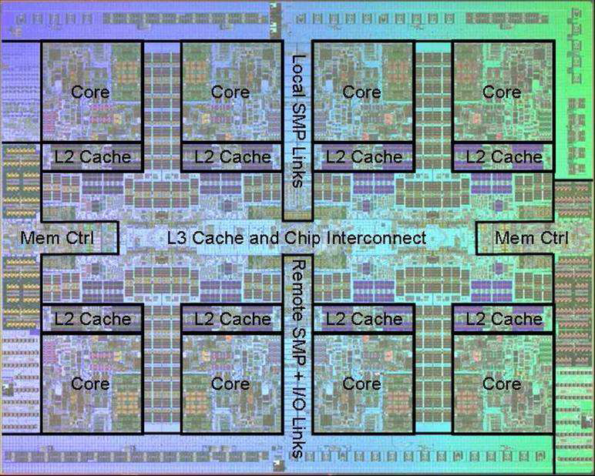
Power 7 On-Chip Caches [IBM 2010]
32KB I-Cache/core
32KB D-Cache/core
3-cycle latency
256KB Unified
L2 Cache/core
8-cycle latency
32MB Unified
Shared L3 Cache
Embedded DRAM
25-cycle latency
to local slice

Slide 55
Multilevel Cache Policies
Multilevel Inclusion
L1 cache data is always present in L2 cache
A miss in L1, but a hit in L2 copies block from L2 to L1
A miss in L1 and L2 brings a block into L1 and L2
A write in L1 causes data to be written in L1 and L2
Typically, write-through policy is used from L1 to L2
Typically, write-back policy is used from L2 to main memory
To reduce traffic on the memory bus
A replacement or invalidation in L2 must be propagated to L1

Slide 56
Multilevel Cache Policies – cont’d
Multilevel exclusion
L1 data is never found in L2 cache – Prevents wasting space
Cache miss in L1, but a hit in L2 results in a swap of blocks
Cache miss in both L1 and L2 brings the block into L1 only
Block replaced in L1 is moved into L2
Example: AMD Athlon
Same or different block size in L1 and L2 caches
Choosing a larger block size in L2 can improve performance
However different block sizes complicates implementation
Pentium 4 has 64-byte blocks in L1 and 128-byte blocks in L2

