Slide 1
US Size Business impact
By: Ashley, Raphael, and Ethan

Slide 2
Our Process – Trial and error
First Attempt – Car Data
Second Attempt – Multiple Job Holding Data
Third Attempt – Business Size Impact Data

Slide 3
Process
Where We Found Our Data
Data Exploration and Cleanup
Analysis Process

Slide 4
Questions to Answer
Is there any correlation between Minimum Wage, business size, and number of establishments?
Is there a correlation between the number of business sizes establishments and key measures of economic growth?
Does the employee size of the business matter? Between small, medium, and large size businesses which one has the greatest correlation to positive overall economic stability.
What is the ideal business size an employee would want to work on a personal perspective?

Slide 5
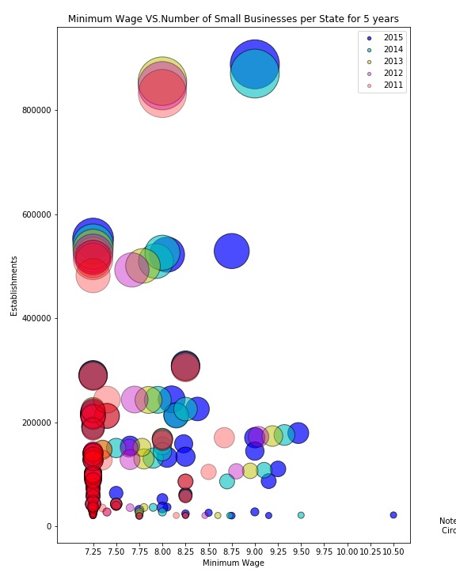
Is there any correlation between Minimum Wage, business size, and number of establishments?

Slide 6
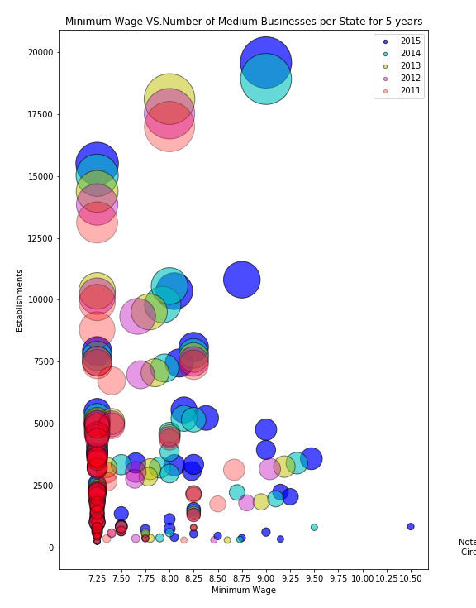
Is there any correlation between Minimum Wage, business size, and number of establishments?

Slide 7
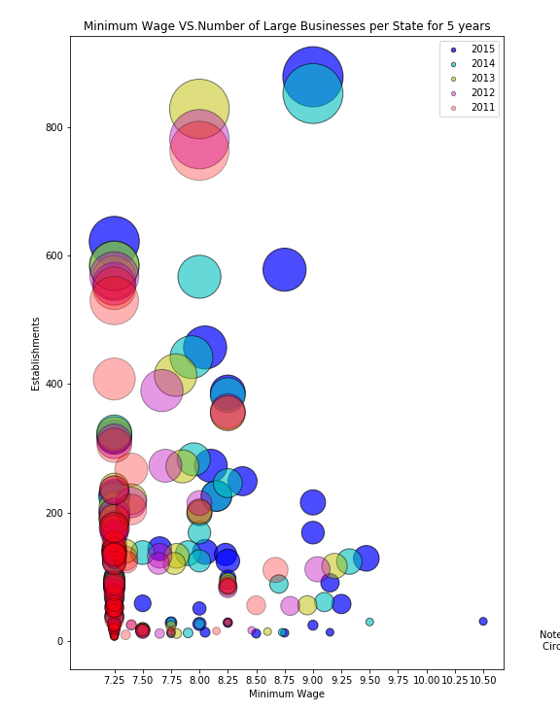
Is there any correlation between Minimum Wage, business size, and number of establishments?

Slide 8
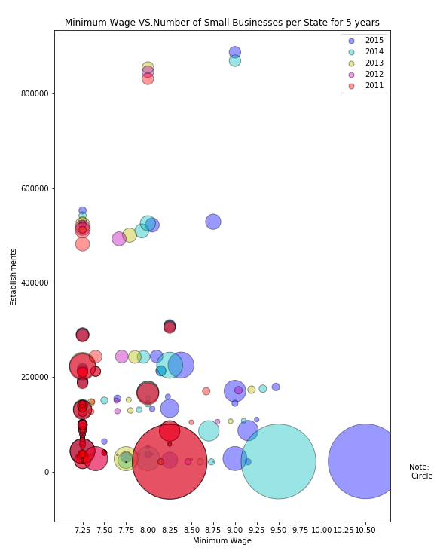
Is there any correlation between Minimum Wage, business size, and number of establishments?

Slide 9
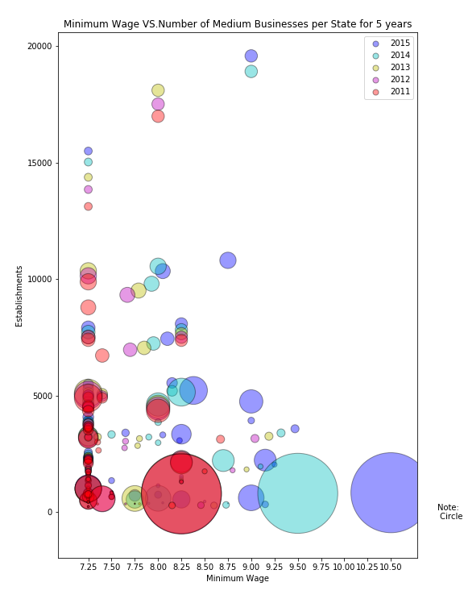
Is there any correlation between Minimum Wage, business size, and number of establishments?

Slide 10
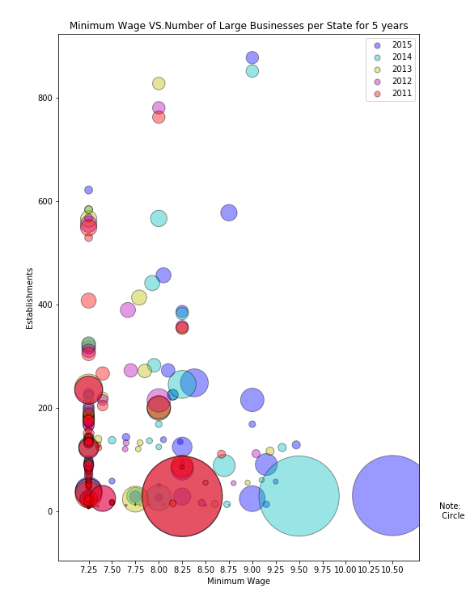
Is there any correlation between Minimum Wage, business size, and number of establishments?

Slide 11
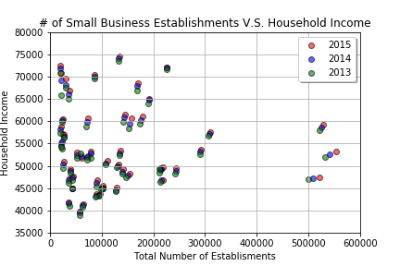
Number of business establishments and key measures of economic growth

Slide 12
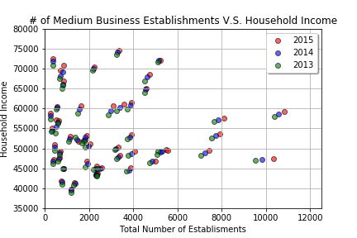
Number of business establishments and key measures of economic growth

Slide 13
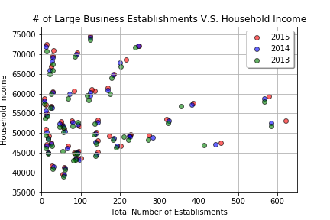
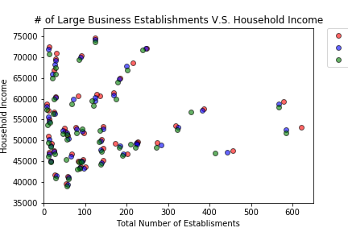
Number of business establishments and key measures of economic growth

Slide 14
Number of business establishments and key measures of economic growth

Slide 15
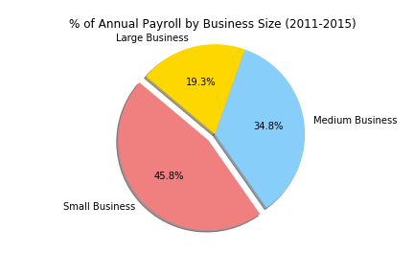
Does the amount of employees in a business matter?

Slide 16
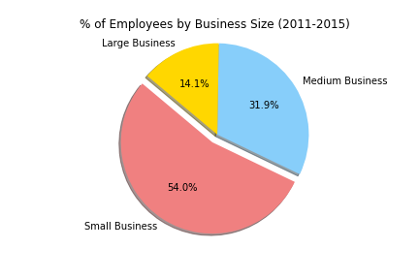
Does the amount of employees in a business matter?

Slide 17
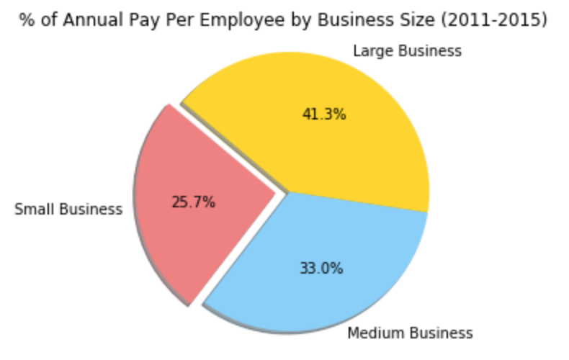
Does the amount of employees in a business matter?

Slide 18
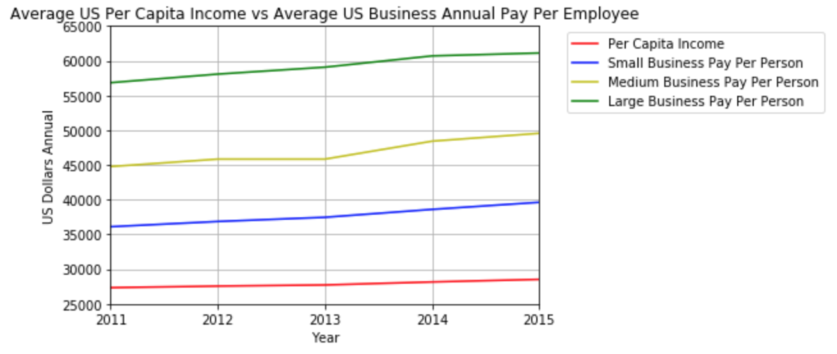
What is the ideal business size an employee would want to work on a personal perspective?

Slide 19
Conclusion
Business size does effect the outcome annual pay. The larger the business, the more annual pay an employee will have.
Minimum wage does not effect business size.
Population effects the amount of business in an area.

