Slide 1

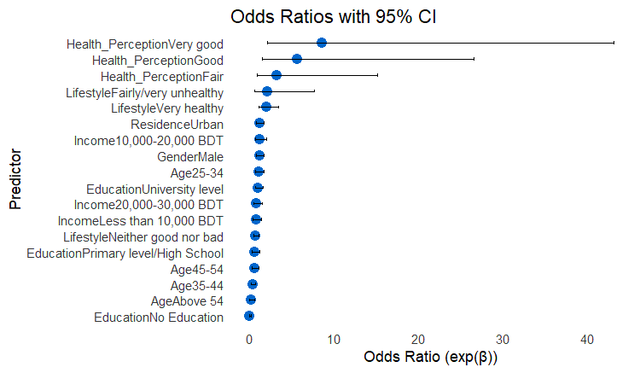
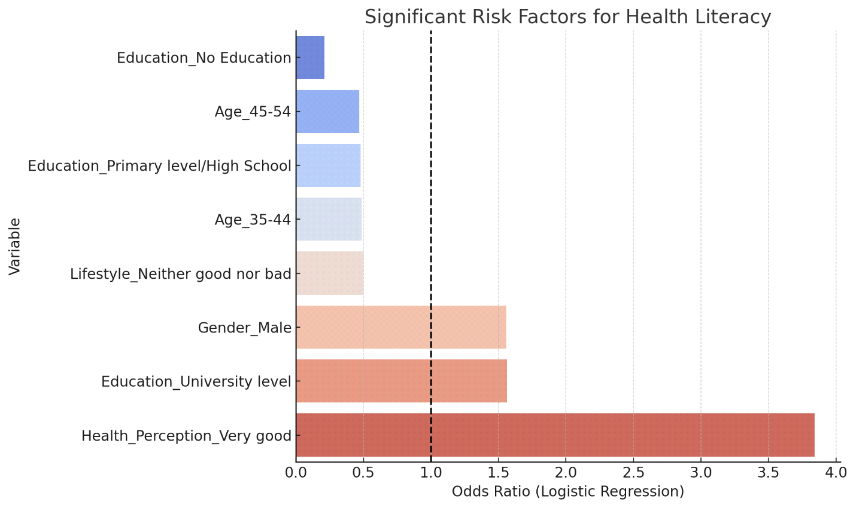
Project Title: DIGITAL HEALTH LITERACY AND IMPLEMENTATION OF AI –SEEKING BEHAVIORS IN THE NORTHERN REGION PEOPLES USING eHEALS
Programme of Study: Aimed at assessing and enhancing DHL through
AI and eHEALS in northern Bangladesh
Researcher: Airen Akther
Aims & Objectives
Key Concepts
Bangladesh has long faced significant health injuries, particularly between pastoral and civic areas. The difference between these regions are notable in terms of healthcare vacuity and the quality of care handed. This study aims to address this gap by examining the digital health knowledge and chops of individualities in the northern region, fastening on their capability to use digital healthcare platforms. As countries work to improve access to essential health services, using digital technology in education and healthcare has the potential to bridge gaps especially for underserved communities. However, further studies are needed to understand how effectively these tools are being used and how they can be improved to meet local needs. The objectives are listed below:
To investigate the attachment on globalization
To sought out the lack or risk factors
To execute a best model in predicting improving literacy level in Bangladesh.
Digital health literacy (DHL), also referred to as eHealth literacy, is the ability to seek, find, understand, and appraise health information from electronic sources and apply the knowledge gained to addressing or solving a health problem
Big Data analytics is the act of gathering, arranging, and examining huge amounts of data to identify trends and other pertinent details. It makes use of technology and procedures that manage numerous, intricate, and sizable datasets.
Machine learning is a branch of artificial intelligence that deals with building algorithms that can analyze, interpret, and forecast data to make judgments. Machine learning models forecast the chance of equipment failure in this situation.
Data preprocessing- The methods utilized to transform unprocessed data into a clean dataset. Preprocessing in predictive maintenance can involve data transformation, noise filtering, missing value imputation, and standardization.
Logistic regression is a type of supervised learning technique used primarily for binary classification problems. It predicts the likelihood of a certain outcome, event, or classification based on input data. The result produced by the model is categorical with only two possible values such as yes/no, 0/1, or true/false—for instance, a '0' may indicate a negative outcome, while a '1' represents a positive outcome
Model evaluation is the process of applying metrics like precision, recall, F1-score, and confusion matrix to assess a machine learning model's accuracy and predictive power.
Research Methodology
Figure 6. Important feature analysis of digital health literacy
Data/ Observations
Key Findings
Once the data had been preprocessed, I conducted a logistic regression analysis to explore the relationship between digital health literacy and various participant characteristics. Based on this analysis, I identified several risk factors to further assess how health literacy is influenced by these individual traits (see Figure 6). All statistical procedures were carried out using Microsoft Excel (Version 2013), Power BI (Version 2013), and RStudio (Version 4.4.3). Data cleaning and missing value imputation were managed in Excel, while the logistic regression modeling and risk factor analysis were performed in Rstudio.
The data used in this study were primary in nature, gathered directly from original sources.
An online survey was conducted using Google Forms to collect responses. A convenience sampling method was employed, involving 1,263 participants from various locations across Bangladesh, including hospitals, high schools, colleges, and other public spaces. Individuals who were unable to read English and those under the age of 18 were excluded from the study.
A total of 704 participants(I took only the northern part in my studies) were recruited for the study and more than half (51.136363%) were male (Figure 1). Fifty-one (51.85%) live in urban. Most of the participants in this survey education level is high about 45.45% participants are university level students.
This study examined digital health literacy—also known as online health literacy—and explored various factors that influence it within this context.
The findings of this study also showed a positive relationship between digital health literacy and individuals’ attitudes toward online health assessments.
Although there is some existing research on digital health in Bangladesh, gender-specific aspects remain largely unexplored this study found that men generally possess greater knowledge and familiarity with digital tools compared to women .
In this article, we offered a practical definition of health literacy, reflecting key elements from existing literature. Additionally, we introduced a new conceptual framework based on a review of health literacy theories.
In this survey results confirm that socioeconomic disadvantages—particularly in education, location, and income—play a role in shaping digital health literacy. This study adds to the growing body of knowledge on the connection between digital health literacy and individual characteristics, especially in the northern regions of Bangladesh.
Research Questions/ Hypothesis
What is the level of digital health literacy knowledge in northern region peoples?
What kind of factors are main concern for DHL and how to improve this ?
How can they take to AI in their daily activities ? Is it positive/neutral/negative?
Is it possible for DHL readings can help with the predictive ?
Score Range | Interpretation
0–3 | Low digital health literacy (DHL)
3–6 | Moderate DHL — limited skills and access
6–8 | High DHL — generally competent
8–10 | Very high DHL — digitally empowered individuals
Component | Average Score
Internet use | 1.40 / 2
Health-related app usage | 0.27 / 1
Online health service usage | 0.31 / 1
Online source usage (6 types) | 1.71 / 6
Total DHL Score | 3.68 / 10
Conclusions
This study explored the level of digital health literacy and examined how artificial intelligence can be used to assess and enhance literacy in this area. In the process of measuring digital health literacy, several key factors were identified as being significantly associated with literacy levels. Among these, the lack of formal education emerged as a major risk factor for poor digital health literacy in the northern regions of Bangladesh. While these results align with some earlier studies, they also contrast with others, particularly in how strongly education correlates with health literacy. This highlights the need for further research, backed by reliable data, to better understand how educational attainment influences digital health literacy within specific geographical areas. The insights gained from this study could inform coordinated local development efforts and guide district-level administrative strategies aimed at improving digital health literacy in Bangladesh.
Characteristics | Frequency (704) | Percentage (%)
Gender
Male | 360 | 51.13636364
Female | 343 | 48.72159091
Age |  | 0
18-24 | 293 | 41.61931818
25-34 | 139 | 19.74431818
35-44 | 99 | 14.0625
45-54 | 90 | 12.78409091
Above 54 | 82 | 11.64772727
Income level |  | 0
less than 10000 | 240 | 34.09090909
10000-20000 | 202 | 28.69318182
20000-30000 | 135 | 19.17613636
>30000 | 240 | 34.09090909
Resident |  | 0
Urban | 365 | 51.84659091
Rural | 338 | 48.01136364
Education |  | 0
University level | 320 | 45.45454545
Higher Secondary/college | 177 | 25.14204545
Primary level/High School | 126 | 17.89772727
No Education | 80 | 11.36363636
Figure 2. Interpretation of DHL score
Figure 3. Estimated DHL score (1-10 scale)
Figure 4. Odds count in predictor variable
Metric | Value
Accuracy | 66.5%
Precision (High HL) | 51.2%
Recall (High HL) | 35.0%
F1-Score (High HL) | 41.6%
Figure 1. Characteristics of the participants
Figure 5. Model Performance
References
M. B. Science, “Internet Use for Health-Related Information and Its Related Factors among Undergraduate Students in Mawlana Bhashani Science and Technology University ( MBSTU ): A Cross-Sectional Study,” no. February, 2025.
K. Leksy, “Coronavirus-Related Health Literacy of Polish School Principals A Cross-Sectional Study,” no. March 2020, 2023, doi: 10.15804/tner.2023.73.3.03.
A. Nazari, M. Hoseinnia, A. Pirzadeh, and A. Salahshouri, “The Correlation Among COVID-19 Vaccine Acceptance , the Ability to Detect Fake News , and e-Health Literacy,” vol. 7, no. 3, 2023, doi: 10.3928/24748307-20230621-01.
A. S. Azahra, D. I. Pirdaus, and A. Prabowo, “Digital Health Literacy and Telemedicine in the Information Age: A Comprehensive Review and Future Prospects,” Int. J. Linguist. Commun. Broadcast., vol. 2, no. 1, pp. 13–19, 2024, doi: 10.46336/ijlcb.v2i1.89.
A. Alhur et al., “Digital Health Literacy and Web-Based Health Information-Seeking Behaviors in the Saudi Arabian Population,” Cureus, vol. 15, no. 12, 2023, doi: 10.7759/cureus.51125.

