Slide 1
Auto Advisor
Developers: Airik Leon, David Stumpe, Dave Chirdon, Jason Caldwell

Slide 2
Inspiration for the project
All cars need maintenance at some point.
In order to make a decision, consumers should get quotes from multiple shops to make an informed decision.
With autos you would have to take your auto to multiple shops. This would require inspection fees for each shop to finalize your decision.
Our prototype creates a platform for users to place quotes & shops to place bids in order to reduce fees for consumers.

Slide 3
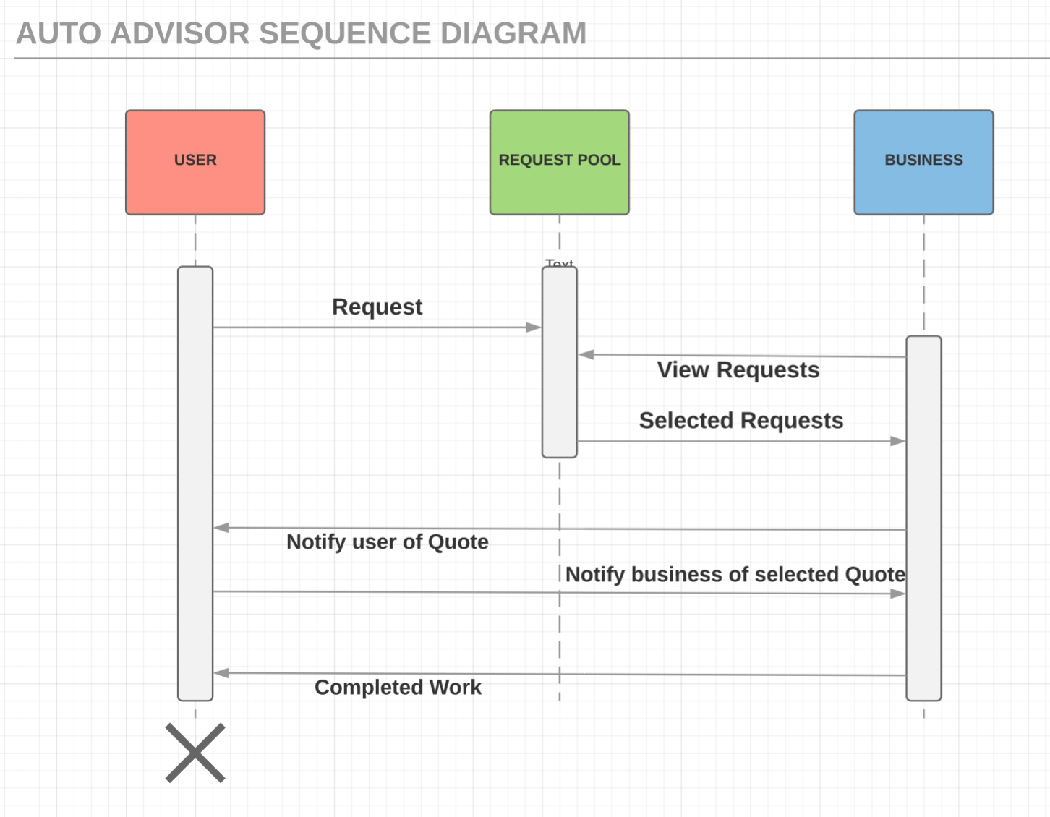
In summary

Slide 4

Main Technologies

Slide 5
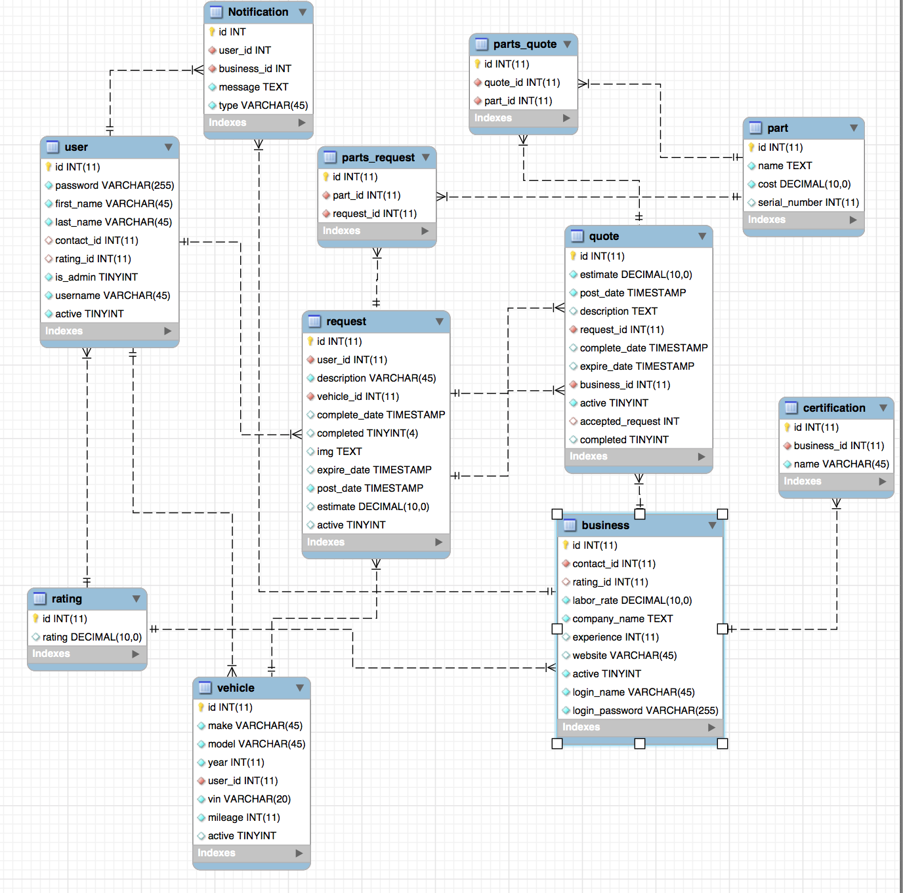
Database Schema

Slide 6
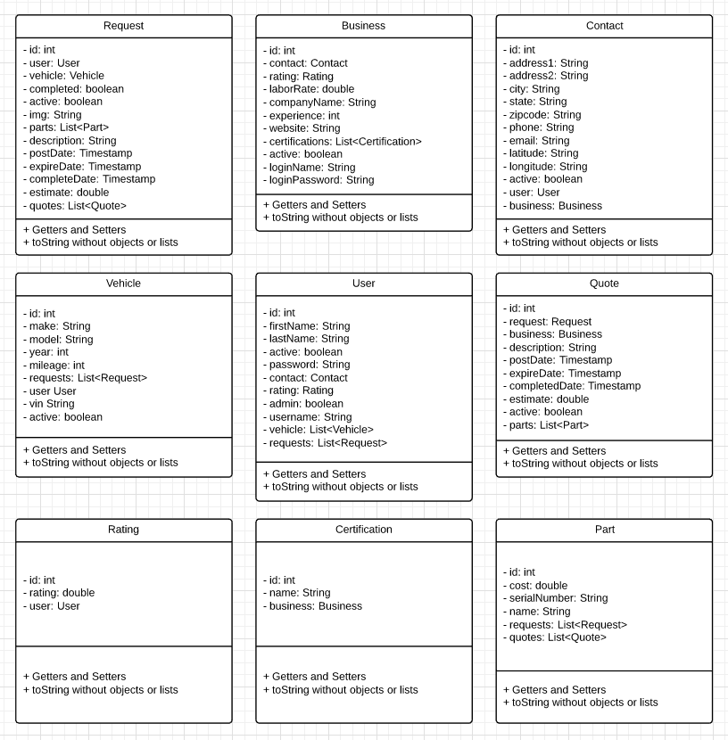
UML Class Diagram

Slide 7
Java backend
Build tool: Gradle
ORM: JPA
Integration/Unit testing: Junit
Jackson Library: JSON to object & object to JSON
Spring/Spring security: bCrypt

Slide 8
RESTful web service
HTTP AJAX requests used:
- GET, POST, PUT, DELETE
Used full CRUD for Entities users, business, requests…etc.
Request/Quotes are routed through the business/user for security
Views know nothing about the model/controller (SPRING, MySQL)
MVVM architecture where AngularJs composes the view from the view model’s services & components.

Slide 9
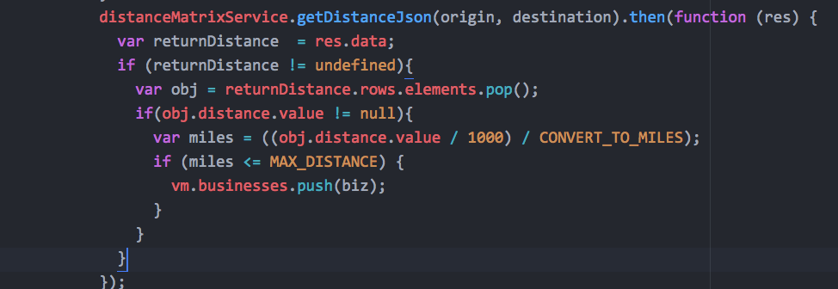
Code snippets (filtering by distance)
Geocode on registration/update to retrieve lat/long

Slide 10
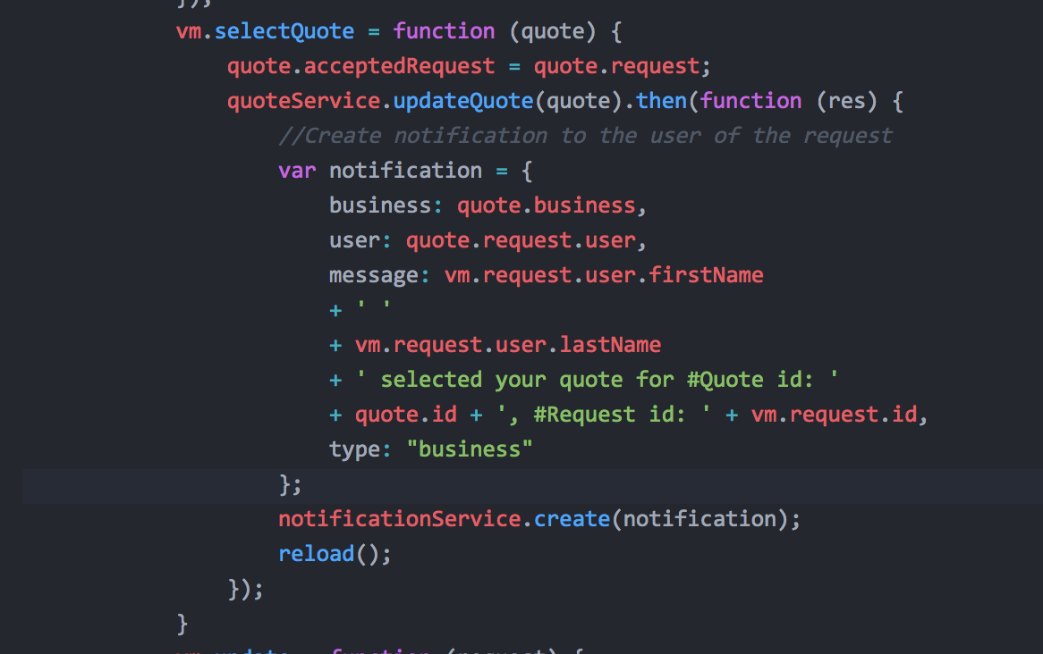
Code snippet – creating notifications

Slide 11
Future Enhancements
Parts, Ratings implementation
Validate user input
Instant notifications
S3 bucket for storage
Optimizing “request” on GET requests

Slide 12
Questions?

