Slide 1

ACCESSIBLE ACCOMODATION
MAKING ACCOMODATION EASILY ACCESSIBLE TO ALL INDIVIDUALS

Slide 2

UNIVERSITY OF GHANA, LEGON
(All rights reserved)
DEPARTMENT OF COMPUTER ENGINEERING
SCHOOL OF ENGINEERING
SEMESTER 1 2022/2023 ACADEMIC YEAR
UNIVERSITY OF GHANA
COURSE CODE AND TITLE: CPEN 211 Database System Design
COURSE INSTRUCTOR: John Korankye Assiamah
PROJECT: 1

Slide 3

GROUP: 1
Members
Lawerteh Danso Michael-10956332
Doe Agudey Daniel-10956661
Acquah Edward Ayirebi-10986982
Danso Twum Kwadjo-10947466
Acquaah-Arhin Abba-10957499
Eyiram Aba Agborson-10955078
Wurapa Larry Kwabena - 10966173

Slide 4
Problem: Lack of accommodation on campus.
Solution:
Accessible accommodation through a software or website advertisement platform.
A software or website where students can log in and have access to all kinds of rooms around campus which are available for booking for a specific period.
Private hostels, public hostels and individuals who wish to transform their homes or rented homes into halls of residence, can also log in and advertise there.
Hence an applicant can choose their room preference (number in a room, location, price etc.) based on this data, hostels or room that fit the applicant preference will be made available for the applicant to choose from. The applicant can also check up on all rooms manually.
With such an app or website there will be at least enough rooms for a considerable number of students and staff to choose from.
NOTE: In this first stage we are only creating a database for the whole project.

Slide 5
STRUCTURE OF DATABASE
ENTITIES
Category
Vendor or room manager
Room
Applicant
Payment
Applicant room

Slide 6
ENTITIES AND THEIR VARIOUS ATTRIBUTES
Attributes of the hostel manager or room vendor.
Vendor id
Name.
Contact information (email, telephone number).
Attributes of the accommodation or room.
Room id
Location
Type
The price tag of the room per individual.
Attributes of applicant
Applicant id
Name
Age
School
Level
School id
Contact information (email, telephone number).
Attributes of applicant’s room
Applicant id
Room id

Slide 7
ENTITIES AND THEIR VARIOUS ATTRIBUTES
Attributes of category
Category id
Category name
Description
Attributes of payment
Payment id
Payment method(momo, account number)

Slide 8
ENTITIES AND THE RELATIONSHIPS BETWEEN THEM
ENTITY | RELATIONSHIP | ENTITY
VENDOR | OWNERSHIP AND ADVERTISING | ROOM
VENDOR | LEASING | APPLICANT
CATEGORY | CLASSIFICATION | ROOM
APPLICANT | MAKE | PAYMENT
VENDOR | RECEIVE | PAYMENT
APPLICANT | RENTING OR HIRING | ROOM
APPLICANT_ROOM | ASSIGNMENT OR DEDICATE | ROOM

Slide 9
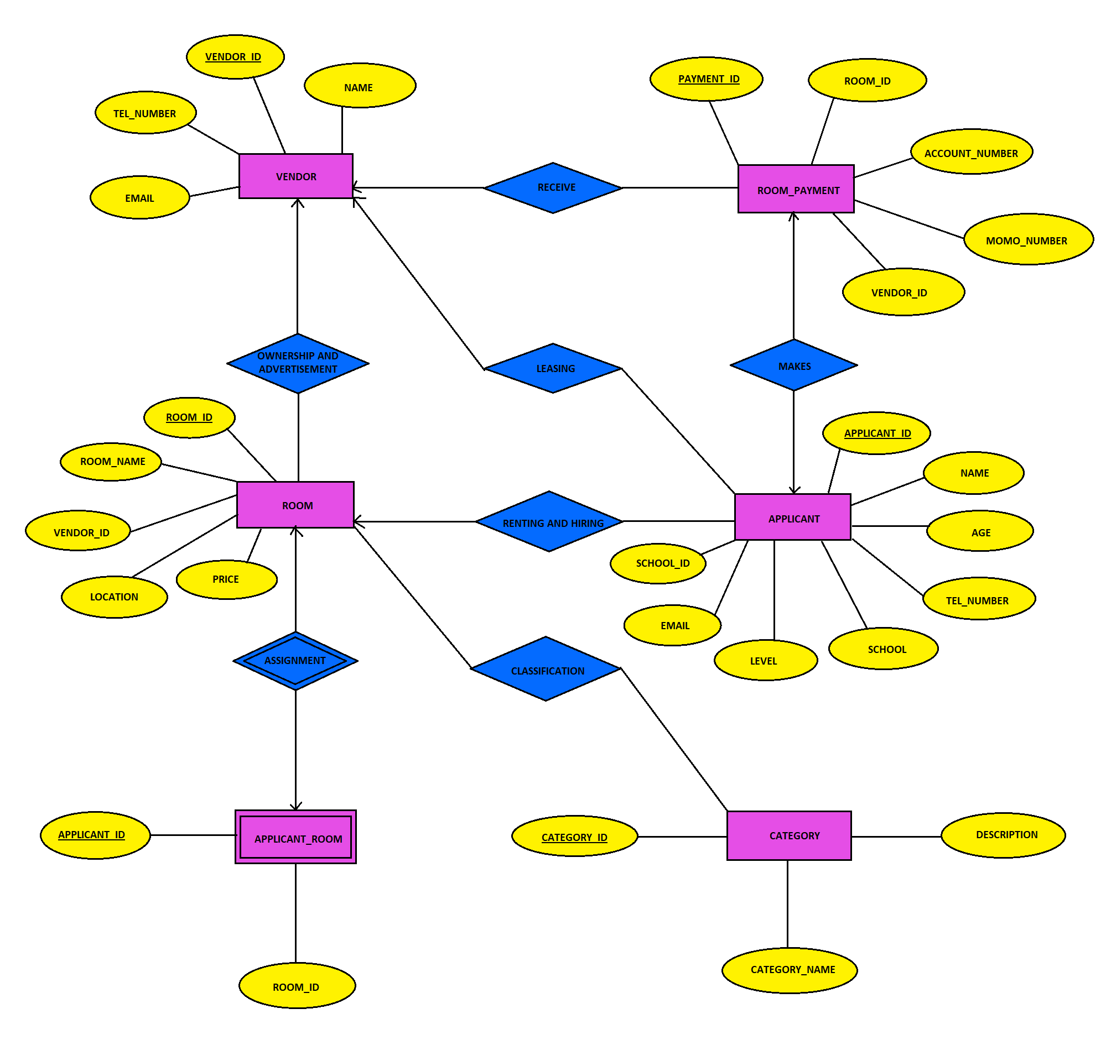
ENTITY RELATIONSHIP DIAGRAM

Slide 10
STRUCTURE OF DATABASE
SCHEMA
Category ( category_id, category_name, description)
Vendor (vendor_id. Name, tel_number, email)
Room (room_id, room_name, vendor_id, location, price)
Room_payment (payment_id, room_id, vendor_id, account_number, momo_number)
Applicant ( applicant_id, name, age, school, level, school_id, tel_number, email)
Applicant_room (applicant_id, room_id

Slide 11
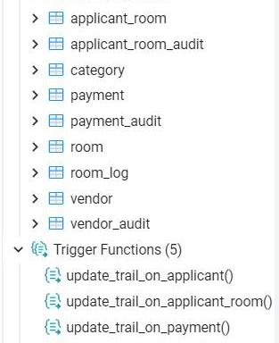
STRUCTURE OF DATABASE
ALL RELATIONS AND FUNCTIONS

Slide 12
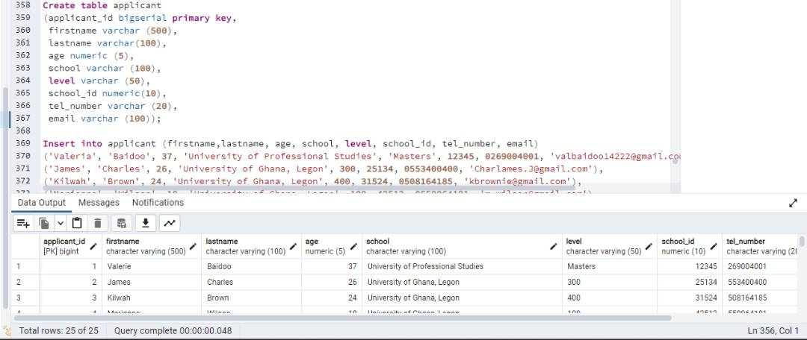
STRUCTURE OF DATABASE
APPLICANT TABLE

Slide 13
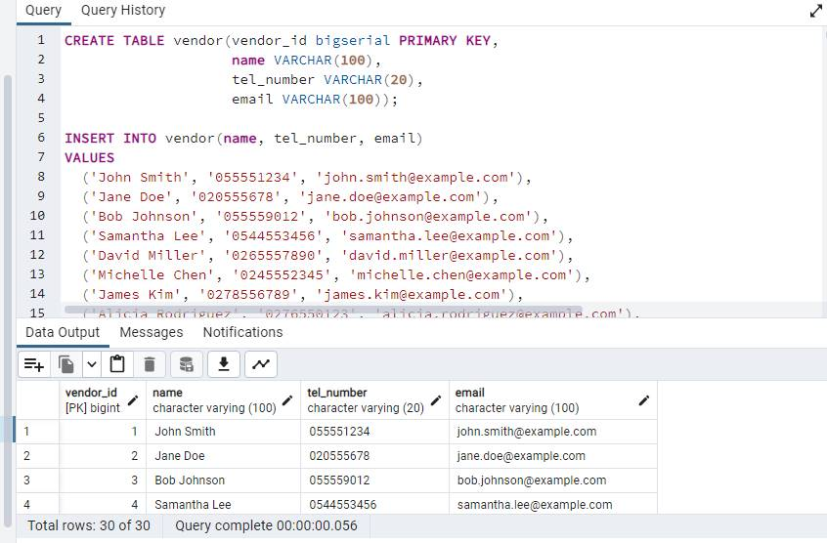
VENDOR TABLE

Slide 14
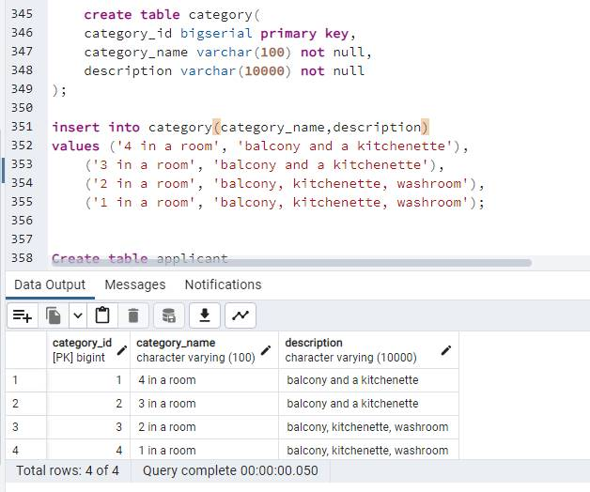
CATEGORY
TABLE

Slide 15
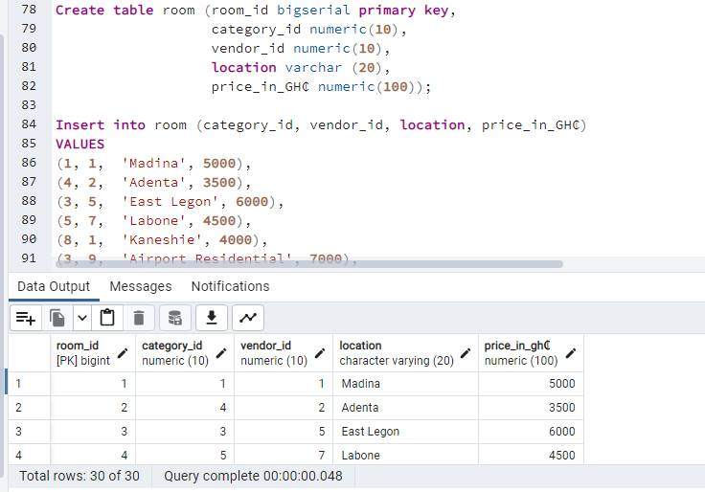
ROOM TABLE

Slide 16
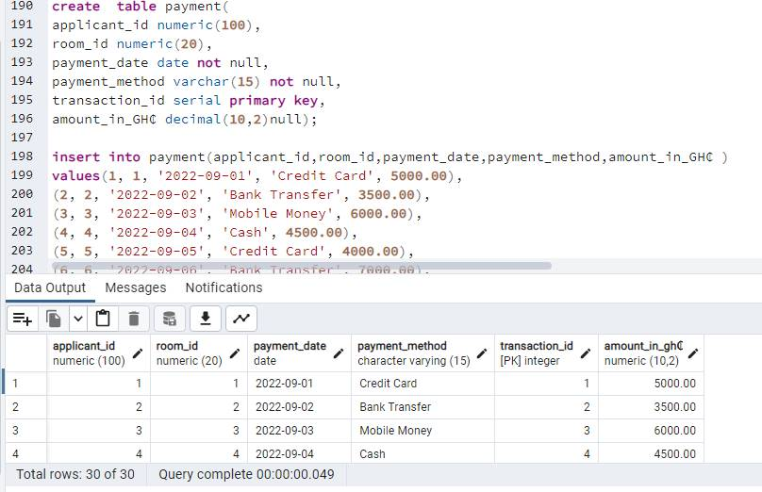
PAYMENT TABLE

Slide 17
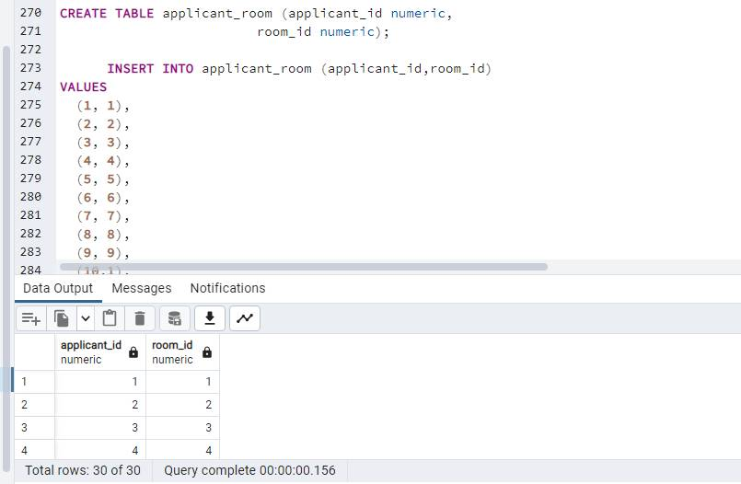
APPLICANT ROOM TABLE

Slide 18
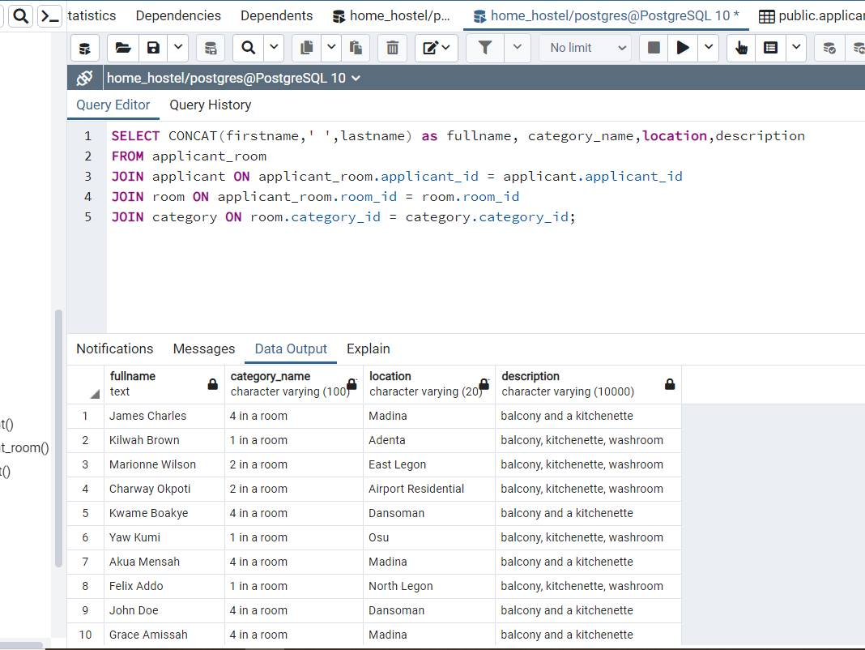
QUERY FOR THE RETRIEVAL OF APPLICANTS AND INFO ABOUT THEIR RESPECTIVE ROOMS

Slide 19
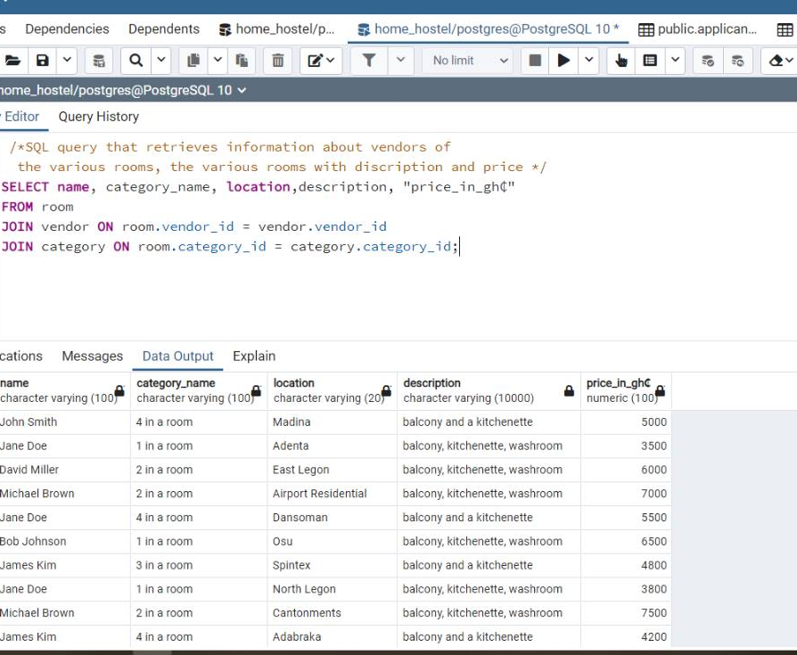
SQL query that retrieves information about vendors of the various rooms, the various rooms with discription and price
SELECT name, category_name, location,description, "price_in_gh₵“
FROM room
JOIN vendor ON room.vendor_id = vendor.vendor_id
JOIN category ON room.category_id = category.category_id;

Slide 20
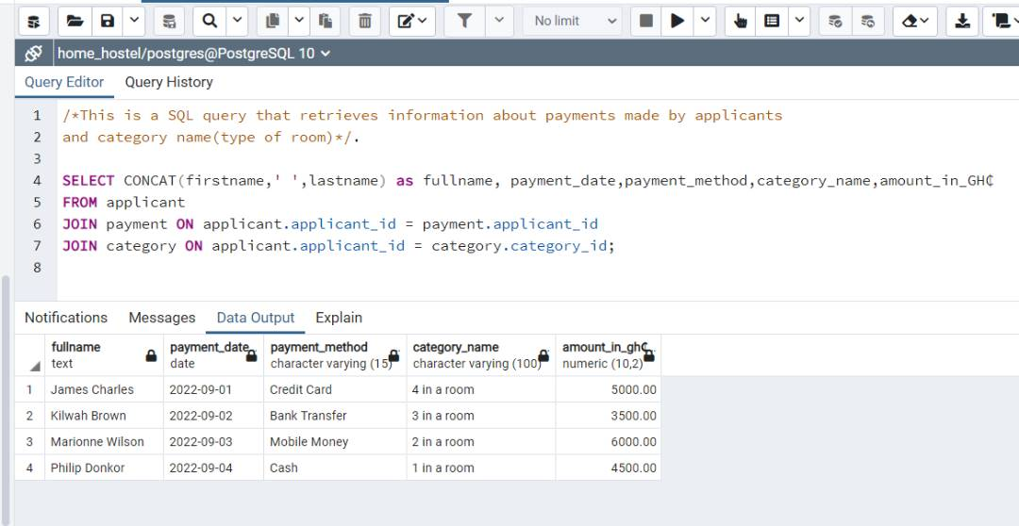
This is a SQL query that retrieves information about payments made by applicants and category name(type of room).
SELECT CONCAT(firstname,' ',lastname) as fullname, payment_date,payment_method,category_name,amount_in_GH₵
FROM applicant
JOIN payment ON applicant.applicant_id = payment.applicant_id
JOIN category ON applicant.applicant_id = category.category_id;

Slide 21
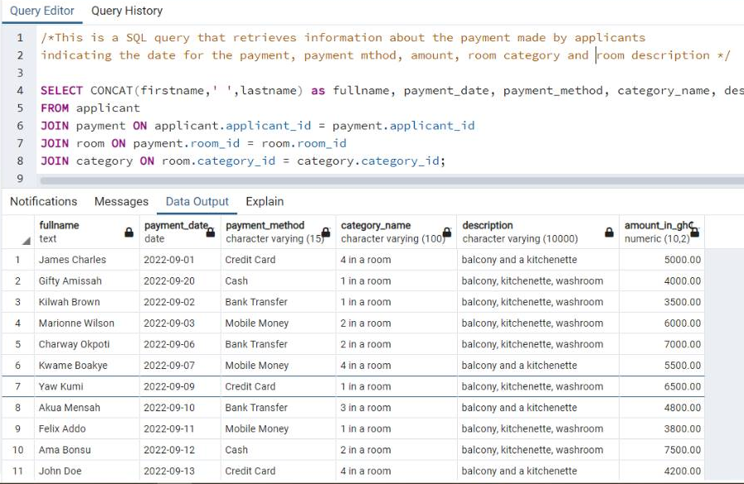
This is a SQL query that retrieves information about the payment made by applicantsindicating the date for the payment, payment mthod, amount, room category and room description
SELECT CONCAT(firstname,' ',lastname) as fullname, payment_date, payment_method, category_name, description, amount_in_GH₵
FROM applicant
JOIN payment ON applicant.applicant_id = payment.applicant_id
JOIN room ON payment.room_id = room.room_id
JOIN category ON room.category_id = category.category_id;

Slide 22
THE END

