Slide 1


Onboarding
2020 Project Teams Gathering

Slide 2
New Developer Onboarding
Open Source
Open Design
Open Community
Open Development
Airship overview & history
Airship projects & related projects
Stepping through an Airship deployment
Learning more
Getting involved

Slide 3
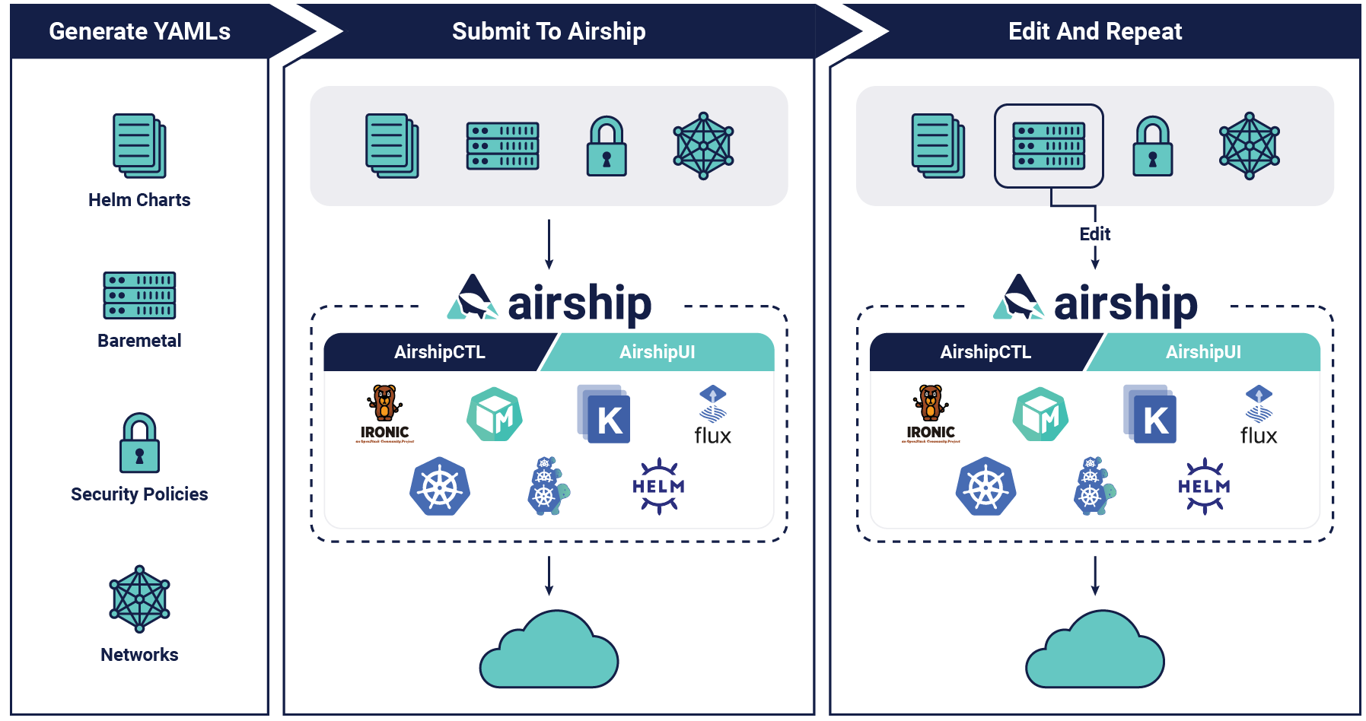
Airship Overview
“Airship is a collection of loosely coupled, but interoperable, open source tools that declaratively automate cloud provisioning.”
Motivations
Orchestration: Batteries included
Singular Deployment Method
Predictable Upgrades
Repeatable Multi-site Deployments
Resiliency
Enterprise-Grade Security

Slide 4
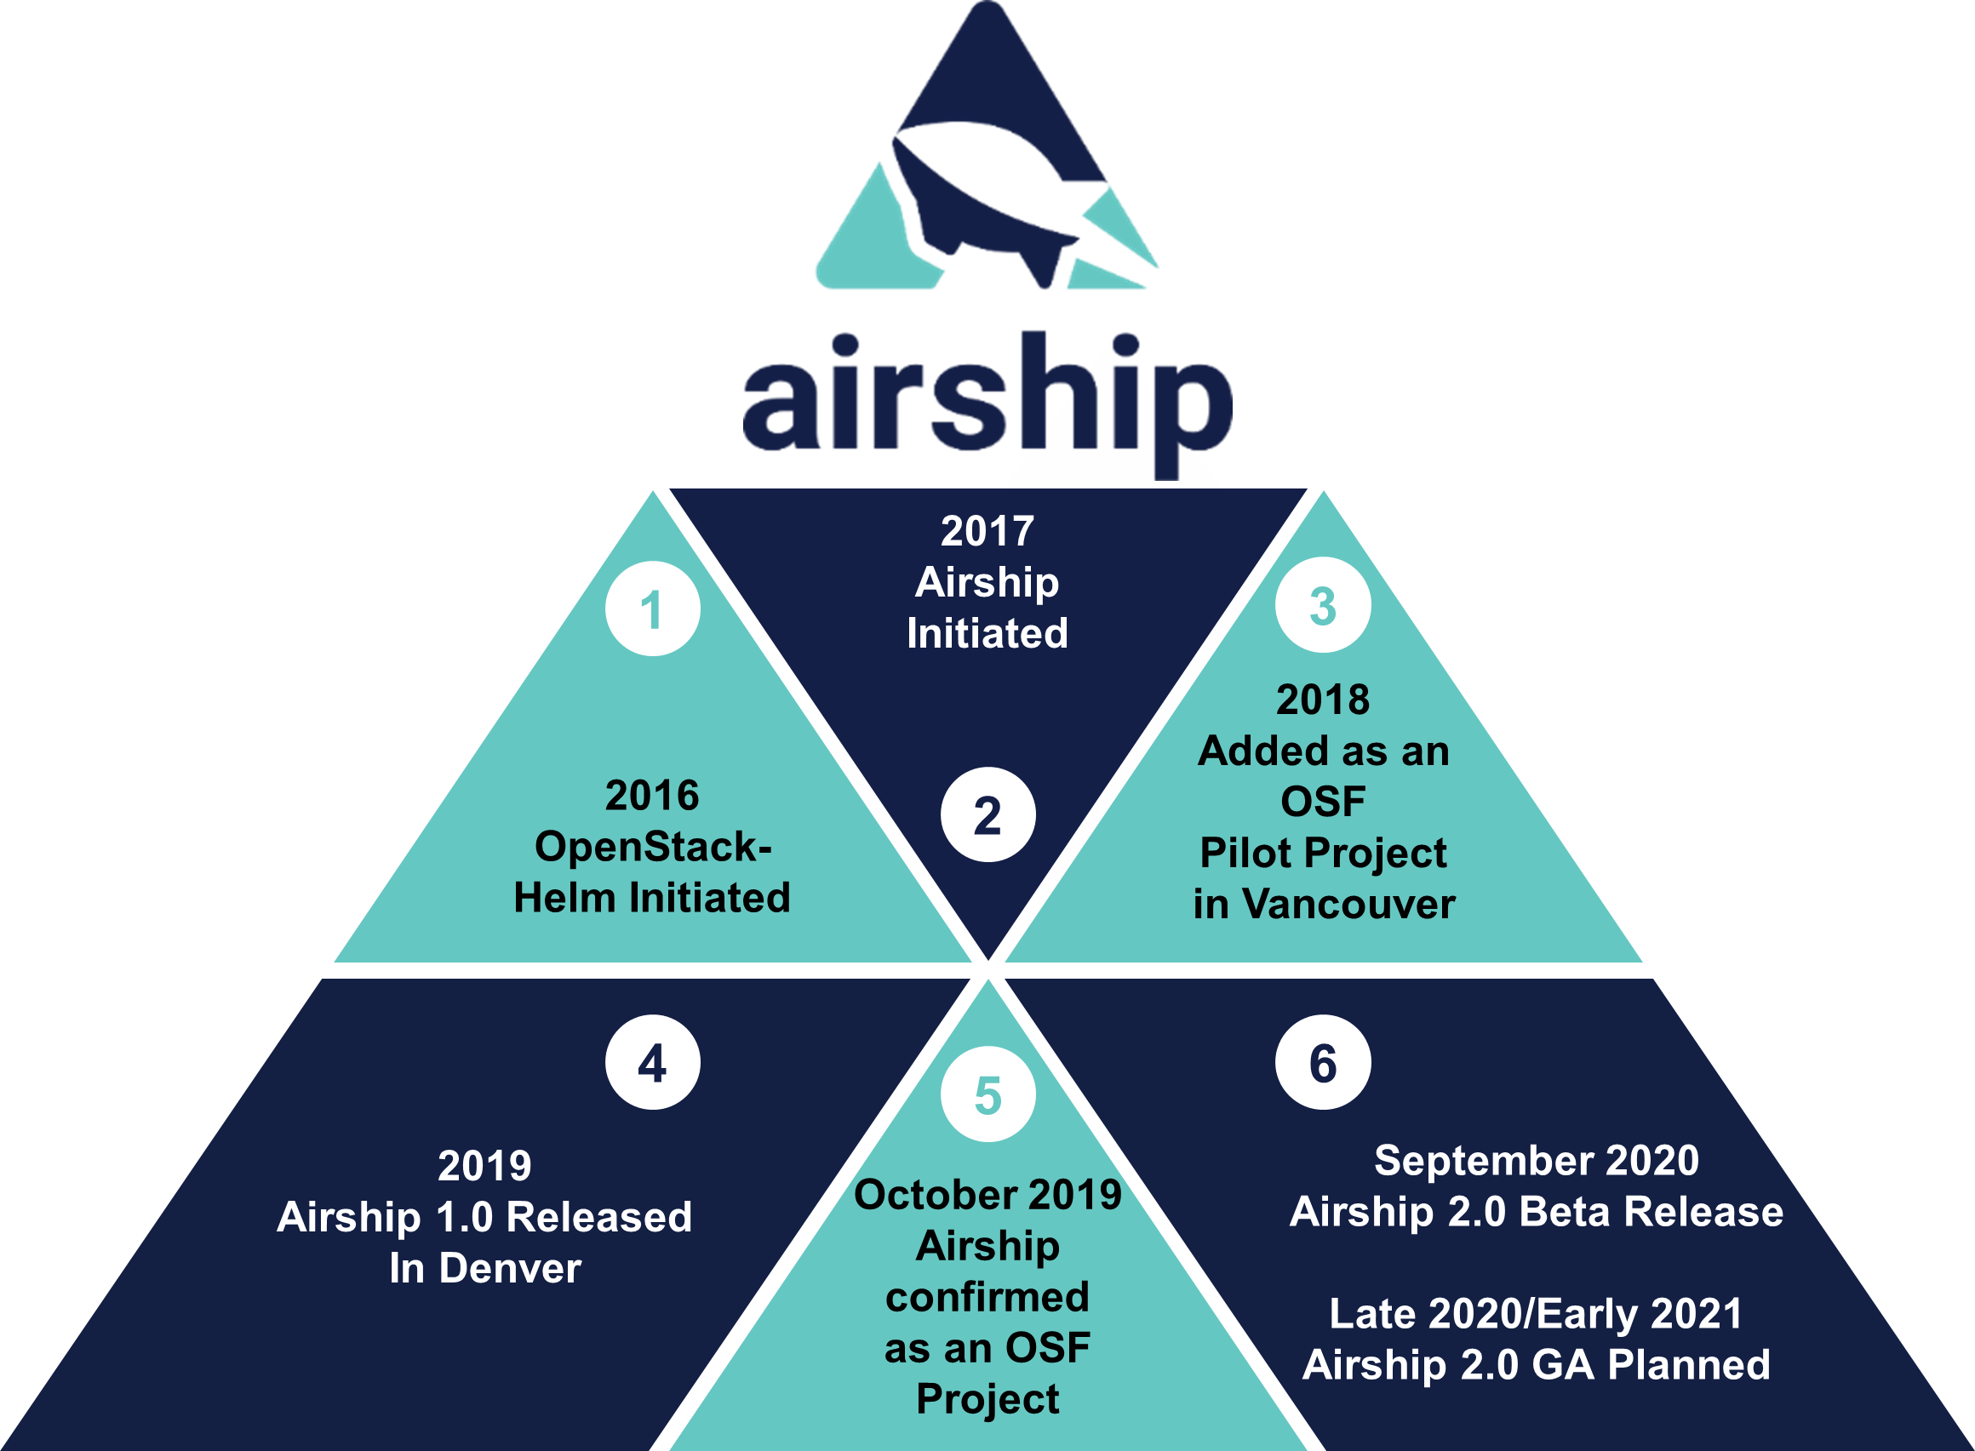
History of Airship

Slide 5





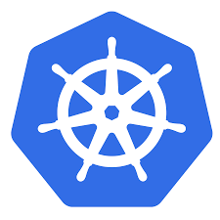
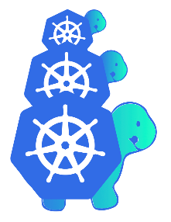

The Evolution to Airship 2.0
Smaller, ephemeral footprint
Adoption of established upstream projects
Less downstream customization of manifests
Expanded support for multiple platforms (public cloud, Docker, bare metal)
Improved speed of deployment vs. Airship 1.0
Airship UI enhances the user experience
Airship in a Pod improves the onboarding experience
Support for smaller deployments

Slide 6
Airship 2.0 – Components involved
Component | Function
AirshipCTL | Integrating and Orchestrating open infrastructure
Airship UI | Visualization and management of Kubernetes clusters and declarative intent
Airship ImageBuilder | Declarative ISO/QCOW generation
Kustomize | Deduplication of declarative intent at scale
KubeADM | Kubernetes configuration and management
Cluster API | Declarative provisioning of Kubernetes Clusters
Metal3 and Ironic | Declarative provisioning of bare metal infrastructure
Flux Helm Operator | Declarative Helm Chart management
Airship HostConfig Operator | Declarative Day-2 host management
Airship Treasuremap | Library of integrated declarative intent for operators to consume and extend

Slide 7

Off-site
On-site
Ephemeral Host
Kubernetes Node
(1..N)
Kubernetes Node
(1..N)
Worker
Hosts
(1..N)
Redfish API
K8s API
airshipctl
1
Git Repo
(e.g. Treasuremap)
Target Control Host
Redfish API
1
airshipctl document pull fetches YAML repositories from Git
Step 1:
Preparation and
Ephemeral Deployment

Slide 8
Off-site
On-site
Ephemeral Host
Kubernetes Node
(1..N)
Kubernetes Node
(1..N)
Worker
Hosts
(1..N)
Redfish API
2
K8s API
airshipctl
1
Git Repo
(e.g. Treasuremap)
Target Control Host
Redfish API
1
airshipctl document pull fetches YAML repositories from Git
airshipctl phase run bootstrap builds an ISO for the ephemeral node
Step 1:
Preparation and
Ephemeral Deployment
2

Slide 9
Off-site
On-site
Ephemeral Host
Kubernetes Node
(1..N)
Kubernetes Node
(1..N)
Worker
Hosts
(1..N)
Redfish API
3
2
K8s API
airshipctl
1
Git Repo
(e.g. Treasuremap)
Target Control Host
Redfish API
1
airshipctl document pull fetches YAML repositories from Git
airshipctl phase run bootstrap builds an ISO for the ephemeral node
airshipctl baremetal remotedirect boots the ephemeral node/cluster over redfish
Step 1:
Preparation and
Ephemeral Deployment
2
3

Slide 10
Off-site
On-site
Ephemeral Host
Kubernetes Node
(1..N)
Kubernetes Node
(1..N)
Worker
Hosts
(1..N)
Redfish API
3
2
4
K8s API
airshipctl
1
Git Repo
(e.g. Treasuremap)
Target Control Host
Redfish API
1
airshipctl document pull fetches YAML repositories from Git
airshipctl phase run bootstrap builds an ISO for the ephemeral node
airshipctl baremetal remotedirect boots the ephemeral node/cluster over redfish
airshipctl phase run initinfra-ephemeral deploys Metal3 and Calico
Step 1:
Preparation and
Ephemeral Deployment
2
3
4

Slide 11
Off-site
On-site
Ephemeral Host
Kubernetes Node
(1..N)
Kubernetes Node
(1..N)
Worker
Hosts
(1..N)
Redfish API
3
2
4
K8s API
airshipctl
5
1
Git Repo
(e.g. Treasuremap)
Target Control Host
Redfish API
1
airshipctl document pull fetches YAML repositories from Git
airshipctl phase run bootstrap builds an ISO for the ephemeral node
airshipctl baremetal remotedirect boots the ephemeral node/cluster over redfish
airshipctl phase run initinfra-ephemeral deploys Metal3 and Calico airshipctl phase run clusterctl-init-ephemeral deploys CAPI controllers
Step 1:
Preparation and
Ephemeral Deployment
2
3
4
5

Slide 12
Off-site
On-site
Ephemeral Host
Kubernetes Node
(1..N)
Kubernetes Node
(1..N)
Worker
Hosts
(1..N)
Redfish API
1
K8s API
airshipctl
1
Target Control Host
Redfish API
K8s API
1
airshipctl phase run controlplane-ephemeral provisions the target control plane
Step 2:
Provision Target Cluster

Slide 13
Off-site
On-site
Ephemeral Host
Kubernetes Node
(1..N)
Kubernetes Node
(1..N)
Worker
Hosts
(1..N)
Redfish API
1
K8s API
airshipctl
1
2
Target Control Host
Redfish API
K8s API
1
airshipctl phase run controlplane-ephemeral provisions the target control plane
airshipctl phase run initinfra-target deploys Metal3, Calico, and Helm-Operator
Step 2:
Provision Target Cluster
2

Slide 14
Off-site
On-site
Ephemeral Host
Kubernetes Node
(1..N)
Kubernetes Node
(1..N)
Worker
Hosts
(1..N)
Redfish API
1
K8s API
airshipctl
1
2
3
Target Control Host
Redfish API
K8s API
1
airshipctl phase run controlplane-ephemeral provisions the target control plane
airshipctl phase run initinfra-target deploys Metal3, Calico, and Helm-Operator
airshipctl baremetal clusterctl-init-target deploys CAPI controllers
Step 2:
Provision Target Cluster
2
3

Slide 15
Off-site
On-site
Ephemeral Host
Kubernetes Node
(1..N)
Kubernetes Node
(1..N)
Worker
Hosts
(1..N)
Redfish API
4
1
K8s API
airshipctl
1
4
2
3
Target Control Host
Redfish API
K8s API
1
airshipctl phase run controlplane-ephemeral provisions the target control plane
airshipctl phase run initinfra-target deploys Metal3, Calico, and Helm-Operator
airshipctl baremetal clusterctl-init-target deploys CAPI controllers
airshipctl phase run clusterctl-move pivot target cluster to CAPI self-management
Step 2:
Provision Target Cluster
2
3
4

Slide 16
Off-site
On-site
Ephemeral Host
Kubernetes Node
(1..N)
Kubernetes Node
(1..N)
Worker
Hosts
(1..N)
Kubernetes Nodes
Redfish API
4
1
K8s API
airshipctl
1
4
2
3
Target Control Host
Redfish API
K8s API
5
5
1
airshipctl phase run controlplane-ephemeral provisions the target control plane
airshipctl phase run initinfra-target deploys Metal3, Calico, and Helm-Operator
airshipctl baremetal clusterctl-init-target deploys CAPI controllers
airshipctl phase run clusterctl-move pivot target cluster to CAPI self-management airshipctl phase run workers-target provisions the rest of the target cluster nodes
Step 2:
Provision Target Cluster
2
3
4
5

Slide 17
Off-site
On-site
Ephemeral Host
Kubernetes Node
(1..N)
Kubernetes Node
(1..N)
Worker
Hosts
(1..N)
Kubernetes Nodes
Redfish API
K8s API
airshipctl
1
Target Control Host
Redfish API
1
K8s API
Step 3:
Workload Deployment
1
airshipctl phase run workload-target deploys software workloads to the cluster

Slide 18
Onboarding Materials
Get Ramped Up!
Get Involved!
Airship documentation: https://docs.airshipit.org
Airship Blog Series: https://airshipit.org/blog
Airshipctl project and GitHub issues
Treasuremap project and GitHub issues
AirshipUI project and GitHub issues
Kustomize Airship Plugins video from the Summit
Airship 101 video from the Open Infra Summit
Layering and de-duplication doc (WIP)
Airship-in-a-Pod changeset (WIP)
Airship Wiki
airship-discuss@lists.openstack.org
Freenode IRC: #airshipit
Airshipit.org/slack: #airshipit
IRC/Slack team meetings are every other Tuesdays
Design meetings are Tuesdays & Thursdays
Scope grooming meetings are Wednesdays

Slide 19

t
Community Channels
Mailing Lists: lists.airshipit.org
Freenode IRC: #airshipit
Airshipit.org/slack: #airshipit
Website: www.airshipit.org
Wiki: https://wiki.openstack.org/wiki/Airship
Documentation: https://docs.airshipit.org
OpenDev: https://opendev.org/airship
YouTube: https://www.youtube.com/user/OpenStackFoundation/

