Slide 1
Module 1, Section 1: Cloud Concepts Overview
Notes:
Welcome to Module 1, Section 1 – Cloud Concepts Overview.

Slide 2
Module Objectives
  Discuss key concepts related to cloud computing and the advantages of cloud computing:
  Define different types of cloud computing.
  Describe cloud deployment models.
  Multi-Cloud : uses & problems
  Important Cloud Terminology
Notes:
The goal of this module is to discuss key concepts related to cloud computing and the advantages of cloud computing with Amazon Web Services.
We will:
• Define different types of cloud computing to understand internet-based computing and three broad categories of cloud computing.
• Describe the six advantages of cloud computing that are helping organizations make the decision to get out of the low-value parts of IT and focus on things that drive business success.
• Describe three cloud deployment models to understand alternative models of cloud usage.
• Review the AWS Cloud Adoption Framework which helps organizations understand how cloud adoption transforms the way they work.
After this overview, you will have the opportunity to complete a Knowledge Assessment.

Slide 3
Part 1: What is Cloud Computing?
Notes:
In part one, we’ll answer the question, “What is cloud computing?”

Slide 4

What is Cloud Computing?
Notes:
What does cloud computing mean to you?
Take a moment to provide a quick sentence on what you understand cloud computing to be.
Note: There’s no wrong answer.

Slide 5
What is Cloud Computing?
Cloud computing is the on-demand delivery of compute power, database storage, applications, and other IT resources through a cloud services platform via the internet with pay-as-you-go pricing.
Notes:
Cloud computing is the on-demand delivery of compute power, database storage, applications, and other IT resources through a cloud services platform via the internet, with pay-as-you-go pricing.
The most basic way to define what the “cloud” is that it is a computer located somewhere else that is accessed via the Internet and utilized in some way. Web services is also another name for what people call the cloud.
The cloud is comprised of server computers located in large data centers in different locations around the world. When you use a cloud service like Amazon Web Services (AWS), you are utilizing the computers owned by AWS. AWS is a cloud services provider.
The computers contain various technology features and services, like building blocks, that can be used to assemble solutions that help a user meet their business goals and technology requirements. With cloud computing, organizations can consume on-demand computing and storage resources rather than building, operating, and improving infrastructure on their own.
Visit the link to learn more
https://aws.amazon.com/what-is-cloud-computing/.

Slide 6


Before Cloud Computing
Cloud computing enables you to stop thinking of your infrastructure as hardware, and instead think of it (and use it) as software.
Notes:
Cloud computing enables you to stop thinking of your infrastructure as hardware, and instead think of it (and use it) as software. Before cloud computing, you would have to provision capacity based on guessing theoretical maximum peaks. If you didn’t meet your projected maximum peaks, or you exceeded them, you would be paying for expensive resources that would stay idle or have insufficient capacity to meet your needs.

Slide 7

Before Cloud Computing
Hardware solutions are physical. This means they require:
  Space
  Staff
  Physical security
  Planning
  Capital expenditure
Guess at theoretical maximum peaks
  Is there enough resource capacity?
  Do we have sufficient storage?
  What if your needs change?
  You have to go through the time, effort, and cost required to change all these.
Notes:
Managing hardware takes away time and resources you could be using to improve your architecture and your application. Hardware solutions are physical. This means they require space, staff, physical security, planning and capital expenditure.
You have to guess at theoretical maximum peaks, asking if there is enough resource capacity or if you have sufficient storage. What if your needs change? You have to go through the time, effort, and cost required to change all of these.
For example, if you want to provision a new web site, you would have to go out and buy the hardware, rack and stack it, put it in a data center, and then manage it or have someone else manage it. This approach is very expensive.
Cloud computing addresses some of the issues in the traditional computing model. One of the most prohibitive aspects of traditional computing is the significant up-front investment of acquiring, provisioning, and maintaining on-premises infrastructure. Cloud computing can get businesses up and running with a new solution in place quickly and with very low up-front costs. Then, you can elastically scale up and down in an automated fashion so that you pay only for what you use.
Cloud computing also allows you to select the services that best match your needs, giving you flexibility with a wide range of choices and the ability to change your configuration at will. All of these services are provided on a secured infrastructure.

Slide 8

Utilizing Cloud Computing
Software is flexible.
  If your needs change, your software can change much more quickly, easily, and cost-effectively than your hardware.
Notes:
Accessing and using your infrastructure as software offers a number of benefits-flexibility in particular. If your needs change, your software can change much more quickly, easily, and cost-effectively than your hardware.
With a cloud services provider like AWS, you don't have to anticipate your hardware needs ahead of time and then order, install, and set it up at your data center. You also don’t need to undergo a long procurement cycle. With a few clicks, you can provision exactly what you need-and it will be available to you in a few minutes.
That means you can provision and terminate resources as necessary on AWS, instead of paying for hardware when you’re not using it. You can treat resources as temporary and disposable resources, free from the inflexibility and constraints of a fixed and finite IT infrastructure.
By harnessing the power of AWS, you can be more agile and efficient with change management, testing, reliability, and capacity planning.

Slide 9
Part : What are Models of Cloud Computing?
Notes:
In part one, we’ll answer the question, “What is cloud computing?”

Slide 10
Models of Cloud Computing
Cloud computing models refer to the different ways cloud services are delivered to users.
These models define what part of the technology stack you manage and what part the cloud provider manages.

Slide 11

Three Models of Cloud Computing
IaaS
Infrastructure
as a Service
PaaS
Platform
as a Service
SaaS
Software
as a Service
Notes:
Cloud services can fall into one of three primary categories, based mainly around how much control and responsibility you have over how the service is configured.
With IaaS (or Infrastructure as a Service), you manage the server, which can be physical or virtual, as well as the operating system (Windows or Linux). In general, the data center provider has no access to your server.
Basic building blocks for cloud IT include:
Networking features
Compute, and
Data storage space
With PaaS (or Platform as a Service), someone else manages the underlying hardware and operating systems. This enables you to run applications without managing underlying infrastructure (for example -- patching, updates, maintenance, hardware and operating systems). PaaS also provides a framework for developers that they can build upon to create customized applications.
With SaaS (or Software as a Service), you manage your files, while the service provider takes care of all of the data centers, servers, networks, storage, maintenance, patching, etc. All you worry about is the software and how you want to use it. You are provided with a complete product that is run and managed by the service provider. Facebook and Dropbox are examples of SaaS. You manage your Facebook contacts and Dropbox files, and the service providers manage the systems.

Slide 12

Models of Cloud Computing
Infrastructure as a Service:
provides basic building blocks like virtual machines, storage, and networking—on-demand. You are responsible for installing and managing your own software (like OS, apps, etc.).
You get a computer in the cloud that you can use as if it’s your own. You install what you need and take care of it.
Like empty kitchen
Platform as a Service:
provides a ready-made platform where you can build, test, and deploy your applications—without managing the underlying infrastructure.
You only focus on writing your code or app. The platform handles everything else like server setup or database.
Like kitchen with oven & ingredients
Software as a Service:
offers ready-to-use software applications over the internet. You don’t worry about how it's built or maintained—just sign in and use it.
You open your browser and start using apps like Gmail or Netflix—no installation, no setup.
Like ordering pizza

Slide 13
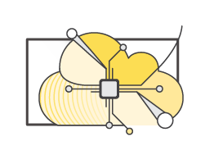

Three Cloud Deployment Models
  All-In Cloud / Public
  Hybrid
  Private Cloud
  (On-premises)
Notes:
Now, let’s reveal the three cloud deployment models.
"All-In" Cloud is a cloud-based application that is fully deployed in the cloud, and all parts of the application run in the cloud. Applications in the cloud have either been created in the cloud or have been migrated from an existing infrastructure. Cloud-based applications can be built on low-level infrastructure pieces (for example, networking, compute or storage) or can use higher-level services that provide abstraction from the management, architecting, and scaling requirements of core infrastructure.
A hybrid deployment is a way to connect infrastructure and applications between cloud-based resources and existing resources that are not located in the cloud. The most common method of hybrid deployment is between the cloud and existing on-premises infrastructure (sometimes called on-prem). On-premises infrastructure is located within the physical confines of an enterprise, often in the company's data center. A hybrid deployment model is used to extend an organization's infrastructure into the cloud while connecting cloud resources to an internal system. For more information on how AWS can help you with your hybrid deployment, visit the link https://aws.amazon.com/enterprise/hybrid/.
When you run a cloud infrastructure from your own data center, that’s called on-premises or private cloud. While this kind of deployment lacks many of the benefits of cloud computing, it does provide dedicated resources and is a popular choice for organizations who need to meet certain compliance standards. In most cases, this deployment model is the same as legacy IT infrastructure while using application management and virtualization to increase resource utilization.

Slide 14
Cloud Deployment Models
Public Cloud / All-in Cloud
Infra owned & operated by 3rd party.
Resources shared with others but each customer’s data is isolated
Private Cloud / on premises
Infra owned by a single organization.
Managed internally or by 3rd party.
Hybrid Cloud
Combo.
Used for Flexibility & Cost efficiency

Slide 15
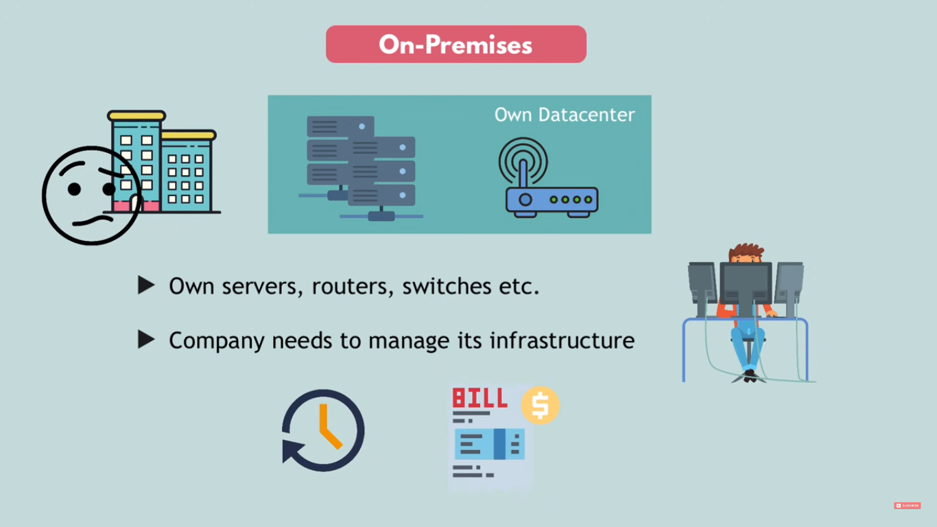
Notes:
Now, let’s reveal the three cloud deployment models.
"All-In" Cloud is a cloud-based application that is fully deployed in the cloud, and all parts of the application run in the cloud. Applications in the cloud have either been created in the cloud or have been migrated from an existing infrastructure. Cloud-based applications can be built on low-level infrastructure pieces (for example, networking, compute or storage) or can use higher-level services that provide abstraction from the management, architecting, and scaling requirements of core infrastructure.
A hybrid deployment is a way to connect infrastructure and applications between cloud-based resources and existing resources that are not located in the cloud. The most common method of hybrid deployment is between the cloud and existing on-premises infrastructure (sometimes called on-prem). On-premises infrastructure is located within the physical confines of an enterprise, often in the company's data center. A hybrid deployment model is used to extend an organization's infrastructure into the cloud while connecting cloud resources to an internal system. For more information on how AWS can help you with your hybrid deployment, visit the link https://aws.amazon.com/enterprise/hybrid/.
When you run a cloud infrastructure from your own data center, that’s called on-premises or private cloud. While this kind of deployment lacks many of the benefits of cloud computing, it does provide dedicated resources and is a popular choice for organizations who need to meet certain compliance standards. In most cases, this deployment model is the same as legacy IT infrastructure while using application management and virtualization to increase resource utilization.

Slide 16
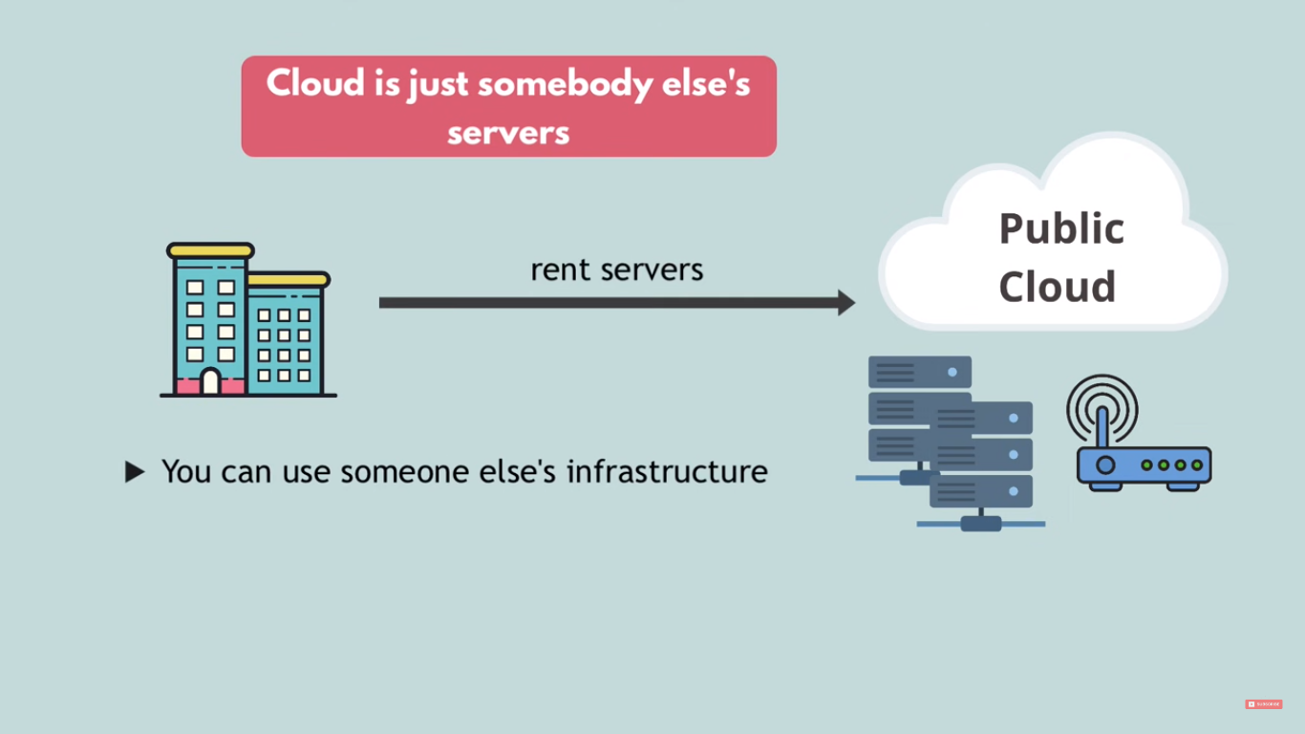
Notes:
Now, let’s reveal the three cloud deployment models.
"All-In" Cloud is a cloud-based application that is fully deployed in the cloud, and all parts of the application run in the cloud. Applications in the cloud have either been created in the cloud or have been migrated from an existing infrastructure. Cloud-based applications can be built on low-level infrastructure pieces (for example, networking, compute or storage) or can use higher-level services that provide abstraction from the management, architecting, and scaling requirements of core infrastructure.
A hybrid deployment is a way to connect infrastructure and applications between cloud-based resources and existing resources that are not located in the cloud. The most common method of hybrid deployment is between the cloud and existing on-premises infrastructure (sometimes called on-prem). On-premises infrastructure is located within the physical confines of an enterprise, often in the company's data center. A hybrid deployment model is used to extend an organization's infrastructure into the cloud while connecting cloud resources to an internal system. For more information on how AWS can help you with your hybrid deployment, visit the link https://aws.amazon.com/enterprise/hybrid/.
When you run a cloud infrastructure from your own data center, that’s called on-premises or private cloud. While this kind of deployment lacks many of the benefits of cloud computing, it does provide dedicated resources and is a popular choice for organizations who need to meet certain compliance standards. In most cases, this deployment model is the same as legacy IT infrastructure while using application management and virtualization to increase resource utilization.

Slide 17
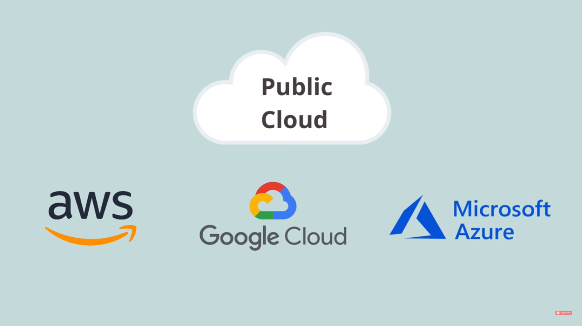
Notes:
Now, let’s reveal the three cloud deployment models.
"All-In" Cloud is a cloud-based application that is fully deployed in the cloud, and all parts of the application run in the cloud. Applications in the cloud have either been created in the cloud or have been migrated from an existing infrastructure. Cloud-based applications can be built on low-level infrastructure pieces (for example, networking, compute or storage) or can use higher-level services that provide abstraction from the management, architecting, and scaling requirements of core infrastructure.
A hybrid deployment is a way to connect infrastructure and applications between cloud-based resources and existing resources that are not located in the cloud. The most common method of hybrid deployment is between the cloud and existing on-premises infrastructure (sometimes called on-prem). On-premises infrastructure is located within the physical confines of an enterprise, often in the company's data center. A hybrid deployment model is used to extend an organization's infrastructure into the cloud while connecting cloud resources to an internal system. For more information on how AWS can help you with your hybrid deployment, visit the link https://aws.amazon.com/enterprise/hybrid/.
When you run a cloud infrastructure from your own data center, that’s called on-premises or private cloud. While this kind of deployment lacks many of the benefits of cloud computing, it does provide dedicated resources and is a popular choice for organizations who need to meet certain compliance standards. In most cases, this deployment model is the same as legacy IT infrastructure while using application management and virtualization to increase resource utilization.

Slide 18
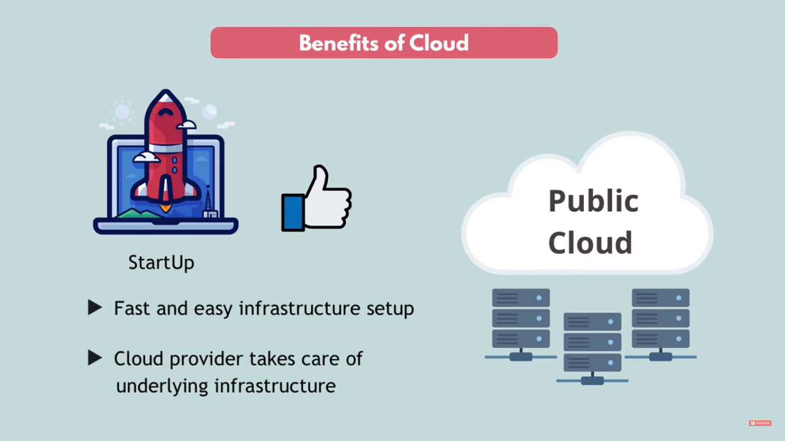
Notes:
Now, let’s reveal the three cloud deployment models.
"All-In" Cloud is a cloud-based application that is fully deployed in the cloud, and all parts of the application run in the cloud. Applications in the cloud have either been created in the cloud or have been migrated from an existing infrastructure. Cloud-based applications can be built on low-level infrastructure pieces (for example, networking, compute or storage) or can use higher-level services that provide abstraction from the management, architecting, and scaling requirements of core infrastructure.
A hybrid deployment is a way to connect infrastructure and applications between cloud-based resources and existing resources that are not located in the cloud. The most common method of hybrid deployment is between the cloud and existing on-premises infrastructure (sometimes called on-prem). On-premises infrastructure is located within the physical confines of an enterprise, often in the company's data center. A hybrid deployment model is used to extend an organization's infrastructure into the cloud while connecting cloud resources to an internal system. For more information on how AWS can help you with your hybrid deployment, visit the link https://aws.amazon.com/enterprise/hybrid/.
When you run a cloud infrastructure from your own data center, that’s called on-premises or private cloud. While this kind of deployment lacks many of the benefits of cloud computing, it does provide dedicated resources and is a popular choice for organizations who need to meet certain compliance standards. In most cases, this deployment model is the same as legacy IT infrastructure while using application management and virtualization to increase resource utilization.

Slide 19
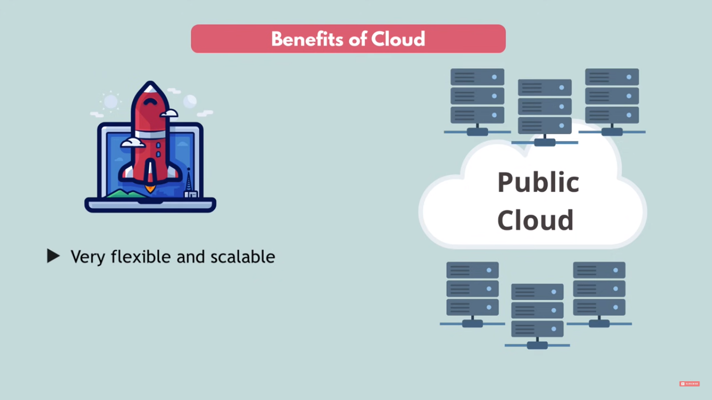
Notes:
Now, let’s reveal the three cloud deployment models.
"All-In" Cloud is a cloud-based application that is fully deployed in the cloud, and all parts of the application run in the cloud. Applications in the cloud have either been created in the cloud or have been migrated from an existing infrastructure. Cloud-based applications can be built on low-level infrastructure pieces (for example, networking, compute or storage) or can use higher-level services that provide abstraction from the management, architecting, and scaling requirements of core infrastructure.
A hybrid deployment is a way to connect infrastructure and applications between cloud-based resources and existing resources that are not located in the cloud. The most common method of hybrid deployment is between the cloud and existing on-premises infrastructure (sometimes called on-prem). On-premises infrastructure is located within the physical confines of an enterprise, often in the company's data center. A hybrid deployment model is used to extend an organization's infrastructure into the cloud while connecting cloud resources to an internal system. For more information on how AWS can help you with your hybrid deployment, visit the link https://aws.amazon.com/enterprise/hybrid/.
When you run a cloud infrastructure from your own data center, that’s called on-premises or private cloud. While this kind of deployment lacks many of the benefits of cloud computing, it does provide dedicated resources and is a popular choice for organizations who need to meet certain compliance standards. In most cases, this deployment model is the same as legacy IT infrastructure while using application management and virtualization to increase resource utilization.

Slide 20
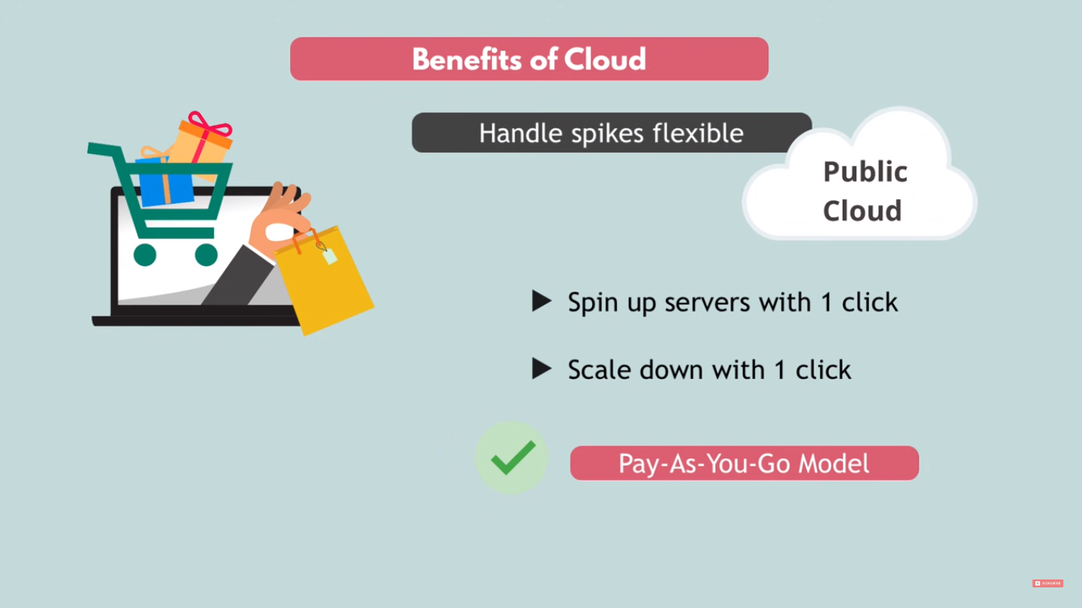
Notes:
Now, let’s reveal the three cloud deployment models.
"All-In" Cloud is a cloud-based application that is fully deployed in the cloud, and all parts of the application run in the cloud. Applications in the cloud have either been created in the cloud or have been migrated from an existing infrastructure. Cloud-based applications can be built on low-level infrastructure pieces (for example, networking, compute or storage) or can use higher-level services that provide abstraction from the management, architecting, and scaling requirements of core infrastructure.
A hybrid deployment is a way to connect infrastructure and applications between cloud-based resources and existing resources that are not located in the cloud. The most common method of hybrid deployment is between the cloud and existing on-premises infrastructure (sometimes called on-prem). On-premises infrastructure is located within the physical confines of an enterprise, often in the company's data center. A hybrid deployment model is used to extend an organization's infrastructure into the cloud while connecting cloud resources to an internal system. For more information on how AWS can help you with your hybrid deployment, visit the link https://aws.amazon.com/enterprise/hybrid/.
When you run a cloud infrastructure from your own data center, that’s called on-premises or private cloud. While this kind of deployment lacks many of the benefits of cloud computing, it does provide dedicated resources and is a popular choice for organizations who need to meet certain compliance standards. In most cases, this deployment model is the same as legacy IT infrastructure while using application management and virtualization to increase resource utilization.

Slide 21
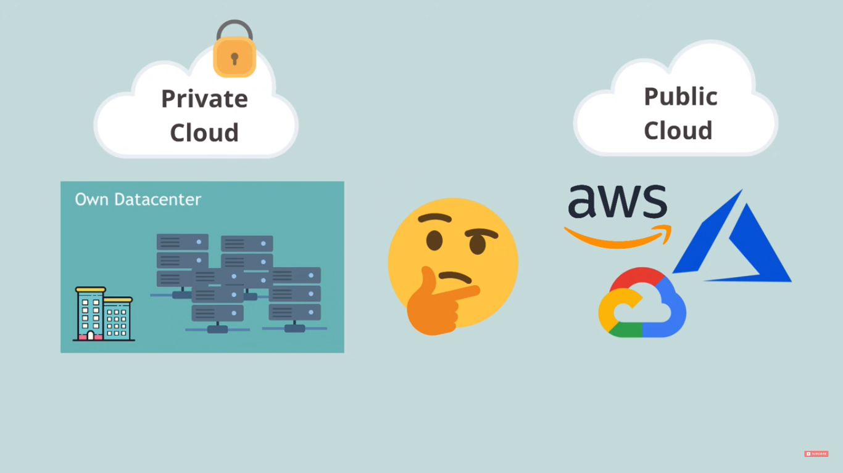
Notes:
Now, let’s reveal the three cloud deployment models.
"All-In" Cloud is a cloud-based application that is fully deployed in the cloud, and all parts of the application run in the cloud. Applications in the cloud have either been created in the cloud or have been migrated from an existing infrastructure. Cloud-based applications can be built on low-level infrastructure pieces (for example, networking, compute or storage) or can use higher-level services that provide abstraction from the management, architecting, and scaling requirements of core infrastructure.
A hybrid deployment is a way to connect infrastructure and applications between cloud-based resources and existing resources that are not located in the cloud. The most common method of hybrid deployment is between the cloud and existing on-premises infrastructure (sometimes called on-prem). On-premises infrastructure is located within the physical confines of an enterprise, often in the company's data center. A hybrid deployment model is used to extend an organization's infrastructure into the cloud while connecting cloud resources to an internal system. For more information on how AWS can help you with your hybrid deployment, visit the link https://aws.amazon.com/enterprise/hybrid/.
When you run a cloud infrastructure from your own data center, that’s called on-premises or private cloud. While this kind of deployment lacks many of the benefits of cloud computing, it does provide dedicated resources and is a popular choice for organizations who need to meet certain compliance standards. In most cases, this deployment model is the same as legacy IT infrastructure while using application management and virtualization to increase resource utilization.

Slide 22
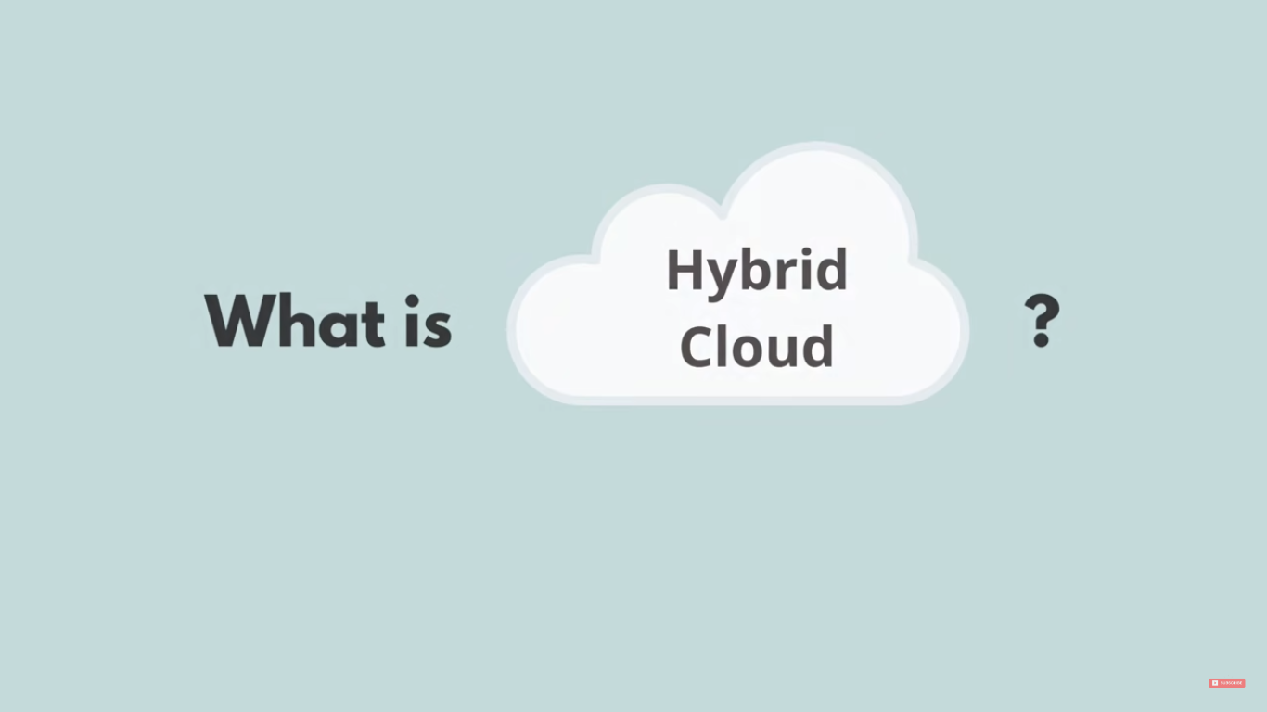
Notes:
Now, let’s reveal the three cloud deployment models.
"All-In" Cloud is a cloud-based application that is fully deployed in the cloud, and all parts of the application run in the cloud. Applications in the cloud have either been created in the cloud or have been migrated from an existing infrastructure. Cloud-based applications can be built on low-level infrastructure pieces (for example, networking, compute or storage) or can use higher-level services that provide abstraction from the management, architecting, and scaling requirements of core infrastructure.
A hybrid deployment is a way to connect infrastructure and applications between cloud-based resources and existing resources that are not located in the cloud. The most common method of hybrid deployment is between the cloud and existing on-premises infrastructure (sometimes called on-prem). On-premises infrastructure is located within the physical confines of an enterprise, often in the company's data center. A hybrid deployment model is used to extend an organization's infrastructure into the cloud while connecting cloud resources to an internal system. For more information on how AWS can help you with your hybrid deployment, visit the link https://aws.amazon.com/enterprise/hybrid/.
When you run a cloud infrastructure from your own data center, that’s called on-premises or private cloud. While this kind of deployment lacks many of the benefits of cloud computing, it does provide dedicated resources and is a popular choice for organizations who need to meet certain compliance standards. In most cases, this deployment model is the same as legacy IT infrastructure while using application management and virtualization to increase resource utilization.

Slide 23
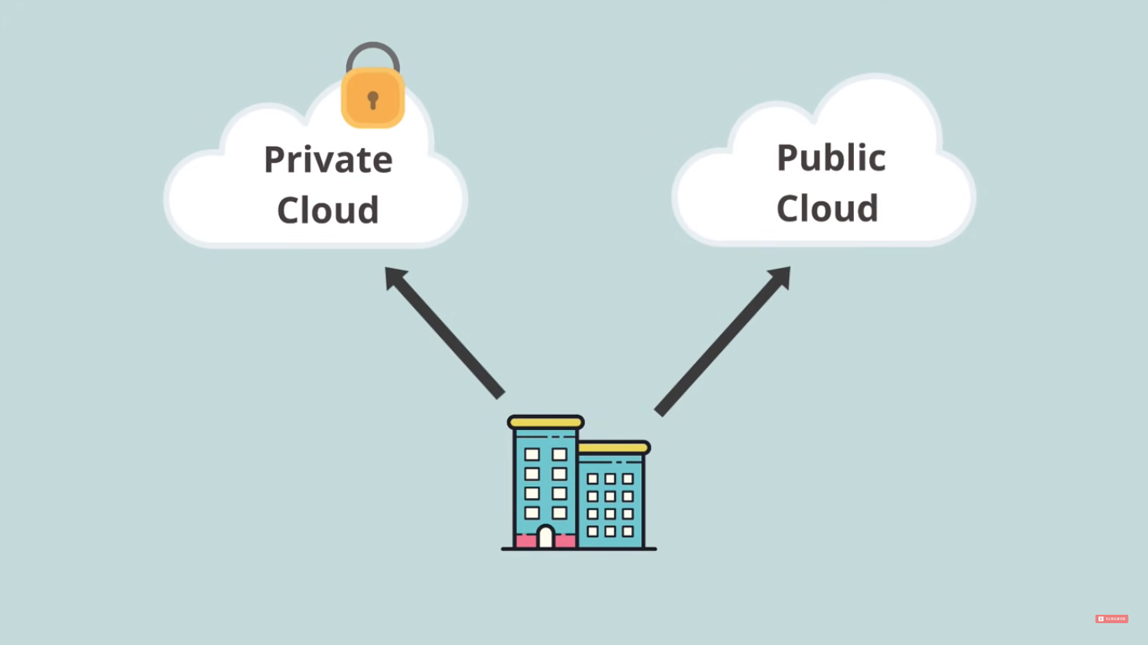
Notes:
Now, let’s reveal the three cloud deployment models.
"All-In" Cloud is a cloud-based application that is fully deployed in the cloud, and all parts of the application run in the cloud. Applications in the cloud have either been created in the cloud or have been migrated from an existing infrastructure. Cloud-based applications can be built on low-level infrastructure pieces (for example, networking, compute or storage) or can use higher-level services that provide abstraction from the management, architecting, and scaling requirements of core infrastructure.
A hybrid deployment is a way to connect infrastructure and applications between cloud-based resources and existing resources that are not located in the cloud. The most common method of hybrid deployment is between the cloud and existing on-premises infrastructure (sometimes called on-prem). On-premises infrastructure is located within the physical confines of an enterprise, often in the company's data center. A hybrid deployment model is used to extend an organization's infrastructure into the cloud while connecting cloud resources to an internal system. For more information on how AWS can help you with your hybrid deployment, visit the link https://aws.amazon.com/enterprise/hybrid/.
When you run a cloud infrastructure from your own data center, that’s called on-premises or private cloud. While this kind of deployment lacks many of the benefits of cloud computing, it does provide dedicated resources and is a popular choice for organizations who need to meet certain compliance standards. In most cases, this deployment model is the same as legacy IT infrastructure while using application management and virtualization to increase resource utilization.

Slide 24
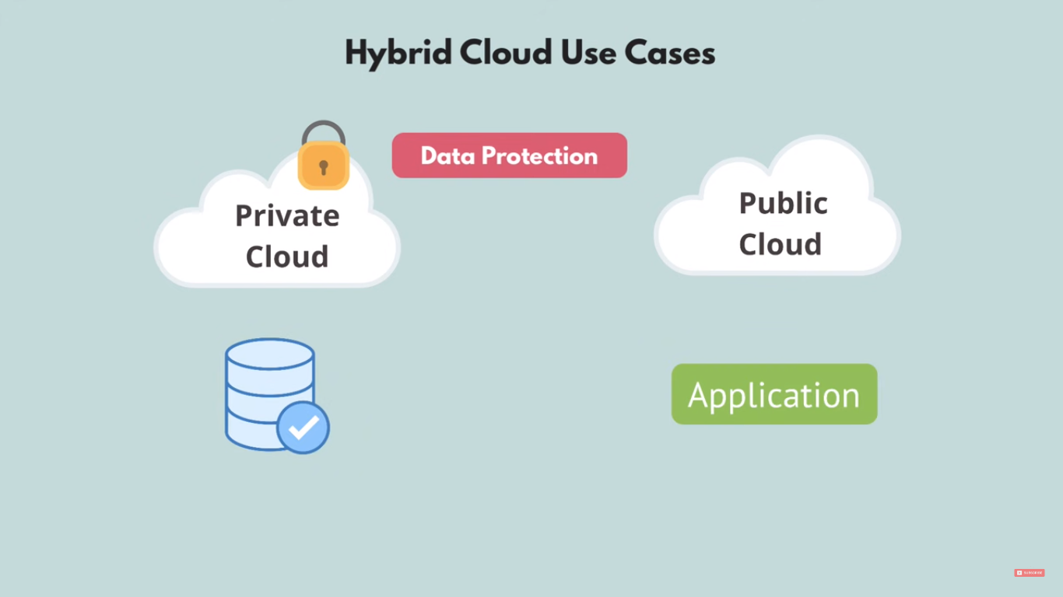
Notes:
Now, let’s reveal the three cloud deployment models.
"All-In" Cloud is a cloud-based application that is fully deployed in the cloud, and all parts of the application run in the cloud. Applications in the cloud have either been created in the cloud or have been migrated from an existing infrastructure. Cloud-based applications can be built on low-level infrastructure pieces (for example, networking, compute or storage) or can use higher-level services that provide abstraction from the management, architecting, and scaling requirements of core infrastructure.
A hybrid deployment is a way to connect infrastructure and applications between cloud-based resources and existing resources that are not located in the cloud. The most common method of hybrid deployment is between the cloud and existing on-premises infrastructure (sometimes called on-prem). On-premises infrastructure is located within the physical confines of an enterprise, often in the company's data center. A hybrid deployment model is used to extend an organization's infrastructure into the cloud while connecting cloud resources to an internal system. For more information on how AWS can help you with your hybrid deployment, visit the link https://aws.amazon.com/enterprise/hybrid/.
When you run a cloud infrastructure from your own data center, that’s called on-premises or private cloud. While this kind of deployment lacks many of the benefits of cloud computing, it does provide dedicated resources and is a popular choice for organizations who need to meet certain compliance standards. In most cases, this deployment model is the same as legacy IT infrastructure while using application management and virtualization to increase resource utilization.

Slide 25
Part 3: What is Multi-Cloud?
Notes:
In part one, we’ll answer the question, “What is cloud computing?”

Slide 26
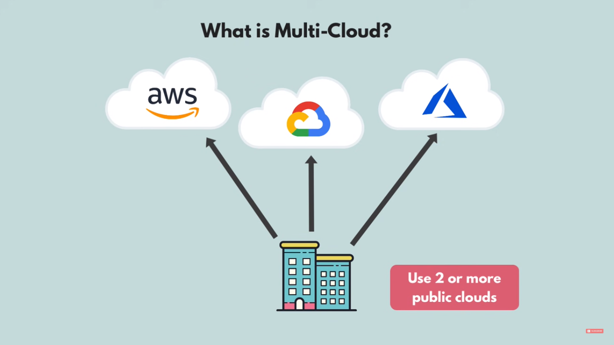
Notes:
Now, let’s reveal the three cloud deployment models.
"All-In" Cloud is a cloud-based application that is fully deployed in the cloud, and all parts of the application run in the cloud. Applications in the cloud have either been created in the cloud or have been migrated from an existing infrastructure. Cloud-based applications can be built on low-level infrastructure pieces (for example, networking, compute or storage) or can use higher-level services that provide abstraction from the management, architecting, and scaling requirements of core infrastructure.
A hybrid deployment is a way to connect infrastructure and applications between cloud-based resources and existing resources that are not located in the cloud. The most common method of hybrid deployment is between the cloud and existing on-premises infrastructure (sometimes called on-prem). On-premises infrastructure is located within the physical confines of an enterprise, often in the company's data center. A hybrid deployment model is used to extend an organization's infrastructure into the cloud while connecting cloud resources to an internal system. For more information on how AWS can help you with your hybrid deployment, visit the link https://aws.amazon.com/enterprise/hybrid/.
When you run a cloud infrastructure from your own data center, that’s called on-premises or private cloud. While this kind of deployment lacks many of the benefits of cloud computing, it does provide dedicated resources and is a popular choice for organizations who need to meet certain compliance standards. In most cases, this deployment model is the same as legacy IT infrastructure while using application management and virtualization to increase resource utilization.

Slide 27
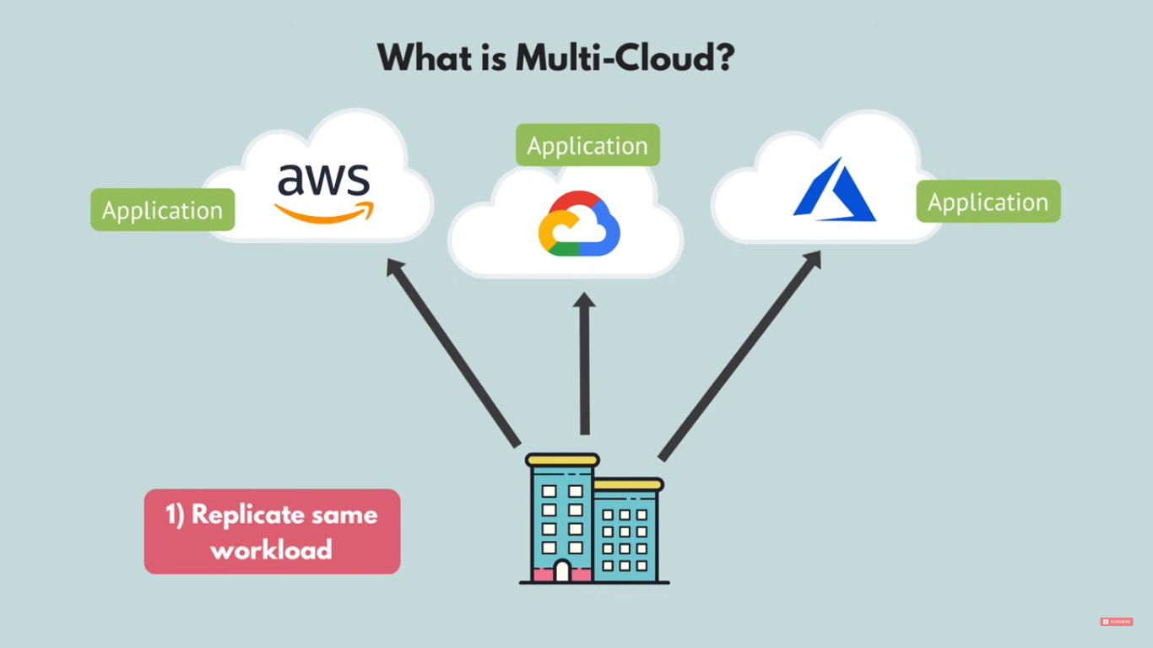
Notes:
Now, let’s reveal the three cloud deployment models.
"All-In" Cloud is a cloud-based application that is fully deployed in the cloud, and all parts of the application run in the cloud. Applications in the cloud have either been created in the cloud or have been migrated from an existing infrastructure. Cloud-based applications can be built on low-level infrastructure pieces (for example, networking, compute or storage) or can use higher-level services that provide abstraction from the management, architecting, and scaling requirements of core infrastructure.
A hybrid deployment is a way to connect infrastructure and applications between cloud-based resources and existing resources that are not located in the cloud. The most common method of hybrid deployment is between the cloud and existing on-premises infrastructure (sometimes called on-prem). On-premises infrastructure is located within the physical confines of an enterprise, often in the company's data center. A hybrid deployment model is used to extend an organization's infrastructure into the cloud while connecting cloud resources to an internal system. For more information on how AWS can help you with your hybrid deployment, visit the link https://aws.amazon.com/enterprise/hybrid/.
When you run a cloud infrastructure from your own data center, that’s called on-premises or private cloud. While this kind of deployment lacks many of the benefits of cloud computing, it does provide dedicated resources and is a popular choice for organizations who need to meet certain compliance standards. In most cases, this deployment model is the same as legacy IT infrastructure while using application management and virtualization to increase resource utilization.

Slide 28
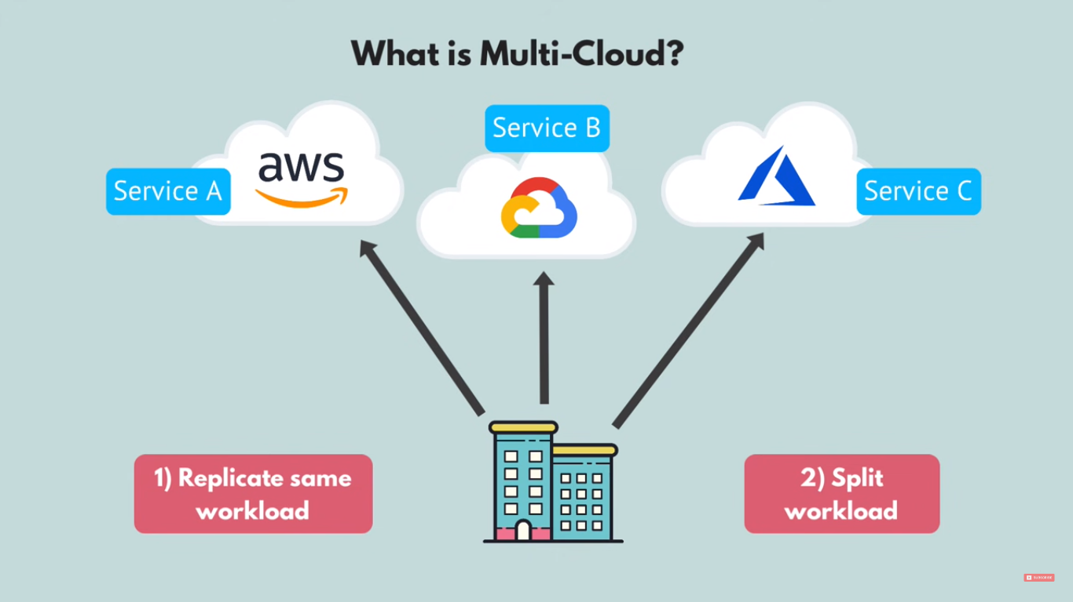
Notes:
Now, let’s reveal the three cloud deployment models.
"All-In" Cloud is a cloud-based application that is fully deployed in the cloud, and all parts of the application run in the cloud. Applications in the cloud have either been created in the cloud or have been migrated from an existing infrastructure. Cloud-based applications can be built on low-level infrastructure pieces (for example, networking, compute or storage) or can use higher-level services that provide abstraction from the management, architecting, and scaling requirements of core infrastructure.
A hybrid deployment is a way to connect infrastructure and applications between cloud-based resources and existing resources that are not located in the cloud. The most common method of hybrid deployment is between the cloud and existing on-premises infrastructure (sometimes called on-prem). On-premises infrastructure is located within the physical confines of an enterprise, often in the company's data center. A hybrid deployment model is used to extend an organization's infrastructure into the cloud while connecting cloud resources to an internal system. For more information on how AWS can help you with your hybrid deployment, visit the link https://aws.amazon.com/enterprise/hybrid/.
When you run a cloud infrastructure from your own data center, that’s called on-premises or private cloud. While this kind of deployment lacks many of the benefits of cloud computing, it does provide dedicated resources and is a popular choice for organizations who need to meet certain compliance standards. In most cases, this deployment model is the same as legacy IT infrastructure while using application management and virtualization to increase resource utilization.

Slide 29
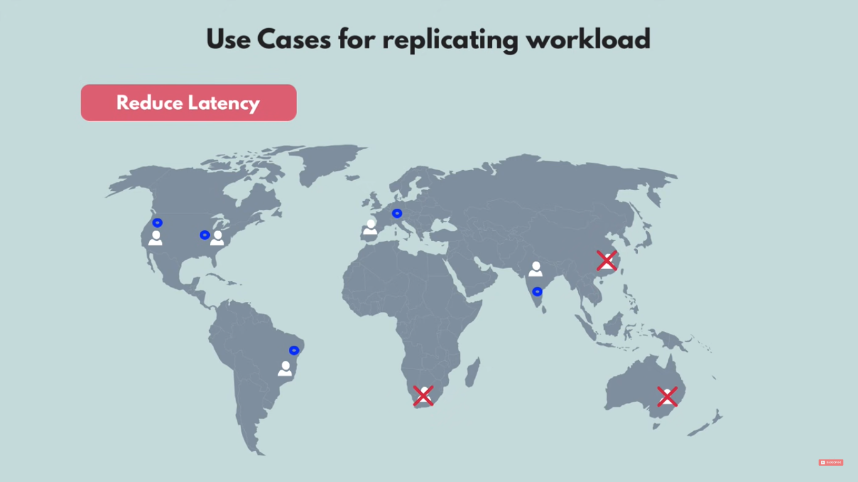
Notes:
Now, let’s reveal the three cloud deployment models.
"All-In" Cloud is a cloud-based application that is fully deployed in the cloud, and all parts of the application run in the cloud. Applications in the cloud have either been created in the cloud or have been migrated from an existing infrastructure. Cloud-based applications can be built on low-level infrastructure pieces (for example, networking, compute or storage) or can use higher-level services that provide abstraction from the management, architecting, and scaling requirements of core infrastructure.
A hybrid deployment is a way to connect infrastructure and applications between cloud-based resources and existing resources that are not located in the cloud. The most common method of hybrid deployment is between the cloud and existing on-premises infrastructure (sometimes called on-prem). On-premises infrastructure is located within the physical confines of an enterprise, often in the company's data center. A hybrid deployment model is used to extend an organization's infrastructure into the cloud while connecting cloud resources to an internal system. For more information on how AWS can help you with your hybrid deployment, visit the link https://aws.amazon.com/enterprise/hybrid/.
When you run a cloud infrastructure from your own data center, that’s called on-premises or private cloud. While this kind of deployment lacks many of the benefits of cloud computing, it does provide dedicated resources and is a popular choice for organizations who need to meet certain compliance standards. In most cases, this deployment model is the same as legacy IT infrastructure while using application management and virtualization to increase resource utilization.

Slide 30
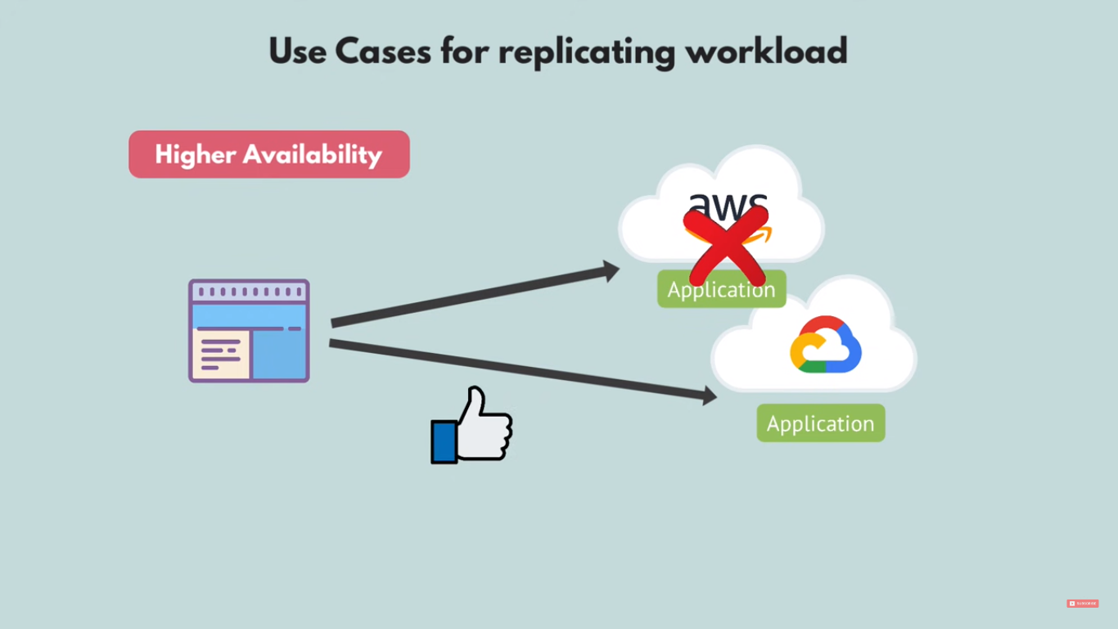
Notes:
Now, let’s reveal the three cloud deployment models.
"All-In" Cloud is a cloud-based application that is fully deployed in the cloud, and all parts of the application run in the cloud. Applications in the cloud have either been created in the cloud or have been migrated from an existing infrastructure. Cloud-based applications can be built on low-level infrastructure pieces (for example, networking, compute or storage) or can use higher-level services that provide abstraction from the management, architecting, and scaling requirements of core infrastructure.
A hybrid deployment is a way to connect infrastructure and applications between cloud-based resources and existing resources that are not located in the cloud. The most common method of hybrid deployment is between the cloud and existing on-premises infrastructure (sometimes called on-prem). On-premises infrastructure is located within the physical confines of an enterprise, often in the company's data center. A hybrid deployment model is used to extend an organization's infrastructure into the cloud while connecting cloud resources to an internal system. For more information on how AWS can help you with your hybrid deployment, visit the link https://aws.amazon.com/enterprise/hybrid/.
When you run a cloud infrastructure from your own data center, that’s called on-premises or private cloud. While this kind of deployment lacks many of the benefits of cloud computing, it does provide dedicated resources and is a popular choice for organizations who need to meet certain compliance standards. In most cases, this deployment model is the same as legacy IT infrastructure while using application management and virtualization to increase resource utilization.

Slide 31
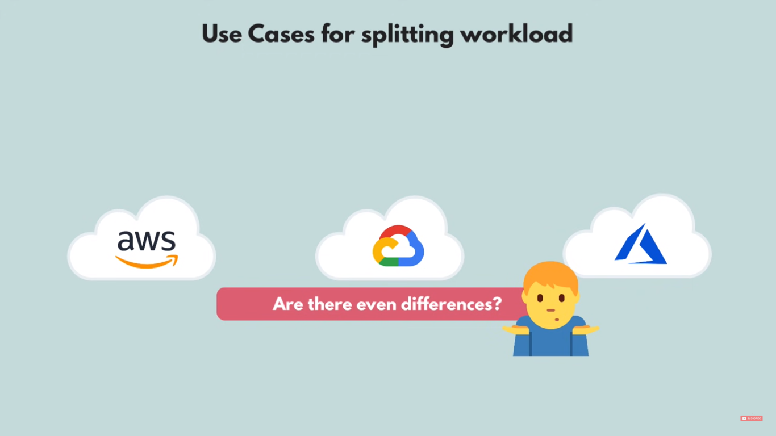
Notes:
Now, let’s reveal the three cloud deployment models.
"All-In" Cloud is a cloud-based application that is fully deployed in the cloud, and all parts of the application run in the cloud. Applications in the cloud have either been created in the cloud or have been migrated from an existing infrastructure. Cloud-based applications can be built on low-level infrastructure pieces (for example, networking, compute or storage) or can use higher-level services that provide abstraction from the management, architecting, and scaling requirements of core infrastructure.
A hybrid deployment is a way to connect infrastructure and applications between cloud-based resources and existing resources that are not located in the cloud. The most common method of hybrid deployment is between the cloud and existing on-premises infrastructure (sometimes called on-prem). On-premises infrastructure is located within the physical confines of an enterprise, often in the company's data center. A hybrid deployment model is used to extend an organization's infrastructure into the cloud while connecting cloud resources to an internal system. For more information on how AWS can help you with your hybrid deployment, visit the link https://aws.amazon.com/enterprise/hybrid/.
When you run a cloud infrastructure from your own data center, that’s called on-premises or private cloud. While this kind of deployment lacks many of the benefits of cloud computing, it does provide dedicated resources and is a popular choice for organizations who need to meet certain compliance standards. In most cases, this deployment model is the same as legacy IT infrastructure while using application management and virtualization to increase resource utilization.

Slide 32
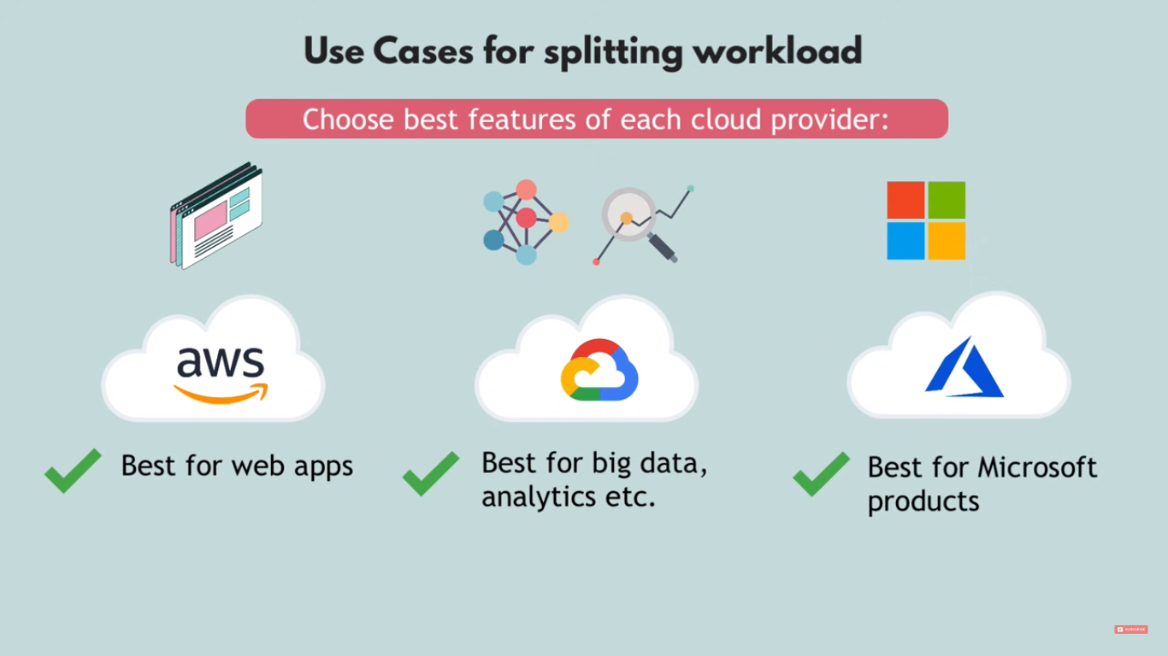
Notes:
Now, let’s reveal the three cloud deployment models.
"All-In" Cloud is a cloud-based application that is fully deployed in the cloud, and all parts of the application run in the cloud. Applications in the cloud have either been created in the cloud or have been migrated from an existing infrastructure. Cloud-based applications can be built on low-level infrastructure pieces (for example, networking, compute or storage) or can use higher-level services that provide abstraction from the management, architecting, and scaling requirements of core infrastructure.
A hybrid deployment is a way to connect infrastructure and applications between cloud-based resources and existing resources that are not located in the cloud. The most common method of hybrid deployment is between the cloud and existing on-premises infrastructure (sometimes called on-prem). On-premises infrastructure is located within the physical confines of an enterprise, often in the company's data center. A hybrid deployment model is used to extend an organization's infrastructure into the cloud while connecting cloud resources to an internal system. For more information on how AWS can help you with your hybrid deployment, visit the link https://aws.amazon.com/enterprise/hybrid/.
When you run a cloud infrastructure from your own data center, that’s called on-premises or private cloud. While this kind of deployment lacks many of the benefits of cloud computing, it does provide dedicated resources and is a popular choice for organizations who need to meet certain compliance standards. In most cases, this deployment model is the same as legacy IT infrastructure while using application management and virtualization to increase resource utilization.

Slide 33
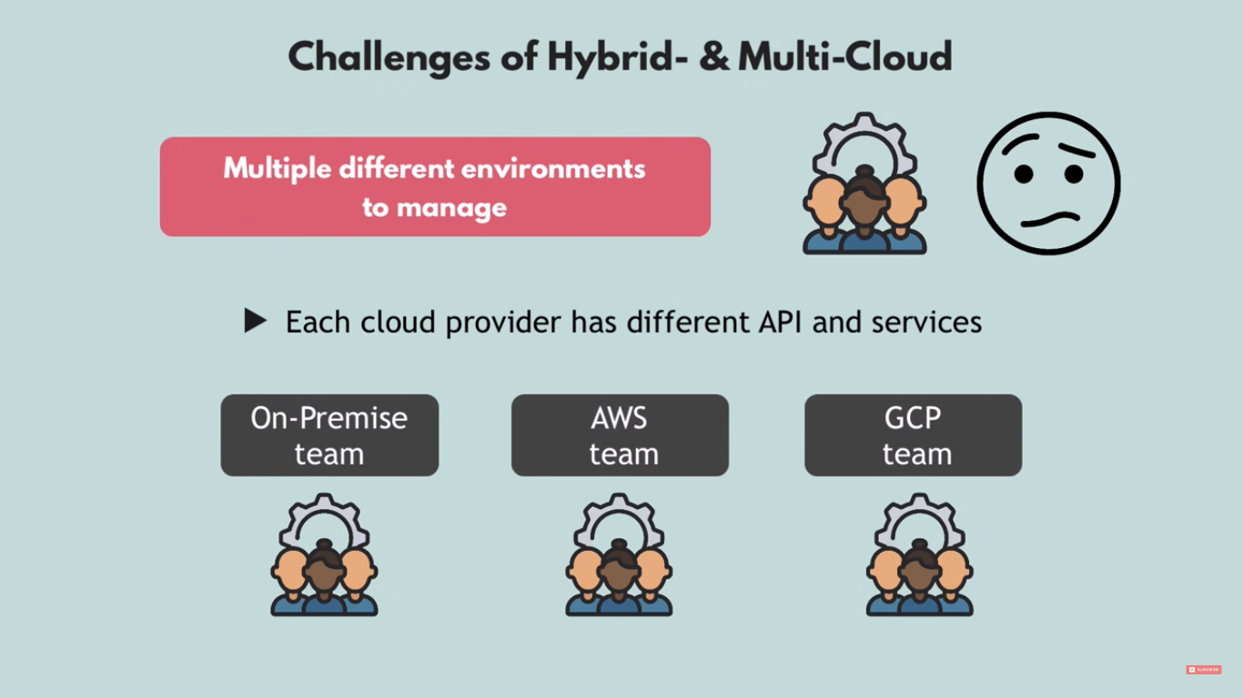
Notes:
Now, let’s reveal the three cloud deployment models.
"All-In" Cloud is a cloud-based application that is fully deployed in the cloud, and all parts of the application run in the cloud. Applications in the cloud have either been created in the cloud or have been migrated from an existing infrastructure. Cloud-based applications can be built on low-level infrastructure pieces (for example, networking, compute or storage) or can use higher-level services that provide abstraction from the management, architecting, and scaling requirements of core infrastructure.
A hybrid deployment is a way to connect infrastructure and applications between cloud-based resources and existing resources that are not located in the cloud. The most common method of hybrid deployment is between the cloud and existing on-premises infrastructure (sometimes called on-prem). On-premises infrastructure is located within the physical confines of an enterprise, often in the company's data center. A hybrid deployment model is used to extend an organization's infrastructure into the cloud while connecting cloud resources to an internal system. For more information on how AWS can help you with your hybrid deployment, visit the link https://aws.amazon.com/enterprise/hybrid/.
When you run a cloud infrastructure from your own data center, that’s called on-premises or private cloud. While this kind of deployment lacks many of the benefits of cloud computing, it does provide dedicated resources and is a popular choice for organizations who need to meet certain compliance standards. In most cases, this deployment model is the same as legacy IT infrastructure while using application management and virtualization to increase resource utilization.

Slide 34
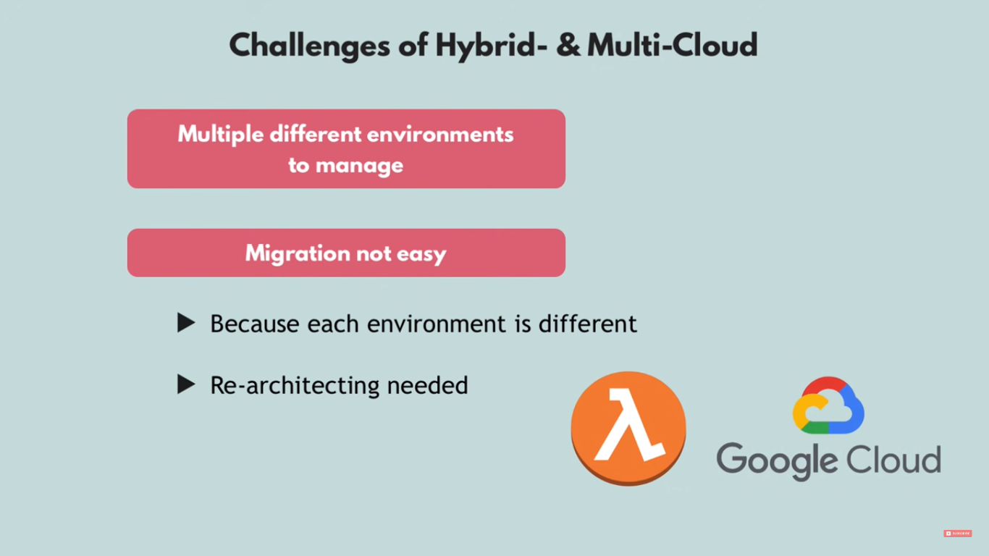
Notes:
Now, let’s reveal the three cloud deployment models.
"All-In" Cloud is a cloud-based application that is fully deployed in the cloud, and all parts of the application run in the cloud. Applications in the cloud have either been created in the cloud or have been migrated from an existing infrastructure. Cloud-based applications can be built on low-level infrastructure pieces (for example, networking, compute or storage) or can use higher-level services that provide abstraction from the management, architecting, and scaling requirements of core infrastructure.
A hybrid deployment is a way to connect infrastructure and applications between cloud-based resources and existing resources that are not located in the cloud. The most common method of hybrid deployment is between the cloud and existing on-premises infrastructure (sometimes called on-prem). On-premises infrastructure is located within the physical confines of an enterprise, often in the company's data center. A hybrid deployment model is used to extend an organization's infrastructure into the cloud while connecting cloud resources to an internal system. For more information on how AWS can help you with your hybrid deployment, visit the link https://aws.amazon.com/enterprise/hybrid/.
When you run a cloud infrastructure from your own data center, that’s called on-premises or private cloud. While this kind of deployment lacks many of the benefits of cloud computing, it does provide dedicated resources and is a popular choice for organizations who need to meet certain compliance standards. In most cases, this deployment model is the same as legacy IT infrastructure while using application management and virtualization to increase resource utilization.

Slide 35
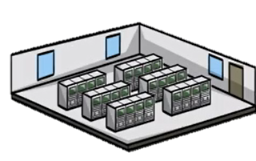
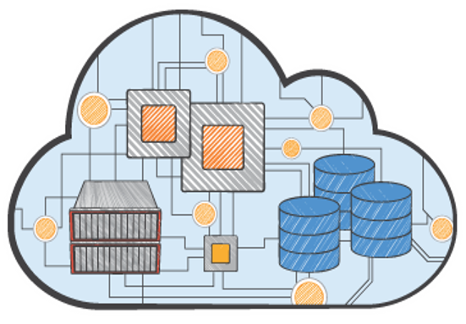
All-In Cloud versus On-Premises
All-In Cloud
No upfront investment
Low ongoing costs
Focus on innovation
Flexible capacity
Speed and agility
Global reach on demand
On-Premises
Large initial purchase
Labor, patches, and upgrade cycles
Systems administration
Fixed capacity
Long procurement cycle and setup
Limited geographic regions
Notes:
To summarize:
With the All-In solution, there is no upfront investment, so you avoid the large capital purchases required for an On-Premises solution. You have immediate access to resources without having to procure, install, and configure cabling, racks, servers, and storage in a physical location with appropriate facilities like cooling and power. Instead, you just click to order and pay for the resources you need, which are available almost immediately.
Cloud computing helps you reduce ongoing IT costs in multiple ways. AWS continually lowers prices due to massive economies of scale and continual improvements. Multiple pricing options also help you optimize costs based on your unique workloads. You pay only for what you use on a variable, monthly basis. On-premises solutions typically require upgrades on 1-year, 3-year, or 5-year cycles.
Cloud gives you managed IT resources on demand, at a fraction of the cost of traditional infrastructure. This cost savings empowers organizations to shift resources toward innovative new projects that grow their business by focusing on “apps not ops.”
Predicting how customers are going to adopt your new application is complex, making it difficult to estimate your infrastructure capacity needs. Flexible capacity means that your resources are dynamic. You can quickly provision resources as demand goes up and turn off what you don’t need as demand declines.
Cloud computing’s speed and agility makes it possible for you to respond to changing market conditions. With AWS, resources can be provisioned as needed. This self-service environment changes how you develop and deploy applications, allowing your team to experiment more quickly and more frequently. The amount of time it takes to get a server procured, delivered, and running limits this in a traditional infrastructure.
With on-premises, it is hard to deliver great performance to a distributed user base. The initial purchase is large, it’s labor intensive with patches, upgrade cycles and systems administration with fixed capacity. There are long procurement cycles and setup, so companies focus on one geographic region at a time to save costs and time. Without geographical limitations, you can deploy your application in any of the AWS regions around the world with lower latency and at minimal cost.

Slide 36
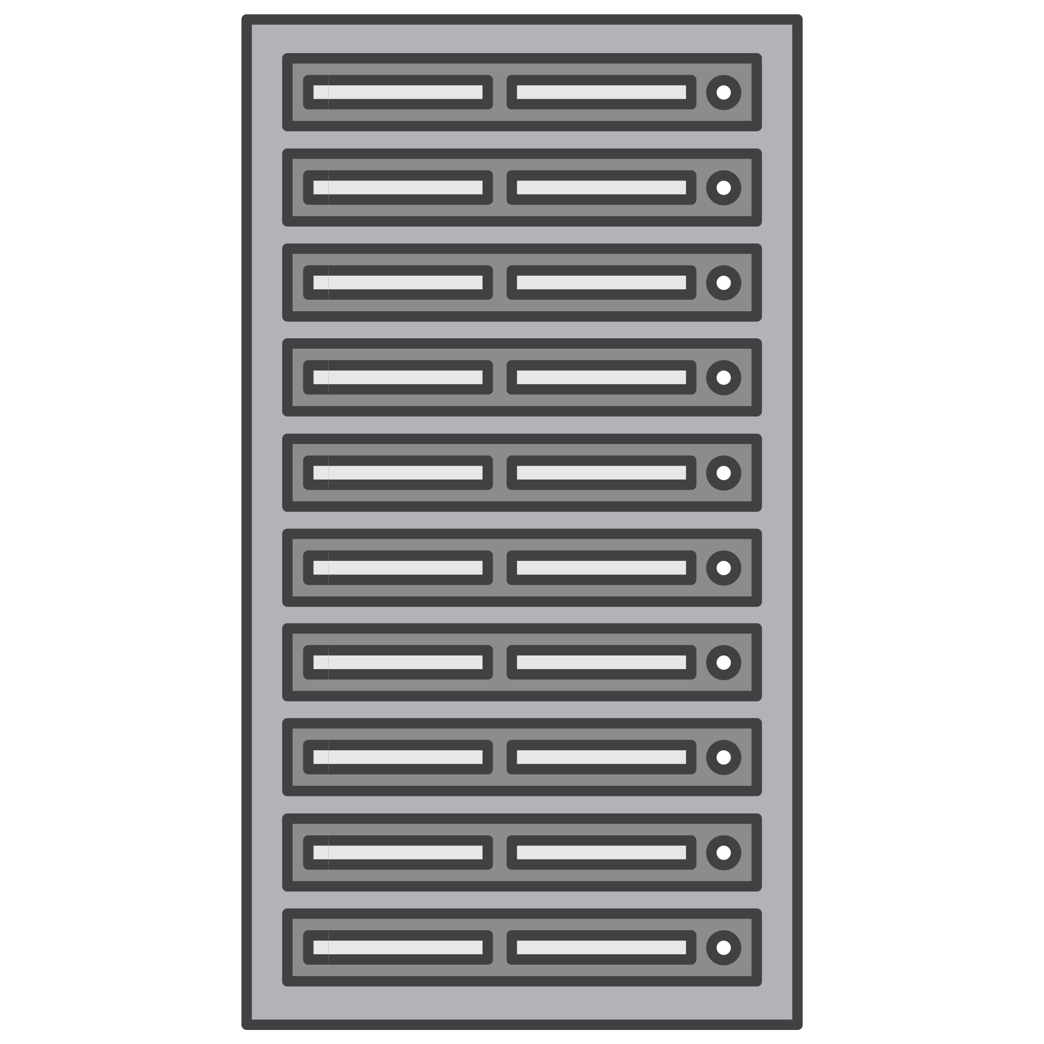

What can you do in the cloud?
You can use a cloud computing platform for:
Application Hosting
Backup and Storage
Content Delivery
Websites
Enterprise IT
Databases
Notes:
You can use a cloud computing platform for the following:
• Application Hosting for an on-demand infrastructure to host internal or SaaS applications.
• Backup and Storage to store data and build dependable backup solutions.
• Content Delivery to distribute content worldwide, with high data transfer speeds.
• Host static and dynamic websites.
• Enterprise IT to host internal- or external-facing IT applications in AWS's secure environment.
• Use a variety of scalable database solutions, from hosted enterprise database software to non-relational database solutions.

Slide 37
Part 4: Important Cloud Terminology
Notes:
In part one, we’ll answer the question, “What is cloud computing?”

Slide 38
Important Cloud Terminology
  High Availability (Highly Available):
    Accessible when you need it
  Fault Tolerance (Fault Tolerant):
    Ability to withstand a certain amount of failure and still remain functional
  Scalability (Scalable):
    Ability to easily grow in size, capacity, and/or scope when required
    Growth is (usually) based on demand
  Elasticity (Elastic):
    Ability to grow (scale) when required and to reduce in size when resources are no longer needed
Notes:
Now let’s review some important cloud terminology. High availability, fault tolerance, scalability, and elasticity are four terms often used when discussing the cloud. These concepts are the fundamental building blocks of AWS and will be referred to throughout the course.
High availability refers to a resource that is accessible when you attempt to access it. For example, if every time you go to the ATM to make a withdrawal it works as expected the ATM is highly available; however, if you go to use it and there is a sign on the front that says “Out of Order”, it is not highly available.
Fault tolerance is the ability to withstand a certain amount of failure and still remain functional. It also refers to the ability of a system to be self-healing and return to full capacity despite a failure. It is the ability of a system to fail in some way but still remain functional.
Scalability is the ability to easily grow in size, capacity, and/or scope when required particularly in response to demand. If something cannot quickly grow in an easy manner it is not scalable.
Elasticity is the ability to not only grow (or scale) when required, but also to reduce or contract in size as needed. A system that is elastic can scale to grow as needed usually based on demand and contract as demand decreases.

Slide 39
Summary
  Cloud computing is the on-demand delivery of IT resources online with pay-as-you-go pricing.
  Three models of cloud computing are:
    Infrastructure as a Service (IaaS)
    Platform as a Service (PaaS)
    Software as a Service (SaaS)
  All-in cloud, hybrid, and private cloud are three cloud deployment models.
  Cloud services are available to replace traditional on-premises computing activities.
Notes:
In summary, cloud computing is the on-demand delivery of IT resources online with pay-as-you-go pricing.
The three models of cloud computing are:
Infrastructure as a Service (IaaS)
Platform as a Service (PaaS), and
Software as a Service (SaaS)
All-in cloud, hybrid, and private cloud, are three cloud deployment models.
Cloud services are available to replace traditional on-premises computing activities.

