Slide 1
INVENTORY STORE MANAGEMENT
Gaurav Thorat 002957343
Sai Srujan Penta 002928427
Pranaya Chilamkuri 002924536
Aishwarya Wagdarkar 002964461
Yashwanth Avula 002985604

Slide 2
PROBLEM STATEMENT:
TO CREATE A MANAGEMENT SYSTEM THAT OVERSEES PRODUCT SALES, UPDATES TRANSACTIONS, AND HELP RETAIL STORES RUN MORE EFFECTIVELY BY KEEPING INVENTORY UP TO DATE.

Slide 3
PROPOSED SOLUTION
WE CREATED A RETAIL MANAGEMENT SYSTEM THAT FOLLOWS BUSINESS RULES AND ALLOWS RETAIL COMPANIES TO WORK EFFICIENTLY.
THE PROPOSED MODEL ALLOWS FOR INVENTORY TRACKING AND SENDS NOTIFICATION TO THE STORE MANAGER WHEN PRODUCTS ARE OUT OF STOCK.
THE PROPOSED MANAGEMENT SYSTEM ALSO MAKES RETURNING PRODUCTS BY THE CUSTOMER A SIMPLE PROCESS AND CHECKS THE EXPIRATION DATE FOR PRODUCTS AND UPDATES AS NEEDED.
THIS RETAIL MANAGEMENT SYSTEM ALSO CONTROLS SALES AND PAYMENTS.

Slide 4
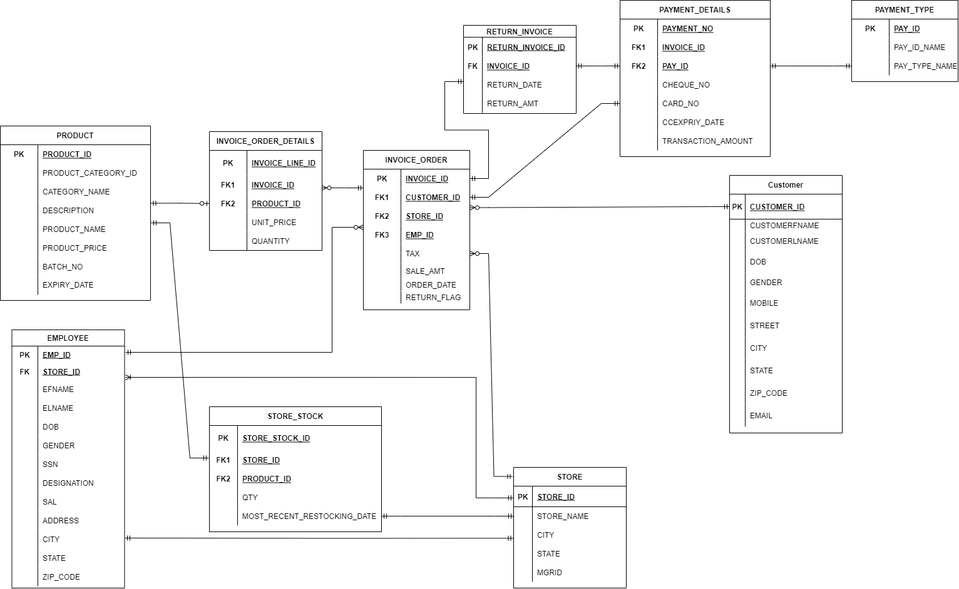
ER DIAGRAM

Slide 5
Team Contribution
Gaurav Thorat: Sequences and Packages, Insertion of data.
Pranaya : Procedure to check quantities, Insertion of data. Procedures to grant access for manager of the store.
Srujan : Table insertion procedures, Insertion of data. Procedure to process transaction on invoices.
Aishwarya : Table creation procedures, Insertion of data, trigger notification
Yashwanth : Procedures to grant access for employees of the store. Insertion of data, Trigger notification to managers when product is falling short.

Slide 6
THANKYOU

