Slide 1
QUANTUM COMPUTING
DONE BY:
AISHA FARHEEN RASHEED A
ROLL NO:04

Slide 2
WHAT IS QUANTUM COMPUTING
-This branch of computer science is based on the principles of the superposition of matter and quantum entanglement and uses a different computation method from the traditional one.
-In theory, it would be able to store many more states per unit of information and operate with much more efficient algorithms at the numerical level, such as Shor's or quantum annealing.
-quantum computing faces evident problems regarding scalability and incoherence, it makes it possible to perform multiple simultaneous operations and eliminates the tunnel effect that limits current nanometres scale programming.

Slide 3
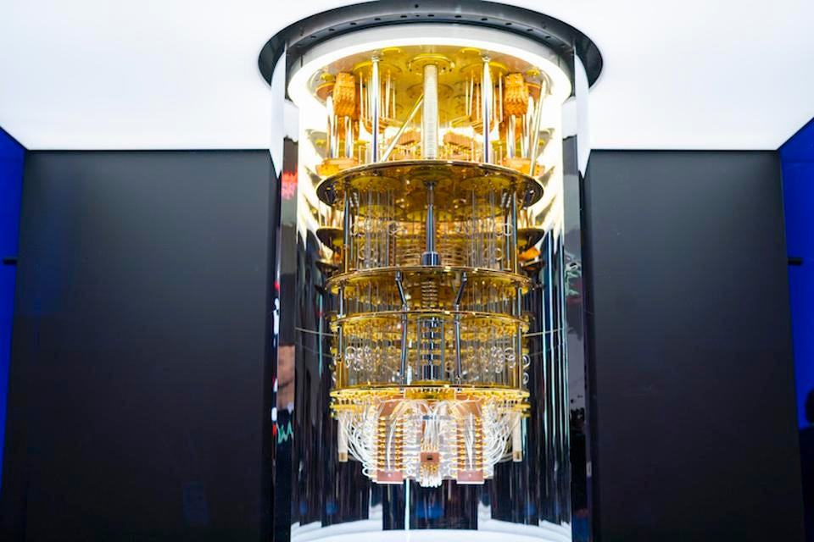
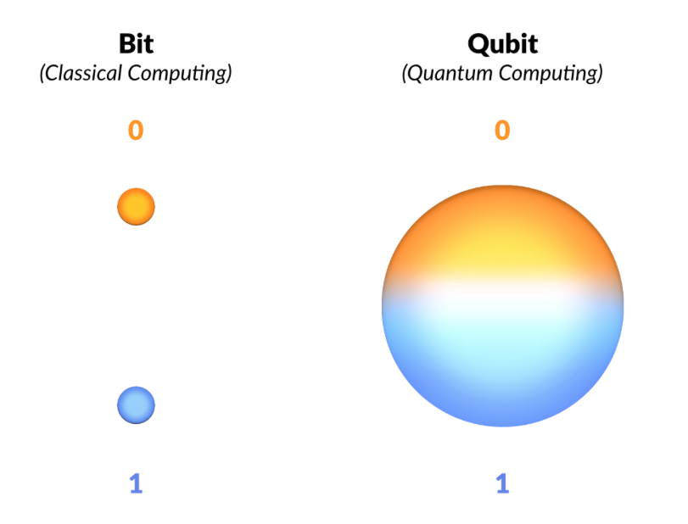
Why do we need quantum computers?
When scientists and engineers encounter difficult problems, they turn to supercomputers.
These are very large classical computers, often with thousands of classical CPU and GPU cores. However, even supercomputers struggle to solve certain kinds of problems.

Slide 4
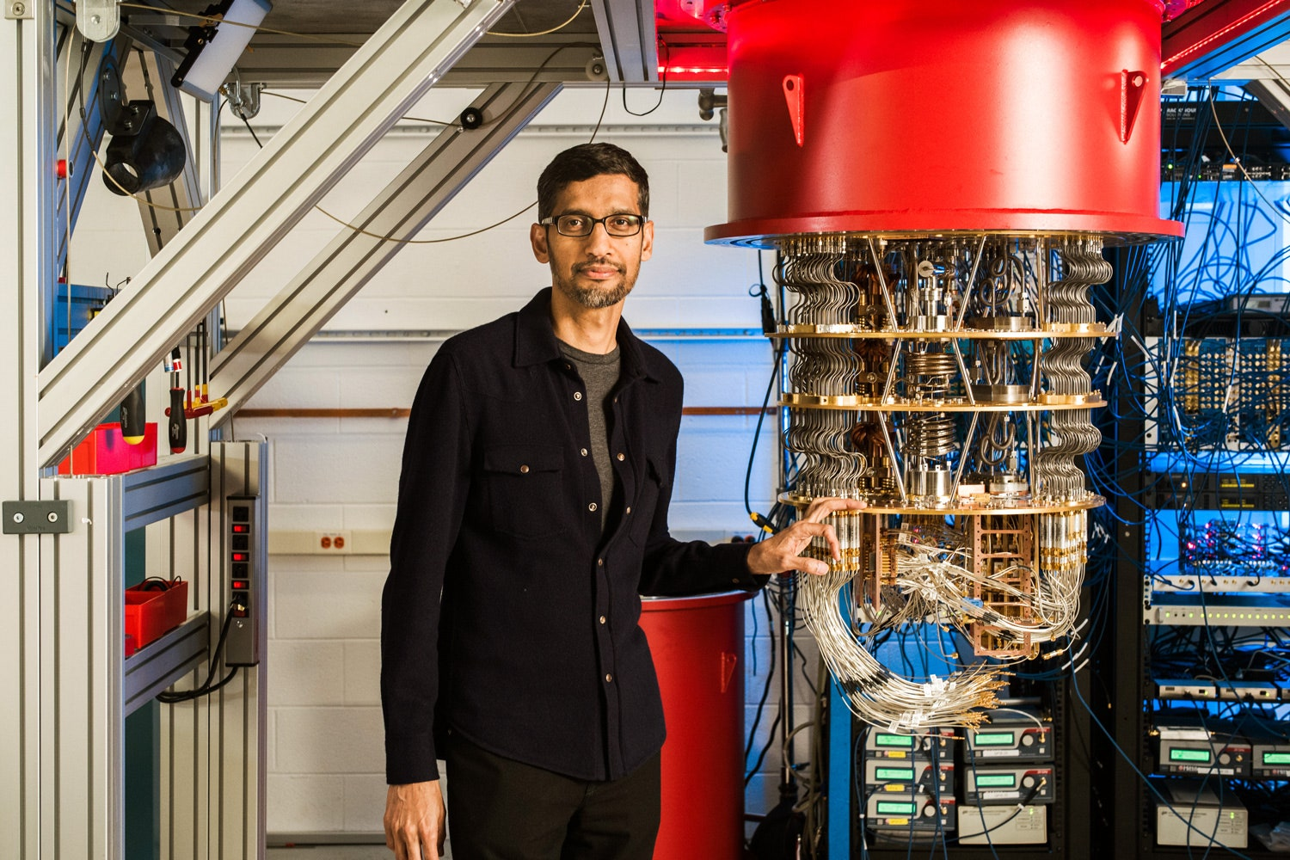
If a supercomputer gets stumped, that's probably because the big classical machine was asked to solve a problem with a high degree of complexity. When classical computers fail, it's often due to complexity.
Complex problems are problems with lots of variables interacting in complicated ways.
Modeling the behavior of individual atoms in a molecule is a complex problem, because of all the different electrons interacting with one another.
Sorting out the ideal routes for a few hundred tankers in a global shipping network is complex too.

Slide 5
WHAT IS QUANTUM MECHANICS
-Quantum mechanics explain how the universe works at a scale smaller than atoms. It is also called quantum physics or quantum theory. Mechanics is the part of physics that explains how things move and quantum is the Latin word for 'how much'.
-We propose six principles as the fundamental principles of quantum mechanics: principle of space and time, Galilean principle of relativity, Hamilton's principle, wave principle, probability principle, and principle of indestructibility and increatiblity of particles.
-quantum mechanics plays a role in the brain since quantum mechanics determines the shapes and properties of molecules like neurotransmitters and proteins, and these molecules affect how the brain works. This is the reason that drugs such as morphine affect consciousness.

Slide 6

WHAT IS A QUBIT?
Quantum computing uses the qubit as the basic unit of information rather than the conventional bit.
The main characteristic of this alternative system is that it permits the coherent superposition of ones and zeros, the digits of the binary system around which all computing revolves.
Bits, on the other hand, can only have one value at a time — either one or zero —.

Slide 7
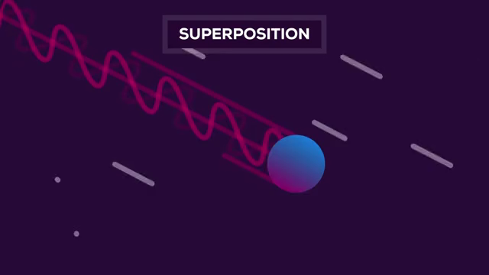
This aspect of quantum technology means that a qubit can be both zero and one at the same time, and in different proportions.
This multiplicity of states makes it possible for a quantum computer with just 30 qubits, for example, to perform 10 billion floating-point operations per second, which is about 5.8 billion more than the most powerful PlayStation video game console on the market.

Slide 8
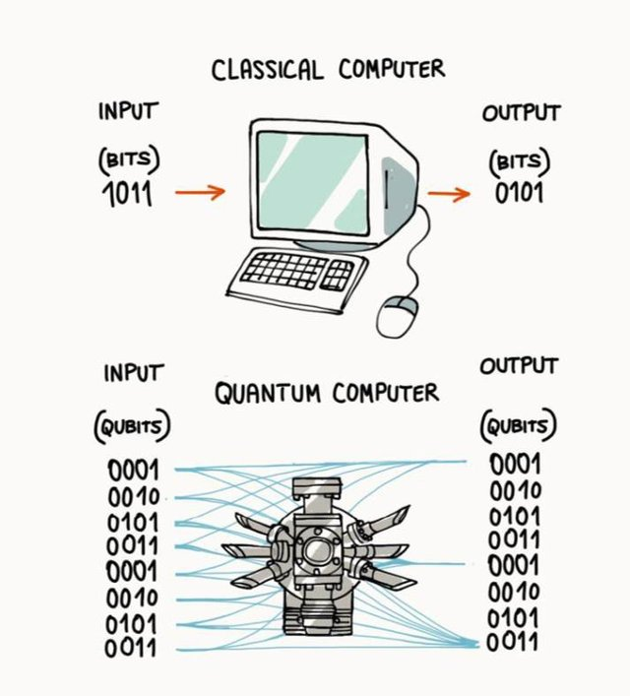
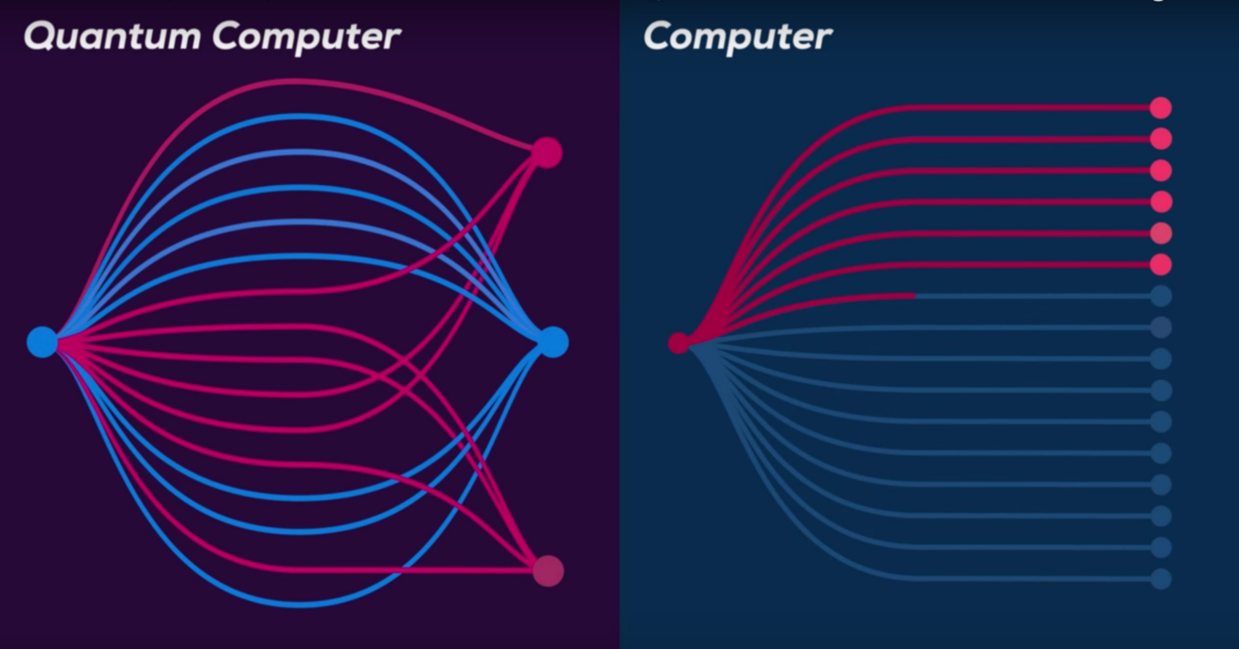
CLASSICAL COMPUTING VS QUANTUM COMPUTING

Slide 9
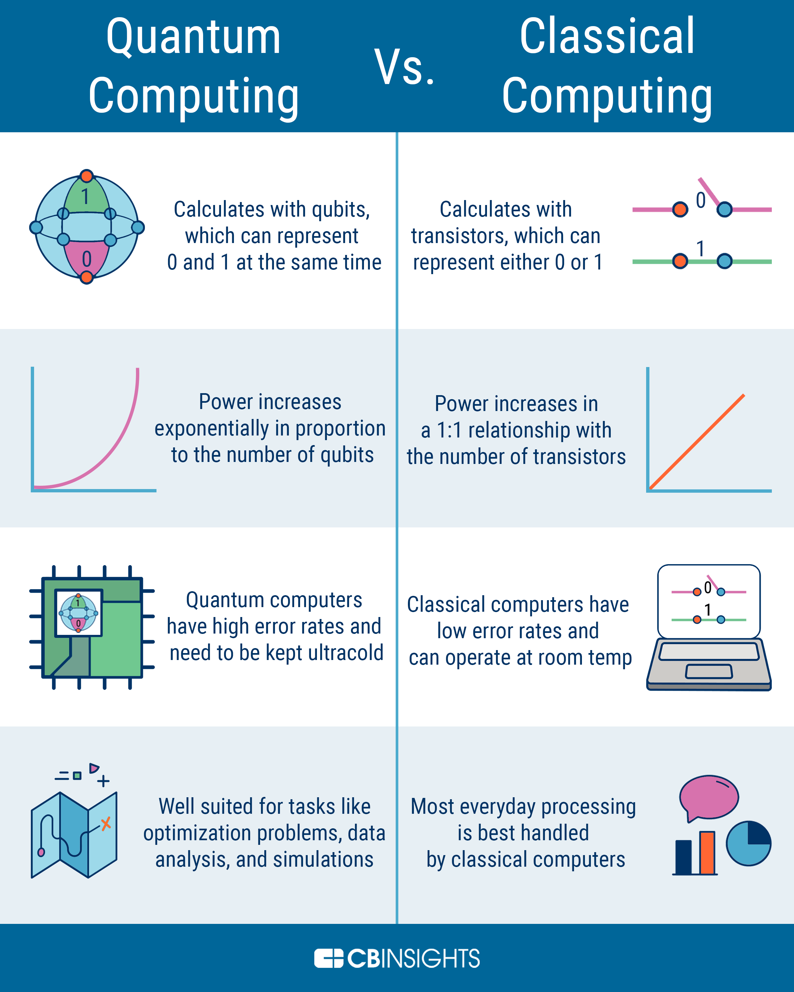
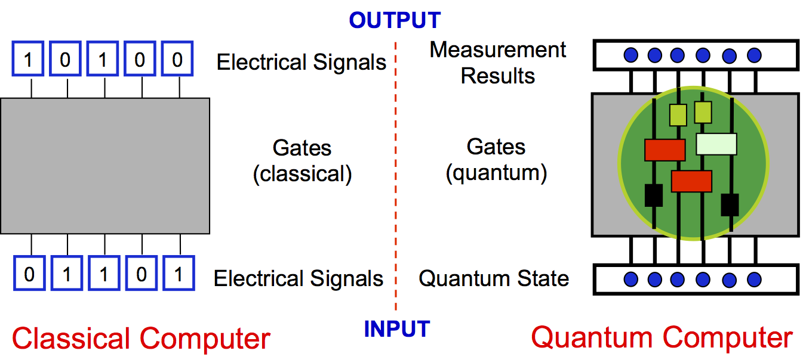

Slide 10
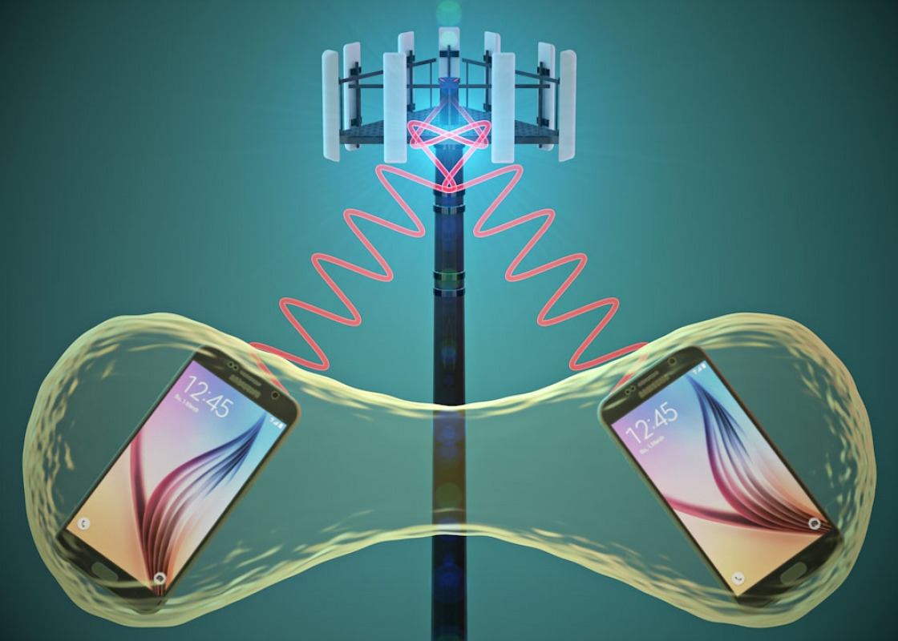
How do quantum computers work?
Superfluid's- Your desktop computer likely uses a fan to get cold enough to work. Our quantum processors need to be very cold – about a hundredth of a degree above absolute zero.
Superconductors- At those ultra-low temperatures certain materials in our processors exhibit another important quantum mechanical effect: electrons move through them without resistance.

Slide 11
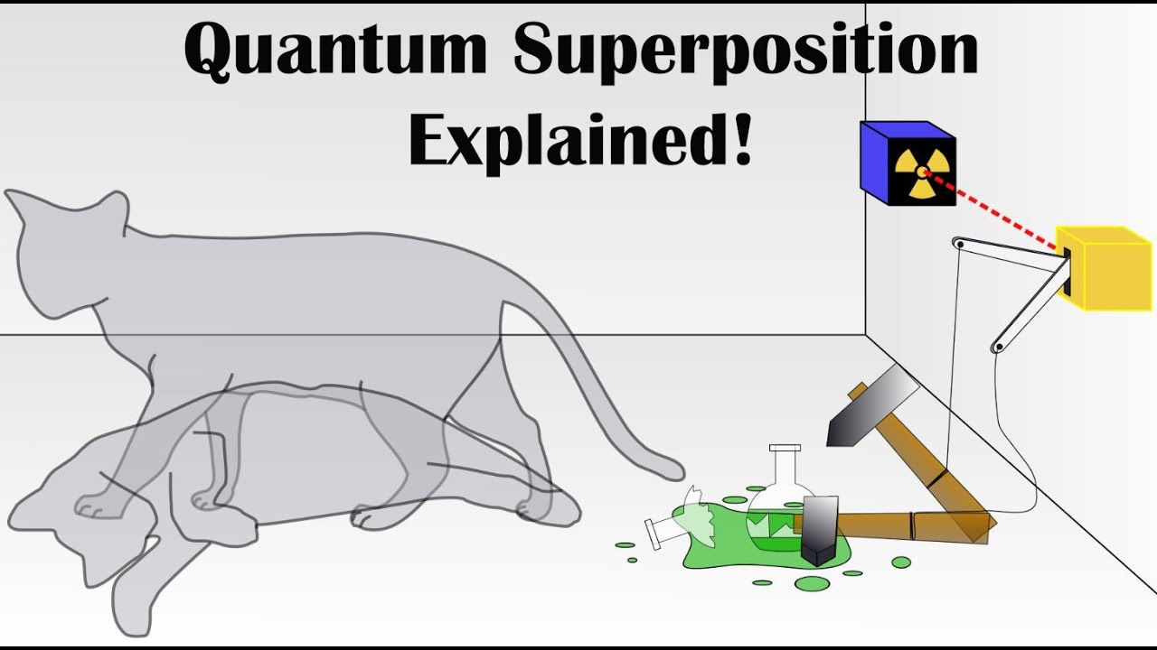
3. Control Our quantum computers use Josephson junctions as superconducting qubits. By firing microwave photons at these qubits, we can control their behavior and get them to hold, change, and read out individual units of quantum information.
4. Superposition A qubit itself isn't very useful. But it can perform an important trick: placing the quantum information it holds into a state of superposition, which represents a combination of all possible configurations of the qubit.
5. Entanglement Entanglement is a quantum mechanical effect that correlates the behavior of two separate things. When two qubits are entangled, changes to one qubit directly impact the other.

Slide 12
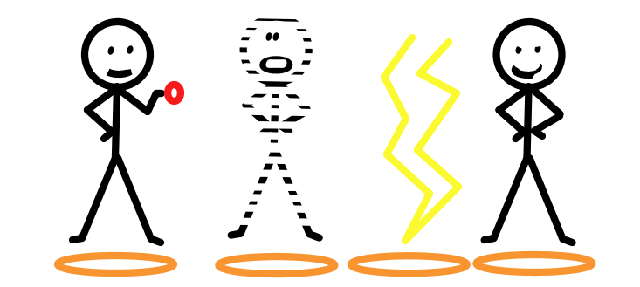
APPLICATION OF QUANTUM COMPUTING
A. Quantum teleportation
-Quantum teleportation is a technique for transferring quantum information from a sender at one location to a receiver some distance away. While teleportation is portrayed in science fiction as a means to transfer physical objects from one location to the next, quantum teleportation only transfers quantum information.
-Quantum teleportation a quantum information protocol by which the unknown quantum state of one particle can be transferred to another distant particle, using a pair of entangled particles, a projective measurement, and exchange of two bits of classical information.

Slide 13
B. Cyber security.
With quantum computing, however, cracking encryption becomes much easier, which poses a threat to data security. A new industry is growing that helps companies prepare for upcoming vulnerabilities in their cyber security.
C. Artificial intelligence.
Quantum computing potentially opens up new opportunities in artificial intelligence, which often involves the combinatoric processing of very large quantities of data in order to make better predictions and decisions (think facial recognition or fraud detection).
D. Financial services.
Finance was one of the earliest domains to embrace Big Data. And much of the science behind the pricing of complex assets such as stock options involves combinatory calculation.

Slide 14
FUTURE SCOPE
-Quantum computing and quantum communication could impact many sectors, including healthcare, energy, finance, security, and entertainment. Recent studies predict a multibillion-dollar quantum industry by 2030.
-quantum computing can make it possible by solving equations that impede advances in extracting an exact model of molecules. This development has the potential to transform biology, chemistry and material science.
-The largest quantum computers have dozens of qubits. However, IBM plans to deliver a 1,121-qubit computer by 2023, and others have shared similar plans. This will cause significant change in the business landscape. Here's what the quantum world could look like with 1,000 qubits.

Slide 15
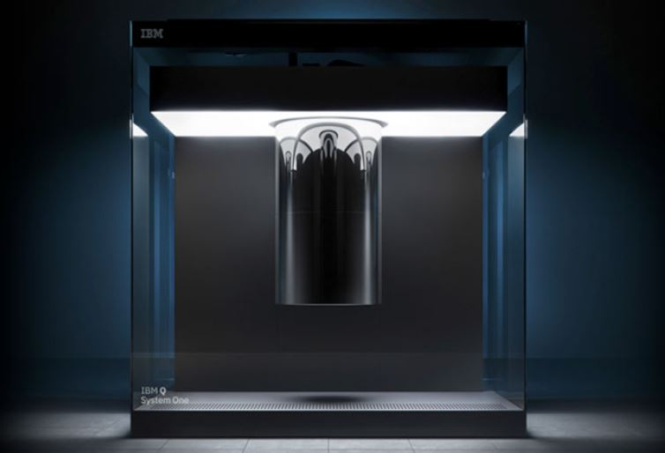
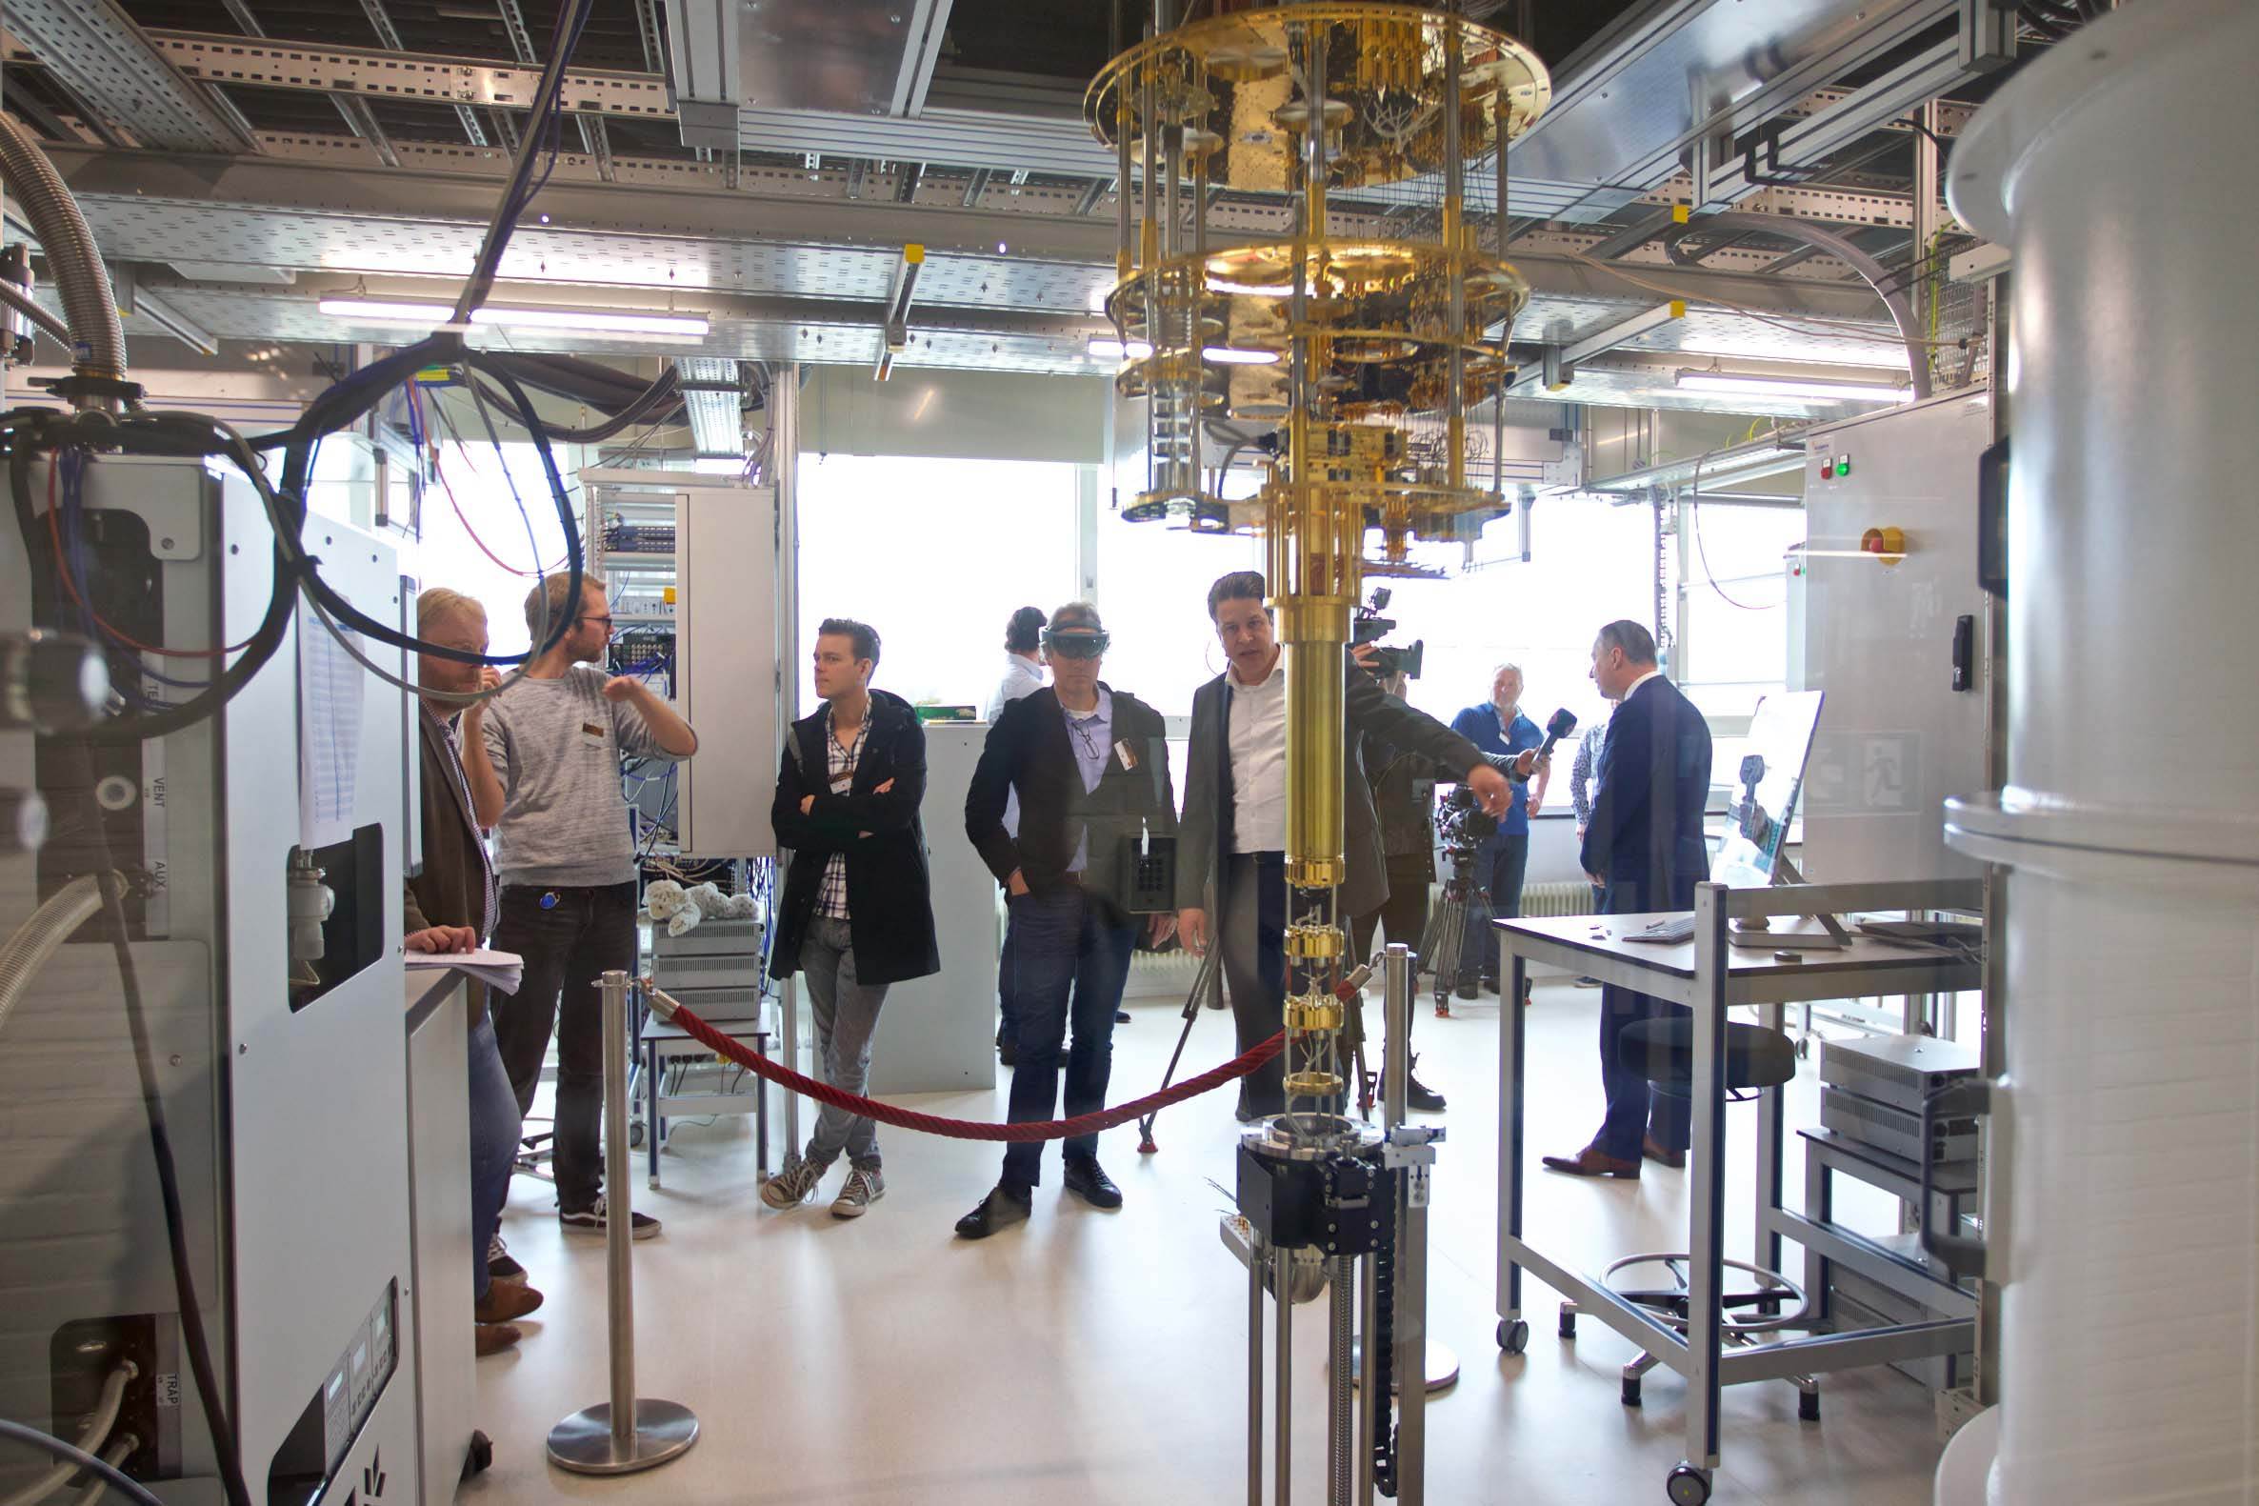
IBM Q System One is the first circuit-based commercial quantum computer, introduced by IBM in January 2019. This integrated quantum computing system is housed in a 2.7x2.7x2.7 m airtight glass cube that maintains a controlled physical environment.
Azure Quantum is a full-stack cloud service designed to allow users remote access to quantum computers. Azure Quantum focuses on integrating quantum computing tools and its Azure cloud service.

Slide 16

Learn quantum computing programming
-IBM's quantum computers are programmed using Qiskit a software development kit in Python.
-Qiskit is free, open source, and accompanied with a comprehensive textbook and semester-length course.
-QISKit is the software that sits between quantum algorithms from one side, and the physical quantum device from the other.
-It translates common programming languages like Python into quantum machine language. This means anyone outside of the IBM Q lab can program a quantum computer.

Slide 17
THANK YOU

