Slide 1
Iterative Deepening A* & Constraint Satisfaction Problems
Lecture Module 6

Slide 2
IDA* Algorithm
At each iteration, perform a DFS cutting off a branch when its total cost (g+h) exceeds a given threshold.
This threshold starts at the estimate of the cost of the initial state, and increases for each iteration of the algorithm.
At each iteration, the threshold used for the next iteration is the minimum cost of all values exceeded the current threshold.

Slide 3
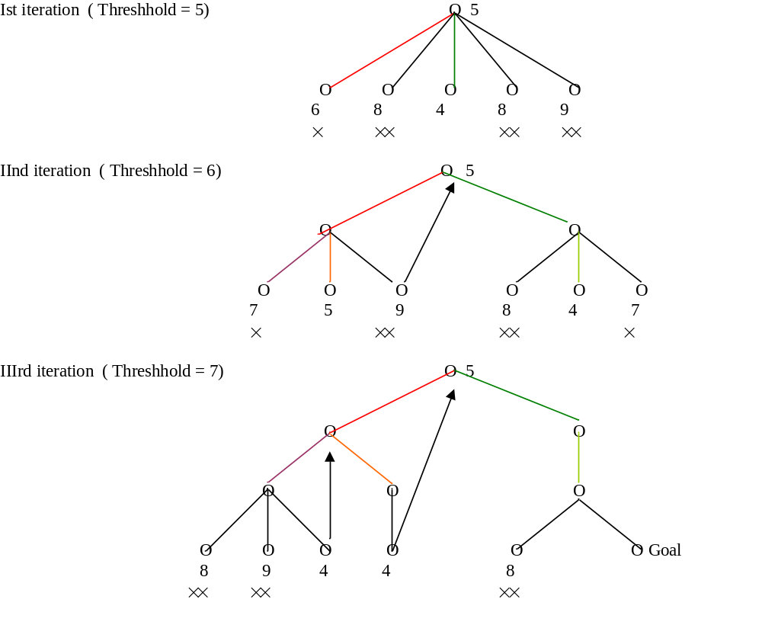

Slide 4
Contd..
Given an admissible monotone cost function, IDA* will find a solution of least cost or optimal solution if one exists.
IDA* not only finds cheapest path to a solution but uses far less space than A* and it expands approximately the same number of nodes as A* in a tree search.
An additional benefit of IDA* over A* is that it is simpler to implement, as there are no open and closed lists to be maintained.
A simple recursion performs DFS inside an outer loop to handle iterations.

Slide 5
Constrained Satisfaction
Many AI problems can be viewed as problems of constrained satisfaction in which the goal is to solve some problem state that satisfies a given set of constraints.
Example of such a problem are
  Crypt-Arithmetic puzzles.
  Many design tasks can also be viewed as constrained satisfaction problems.
  N-Queen: Given the condition that no two queens on the same row/column/diagonal attack each other.
  Map colouring: Given a map, colour three regions in blue, red and black, such that no two neighbouring regions have the same colour.
Such problems do not require a new search methods.
  They can be solved using any of the search strategies which can be augmented with the list of constraints that change as parts of the problem are solved.

Slide 6
Algorithm
Until a complete solution is found or all paths have lead to dead ends
{
  Select an unexpanded node of the search graph.
  Apply the constraint inference rules to the selected node to generate all possible new constraints.
  If the set of constraints contain a contradiction, then report that this path is a dead end.
  If the set of constraint describes a complete solution, then report success.
  If neither a contradiction nor a complete solution has been found, then
    apply the problem space rules to generate new partial solutions that are consistent with the current set of constraints.
    Insert these partial solutions into the search graph.
}

Slide 7
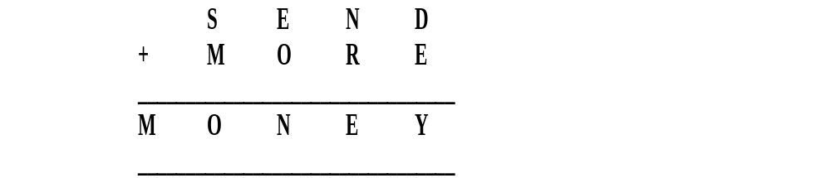
Crypt-Arithmetic puzzle
Problem Statement:
  Solve the following puzzle by assigning numeral (0-9) in such a way that each letter is assigned unique digit which satisfy the following addition.
  Constraints : No two letters have the same value. (The constraints of arithmetic).
Initial Problem State
  S = ? ; E = ? ;N = ? ; D = ? ; M = ? ;O = ? ; R = ? ;Y = ?

Slide 8
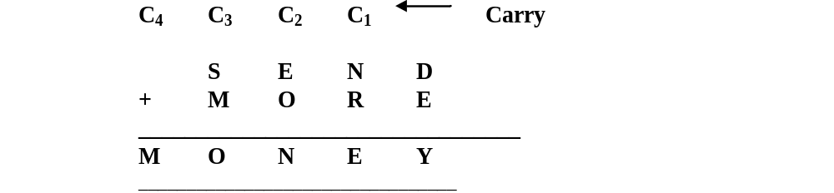
Carries :
    C₄ = ? ; C₃ = ? ; C₂ = ? ; C₁ = ?
Constraint equations:
    Y = D + E C₁
    E = N + R + C₁ C₂
    N = E + O + C₂ C₃
        O = S + M + C₃ C₄
    M = C₄

Slide 9
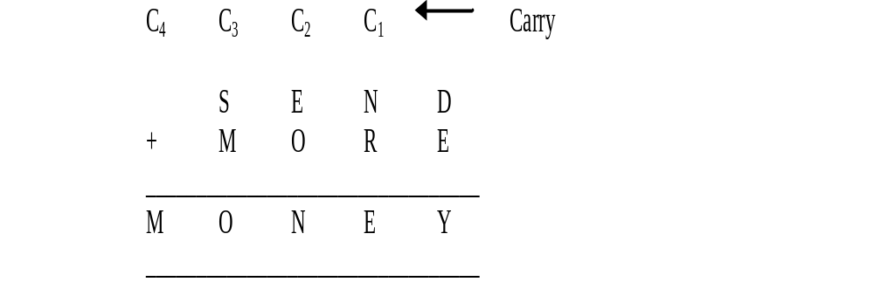
We can easily see that M has to be non zero digit, so the value of C4 =1
M = C4 ⇒ M = 1
O = S + M + C3 → C4
For C4 =1, S + M + C3 > 9 ⇒
S + 1 + C3 > 9 ⇒ S+C3 > 8.
If C3 = 0, then S = 9 else if C3 = 1,
then S = 8 or 9.
We see that for S = 9
  C3 = 0 or 1
  It can be easily seen that C3 = 1 is not possible as O = S + M + C3 ⇒ O = 11 ⇒ O has to be assigned digit 1 but 1 is already assigned to M, so not possible.
  Therefore, only choice for C3 = 0, and thus O = 10. This implies that O is assigned 0 (zero) digit.
Therefore, O = 0
M = 1, O = 0
    Y = D + E → C1
    E = N + R + C1 → C2
    N = E + O + C2 → C3
    O = S + M + C3 → C4
    M = C4

Slide 10
Since C3 = 0; N = E + O + C2 produces no carry.
As O = 0, N = E + C2 .
Since N ≠ E, therefore, C2 = 1.
Hence N = E + 1
Now E can take value from 2 to 8 {0,1,9 already assigned so far }
  If E = 2, then N = 3.
  Since C2 = 1, from E = N + R + C1 , we get 12 = N + R + C1
    If C1 = 0 then R = 9, which is not possible as we are on the path with S = 9
    If C1 = 1 then R = 8, then
        From Y = D + E , we get 10 + Y= D + 2 .
        For no value of D, we can get Y.
  Try similarly for E = 3, 4. We fail in each case.
    Y = D + E → C1
    E = N + R + C1 → C2
    N = E + O + C2 → C3
    O = S + M + C3 → C4
    M = C4

Slide 11
If E = 5, then N = 6
  Since C2 = 1, from E = N + R + C1 , we get 15 = N + R + C1 ,
  If C1 = 0 then R = 9, which is not possible as we are on the path with S = 9.
  If C1 = 1 then R = 8, then
    From Y = D + E , we get 10 + Y= D + 5 i.e., 5 + Y = D.
    If Y = 2 then D = 7. These values are possible.
Hence we get the final solution as given below and on backtracking, we may find more solutions.
S = 9 ; E = 5 ; N = 6 ; D = 7 ;
M = 1 ; O = 0 ; R = 8 ;Y = 2
    Y = D + E → C1
    E = N + R + C1 → C2
    N = E + O + C2 → C3
    O = S + M + C3 → C4
    M = C4

Slide 12
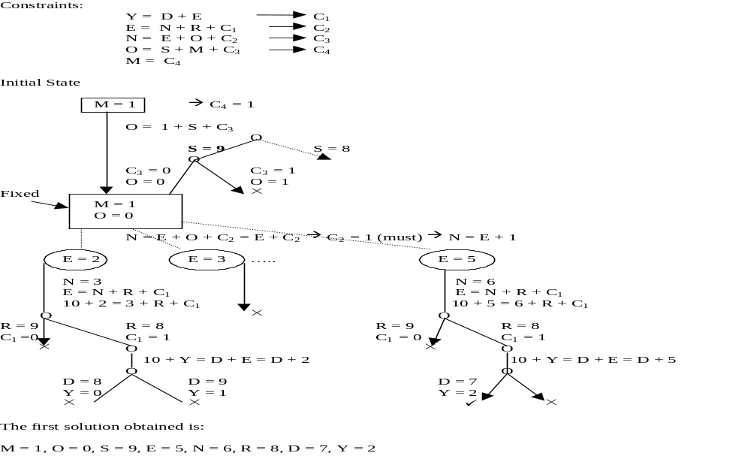

Slide 13
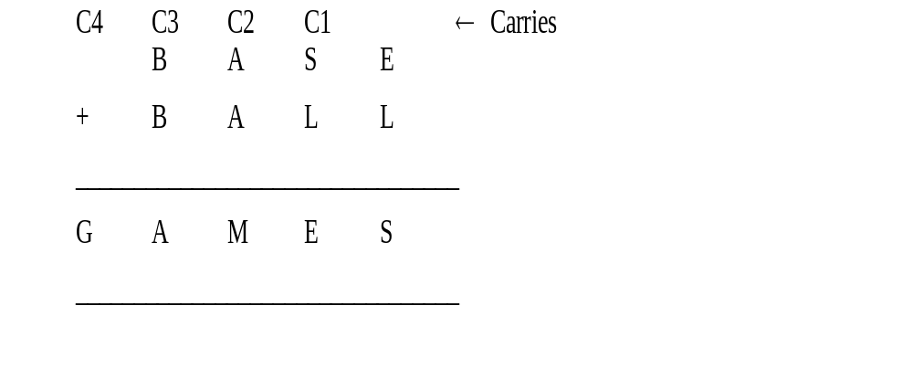
Constraints equations are:
E + L = S → C1
S + L + C1= E → C2
2A + C2 = M → C3
2B + C3 = A → C4
G = C4
Initial Problem State
G = ?; A = ?;M = ?; E = ?; S = ?; B = ?; L = ?

Slide 14
