Slide 1
Constraint Satisfaction Problem

Slide 2
Outline
Constraint satisfaction problem (CSP)
Consistency checking
Solving constraint satisfaction problems
Practical consistency checking algorithms
Summary
CS411 - Artificial Intelligence I

Slide 3
Motivation
Many practical search problems involve constraints, i.e., solutions to these problems must satisfy certain constraints, or restrictions.
In particular, we will study an important class of search problems, called Constraint Satisfaction Problems (CSPs) and their search techniques.
The key feature of this type of search is to use constraints actively to prune the search space.
CS411 - Artificial Intelligence I

Slide 4
Constraint Satisfaction Problem (CSP)
CSP is important to
  Artificial intelligence,
  Operations research, and
  Computer science in general
because many search problems, such as graph coloring, scene and edge labeling, logical puzzles, planning and scheduling, to name a few, can all be modeled as CSPs.
CS411 - Artificial Intelligence I

Slide 5
Definition of CSP
Constraint Satisfaction Problem (CSP) has 3 components:
  Variables: A finite set V = {v₁,v₂, ..., v_{n}} of n variables v_{i}, which are also referred to as constraint variables.
  Values: Each variable v_{i} takes its values from an associated finite domain Di.
  Constraints: A set C of constraints, i.e., relations on the variables.
A solution to a CSP is an assignment of values to variables such that constraints are satisfied.
  The problem may be finding one or all solutions.
CS411 - Artificial Intelligence I

Slide 6
An example CSP
This example CSP has the following variables, domains, and constraints:
  Variables: X, Y, Z, W
  Domains: D_{x} = (1 2 4 5 6 7 9)
  D_{y} = (3 5 7 8 9)
  D_{z} = (0 5 6 3 8 10 11)
  D_{w} = (4 5 6 7 10 11)
  Constraints: Y = X + 1, Z ≥ Y + 1, W ≠ Y, W ≠ Z
Find all the possible compatible value sets for X, Y, W, and Z.
CS411 - Artificial Intelligence I

Slide 7
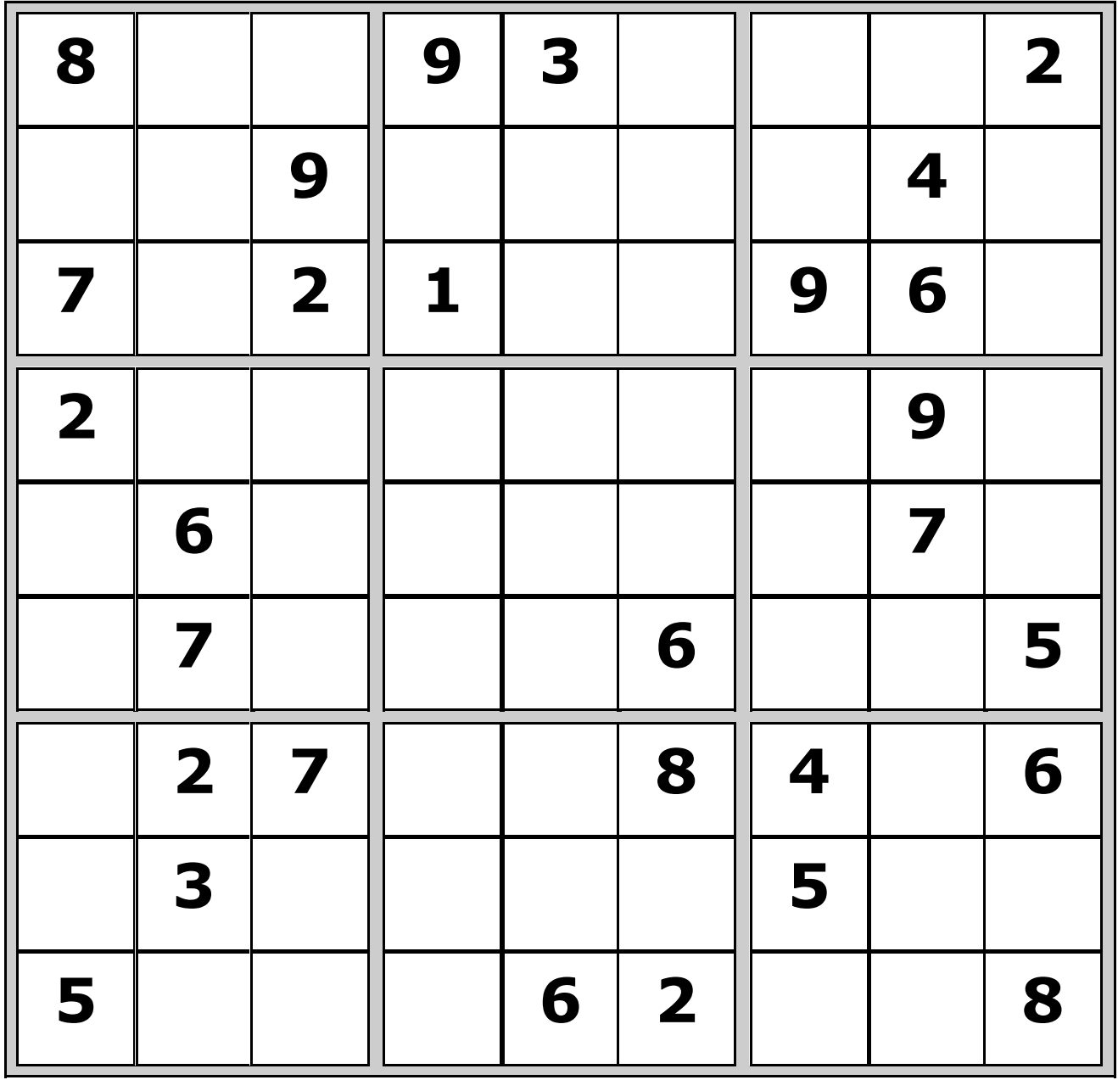
Sudoku is a CSP problem
What are the variables?
  Unknowns
What are the domains?
  Possible values
What are the constraints?
  Relations
CS411 - Artificial Intelligence I

Slide 8
Outline
Constraint satisfaction problem (CSP)
Consistency checking
Solving constraint satisfaction problems
Practical consistency checking algorithms
Summary
CS411 - Artificial Intelligence I

Slide 9
Solving CSP: Naive approaches
The finiteness of the domains is the key feature of this class of problems.
Simple algorithms can be devised to find the solutions if any and terminate. The real problem is efficiency.
  Generate and test: randomly select a value from the domain of each variable and test on all constraints
  Backtrack search: depth-first search combined with constraint testing before successor generation step to check whether any constraint has been violated by the variable assignments made up to this point.
CS411 - Artificial Intelligence I

Slide 10
Generate and test
For example, we have
Variables X, Y, W and
Their domains Dx = (1 2 4 5), Dy= (0 2 4 8 9), Dw = (0 3 4 5)
Constraints X = Y, Y = W
Generate and test (very inefficient):
  Generate a possible solution: get one value for each variable, e.g.,
    X = 1, Y= 0, W=0
  Test the constraints: not satisfied and go back to the generation step to generate another possible solution.
CS411 - Artificial Intelligence I

Slide 11
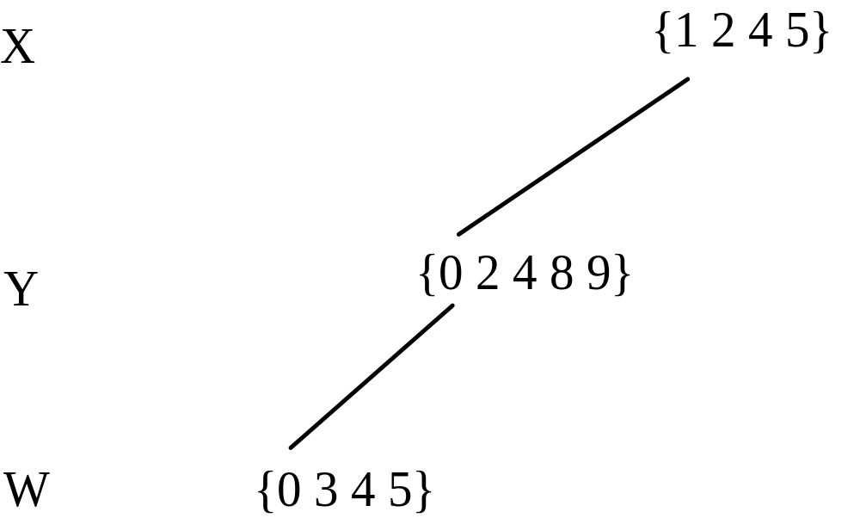
Backtrack search
E.g., we have constraints X = Y, Y = W
CS411 - Artificial Intelligence I

Slide 12
Solving CSP
Traditionally, backtrack search is used to solve CSPs. However, backtrack search is also very inefficient.
To improve the search efficiency, a number of consistency check techniques have been developed to pre-process the problem such that many backtracks can be avoided.
These techniques are based on the idea of a priori pruning,
  using constraints to reduce the search space before each search step.
CS411 - Artificial Intelligence I

Slide 13
Consistency check
For instance, given two constraint variables, X and Y, where
  X takes values from the domain: (1 2 3 4 5),
  Y takes values from the domain: (3 4 6)
  constraint: X = Y
This constraint indicates that a value in the domain of X must also be in the domain of Y and vice versa.
  To satisfy the constraint, inconsistent values should be removed from the domains. We have (3 4) as the new domain for X and Y.
This process is called consistency check. When combined with depth-first search, it greatly reduce the search space.
CS411 - Artificial Intelligence I

Slide 14
Node and arc consistency
The most important techniques for consistency checking are node consistency and arc consistency, which are used for unary and binary constraints
  A unary constraint refers to a constraint that has only one variable, e.g.,
  X > 5
  a binary constraint refers to a constraint that has two variables, e.g.,
  X = Y + 5
CS411 - Artificial Intelligence I

Slide 15
Constraint graph
Such a CSP can be represented with a graph G, where
  each node (we give the node a number i) represents a variable and
  each arc between two variables represents a binary constraint, C_{ij}.
A unary constraint, denoted by C_{i}, is represented by the arc originating from and terminating at the same node.
Such a graph is often called a
  constraint graph or
  constraint network.
CS411 - Artificial Intelligence I

Slide 16
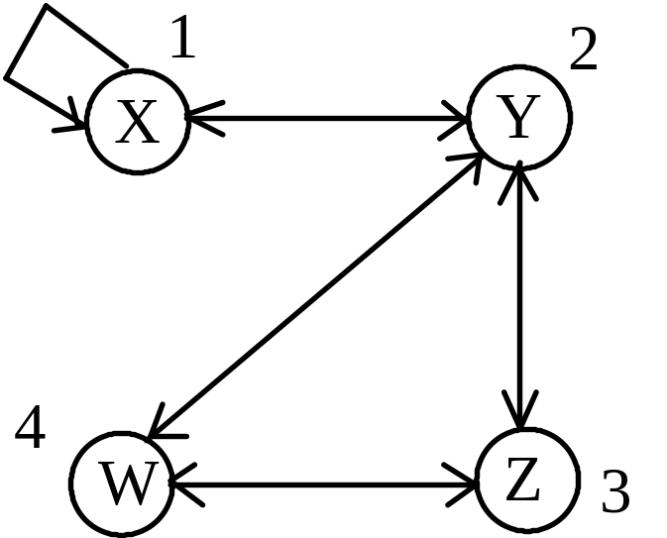
An example
We have the following CSP:
    X with the domain (1 2 4 5 6 7 9 10 11)
    Y with the domain (3 5 7 8 9)
    Z with the domain (0 5 6 3 8 10 11)
    W with the domain (10 11 4 5 6 7)
The constraints are as follows:
    X < 10
    Y = X + 1
    Z ≥ Y + 1
    W ≠ Y
    W ≠ Z
The constraint graph for the CSP
CS411 - Artificial Intelligence I

Slide 17
Node and arc consistency
We now can use the standard graph theory terms for the description and analysis of a constraint graph.
We define two important types of consistency in this representation,
  node consistency
  arc consistency.
CS411 - Artificial Intelligence I

Slide 18
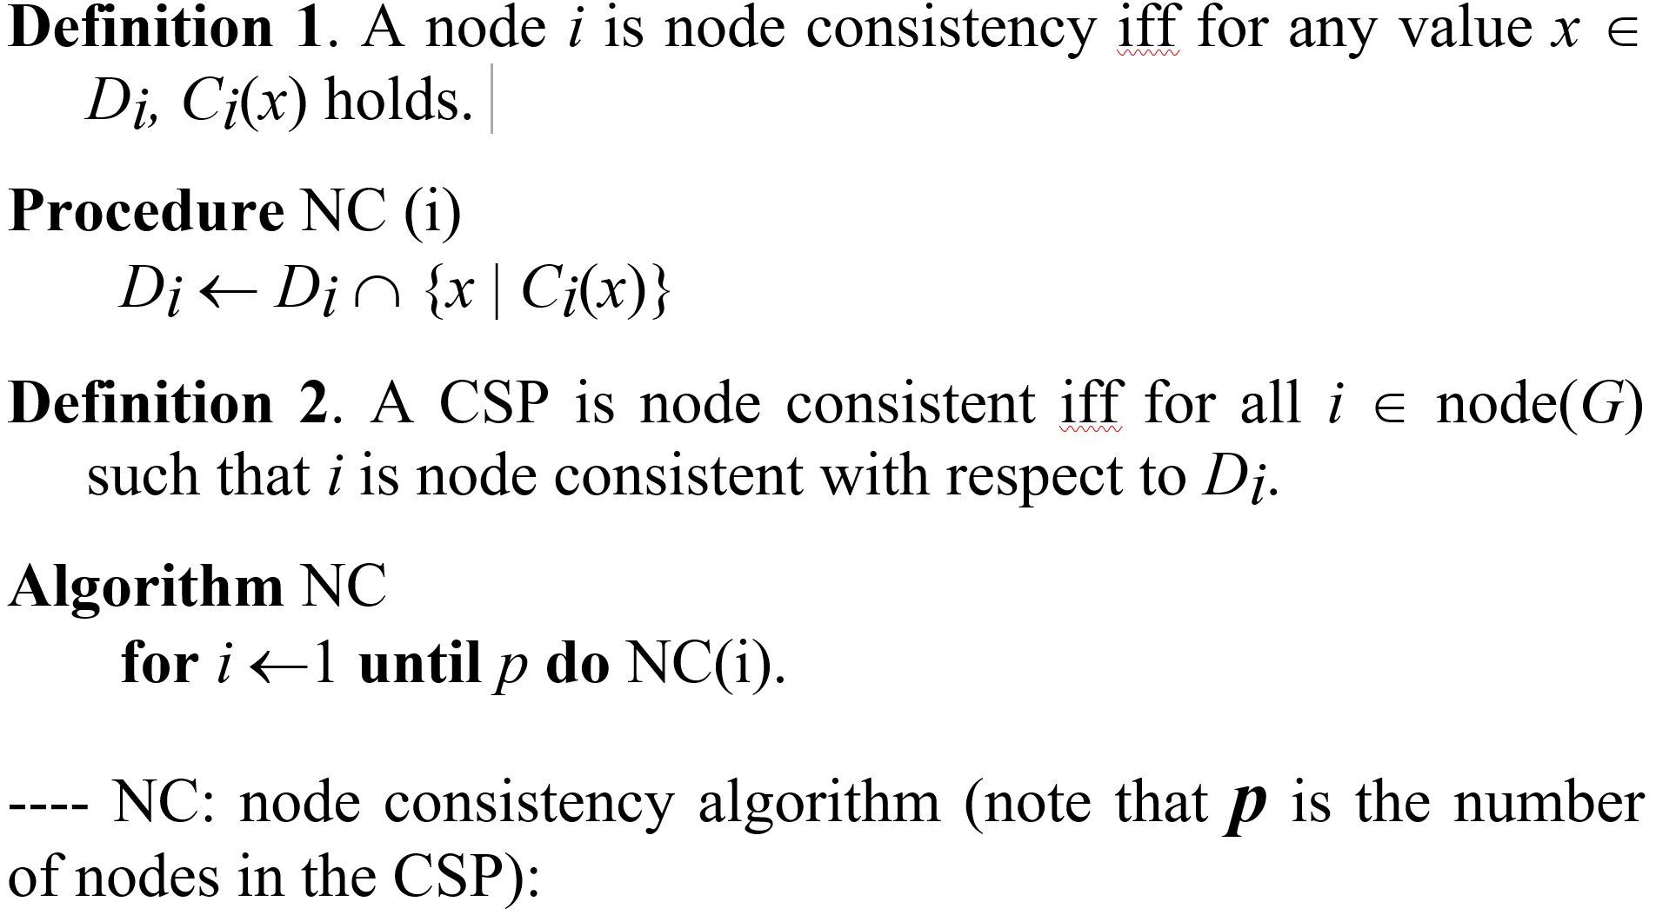
Node consistency
CS411 - Artificial Intelligence I

Slide 19
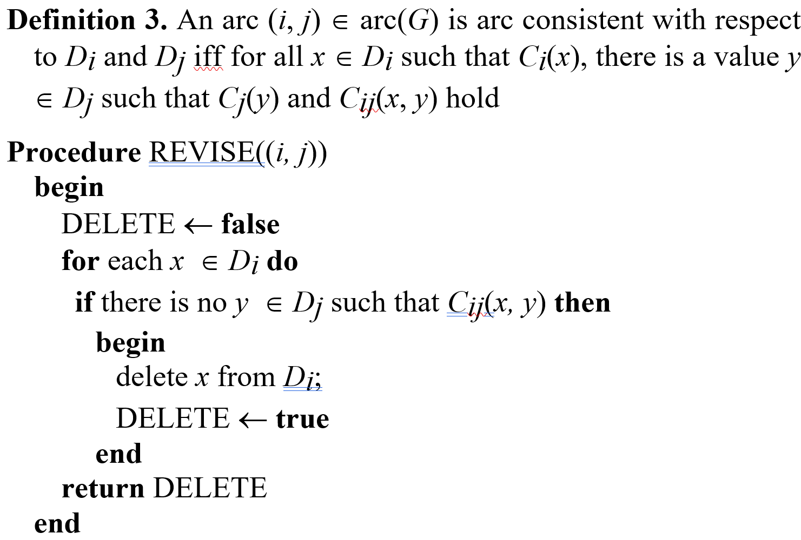
Arc consistency (recall: an arc has a direction)
CS411 - Artificial Intelligence I

Slide 20
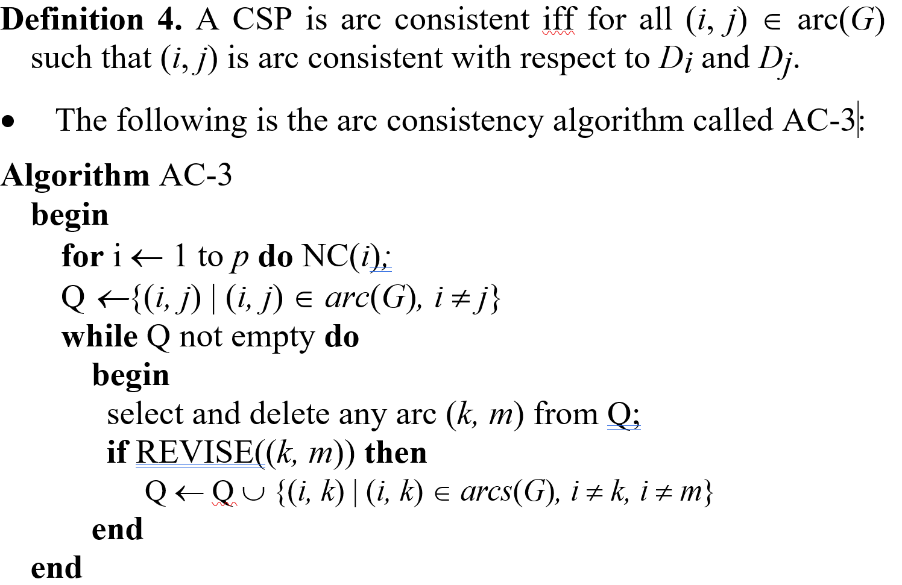
Arc consistency (contd)
CS411 - Artificial Intelligence I

Slide 21
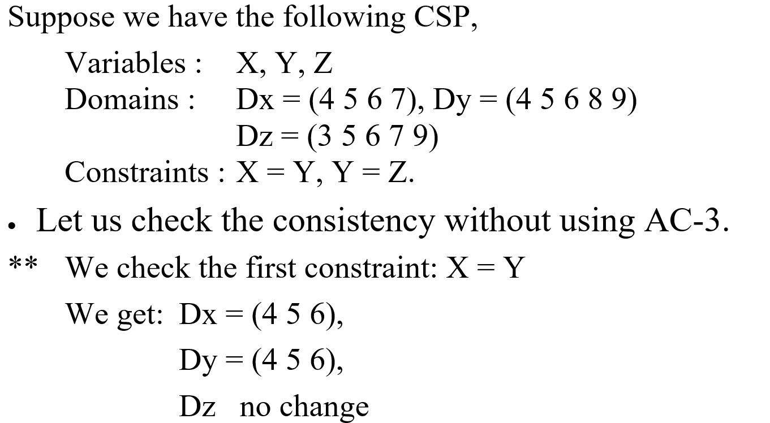
An intuitive example
CS411 - Artificial Intelligence I

Slide 22

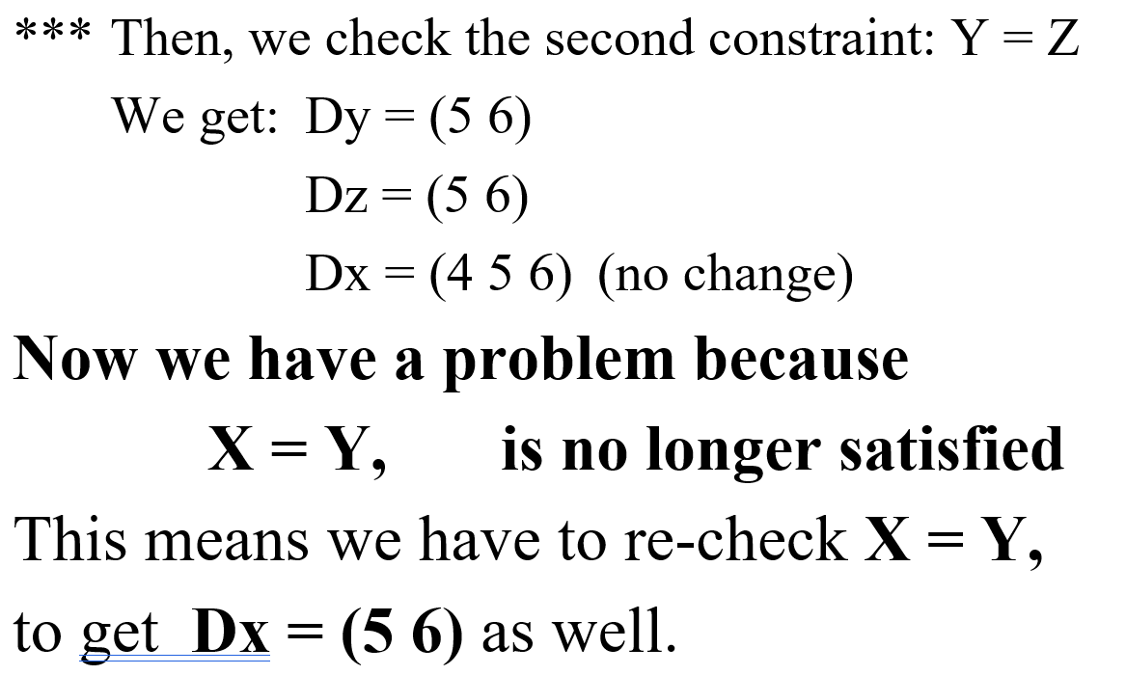
An intuitive example (contd)
CS411 - Artificial Intelligence I

Slide 23
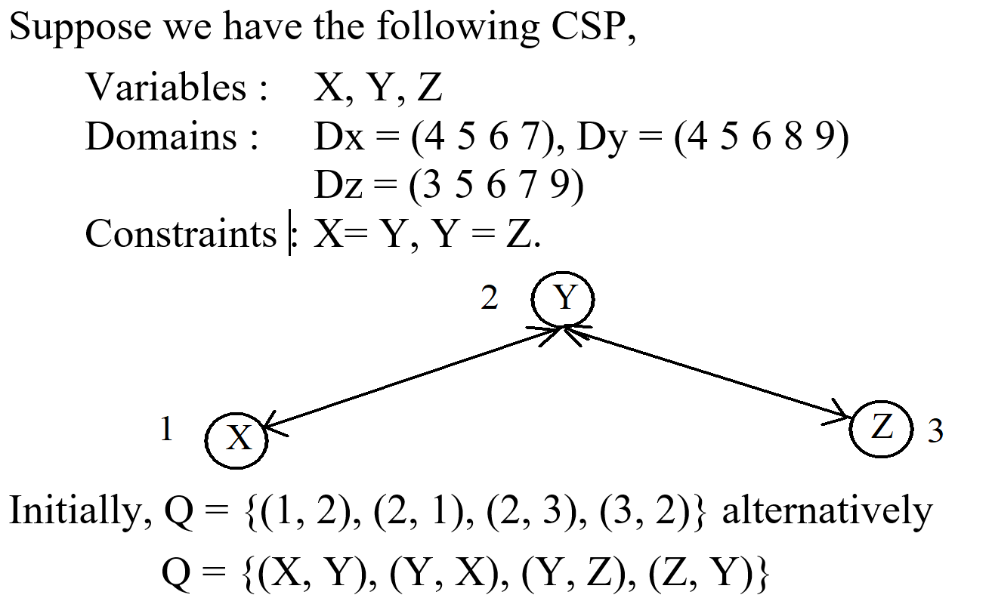
The example with AC-3
CS411 - Artificial Intelligence I

Slide 24
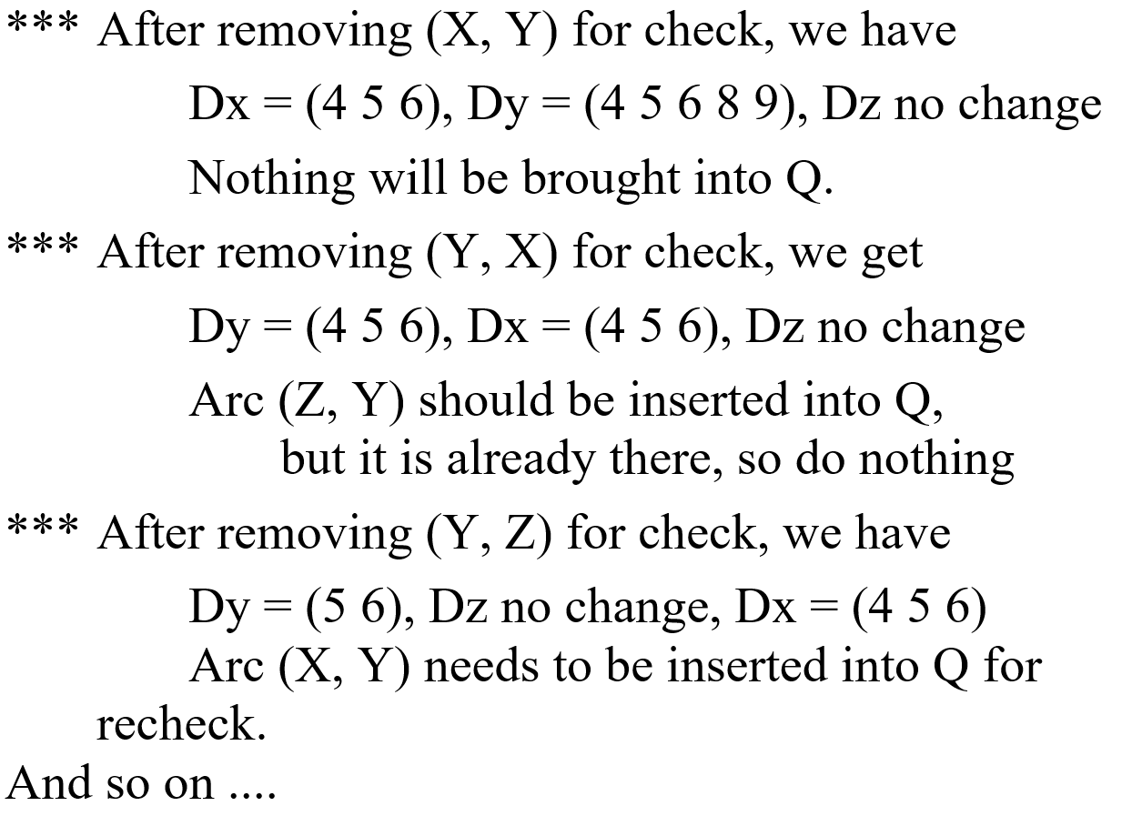
The example with AC-3 (contd)
CS411 - Artificial Intelligence I

Slide 25
Analyzing the arc consistency algorithms
The node consistency algorithm is simple, we will not discuss it any further.
The arc consistency algorithm basically performs two main functions.
  check (or to revise) a particular arc for consistency, i.e., removing those inconsistent values from the variable domain of the arc.
  propagate domain modifications to other related constraints and bring them up to be rechecked.
CS411 - Artificial Intelligence I

Slide 26
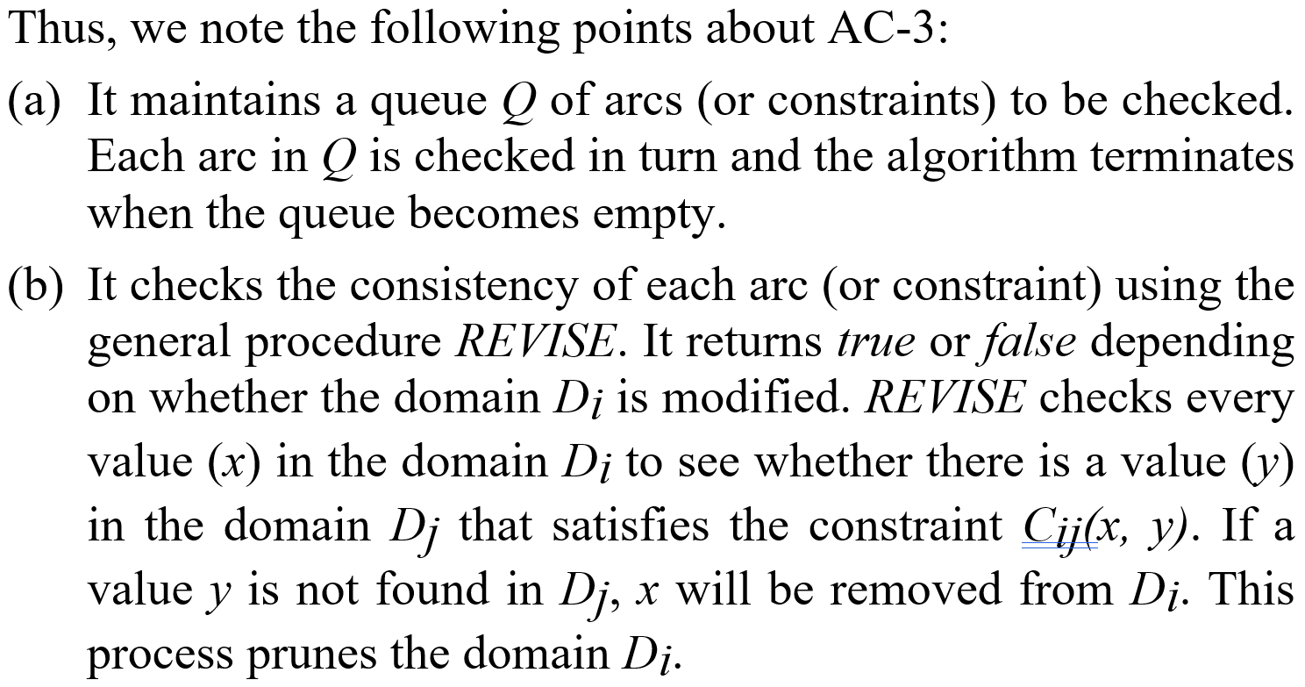
Analyzing the arc consistency algorithms (contd)
CS411 - Artificial Intelligence I

Slide 27
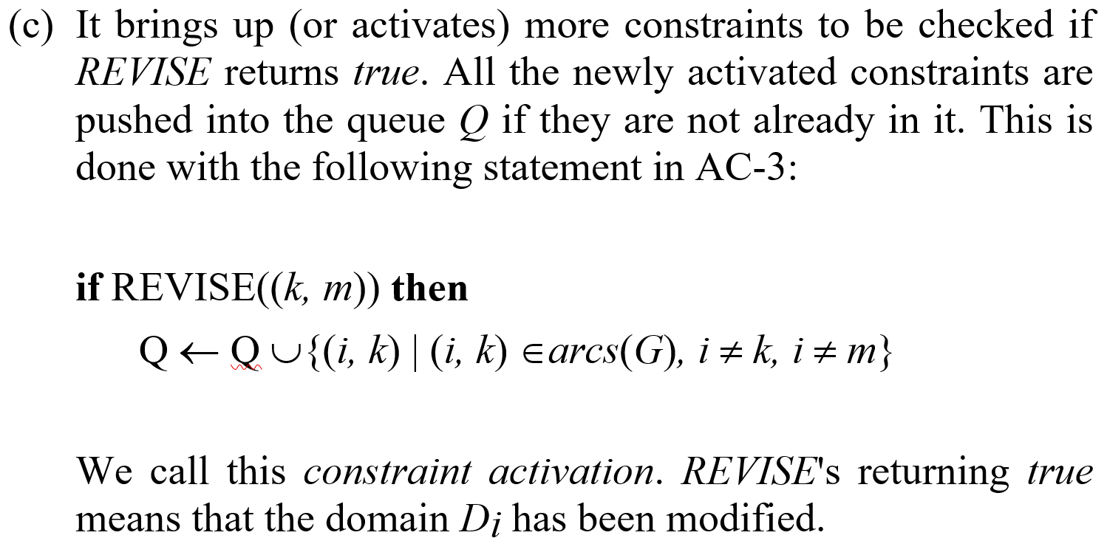
Analyzing the arc consistency algorithms (contd)
CS411 - Artificial Intelligence I

Slide 28
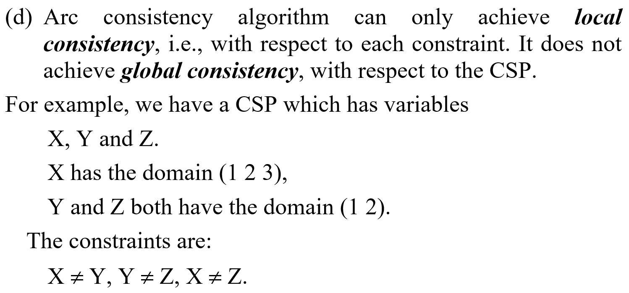
Analyzing the arc consistency algorithms (contd)
CS411 - Artificial Intelligence I

Slide 29
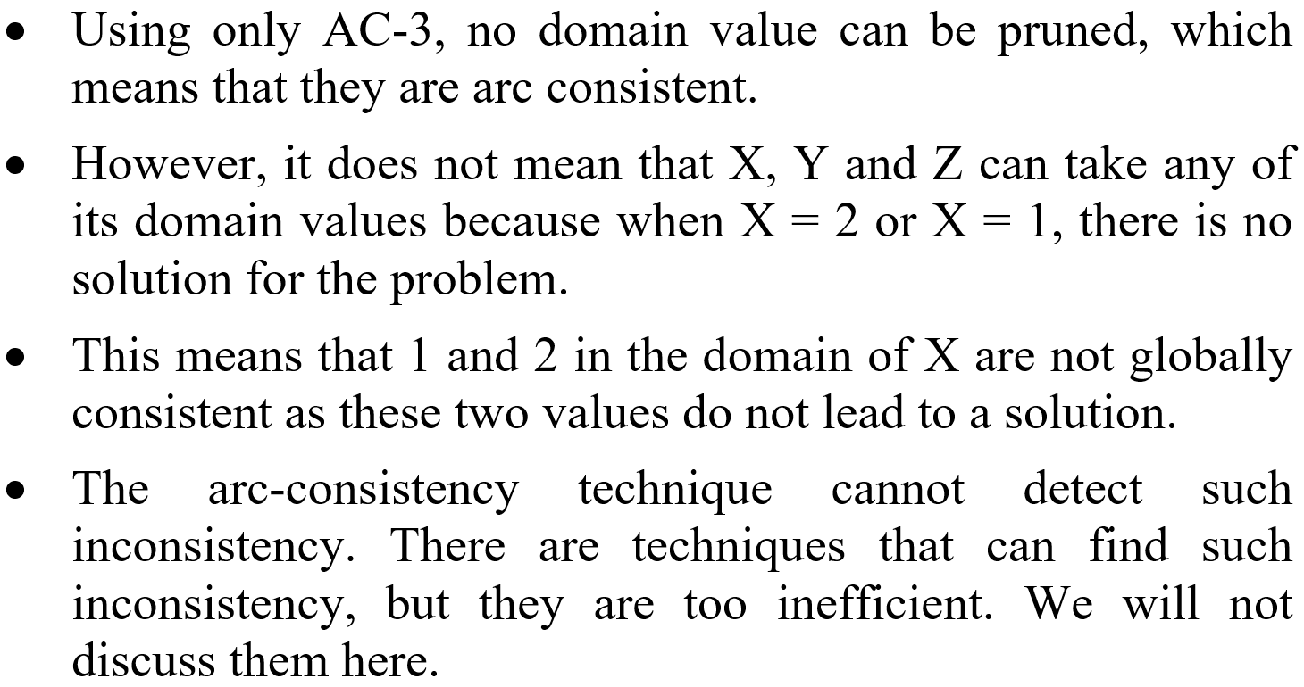
Analyzing the arc consistency algorithms (contd)
CS411 - Artificial Intelligence I

Slide 30
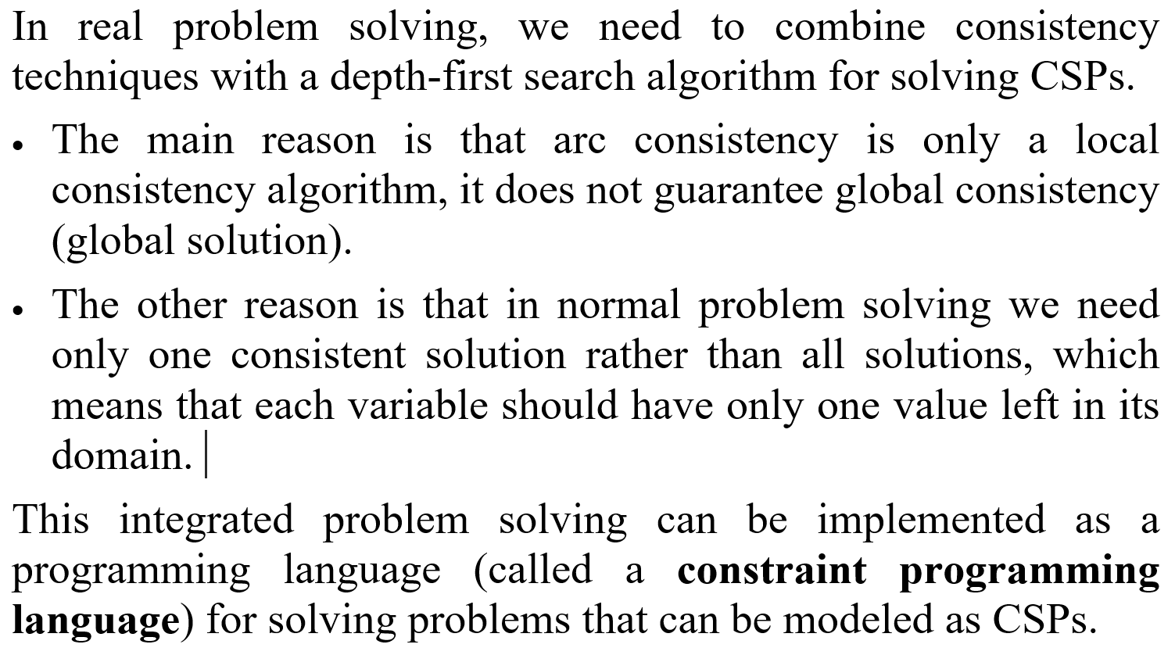
Depth-first search with consistency check
CS411 - Artificial Intelligence I

Slide 31
Outline
Constraint satisfaction problem (CSP)
Consistency checking
Solving constraint satisfaction problems
Practical consistency checking algorithms
Summary
CS411 - Artificial Intelligence I

Slide 32
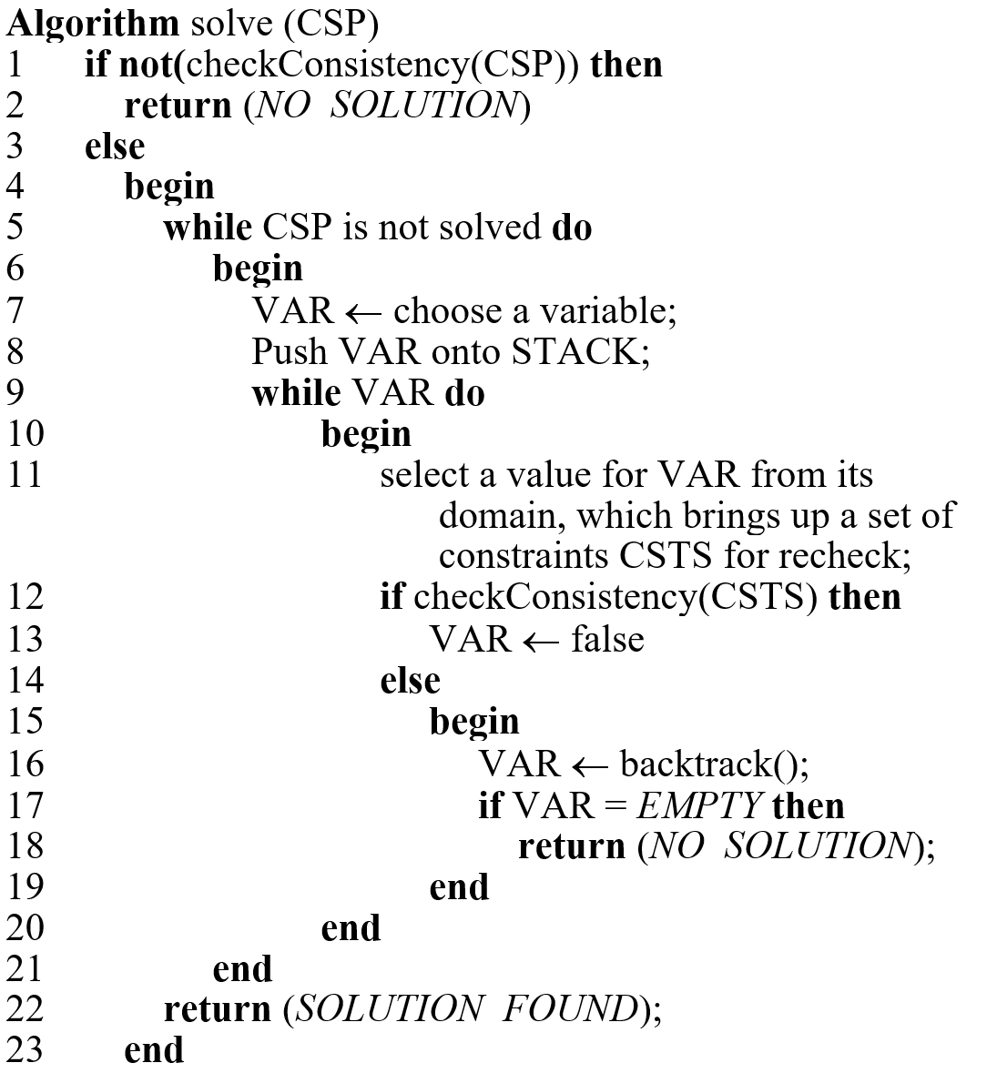
An algorithm for the integrated approach
CS411 - Artificial Intelligence I

Slide 33
Analyzing the solve algorithm
At line 1, before search is started, a consistency check is performed.
At line 5, a solved CSP means that every variable in the CSP has obtained a single value.
Line 5-21 performs search and consistency check.
Line 7 chooses a variable from the remaining undecided variables to make a value assumption. Since search and consistency check so far has not produced a solution, further search is needed.
Line 8 is for backtracking purpose. When a search path is proven unsuccessful (consistency check at line 12 fails), backtracker needs to backtrack to the previous choice point (or previous variable) to try an alternative value.
If the previous variable has no more value left, backtracker goes to the variable before this previous variable, and so on.
Line 17 indicates that there is no more variable on STACK, which means that the CSP has no solution.
CS411 - Artificial Intelligence I

Slide 34
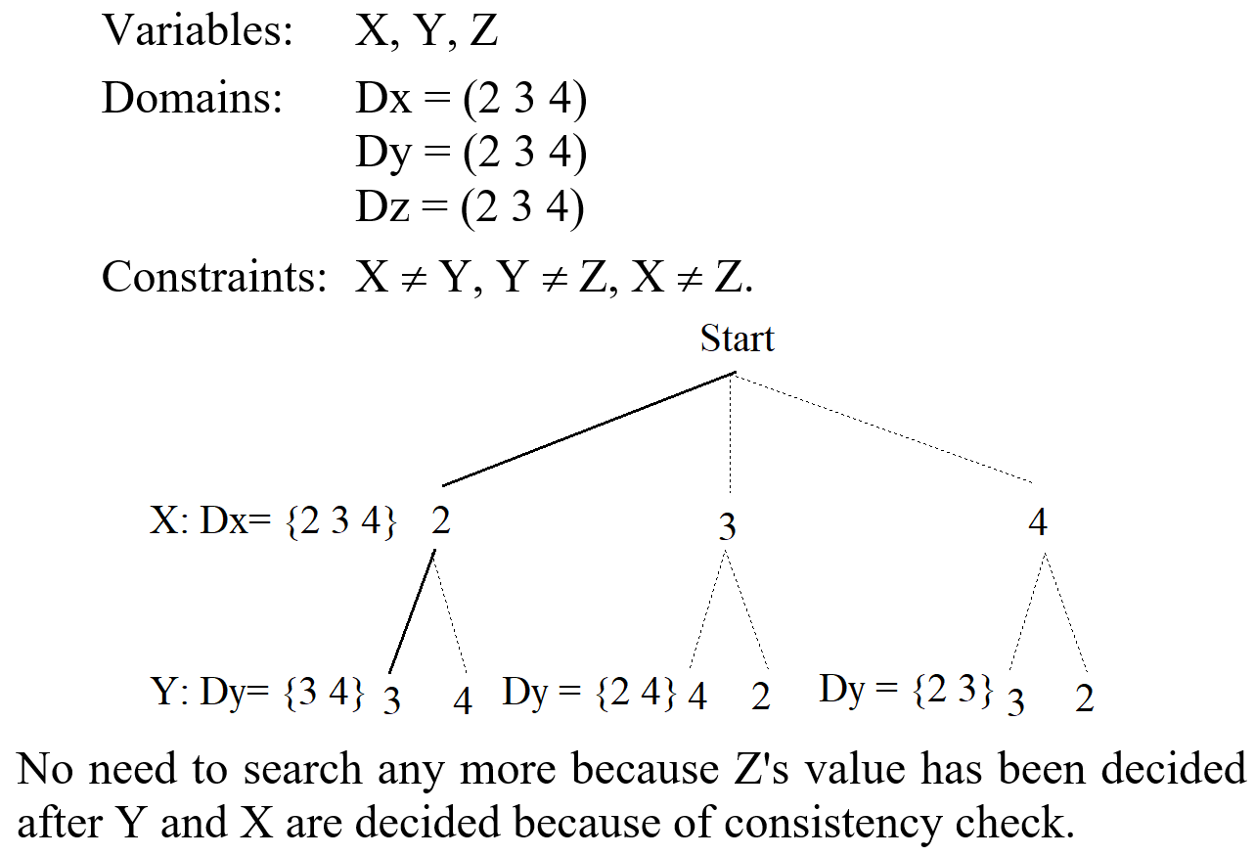
An example
We have this CSP
CS411 - Artificial Intelligence I

Slide 35
Problem solving in the CSP model
The user models the problem to be solved with variables, domains and constraints,
  i.e., modeling the problem as a CSP.
The system uses
  Depth-first search (possibly combined with branch and bound technique for optimization) and
  Consistency check to search for a solution.
  At each stage of the search, a consistency check is performed to remove those inconsistent values from variable domains to prune the search space.
CS411 - Artificial Intelligence I

Slide 36
Variable ordering heuristics
In search, the algorithm (line 7) should dynamically order the variables.
  Select the next variable that has the smallest domain.
Intuitively, if we want the size of the search tree to be as small as possible, it is better to put the node with the smallest branching factor first.
CS411 - Artificial Intelligence I

Slide 37
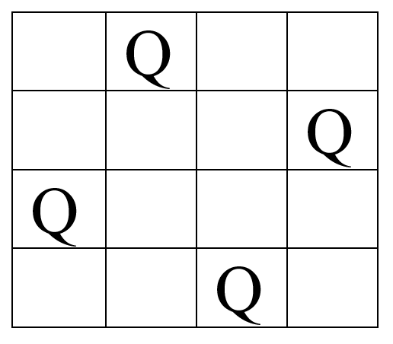
N-queens problem
Given a n x n chessboard, placing n queens on the chessboard so that no two queens attack each other horizontally, vertically or diagonally.
Here is a solution for a 4-queens problem
CS411 - Artificial Intelligence I

Slide 38
N-queens problem is a CSP
What are variables?
What are their domains?
What are constraints?
CS411 - Artificial Intelligence I

Slide 39
Constraint programming
Based on the solve algorithm, constraint programming languages have been designed and implemented.
  Such languages are in common use for solving scheduling and resource allocation problems.
Constraint programming languages are typical examples of declarative programming.
  You tell the system what your problem is. The system will figure out how to solve it. You don’t need to program the problem-solving procedures.
    Specify your variable, domains, and constraints
    Specify your optimization objective.
CS411 - Artificial Intelligence I

Slide 40
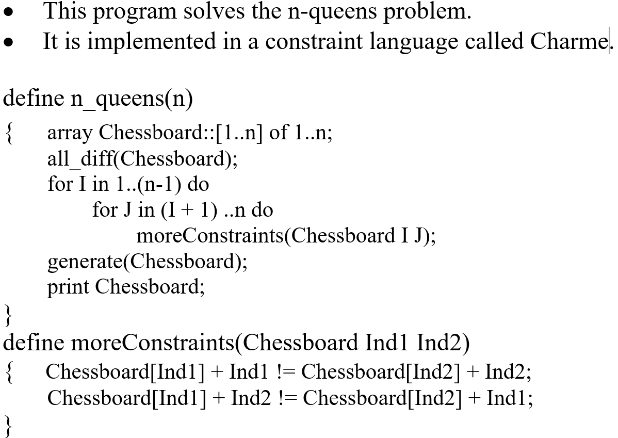
An example program in Charme
CS411 - Artificial Intelligence I

Slide 41
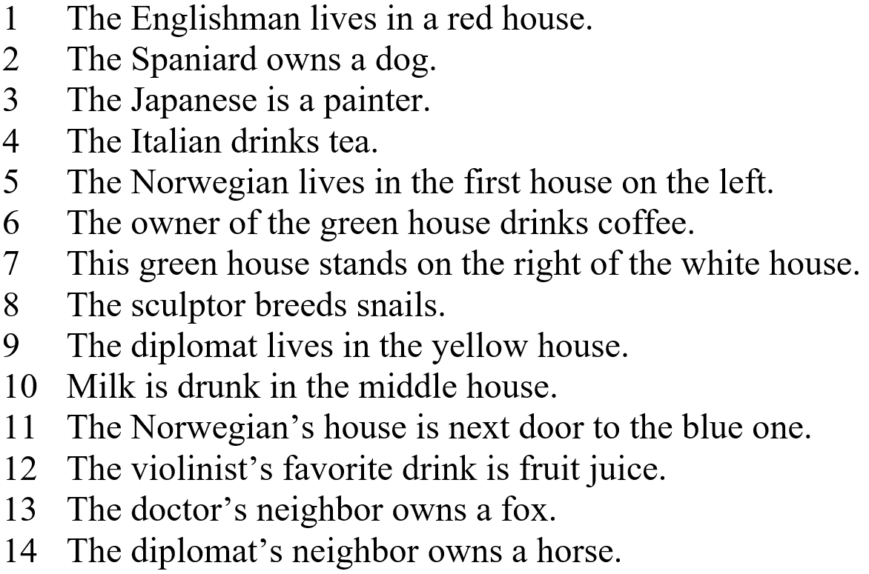
Model this problem as a CSP
Five men with different nationalities live in the first 5 houses of a street.
They practice five distinct professions, and each of them possesses a favorite animal (all different).
They like different beverages.
The five houses are painted in different colors. The additional constraints are as follows.
CS411 - Artificial Intelligence I

Slide 42
Including optimization
Due to depth-first search and backtracking, the obvious optimization strategy that can be implemented is the depth-first branch and bound.
  The basic idea is to take an exhaustive enumeration procedure (e.g., the solve algorithm) and an evaluation function (or cost function) to optimize.
The search proceeds as follows.
  The enumeration procedure is first executed. When it yields a solution at cost C, a new constraint is dynamically introduced, say the cost of any other solution must be better than C.
  Then the system backtracks to find another solution. Each time a new solution is found, a new constraint is generated, and the search becomes more and more constrained.
  The process terminates when there is no better solution that can be found.
CS411 - Artificial Intelligence I

Slide 43
Depth-first search with branch and bound (DFBB)
DFBB also called backtracking search with branch and bound
DFBB is DFS in which upon finding a solution, the algorithm updates current best solution.
DFBB does not explore paths that are guaranteed to lead to solutions worse than current best solution (bound).
On termination, the current best solution is a globally optimal solution.
CS411: Artificial Intelligence I

Slide 44
An example: v₀ is the start and v₃ is the goal
v_{1,1}
₅
v_{2,1}
₁
₃
₄
₄
₃
₃
₁
v₀
v₀
v_{1,2}
v_{2,2}
v₃
₁
₁
₂
₂
₃
v_{1,3}
₁
v_{2,3}
v_{1,2}
v_{1,3}
₇
v_{1,1}
₅
₃
₄
₃
₁
₇
v_{2,1}
v_{2,3}
v_{2,1}
v_{2,2}
v_{2,2}
v_{2,3}
₄
₁
₄
₁
₁
₁
v₃
v₃
v₃
v₃
v₃
v₃
CS411: Artificial Intelligence I

Slide 45
Solved by branch-and-bound (hill-climbing with bounds)
v₀
Notice the search order, which is hill-climbing
₁
₂
₃
v_{1,1}
v_{1,2}
v_{1,3}
₅
₃
₄
₃
₁
₇
v_{2,1}
v_{2,3}
v_{2,1}
v_{2,2}
v_{2,2}
v_{2,3}
_{X>6}
₁
_{X>7}
_{X>6}
₁
_{X>9}
v₃
v₃
_{Cost = 5}
a feasible solution found, which serves as an upper bound of the optimal solution!
_{Cost = 4*}
_{a better solution}
CS411: Artificial Intelligence I

Slide 46
Applications of CSP
CSP is such a simple model, but it can be used to model many practical problems, not just the puzzles.
  Scheduling, sequencing, e.g., scheduling flights, manufacture productions, construction projects, shipping, loading and unloading cargo from ships, etc.
  Time tabling, e.g., scheduling of course and exams.
  Manpower rostering
    E.g., assigning team of workers to clean arriving flights.
  Resource allocations
  and many other optimization problems.
All these problems may have different names, but their tasks are the same.
CS411 - Artificial Intelligence I

Slide 47
Outline
Constraint satisfaction problem (CSP)
Consistency checking
Solving constraint satisfaction problems
Practical consistency checking algorithms
Summary
CS411 - Artificial Intelligence I

Slide 48
Practical algorithms for consistency check
In the solve algorithm, we use “checkConsistency”. We didn’t say we use AC-3. In practice, there is normally no need to use AC-3.
  AC-3 is not an efficient algorithm for solving real-CSPs.
  It is a general algorithm that can be used to check the consistency of any binary constraint.
However, general algorithms are normally not efficient because the specific features of a problem are not taken into account.
  In our case, with the knowledge of these features, it is possible to design much more efficient specific algorithms for performing consistency check of specific constraints. This is important for practical CSP problem solving.
CS411 - Artificial Intelligence I

Slide 49
1. When should a constraint be checked?
Two main points need to be noted here.
  Although a consistency check may result in domain pruning for a constraint, it may be too inefficient to check it. In this case, it may be better to delay the constraint until more information is available.
  For example, we have the constraint
    X + Y + Z = P + Q
  This constraint involves 5 variables. Although, checking this constraint may result in some pruning, it is too inefficient to check.
  Then, we may choose to delay this constraint until some variables’ values have been decided.
CS411 - Artificial Intelligence I

Slide 50
When should a constraint be checked? (contd)
A domain change may not affect the constraint. Then there is no need to activate the constraint for check.
  For example, we have the constraint
  X ≥ Y,
  where X is in (1 2 3 4 5 6) and Y is in (1 2 3 4 5 6 7 8 9). During the first check, the values 8 and 9 are removed from the domain of Y.
  Now suppose the value 3 is removed from the domain of Y due to some constraints.
    It is obvious that this removal does not affect the consistency since no pruning can be achieved to X. Therefore, there is no need to activate the constraint for recheck.
CS411 - Artificial Intelligence I

Slide 51
2. Initial check and recheck techniques may be different
Initial check refers to the first check of a constraint. Rechecks refer to the later checks.
  For example, we have the constraint: X = Y, where X has the domain (1 2 3 4 5 6) and Y has the domain (2 3 4 6 7 8).
  For initial check, since we do not have any information, so every value in the domain of X and Y needs to be checked. This results in both domains being (2 3 4 6).
  For recheck, we can do better. If we know (we always know) that 2 is removed from the domain of X due to some constraints, we can simply remove 2 from the domain of Y to restore consistency. There is no need to check other values in the domain of Y. This saves time.
CS411 - Artificial Intelligence I

Slide 52
3. How to efficiently check a constraint
This requires careful study of the constraint.
The main point is that we should avoid:
  Checking those domain values that will not produce any pruning.
We will discuss some efficient consistency check methods for certain types of constraints later.
CS411 - Artificial Intelligence I

Slide 53
4. Constraint transformation
Constraint satisfaction is a dynamic process. A constraint may change its form when certain events occurs.
  Normally, such a change converts a complicated constraint into a simpler one. This often makes consistency check easier and more efficient.
  For example, the constraint X = Y * Z may be changed into X = a * Z when Y’s value becomes known to be a (a is a constant) in problem solving. This new constraint is much simpler to check than the original one.
Due to change of constraint type, it is desirable to use the consistency check method for X = a * Z to check this constraint rather than the one for X = Y * Z.
CS411 - Artificial Intelligence I

Slide 54
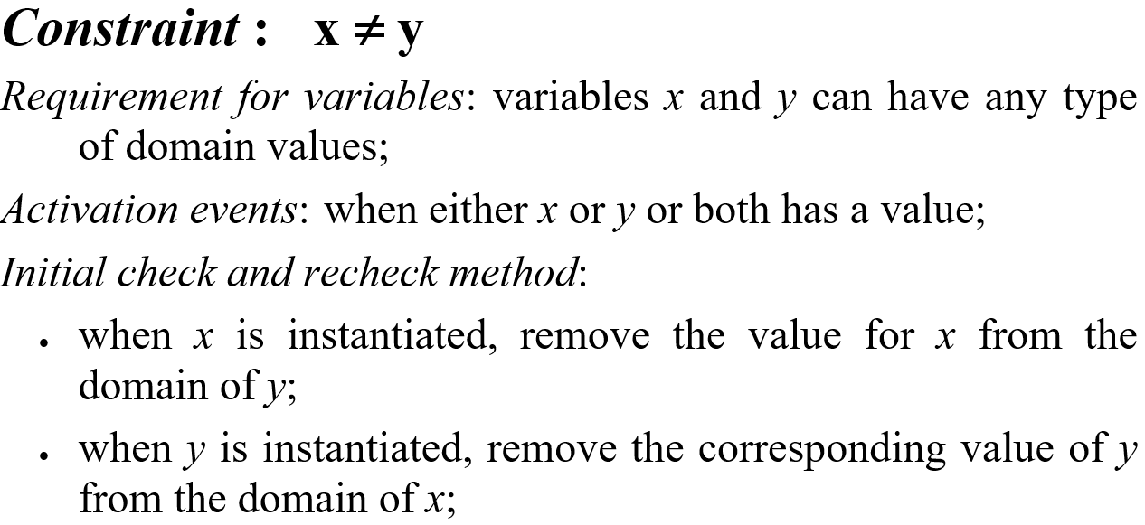
Some specific consistency check techniques
Similar check methods can also be devised for constraints such as x ≠ a*y + b, where a and b are constants.
CS411 - Artificial Intelligence I

Slide 55
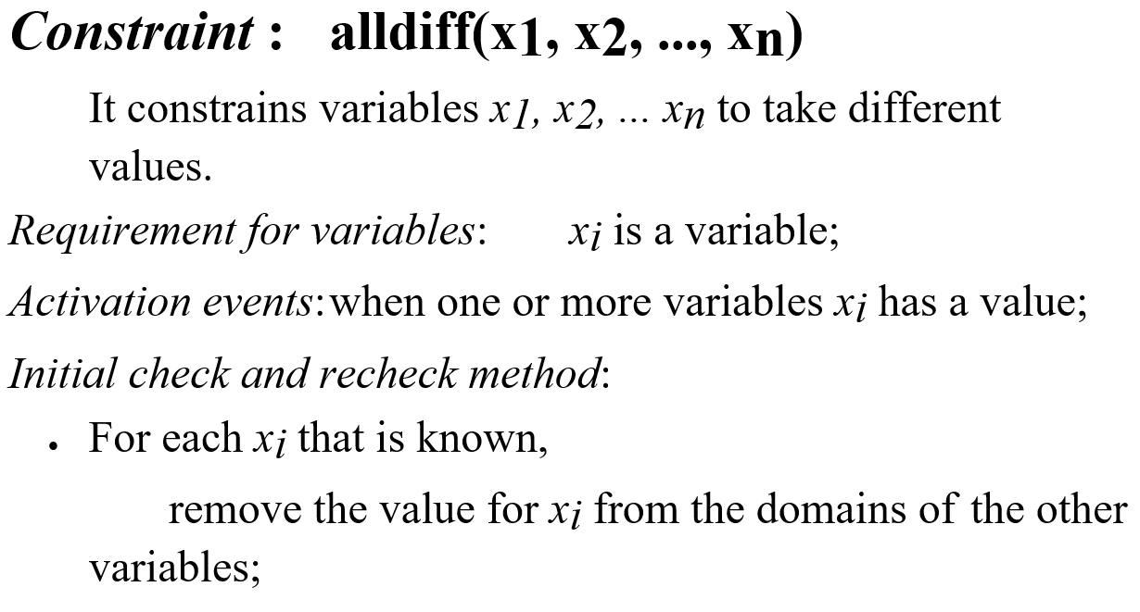
Some specific consistency check techniques (contd)
CS411 - Artificial Intelligence I

Slide 56
Some specific consistency check techniques (contd)
Constraint : x = y
  Requirement for variables: x and y are variables with integer domains;
  Activation events: when a bound of either x, y or both change;
  Initial check and recheck method:
    If min_{x} > min_{y}, we only need to prune the values in y such that the new min_{y} >= min_{x}. The same procedure can be used for x if min_{x} < min_{y};
    If max_{x} > max_{y}, we need to remove the values in x such that the new max_{x} <= max_{y}. The same procedure can be used for y if max_{x} < max_{y};
  When the new min_{x} or max_{x} is not equal to min_{y} or max_{y} respectively, further pruning is possible. This may be done by repeating the above two procedures, until they are equal.
CS411 - Artificial Intelligence I

Slide 57
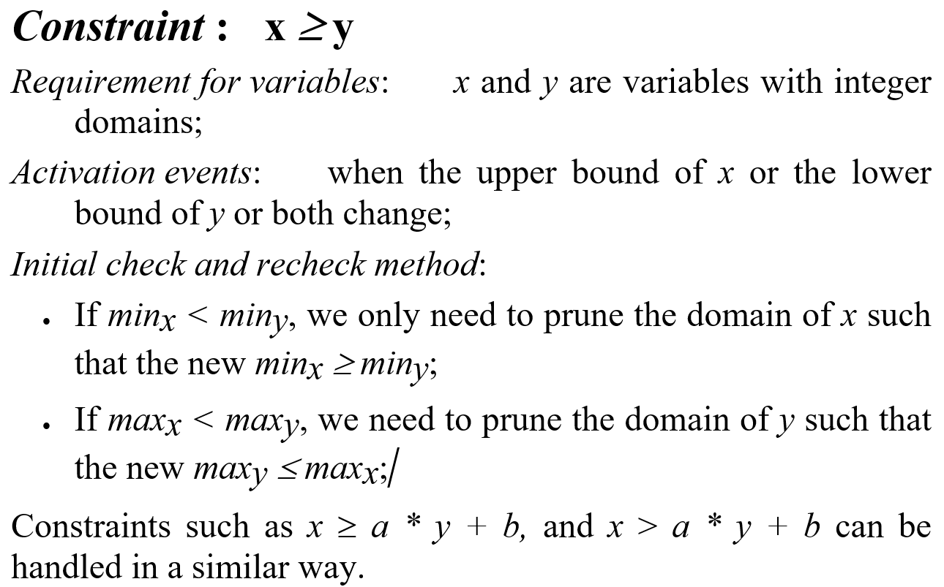
Some specific consistency check techniques (contd)
CS411 - Artificial Intelligence I

Slide 58
Outline
Constraint satisfaction problem (CSP)
Consistency checking
Solving constraint satisfaction problems
Practical consistency checking algorithms
Summary
CS411 - Artificial Intelligence I

Slide 59
Summary
The algorithms for consistency checking have been studied extensively.
There are constraint programming languages that can be used to program and to solve practical problems.
  Mainly for resource allocation and scheduling.
It will be interesting to see more integration of this technology into other AI topics, e.g., reasoning, learning, etc.
CS411 - Artificial Intelligence I

