Slide 1
STUDENT PERFORMANCE PREDICTION FOR CAMPUS PLACEMENT
Presented by:
Ayesha Shahanaz.
19567T7605.
Guided by:
Dr. N.Ramana.

Slide 2
AGENDA
MACHINE LEARNING.
MACHINE LEARNING ALGORITHMS.
MODULES.
SYSTEM REQUIREMENTS.
FEATURE ENGINEERING.
RESULTS.
CONCLUSION.
FUTURE SCOPE.

Slide 3

WHAT IS MACHINE LEARNING?
“Machine Learning is an application of Artificial Intelligence (AI) that provides systems the ability to automatically learn and improve from experience without being explicitly programmed. Machine Learning focuses on the development of computer programs that can access data and use it learn for themselves.”

Slide 4
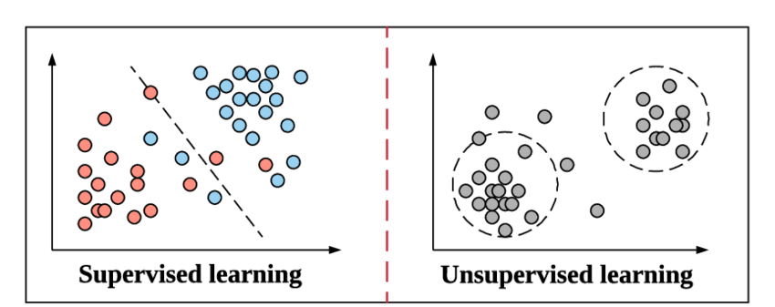
MACHINE LEARNING ALGORITHMS.
Supervised Learning: Consist of a target variables which is to be predicted from a given set of predictors.
Unsupervised Learning: donot have any target variable to predict.

Slide 5
MODULES
1. Decision Tree : A schematic tree-shaped diagram used to clarify and find an answer to a complex problem. The Decision tree is built by passing the training set(sample data) containing record of a certain no. of students whose performance is to be analyzed by taking in consideration attributes. The data is then classified by calculating the entropy of each particular attribute and further decision tree is built.
The entropy formulae used is: Entropy = -plog2p - qlog2q.
2. Support Vector Machine : It is used for supervised learning models and associated with learning algorithms used for analysing data. It find the closest pair of points.
Algorithm : candidateSV = {closest pair from opposite classes}
while there are violoting points do
Find a violator
CandidateSV = CandidateSV U violator
If any αp < 0 due to addition of c to S then
CandidateSV = CandidateSV \ p
Repeat till all such points are pruned
End if

Slide 6
3. Xgboost: These are used for regression and classification problems. Gradient boosting trees produces a prediction model in the form of an ensemble of weak prediction models. Every boosting algorithm has its own underlying marhematics.

Slide 7
SYSTEM REQUIREMENTS:
HARDWARE REQUIREMENTS:
• System : Pentium IV 2.4GHz.
• HardDisk : 40 GB.
• Monitor : 15 VGA Color.
• Ram : 512 Mb
SOFTWARE REQUIREMENTS:
• Operating system : Windows 10
• Technology : MACHINE LEARNING
• IDE : Jupyter Notebook
• Coding : PYTHON
• DataBase : MYSQL

Slide 8
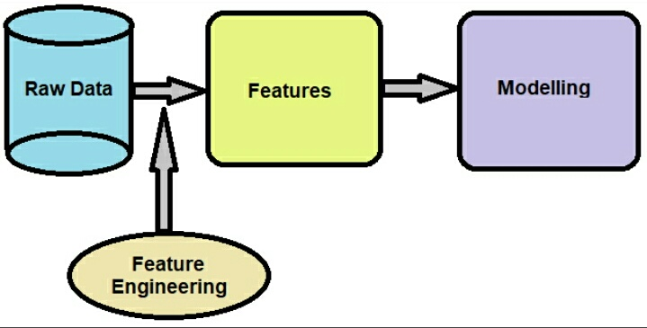
FEATURE ENGINEERING
Feature engineering is the process of using domain knowledge to extract features from raw data via data mining techniques. These features can be used to improve the performance of machine learning algorithms. Feature engineering can be considered as applied machine learning itself.

Slide 9
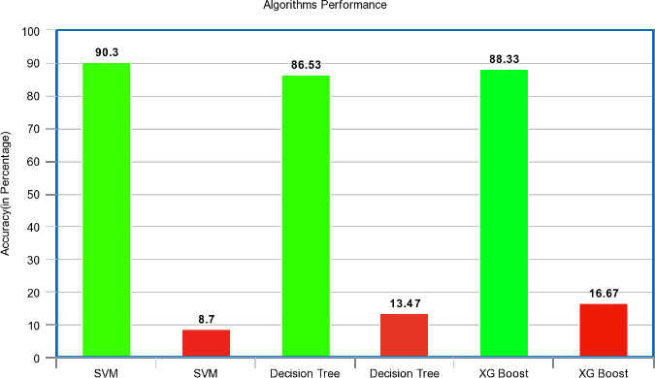
RESULTS
The data is trained and tested with all three algorithms and out of all SVM gave more accuracy with 95.2 percent and then the XG Boost with 97.75 percent accuracy. As SVM gave the highest accuracy, all further data predictions are chosen to be followed with SVM. So, finally a web application is made to give the input parameters of the student and the final prediction is generated and displayed. The background algorithm being used is SVM and the new prediction are keep on adding to the dataset for further more accuracy.

Slide 10
CONCLUSION:
A placement predictor is a system that could predict the chances or the type of company a pre-final and final year student has chances to be placed. This system is necessary for predicting student’s placement using Data Mining Techniques by considering the student dataset which is uploaded by TPO. This system is built by utilizing SVM, One Hot encoding, Decision tree and XG-boost algorithms.

Slide 11
FUTURE SCOPE
A powerful web application can be developed where inputs are not given directly instead student parameters are taken by evaluating students through various evaluations and examining. Technical, analytical, logical, memory based, psychometry and general awareness, interests and skill based tests can be designed and parameters are collected through them so that results will be certainly accurate and the system will be more reliable to use.
Also decision trees have few limitations like over fitting, no pruning, lack of capability to deal with null and missing values and few algorithms have problem with huge number of values. All these can be taken into consideration and even more reliable and more accurate algorithms can be used. Then the project will be more powerful to depend upon and even more efficient to depend upon.

