Slide 1
[220 / 319] Operators
Department of Computer Sciences
University of Wisconsin-Madison
Readings:
Chapter 1 of Think Python,
Chapter 2 of Python for Everybody
Additional readings:
Computer terminology

Slide 2
Learning Objectives
Run Python code using:
  Command line
  Jupyter Notebook
Evaluate:
numeric expressions containing mathematical operators (e.g., “+” and “-“)
string expressions containing string operators and escape characters
Differentiate:
behavior of the /, //, and % operators
Recognize examples of different Python data types:
int, float, str, bool
Evaluate:
expressions containing comparison operators (e.g., “==” and “>”)
Boolean expressions containing the operators “and”, “or”, “not”
mixed expressions using the correct order of operations (precedence)

Slide 3
Today's Outline
Software
Interpreters
Notebooks
        Demos
Operator Precedence
Demos
Boolean Logic
Demos

Slide 4
What you need to write/run code
An interpreter
Python 3 (not 2!)
some extra packages (comes with anaconda installation)
runs Python code
Jupyter Notebooks
comes with anaconda installation
acts like both interpreter and editor (type and save Python code)

Slide 5
Interpreter
A program that runs a program
Translates something the human likes (nice Python code) to something the machine likes (ONEs and ZEROs)

Slide 6
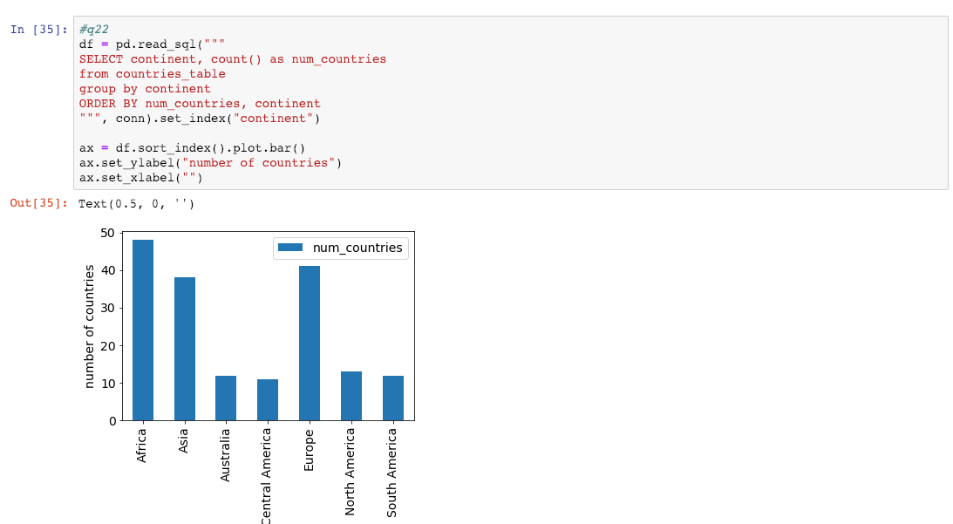
Jupyter Notebooks
notebooks breakup code into
"cells" containing Python code
...
visuals produced by the
code are interleaved
A Notebook is a file that contains code and other things
(e.g., documentation, images, tables, etc.)
...

Slide 7
Jupyter Notebooks
notebooks breakup code into
"cells" containing Python code
...
visuals produced by the
code are embedded in the Notebook
.ipynb (Interactive Python Notebook) files are not easy to open in a regular text editor

Slide 8
3 ways we'll run Python
1. interactive mode
Quick syntax check
ty-mac:~$ python
Python 3.9.7 (default, Sep 16 2021, 16:59:28)
[Clang 10.0.0 ] :: Anaconda, Inc. on darwin
Type "help", "copyright", "credits" or "license" for more information.
>>> 1 + 1
2
triple arrows mean Python code runs as you type it

Slide 9
3 ways we'll run Python
1. interactive mode
ty-mac:~$ python
Python 3.9.7 (default, Sep 16 2021, 16:59:28)
[Clang 10.0.0 ] :: Anaconda, Inc. on darwin
Type "help", "copyright", "credits" or "license" for more information.
>>> 1 + 1
2
triple arrows mean Python code runs as you type it
2. script mode
Run auto-grader tests
the interpreter program is named "python"; run it
ty-mac:~$ python test.py
the name of the file containing your code (called a "script")
is passed as an argument to the python program

Slide 10
3 ways we'll run Python
1. interactive mode
ty-mac:~$ python
Python 3.9.7 (default, Sep 16 2021, 16:59:28)
[Clang 10.0.0 ] :: Anaconda, Inc. on darwin
Type "help", "copyright", "credits" or "license" for more information.
>>> 1 + 1
2
triple arrows mean Python code runs as you type it
2. script mode
the interpreter program is named "python"; run it
ty-mac:~$ python test.py
the name of the file containing your code (called a "script")
is passed as an argument to the python program
3. notebook "mode"
ty-mac:~$ jupyter notebook
open Jupyter in a web browser
we'll do most work in notebooks this semester

Slide 11
Today's Outline
Software
Interpreters
Notebooks
        Demos
Operator Precedence
Demos
Boolean Logic
Demos

Slide 12
Today's Outline
Software
Interpreters
Notebooks
        Demos
Operator Precedence
Demos
Boolean Logic
Demos

Slide 13
Order of Simplification
Python works by simplifying, applying one operator at a time
3 * 3 + 2 * 2 + 16 ** (1/2)
Rules
First work within parentheses
Do higher precedence first
Break ties left to right (exception: exponent ** operator)

Slide 14
Order of Simplification
Python works by simplifying, applying one operator at a time
3 * 3 + 2 * 2 + 16 ** (1/2)
Rules
First work within parentheses
Do higher precedence first
Break ties left to right (exception: exponent ** operator)

Slide 15
Order of Simplification
Python works by simplifying, applying one operator at a time
3 * 3 + 2 * 2 + 16 ** (1/2)
3 * 3 + 2 * 2 + 16 ** (0.5)
Rules
First work within parentheses
Do higher precedence first
Break ties left to right (exception: exponent ** operator)

Slide 16
Order of Simplification
Python works by simplifying, applying one operator at a time
3 * 3 + 2 * 2 + 16 ** (1/2)
3 * 3 + 2 * 2 + 16 ** (0.5)
Rules
First work within parentheses
Do higher precedence first
Break ties left to right (exception: exponent ** operator)

Slide 17
Order of Simplification
Python works by simplifying, applying one operator at a time
3 * 3 + 2 * 2 + 16 ** (1/2)
3 * 3 + 2 * 2 + 16 ** (0.5)
3 * 3 + 2 * 2 + 4
Rules
First work within parentheses
Do higher precedence first
Break ties left to right (exception: exponent ** operator)

Slide 18
Order of Simplification
Python works by simplifying, applying one operator at a time
3 * 3 + 2 * 2 + 16 ** (1/2)
3 * 3 + 2 * 2 + 16 ** (0.5)
3 * 3 + 2 * 2 + 4
Rules
First work within parentheses
Do higher precedence first
Break ties left to right (exception: exponent ** operator)

Slide 19
Order of Simplification
Python works by simplifying, applying one operator at a time
3 * 3 + 2 * 2 + 16 ** (1/2)
3 * 3 + 2 * 2 + 16 ** (0.5)
3 * 3 + 2 * 2 + 4
9 + 2 * 2 + 4
Rules
First work within parentheses
Do higher precedence first
Break ties left to right (exception: exponent ** operator)

Slide 20
Order of Simplification
Python works by simplifying, applying one operator at a time
3 * 3 + 2 * 2 + 16 ** (1/2)
3 * 3 + 2 * 2 + 16 ** (0.5)
3 * 3 + 2 * 2 + 4
9 + 2 * 2 + 4
Rules
First work within parentheses
Do higher precedence first
Break ties left to right (exception: exponent ** operator)

Slide 21
Order of Simplification
Python works by simplifying, applying one operator at a time
3 * 3 + 2 * 2 + 16 ** (1/2)
3 * 3 + 2 * 2 + 16 ** (0.5)
3 * 3 + 2 * 2 + 4
9 + 2 * 2 + 4
9 + 4 + 4
Rules
First work within parentheses
Do higher precedence first
Break ties left to right (exception: exponent ** operator)

Slide 22
Order of Simplification
Python works by simplifying, applying one operator at a time
3 * 3 + 2 * 2 + 16 ** (1/2)
3 * 3 + 2 * 2 + 16 ** (0.5)
3 * 3 + 2 * 2 + 4
9 + 2 * 2 + 4
9 + 4 + 4
Rules
First work within parentheses
Do higher precedence first
Break ties left to right (exception: exponent ** operator)

Slide 23
Order of Simplification
Python works by simplifying, applying one operator at a time
3 * 3 + 2 * 2 + 16 ** (1/2)
3 * 3 + 2 * 2 + 16 ** (0.5)
3 * 3 + 2 * 2 + 4
9 + 2 * 2 + 4
9 + 4 + 4
13 + 4
Rules
First work within parentheses
Do higher precedence first
Break ties left to right (exception: exponent ** operator)

Slide 24
Order of Simplification
Python works by simplifying, applying one operator at a time
3 * 3 + 2 * 2 + 16 ** (1/2)
3 * 3 + 2 * 2 + 16 ** (0.5)
3 * 3 + 2 * 2 + 4
9 + 2 * 2 + 4
9 + 4 + 4
13 + 4
Rules
First work within parentheses
Do higher precedence first
Break ties left to right (exception: exponent ** operator)

Slide 25
Order of Simplification
Python works by simplifying, applying one operator at a time
3 * 3 + 2 * 2 + 16 ** (1/2)
3 * 3 + 2 * 2 + 16 ** (0.5)
3 * 3 + 2 * 2 + 4
9 + 2 * 2 + 4
9 + 4 + 4
13 + 4
17
Rules
First work within parentheses
Do higher precedence first
Break ties left to right (exception: exponent ** operator)

Slide 26
Operator Precendence
What is it? | Python Operator
exponents | **
signs | +x, -x
multiply/divide | *, /, //, %
add/subtract | +, -
comparison | ==, !=, <, <=, >, >=
boolean stuff | not
… | and
… | or
simplify first
simplify last*
these are the ones you should be learning at this point in the semester
(there are a few more not covered now)
* one exception is an optimization
known as "short circuiting"

Slide 27
Operator Precendence
What is it? | Python Operator
exponents | **
signs | +x, -x
multiply/divide | *, /, //, %
add/subtract | +, -
comparison | ==, !=, <, <=, >, >=
boolean stuff | not
… | and
… | or
simplify first
Mathematical
Logic
simplify last*
these are the ones you should be learning at this point in the semester
(there are a few more not covered now)
* one exception is an optimization
known as "short circuiting"

Slide 28
Today's Outline
Software
Interpreters
Notebooks
        Demos
Operator Precedence
Demos
Boolean Logic
Demos

Slide 29
Today's Outline
Software
Interpreters
Notebooks
        Demos
Operator Precedence
Demos
Boolean Logic
Demos

Slide 30
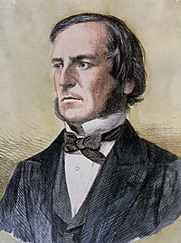
Boolean Logic
The logic of truth:
Named after George Boole
Two values: True and False
Three operators: and, or, and not

Slide 31
Boolean Logic
The logic of truth:
Named after George Boole
Two values: True and False
Three operators: and, or, and not
AND
OR
NOT
False
True
False
True
False
True
False
False
False
False
False
True
True
False
True
False
True
True
True
True

Slide 32
It’s a Saturday AND
we’re attending CS 220 lecture
AND
OR
NOT
False
True
False
True
False
True
False
False
False
False
False
True
True
False
True
False
True
True
True
True

Slide 33
FALSE!
It’s a Saturday AND
we’re attending CS 220 lecture
AND
OR
NOT
False
True
False
True
False
True
False
False
False
False
False
True
True
False
True
False
True
True
True
True

Slide 34
Project 1 is due on Wednesday
OR I’ll eat my hat
AND
OR
NOT
False
True
False
True
False
True
False
False
False
False
False
True
True
False
True
False
True
True
True
True

Slide 35
TRUE!
Project 1 is due on Wednesday
OR I’ll eat my hat
AND
OR
NOT
False
True
False
True
False
True
False
False
False
False
False
True
True
False
True
False
True
True
True
True

Slide 36
Control Flow: Remember that conditionals and loops sometimes do something.
We'll use bool logic a LOT to control when we do/don't.
AND
OR
NOT
False
True
False
True
False
True
False
False
False
False
False
True
True
False
True
False
True
True
True
True

Slide 37
Today's Outline
Software
Interpreters
Notebooks
        Demos
Operator Precedence
Demos
Boolean Logic
Demos

