Slide 1
[220 / 319] Variables and Expressions
Department of Computer Sciences
University of Wisconsin-Madison
Readings:
Chapter 2 of Think Python,
Chapter 3 of Python for Everybody
Due: P1

Slide 2
Learning Objectives
Evaluate expressions by identifying:
  operators and operands
  literal values and variables
  correct order of operations
Write correct Boolean expressions
  containing Boolean operators “or” and “and”
Write assignment statements
  with variables following proper naming rules
Define, give examples of, and identify 3 kinds of errors
  Syntax, runtime, and semantic
Write code to perform computations with
  int, float, string, and bool types

Slide 3
Today's Outline
Review
Operator Precedence
Expressions, Variables, and Assignments
        Demos
Bugs
Demos
Naming variables
Demos

Slide 4
Unordered
Ordered by Precedence
What is it? | Python Operator
comparison | ==, !=, <, <=, >, >=
signs | +x, -x
AND | and
add/subtract | +, -
exponents | **
NOT | not
OR | or
multiply/divide | *, /, //, %
What is it? | Python Operator
simplify first
simplify last

Slide 5
Unordered
Ordered by Precedence
What is it? | Python Operator
comparison | ==, !=, <, <=, >, >=
signs | +x, -x
AND | and
add/subtract | +, -
NOT | not
OR | or
multiply/divide | *, /, //, %
What is it? | Python Operator
exponents | **
simplify first
simplify last

Slide 6
Unordered
Ordered by Precedence
What is it? | Python Operator
comparison | ==, !=, <, <=, >, >=
AND | and
add/subtract | +, -
NOT | not
OR | or
multiply/divide | *, /, //, %
What is it? | Python Operator
exponents | **
signs | +x, -x
simplify first
simplify last

Slide 7
Unordered
Ordered by Precedence
What is it? | Python Operator
comparison | ==, !=, <, <=, >, >=
AND | and
add/subtract | +, -
NOT | not
OR | or
What is it? | Python Operator
exponents | **
signs | +x, -x
multiply/divide | *, /, //, %
simplify first
simplify last

Slide 8
Unordered
Ordered by Precedence
What is it? | Python Operator
comparison | ==, !=, <, <=, >, >=
AND | and
NOT | not
OR | or
What is it? | Python Operator
exponents | **
signs | +x, -x
multiply/divide | *, /, //, %
add/subtract | +, -
simplify first
simplify last

Slide 9
Unordered
Ordered by Precedence
What is it? | Python Operator
AND | and
NOT | not
OR | or
What is it? | Python Operator
exponents | **
signs | +x, -x
multiply/divide | *, /, //, %
add/subtract | +, -
comparison | ==, !=, <, <=, >, >=
simplify first
simplify last

Slide 10
Unordered
Ordered by Precedence
What is it? | Python Operator
AND | and
OR | or
What is it? | Python Operator
exponents | **
signs | +x, -x
multiply/divide | *, /, //, %
add/subtract | +, -
comparison | ==, !=, <, <=, >, >=
NOT | not
simplify first
simplify last

Slide 11
Unordered
Ordered by Precedence
What is it? | Python Operator
OR | or
What is it? | Python Operator
exponents | **
signs | +x, -x
multiply/divide | *, /, //, %
add/subtract | +, -
comparison | ==, !=, <, <=, >, >=
NOT | not
AND | and
simplify first
simplify last

Slide 12
Unordered
Ordered by Precedence
What is it? | Python Operator
What is it? | Python Operator
exponents | **
signs | +x, -x
multiply/divide | *, /, //, %
add/subtract | +, -
comparison | ==, !=, <, <=, >, >=
NOT | not
AND | and
OR | or
simplify first
simplify last

Slide 13
Unordered
Ordered by Precedence
What is it? | Python Operator
What is it? | Python Operator
exponents | **
signs | +x, -x
multiply/divide | *, /, //, %
add/subtract | +, -
comparison | ==, !=, <, <=, >, >=
NOT | not
AND | and
OR | or
simplify first
10 - -2 // 3
simplify last

Slide 14
Unordered
Ordered by Precedence
What is it? | Python Operator
What is it? | Python Operator
exponents | **
signs | +x, -x
multiply/divide | *, /, //, %
add/subtract | +, -
comparison | ==, !=, <, <=, >, >=
NOT | not
AND | and
OR | or
simplify first
simplify last
logical operators
can "short circuit"
1+1==2 or 3 ** 10000000 > 2 ** 20000000

Slide 15
Today's Outline
Review
Expressions, Variables, and Assignments
        Demos
Bugs
Demos
Naming variables
Demos

Slide 16
Expressions
Expressions are a mix of operators and operands. For example:
5 + 5
(8/2) ** 2 * 3.14
3 * 3 > 4 + 4
3 % 2 == 0 or 3 % 2 == 1

Slide 17
Expressions
Expressions are a mix of operators and operands. For example:
5 + 5
(8/2) ** 2 * 3.14
3 * 3 > 4 + 4
3 % 2 == 0 or 3 % 2 == 1
Each of these operands is an example of a literal: a fixed value

Slide 18
Expressions
Expressions are a mix of operators and operands. For example:
x + y
(diameter/2) ** 2 * pi
value1 * value1 > value2 + value2
num % 2 == 0 or num % 2 == 1
An operand may also be a variable: not fixed

Slide 19
Expressions
Expressions are a mix of operators and operands. For example:
x + y
(diameter/2) ** 2 * pi
value1 * value1 > value2 + value2
num % 2 == 0 or num % 2 == 1
Quick Test! Circle the literals (others are variables)
      0
      zero
      num1
      True
      hello
      "goodbye"
An operand may also be a variable: not fixed

Slide 20
Expressions
Expressions are a mix of operators and operands. For example:
x + y
(diameter/2) ** 2 * pi
value1 * value1 > value2 + value2
num % 2 == 0 or num % 2 == 1
Quick Test! Circle the literals (others are variables)
      0
      zero
      num1
      True
      hello
      "goodbye"
An operand may also be a variable: not fixed

Slide 21
Expressions
Expressions are a mix of operators and operands. For example:
x + y
(diameter/2) ** 2 * pi
value1 * value1 > value2 + value2
num % 2 == 0 or num % 2 == 1
Quick Test! Circle the literals (others are variables)
      0
      zero
      num1
      True
      hello
      "goodbye"
An operand may also be a variable: not fixed

Slide 22
Expressions
Expressions are a mix of operators and operands. For example:
x + y
(diameter/2) ** 2 * pi
value1 * value1 > value2 + value2
num % 2 == 0 or num % 2 == 1
Quick Test! Circle the literals (others are variables)
      0
      zero
      num1
      True
      hello
      "goodbye"
An operand may also be a variable: not fixed

Slide 23
Expressions
Expressions are a mix of operators and operands. For example:
x + y
(diameter/2) ** 2 * pi
value1 * value1 > value2 + value2
num % 2 == 0 or num % 2 == 1
Quick Test! Circle the literals (others are variables)
      0
      zero
      num1
      True
      hello
      "goodbye"
An operand may also be a variable: not fixed
How do we put a value in a variable?

Slide 24
Assignment
An assignment computes an expression (maybe a simple one) and puts the result in a variable:
x + y
(diameter/2) ** 2 * pi
value1 * value1 > value2 + value2
num % 2 == 0 or num % 2 == 1

Slide 25
Assignment
An assignment computes an expression (maybe a simple one) and puts the result in a variable:
total = x + y
area = (diameter/2) ** 2 * pi
is_bigger = value1 * value1 > value2 + value2
is_even_or_odd = num % 2 == 0 or num % 2 == 1

Slide 26
Assignment
An assignment computes an expression (maybe a simple one) and puts the result in a variable:
total = x + y
area = (diameter/2) ** 2 * pi
is_bigger = value1 * value1 > value2 + value2
is_even_or_odd = num % 2 == 0 or num % 2 == 1

Slide 27
Assignment
An assignment computes an expression (maybe a simple one) and puts the result in a variable:
total = x + y
area = (diameter/2) ** 2 * pi
is_bigger = value1 * value1 > value2 + value2
is_even_or_odd = num % 2 == 0 or num % 2 == 1

Slide 28
Assignment
An assignment computes an expression (maybe a simple one) and puts the result in a variable:
total = x + y
area = (diameter/2) ** 2 * pi
is_bigger = value1 * value1 > value2 + value2
is_even_or_odd = num % 2 == 0 or num % 2 == 1
Expression

Slide 29
Assignment
An assignment computes an expression (maybe a simple one) and puts the result in a variable:
total = x + y
area = (diameter/2) ** 2 * pi
is_bigger = value1 * value1 > value2 + value2
is_even_or_odd = num % 2 == 0 or num % 2 == 1
Expression
Assignment Operator

Slide 30
Assignment
An assignment computes an expression (maybe a simple one) and puts the result in a variable:
total = x + y
area = (diameter/2) ** 2 * pi
is_bigger = value1 * value1 > value2 + value2
is_even_or_odd = num % 2 == 0 or num % 2 == 1
Variable
Expression
Assignment Operator

Slide 31
Today's Outline
Review
Expressions, Variables, and Assignments
        Demos
Bugs
Demos
Naming variables
Demos

Slide 32
Today's Outline
Review
Expressions, Variables, and Assignments
        Demos
Bugs
Demos
Naming variables
Demos

Slide 33
Categories of Errors
1
dog cat the of chase any
[word soup, not grammatically sensible]
2
3

Slide 34
Categories of Errors
1
Syntax Error
It never makes sense in any context; Python doesn't even run
5 = x
2
3

Slide 35
Categories of Errors
1
Syntax Error
It never makes sense in any context; Python doesn't even run
5 = x
2
this sentence is false
[grammatical, but my head explodes if I think about it]
3

Slide 36
Categories of Errors
1
Syntax Error
It never makes sense in any context; Python doesn't even run
5 = x
Runtime Error
Need to run to find out whether it will crash
Appears with different names (TypeError, ZeroDivisionError, etc)
x = 5 / 0
2
3

Slide 37
Categories of Errors
1
Syntax Error
It never makes sense in any context; Python doesn't even run
5 = x
Runtime Error
Need to run to find out whether it will crash
Appears with different names (TypeError, ZeroDivisionError, etc)
x = 5 / 0
2
3
one week is 10 days long
[grammatical, coherent, but incorrect]

Slide 38
Categories of Errors
1
Syntax Error
It never makes sense in any context; Python doesn't even run
5 = x
Runtime Error
Need to run to find out whether it will crash
Appears with different names (TypeError, ZeroDivisionError, etc)
x = 5 / 0
Semantic Error
It runs with no error, but you get the wrong answer
square_area = square_side * 2
2
3

Slide 39
Categories of Errors
1
Syntax Error
It never makes sense in any context; Python doesn't even run
5 = x
Runtime Error
Need to run to find out whether it will crash
Appears with different names (TypeError, ZeroDivisionError, etc)
x = 5 / 0
Semantic Error
It runs with no error, but you get the wrong answer
square_area = square_side * 2
2
what kind of error is the worst?
3

Slide 40
Today's Outline
Review
Expressions, Variables, and Assignments
        Demos
Bugs
Demos
Naming variables
Demos

Slide 41
Example: int expressions
?
seconds = 12345
Print out hours, minutes, and seconds

Slide 42
Example: float expressions
?
Compound growth:
you start with $1000
every year it grows by 7%
you wait 30 years
how much do you have at the end?
year 0: $1000
year 1: $1070
year 2: ...

Slide 43
Example: string expressions
Visually compare two scores:
Alice has 10 points
Bob has 8 points
Desired output:
alice: ||||||||||
bob: ||||||||
even better
alice: ||||||||||
bob: ||||||||

Slide 44
Example: bool expressions
Bounds check: is the value between 0 and 100?
YES
NO
output is
you may continue: True
output is
you may continue: False

Slide 45
Today's Outline
Review
Expressions, Variables, and Assignments
        Demos
Bugs
Demos
Naming variables
Demos

Slide 46
What Variable Names are Allowed?
1st_score = 100 [bad variable] score_1 = 100 [good variable]
firstScore = 100 [not a recommended variable] first_score = 100 [recommended variable]
current rules are quite complex:
https://www.python.org/dev/peps/pep-3131
please don’t use camel case:
https://www.python.org/dev/peps/pep-0008/
Python 3 has become friendlier to non-English programmers
quero_café = True
this is allowed, and
different than "e"

Slide 47
Rules for naming variables
1
Only use letters a-z (upper and lower), numbers, and underscores
2
Don’t start with a number
3
Don’t use Python keywords (e.g., and, False, etc)
For 220, you may use only variables containing English alphabets

Slide 48
Rules for naming variables
1
Only use letters a-z (upper and lower), numbers, and underscores
2
Don’t start with a number
3
Don’t use Python keywords (e.g., and, False, etc)
GOOD:
cs220
CS220
cs_220
_cs220
BAD:
220class
and
pi3.14
x!
what rules are violated?

Slide 49
Rules for naming variables
1
Only use letters a-z (upper and lower), numbers, and underscores
2
Don’t start with a number
3
Don’t use Python keywords (e.g., and, False, etc)
GOOD:
cs220
CS220
cs_220
_cs220
BAD:
220class
and
pi3.14
x!
2

Slide 50
Rules for naming variables
1
Only use letters a-z (upper and lower), numbers, and underscores
2
Don’t start with a number
3
Don’t use Python keywords (e.g., and, False, etc)
GOOD:
cs220
CS220
cs_220
_cs220
BAD:
220class
and
pi3.14
x!
2
3

Slide 51
Rules for naming variables
1
Only use letters a-z (upper and lower), numbers, and underscores
2
Don’t start with a number
3
Don’t use Python keywords (e.g., and, False, etc)
GOOD:
cs220
CS220
cs_220
_cs220
BAD:
220class
and
pi3.14
x!
2
3
1
1

Slide 52
Rules for naming variables
1
Only use letters a-z (upper and lower), numbers, and underscores
2
Don’t start with a number
3
Don’t use Python keywords (e.g., and, False, etc)
GOOD:
cs220
CS220
cs_220
_cs220
BAD:
220class
and
pi3.14
x!
2
3
1
1

Slide 53
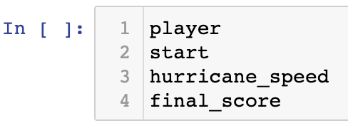
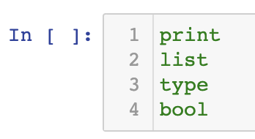
Identifying keywords
3
Don’t use Python keywords (e.g., and, False, etc)
How to figure out if something is a Python keyword?
Python keywords turn green in color in jupyter notebook
If used as a variable, that keyword will no longer work as intended!
GOOD:
BAD:
Pay attention to green colorization within jupyter notebook

Slide 54
Today's Outline
Review
Expressions, Variables, and Assignments
        Demos
Bugs
Demos
Naming variables
Demos

Slide 55
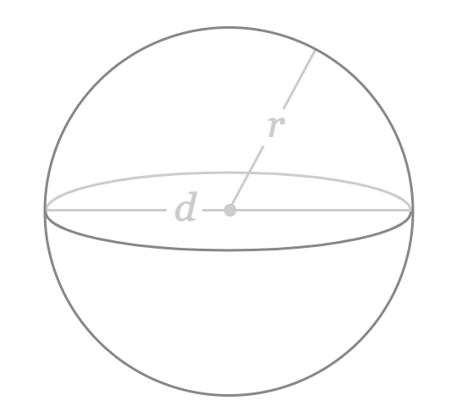
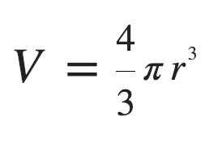
Practice: Sphere Volume
extension: find radius given a volume
https://www.google.com/search?q=sphere%20calc%3A%20find%20V&oq=area+of+a+sphere&aqs=chrome.0.0l6.2671j0j7&sourceid=chrome&ie=UTF-8&skip=s

Slide 56
Practice: Character Art - Block
write some code to draw the following:
##########
##########
##########
##########
##########
##########
height
width

Slide 57
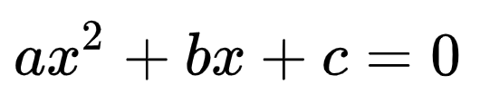
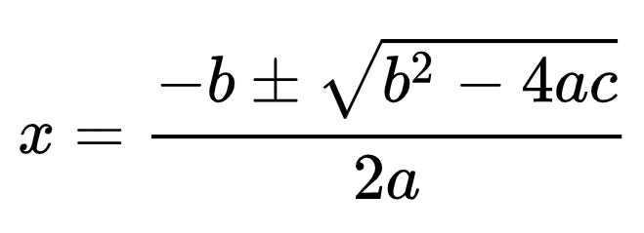
Practice: Quadratic Formula
what values of x satisfy the above?
https://en.wikipedia.org/wiki/Quadratic_formula

Slide 58
Challenge*: Checkers
write some code to draw the following:
# # # # #
# # # # #
# # # # #
# # # # #
# # # # #
# # # # #
height
width
* Challenge = beyond what you would be asked to do on an exam

Slide 59
Challenge: Border
write some code to draw the following:
##########
# #
# #
# #
# #
##########
height
width

Slide 60
Challenge: Snake
write some code to draw the following:
##########
#
##########
#
##########
#
##########
#
height
width

