Slide 1
[220 / 319] Using Functions
Department of Computer Sciences
University of Wisconsin-Madison
Readings:
Parts of Chapter 3 of Think Python,
Chapter 5.1 to 5.4 of Python for Everybody
Due: Quiz1

Slide 2
Learning Objectives
How to call functions
input/output
terminology: call / invoke, parameter, argument, keyword argument, return value
control flow
Function usage examples
input()
print(), along with keyword arguments “end” and “sep”
type cast functions: int(), bool(), float(), str()
Using functions from built-in module:
round(), abs()
keywords: import, from
attribute operator: “.”
help: inspect a module

Slide 3
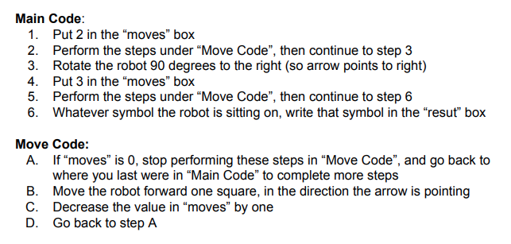
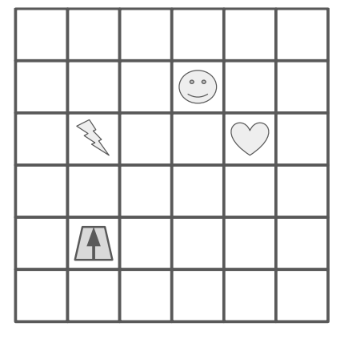
Functions are like “mini programs”,
as in our robot worksheet problem

Slide 4
“Move Code” is a function
Functions are like “mini programs”,
as in our robot worksheet problem

Slide 5
today we’ll learn how to use functions in Python
Functions are like “mini programs”,
as in our robot worksheet problem

Slide 6
we’ll learn about how to give functions input by passing arguments (e.g., 2) to parameters (e.g., moves)
today we’ll learn how to use functions in Python
Functions are like “mini programs”,
as in our robot worksheet problem

Slide 7
we’ll learn about how to give functions input by passing arguments (e.g., 2) to parameters (e.g., moves)
today we’ll learn how to use functions in Python
we’ll also learn how to ask functions
questions and get answers called return values
Functions are like “mini programs”,
as in our robot worksheet problem

Slide 8
we’ll learn about how to give functions input by passing arguments (e.g., 2) to parameters (e.g., moves)
today we’ll learn how to use functions in Python
we’ll also learn how to ask functions
questions and get answers called return values
next lecture, we’ll learn how to write our own new functions
Functions are like “mini programs”,
as in our robot worksheet problem

Slide 9
Terminology / Vocabulary
function definition: a grouping of lines of code; a way for us to tell our program to run that entire group of code
call / invoke: a statement in Python code that instructs the program to run all the lines of code in a function definition, and then come back afterward
parameter: variable that receives input to function
argument: value sent to a function (lines up with parameter)
keyword argument: argument explicitly tied to a parameter
return value: function output sent back to calling code
next lecture, we’ll learn how to write our own new functions

Slide 10
print(“hello”) result = f(x)
Calling/Invoking a Function in Python

Slide 11
print(“hello”) result = f(x)
Calling/Invoking a Function in Python
ALWAYS: function’s name

Slide 12
print(“hello”) result = f(x)
Calling/Invoking a Function in Python
ALWAYS: function’s name
ALWAYS: followed by parentheses

Slide 13
print(“hello”) result = f(x)
Calling/Invoking a Function in Python
arguments
ALWAYS: function’s name
ALWAYS: followed by parentheses
SOMETIMES: with one or more arguments

Slide 14
print(“hello”) result = f(x)
Calling/Invoking a Function in Python
return value
ALWAYS: function’s name
ALWAYS: followed by parentheses
SOMETIMES: with one or more arguments
SOMETIMES: producing a result

Slide 15
print(“hello”, “world”) x = input()
Calling/Invoking a Function in Python
ALWAYS: function’s name
ALWAYS: followed by parentheses
SOMETIMES: with one or more arguments
SOMETIMES: producing a result

Slide 16
Notebook examples

