Slide 1
[220 / 319] Function Scope
Department of Computer Sciences
University of Wisconsin-Madison
Readings:
Parts of Chapter 3 of Think Python

Slide 2
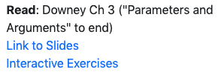
Learning Objectives Today
Explain rules of scope of local variables in a function
When are they created?
When are they destroyed?
What parts of a program have access to them? (frames)
Understand global variables
How can they be used and modified within a function?(global keyword)
Where are they stored? (global frame)
What parts of a program have access to them?
How can they be mis-represented as local variables?
Explain argument passing
“pass by value”
don't memorize the examples,
learn the rules of Python
sample question: why did Python
do this thing I didn't expect
at this specific line (ask us!)

Slide 3
Today's Outline
Context
Examples
Frames
        Demos: Local Variables
Demos: Global Variables
Demos: Argument Passing

Slide 4
Context
Often (in life and programming), the same name can mean different things in different contexts
Examples?
Human name: Michael (who is in the room?)
Street address: 534 State Street (what city are we in?)
Files: test.py (which directory are we in?)

Slide 5
Context
Often (in life and programming), the same name can mean different things in different contexts
Examples?
Human name: Michael (who is in the room?)
Street address: 534 State Street (what city are we in?)
Files: test.py (which directory are we in?)
Our code often have different variables with the same name
How do we keep variable names organized?
How do we know what a variable name is referring to?

Slide 6
Context
Often (in life and programming), the same name can mean different things in different contexts
Examples?
Human name: Michael (who is in the room?)
Street address: 534 State Street (what city are we in?)
Files: test.py (which directory are we in?)
Our code often have different variables with the same name
How do we keep variable names organized?
How do we know what a variable name is referring to?
with groups called “frames”
we’ll learn some
rules for this

Slide 7
Today's Outline
Context
Frames
        Demos: Local Variables
Demos: Global Variables
Demos: Argument Passing

Slide 8
Frames
Every time a function is invoked (i.e., called), the invocation gets a new “frame” for holding variables
The parameters also exist in a frame
Global frame
There is always one global frame that all functions can access
When a variable name is used, Python looks two places:
    the function invocation’s frame
    the global frame
1
2

Slide 9
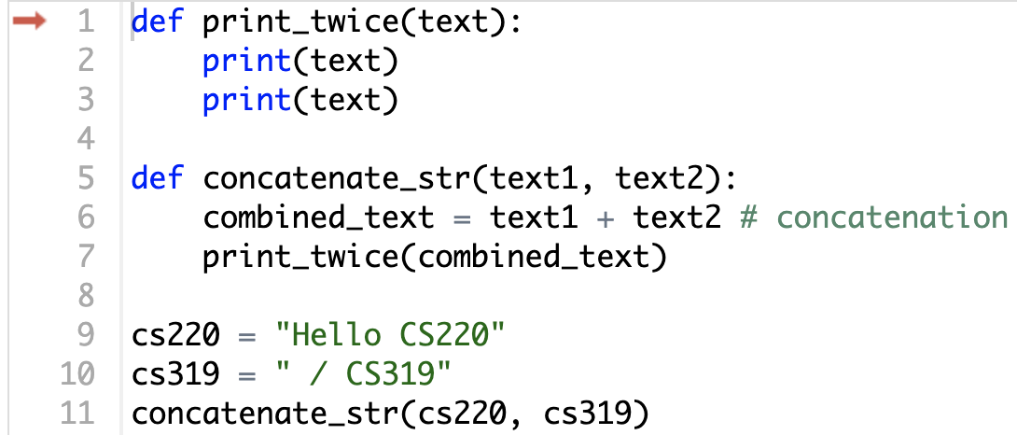
Understanding scope: example

Slide 10
Understanding scope: example
cs220 and cs319 will be in the global frame

Slide 11
Understanding scope: example
two frames will exist during
the time we’re executing
in print_twice
cs220 and cs319 will be in the global frame

Slide 12
Understanding scope: example
two frames will exist during
the time we’re executing
in print_twice
cs220 and cs319 will be in the global frame
you don’t generally see or interact
with frames when programming,
but it’s an important mental model

Slide 13
Understanding scope: example
can access: cs220, cs319, text
can access: cs220, cs319, text1, text2, combined_text
this code can access: line1, line2
we call the variables that can currently be
accessed “in scope” and variables that
cannot be “out of scope”

Slide 14
Understanding scope: example
Arguments are copied to parameters:
this is called “pass by value”

Slide 15
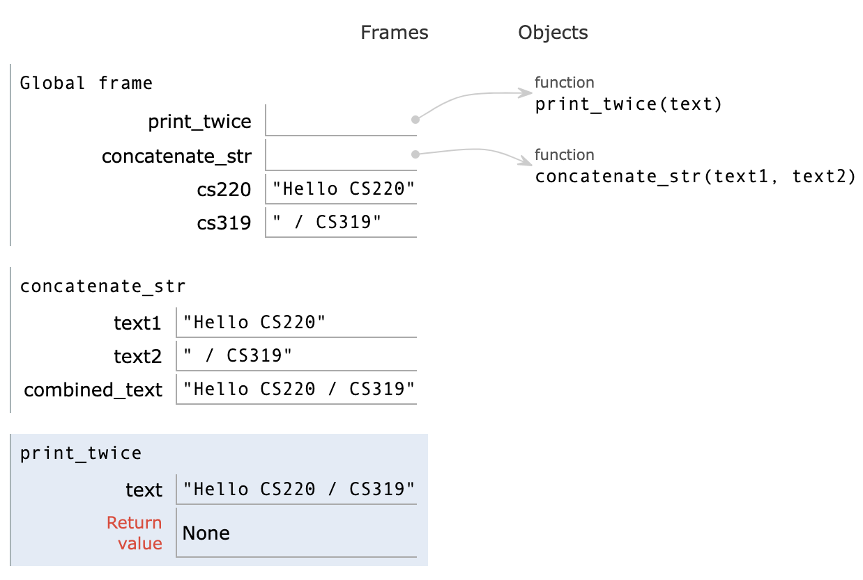
Understanding scope: example (PythonTutor)

Slide 16
Understanding scope: example
def print_twice(text):
print(text)
print(text)
def concatenate_str(text1, text2):
combined_text = text1 + text2 # concatenation
print_twice(combined_text)
cs220 = "Hello CS220"
cs319 = " / CS319"
concatenate_str(cs220, cs319)
Try this example yourself using PythonTutor

Slide 17
Today's Outline
Context
Frames
        Demos: Local Variables
Demos: Global Variables
Demos: Argument Passing
Let's do some examples in PythonTutor

Slide 18
Lessons about Local Variables
def set_x():
x = 100
print(x)
Lesson 1: functions don't execute unless they're called

Slide 19
Lessons about Local Variables
def set_x():
x = 100
set_x()
print(x)
Lesson 2: variables created in a function die after function returns

Slide 20
Lessons about Local Variables
def count():
x = 1
x += 1
print(x)
count()
count()
count()
Lesson 3: variables start fresh every time a function is called again

Slide 21
Lessons about Local Variables
def display_x():
print(x)
def main():
x = 100
display_x()
main()
Lesson 4: you can't see the variables of other function invocations, even those that call you

Slide 22
Today's Outline
Context
Frames
        Demos: Local Variables
Demos: Global Variables
Demos: Argument Passing

Slide 23
Lessons about Global Variables
msg = 'hello' # global, outside any func
def greeting():
print(msg)
print('before: ' + msg)
greeting()
print('after: ' + msg)
Lesson 5: you can generally just use global variables inside a function

Slide 24
Lessons about Global Variables
msg = 'hello'
def greeting():
msg = 'welcome!'
print('greeting: ' + msg)
print('before: ' + msg)
greeting()
print('after: ' + msg)
Lesson 6: if you do an assignment to a variable in a function, Python assumes you want it local

Slide 25
Lessons about Global Variables
msg = 'hello'
def greeting():
print('greeting: ' + msg)
msg = 'welcome!'
print('before: ' + msg)
greeting()
print('after: ' + msg)
Lesson 7: assignment to a variable should be before its use in a function, even if there's
a global variable with the same name

Slide 26
Lessons about Global Variables
msg = 'hello'
def greeting():
global msg
print('greeting: ' + msg)
msg = 'welcome!'
print('before: ' + msg)
greeting()
print('after: ' + msg)
Lesson 8: use a global declaration to prevent Python from creating a
local variable when you want a global variable

Slide 27
Today's Outline
Context
Frames
        Demos: Local Variables
Demos: Global Variables
Demos: Argument Passing

Slide 28
Lessons about Argument Passing
def f(x):
x = 'B'
print('inside: ' + x)
val = 'A'
print('before: ' + val)
f(val)
print('after: ' + val)
Lesson 9: in Python, arguments are "passed by value", meaning
reassignments to a parameter don't change the argument outside

Slide 29
Lessons about Argument Passing
x = 'A'
def f(x):
x = 'B'
print('inside: ' + x)
print('before: ' + x)
f(x)
print('after: ' + x)
Lesson 10: it's irrelevant whether the argument (outside) and
parameter (inside) have the same variable name

Slide 30
Lesson Summary
Lesson 1: functions don't execute unless they're called
Lesson 2: variables created in a function die after function returns
Lesson 3: variables start fresh every time a function is called again
Lesson 4: you can't see the variables of other function invocations, even those that call you
Lesson 5: you can generally just use global variables inside a function
Lesson 6: if you do an assignment to a variable in a function, Python assumes you want it local
Lesson 7: assignment to a variable should be before its use in a function, even if there's a a global variable with the same name
Lesson 8: use a global declaration to prevent Python from creating a local variable when you want a global variable
Lesson 9: in Python, arguments are "passed by value", meaning reassignments to a parameter don't change the argument outside
Lesson 10: it's irrelevant whether the argument (outside) and parameter (inside) have the same variable name
Local
Global
Parameters

