Slide 1
[220 / 319] Files
Department of Computer Sciences
University of Wisconsin-Madison
Readings:
Chapter 14 of Downey book

Slide 2
Learning Objectives Today
Basic file interactions
opening/closing
reading/writing
OS module
listdir, mkdir, exists, isdir, isfile, join
File exceptions
Encodings

Slide 3
Learning Objectives Today
Basic file interactions
opening/closing
reading/writing
OS module
listdir, mkdir, exists, isdir, isfile, join
File exceptions
Encodings

Slide 4
File objects
built-in open function
      f = open(path)
      # read data from f
      # OR
      # write data to f
      f.close()
file object
file path

Slide 5
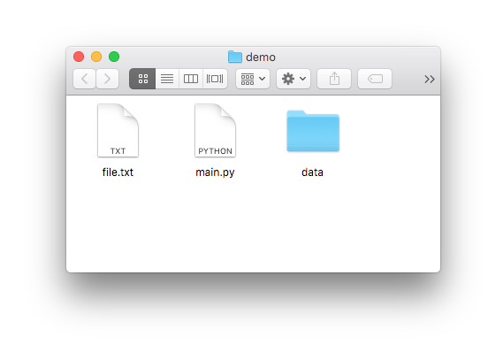
File objects
built-in open function
main.ipynb:
      f = open(path)
      # read data from f
      # OR
      # write data to f
      f.close()
file object
file path
we’re running the code here

Slide 6
File objects
built-in open function
main.ipynb:
      f = open(“file.txt”)
      # read data from f
      # OR
      # write data to f
      f.close()
file object
file path
suppose we want to open file.txt

Slide 7
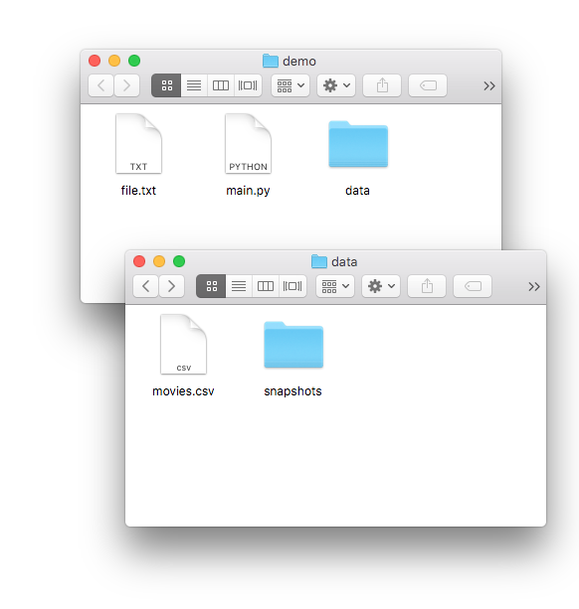
File objects
built-in open function
main.ipynb:
      f = open(
      “data/movies.csv”)
      # read data from f
      # OR
      # write data to f
      f.close()
file object
file path
data/movies.csv

Slide 8
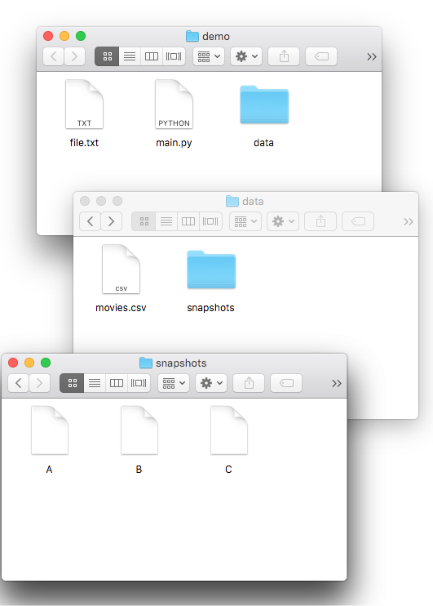
File objects
built-in open function
main.ipynb:
main.ipynb:
      f = open(
      “data/snapshots/A”)
      # read data from f
      # OR
      # write data to f
      f.close()
file object
file path
data/snapshots/A

Slide 9
File objects
main.ipynb:
main.ipynb:
      f = open(“file.txt”)
      # read data from f
      # OR
      # write data to f
      f.close()

Slide 10
File objects
main.ipynb:
main.ipynb:
      f = open(“file.txt”)
      # read data from f
      # OR
      # write data to f
      f.close()
using file

Slide 11

File objects
imagine a file object as a sandwich…
f = open(…)
use file
main.ipynb:
      f = open(“file.txt”)
      # read data from f
      # OR
      # write data to f
      f.close()
f.close()
using file
Reasons for closing
avoid data loss
limited number of open files
cleanup

Slide 12
Learning Objectives Today
Basic file interactions
opening/closing
reading/writing
OS module
listdir, mkdir, exists, isdir, isfile, join
File exceptions
Encodings

Slide 13
Reading a file
      f = open(“file.txt”)
      # read data from f
      # OR
      # write data to f
      f.close()
I promise
to always
close my files

Slide 14
Reading a file
      f = open(“file.txt”)
      data = f.read()
      print(data)
      f.close()
I promise
to always
close my files
Option 1
data is: “I promise\nto always\nclose my files”
read() method
fetch entire file contents
return as a string

Slide 15
Reading a file
      f = open(“file.txt”)
      # read data from f
      # OR
      # write data to f
      f.close()
Option 2
file objects can be iterated over, using a for loop!

Slide 16
Reading a file – alternate ways
f = open("file.txt")
lines = list(f)
f.close()
convert it to a list
f = open("file.txt")
for l in f:
print(l)
f.close()
iterate over f with a for loop

Slide 17
Write a file
      f = open(“file.txt”)
      # read data from f
      # OR
      # write data to f
      f.close()
I promise
to always
close my files

Slide 18
Write a file
“w” mode indicates we want to write to this file
      f = open(“file.txt”, “w”)
      # read data from f
      # OR
      # write data to f
      f.close()
I promise
to always
close my files

Slide 19
Write a file
“w” mode indicates we want to write to this file
      f = open(“file.txt”, “w”)
      f.write(“hello”)
      f.write(“ world\n”)
      f.write(“!!!!!\n”)
      f.close()
I promise
to always
close my files
let’s run it!

Slide 20
Write a file
“w” mode indicates we want to write to this file
      f = open(“file.txt”, “w”)
      f.write(“hello”)
      f.write(“ world\n”)
      f.write(“!!!!!\n”)
      f.close()
opening with “w” is
dangerous. It immediately
wipes out your file.
(or creates a new one if
there isn’t already a file.txt)

Slide 21
Write a file
“w” mode indicates we want to write to this file
      f = open(“file.txt”, “w”)
      f.write(“hello”)
      f.write(“ world\n”)
      f.write(“!!!!!\n”)
      f.close()
hello

Slide 22
Write a file
“w” mode indicates we want to write to this file
      f = open(“file.txt”, “w”)
      f.write(“hello”)
      f.write(“ world\n”)
      f.write(“!!!!!\n”)
      f.close()
hello world

Slide 23
Write a file
“w” mode indicates we want to write to this file
      f = open(“file.txt”, “w”)
      f.write(“hello”)
      f.write(“ world\n”)
      f.write(“!!!!!\n”)
      f.close()
hello world
!!!!!!

Slide 24
Write a file
“w” mode indicates we want to write to this file
      f = open(“file.txt”, “w”)
      f.write(“hello”)
      f.write(“ world\n”)
      f.write(“!!!!!\n”)
      f.close()
hello world
!!!!!!
be careful with newlines
(write doesn't add them like print does)

Slide 25
Learning Objectives Today
Basic file interactions
opening/closing
reading/writing
OS module
listdir, mkdir, exists, isdir, isfile, join
File exceptions
Encodings

Slide 26
OS Module (Operating System)
Many functions in os and os.path for working w/ files
os.listdir
os.mkdir
os.path.exists
os.path.isfile
os.path.isdir
os.path.join

Slide 27
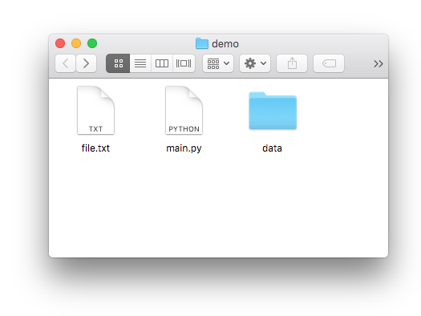
OS Module (Operating System)
Many functions in os and os.path for working w/ files
os.listdir
os.mkdir
os.path.exists
os.path.isfile
os.path.isdir
os.path.join
>>> import os
>>> os.listdir(“.”)
[“file.txt”, “main.ipynb”, “data”]

Slide 28
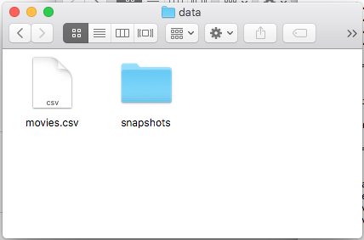
OS Module (Operating System)
Many functions in os and os.path for working w/ files
os.listdir
os.mkdir
os.path.exists
os.path.isfile
os.path.isdir
os.path.join
>>> import os
>>> os.listdir(“data”)
[“movies.csv”, “snapshots”]

Slide 29
OS Module (Operating System)
Many functions in os and os.path for working w/ files
os.listdir
os.mkdir
os.path.exists
os.path.isfile
os.path.isdir
os.path.join
>>> import os
>>> os.mkdir(“test”)

Slide 30
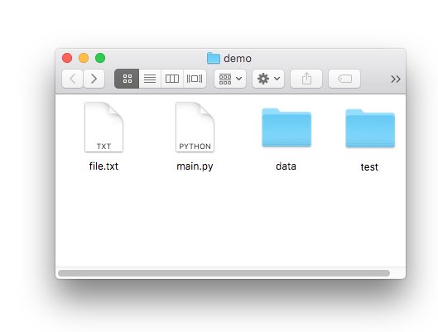
OS Module (Operating System)
Many functions in os and os.path for working w/ files
os.listdir
os.mkdir
os.path.exists
os.path.isfile
os.path.isdir
os.path.join
>>> import os
>>> os.mkdir(“test”)

Slide 31
OS Module (Operating System)
Many functions in os and os.path for working w/ files
os.listdir
os.mkdir
os.path.exists
os.path.isfile
os.path.isdir
os.path.join
>>> import os
>>> os.path.exists(“file.txt”)
True

Slide 32
OS Module (Operating System)
Many functions in os and os.path for working w/ files
os.listdir
os.mkdir
os.path.exists
os.path.isfile
os.path.isdir
os.path.join
>>> import os
>>> os.path.exists(“haha.txt”)
False

Slide 33
OS Module (Operating System)
Many functions in os and os.path for working w/ files
os.listdir
os.mkdir
os.path.exists
os.path.isfile
os.path.isdir
os.path.join
>>> import os
>>> os.path.isfile(“haha.txt”)
False

Slide 34
OS Module (Operating System)
Many functions in os and os.path for working w/ files
os.listdir
os.mkdir
os.path.exists
os.path.isfile
os.path.isdir
os.path.join
>>> import os
>>> os.path.isfile(“file.txt”)
True

Slide 35
OS Module (Operating System)
Many functions in os and os.path for working w/ files
os.listdir
os.mkdir
os.path.exists
os.path.isfile
os.path.isdir
os.path.join
>>> import os
>>> os.path.isfile(“data”)
False

Slide 36
OS Module (Operating System)
Many functions in os and os.path for working w/ files
os.listdir
os.mkdir
os.path.exists
os.path.isfile
os.path.isdir
os.path.join
>>> import os
>>> os.path.isdir(“data”)
True

Slide 37
OS Module (Operating System)
Many functions in os and os.path for working w/ files
os.listdir
os.mkdir
os.path.exists
os.path.isfile
os.path.isdir
os.path.join
>>> import os
>>> os.path.join(“data”, “movies.csv”)
data/movies.csv
on Mac/Linux

Slide 38
OS Module (Operating System)
Many functions in os and os.path for working w/ files
os.listdir
os.mkdir
os.path.exists
os.path.isfile
os.path.isdir
os.path.join
>>> import os
>>> os.path.join(“data”, “movies.csv”)
data\movies.csv
on Windows

Slide 39
Windows
Linux
Your project:
path = "\".join("data", "movies.csv")
f = open(path)
...
...
submit
you run test.py
we run test.py

Slide 40
Learning Objectives Today
Basic file interactions
opening/closing
reading/writing
OS module
listdir, mkdir, exists, isdir, isfile, join
File exceptions
Encodings

Slide 41
Exceptions
Working with files leads to many exceptions
missing files
lacking permissions
not enough space
mixing up directories and files
corrupt formats
etc, etc

Slide 42
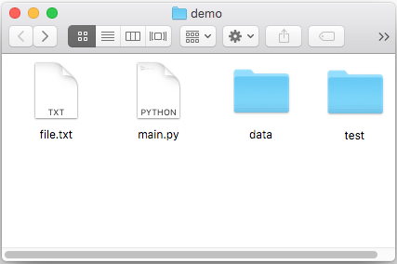
Exceptions
Working with files leads to many exceptions
missing files
lacking permissions
not enough space
mixing up directories and files
corrupt formats
etc, etc
import os
os.mkdir('dump')
f = open(os.path.join('dump', 'out.txt'), 'w')
f.write('hi')
f.close()

Slide 43
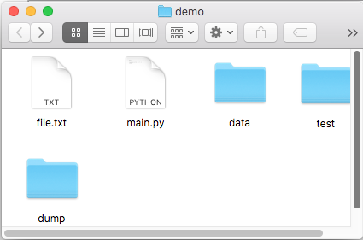
Exceptions
Working with files leads to many exceptions
missing files
lacking permissions
not enough space
mixing up directories and files
corrupt formats
etc, etc
run once
import os
os.mkdir('dump')
f = open(os.path.join('dump', 'out.txt'), 'w')
f.write('hi')
f.close()

Slide 44
Exceptions
Working with files leads to many exceptions
missing files
lacking permissions
not enough space
mixing up directories and files
corrupt formats
etc, etc
run again: CRASH!
import os
os.mkdir('dump')
f = open(os.path.join('dump', 'out.txt'), 'w')
f.write('hi')
f.close()
Traceback (most recent call last):
File "test2.py", line 3, in <module>
os.mkdir('dump')
FileExistsError: [Errno 17] File exists: 'dump'

Slide 45
Exceptions
Working with files leads to many exceptions
missing files
lacking permissions
not enough space
mixing up directories and files
corrupt formats
etc, etc
run again with try/except
import os
try:
os.mkdir('dump')
except FileExistsError:
pass # ignore it if dump already existed
f = open(os.path.join('dump', 'out.txt'), 'w')
f.write('hi')
f.close()

Slide 46
Learning Objectives Today
Basic file interactions
opening/closing
reading/writing
OS module
listdir, mkdir, exists, isdir, isfile, join
File exceptions
Encodings

Slide 47
Exercise: person 1 encodes a word with encoding 1,
person 2 decodes with encoding 2
Word:
ukulele
A 00001
B 00010
C 00011
D 00100
E 00000
F 00110
G 00111
H 01000
I 01001
J 01010
K 01011
L 11111
M 01101
N 01110
O 01111
P 10000
Q 10001
R 10010
S 10011
T 10100
U 10101
V 10110
W 10111
X 11000
Y 11001
Z 11010
A 00001
B 00010
C 00011
D 00100
E 00000
F 00110
G 00111
H 01000
I 01001
J 01010
K 01111
L 10101
M 01101
N 01110
O 01011
P 10000
Q 10001
R 10010
S 10011
T 10100
U 01100
V 10110
W 10111
X 11000
Y 11001
Z 11010
encoding 1
encoding 2

Slide 48
Exercise: person 1 encodes a word with encoding 1,
person 2 decodes with encoding 2
Word:
ukulele
lol?e?e
A 00001
B 00010
C 00011
D 00100
E 00000
F 00110
G 00111
H 01000
I 01001
J 01010
K 01011
L 11111
M 01101
N 01110
O 01111
P 10000
Q 10001
R 10010
S 10011
T 10100
U 10101
V 10110
W 10111
X 11000
Y 11001
Z 11010
A 00001
B 00010
C 00011
D 00100
E 00000
F 00110
G 00111
H 01000
I 01001
J 01010
K 01111
L 10101
M 01101
N 01110
O 01011
P 10000
Q 10001
R 10010
S 10011
T 10100
U 01100
V 10110
W 10111
X 11000
Y 11001
Z 11010
encoding 1
encoding 2

Slide 49
Encoding Defaults Done Wrong
Mac
Windows
f = open('example.txt', 'w',
encoding='utf-8')
f.write('baño')
f.close()
f = open('example.txt', ‘r',
encoding='cp1252')
print(f.read())
f.close()
example.txt
example.txt
Windows computer prints “baÃ±o” instead of “baño”

Slide 50
Encoding Defaults Done Wrong
Mac
Windows
f = open('example.txt', 'w',
encoding='utf-8')
f.write('baño')
f.close()
f = open('example.txt', ‘r',
encoding='cp1252')
print(f.read())
f.close()
example.txt
example.txt
Takeaway: if you see weird characters printed by
your program, it’s a good time to learn more about encodings

Slide 51
Coding Demos

Slide 52
Demo 1: add numbers in a file
          Goal: read all lines from a file as integers and add them
          Input:
file containing 50 million numbers between 0 and 100
          Output:
The sum of the numbers
          Example:
          Sum of numbers: 2499463617
          Two ways:
Put all lines in a list first
Directly use iterable file
Bonus: create generator function
that does the str => int conversion

Slide 53
Challenge - Demo 1: Score Tracker
          Goal: tally up points, and print who is winning
          Input:
Person who just scored
          Output:
Everybody’s score
          Example:
          ”Enter winner’s name”: alice
          alice: 1
          ”Enter winner’s name”: bob
          alice: 1
          bob: 1
          ”Enter winner’s name”: alice
          alice: 2
          bob: 1

Slide 54
Challenge - Demo 2: File Finder
          Goal: search directories (recursively) for a given file name, then print that file
          Input:
The filename to search for
          Output:
The contents of that file

Slide 55
Challenge - Demo 3: sorting files by line length
          Goal: output file contents, with shortest line first
          Input:
a text file
          Output:
print lines sorted

