Slide 1
CS 220 / CS319
Introduction
Department of Computer Sciences
University of Wisconsin-Madison

Slide 2
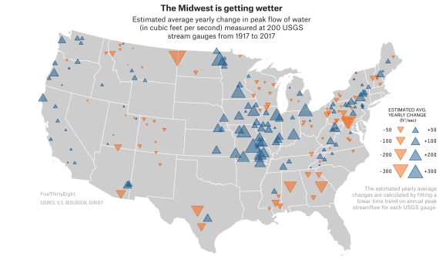
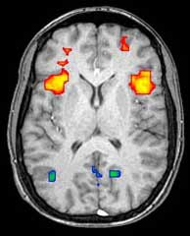

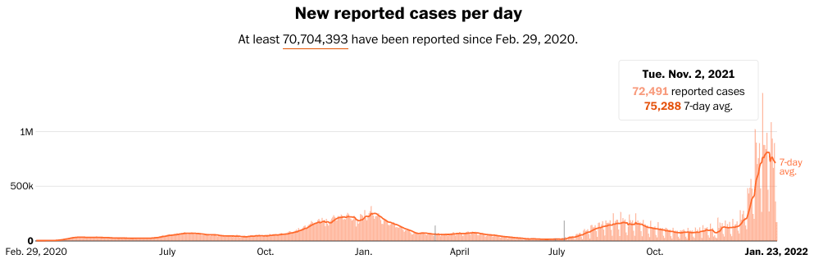
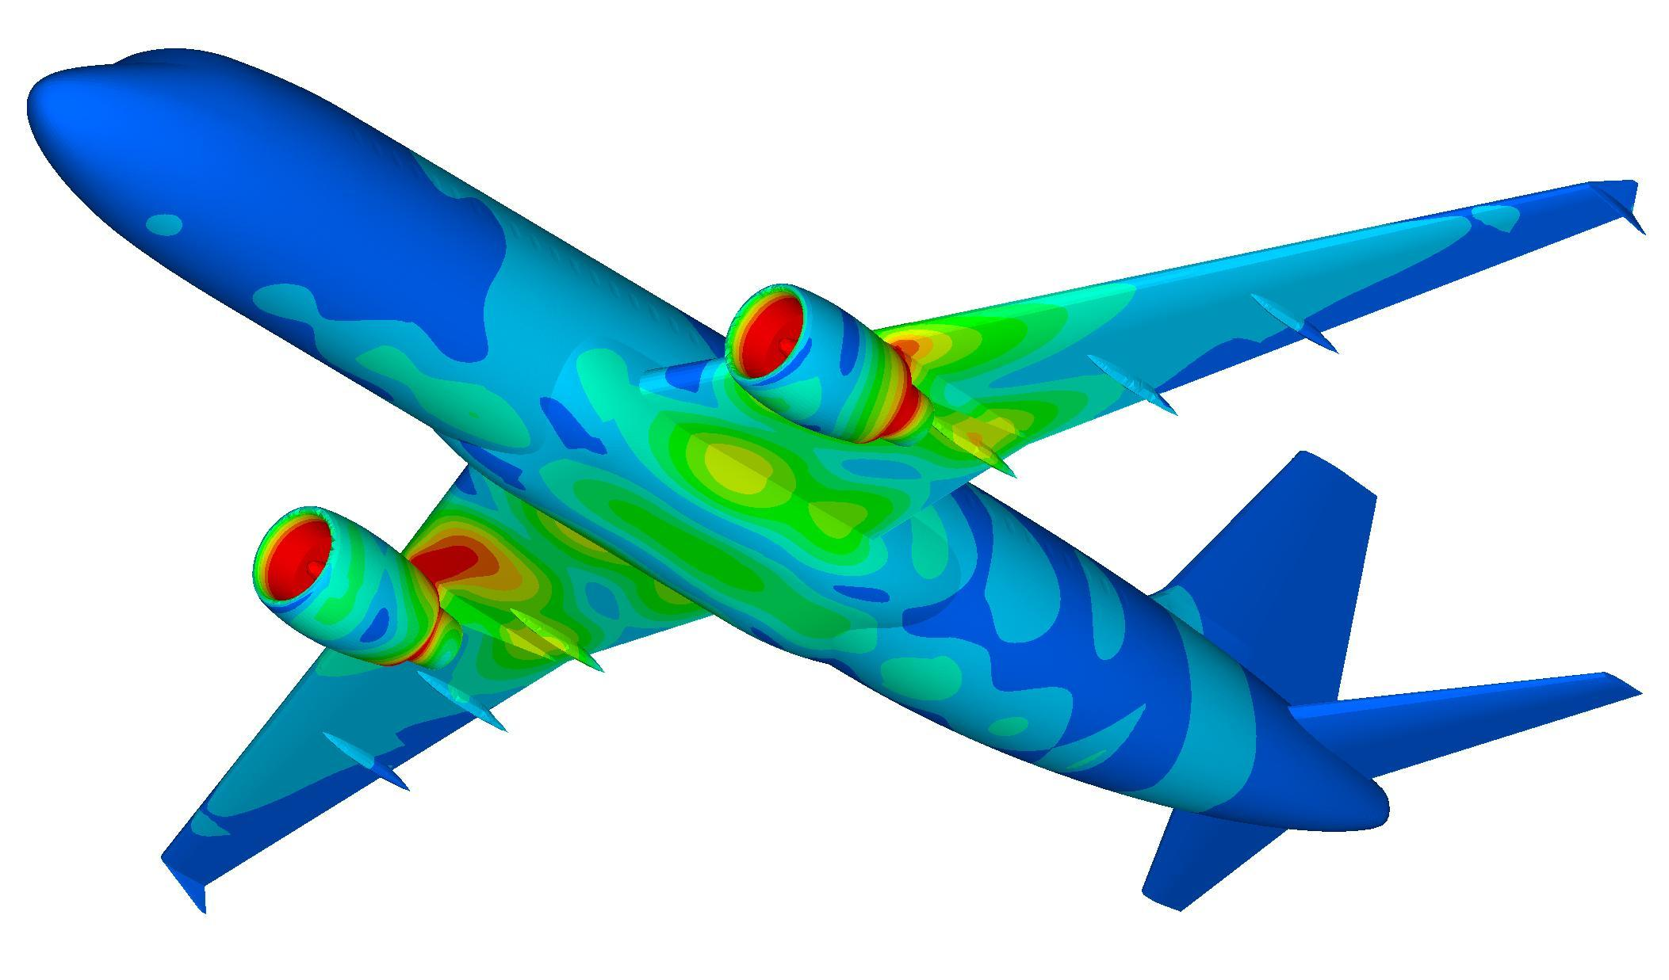
Welcome to Data Science Programming I
Data is now integrated into many fields
Journalism
Biology, physics, chemistry
Psychology, sociology, economics, business
Engineering (mechanical, biomedical, industrial, etc.)
https://en.wikipedia.org/wiki/Neuroimaging
https://fivethirtyeight.com/features/the-midwest-is-getting-drenched-and-its-causing-big-problems/
https://science.howstuffworks.com/life/genetic/gattaca-gaptacaz-adding-letters-the-genetic-alphabet.htm
https://www.washingtonpost.com/graphics/2020/national/coronavirus-us-cases-deaths/
http://www.stressebook.com/finite-element-analysis-in-a-nut-shell/

Slide 3

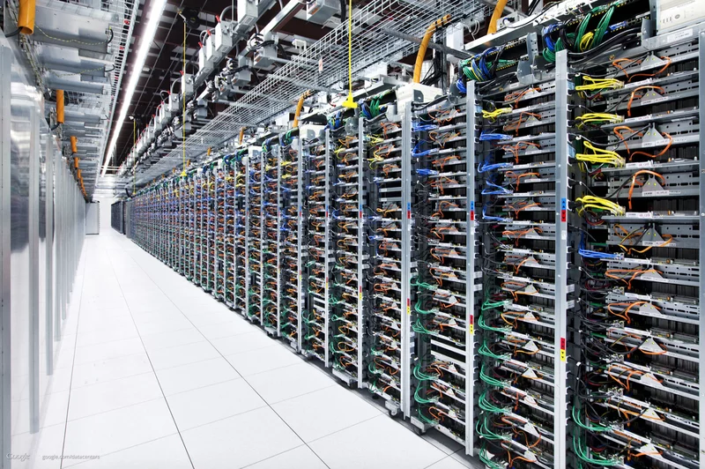
Welcome to Data Science Programming I
Data is now integrated into many fields
Journalism
Biology, physics, chemistry
Psychology, sociology, economics, business
Engineering (mechanical, electrical, industrial, etc)
How can we gain insights from that data?
With computation
Approach 1: human computation
Approach 2: machine computation
https://en.wikipedia.org/wiki/Human_computer
http://fortune.com/2015/11/15/intel-super-7/

Slide 4
Welcome to Data Science Programming I
CS 220 is about approach 2
Faster, more reliable, can churn through more data
Automate to save human effort
“Find the leverage in the world, so you can be more lazy!”
~ Larry Page
Approach 1: human computation
Approach 2: machine computation
https://en.wikipedia.org/wiki/Human_computer
http://fortune.com/2015/11/15/intel-super-7/

Slide 5
Welcome to Data Science Programming I
CS 220 is about approach 2
Faster, more reliable, can churn through more data
Automate to save human effort
Requires being able to tell computers what to do!
society needs more domain experts
in specific fields who can write code
Goal: become "bilingual"
Speak the language of X (biology, mech eng, journalism, etc)
Speak the language of computing
Data Science:
Combines inquiry, statistics, programming, and communication skills to provide actionable insights from data sets

Slide 6
Why CS 220?
Typical intro CS
Challenging language (e.g., C++ or Java)
CS students and other majors together
Heavy on theory, light on data
vs
CS 220 approach
Python (powerful but easier to learn)
Bring more coding into other fields
Light on theory, heavy on data
Emphasize questions and communication

Slide 7
Why CS 220?
100 Best Jobs of 2024
 | Title | Projected Jobs | Median Salary | Education
1 | Nurse Practitioner | 135,500 | $126,260 | Masters
2 | IT Manager | 106,9000 | $169,510 | Bachelor
3 | Physician Assistant | 43,700 | $130,020 | Masters
4 | Financial Manager | 138,300 | $156,100 | Bachelor
5 | Software Developer | 303,700 | $132,270 | Bachelor
6 | Information Security Analyst | 59,100 | $120,360 | Bachelor
7 | Med. & Health Services Manager | 160,600 | $110,680 | Bachelor
8 | Data Scientist | 73,100 | $108,020 | Bachelor
9 | Speech-Language Pathologist | 33,300 | $89,290 | Masters
10 | Actuary | 6,600 | $120,000 | Bachelor
https://money.usnews.com/careers/best-jobs/rankings/the-100-best-j

Slide 8


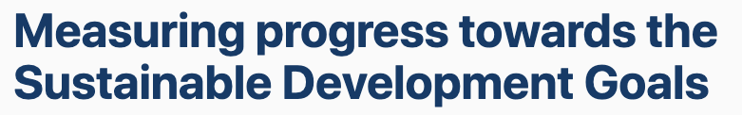
Why CS 220?
People use Data to solve the world’s problems
https://ourworldindata.org/ https://sdg-tracker.org/

Slide 9
Today's Topics
Introductions
Who are the faculty? Who are you?
Course overview
Website

Slide 10
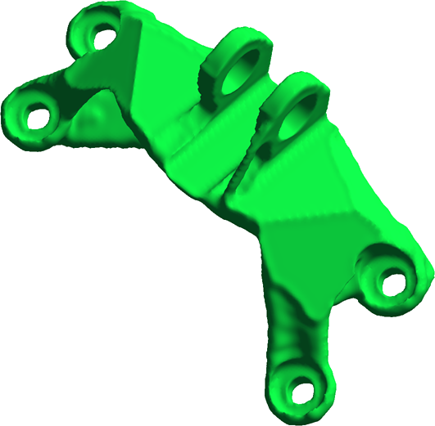



Who are the faculty?
Mike Doescher
Email: mdoescher@wisc.edu
Please call me “Mike”
Industry and Teaching experience
Naval Research Laboratory
Benedictine College
SciArt Software
UW Madison

Slide 11
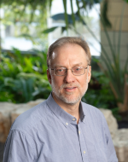

Who are the faculty?
Louis Oliphant (i.e. Louis)
Email: ltoliphant@wisc.edu
BA in Mathematics Education @ BYU, 1995
Taught High School for several years
MS and PhD in Computer Science @ UW-Madison
Dissertation in Machine Learning, 2009
Adaptively Finding and Combining First-Order Rules for Large, Skewed Datasets
Taught at Hiram College in Ohio from 2009-2023
Started at UW-Madison in Fall, 2023
Always looking for chess players

Slide 12
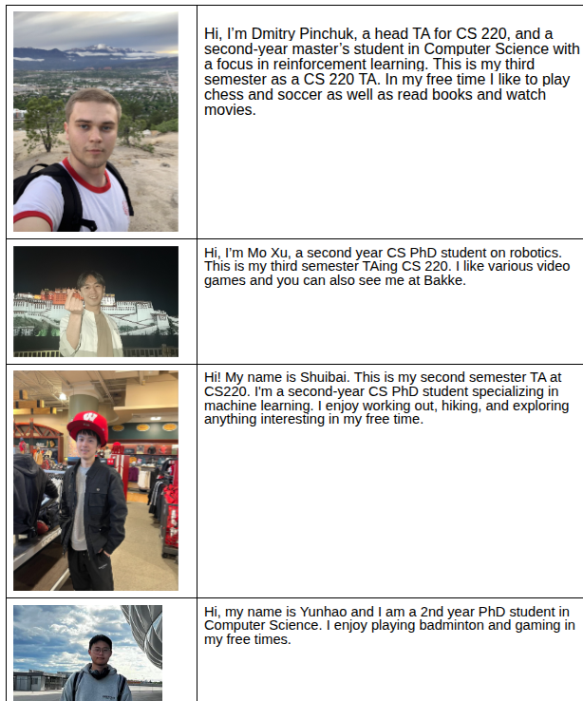
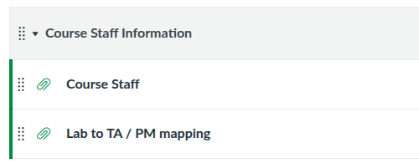
Who are the Staff?
2 Head Teaching Assistants
14 Teaching Assistants
14 Peer mentors

Slide 13

Who are you?
800 students in 4 sections
Say hi to your neighbor and introduce yourself
  Name
  Major (potential major)
  Year in college
  Fun fact
https://pixy.org/4356032/

Slide 14
Today's Topics
Introductions
Course overview
Topics
Lectures
Lab
Readings
Course tools
Grades
Projects
Exams & quizzes
Website

Slide 15
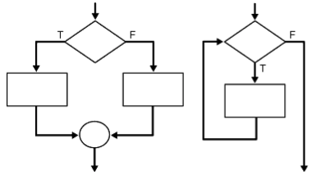
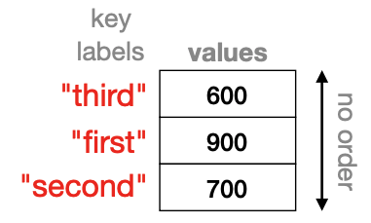
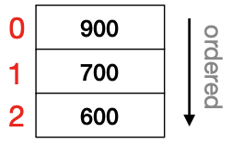
220 Topics
Part 1: Control Flow
What step is currently executing?
How to write functions?
How to conditionally do something?
How to repeat steps?
Part 2: State
How to structure lots of data?
How to save data in files?
Part 3: Data Science
Tabular data
Internet
Databases
Plotting
http://net-informations.com/python/flow/default.htm

Slide 16

Generative AI: The use of artificial intelligence (AI) tools and applications (including, but not limited to, ChatGPT, DALL-E, and others) for course assignments and assessments does not support the learning objectives of this course and is prohibited. Using them in any way for this course is a violation of the course’s expectations and will be addressed through UW-Madison’s academic misconduct policy, specifically UWS 14.03(1)b (b) Uses unauthorized materials or fabricated data in any academic exercise.

Slide 17
Lectures
general concepts
live coding
worksheet practice
Your role
Do readings before or after
Download the template file and code along in lecture
  pixi run lecture
Ask questions during the lectures + office hours
Lectures WON’T be recorded

Slide 18
Labs – CS220
Format
13 labs (3 dropped)
75 minutes on Wed, Thu or Fri
led by Teaching Assistant (TA) and a Peer Mentor (PM)
Lab attendance is required
Meant to practice weekly content & help you succeed on projects
Labs – CS319
Format
Attendance is optional
May attend any lab
we will have labs this first week!!!
(also, get any help needed installing Python during this one)

Slide 19

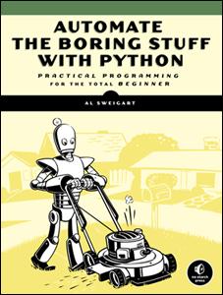

Readings (all free!)
Think Python, 2nd Edition
Allen B. Downey
Assumes no programming background
It’s very concise
Get the 2nd edition, which is for Python 3!
Automate the Boring Stuff
Al Sweigart
Useful for some more advanced topics related to using data
Python for Everyone – Interactive
Barb Ericson
Allows you to practice coding as you learn
CS 220 / CS319
Notes
Course Notes
220 / 319 instructors
Mostly for data science part of class

Slide 20
Course tools
Communication tools
Office hours (best way to get help):
  Shared Google calendar: requires login with your wisc email
Canvas:
  Quizzes
  Personal messages (exam room assignment, exam scantron results, etc.,)
  Grades
Students
One-on-one help
Instructor
TAs / peer mentors

Slide 21
Course tools
Piazza:
  Rule 1: don’t post more than 5 lines of code
  Rule 2: check other posts before posting
Class Forms:
  Feedback form (anonymous / non-anonymous)
  Exam conflict forms
  Thank you form
Project Submission: GradeScope
Email (least-preferred):
  Class mailing lists
Students
One-on-one help
Instructors
TAs / peer mentors

Slide 22
Grades - CS220
47% - programming projects
13 projects
p1: 1%, p9: 2%, remaining projects 4%
32% - exams
10% midterm 1
10% midterm 2
12% final
16% - quizzes
10 quizzes (drop 2 lowest scores)
4% - labs
13 labs
1% - class surveys

Slide 23
Grades – CS319
31% - programming projects
9 CS220 projects: p1 to p9
p1: 1%, p9: 2%, remaining projects 4%
32% - exams
10% midterm 1
10% midterm 2
12% final
16% - quizzes
10 quizzes (drop 2 lowest scores)
20% - graduate-level project
Proposal: 4%
Data Set: 5%
Initial Code: 1%
Final Code: 5%
Presentation: 5%
1% - class surveys

Slide 24
Letter Grades
Your final grade is based on sum of all points earned
Your grade does not depend on other students’ grade – no curving
We will NOT be rounding off scores at the end of the semester
No extra credit
93% - 100%: A
88% - 92.99%: AB
80% - 87.99%: B
75% - 79.99%: BC
70% - 79.99%: C
60% - 69.99% D
Grade cut-offs

Slide 25
Today's Topics
Introductions
Course overview
Topics
Lecture
Lab
Readings
Class communication
Grades
Projects
Exams & quizzes
Website

Slide 26
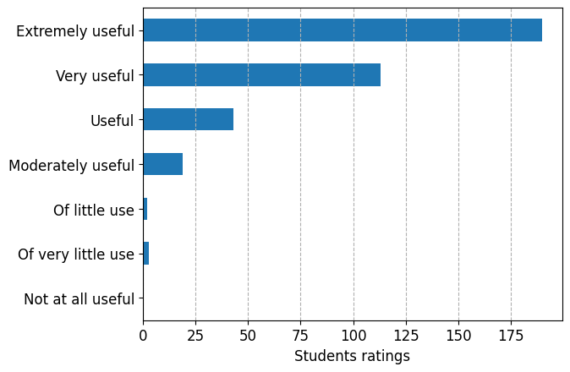
Prior student reaction to projects
Projects: How useful were projects to your learning?

Slide 27
Project Overview
Nearly all projects will relate to some dataset
Timeline
Projects will be due on Fridays at 4:00:00 pm
You get a bank of 12 late days (automatically applied, may not be used on last project)
After late days, 5% deduction per day late (up to 7 days late)
Getting help
Office hours
Lab sessions
Piazza

Slide 28
Pair Programming
You can optionally work in pairs of two
CS220 students can partner with any CS220 students, in any section
CS319 students can partner with any CS319 students
You can choose to keep the same partner, for multiple projects or choose to switch partners
partner 1
partner 2
Best practice: working alongside each other

Slide 29
Pair Programming
partner 1
partner 2
Breaks syllabus rules: working on different parts at different times
Breaks syllabus rules: working on alternate projects individually

Slide 30
Project Grading
YOU
Submit on
GradeScope
your project
your project
Integrated Tests
you run tests
Tests
Late Day Deduction
predicted test score
test score
-
deduction
(rubric)
= final
Make sure that your code
clears tests on GradeScope!

Slide 31
Today's Topics
Introductions
Course overview
Topics
Lecture
Lab
Readings
Class communication
Grades
Projects
Exams & quizzes
Website

Slide 32
Quizzes and Exams
Quizzes
Will be due most weeks, on Fri, at 11:59pm
Focus on recent lectures so you stay current and check your knowledge
Exams: two midterms and one final
Multiple choice
1.5 hours midterms
2 hours final
Given in a large lecture hall
projects - writing and testing code with a computer
quizzes - reading and interpreting code with a computer
exams - reading and interpreting code without a computer

Slide 33
Today's Topics
Introductions
Course overview
Website

Slide 34
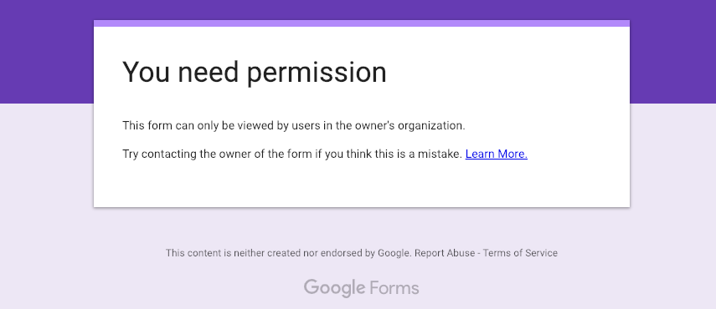
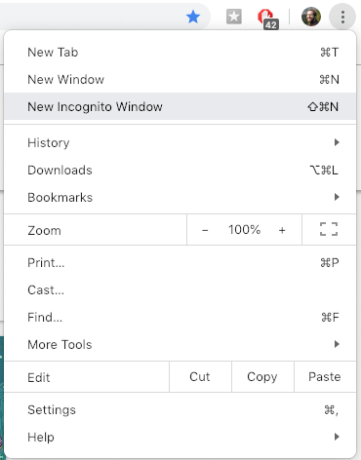
Course Website
https://cs220.cs.wisc.edu/s26/schedule.html
Walk through…
if you see this, it means you're
signed in via Gmail instead of
your campus email
if you were automatically signed into
gmail without being asked, consider
clearing cookies or using an
Incognito Window (in Chrome)

Slide 35
Next steps...
Complete the ”Student Information Survey" survey quiz on canvas.
Read syllabus carefully
Setup Python on your computer and attend your lab for Lab-P1
Submit P1 (Project 1) after attending lab: due next Fri
Sign up for GradeScope

