Slide 1
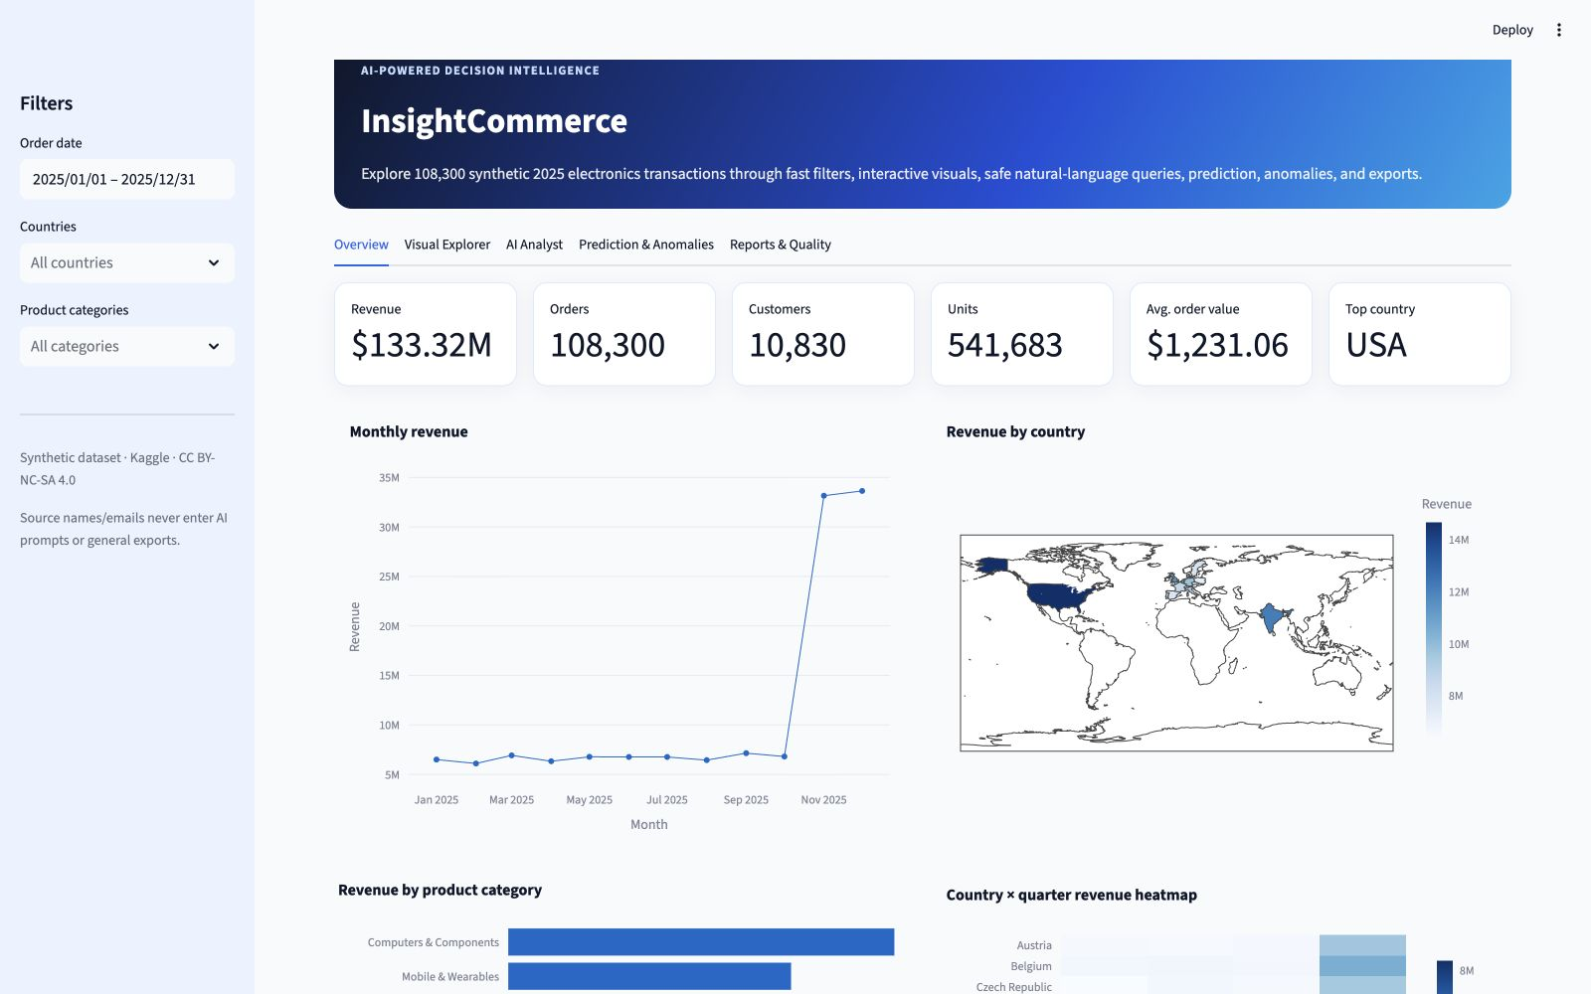
MSc Group Capstone · Deep Learning
InsightCommerce
An AI-Powered E-Commerce Analytics
and Decision Intelligence Platform
SUBMITTED BY
MD. Shahriar Ahamed Ridoy · ID: 261-25-008
Aisha Afroj · ID: 261-25-007
MSc in CSE (Major in Data Science)
Daffodil International University
SUBMITTED TO
Sadat Hasan · Adjunct Faculty
Department of CSE · Faculty of Science and
Information Technology (FSIT)
Synthetic E-Commerce Electronic Sales 2025 · 108,300 transactions
August 2026
Notes:
Good morning. We are Shahriar and Aisha. Our project is InsightCommerce: a decision-intelligence platform built for the Deep Learning course. We will show how verified transaction data moves through a fast dashboard, a guarded AI query workflow, prediction, anomaly detection, and downloadable evidence.
[Sources]
- Local project README.md and output/pdf/InsightCommerce_Group_Capstone_Report.pdf
- Local screenshot docs/dashboard-overview.png
- https://github.com/AishaAfroj/insightcommerce-ai-analytics
[/Sources]

Slide 2
WHY WE BUILT IT
From raw transactions to decisions
people can explain
The project is designed for both exploration and evidence—not just a static dashboard.
The challenge
Our response
1
Too much transaction detail
Explore
Fast global filters and eight prepared chart types.
108,300 rows are difficult to explore manually.
Ask
Schema-aware natural language with a manual chart override.
2
Static charts limit questions
New questions need code or a new report.
Verify
Prediction, anomaly signals, tests, benchmarks, and exports.
3
Generated SQL can be unsafe
An LLM suggestion must be checked before touching data.
The goal: make every insight traceable to checked data.
InsightCommerce · Deep Learning · Daffodil International University
02
Notes:
We began with a practical problem: a large transaction file is not automatically useful. Static charts answer only prepared questions, while LLM-generated code introduces safety risks. InsightCommerce combines fast exploration, guarded questions, advanced analytics, and evidence in one workflow.
[Sources]
- Local project README.md
- Local capstone brief coverage documented in README.md
[/Sources]

Slide 3
DATASET AND SCHEMA
We verified the file before designing the app
Synthetic E-Commerce Electronic Sales 2025 · Kaggle version 1 · CC BY-NC-SA 4.0
The 10 source fields
Revenue is explicit
order_id · date · customer_id · customer_name · customer_email
country · product · price · quantity · order_value
order_value = price × quantity
0 formula mismatches
108,300
0
15
transactions
missing or duplicate IDs
countries · 105 products
Dates run from 1 Jan to 31 Dec 2025.
The reproducible quality profile is PASS.
10,830 synthetic customers across the catalog.
Not present—and not invented: profit, discount, shipping, cancellation, or source category.
InsightCommerce · Deep Learning · Daffodil International University
03
Notes:
Before coding, we inspected the downloaded CSV and built the application around the exact schema. The file contains 108,300 transactions and ten source columns, with zero missing cells and zero duplicate order IDs. It does not contain profit, discount, shipping, cancellation, or category, so the project never presents those as source facts. Only documented calendar fields and a reproducible electronics taxonomy are derived.
[Sources]
- Local data/processed/schema.json
- Local data/processed/quality_report.json
- Local docs/dataset_verification.md
- https://www.kaggle.com/datasets/wojciechkiebowicz/e-commerce-electronic-sales-2025-dataset
[/Sources]

Slide 4
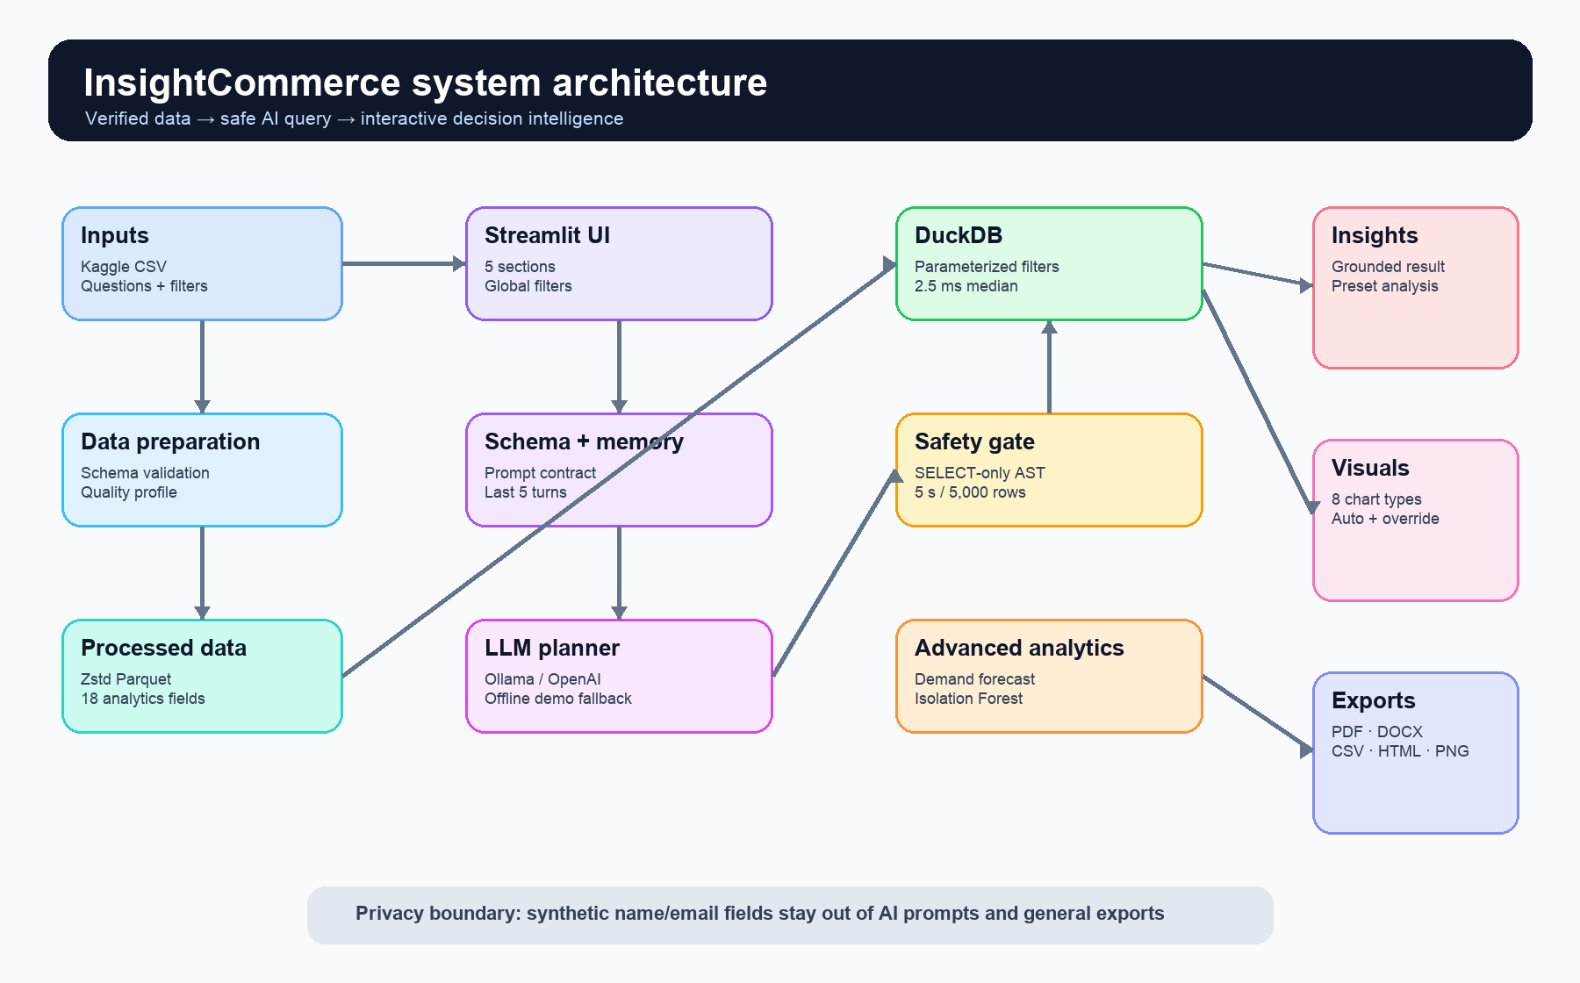
SYSTEM ARCHITECTURE
One pipeline connects verified data
to usable evidence
Streamlit coordinates the experience; DuckDB remains the execution authority.
InsightCommerce · Deep Learning · Daffodil International University
04
Notes:
This is the complete architecture. The CSV is validated and converted to optimized Parquet. The Streamlit interface sends filters to DuckDB. For natural-language questions, the schema and latest five successful turns ground the planner. A SELECT-only safety gate checks the plan before DuckDB runs it. Prediction and anomaly modules use only approved fields, and outputs can be exported.
[Sources]
- Local docs/architecture.png
- Local docs/architecture.mmd
- Local README.md
[/Sources]

Slide 5
VISUAL ANALYTICS
The dashboard keeps exploration
fast and interactive
Six KPI summaries · global filters · eight prepared chart types · manual builder
InsightCommerce · Deep Learning · Daffodil International University
05
Notes:
The overview is the entry point. Date, country, and category filters update the KPI row and every chart together. The Visual Explorer offers line, map, bar, heatmap, treemap, scatter, box, and histogram views. Users can hover, zoom, select a prepared view, or build a manual chart. The dashboard is not a screenshot-only deliverable; every visual is interactive in the running app.
[Sources]
- Local docs/dashboard-overview.png
- Local app.py
- Local src/insightcommerce/charts.py
[/Sources]

Slide 6
SCHEMA-AWARE AI WORKFLOW
A question becomes a checked answer
Example: “Show the monthly revenue trend for 2025.”
1
2
3
4
5
Ask
Plan
Validate
Execute
Explain
Natural language
+ filters
Schema-aware
+ JSON
SELECT-only
+ safety gate
DuckDB result
+ under limits
Grounded answer
+ chart
The LLM proposes the plan. The validator and executed data decide what is true.
InsightCommerce · Deep Learning · Daffodil International University
06
Notes:
Here is the AI workflow. The user asks a question. The planner receives only the safe schema, filter context, and latest five successful turns. It returns a strict JSON plan. The validator rejects unsafe SQL before execution. DuckDB returns the checked result, and only then does the app create the explanation and chart. In the demo, run the monthly revenue preset, show the generated SQL, then change the chart override from line to bar.
[Sources]
- Local src/insightcommerce/prompts.py
- Local src/insightcommerce/assistant.py
- Local src/insightcommerce/sandbox.py
- Local docs/PRESENTATION_DEMO_GUIDE.md
[/Sources]

Slide 7
GUARDRAILS
Safety is enforced before generated code can run
Read-only by design, bounded in time and size, and private fields stay outside the prompt.
Blocked
Allowed—with limits
×
Mutation and commands
✓
One SELECT or CTE
No INSERT, UPDATE, DELETE, DDL, PRAGMA, or multiple statements.
The SQL AST must match the approved orders-table contract.
×
External and hidden access
✓
5 seconds · 5,000 rows
No files, URLs, extensions, hidden schemas, or unrestricted SELECT *.
Execution also runs under a 1 GB DuckDB memory limit.
×
Sensitive fields
✓
One corrective retry
customer_name and customer_email never enter AI prompts or general exports.
A failed plan gets exactly one error-informed correction, then stops.
Conversational memory keeps only the latest 5 successful turns.
InsightCommerce · Deep Learning · Daffodil International University
07
Notes:
The safety boundary is intentionally narrow. The validator accepts one SELECT or CTE over the approved in-memory orders table. It blocks mutation, commands, external access, hidden schemas, unrestricted SELECT star, and sensitive customer fields. Execution is capped at 5,000 rows, five seconds, and one gigabyte. A failed generation receives exactly one corrective retry. Only successful answers enter the five-turn memory.
[Sources]
- Local src/insightcommerce/sandbox.py
- Local src/insightcommerce/memory.py
- Local docs/SECURITY.md
- Local tests/test_sandbox.py
[/Sources]

Slide 8
PREDICTIVE ANALYTICS
Demand prediction follows the pattern—
but we state the limitation
Random Forest daily order model · deterministic weekly holdout
Average daily orders by month
12.4
MAE orders/day
RMSE 18.2 on held-out dates.
0.995
53
R²
test days
Caution: the high score mainly reflects the synthetic dataset’s designed Q4 jump—not evidence of real-world generalization.
InsightCommerce · Deep Learning · Daffodil International University
08
Notes:
The predictive feature estimates daily order demand using calendar features and a Random Forest. We evaluate on 53 deterministic held-out dates. The MAE is 12.4 orders per day and R-squared is 0.995. However, we do not oversell this number: the synthetic dataset contains a very strong Q4 jump, and month explains almost all of the pattern. The score should not be generalized to a real retailer without real historical data and a time-based validation design.
[Sources]
- Local src/insightcommerce/ml.py
- Local docs/MODEL_CARD.md
- Local tests/test_ml_anomaly.py
- Metrics reproduced from local data/processed/orders.parquet
[/Sources]

Slide 9
ANOMALY DETECTION
Anomalies are investigative signals—
not accusations
Isolation Forest scores price, quantity, order value, and product-relative value.
Most common reasons
574
Unusual multivariate price-and-quantity combination
0.93%
210
High value + premium price + above-product norm + max quantity
1,006 of 108,300 rows
116
Maximum observed quantity
106
High value + above-product norm + max quantity
Every flag includes a readable reason code.
A flag is a prompt to investigate—not proof of fraud or error.
InsightCommerce · Deep Learning · Daffodil International University
09
Notes:
The anomaly module uses Isolation Forest on public transaction features. It scores all 108,300 rows and flags 1,006, or about 0.93 percent. Each flag includes a transparent reason, such as maximum quantity or an order far above the product's typical value. We describe these as investigative signals, not as fraud labels or confirmed data errors. In the live demo, hover on the scatter plot, open the reasons table, and download the anomaly CSV.
[Sources]
- Local src/insightcommerce/anomaly.py
- Local docs/MODEL_CARD.md
- Local tests/test_ml_anomaly.py
- Metrics reproduced from local data/processed/orders.parquet
[/Sources]

Slide 10
TESTING AND BENCHMARKS
The project is backed by repeatable checks
Functional tests, query correctness, and performance are recorded as project evidence.
STATUS · PASS
21
10/10
2.52 ms
automated tests
AI question benchmark
aggregation median
Data, safety, memory, charts, exports, ML, and anomalies.
All preset-style benchmark questions returned correct results.
p95 2.66 ms · max 2.71 ms · requirement <500 ms.
Performance margin
The measured median is about 198× faster than the 500 ms capstone threshold on the development Mac.
InsightCommerce · Deep Learning · Daffodil International University
10
Notes:
We did not treat the app working once as enough evidence. The test suite has 21 passing tests covering data, guardrails, memory, charts, exports, prediction, and anomaly detection. The question benchmark passes all ten questions. The filtered aggregation median is 2.52 milliseconds, with a p95 of 2.66, comfortably below the 500 millisecond requirement. These are recorded outputs that can be regenerated before the presentation.
[Sources]
- Local artifacts/benchmarks/performance.json
- Local artifacts/benchmarks/question_benchmark.json
- Local tests/
- Local README.md
[/Sources]

Slide 11
InsightCommerce connects analysis, AI, and evidence
What the capstone demonstrates
Project repository
1
Verified foundation
The real downloaded schema drives every feature.
github.com/AishaAfroj/
insightcommerce-ai-analytics
2
Guarded intelligence
AI proposes; deterministic checks and executed data decide.
MD. Shahriar Ahamed Ridoy
Aisha Afroj
3
Presentation-ready evidence
MSc in CSE (Major in Data Science)
Daffodil International University
Interactive visuals, exports, tests, benchmarks, report, and deployment prep.
Questions?
Thank you
Notes:
To conclude, InsightCommerce demonstrates three things: a verified data foundation, an AI workflow controlled by deterministic safety checks, and evidence that can be reproduced and presented. The repository contains the complete app, report, testing guide, model card, architecture, and deployment files. Thank you. We are ready for questions and the live demonstration.
[Sources]
- https://github.com/AishaAfroj/insightcommerce-ai-analytics
- Local README.md
- Local docs/PRESENTATION_DEMO_GUIDE.md
[/Sources]

