Slide 1
BioPass: Facial Expressions as Passcodes
A Novel 2FA Solution to Enhance Security
Aisha Ntuli x21341006
BSc Hons Computing
Supervised by Michael Bradford

Slide 2
Table of contents
Problem Statement
BioPass Overview
Core Features
Current Progress
Challenges Encountered
Next Steps
Future Potential
Conclusion

Slide 3
Brief History of Two-Factor Authentication
Originally two-factor authentication also known as 2FA was introduced in the 1980’s fo rmilitary and baning systems.
The evolution of 2FA has been:
Hardware Tokens: Early OTP genrators like RSA SecurID.
SMS-Based 2FA: Widely adopted in the 2000s but prone to SIM-swapping attacks.
App-Based 2FA: Google Authenticator and others offered more secure OTP solutions.
Biometric Authentication: Fingerprints, facial recognition, voice verification.
Which brings us to current trend: Incorporating user-friendly methods like password-less authentication. Which is the inspiration for BioPass.

Slide 4
Problem Statement
Passwords are vulnerable to phishing and brute-force attacks.
Many 2FA methods are inconvenient due to constraints such as OTP delay or device dependency.
Facial recognition systems are prone to spoofing with photos and videos

Slide 5
BioPass Overview
BioPass uses live facial recognition with random facial expression prompts as a second authentication factor.
Dynamic and unpredictable nature prevents spoofing.
Easy-to-use yet secure, leveraging widely available laptop cameras.

Slide 6
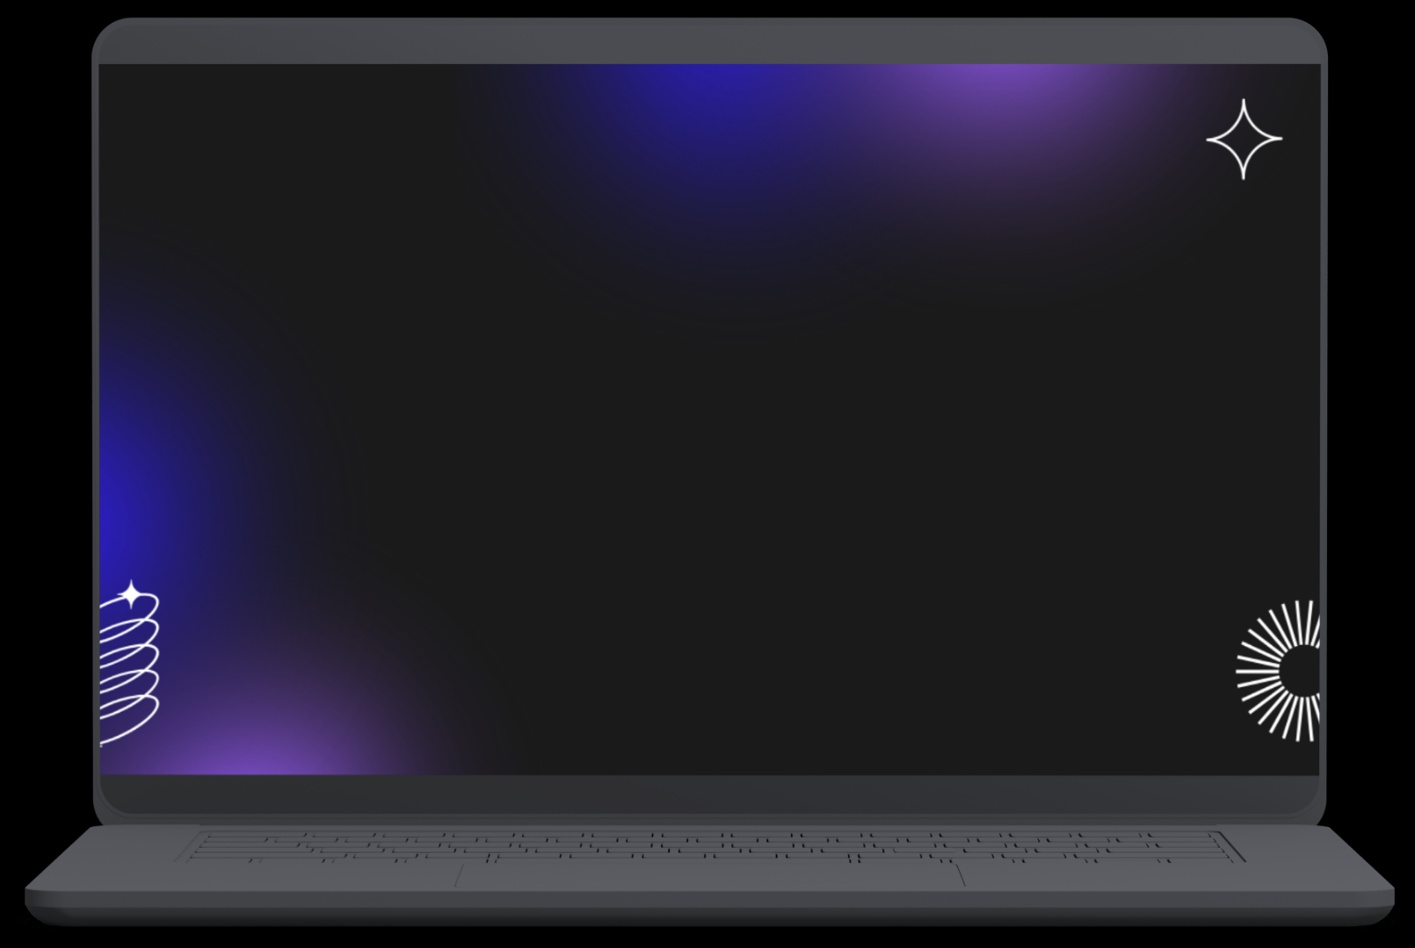
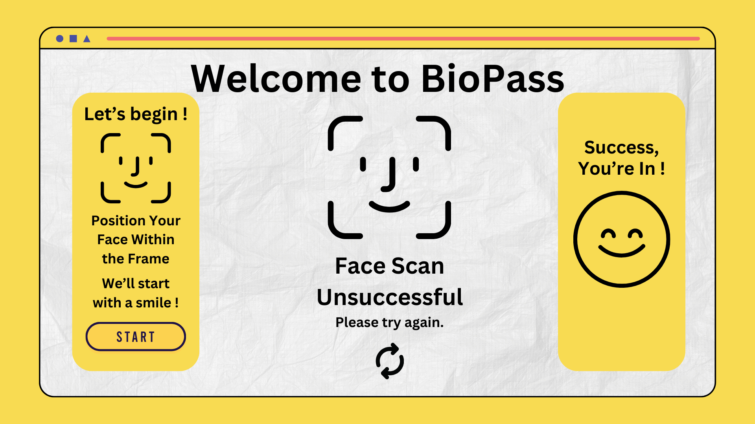
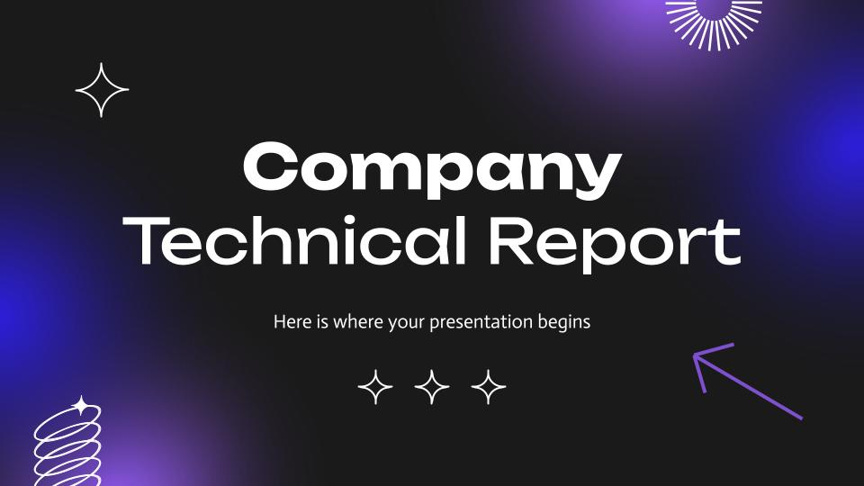
Computer mockup
I chose these colours combined with this aesthetic because I want BioPass to come off as inviting and warm as possible while also presenting as uniform and professional.

Slide 7
Core Features
Live Face Detection: Ensures a real person is in front of the camera.
Randomised Expression Prompts: Prevents replay attacks.
User-Friendly Design: Intuitive and quick process.
Playful Yet Secure Interface: Warm inviting aesthetic for user something that is both corporate friendly and playful.

Slide 8
Technologies and Libraries
Creating a two-factor authentication (2FA) system that uses facial expressions instead of a traditional passcode involves combining facial recognition technology with machine learning techniques.
OpenCV – For capturing the video feed and performing face detection.
Dlib – For facial landmark detection (for recognizing expressions).
TensorFlow/Keras - For training and recognising (you could use pre-trained models).
Face Recognition – For face detection and recognition.
Numpy - For array manipulations.
Pillow – For image processing.

Slide 9
Current Progress
Designed the core user flow.
Developing a prototype interface for desktop systems.
Implemented live face detection using the laptop camera.
Tested expression recognition accuracy with a small dataset

Slide 10
Challenges Encountered
Difficulty in detecting subtle facial expressions under different lighting conditions.
Handling edge cases (e.g., users wearing glasses or masks).
Balancing security and usability for all demographics.

Slide 11
Next Steps
Enhance Expression Recognition: Improve algorithm performance.
Rigorou testing: Expand dataset for diverse demographics and conditions.
Security Evaluation: Conduct spoofing tests and integrate additional anti-spoofing measures.
UI/UX Refinement: Ensure seamless user experience with feedback loops.

Slide 12
Future Potential
Integration with web platforms and mobile apps.
Applications in banking, healthcare and corporate environments.
Expansion into multi-factor authentication with gesture or voice integration.

Slide 13
Mock Business Plan for BioPass
01
02
03
Vision:
Target Markets:
Revenue Model:
Make BioPass the go-to 2FA solution for secure and dynamic authentication.
Financial Services: Secure banking and payment systems.
Healthcare: Protect Sensitive Patient Records.
Corporate Sector: Employee access to sensitive data.
-Freemium Model: Basic features free for individuals; premium features for enterprises.
-Licensing: Partner with security firms for white-label solutions.

Slide 14
Mock Business Plan for BioPass cont.
04
05
Marketing Strategy:
Development Timelne:
-Collaborate with cybersecurity influencers for brand visibility reaching wider audiences.
-Offer trial periods for enterprise clients.
Year 1: Enhance the product and pilot testing with shareholder communication.
Year 2: Launch for general users and scale marketing efforts.
Year 3: Focus on partnerships and international expansion.

Slide 15
Conclusion
BioPass is an innovative 2FA solution combining security with ease of use.
Potential to revoltionaise authentication systems.

Slide 16
Thanks!
DO YOU HAVE ANY QUESTIONS?
youremail@freepik.com
+34 654 321 432
yourwebsite.com
Please keep this slide for attribution

