Slide 1
Large-Scale Social Media Intelligence Platform
Sentiment · Topics · Influence graph · Misinformation · Search
Data Science track · DS-03 -- Aisha Fatima

Slide 2
The data
Dataset | Size | Used for
Reddit comments | 54,848 | Sentiment over time
Reddit posts | 20,292 | Topics over time, search
Sentiment140 | 1.6M tweets | Model benchmark, @mention graph
LIAR | 12,836 claims | Misinformation classifier
YouTube stats | 29,999 videos | Engagement dashboard
Limits: the Reddit export is one subreddit (r/datasets) with no usernames, and none of the data is multilingual.

Slide 3
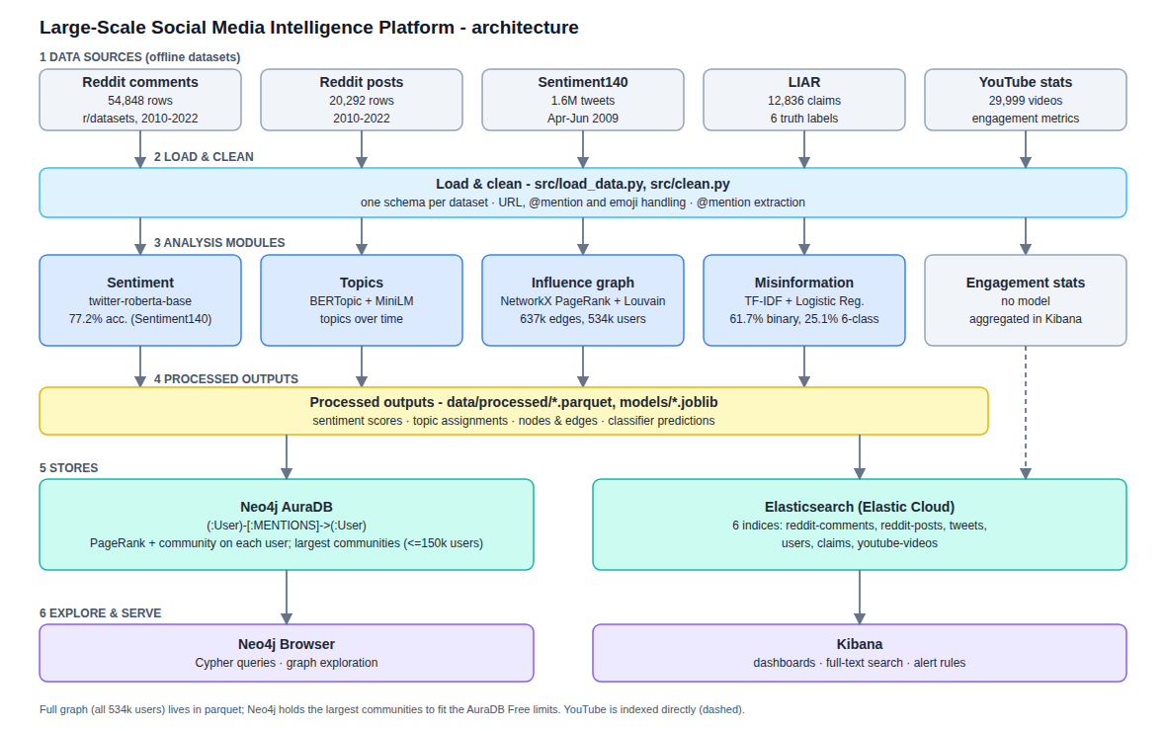
Architecture

Slide 4
Sentiment
77.2%
62 / 25 / 13
0.51
accuracy on 4,000 balanced Sentiment140 tweets
% neutral / positive / negative in 5,000 Reddit comments
correlation with the dataset’s VADER-style score
RoBERTa model trained on tweets (negative / neutral / positive)
Average sentiment about +0.1 to +0.15, almost flat from 2015 to 2022
Sentiment140 labels come from emoticons, so about 77% is a normal result
Early years have too few comments to trust

Slide 5
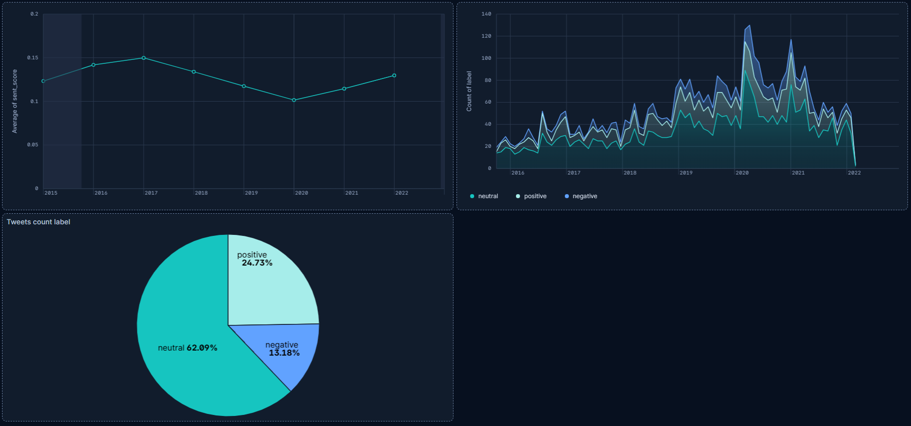

Slide 6
Topics
20,160
32.3%
Reddit posts clustered with BERTopic
posts left unassigned (outliers)
Largest topics: COVID, elections, crime and police, schools, weather, music, movies, healthcare
Timestamps show topics rising and falling across 2010–2022
Deleted and removed posts are filtered out so they do not form fake topics

Slide 7
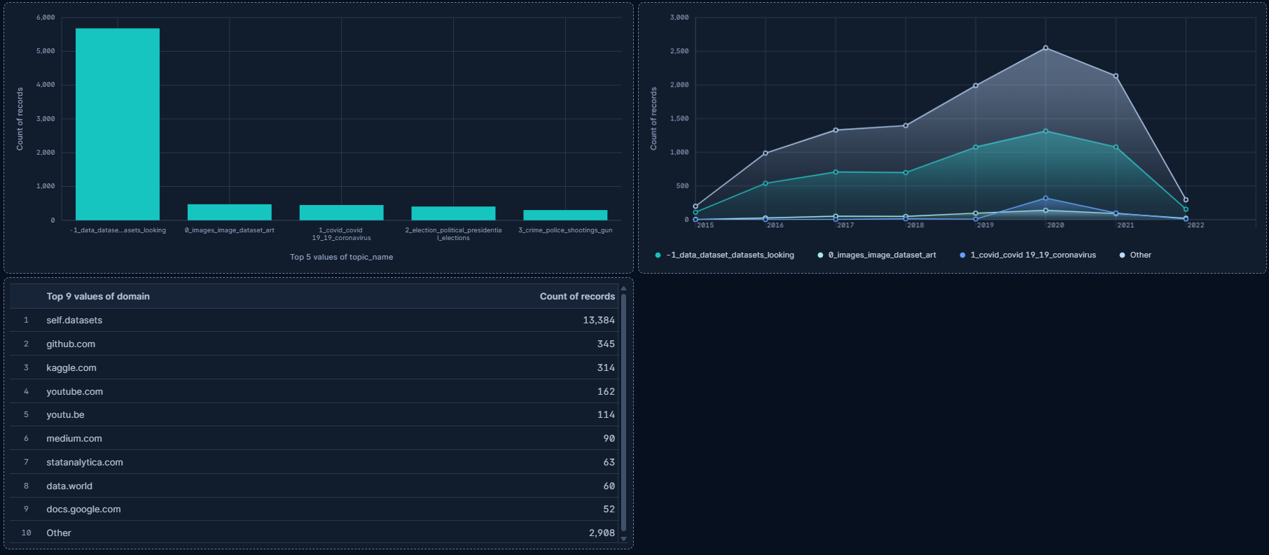

Slide 8
Influence graph
534,347
637,415
3,863
users
@mention edges
communities (largest: 27,442 users)
Top PageRank: @mileycyrus, @ddlovato, @tommcfly, @jonasbrothers, @taylorswift13
Second-largest community (about 20,000 users) is a pop-music cluster
Neo4j holds the largest communities (150,000 users); the full graph is in parquet files

Slide 9
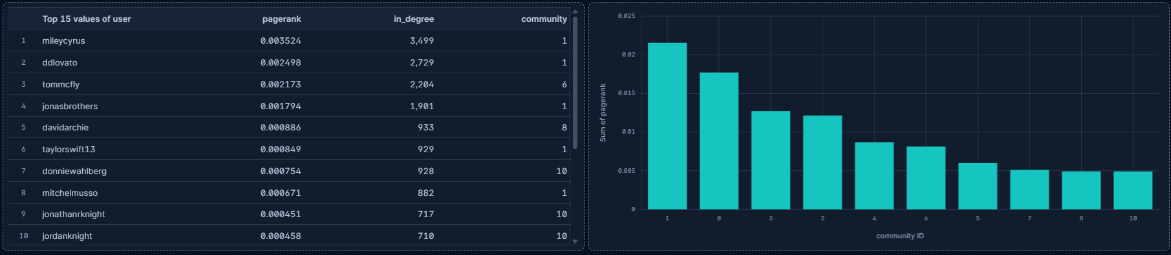

Slide 10
Misinformation (LIAR)
61.7%
25.1%
fake vs real, test split (chance about 50%)
original six labels (chance about 17%)
TF-IDF + logistic regression baseline
A weak signal: the model reads wording, not facts
Dashboards count the test split only; training accuracy (about 75%) is in-sample

Slide 11
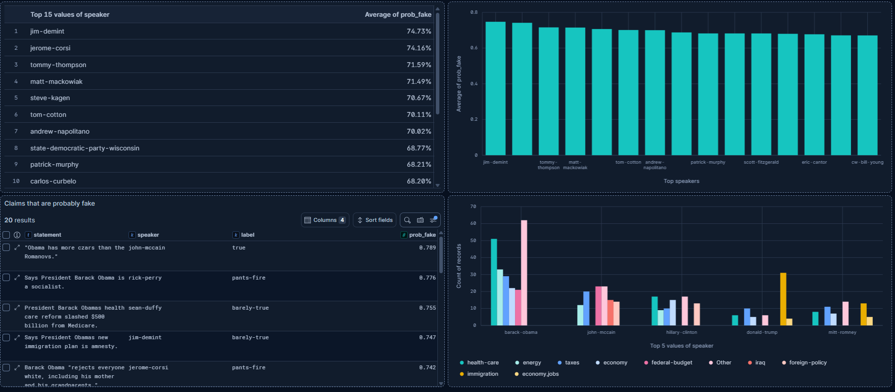

Slide 12
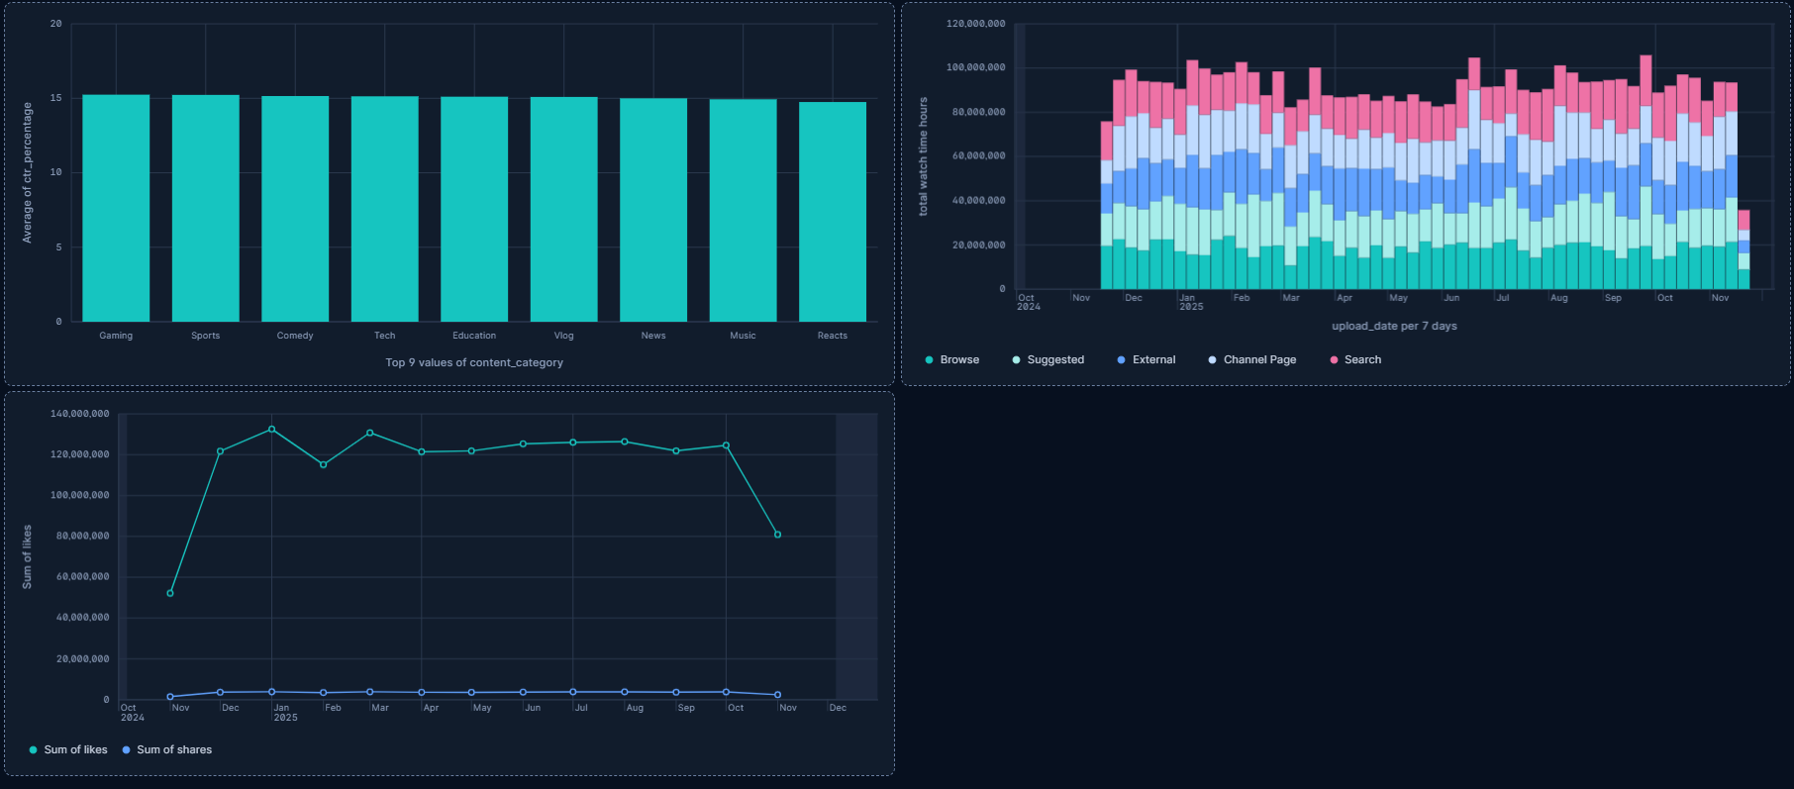
YouTube Dashboard

Slide 13
Search and dashboards
Elasticsearch on Elastic Cloud: 6 indices (comments, posts, tweets, users, claims, YouTube)
Kibana dashboards: sentiment, topics, influencers, misinformation, YouTube
Full-text search across posts, comments, tweets and claims
Alert rules configured (historical data, so a configuration demo)
Live demo or screen recording

Slide 14
Challenges and fixes
LIAR loader silently dropped 45 rows (stray quotes merged records); found by checking published split sizes
Column-name clash between Reddit upvote score and model score broke saving results
First graph filter would have removed followers of popular accounts; caught by testing a small star graph first

Slide 15
Next steps
Fine-tune a transformer on LIAR and add speaker and party features
Score all 55,000 comments, not only a 5,000 sample
Ingest live Reddit and YouTube data through their APIs
Schedule real alert rules
Thank you.

