Slide 1
Ada Boost Algorithm
AdaBoost is the most popular boosting algorithms.
It assigns weights to training instances and adjusts these weights based on the performance of weak learners.
It focuses on misclassified instances, allowing subsequent weak learners to concentrate on these samples.
The final prediction is determined by aggregating the predictions of all weak learners through a weighted majority vote.

Slide 2
Ada Boost Algorithm
Ada boost Algorithm used for both Regression and Classification procedures
An error noticed previous models is adjusted with weighting until an accurate predictor is made.

Slide 3
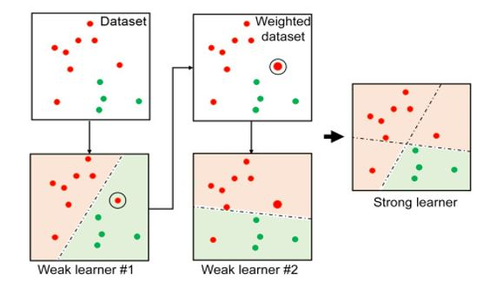
Ada Boost Algorithm

Slide 4
Ada Boost Parameters
estimator=None
n_estimators=50
learning_rate=1.0
loss='linear‘,’square’,’exponential’
random_state=None
base_estimator='deprecated'

Slide 5
Ada Boost Parameters
estimator=None → The default value
n_estimators=50 → The maximum no.of estimator for termination.
learning_rate=1.0→ iteration
loss='linear‘,’square’,’exponential’ →The loss function to use when updating the weights after each boosting iteration.
random_state=None
base_estimator='deprecated'

