Slide 1
CATBoost Algorithm
One of the most essential features of CatBoost is that it was specifically designed to handle categorical features, which are common in many real-world data sets.
CatBoost can automatically convert categorical features into numerical features.

Slide 2
CATBoost Algorithm
CATBOOST APPLICATIONS
Recommendation systems
Fraud detection
Image classification
Text classification
Customer churn prediction
Medical diagnoses
Natural language processing (NLP)

Slide 3
CATBoost Algorithm
PARAMETERS
Verbose
Cols
Drops invariant
Return
Handle missing
sigma

Slide 4
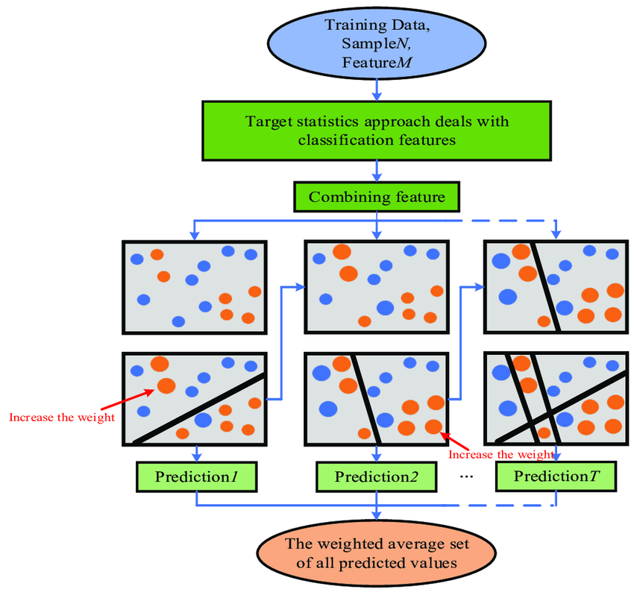
CATBoost Algorithm

Slide 5
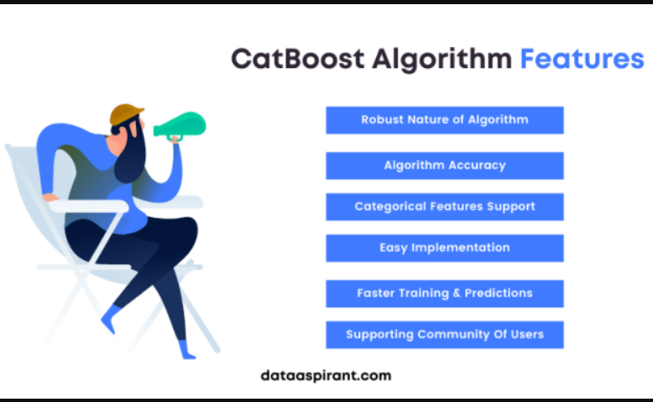
CATBoost Algorithm

