Slide 1
LG Boost Algorithm
Large amount of data easy handled
Poor in small dataset
It uses histogram-based method for selecting best fit
For continuous values split up into bins or bucket
Data parallel acceleration
Cache optimizing

Slide 2
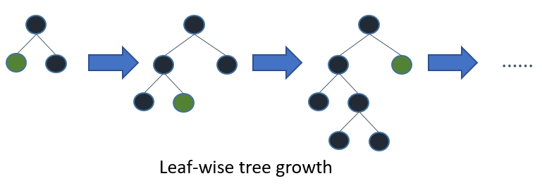
LG Boost Algorithm

Slide 3
LG Boost Parameters
learning _rate
Max_depth
Min_data_in_leaf
Categorical_featue
Feature_fraction
Bagging_fraction
Num_iteration

Slide 4
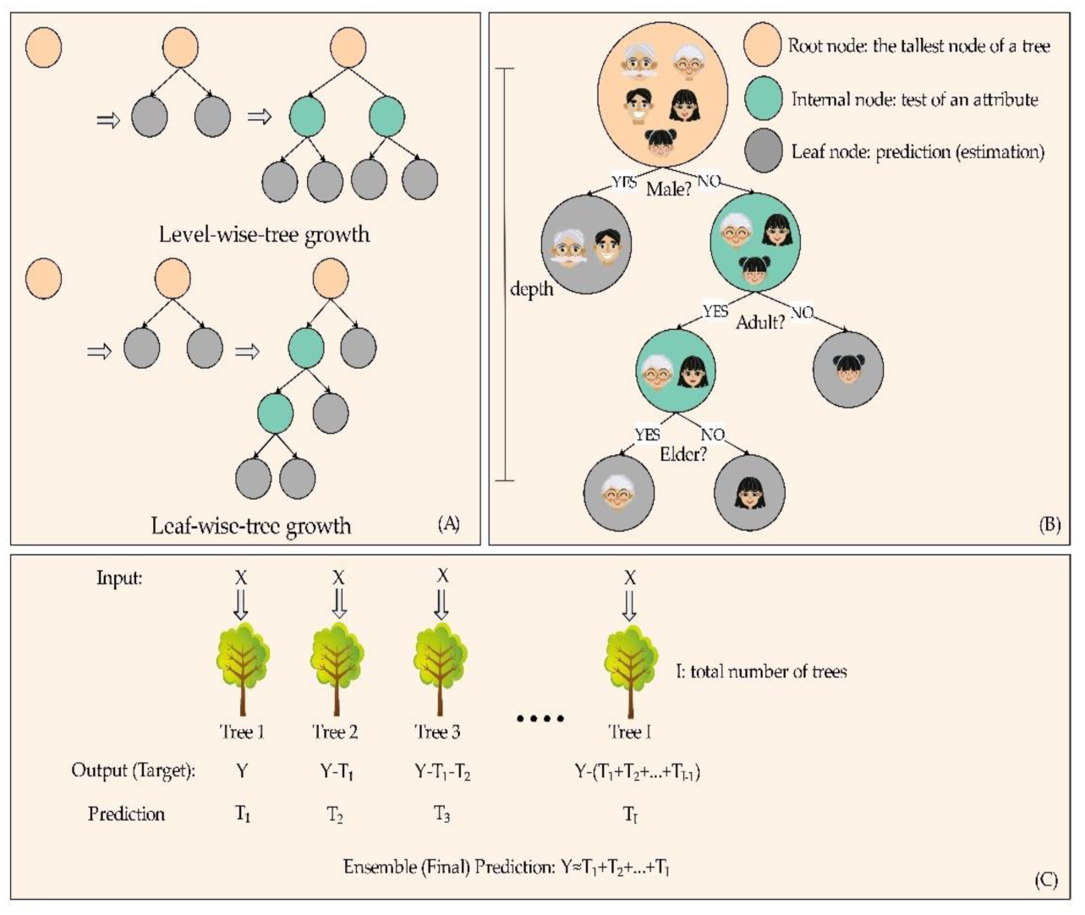
LGBoost

Slide 5
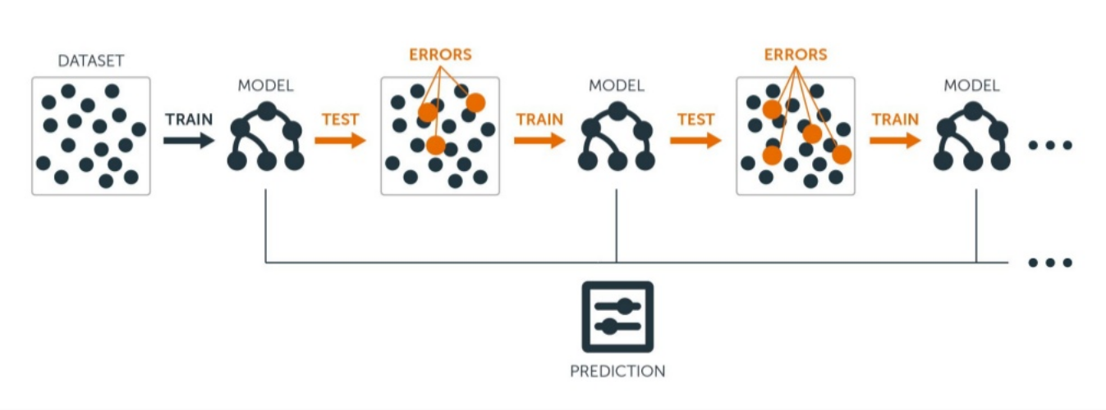
LGBoost

