Slide 1
XGBoost Algorithm
XGBoost is an ensemble learning method.
The beauty of this powerful algorithm lies in its scalability
It drives fast learning through parallel and distributed computing and offers efficient memory usage.
XGBoostimg implements decision trees with boosted gradient, enhanced performance, and speed.

Slide 2
XG Boost Algorithm
The implementation of gradient boosted machines is relatively slow due to the model training that must follow a sequence. They, therefore, lack scalability due to their slowness.
XGBoost is reliant on the performance of a model and computational speed. It provides various benefits, such as parallelization, distributed computing, cache optimization, and out-of-core computing.

Slide 3
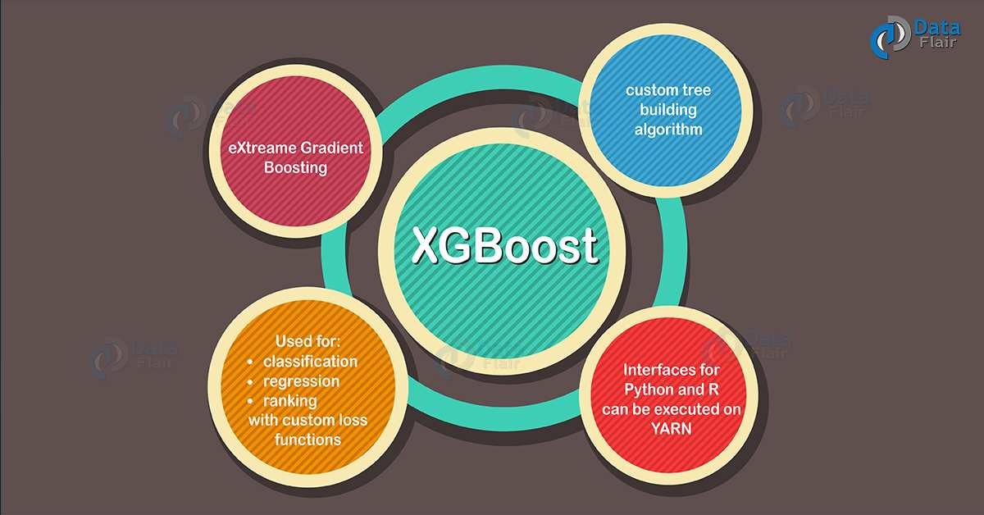
XG Boost Algorithm

Slide 4
XGBoost Parameters
n_estimators: The number of trees in the ensemble, often increased until no further improvements are seen.
max_depth: The maximum depth of each tree, often values are between 1 and 10.
eta: The learning rate used to weight each model, often set to small values such as 0.3, 0.1, 0.01, or smaller.
subsample: The number of samples (rows) used in each tree, set to a value between 0 and 1, often 1.0 to use all samples.
colsample_bytree: Number of features (columns) used in each tree, set to a value between 0 and 1, often 1.0 to use all features.

Slide 5
Ada Boost Parameters
reg:squarederror
reg:squaredlogerror
reg:absoluteerror
reg:pseudohubererror
reg:gamma and reg:tweedie

