Slide 1
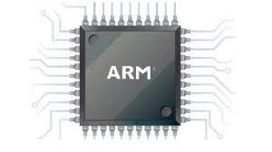
Chess and Maze Game
Miniproject II
Computer Architecture
- Aishez singh 2101CS06
- Hariomkannt Sharma 2101CS31
- Abhijeet kumar 2101CS02

Slide 2
TECH STACK
DE1-SOC FPGA DEVELOPMENT BOARD
ARMV7 PROCESSOR
C PROGRAMMING LANGUAGE
CPULATOR FPGA SIMULATOR

Slide 3
PROJECT AIM
The Basic Aim of this MiniProject II is to teach the fundamentals of implementing C language code on an ARM processor using a DE1-SoC FPGA Board. It uses various tech stack like FPGA Programming, C Programming, ARM Assembly Language, FPGA Simulator, etc.

Slide 4

PROJECT DESCRIPTION
1. CHESS GAME
We are pleased to introduce the chess game software that we have created for our project. This software is designed to provide a seamless and enjoyable experience for chess enthusiasts of all levels.
In chess, each piece on the board is represented by a unique symbol, and moves are made by selecting a piece and then indicating the square to which it will be moved. The notation used to record these moves follows a specific format, with the name of the piece followed by the square it is moving to. For example, the move “E2-E4"..

Slide 5
2. MAZE GAME
We am excited to introduce the maze game software that have created for our project. This software provides a fun and challenging experience for players who enjoy puzzle games.
The objective of a maze game is to navigate a complex network of paths and obstacles to reach a specific destination, typically represented by an Target Location.

Slide 6
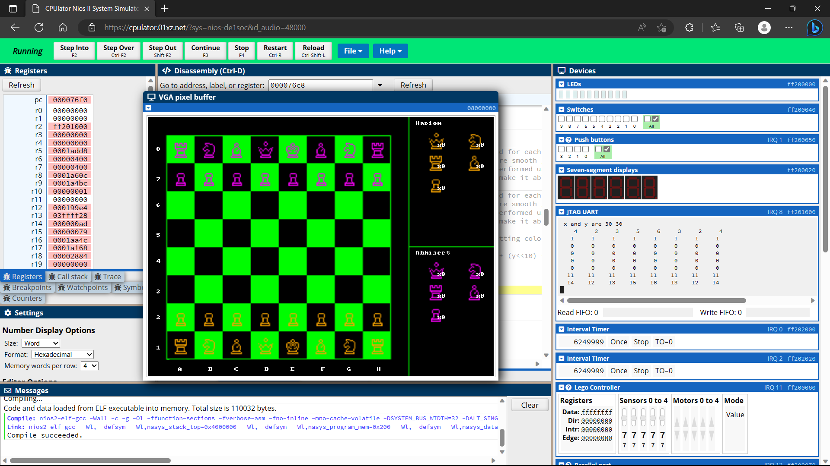
Figure 1: CPUlator – Chess game

Slide 7
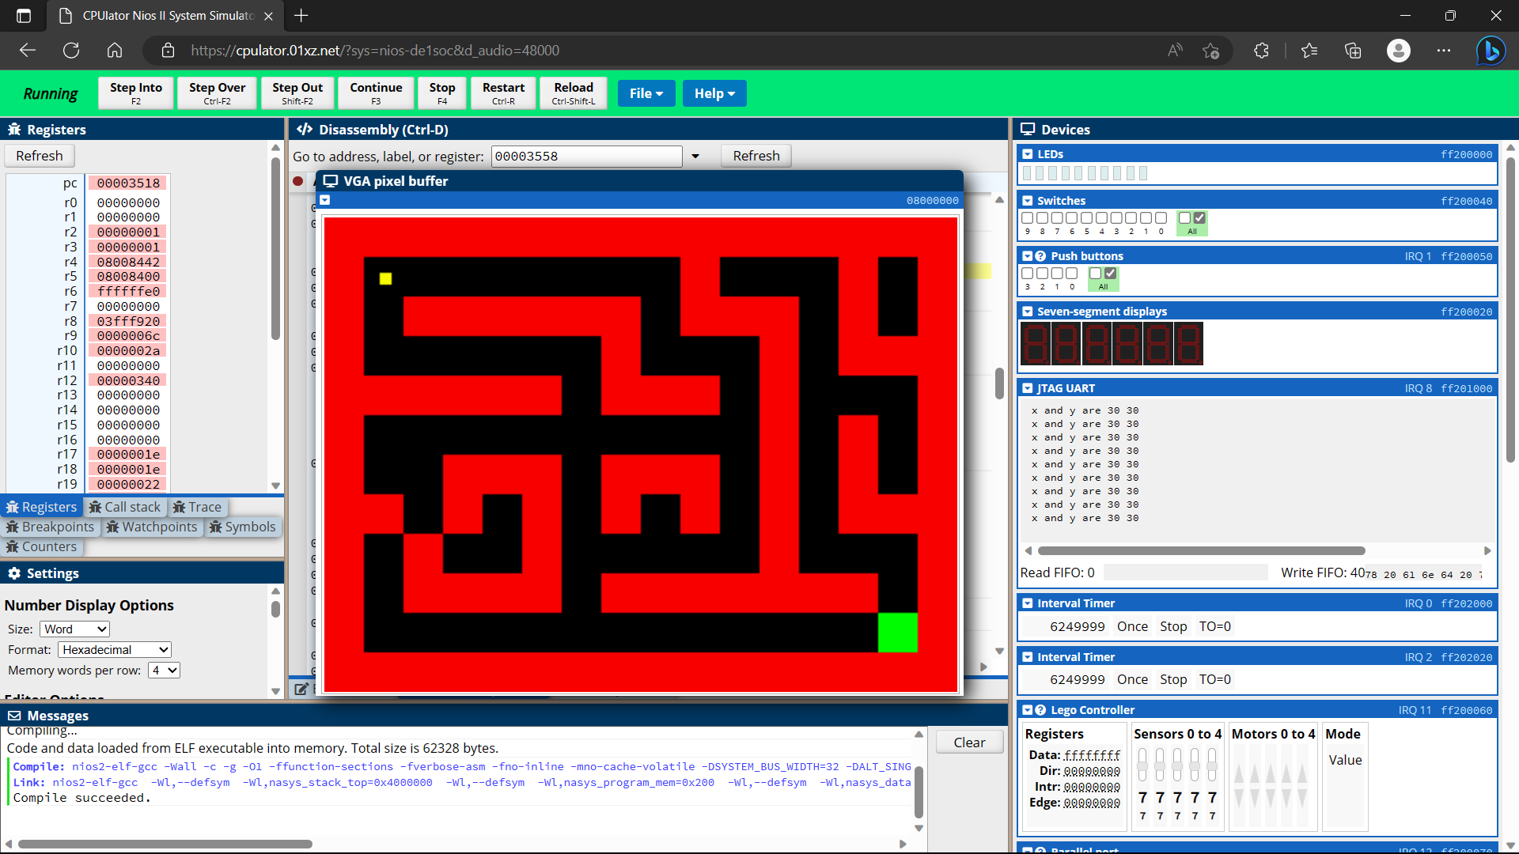
Figure 2: CPUlator – Maze game

Slide 8
STEPS TO RUN
Open CPULator Website.
Select Processor as niosII as FPGA Board as DE1-SoC.
Select Programming Language as C.
Click on Compile and Load.
Click on Continue
The Program will start running in the side window

Slide 9
THANK YOU

